Slide 1
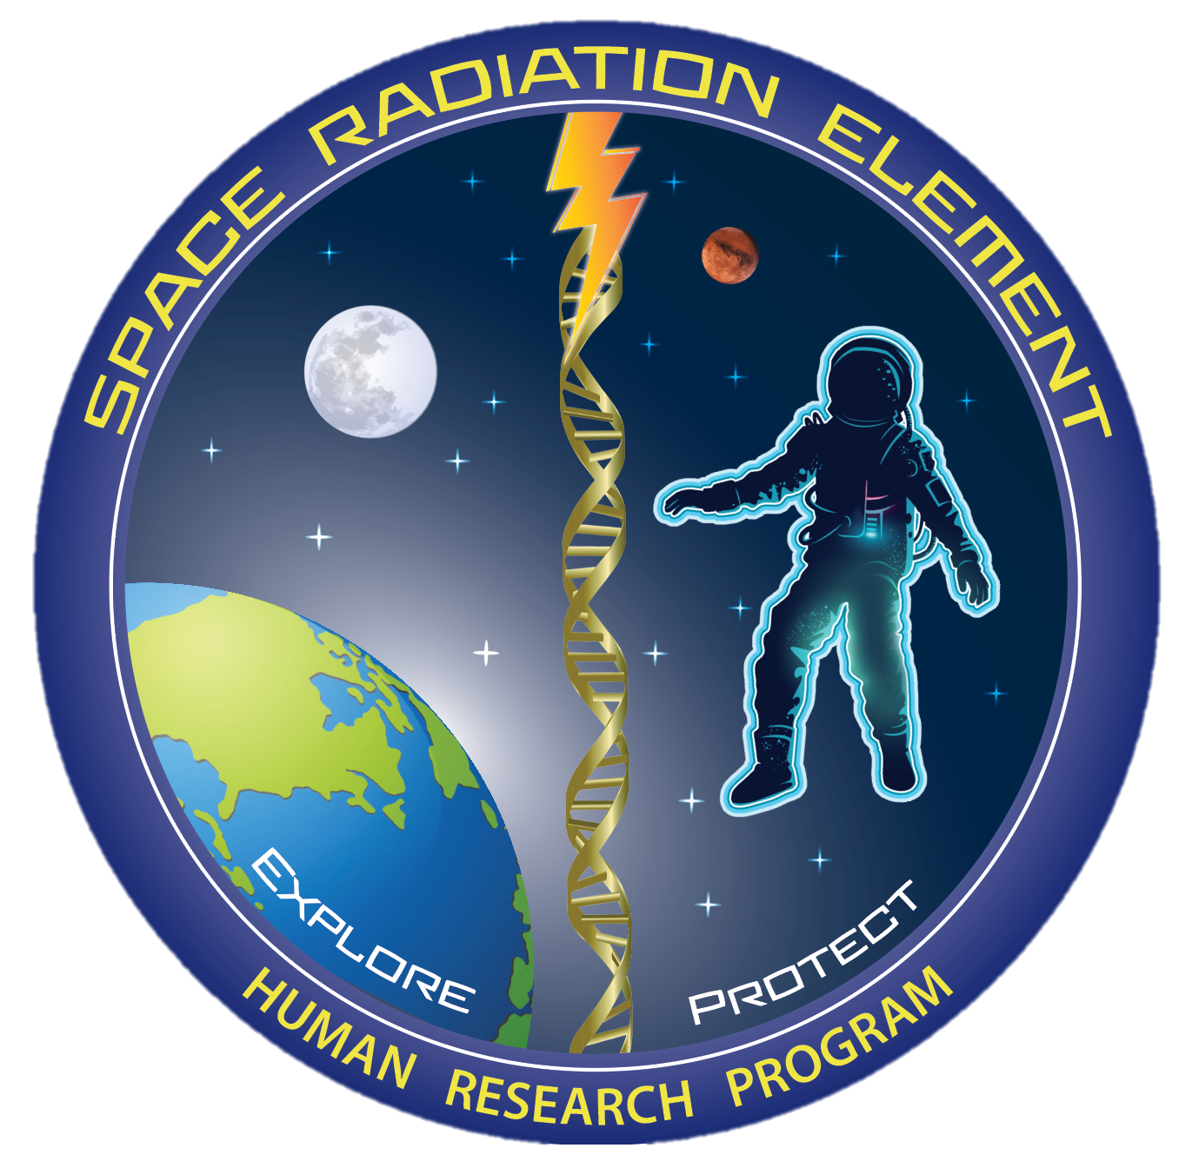
NASA’s Human Research Program (HRP)
Space Radiation Element (SRE)
Janice A. Zawaski, Ph.D.
Space Radiation Deputy Element Scientist
NASA Human Research Program

Slide 2

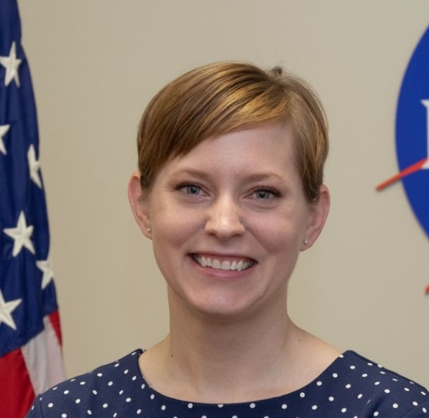
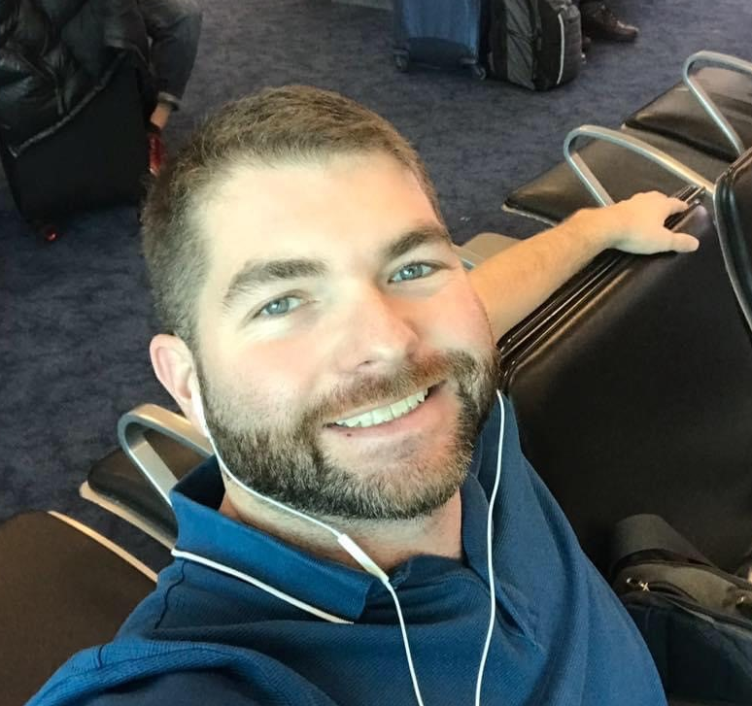


Space Radiation Element
Mission: Characterize and facilitate the management of the human health outcomes associated with space radiation exposure to protect astronaut health and wellbeing to enable human spaceflight
Science
S. Robin Elgart Ph.D., Element Scientist
Janice Zawaski Ph.D., Deputy Element Scientist
Gregory Nelson Ph.D., CNS Discipline Lead
JP Saha Ph.D., Degenerative Tissues Discipline Lead
Brock Sishc Ph.D., Cancer Discipline Lead
Management
Jason Weeks M.S., Element Manager
Nicholas Meyer M.S., Deputy Element Manager
Lisa Stephenson M.B.A., P.M.P., Science Integrator
jsc-hrp-space-radiation-element@mail.nasa.gov
Robin
Janice
Brock
Greg
JP

Slide 3
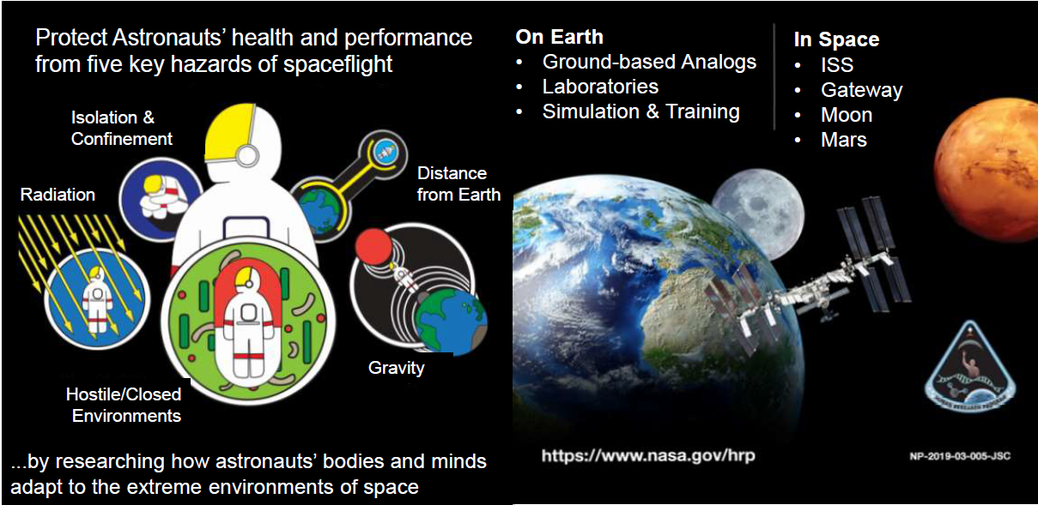
Human Research Program

Slide 4
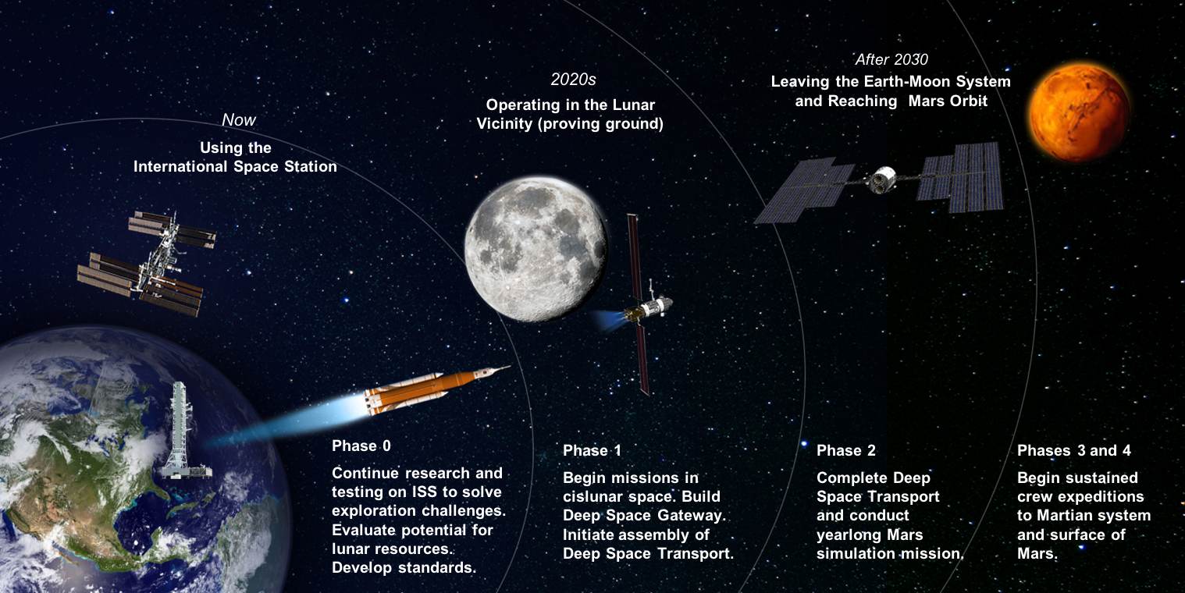
Planned Exploration Activities

Slide 5
Translating Basic Science to Applications (Example in Biomedicine)
Space Biology
Human Research
Basic
Translational Research
Applied
Study how life responds, adapts, develops, interacts and evolves in the space environment and across the gravitational continuum
Cell and Molecular Biology
Microbiology
Animal Biology
Plant Biology
Developmental and Reproductive Biology
Space Biology provides science data and findings that foster research and development
Animal Research
Cells and Tissues
Immunology
Wound Healing and Fracture repair
Bone and Muscle
Radiation/Micro-g Interactions
Microbiome of the Built environment
Identify, characterize and mitigate the risks to human health and performance in space
Exercise and Physiological Countermeasures
Space Radiation Biology
Behavioral Health and Performance
Space Human Factors and Habitability
Exploration Medical Capability
Environmental Monitoring
Basic Science
Medical Operations
Science Exploring
the Unknown
Science Addressing
the Known Risks

Slide 6
What Do we Do? Space Radiation Element Research
Three primary health risks:
Carcinogenesis
Cardiovascular & Immune
Central Nervous System
Formally Degenerative Tissues now listed under the Cardiovascular (CVD) or Immune (IM) Risks
Integrated into the Behavioral Medicine (BMed) Risk
Characterization |  | Mitigation
Dose and Dose Rate Effects | Biomarkers | Countermeasure Identification
Radiation Quality | Individual Susceptibility | Countermeasure Validation
Species Translation | Combined Stressors
https://humanresearchroadmap.nasa.gov/

Slide 7
Questions?
jsc-hrp-space-radiation-element@mail.nasa.gov

Slide 8
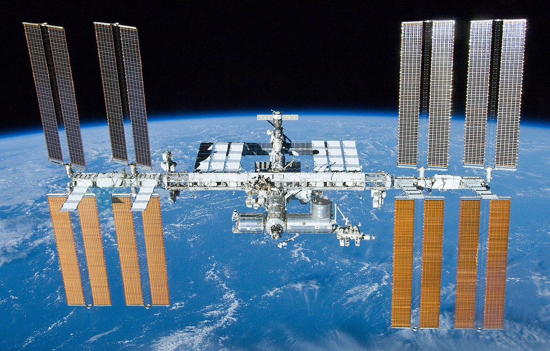
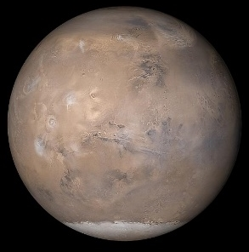
What’s Out There? The Space Radiation Environment
Exposure Type | ISS (51.6⁰ inclination) | Beyond Leo Earth Orbit
Galactic Cosmic Rays (GCR) | Limited to polar regions Fractionated low dose-rate ~ 87% protons, 12% Helium, 1% HZE | Continuous Chronic low dose-rate ~ 87% protons, 12% Helium, 1% HZE
Trapped Radiation | South Atlantic Anomaly (SAA) Fractionated low dose-rate Protons | Transit through Van Allen Belts Quasi-acute Protons
Solar Particle Events (SPEs) | Limited to polar regions Fractionated low dose-rate Protons | Full Event Quasi-acute Protons
Neutrons, Secondary Radiation | Shielding Chronic low dose-rate | Shielding Planetary (albedo) Chronic low dose-rate
Notes:
Space radiation is composed of mainly high energy particles from 3 primary sources. Galactic Cosmic Rays which are theorized to be the result of stellar explosions accelerating every known element on the periodic table across the universe. Then there are the protons and electrons that get trapped in Earth’s magnetic field – commonly referred to as the Van Allen Belts. These are responsible for the South Atlantic Anomaly – a region where the offset of Earth’s geomagnetic and rotational axes create an area where the inner radiation belts impinges into the atmosphere. And then finally, probably the most well known are the Solar Particle Events. These occur when localize magnetic fields on the Sun get so tangled that they reconnect and the energy released accelerates particles out into the solar system. Additionally Neutrons and Secondary radiation can be created inside a spacecraft, habitat, or on a planetary or lunar surface.
But of course the, contribution of each of these sources to a person’s dose is dependent on a number of factors, including where you are in space. For example….
However, on a per day dose rate basis, ISS and Beyond LEO exposures are roughly similar – but it is the composition of the radiation that is different and the fact that there is no geomagnetic protection from solar particle events beyond LEO.

Slide 9
More Resources
Space Radiation Element https://www.nasa.gov/hrp/elements/radiation
NASA Human Research Roadmap – link to risks, gaps, and funding priority (green = low, red = high)
https://humanresearchroadmap.nasa.gov/
NASA Taskbook – Summaries of current and previously funded projects
https://taskbook.nasaprs.com/tbp/welcome.cfm
Life Science Data Archive – Can request past data and search tissue repository
https://lsda.jsc.nasa.gov/
https://lsda.jsc.nasa.gov/Biospecimen
Instructions - https://www.nasa.gov/hrp/elements/radiation/tissue-sharing
NASA GeneLab – Space-related omics database. Users can upload, download, share, store, and analyze spaceflight and spaceflight-relevant data from experiments.
https://genelab.nasa.gov/
The Health Risks of Extraterrestrial Environments (THREE) – Open access space radiation literature
https://three.jsc.nasa.gov/#section=main

