Slide 1
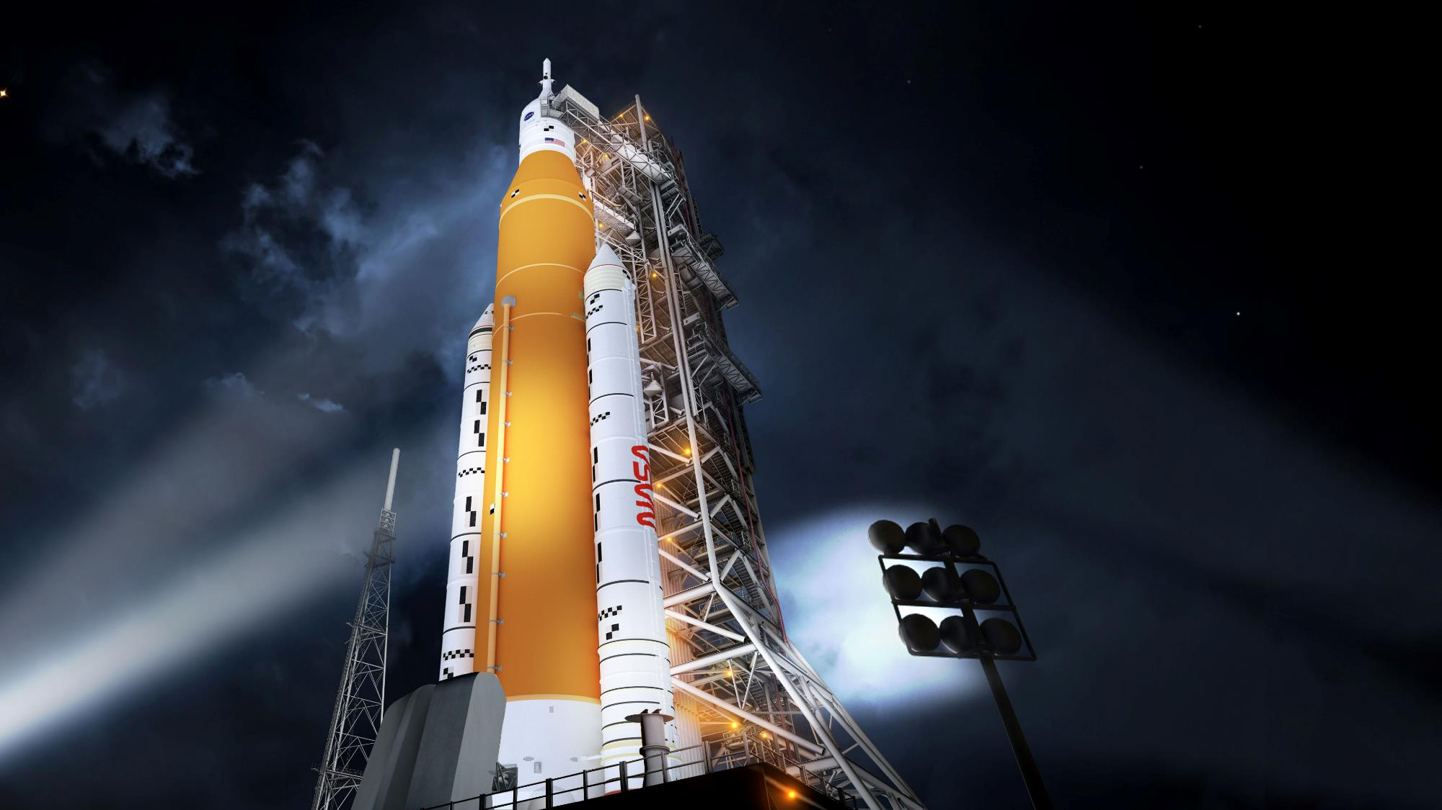

NASA Space Launch System Completes Key Hot Fire Test and Begins Vehicle Integration
AIAA ASCEND
November 15, 2021
John Blevins, AIAA Fellow
Chief Engineer
SLS Program
This material is a work of the U.S. Government and is not subject to copyright protection in the United States.
Notes:
Welcome. Thanks for this opportunity. We have a lot going on right now. I’d like to tell you:
Our plan for SLS – what it is and where it’s going
What SLS can do for Artemis
Explain the major SLS components
Talk about the importance placed on testing for NASA’s next crewed spacecraft
Discuss our accomplishments to date on the SLS for Artemis I and what’s ahead
And give you a quick look at where we are on Artemis II, our first crewed mission to the Moon since Apollo and Artemis III, our second mission to the Moon

Slide 2
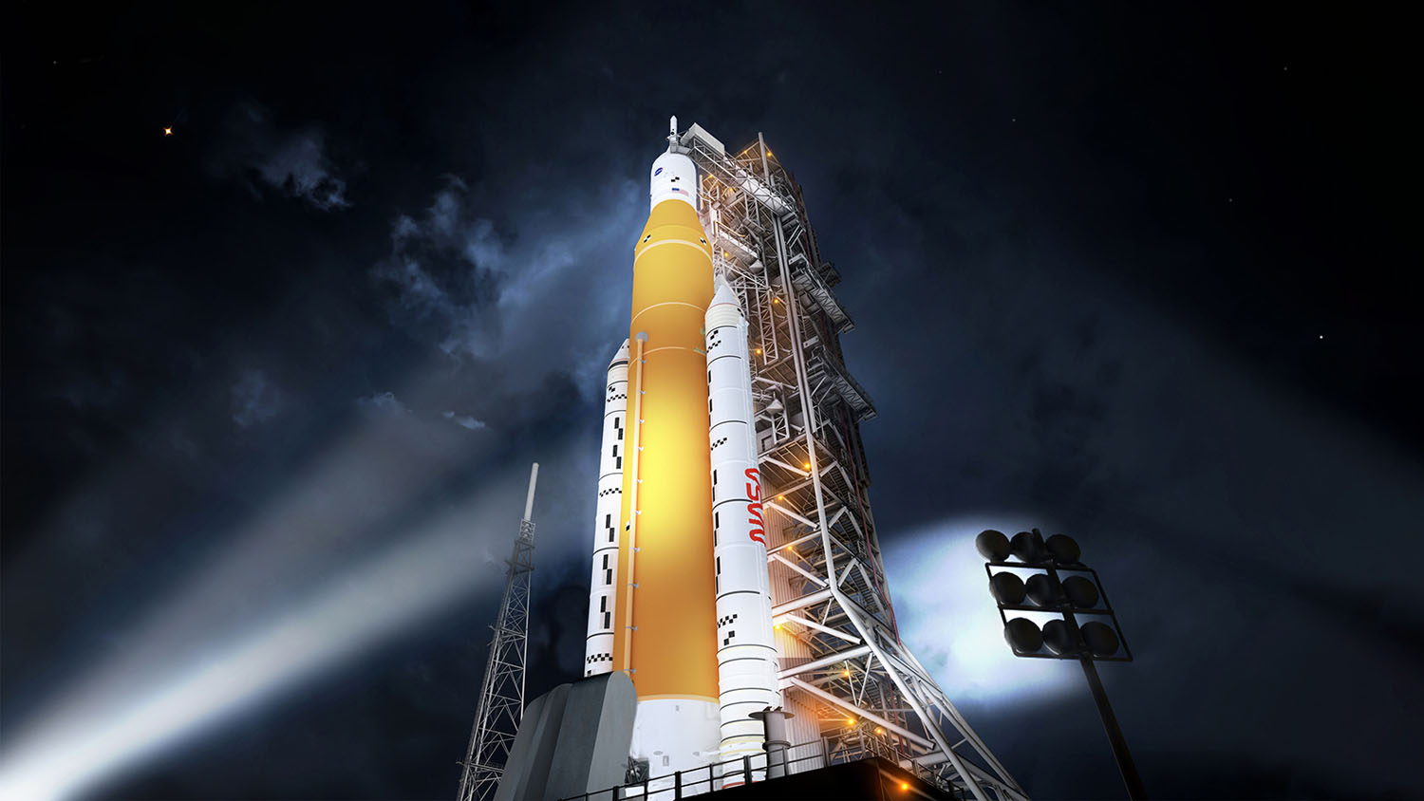

THE POWER OF SLS AND ORION
ORION
The only spacecraft capable of carrying and sustaining crew on missions to deep space, providing emergency abort capability, and safe re-entry from lunar return velocities
NATIONAL CAPABILITY
The SLS, Orion, and Exploration Ground Systems programs leverage more than 3,800 suppliers and 60,000 workers across all 50 states
SLS
The only rocket with the power and capability required to carry astronauts to deep space onboard the Orion spacecraft
Notes:
Together SLS and Orion – along with the ground systems at KSC make up a unique capability and national asset.
Orion – human rated for lunar missions –the ONLY spacecraft capable of carrying and sustaining crews on deep space missions.
SLS is the only exploration-class vehicle capable of sending humans to deep space along with the large systems necessary to live and work in deep space
Standing 322’ tall, weighing in at 5.75 million pounds and boasting 8.8m lbs of thrust… enough to hoist 59K lbs to TLI, the SLS Block 1 will be our workhorse for the first phase of the Artemis Program.
Power and capacity to lift large, complex payloads – reducing the number of launches needed to put hardware in space.
Evolvable – allows for mission flexibility – astronauts on exploration missions – or payloads for scientific missions.
SLS is a foundational asset for America’s space program – it is a key component of the deep space architecture to journey to destinations like Mars and beyond!

Slide 3
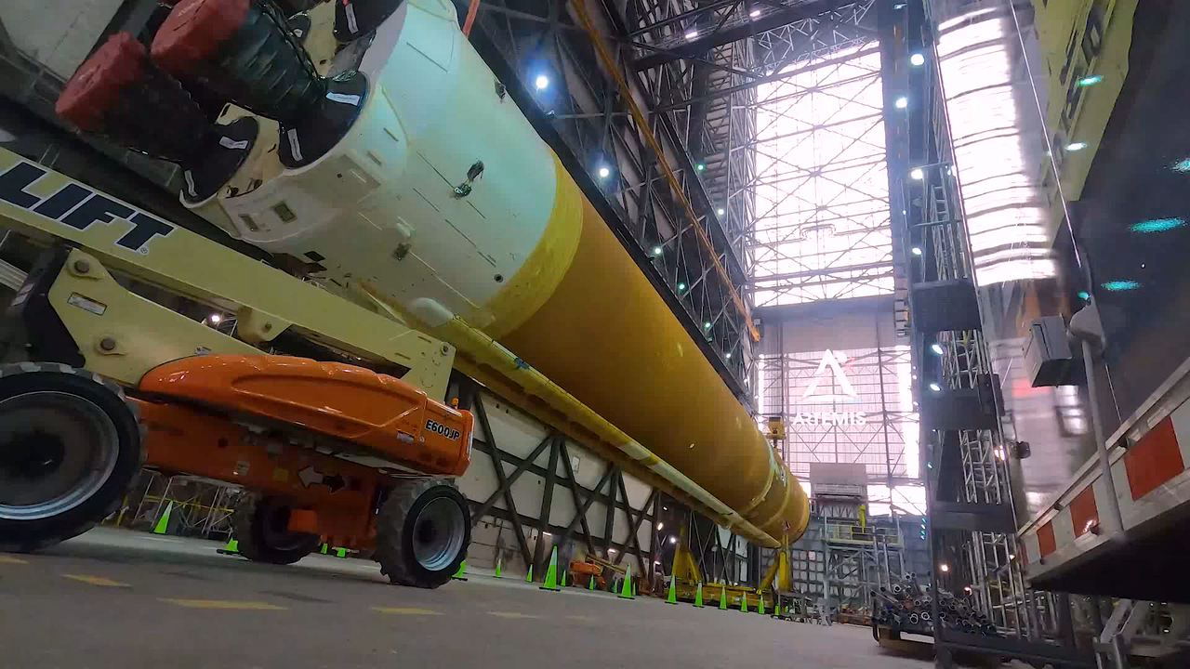
HEAVY LIFT DAY IN THE VAB
Notes:
So where are we at right now with Artemis I? Big things are happening right now down at Kennedy Space Center.
Video: timelapse of Core Stage being mated to the SRBs in the VAB on the Mobile Launcher. (55 seconds)

Slide 4
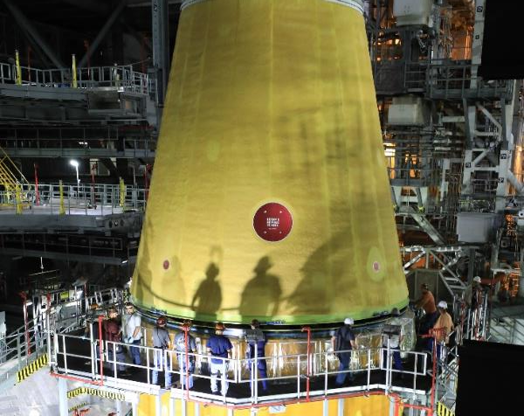
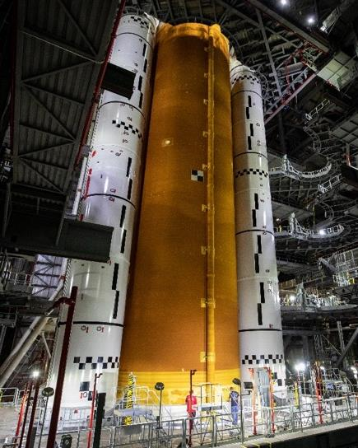
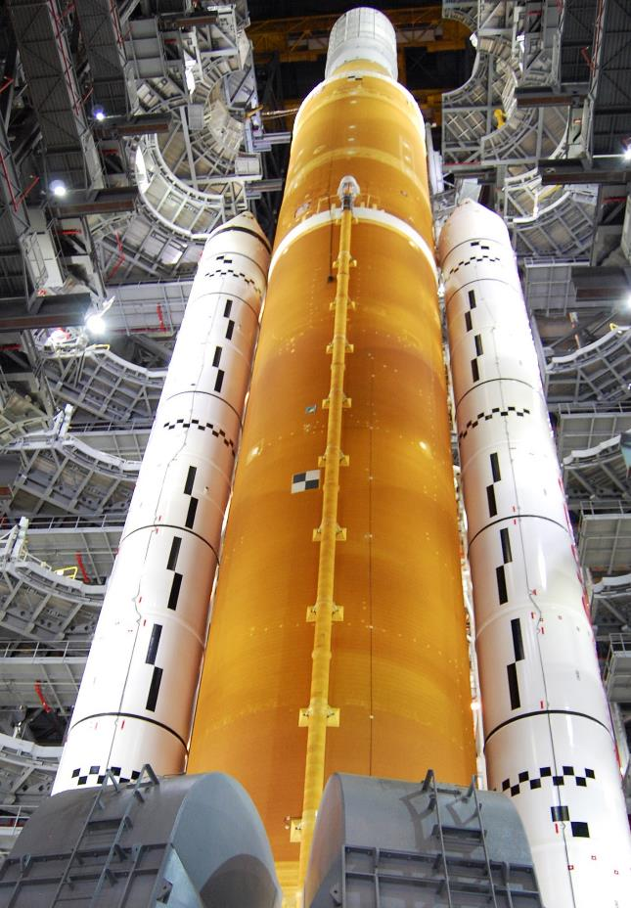
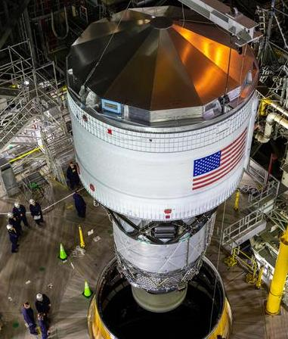
SLS PROGRESS TOWARD ARTEMIS I
LVSA mated with core stage
Core stage mated to solid rocket boosters on mobile launcher
ICPS mated with LVSA
Artemis I rocket during URRT
Fully stacked
Notes:
Summary of progress toward Artemis I:
All elements manufactured, major testing complete, and all elements delivered to KSC
Left: The core stage was lowered between the boosters and mated to them
Upper Center: The LVSA was stacked on top of the core stage and mated to it
Lower Center: ICPS stacked on top of LVSA and mated to it
Right: As part of the Umbilical Release and Retract Test (URRT) crews at KSC retracted the 10 work platforms surrounding the Artemis rocket

Slide 5
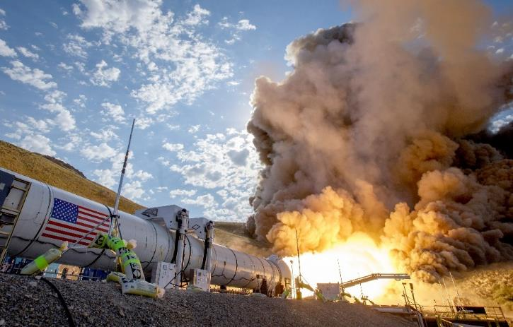
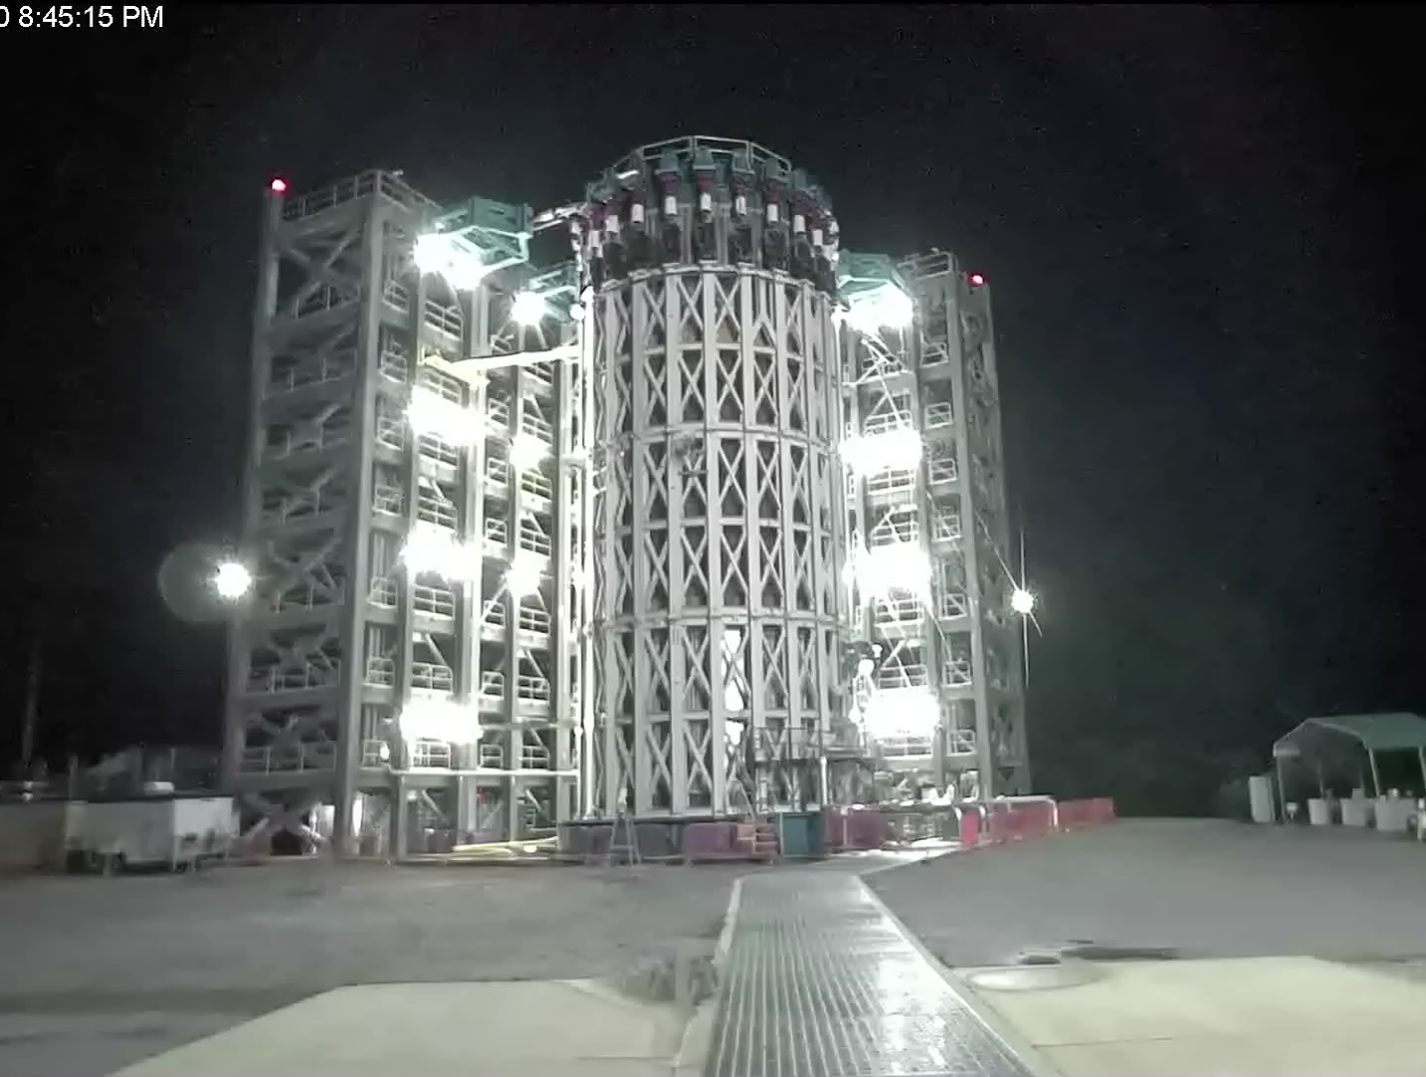
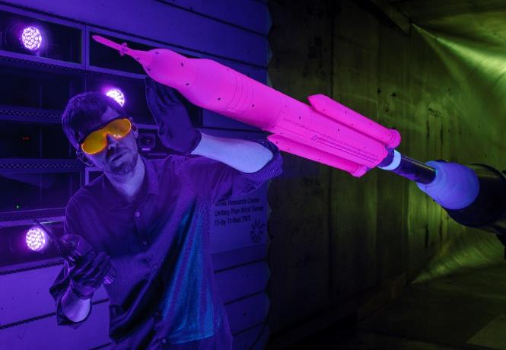
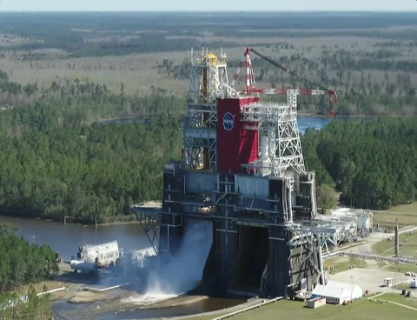
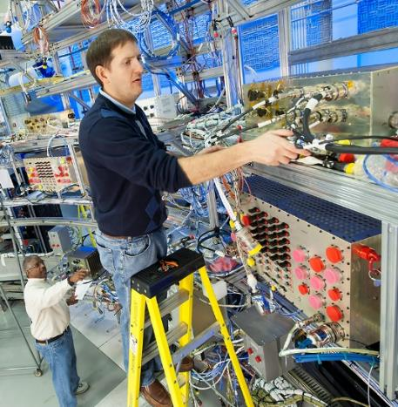
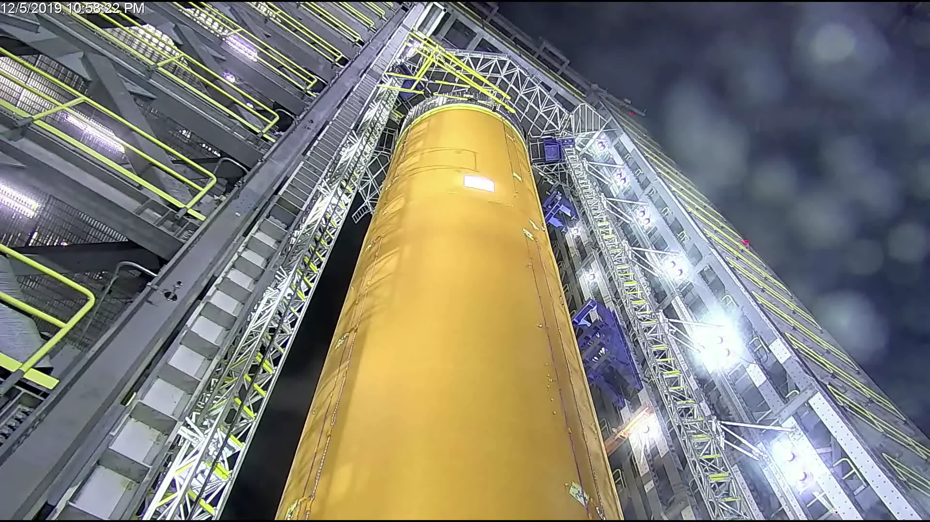
SLS TESTING
Notes:
From wind tunnel to flight hardware, testing is a big part of making SLS safe for astronauts.
Before the vehicle can fly, its components will have been structurally tested to ensure they can survive the extreme pressures and loads experienced in flight.
SLS structural qualification testing at Marshall complete, largest test campaign at MSFC since Space Shuttle. Five structural test articles underwent 199 separate test cases, and more than 421 gigabytes of data were collected to add to computer models used to design the rocket and optimize it in the future.
Software is tested in a flight-like test environment, and then again on the flight hardware to ensure everything functions as needed to send crew to space.
RS-25 engines adaptation hotfire series complete: 2015 – 2019 at Stennis to adapt the RS-25 to SLS performance and environment requirements and develop a modern engine controller and software. Tests also included new engine flight controller development and flight controller qualification as well as development parts for restart engine program. Total of 32 tests totaling nearly 15,000 seconds of hot-fire time.
Eight-test Green Run series at Stennis ending with a simulated launch hot fire test will prove Core Stage 1 is ready for Artemis I.
The 5-segment boosters for SLS underwent both hot and cold firings early in the program. A Flight Support Booster will be test fired in September to qualify a new propellant vendor for future flights.

Slide 6
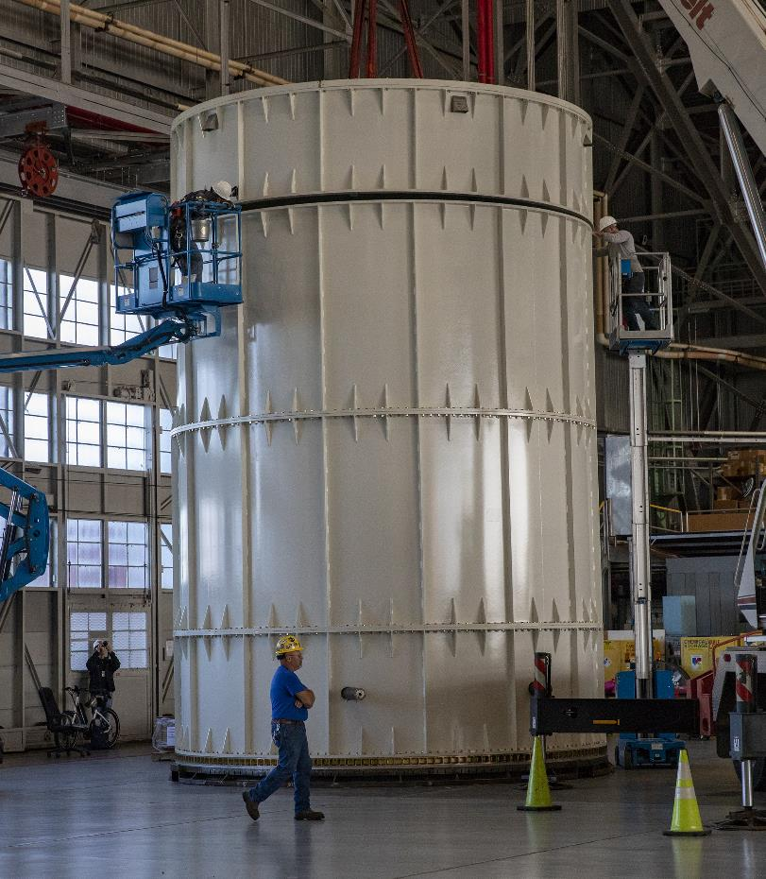
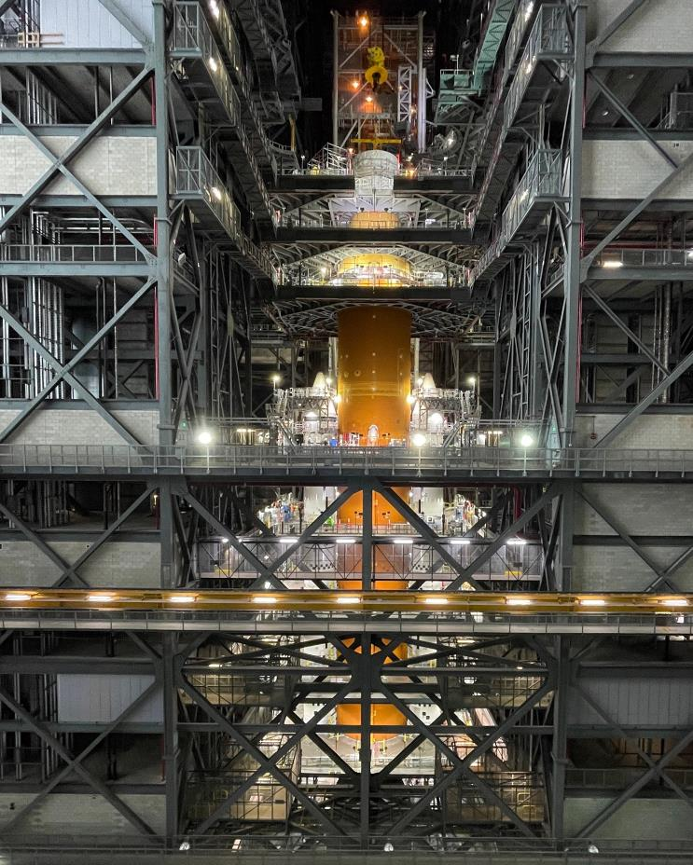
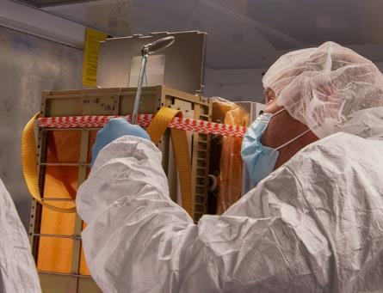
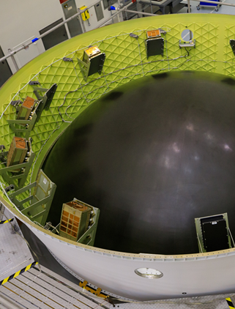
Integrated test and checkout
CubeSat payload
integration in progress
Orion mass simulator for
integrated modal testing
OSA STA stacked on top of launch vehicle ahead of modal testing
CubeSats and dispensers installed in OSA
NEA Scout
Notes:
We are preparing for our last big test campaign of the integrated vehicle before launch – the Integrated Test and Checkout
10 optimized tests in the VAB, during rollout and on the launch pad
Includes a “partial stack” modal test using an Orion mass simulator shown above on the left and center, just to protect the Orion and Service Module.
Collecting operational data, engineering data and development data
Modal
Interface Verification
Communications End-to-end
Umbilical Release and Retract
VAB Project Specific Engineering
Countdown Sequence Test
Flight Safety System
Dynamic Rollout Test
Launch pad Project Specific Engineering Test
Wet Dress Rehearsal
While that’s in progress, we will be working on cubesat integration for deployment during the mission.

Slide 7

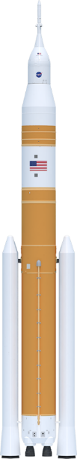
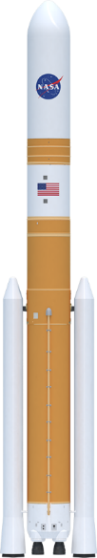



The power of sls
Foundation for a generation of deep space exploration
Payload to LEO
95 t (209.4k lbs)
95 t (209.4k lbs)
105 t (231.4k lbs)
105 t (231.4k lbs)
130 t (286.6k lbs)
130 t (286.6k lbs)
Payload to TLI/Moon
> 27 t (59.5k lbs)
> 27 t (59.5k lbs)
38 t (83.7k lbs)
42 t (92.5k lbs)
> 43 t (94.7k lbs)
> 46 t (101.4k lbs)
Payload Volume
516 ft³ (14.6 m³)
8,118 ft³ (229.9 m³)
10,100 ft³ (286 m³)**
21,930 ft³ (621.1 m³)
10,100 ft³ (286 m³)**
34,910 ft³ (988 m³)
Low Earth Orbit (LEO) represents a typical 200 km circular orbit at 28.5 degrees inclination
Trans Lunar Injection (TLI) is a propulsive maneuver used to set a spacecraft on a trajectory that will cause it to arrive at the Moon. A spacecraft performs TLI to begin a lunar transfer from a low circular parking orbit around Earth.
The numbers depicted here indicate the mass capability at the Trans-Lunar Injection point.
** Not including Orion/Service
Module volume
SLS Block 1 Crew
SLS Block 1 Cargo
SLS Block 1B Crew
SLS Block 1B Cargo
SLS Block 2 Crew
SLS Block 2 Cargo
Maximum Thrust
8.8 M lbs
8.8 M lbs
8.9 M lbs
8.9 M lbs
9.5 M lbs
9.5 M lbs
Notes:
The First 3 Artemis missions will use the block 1 configuration.
But down the road – the SLS will evolve from what is already a greater capability than any existing launch vehicle – to unprecedented capability that will change how we explore.
As the SLS evolves to that Mars-enabling capability – it retains many common elements – avoids needing a completely new vehicle design with each iteration.
By using reliable, proven propulsion systems upgraded from the Space Shuttle Program: RS-25 engines and solid rocket boosters – we have built the safest rocket we can.
Teams here in Huntsville are already working on an Exploration Upper Stage that will allow NASA to launch 40% more payload than the rocket we are flying on Artemis I.
This opens up even more possibilities for missions that can carry both astronauts and large cargos or for NASA’s boldest scientific missions to the outer planets.
SLS will send America’s most important human exploration and science missions faster and farther.
It’s really MORE, FARTHER, FASTER.
So what does progress for Artemis II, Artemis III and beyond look like?

Slide 8
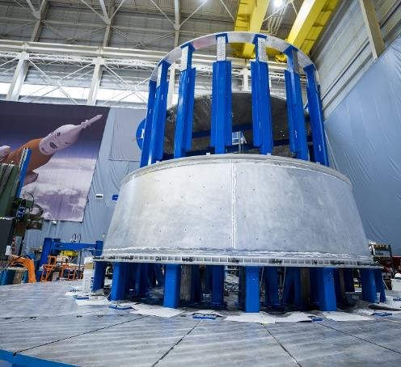
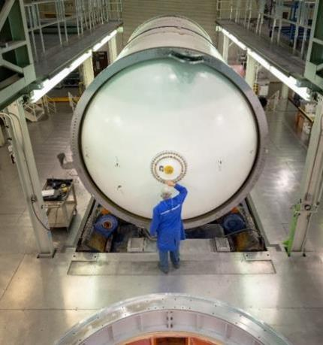
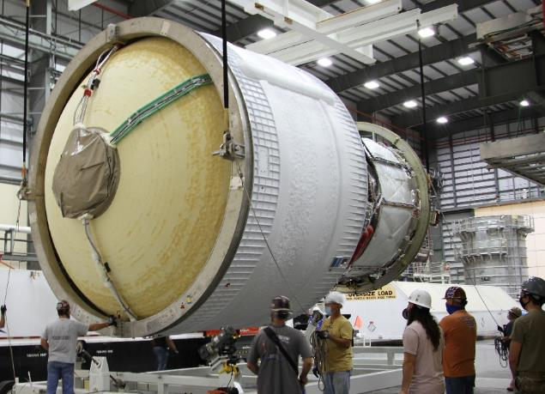
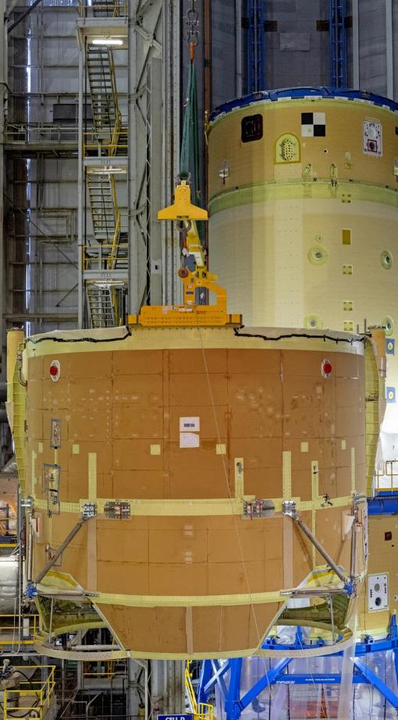
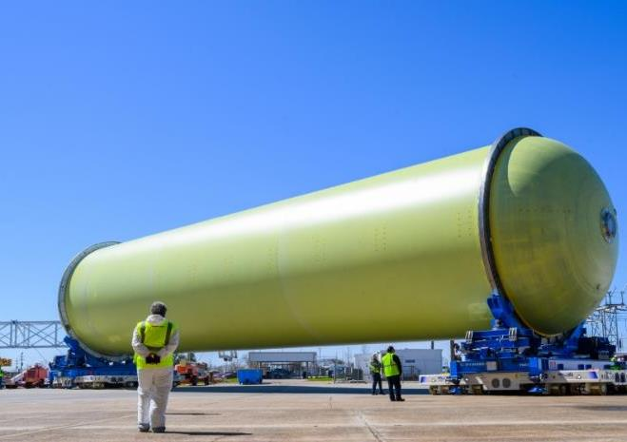
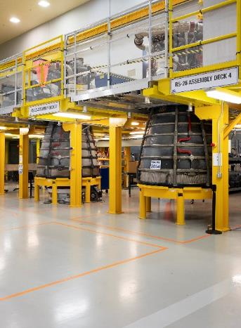
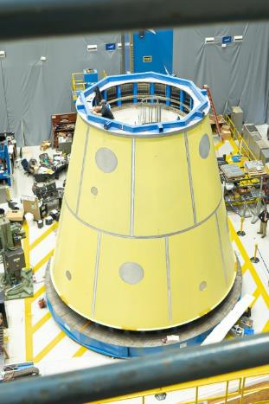
SLS PROGRESS TOWARD ARTEMIS II
Orion Stage Adapter weldment complete
Booster motor
segments complete
ICPS shipped to Cape Canaveral
Boattail and engine section assembled; to be attached to the forward join
RS-25 engines complete
LVSA weldment complete
Liquid Hydrogen Tank
Notes:
Lots of progress toward Artemis II:
All booster motor segments complete and in storage for second flight
All four flight engines complete and stored in place; all controllers green run
Core Stage 2: All major components manufactured; the forward join (forward skirt-LOX tank-intertank) is nearly complete
LVSA welding complete
Welds complete for OSA at MSFC
ICPS is mostly complete and has shipped to ULA at Cape Canaveral for final work
Also realizing production improvements in building CS-2:
Although we have prioritized our resources to complete CS-1, the Artemis 2 core stage production schedule currently is averaging 50% improvement in schedule over the Artemis 1 core stage
We have so far seen a 70% improvement in labor hours on the engine section and 33% improvement on the intertank.
To break that down further, for the engine section, the most complex section of the core stage, we have seen a significant improvement in manufacturing discrepancies, a 97% improvement in rework hours and an overall 70% improvement in baseline labor hours required

Slide 9
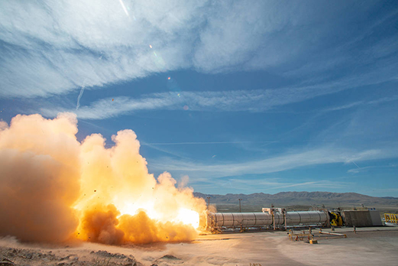
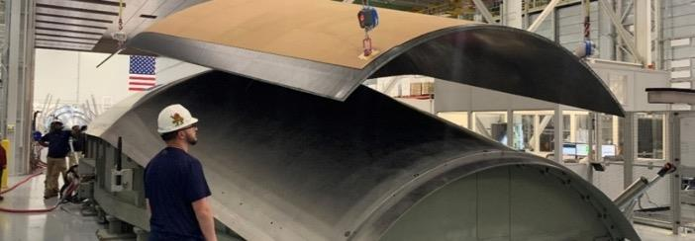

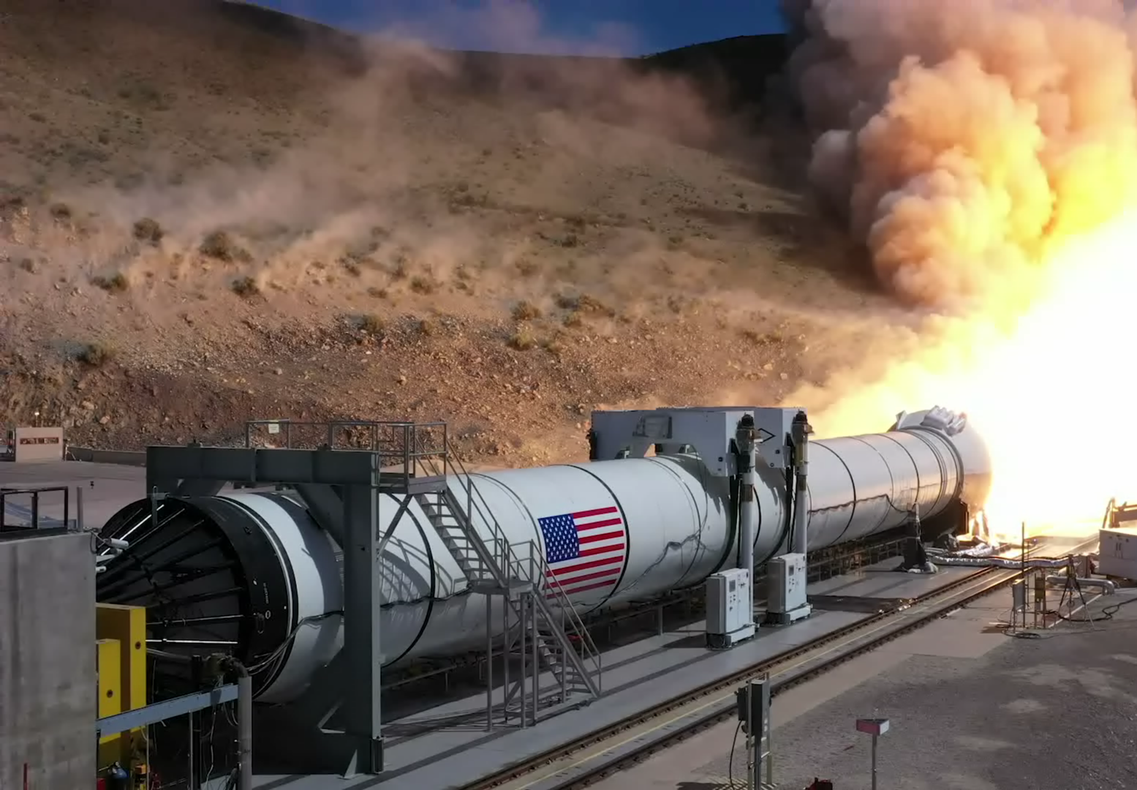
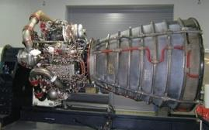
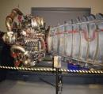
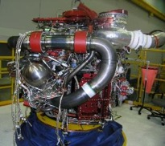
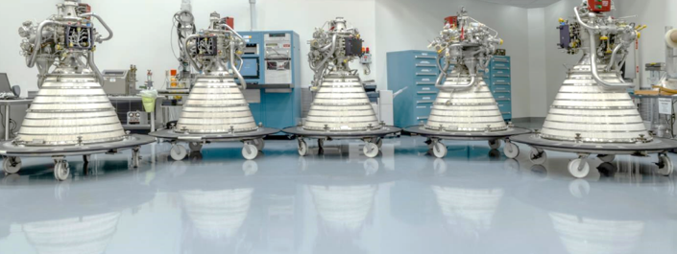
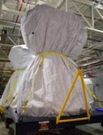
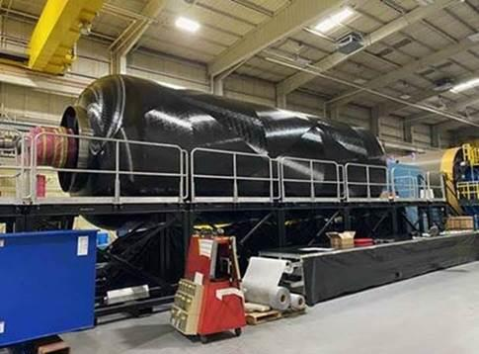
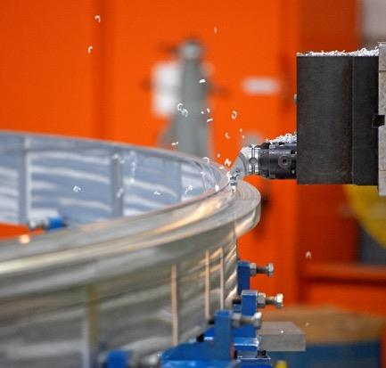
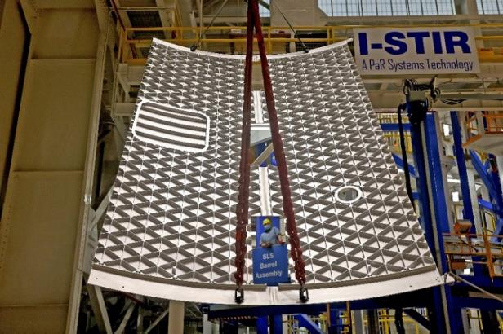
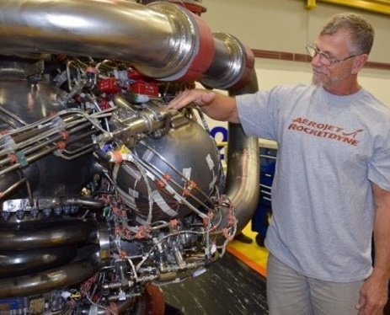
Sls Progress toward Artemis III and beyond
78%
E2048
E2057
Universal stage adapter manufacturing demonstration article
50%
E2061
E2054
Artemis III RS-25 flight
set processing
Successful solid rocket motor hotfire
RL10 engines complete
Trial Composite Wound Case
Artemis III core stage production
EUS Interstage weld confidence, development articles
Additively manufactured parts for future RS-25s
Notes:
Significant progress toward third flight and B1B:
Top left: Flight Support Booster 1 test at Northrop Grumman in Utah in September 2020. Tested propellant and materials for fourth flight & beyond
Top Center: Five of 6 completed RL10 engines to support both ICPS and EUS.
Top Center Top: Universal Stage Adapter development work.
Top Right: Artemis III flight engine set progress.
Bottom left: Trial composite wound case for BOLE boosters
Bottom 2nd from left: Artemis III core stage structural production, specifically trimming rings.
Bottom 3rd from left: EUS weld confidence panels at MAF
Bottom right: POGO accumulator ball is one of several additively manufactured parts being developed for RS-25 restart engines .
Not Shown: Planning underway for modifications at Michoud Assembly Facility to accommodate expanded core stage/EUS production.
So, as you can see, a lot of hardware in the pipeline. Program is well-positioned for Artemis II (‘22) and Artemis III (‘24)
Need booster and EUS updates to notes

Slide 10
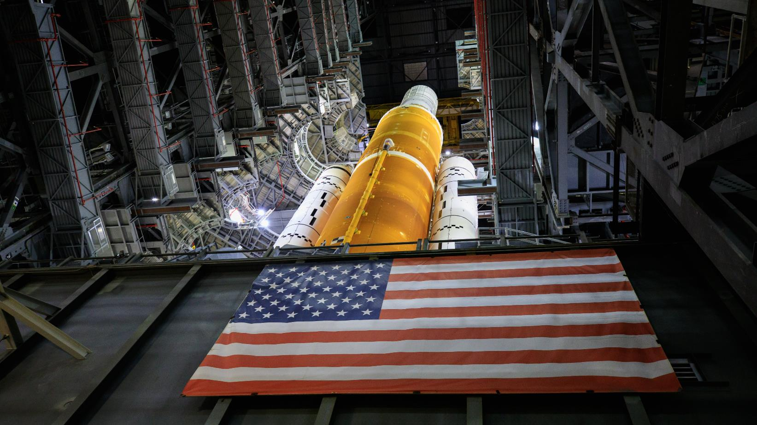

Artemis i: countdown to launch
More testing, joint simulations to come
Wet dress rehearsal
Then roll to Pad B for launch of Artemis I
Mission simulations in progress
Notes:
Artemis I will be launching very, very soon. Right now, NASA crews down at KSC are finishing up testing and joint simulations. Then, the stacked rocket will head to Pad B for the wet dress rehearsal: this will entail the Mobile Launcher rolling out to the pad, fully loading the LH2 and O2 tanks and going through a countdown series to ensure success during the actual flight window. Following wet dress rehearsal… it’s time to launch, and the historic Artemis I mission to take off.

Slide 11
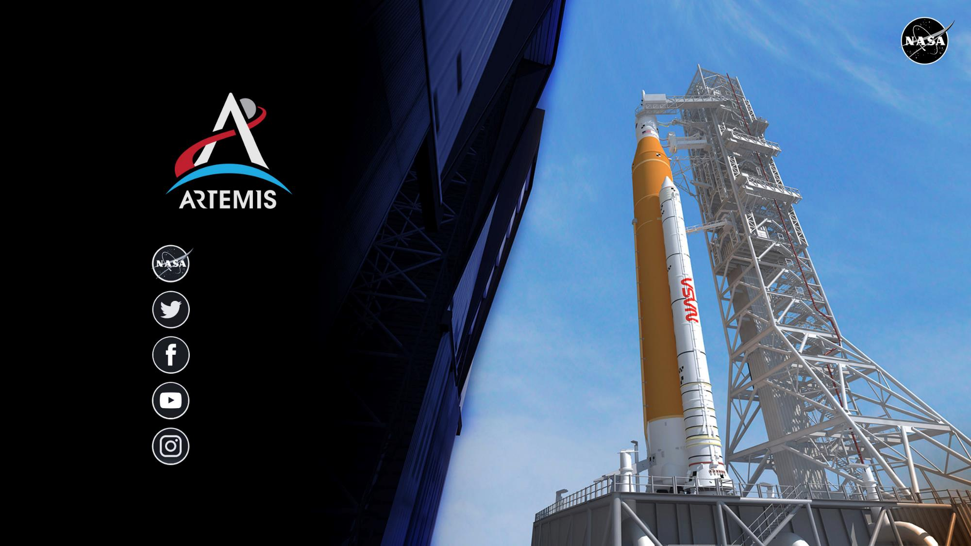
nasa.gov
images.nasa.gov
@NASA_SLS
NASASLS
youtube.com/nasa
@NASAArtemis
Notes:
You can follow developments with SLS, Ground Systems, Orion – and the overall Artemis program by through our social media platforms.
We are proud of this community and honored to do the work we do.
And, we know, as they say, that we are standing on the shoulders of giants.
We don’t take that lightly – nor do we take this mission lightly.
We have delivered the rocket for Artemis I – and we are going.

