Slide 1
The Development of a Qualified Material Process (QMP) via NASA-STD-6030*
*NASA’s Internal Technical Standard “Additive Manufacturing Requirements for Spaceflight Systems” – released 4/21/21
Alison Park – NASA NESC
Rick Russell – NASA NESC Doug Wells – NASA Marshall Space Center
Brian West – NASA Marshall Space Center

Slide 2

Presenter Biography
Alison Park - NASA NESC
Alison Park is the Deputy Technical Fellow of Materials for AM at NASA. She is at a division of the Agency’s HQ Office of the Chief Engineer called NASA Engineering and Safety Center (NESC). Alison’s roles and responsibilities include strengthening its technical capabilities related to Additive Manufacturing, deepening its knowledge base by broadening its perspectives, working with NASA centers to execute technical assessment and support projects for various NASA programs.
Prior to her NASA assignment, she was the Technical Program Manager at a private company responsible for capturing and managing R&D projects to mature AM technologies. She provided leadership and technical guidance to existing and emerging Space rocket engine programs in the area of advanced materials and manufacturing.
She holds a B.S in Materials Engineering from Purdue University and a M.S in Aerospace Materials Engineering from University of California, Los Angeles (UCLA).

Slide 3
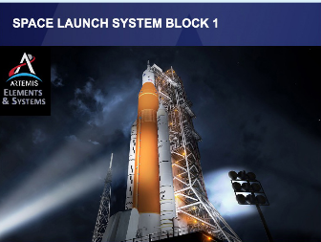
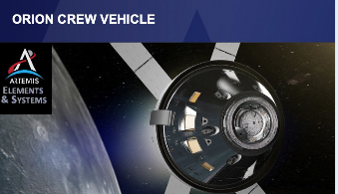
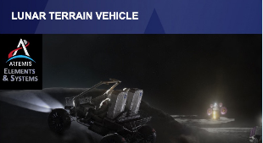
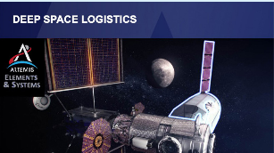
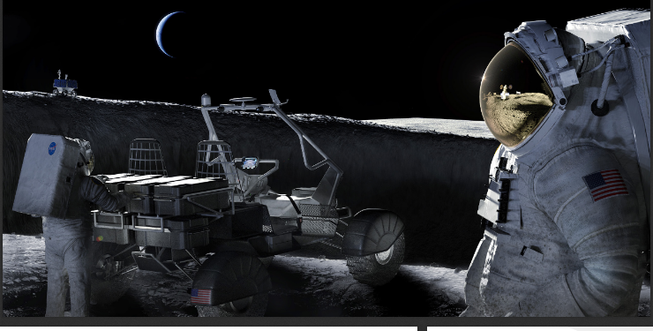
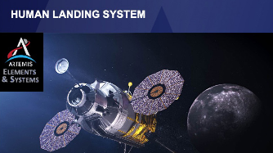
AM parts are already being use for NASA programs in critical applications for Human Spaceflights Human exploration of space, especially deep space, requires extreme reliability

Slide 4
NASA’s Roles in AM Tech Dev and Implementation
NASA has many roles related to AM:
Drive AM technology development effort in support of more affordable access to space and advanced aeronautics applications
Sponsor focused R&D within NASA and through Industry/academic collaborations (e.g., ASTM CoE)
Many NASA presentations at ICAM 2021
Provide framework for Spaceflight hardware certification
NASA must be able to sign a Certification of Flight Readiness (CoFR) for each mission
CoFR states that NASA-purchased services or hardware for access to space are able to safely meet mission objectives according to levied requirements and approved exceptions
Enable NASA’s technical authority to conduct meaningful and efficient evaluations of AM implementations to advise NASA programs on risk : NASA Agency-wide Technical Standard on AM Qual and Cert (released April 2021)

Slide 5
NASA Technical Standards
NASA Technical Standards
Created and published to provide uniform engineering and technical requirements for NASA programs and projects, including requirements for selection, application, and design criteria of an item
NASA Technical Standards – developed and approved for use by NASA HQ’s office and sponsored by NASA Chief Engineer
Applicable technical items may be cited in contract, programs, and other Agency documents

Slide 6
Why NASA needed to have an AM Standard
Provide a consistent structure for engagement
There is not an accepted common engineering practice for AM
Reduce the “Noise” – The current variation on policies, practices, and risk acceptance is tremendous
Allow for awareness and evaluation of risk for AM implementations
To ensure NASA visibility into the AM hardware implementation in high-risk programs
Integrated approach and tailorable for efficiency
Industry standardization gaps
Fill the gaps for a more complete picture of expectations

Slide 7
NASA’s AM Standardization
RELEASED on April 21, 2021
NASA-STD-6030 “Additive Manufacturing Requirements for Spaceflight Systems”
https://standards.nasa.gov/standard/nasa/nasa-std-6030
NASA-STD-6033 “Additive Manufacturing Requirements for Equipment and Facility Control”
https://standards.nasa.gov/standard/nasa/nasa-std-6033
NASA-HDBK-6034: Handbook for above, development underway
Guidance and Example
NASA-STD-6016C (Materials Tech Std) currently in process of revision to incorporate 6030

Slide 8
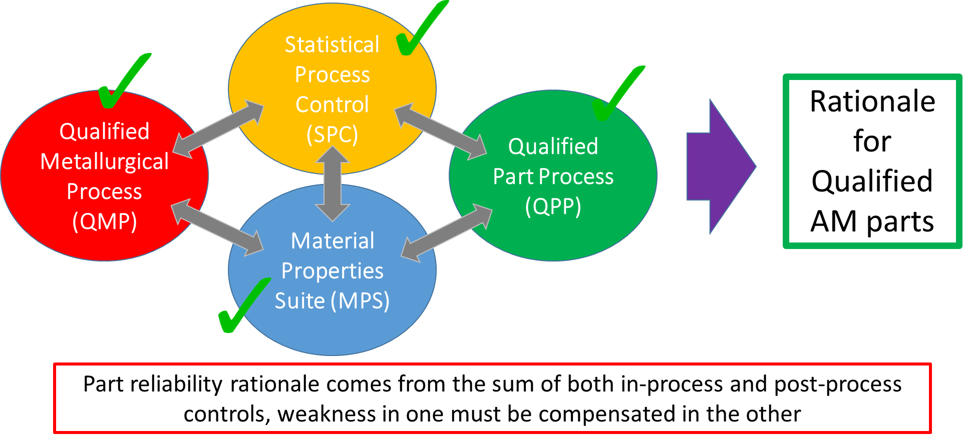
NASA’s AM Qualification Concepts
Today’s topic
Material

Slide 9
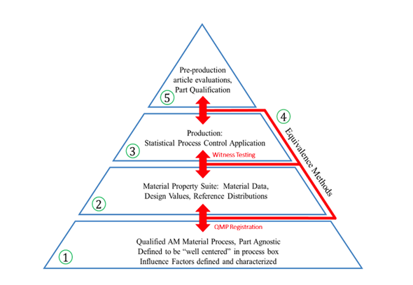
Qualified Material Process (QMP)
One needs to build with a consistent process of matured and stable material quality
Feedstock + machine process controls + post processes --> Fixed
QMP gives you validated, verified, and maintained record of AM process controls
the rationale for the assumed material capability of a part
the quantifiable metrics to monitor the quality of material process over time
The QMP becomes the foundation

Slide 10
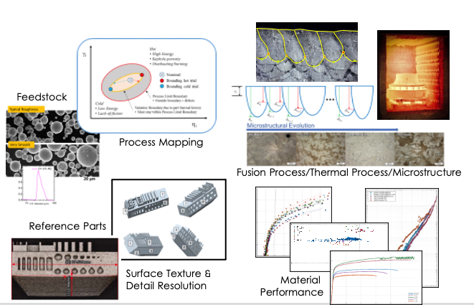
How does QMP actually work?
Step 1 : Define a Candidate Material Process
What is your feedstock
What are control factors governing the AM build process
What are required for post AM processing
Step 2: Do x, y, z to qualify the Candidate Material Process as a QMP
Use of standardized builds
Qualification Criteria – as printed microstructure, surface texture and detail resolution, thermal processing effects on microstructure, mechanical properties (material performance)

Slide 11
Defining Feedstock Controls – Virgin Feedstock Procurement and Reuse
“Feedstock to be used for a Candidate QMP shall be controlled by industry standard specs or configuration-controlled material specs that levy requirements.”
Rationale – control of feedstock is essential to consistent performance of the AM process. Each of these controls is specified to minimize the likelihood of potential process failures related to the feedstock
“A Feedstock reuse protocol shall be defined and implemented.”
Rationale – feedstock can degrade through reuse due to changes in chemistry and morphology. Each of which can affect the quality of the material process and the resulting hardware integrity
NASA STD does not give a ”hard rule” on the number of reuse but…
Acceptability of allowing feedstock reuse needs to be demonstrated when proper controls are verified and maintained

Slide 12
Defining AM Build Process
“AM build process shall be defined in the Candidate QMP by a comprehensive list of fixed, key process variables of known influence on the AM build process for any given AM machine.”
Feedstock characteristics
Environmental conditions in the AM equipment
Process parameter settings
Tool path settings
Dwell times and pauses between layers
Includes process restart procedures

Slide 13
Defining Post Processing
“All AM post-processing that affects bulk material condition shall be defined in the Candidate QMP to manage property and microstructural evolution from the as-built state to the final state.”
Rationale – essential thermal processing controls are necessary to ensure part reliability
Variations are allowed only when it can be shown that equivalent material is produced

Slide 14
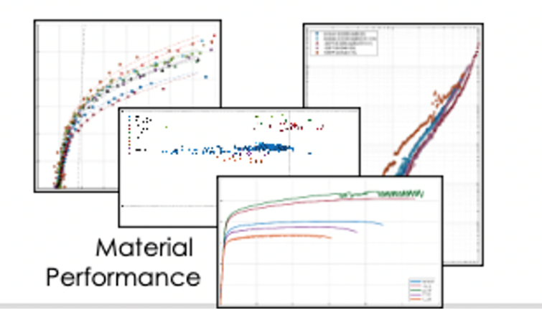
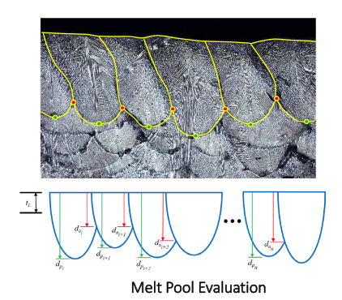
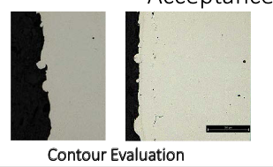
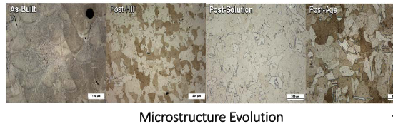
Qualification of Candidate Material Process as a QMP
Quality of the as-built materials – microstructure, defect state, characterization of the top-later melt-pool geometry
Microstructural evolution – as built to final state
Surface Texture and Detail Resolution – via use of reference parts with acceptance criteria
Mechanical Properties - NASA Std gives a minimum quantities and test types for each Part Classification
QMP Report/Record – configuration-controlled record

Slide 15
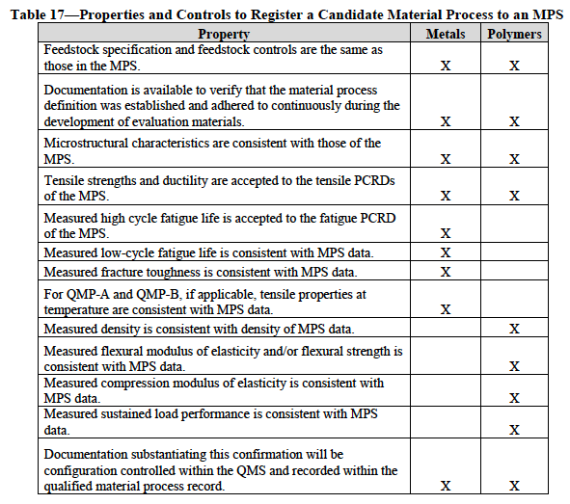
Registration of QMP to Material Properties Suite
Note this is a form of “Engineering Equivalence” to evaluate numerous aspects of the material, but less statistically significant manner for each;
Would rather have the info on microstructure and key performance driven properties than, say 100 tensile data to “improve the stats”
QMP ”Registration” is the process of demonstrating properties of the qualified process
are equivalent to those in the applicable Material Properties Suite (MPS)

Slide 16
In Summary
NASA’s AM Certification: Governing Principles
Understanding of the AM Process
Integration across disciplines throughout the process
Discipline to define and follow the plan
Heavily rooted in the foundational controls – Qualified Material Process state produces a good part consistently
Even though this is a NASA’s internal Technical Standard to be levied on NASA programs, anyone can emulate the framework, implement technical items, use it as a guidance or education

Slide 17
Thank you.
Alison Park
alison.m.park@nasa.gov

