Slide 1
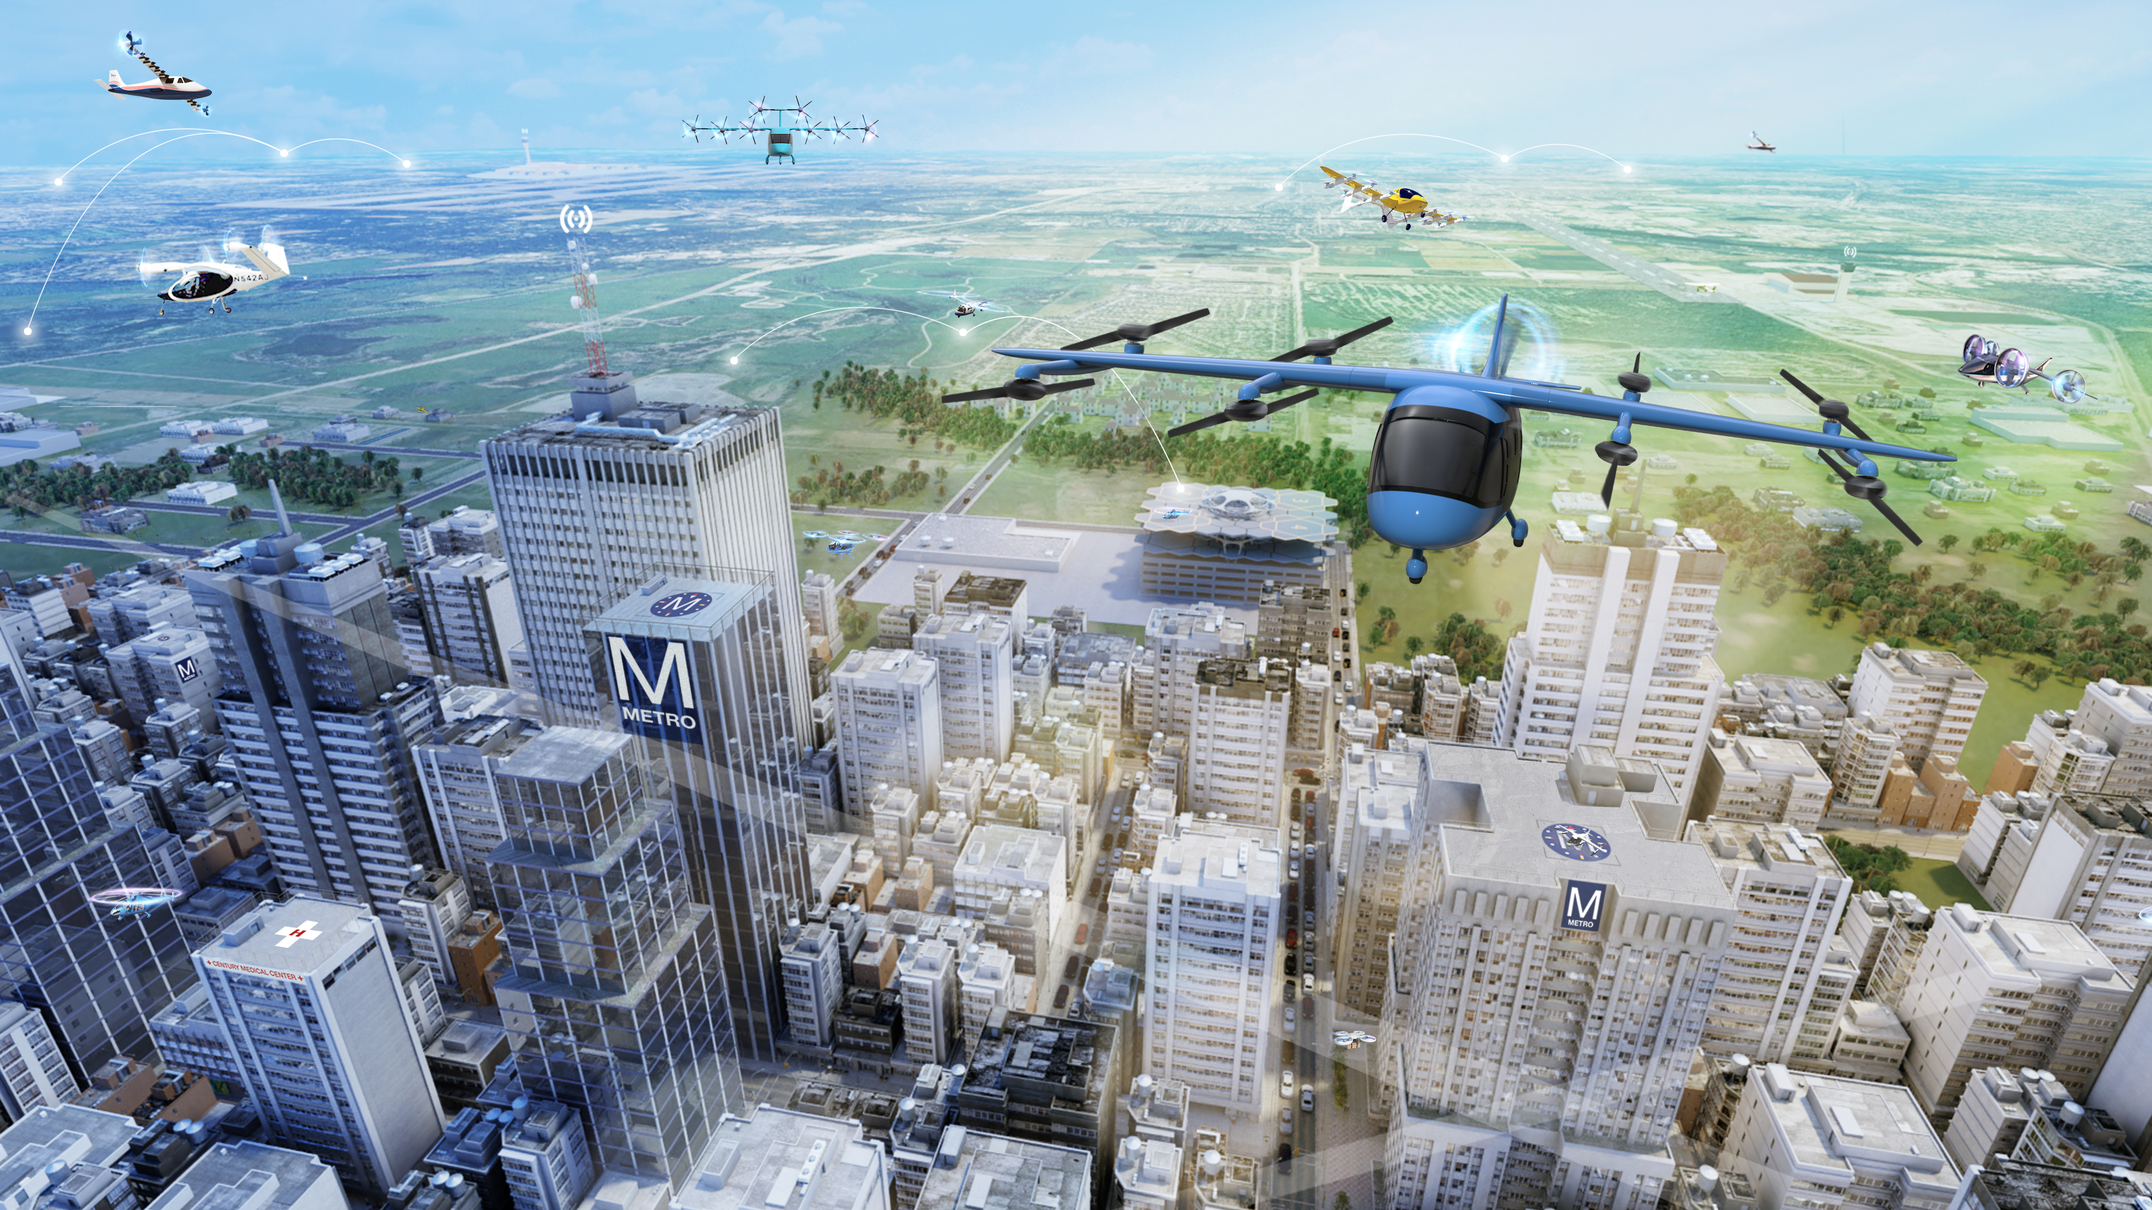

Reimagining Mobility: Update on UAM & AAM
October 6, 2021

Slide 2
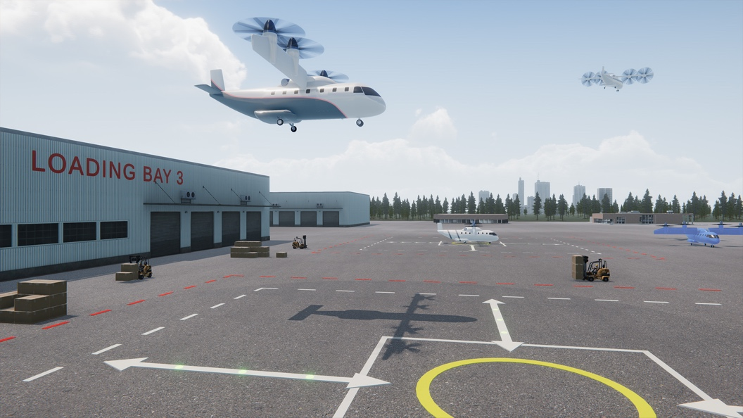
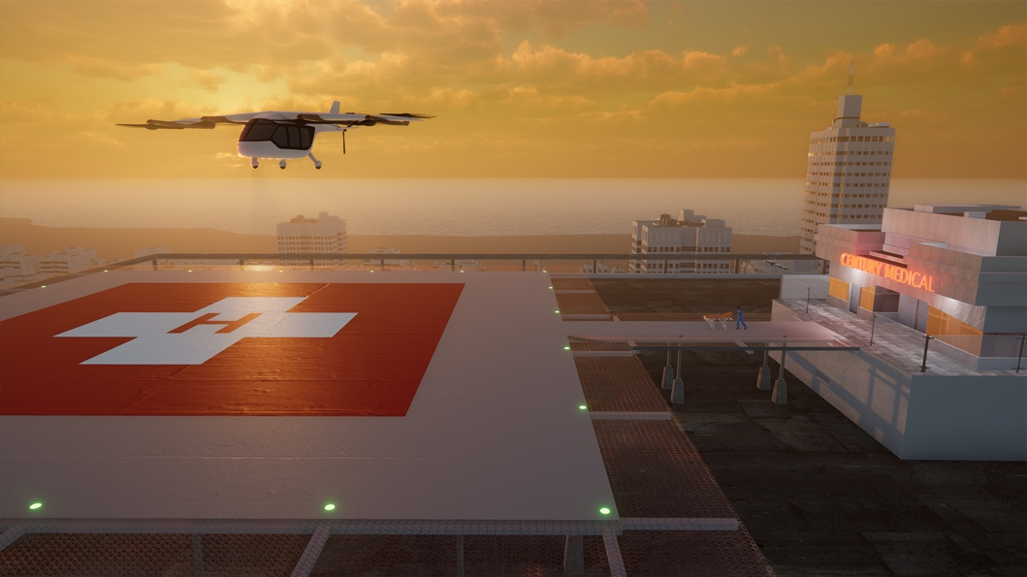
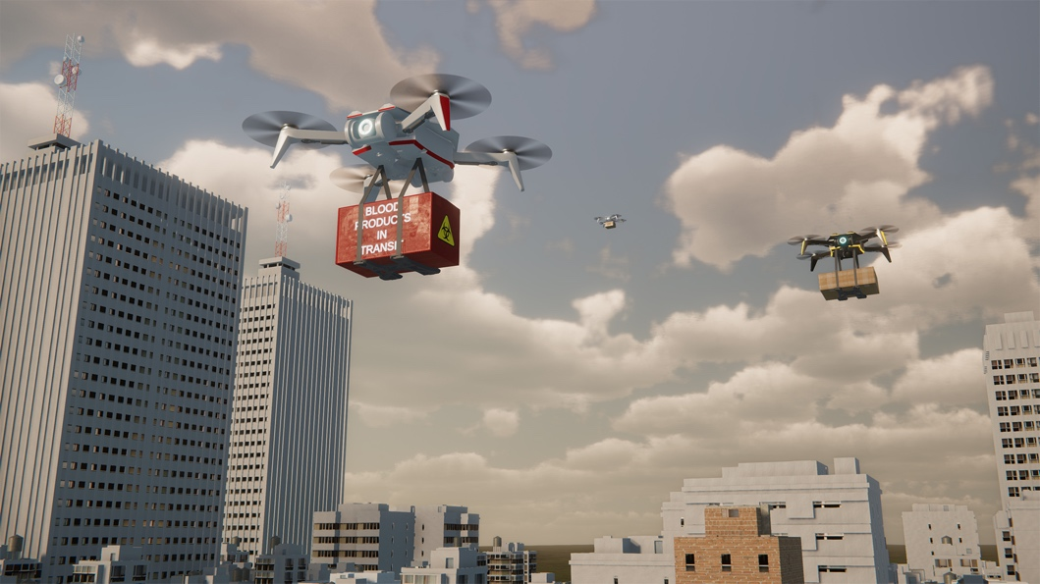
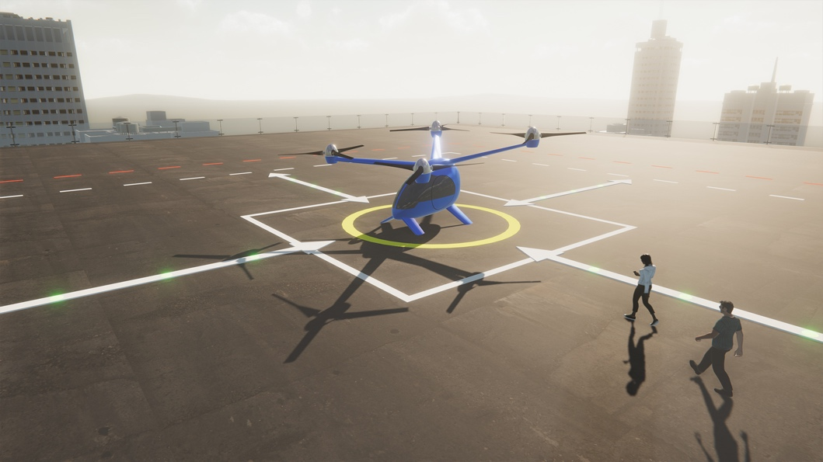
Advanced Air Mobility is Emerging
REGIONAL PASSENGER AND CARGO
TRANSPORT
PUBLIC GOOD
CONSUMER/ ENTERPRISE GOODS AND SERVICES
PASSENGER TRANSPORT
Latest studies show an annual estimated market of $115B by 2035

Slide 3
Urban Air Mobility (UAM) Ecosystem Goals¹
#
  UML-#
  Overarching
  Vehicles
  Airspace
  Community
  Industry Operational Capability
  CY2020
  CY2021
  CY2022
  CY2023
  CY2024
  CY2025
  CY2026
  CY2027
  CY2028
  CY2029
  CY2030
Initial UAM ConOps Development
High Capacity UAM Ports
3
Integration of
Automated Systems
1
4
3
Integrated system-wide safety tools & methods
Piloted UAM aircraft cert. basis
1
Secured Systems Architectures
3
Conforming prototypes
1
Automated Flight and Contingency Management
2
4
1st Type Cert awarded
2
Advanced urban capable aircraft
3
Initial pilot training & licensing
Scaled vehicle production
4
Initial operational approvals
2
Separation Standards
3
2
Low volume airspace operations
Procedures for high-capacity corridors
3
Integrated Weather Tolerant Airspace Operations
4
CNSi Architectures
3
UAM Airspace Architectures and 3rd Party Services
3
Early adopter locations
Local regulations enacted
Multi-Modal Integration
1
3
4
Initial Infrastructure Deployment
3
Operational safety demonstrations
1
Initial commercial operations
2
High-capacity corridors in early adopter cities
3
Scalable weather-tolerant urban ops
4
CNSi: Communication, Navigation, Surveillance, Information
UML: UAM Maturity Level
  ¹ Based on a range of publicly available industry projections; not a consensus view; aggressive
Notes:
Got rid of “unlock”
Now called the goal slide
Validation may cause us to update – e.g. vice 1 CNSi Goal, we’d have a Comm’s Goal, a Navigation Goal and a Surveillance Goal. Or a Goal we didn’t think.

Slide 4



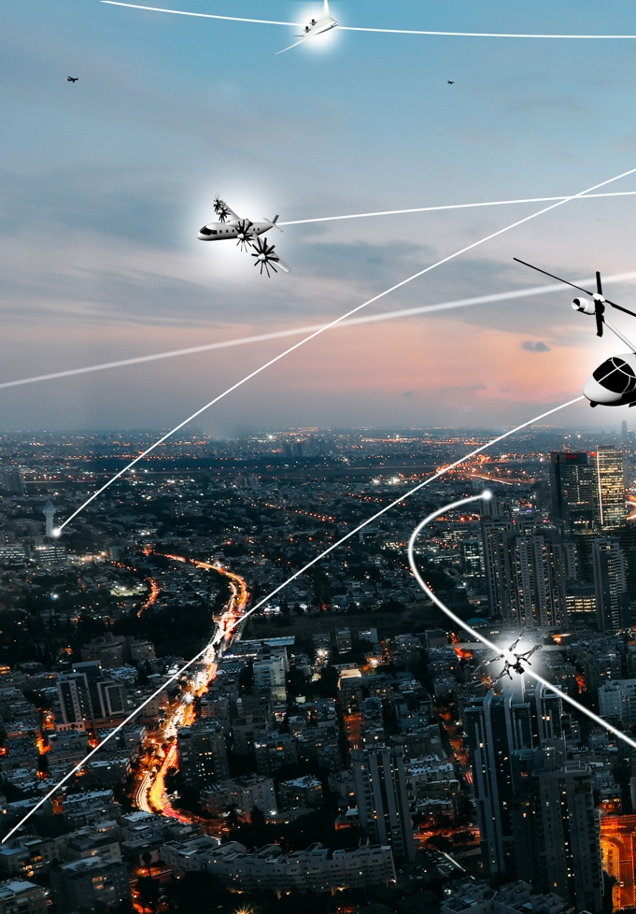

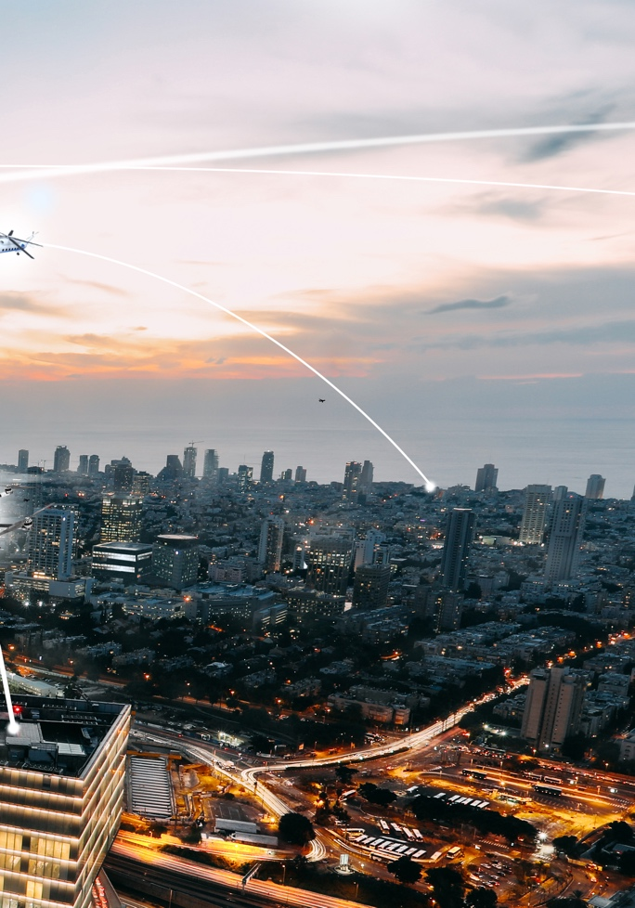
NASA Role to Address AAM Challenges
Vehicle Development and Operations
Airspace Design and Operations
Community Integration
  NASA and key partners are collectively taking on the most difficult mission challenges to enable industry to flourish by 2030
  Research and Development Portfolio
  AAM National Campaign Series
  Robust Ecosystem Partnerships
NASA to deliver long term technical solutions and architecture requirements for the industry and regulatory communities

Slide 5
National Campaign Series support of the Industry Timeline
  Industry proposed
  UML-1 unlock
  Industry proposed
  UML-2 unlock
  Industry proposed UML-3 unlock
  Industry proposed
  UML-4 unlock
  CY2020
  CY2021
  CY2022
  CY2023
  CY2024
  CY2025
  CY2026
  CY2027
  CY2028
  CY2029
  CY2030
NC-1 Operational Safety
Help catalyze UML 1, 2…
NC-2 Complex Operations
Key enablers to accelerate the UML 3&4 timeline…
NC-3 High Volume Vertiports
Remain Agile… Assess and align the AAM strategy with industry needs
Legend
NC Series Progression
X-Series Simulations
R&D Flight Tests
NC-4 Scaled Urban Demo
NC Series Ops Demonstrations
  UML ”unlocks” based on a range of publicly available industry projections and conversations with partners; not a consensus view

Slide 6
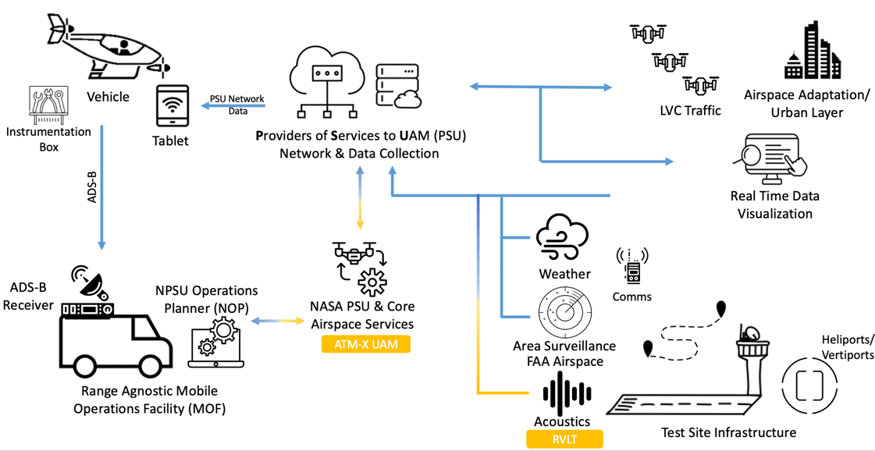
NC Developmental Test - Flight Interfaces Diagram
Notes:
Data management evolve

Slide 7
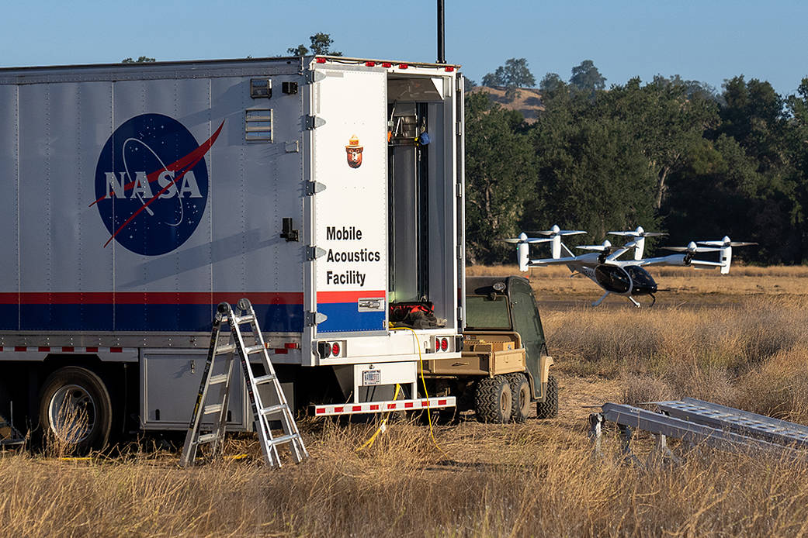
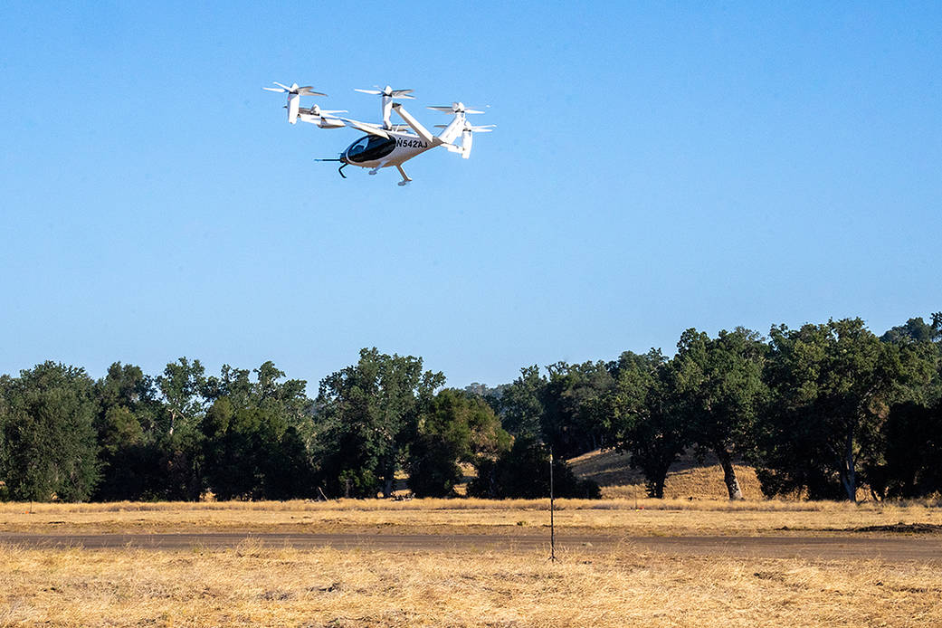

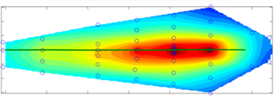
NC-DT Noise Data Collection
Mobile Acoustics Facility along with an array of 58 microphones helped the NC team measure the acoustic profile of Joby’s aircraft
Example Ground Noise Contour from previous helicopter test
Image credit: Joby Aviation

Slide 8
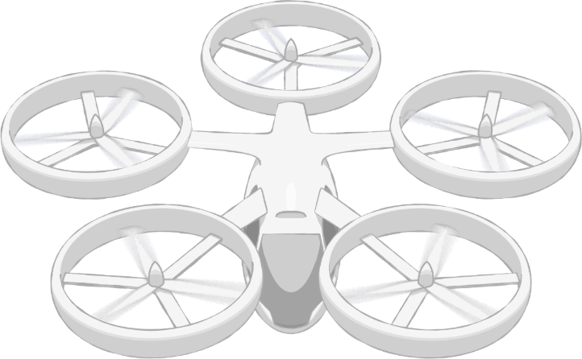
NASA AAM Mission Priorities
Human Response to Noise
Regional M&S Capabilities, & Supply Chain
Community Integration
xTM Architectures
Operational Rules, Roles, & Procedures
Comm, Nav, Surveillance, Information
UAM Supplemental Data Services
In-time Aviation Safety Management System
Community Integration
Airspace System Design & Implementation
Airspace & Fleet Operations Management
Source and Fleet Noise
Vehicle Propulsion Reliability
Environmental and Failure conditions
Distributed Electric Propulsion
Vehicle
Development & Production
Individual Vehicle Management & Operations
Automated Flight and Contingency Management
m:N, Pilots to Operators
Assured Automated Architectures
High Density Vertiplex
National Campaign
Aircraft & Aircrew Barriers
Airspace Barriers
Community Integration Barriers
Systems and Architecture Requirements

Slide 9
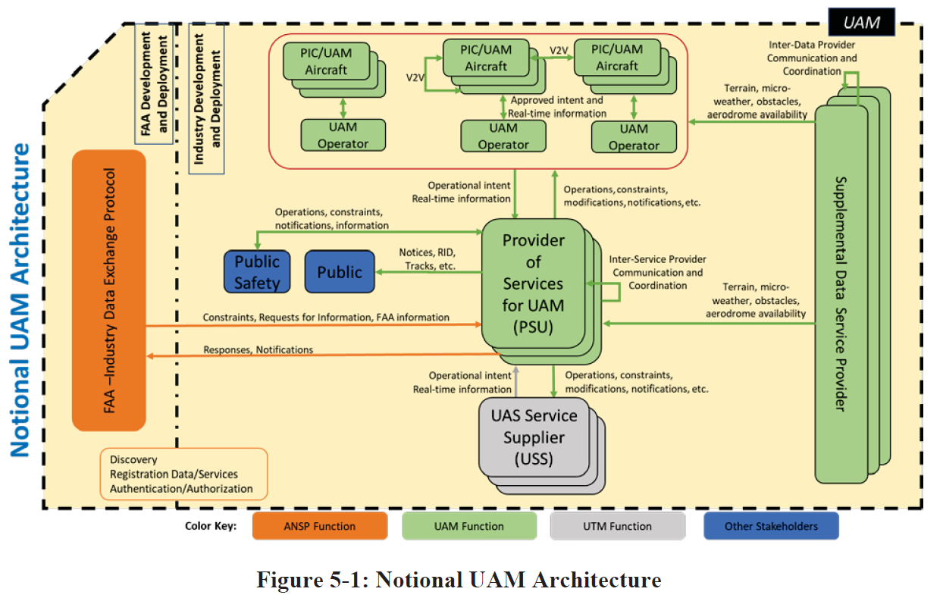
NASA’s Airspace Integration R&D
Figure from FAA NextGen’s v1.0 UAM ConOps document: https://nari.arc.nasa.gov/sites/default/files/attachments/UAM_ConOps_v1.0.pdf

Slide 10
Questions?

Slide 11
Back-up

Slide 12










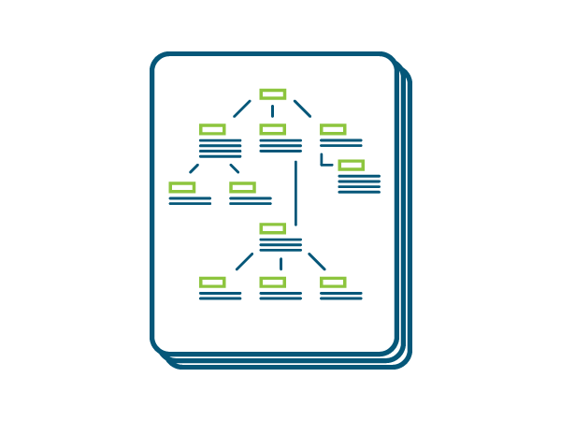

NASA AAM MBSE Framework
AAM Reference Framework
NASA is using a Model-based System Engineering approach to capture and organize the elements of a medium density/complexity “Book of Requirements and Guidelines (BoRG)”
Enabled
by MBSE
Vision & Guiding Principles
Applicable Standards & Regulations
Community Assessment
Assumptions
& Constraints
Supporting Data, Rationale & Evidence
Parametrics
NASA Critical Commitment Deliverables
Common Dictionary / Taxonomy
ConOps & Use Cases
Guidance Material
System
Requirements
System Architectures
AAM System and
Architecture Requirements
AAM Mission Critical Commitment:
  Based on validated operational concepts, simulations, analyses, and results from National Campaign demonstrations, the AAM Mission will deliver aircraft, airspace, and infrastructure system and architecture requirements to enable sustainable and scalable medium density advanced air mobility operations
Notes:
NASA to deliver long term technical solutions and architecture requirements for the industry and regulatory communities
Update CC?

Slide 13
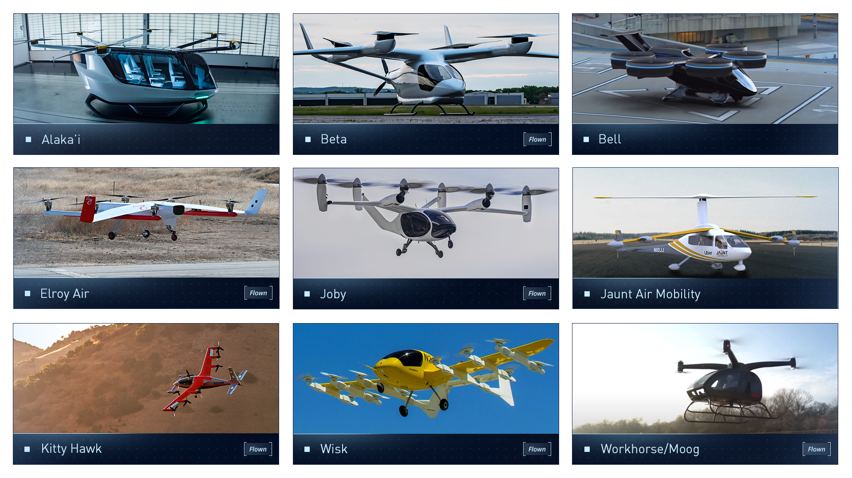
Strong Domestic (e)VTOL Industry Base

Slide 14
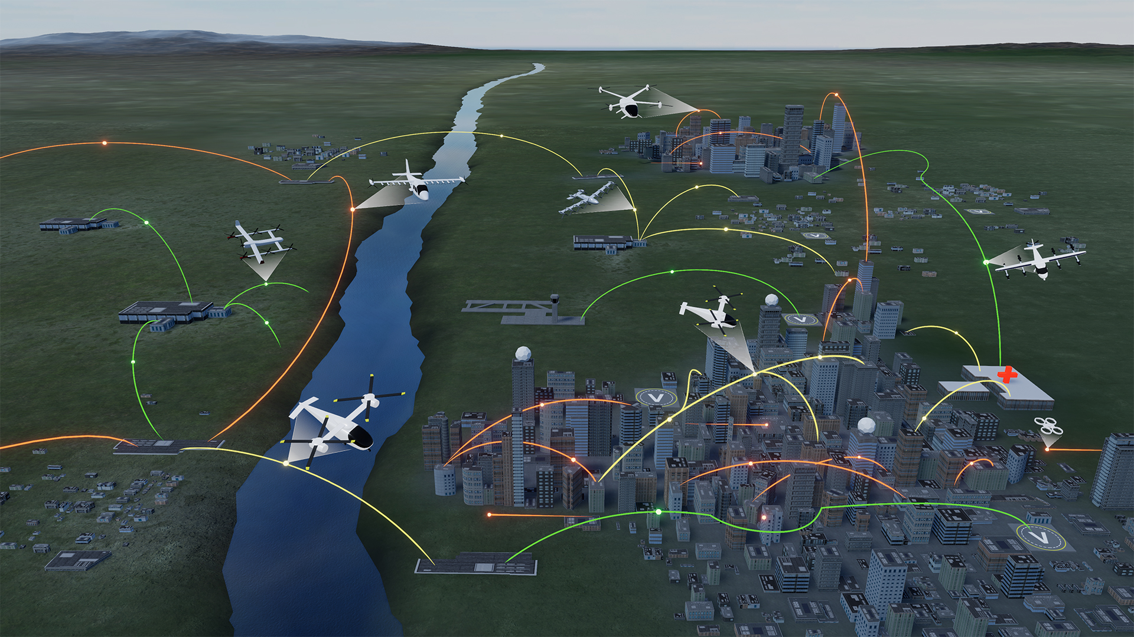



UAM Maturity Levels (UML)
Advanced Air Mobility (AAM) Mission
UML-4 Medium Density/Complexity, collaborative and responsible automated systems
UML-3 Low Density, Medium Complexity, comprehensive safety assurance automation
UML-2 Low Density/Complexity, assistive automation
UML-1 Conforming prototypes
On Demand
Air-Taxi
Rural Operations
Urban Operations
Regional
Network
Inter-City
eVTOL
Cargo
Delivery
Cargo
Delivery
Airport
Transfer
Medical
Transfer
Distribution
Center/Warehouse
High Density
Corridor
Air
Ambulance
Fleet
Operations
Inter-city
eVTOL
Small
Package Delivery
Cross-metro
Transfer
Safe, sustainable, affordable, and accessible aviation for transformational local and intraregional missions

Slide 15




AAM Ecosystem Working Group (AEWG) https://nari.arc.nasa.gov/aam-portal/
  Align on a common vision
  for AAM
  Collectively identify and investigate key hurdles and associated needs
  Learn about NASA’s research and planned transition paths
  Develop AAM system and architecture requirements
  Adopt a strategy for engaging the public on AAM
  Support regulatory and standards development
  Form a connected stakeholder community
Accelerate the development of safe and scalable AAM flight operations
by bringing together the broad and diverse ecosystem

