Slide 1
Mesh Network Deployment for LBFD-BURST
Alek Cerne
AFRC - 540
Mentor: Sky Yarbrough

Slide 2
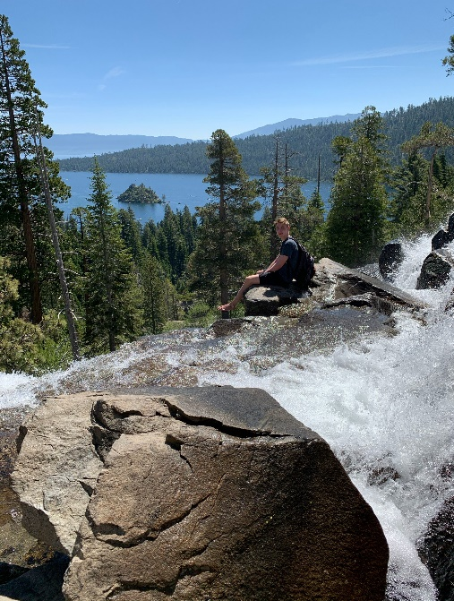

Alek Cerne
University of Michigan
Computer Engineering
2020
Previous Work:
Qualcomm
Dell EMC
Texas Instrument
Hobbies:
Soccer
Sailing
Snowboarding
Cooking
Hiking

Slide 3
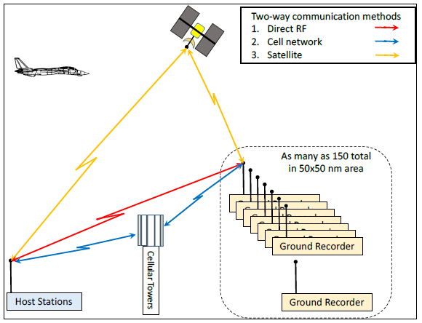
Mesh Deployment Overview
BURST is a remote trigger system for a sonic boom recorder
BURST receives a message which is sent via a web-based interface, provided by our Iridium Service provider (KeyW & Guardian Mobility), through the Iridium Satellite Constellation.
BURST triggers the recorder based on the start/stop times in the message.

Slide 4
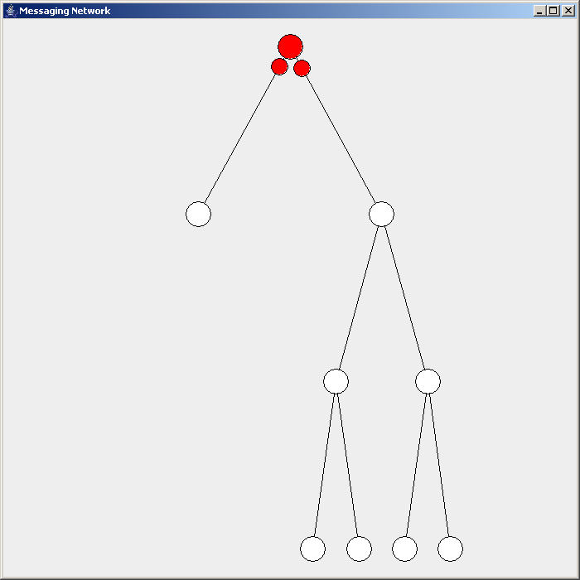
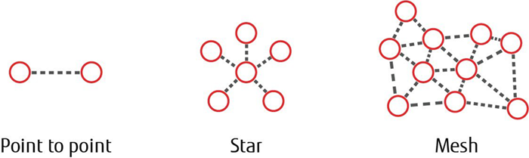
Mesh Networks
Mesh networks are a local network topology in which the infrastructure nodes connect directly, dynamically and non-hierarchically to as many other nodes as possible and cooperate with one another to efficiently route data
Mesh networks dynamically self-organize and self-configure, which can reduce installation overhead
The ability to self-configure enables dynamic distribution of workloads, particularly in the event a few nodes should fail
Flooding
Self-Healing
Scaling
Routing

Slide 5
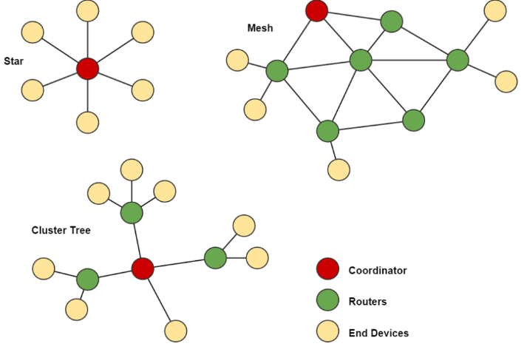
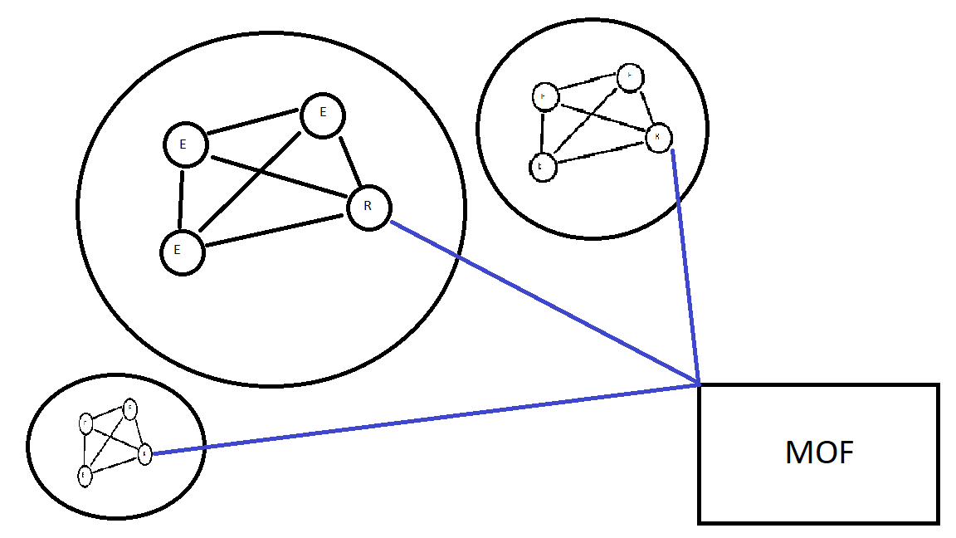
Background and Motivation
Implementing a mesh network between GRS units and the Mobile Operations Facility provides:
  Reduced operational costs due to less long-haul connections required
  Better coverage as GRS mesh can have multiple entry points
  Easy to add, remove and scale mesh by changing number of GRS units
  Smaller probability of outage between nodes due to mesh robustness
Multiple technologies to support mesh such as LTE, Iridium, LoRaWAN, NB-IOT
Need a method to evaluate the feasibility of a mesh network's deployment that includes location, technology used, etc.

Slide 6
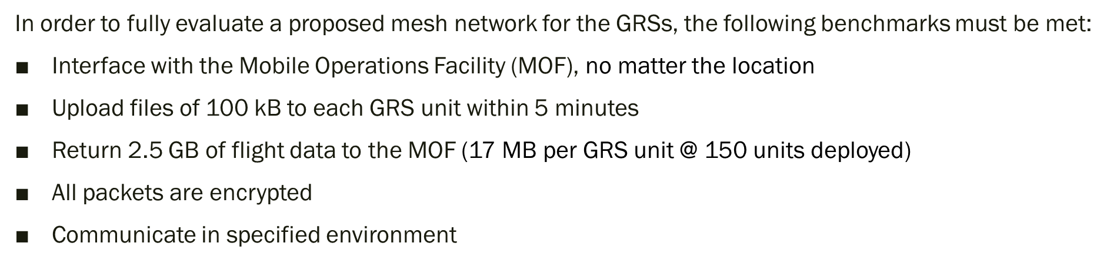
Simulation Parameters

Slide 7
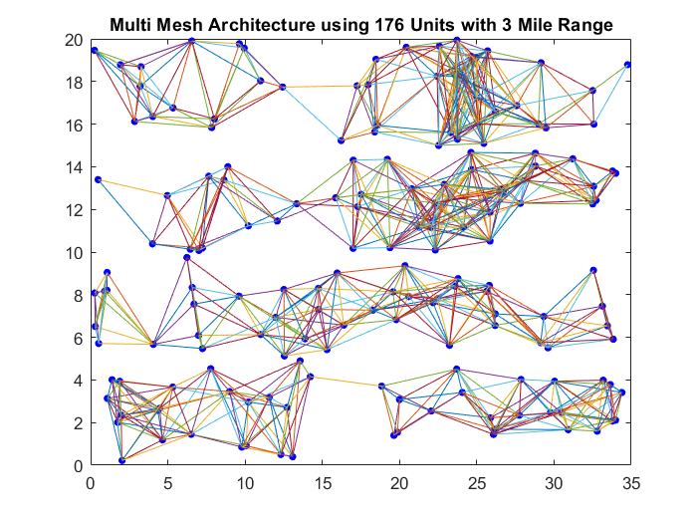
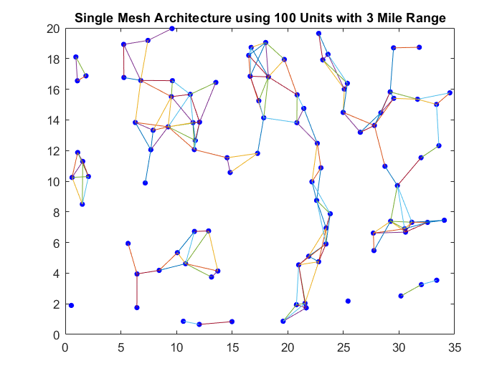
Meshes and Nodes
Preliminary simulation allowed for node and mesh generation to help verify the mesh capabilities with varying number of units and data range from each node
Node connection limits made partial vs. full mesh creation possible
Multiple meshes vs. single mesh

Slide 8
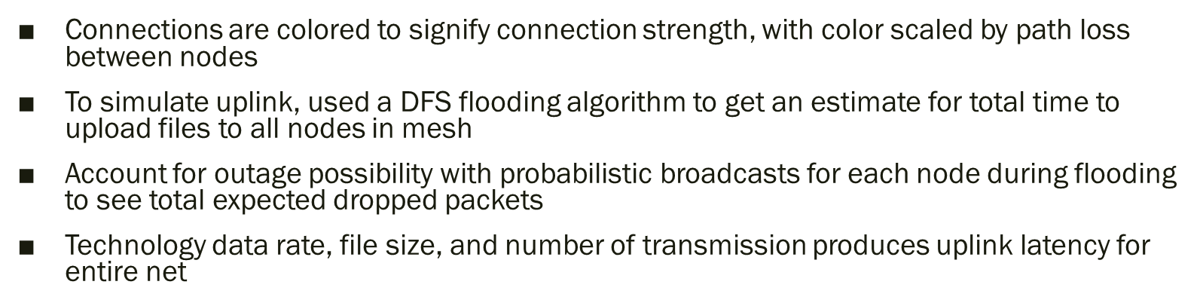
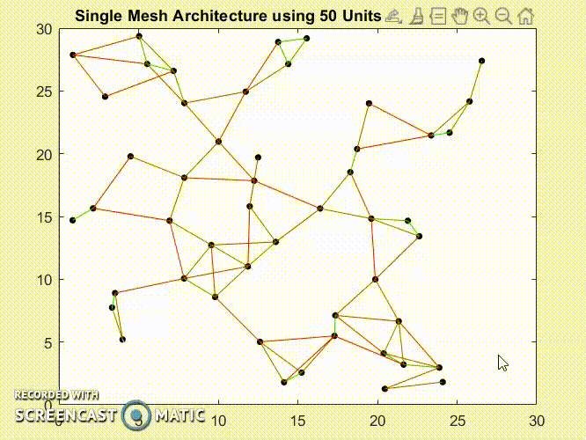
Connectivity/Uplink and Downlink

Slide 9
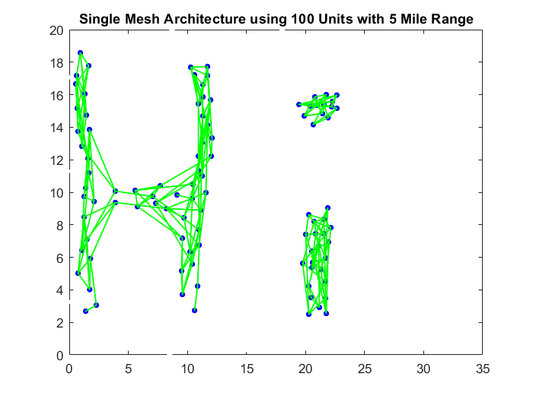
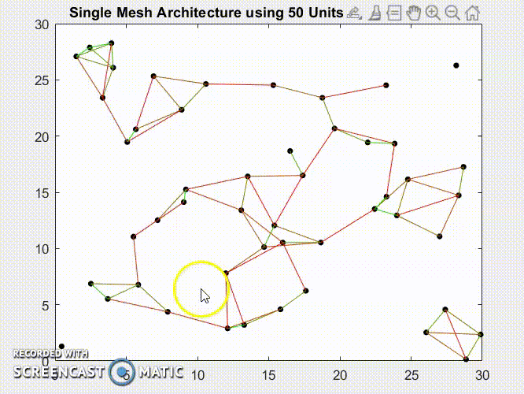
Mesh Structure and UI
To add flexibility to the simulated mesh structure, UI feature allows for nodes to be “dragged and dropped” to allow node and connection restructuring
Moveable nodes can aid in decreasing dead zones of coverage or in increasing node concentration in certain areas
Removing max range connections and highly isolated nodes can increase overall mesh strength

Slide 10
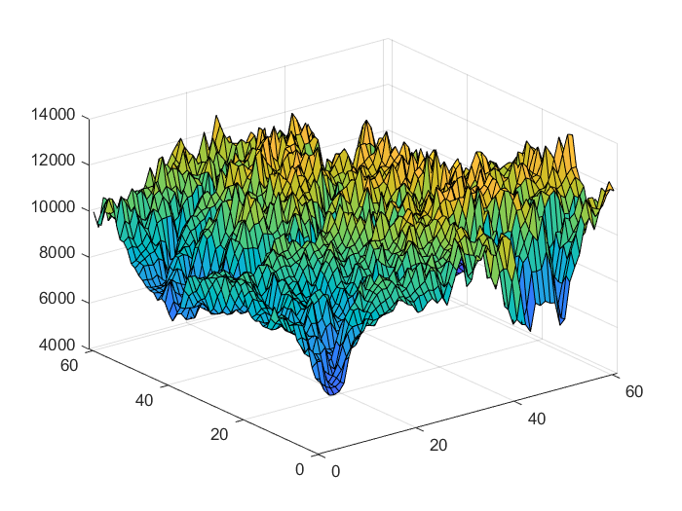
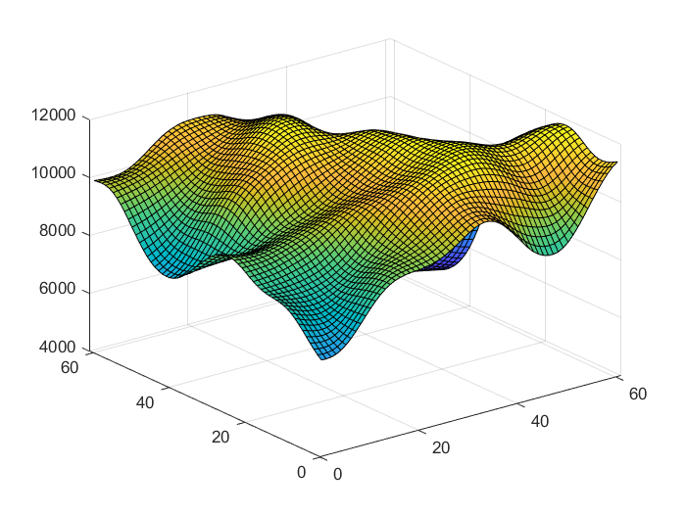

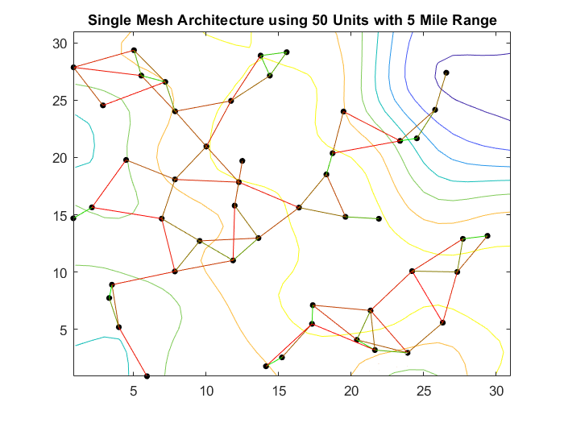
Elevation and Virtual On-Site Interface
To test the mesh with some level of certainty for a given location, the ability for the mesh to function with that location’s topography is immensely important
Each node now has an elevation trait so connectivity distances must now bridge hills and valleys
Elevation data is sampled from DTED set 0 (civilian data)

Slide 11
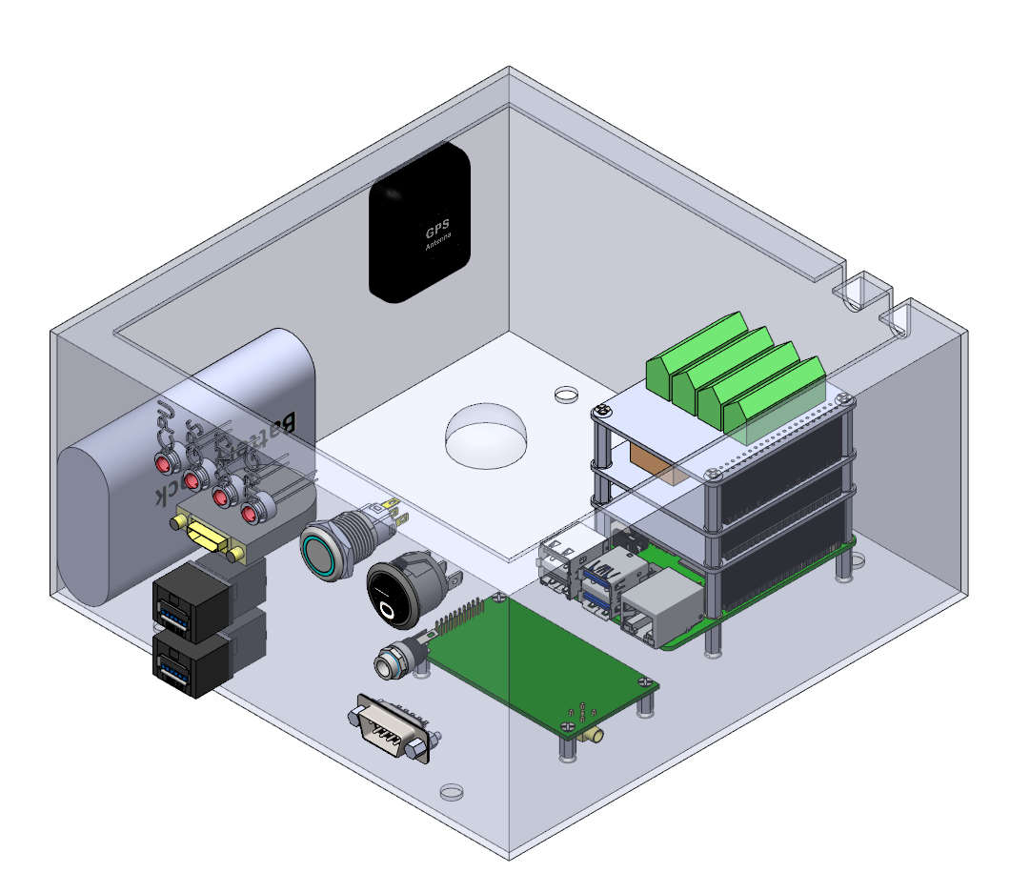
What’s Next
Find accurate method for simulating downlink from mesh
Ability to add buildings for interference simulation
Full simulation of a chosen technology under all the Phase 3 parameters
Development of code to go on BURST units to facilitate and host mesh network

Slide 12
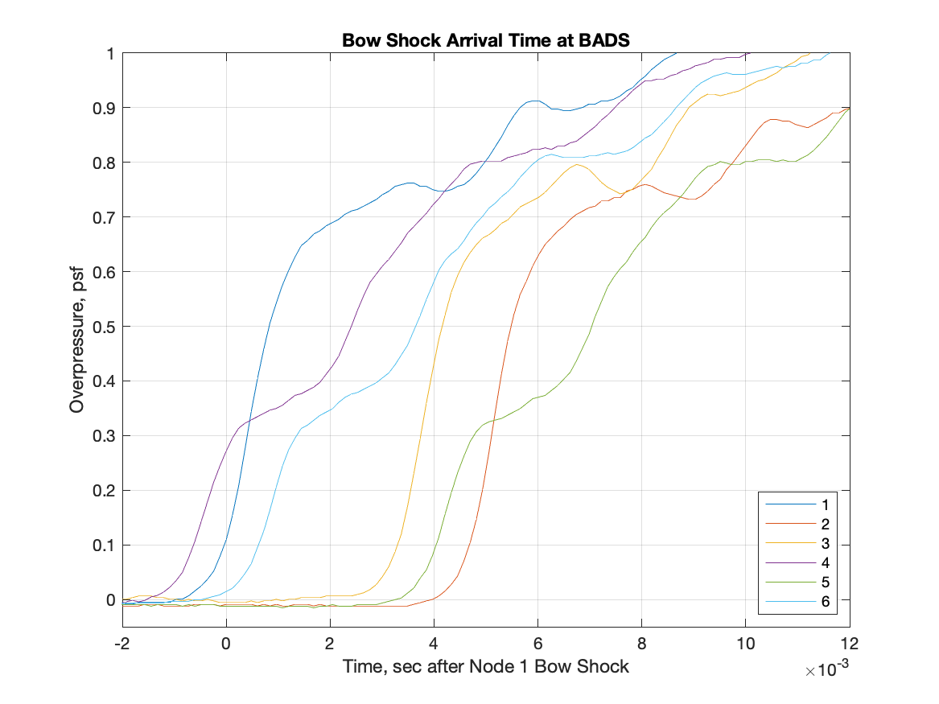
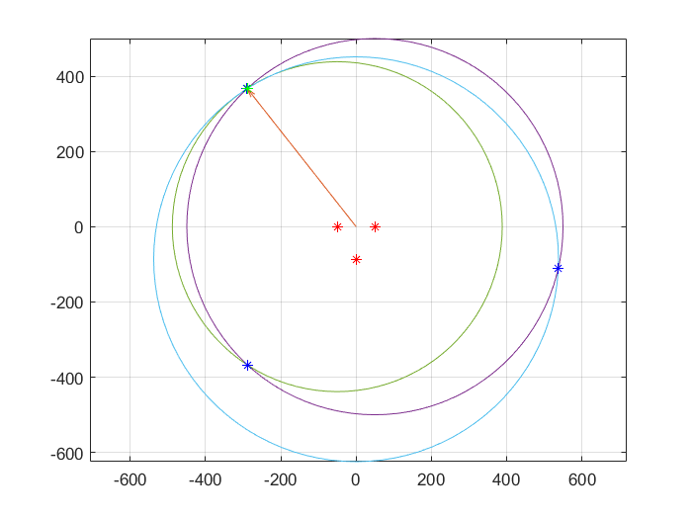
Boom Directionality Project
Tasked to use three microphones to calculate the azimuth angle from recorded sonic booms
In order to attain azimuth, simulation uses microphone delays from the boom recordings to estimate angle of the audio source of the boom carpet
While the simulation was able to very accurately approximate azimuth angles with a high degree of angular resolution, it failed when parameters such as sample rate and array size were swept
Next task is to create an automated method of running the BADS azimuth calculation on Raspberry Pi

Slide 13
Acknowledgements
Special Thanks:
Sky Yarbrough
Lydia Hantsche
Lisa Illowsky
Sonic Boom Team
NASA Interns

Slide 14
Questions?

