Slide 1


Dust Testing Standard Overview
October 2021
PI: Kristen John
PM: Chuck Rogers
This document has been reviewed for Proprietary, SBU, and Export Control (ITAR/EAR) and has been determined to be non-sensitive. It has been released to the public via the NASA Scientific and Technical Information (STI) Process.

Slide 2
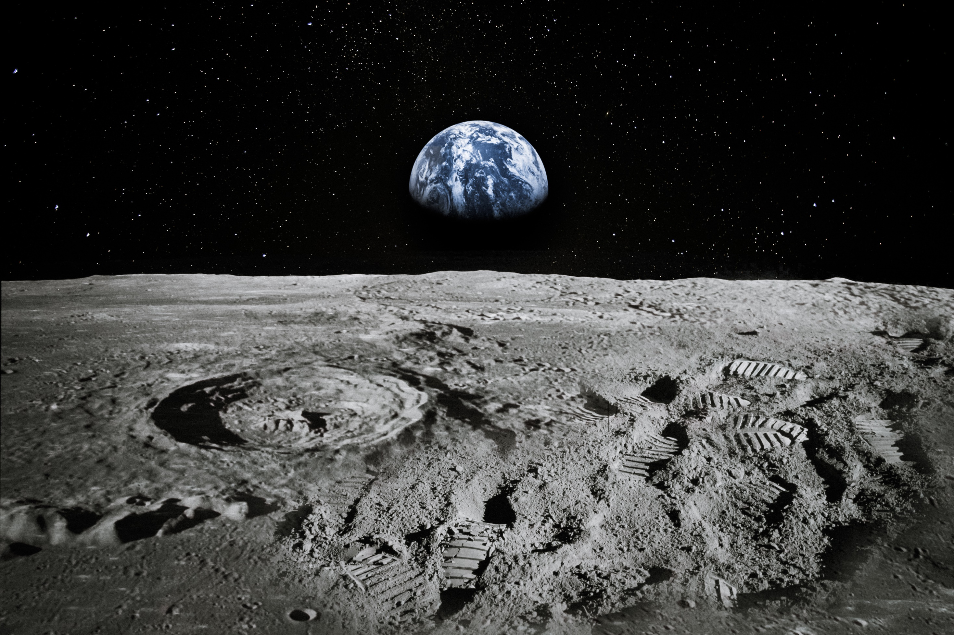
NASA-STD-1008
Classifications and Requirements for Testing Systems and Hardware to be Exposed to Dust in Planetary Environments
This document has been reviewed for Proprietary, SBU, and Export Control (ITAR/EAR) and has been determined to be non-sensitive. It has been released to the public via the NASA Scientific and Technical Information (STI) Process.
Notes:
Define “dust”

Slide 3

Focus
Purpose
Establish the minimum requirements for testing with dust
Provide general guidance for testing methodologies and best practices
Provide developers and end-users with information that will guide testing of systems and hardware for exposure to dusty environments
Facilitate consistency and efficiency in the testing of space systems, subsystems, or components with operations and missions in dusty environments
This document has been reviewed for Proprietary, SBU, and Export Control (ITAR/EAR) and has been determined to be non-sensitive. It has been released to the public via the NASA Scientific and Technical Information (STI) Process.

Slide 4
Focus
Current Status
Document went through agency-wide review.
It was approved on Sept 21st and is available on https://standards.nasa.gov/standard/nasa/nasa-std-1008
This document has been reviewed for Proprietary, SBU, and Export Control (ITAR/EAR) and has been determined to be non-sensitive. It has been released to the public via the NASA Scientific and Technical Information (STI) Process.

Slide 5
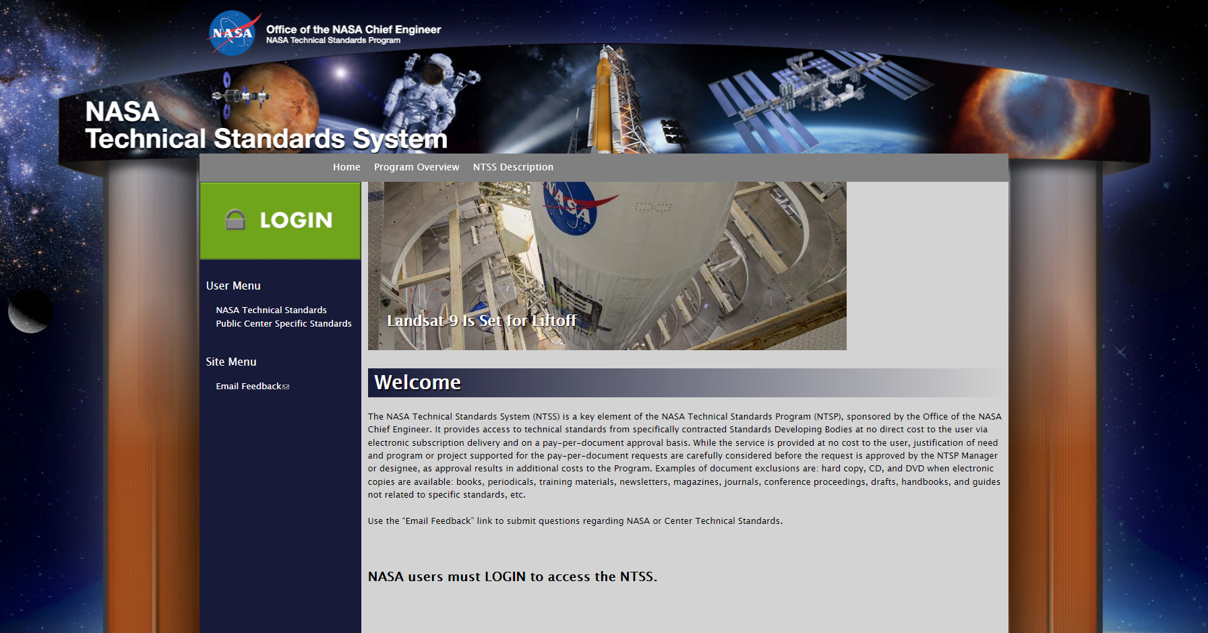
Document is available publically at standards.nasa.gov
Click on “NASA Technical Standards,” click “1000” link, then click on the document number. You will see the Summary Page. Scroll down to “Download Current Revision” and click the link below it.
Or go directly to: https://standards.nasa.gov/standard/nasa/nasa-std-1008
This document has been reviewed for Proprietary, SBU, and Export Control (ITAR/EAR) and has been determined to be non-sensitive. It has been released to the public via the NASA Scientific and Technical Information (STI) Process.

Slide 6
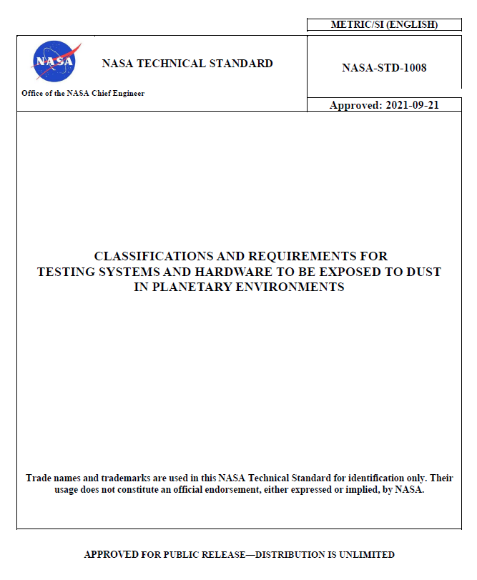
This document has been reviewed for Proprietary, SBU, and Export Control (ITAR/EAR) and has been determined to be non-sensitive. It has been released to the public via the NASA Scientific and Technical Information (STI) Process.

Slide 7
Document Overview
SECTION 4.
Dust Requirements & Standards
4.1 Dust Impact Assessment Process
4.2 Sources of Dust
a. Planetary External (PE)
b. Planetary Pressurized (PP)
c. In-Space Pressurized (SP)
d. In-Space External (SE)
SECTION 5.
Testing Methodologies & Best Practices
5.1 Simulant Prep & Storage
5.2 Simulant Loading Definitions
5.3 Testing Practices & Categories
5.4 Simulants
5.5 Facilities
This document has been reviewed for Proprietary, SBU, and Export Control (ITAR/EAR) and has been determined to be non-sensitive. It has been released to the public via the NASA Scientific and Technical Information (STI) Process.
Notes:
Organization and approach

Slide 8
Document Overview
SECTION 4.
Dust Requirements & Standards
4.1 Dust Impact Assessment Process
4.2 Sources of Dust
a. Planetary External (PE)
b. Planetary Pressurized (PP)
c. In-Space Pressurized (SP)
d. In-Space External (SE)
SECTION 5.
Testing Methodologies & Best Practices
5.1 Simulant Prep & Storage
5.2 Simulant Loading Definitions
5.3 Testing Practices & Categories
5.4 Simulants
5.5 Facilities
This document has been reviewed for Proprietary, SBU, and Export Control (ITAR/EAR) and has been determined to be non-sensitive. It has been released to the public via the NASA Scientific and Technical Information (STI) Process.
Notes:
Organization and approach

Slide 9
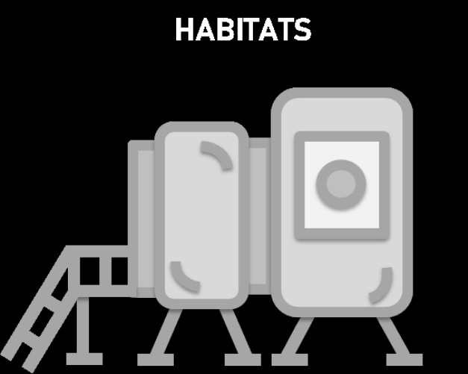

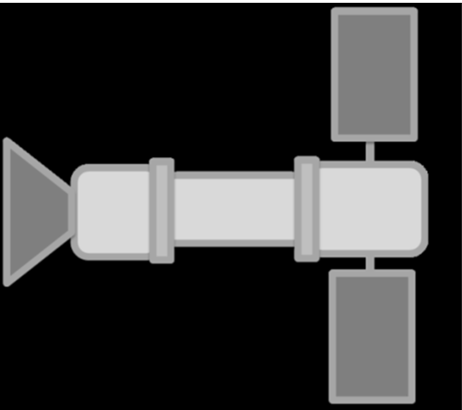
Ho
Working Environments Classification
Planetary External (PE)
Planetary Pressurized (PP)
w/ gravity
outside pressurized vehicle
inside pressurized vehicle
In-Space External (SE)
In-Space Pressurized (SP)
w/ out gravity
This document has been reviewed for Proprietary, SBU, and Export Control (ITAR/EAR) and has been determined to be non-sensitive. It has been released to the public via the NASA Scientific and Technical Information (STI) Process.

Slide 10
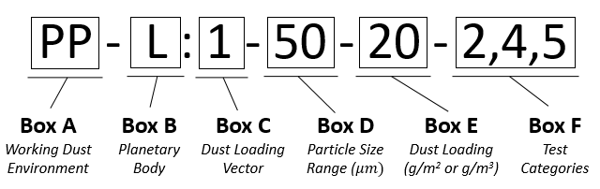
Dust Class ID
User may assign alpha-numeric code to identify protocol to which they validated their hardware
This document has been reviewed for Proprietary, SBU, and Export Control (ITAR/EAR) and has been determined to be non-sensitive. It has been released to the public via the NASA Scientific and Technical Information (STI) Process.

Slide 11
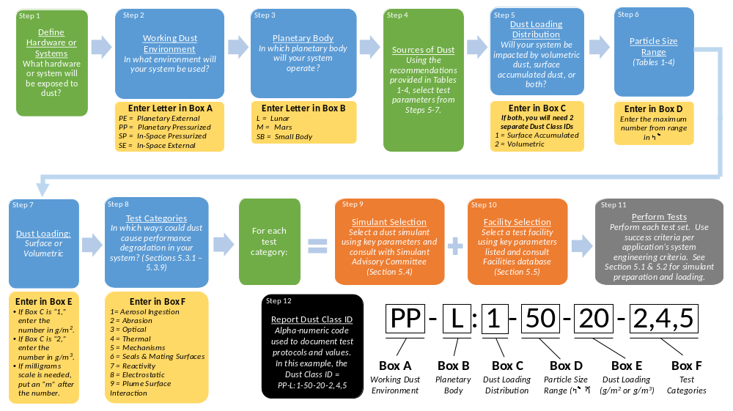
This document has been reviewed for Proprietary, SBU, and Export Control (ITAR/EAR) and has been determined to be non-sensitive. It has been released to the public via the NASA Scientific and Technical Information (STI) Process.

Slide 12
Step 1
Step 2
Step 3
Step 4
Define Hardware or Systems
What hardware or system will be exposed to dust?
Working Dust Environment
In what environment will your system be used?
Planetary Body
In which planetary body will your system operate?
Enter Letter in Box A
PE = Planetary External
PP = Planetary Pressurized
SP = In-Space Pressurized
SE = In-Space External
Enter Letter in Box B
L = Lunar
M = Mars
SB = Small Body
Step 9
Step 10
Step 11
Step 12
PP - L
Report Dust Class ID
Alpha-numeric code used to document test protocols and values.
In this example, the Dust Class ID =
PP-L:1-50-20-2,4,5
Box A
Working Dust Environment
Box B
Planetary Body
This document has been reviewed for Proprietary, SBU, and Export Control (ITAR/EAR) and has been determined to be non-sensitive. It has been released to the public via the NASA Scientific and Technical Information (STI) Process.

Slide 13
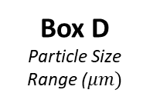
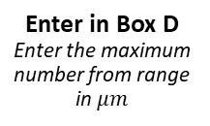
Step 1
Step 2
Step 3
Step 4
Step 5
Step 6
Define Hardware or Systems
What hardware or system will be exposed to dust?
Working Dust Environment
In what environment will your system be used?
Planetary Body
In which planetary body will your system operate?
Sources of Dust
Using the recommendations provided in Tables 2-5, select test parameters from Steps 5-7.
Dust Loading Vector
Will your system be impacted by volumetric dust, surface accumulated dust, or both?
Particle Size Range
(Tables 2-5)
Enter Letter in Box A
PE = Planetary External
PP = Planetary Pressurized
SP = In-Space Pressurized
SE = In-Space External
Enter Letter in Box B
L = Lunar
M = Mars
SB = Small Body
Enter in Box C
If both, you will need 2 separate designators
1 = Surface Accumulated
2 = Volumetric
Enter in Box D
Enter the maximum number from range in $μm$
Step 7
Step 8
Step 9
Step 10
Step 11
Dust Loading:
Surface or Volumetric
Enter in Box E
If Box C is “1,” enter the number in g/m².
If Box C is “2,” enter the number in g/m³.
If milligrams scale is needed, put an “m” after the number.
Step 12
PP - L : 1 - 50 - 20
Report Dust Class ID
Alpha-numeric code used to document test protocols and values.
In this example, the Dust Class ID =
PP-L:1-50-20-2,4,5
Box A
Working Dust Environment
Box B
Planetary Body
Box C
Dust Loading Vector
Box D
Particle Size Range ($μm)$
Box E
Dust Loading (g/m² or g/m³)
Box F
Test Categories
This document has been reviewed for Proprietary, SBU, and Export Control (ITAR/EAR) and has been determined to be non-sensitive. It has been released to the public via the NASA Scientific and Technical Information (STI) Process.

Slide 14
Step 1
Step 2
Step 3
Step 4
Step 5
Step 6
Define Hardware or Systems
What hardware or system will be exposed to dust?
Working Dust Environment
In what environment will your system be used?
Planetary Body
In which planetary body will your system operate?
Sources of Dust
Using the recommendations provided in Tables 2-5, select test parameters from Steps 5-7.
Dust Loading Vector
Will your system be impacted by volumetric dust, surface accumulated dust, or both?
Particle Size Range
(Tables 2-5)
Enter Letter in Box A
PE = Planetary External
PP = Planetary Pressurized
SP = In-Space Pressurized
SE = In-Space External
Enter Letter in Box B
L = Lunar
M = Mars
SB = Small Body
Enter in Box C
If both, you will need 2 separate designators
1 = Surface Accumulated
2 = Volumetric
Enter in Box D
Enter the maximum number from range in $μm$
Step 8
Step 9
Step 7
Test Categories
In which ways could dust cause performance degradation in your system? (Sections 5.3.1 – 5.3.9)
For each test category:
Step 10
Step 11
Dust Loading:
Surface or Volumetric
Enter in Box E
If Box C is “1,” enter the number in g/m².
If Box C is “2,” enter the number in g/m³.
If milligrams scale is needed, put an “m” after the number.
Enter in Box F
1= Aerosol Ingestion
2 = Abrasion
3 = Optical
4 = Thermal
5 = Mechanisms
6 = Seals & Mating Surfaces
7 = Reactivity
8 = Electrostatic
9 = Plume Surface Interaction
Step 12
PP - L : 1 - 50 - 20 - 2,4,5
Report Dust Class ID
Alpha-numeric code used to document test protocols and values.
In this example, the Dust Class ID =
PP-L:1-50-20-2,4,5
Box A
Working Dust Environment
Box B
Planetary Body
Box C
Dust Loading Vector
Box D
Particle Size Range ($μm)$
Box E
Dust Loading (g/m² or g/m³)
Box F
Test Categories
This document has been reviewed for Proprietary, SBU, and Export Control (ITAR/EAR) and has been determined to be non-sensitive. It has been released to the public via the NASA Scientific and Technical Information (STI) Process.

Slide 15
Step 1
Step 2
Step 3
Step 4
Step 5
Step 6
Define Hardware or Systems
What hardware or system will be exposed to dust?
Working Dust Environment
In what environment will your system be used?
Planetary Body
In which planetary body will your system operate?
Sources of Dust
Using the recommendations provided in Tables 2-5, select test parameters from Steps 5-7.
Dust Loading Vector
Will your system be impacted by volumetric dust, surface accumulated dust, or both?
Particle Size Range
(Tables 2-5)
Enter Letter in Box A
PE = Planetary External
PP = Planetary Pressurized
SP = In-Space Pressurized
SE = In-Space External
Enter Letter in Box B
L = Lunar
M = Mars
SB = Small Body
Enter in Box C
If both, you will need 2 separate designators
1 = Surface Accumulated
2 = Volumetric
Enter in Box D
Enter the maximum number from range in $μm$
Step 8
Step 9
Step 7
Test Categories
In which ways could dust cause performance degradation in your system? (Sections 5.3.1 – 5.3.9)
For each test category:
Step 10
Step 11
Dust Loading:
Surface or Volumetric
Simulant Selection
Select a dust simulant using key parameters and consult with Simulant Advisory Committee
(Section 5.4)
Facility Selection
Select a test facility using key parameters listed and consult Facilities database
(Section 5.5)
Perform Tests
Perform each test set. Use success criteria per application’s system engineering criteria. See Section 5.1 & 5.2 for simulant preparation and loading.
Enter in Box E
If Box C is “1,” enter the number in g/m².
If Box C is “2,” enter the number in g/m³.
If milligrams scale is needed, put an “m” after the number.
Enter in Box F
1= Aerosol Ingestion
2 = Abrasion
3 = Optical
4 = Thermal
5 = Mechanisms
6 = Seals & Mating Surfaces
7 = Reactivity
8 = Electrostatic
9 = Plume Surface Interaction
Step 12
PP - L : 1 - 50 - 20 - 2,4,5
Report Dust Class ID
Alpha-numeric code used to document test protocols and values.
In this example, the Dust Class ID =
PP-L:1-50-20-2,4,5
Box A
Working Dust Environment
Box B
Planetary Body
Box C
Dust Loading Vector
Box D
Particle Size Range ($μm)$
Box E
Dust Loading (g/m² or g/m³)
Box F
Test Categories
This document has been reviewed for Proprietary, SBU, and Export Control (ITAR/EAR) and has been determined to be non-sensitive. It has been released to the public via the NASA Scientific and Technical Information (STI) Process.

Slide 16
Document Overview
SECTION 4.
Dust Requirements & Standards
4.1 Dust Impact Assessment Process
4.2 Sources of Dust
a. Planetary External (PE)
b. Planetary Pressurized (PP)
c. In-Space Pressurized (SP)
d. In-Space External (SE)
SECTION 5.
Testing Methodologies & Best Practices
5.1 Simulant Prep & Storage
5.2 Simulant Loading Definitions
5.3 Testing Practices & Categories
5.4 Simulants
5.5 Facilities
This document has been reviewed for Proprietary, SBU, and Export Control (ITAR/EAR) and has been determined to be non-sensitive. It has been released to the public via the NASA Scientific and Technical Information (STI) Process.
Notes:
Organization and approach

Slide 17
Document Overview
Table provided for each section that contains guidance on particle size, surface accumulated loading, volumetric loading, dust velocity, and charge to mass ratio. It provides this information for various sources of dust depending on the environment.
PE – Human generated surface transported dust, rocket plume dust, natural charged dust transport, natural impact ejecta
PP – EVA suit cross-hatch transported dust, hardware cross-hatch transported dust
SP – micro-G free floating dust, micro-G surface adhering dust
SE – rocket plume dust, natural charged dust transport, natural impact ejecta
SECTION 4.
Dust Requirements & Standards
4.1 Dust Impact Assessment Process
4.2 Sources of Dust
a. Planetary External (PE)
b. Planetary Pressurized (PP)
c. In-Space Pressurized (SP)
d. In-Space External (SE)
This document has been reviewed for Proprietary, SBU, and Export Control (ITAR/EAR) and has been determined to be non-sensitive. It has been released to the public via the NASA Scientific and Technical Information (STI) Process.
Notes:
Organization and approach

Slide 18
Document Overview
SECTION 4.
Dust Requirements & Standards
4.1 Dust Impact Assessment Process
4.2 Sources of Dust
a. Planetary External (PE)
b. Planetary Pressurized (PP)
c. In-Space Pressurized (SP)
d. In-Space External (SE)
SECTION 5.
Testing Methodologies & Best Practices
5.1 Simulant Prep & Storage
5.2 Simulant Loading Definitions
5.3 Testing Practices & Categories
5.4 Simulants
5.5 Facilities
This document has been reviewed for Proprietary, SBU, and Export Control (ITAR/EAR) and has been determined to be non-sensitive. It has been released to the public via the NASA Scientific and Technical Information (STI) Process.
Notes:
Organization and approach

Slide 19
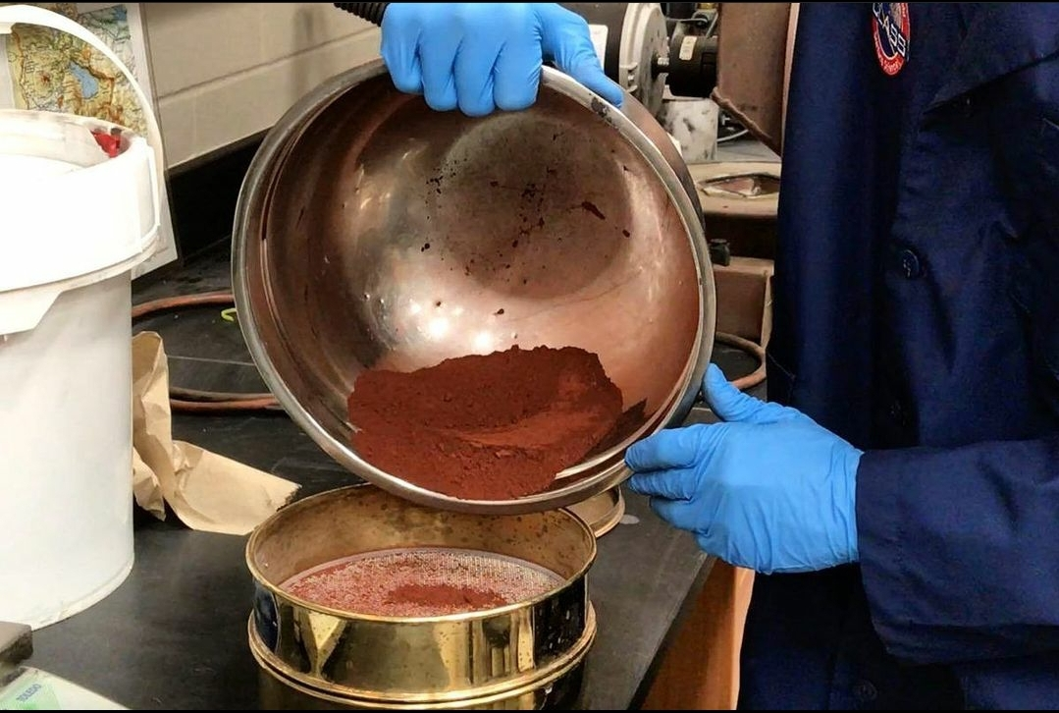
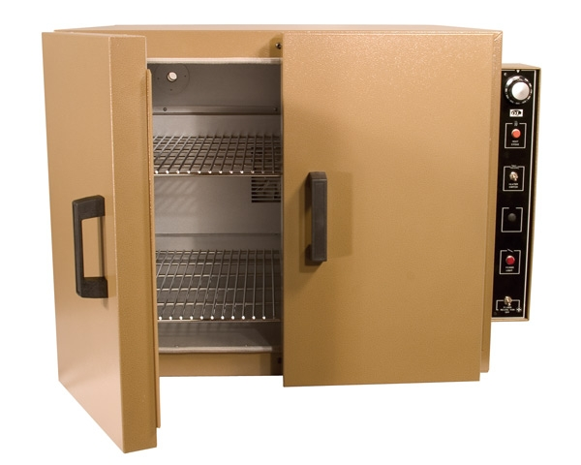
Section 5. Testing Methodologies & Best Practices
SECTION 5.
Testing Methodologies & Best Practices
5.1 Simulant Prep & Storage
5.1.1 Particle Separation
5.1.1.1 Sieve
5.1.1.2 Cyclone Separation
5.1.2 Bake-out
5.1.2.1 Forms of Water
5.1.2.2 Moister Level Best Practices
5.1.2.3 Moisture Considerations for Vacuum Testing
5.1.3 Storage
5.2 Simulant Loading Definitions
5.3 Testing Practices & Categories
5.4 Simulants
5.5 Facilities
This document has been reviewed for Proprietary, SBU, and Export Control (ITAR/EAR) and has been determined to be non-sensitive. It has been released to the public via the NASA Scientific and Technical Information (STI) Process.

Slide 20
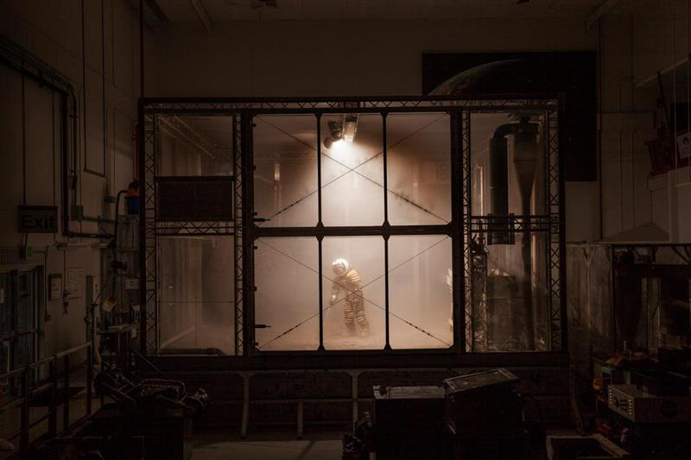
Section 5. Testing Methodologies & Best Practices
SECTION 5.
Testing Methodologies & Best Practices
5.1 Simulant Prep & Storage
5.2 Simulant Loading Definitions
5.2.1 Surface Accumulated Loading
5.2.1.1 Method 1: Pre-Load the Dust
5.2.1.2 Method 2: Vacuum Chamber Dust Loading
5.2.2 Volumetric
5.3 Testing Practices & Categories
5.4 Simulants
5.5 Facilities
This document has been reviewed for Proprietary, SBU, and Export Control (ITAR/EAR) and has been determined to be non-sensitive. It has been released to the public via the NASA Scientific and Technical Information (STI) Process.

Slide 21
Section 5. Testing Methodologies & Best Practices
SECTION 5.
Testing Methodologies & Best Practices
5.1 Simulant Prep & Storage
5.2 Simulant Loading Definitions
5.3 Testing Practices & Categories
5.3.1 Aerosol Ingestion
5.3.2 Abrasion
5.3.3 Optical
5.3.4 Thermal
5.3.5 Mechanisms
5.3.6 Seals & Mating Surfaces
5.3.7 Reactivity
5.3.8 Electrostatic Properties
5.3.9 Plume Surface Interaction
5.4 Simulants
5.5 Facilities
This document has been reviewed for Proprietary, SBU, and Export Control (ITAR/EAR) and has been determined to be non-sensitive. It has been released to the public via the NASA Scientific and Technical Information (STI) Process.

Slide 22
Section 5. Testing Methodologies & Best Practices
SECTION 5.
Testing Methodologies & Best Practices
5.1 Simulant Prep & Storage
5.2 Simulant Loading Definitions
5.3 Testing Practices & Categories
5.3.1 Aerosol Ingestion
5.3.1 Simulant Characteristics
5.3.2 Facility Capability
5.3.3 Methodology
5.3.4 Best Practices
5.3.2 Abrasion
5.3.3 Optical
5.3.4 Thermal
5.3 Testing Practices & Categories (cont.)
5.3.5 Mechanisms
5.3.6 Seals & Mating Surfaces
5.3.7 Reactivity
5.3.8 Electrostatic
5.3.9 Plume Surface Interaction
5.4 Simulants
5.5 Facilities
This document has been reviewed for Proprietary, SBU, and Export Control (ITAR/EAR) and has been determined to be non-sensitive. It has been released to the public via the NASA Scientific and Technical Information (STI) Process.

Slide 23
Testing Categories
5.3.1 Aerosol Ingestion
Aerosol ingestion testing supports the development and use of hardware/system(s) that have the potential to ingest dust. This section is applicable to hardware/systems(s) exposed to dust within any pressurized habitable volumes/compartments and surface atmospheric environments.
5.3.2 Abrasion
Abrasion testing supports the development and use of materials used in hardware/system(s) that frequently interact and wear over time. This section is applicable to soft goods, which are flexible materials (e.g., textiles or thin films of synthetic or natural materials and hard goods, which are inflexible materials (e.g., rigid metals or ceramics).
5.3.3 Optical
Optical testing supports the development and use of hardware/system(s) that have the potential to have their properties and operation altered by dust. This section is applicable to optical equipment (e.g., solar panels, viewports, camera lenses, laser-based optical systems, all mirrors, wavelength filter lenses, and radiative measurement sensors) and relative navigation equipment (e.g., docking targets, reflectors.)
This document has been reviewed for Proprietary, SBU, and Export Control (ITAR/EAR) and has been determined to be non-sensitive. It has been released to the public via the NASA Scientific and Technical Information (STI) Process.

Slide 24
Testing Categories
5.3.4 Thermal
Thermal testing supports the development and use of hardware/system(s) that have the potential to have their properties and operation altered by dust. This section is applicable to active thermal management components/systems, dust loading, and associated thermal impacts on hardware/systems. The primary focus is on radiators, as this is expected to be a key component directly impacted by dust buildup/coverage. However, consideration of other hardware/system(s) that generate heat (e.g., motors, power supplies) must be considered to determine potential impact to operational conditions.
5.3.5 Mechanisms
Mechanisms testing supports the development and use of hardware/system(s) that have the potential to have their properties and operation altered by dust. This section is applicable to hardware with interacting surfaces in relative motion (e.g., bearings, gears, screws, and slip rings), mechanism casings and soft goods (i.e., lubricants and grease), and their seals at the system level. Other applicable mechanisms can include, but are not limited to: deployable appendages including solar arrays, retention and release mechanisms, antennas and masts, actuators, transport mechanisms, switches, rotating systems including momentum wheels, reaction wheels, control moment gyroscopes, motors, and roll rings.
5.3.6 Seals & Mating Surfaces
Seals and mating surfaces testing supports the development and use of hardware/system(s) that have the potential to have their properties and operation altered by dust contamination. This section is applicable to static seals for hatches, docking systems, space suits, habitation modules, and sample containers.
This document has been reviewed for Proprietary, SBU, and Export Control (ITAR/EAR) and has been determined to be non-sensitive. It has been released to the public via the NASA Scientific and Technical Information (STI) Process.

Slide 25
Testing Categories, con’t
5.3.7 Reactivity
Reactivity testing supports the development and use of hardware/system(s) that have the potential to have their properties and operation altered by dust contamination or chemical reactivity. This section is applicable to surfaces and organic and inorganic materials that have the potential to react with activated dust surfaces. This section is different than previous sections in that it serves to show how simulants may be altered to recreate the natural reactivity of lunar surface environment dust particle reactivity.
5.3.8 Electrostatic Properties
Electrostatics testing supports the development and use of hardware/system(s) that have the potential to have their properties and operation altered by the electrical properties of dust. This section encompasses electrostatic properties of granular materials, electrostatic discharge (ESD) circuit shorts from accumulated dust, and electrical arcing.
5.3.9 Plume Surface Interaction
Rocket engines produce gas plumes that interact with the planetary surface environment. When vehicles conduct near-surface operations (e.g., landing or take-off), gas plumes interact with planetary surfaces and may cause erosion, lofting, and/or heating of surface materials. Ejected dust may strike the vehicle producing the plume, hardware/system(s) in the vehicle’s immediate vicinity or objects on orbit. PSI may cause dust loading or impact damage (e.g., media blasting). The nature of PSI effects depends on the target body’s regolith, atmospheric, topographic, and gravitational properties; the vehicle’s architecture, engine configuration and duty cycle, and the flight path of the landing vehicle; and the proximity of nearby hardware/system(s).
This document has been reviewed for Proprietary, SBU, and Export Control (ITAR/EAR) and has been determined to be non-sensitive. It has been released to the public via the NASA Scientific and Technical Information (STI) Process.

Slide 26
Section 5. Testing Methodologies & Best Practices
SECTION 5.
Testing Methodologies & Best Practices
5.1 Simulant Prep & Storage
5.2 Simulant Loading Definitions
5.3 Testing Practices & Categories
5.4 Simulants
5.5 Facilities
Document points to Simulant Advisory Committee
Document points to LSIC Facilities Directory
Simulants
Facilities
https://ares.jsc.nasa.gov/projects/simulants/
https://lsic-wiki.jhuapl.edu/x/HINf
This document has been reviewed for Proprietary, SBU, and Export Control (ITAR/EAR) and has been determined to be non-sensitive. It has been released to the public via the NASA Scientific and Technical Information (STI) Process.
Notes:
Wiki pages, sim adv committee

Slide 27
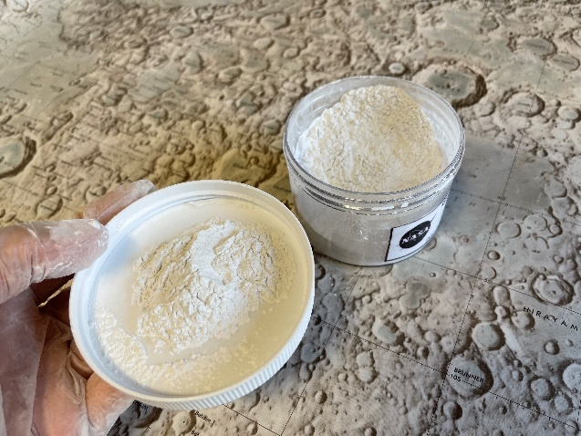
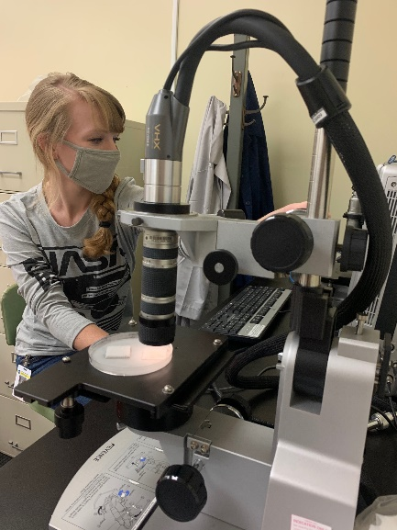
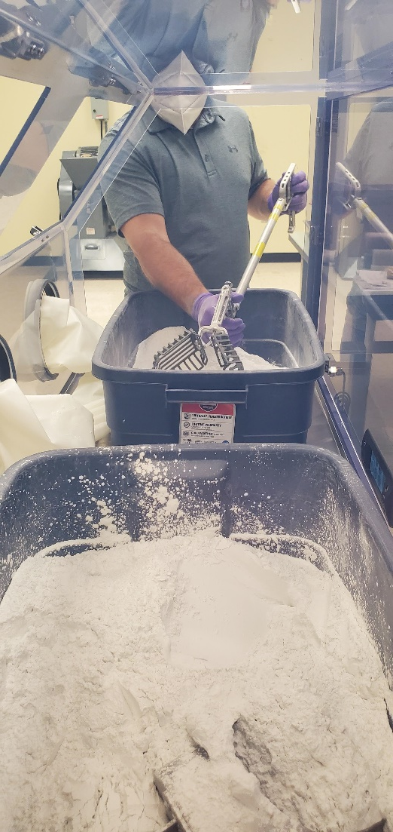
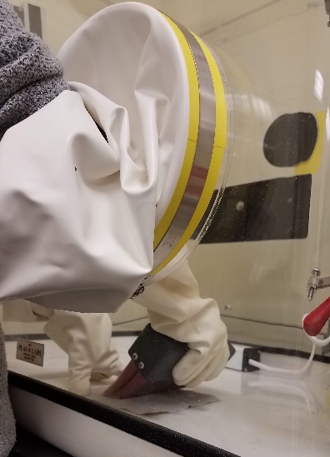
Testing with Dust?
Look at Available Dust Testing Papers & Publications https://wiki.jsc.nasa.gov/fod/index.php/Lunar_Dust_Testing_Literature
Review Current Dust Testing Efforts https://wiki.jsc.nasa.gov/fod/index.php/Lunar_Dust_Testing_Campaigns
Read the Dust Mitigation Best Practices Guide (When Available)
Understand the NASA Standard for Dust Testing https://standards.nasa.gov/standard/nasa/nasa-std-1008
Select your Simulants (Simulant Advisory Committee) https://ares.jsc.nasa.gov/projects/simulants/ https://wiki.jsc.nasa.gov/fod/index.php/Simulant_Advisory_Committee
Identify your Facilities (LSIC Facilities Directory) https://lsic-wiki.jhuapl.edu/x/hinf
This document has been reviewed for Proprietary, SBU, and Export Control (ITAR/EAR) and has been determined to be non-sensitive. It has been released to the public via the NASA Scientific and Technical Information (STI) Process.

Slide 28
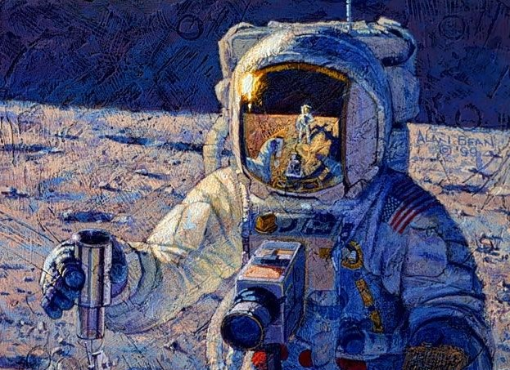
For more information, please reach out to
Kristen John/JSC
Charles (Chuck) E. Rogers/AFRC
This document has been reviewed for Proprietary, SBU, and Export Control (ITAR/EAR) and has been determined to be non-sensitive. It has been released to the public via the NASA Scientific and Technical Information (STI) Process.
Plan for testing technologies
  Kick-off 5 technologies in FY 21
  Test ~5 technologies in FY 22 (some continued from 21 and some new ones)

