Slide 1
Space Nuclear Propulsion (SNP) Project Overview
October 2021
Space Technology Mission Directorate
Technology Demonstration Mission Program
Space Nuclear Propulsion Project
Dayna Ise, SNP Project Manager

Slide 2

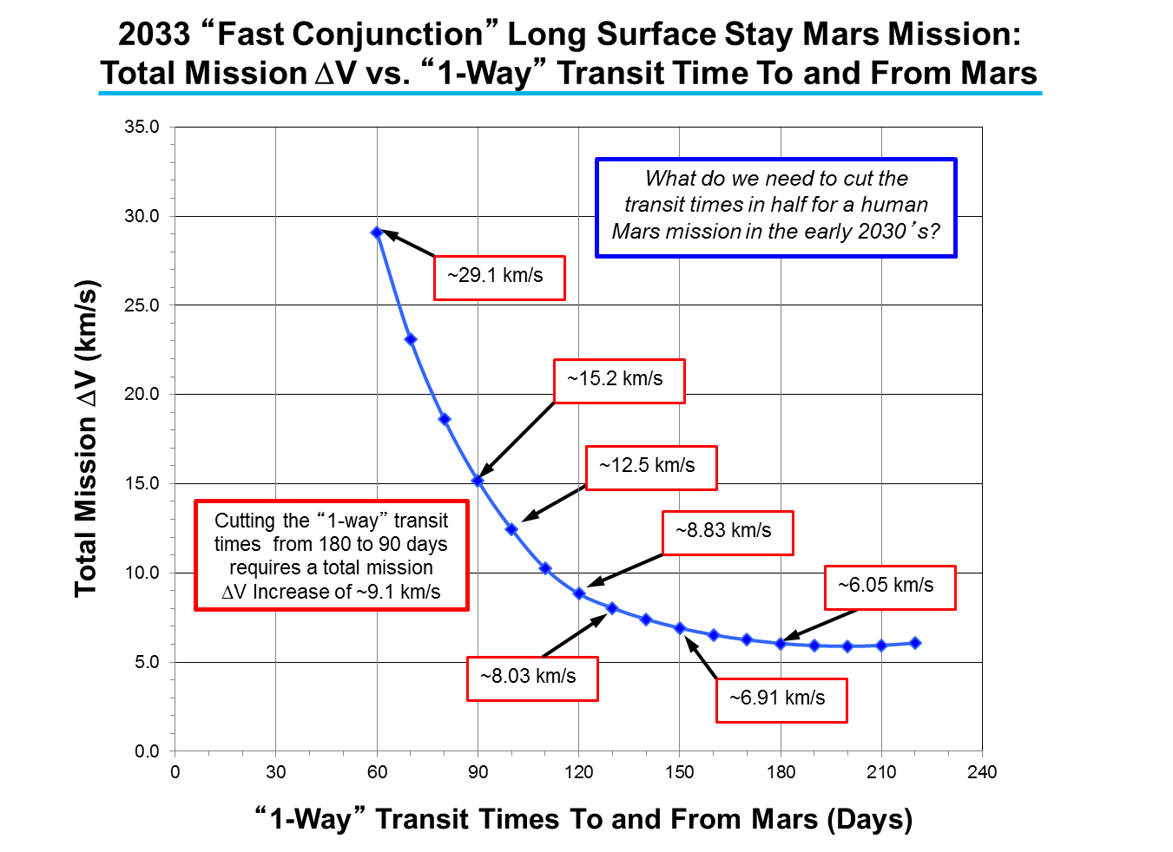
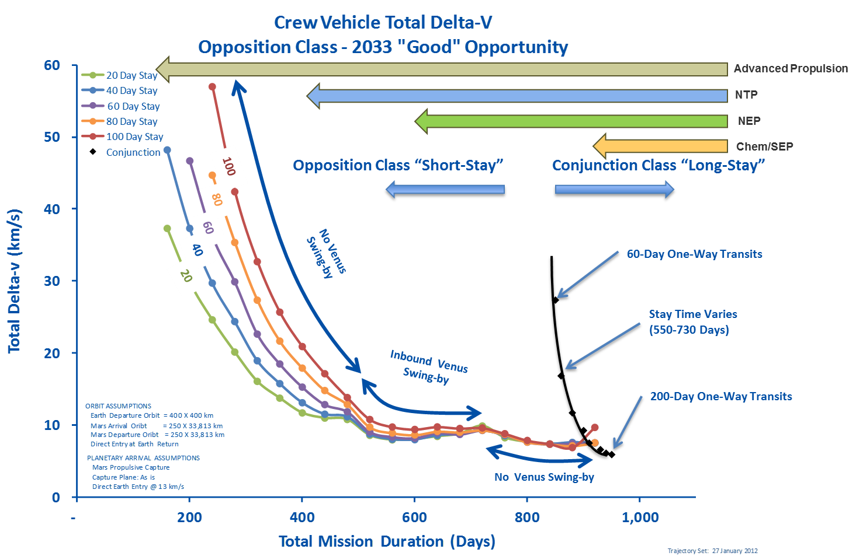
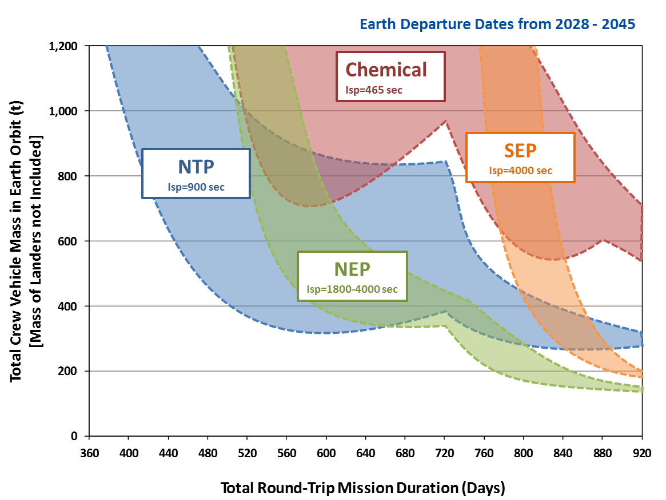
SPACE NUCLEAR PROPULSION
Why is Nuclear Propulsion Attractive for Human
Missions to Mars?
Short Stay Opposition Mission with Earth Departure Dates 2028-2045
Nuclear Thermal Propulsion (NTP) and Nuclear Electric Propulsion (NEP) allows for shorter total mission time and shorter trip time (Less exposure to galactic cosmic radiation and zero-g)
Nuclear allows mission robustness and potential abort scenarios
Fewer rocket launches can save operation time, money, and reduce risk
Current efforts in NTP are initial steps towards advanced space nuclear power and propulsion, which could eventually help enable exploration and development of the solar system

Slide 3
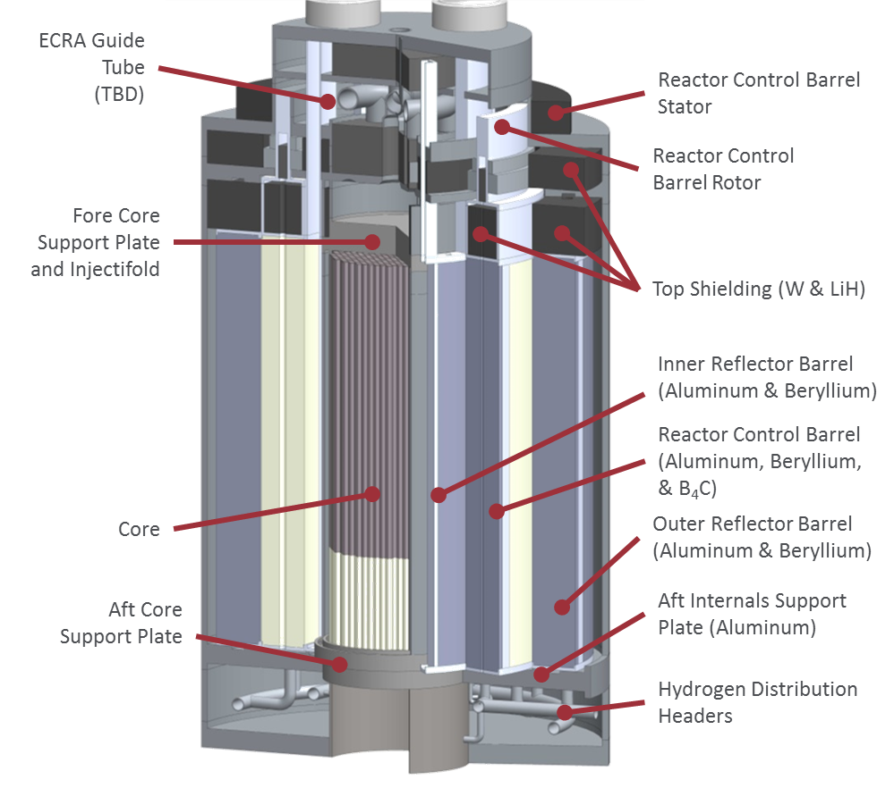
SPACE NUCLEAR PROPULSION
High Assay Low-Enriched Uranium (HALEU)
Can NTP Systems Using Low-Enriched Uranium (LEU) be Developed?
Directly reduce cost through savings related to safeguards and security
Indirectly (and more significantly) reduced cost through enabling use of an optimal development approach and team
Consistent with ongoing programs to convert operational Highly Enriched Uranium (HEU) systems to LEU
  Consistent with US policy. “The United States is committed to eliminating the use of HEU in all civilian applications, including in the production of medical radioisotopes, because of its direct significance for potential use in nuclear weapons, acts of nuclear terrorism, or other malevolent purposes.” (2012 White House “Fact Sheet”)
    Space Policy Directive 6 (12/2020) also mandates use of LEU in most cases
  Initial LEU Conceptual Designs Very Promising
Image Courtesy of BWXT

Slide 4
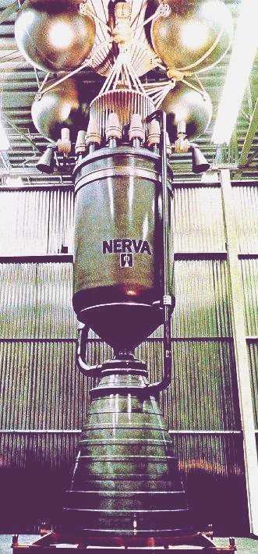
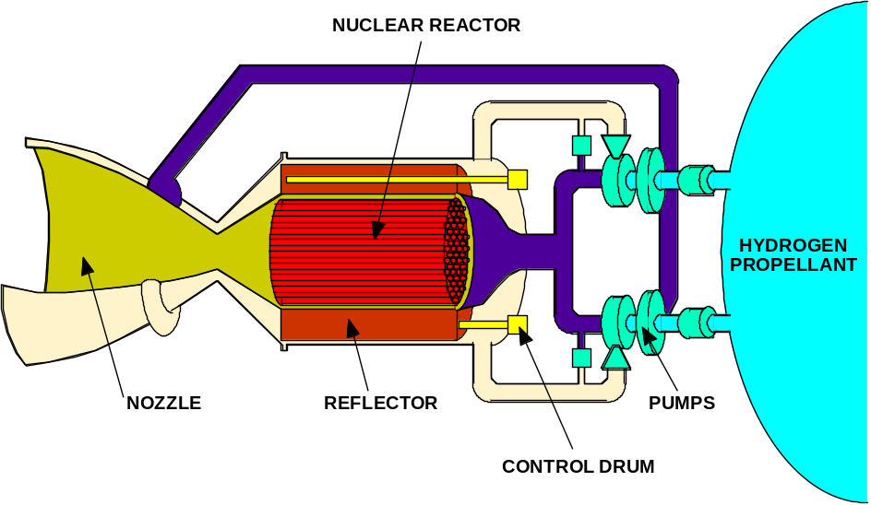
SPACE NUCLEAR PROPULSION
How Does Nuclear Thermal Propulsion (NTP) Work?
Propellant heated directly by a nuclear reactor and thermally expanded/accelerated through a nozzle (Low molecular weight propellant – typically Hydrogen)
Thrust directly related to thermal power of reactor: 100,000 N ≈ 450 MW_{th} at 900 sec
Specific Impulse directly related to exhaust temperature: 830 - 1000 sec (2300 - 3100K)
Specific Impulse improvement over chemical rockets due to lower molecular weight of propellant (exhaust stream of O₂/H₂ engine runs much hotter than NTP)
Major Elements of a Nuclear Thermal Rocket
NERVA Nuclear Thermal Rocket Prototype

Slide 5
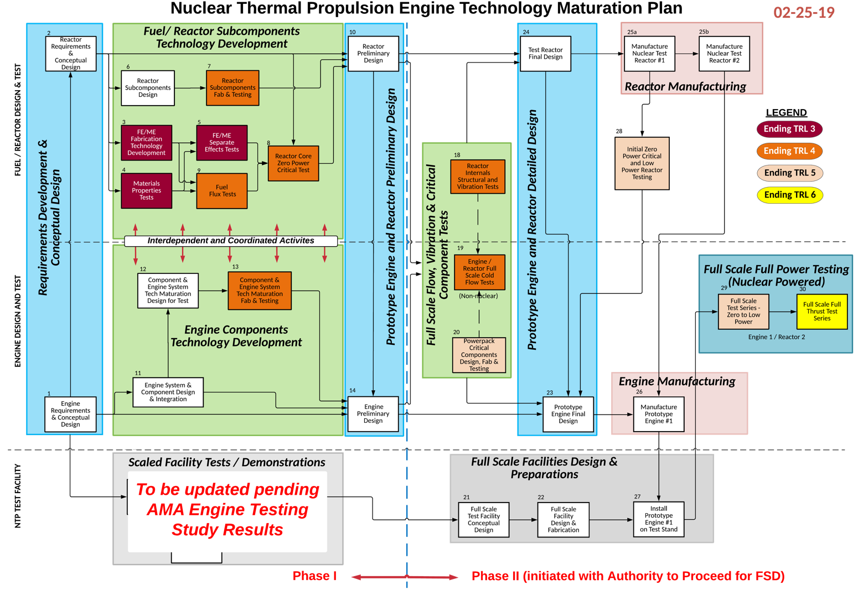
SPACE NUCLEAR PROPULSION
Development Plan for NTP
Overall Nuclear Thermal Propulsion Strategy:
Develop a subscale nuclear engine that demonstrates a viable NTP propulsion system and is scalable to the Mars mission engine needs. Evolve to Mars engine system as a part of a Mars NP propulsive stage.
  Develop a HALEU solid solution fuel form that can provide reactor exit temperatures > 2700 K (corresponds to > 900s I_{sp}).
  Design a reactor with an eye toward capability to be scaled to a size to support Mars mission engine needs. (Scaling is to be an engineering solution rather than further tech development.)
  Design and develop a subscale engine (Key attribute goals: 10K-15K lbf thrust, 900s I_{sp})
  Determine Demonstration option (either ground test or demonstration flight).

Slide 6
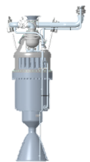

Updated SNP Fuel and Moderator Development Plan
July 2021
FY 2022
Late 2020s
Late 2030s
Industry Designs, Input from Other Space Reactor Programs
CERCER Fuel Development
PRIME 2
Nuclear and non-nuclear testing
PRIME 1 Pathfinder
Control system testing
Subscale engine testing
Flight or Ground Demonstration
Human Rated Engine
SMART testing
Fuel form down selection
CERMET Fuel Development
Low-power reactor testing
Nuclear and non-nuclear testing
New Technology On Ramps
Technology Qualification
High Temperature Alloy Fuel Development
New Technology Development
Technology Maturation

Slide 7
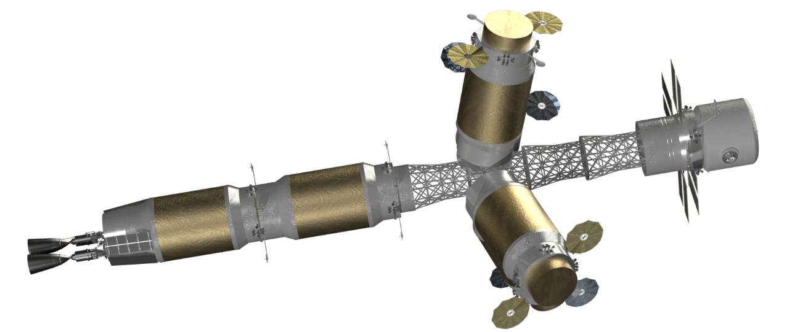
Conclusions: Why Nuclear, Why Now?
Space fission propulsion systems are game changing technologies for space exploration and cis-lunar mobility.
First generation NTP systems provide significant benefits to sustained human Mars exploration and other missions.
  Imagine Earth-Mars transit times of 120 days; imagine 540 day total Mars mission times; imagine reduced crew health effects from cosmic radiation and exposure to microgravity; imagine robust architectures including abort capability.
Advanced space fission power and propulsion systems will enable extremely ambitious space exploration and development.

Slide 8
Backup

Slide 9
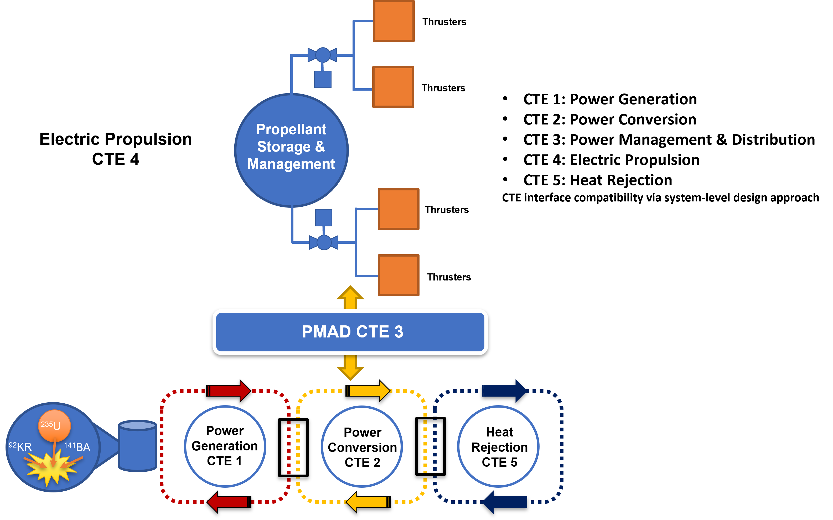
How Does Nuclear Electric Propulsion (NEP) System Work?
NEP uses the system (shown diagrammatically) to convert nuclear power to electricity that can power an electric propulsion system
NEP system broken into 5 Critical Technology Elements (CTE)
Each CTE is further divided into assemblies and components
NEP technology choices should be based on numerous metrics: performance (on the system level), manufacturability, operability, testability, robustness, cost, industry alignment

Slide 10
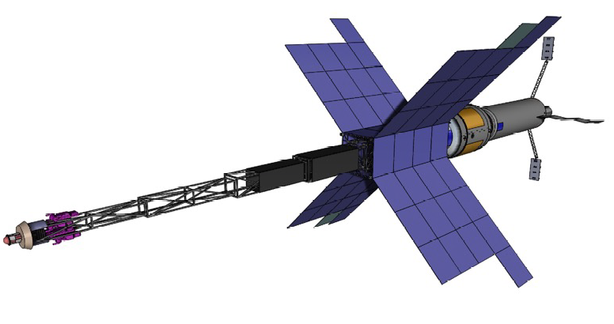
Development Plan for NEP
Development of a technology maturation plan (TMP) and definition of requirements to guide early stage NEP development (TMP development already started in FY21)
Industry and Government to continue with parallel technology maturation efforts, including
  Early phase risk reduction for high risk elements, targeting near-term TRL advancement payoff
  Fabrication and test of prototype systems
  A focus on subsystems with historically long lead times for development and/or acquisition
  Modeling & Simulation (M&S) efforts to drive tasking for FY23 (and beyond) (SNP-sponsored M&S work on reactor already started in FY21)
  System-level analytical assessments of technology/design options to support down-selections in the NEP system (work already started in FY21)
SNP plans to use expected NEP funding to target a few high-payoff activities, and is actively developing a plan that expands NEP work to a far greater range if more funding becomes available

