Slide 1


Jeff Gramling​, MSR Program Director
NASA HQ
​
ExMAG
October 14, 2021
Notes:
STILL

Slide 2












MSR Architecture Overview
Mars
Mars 2020
Tube Delivery
SRL
Mars Ascent
Vehicle
Tube Retrieval
Sample Fetch Rover
Tube Collection & Depot
Orbiting Sample
Retrieve OS
Relay Support
ERO
Break-the-Chain
Avoid Earth
Earth Entry Vehicle
Earth
Mars2020
Earth Return Orbiter
Sample Retrieval Lander
Sample Return and Science

Slide 3

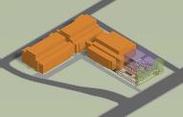
MSR Campaign
Mars Sample Return Program
1 2 3 4
Sample Caching Rover
(Mars 2020) Operations
Sample acquisition/caching
Sample (subset) delivery
Sample Retrieval Lander
Fetch Rover
Orbiting Sample (OS) container
Mars Ascent Vehicle
Earth Return
Orbiter
Capture/Containment System
Earth Return Vehicle
Mars Returned Sample Handling
Sample Receiving Facility
Curation
Sample science investigations
“Initiates the Campaign” “New Element” “New Element” “New Element”
Ground Element
Covered by MSR Budget
to be reviewed at a future date
The MSR Campaign spans three launches and one ground element
The MSR Program manages development and operations of elements 2 and 3 above and interfaces to elements 1 and 4; program concludes with recovery/containment of samples for transfer to SRF
The MEP Program manages M2020 Phase E operations & will be the home of the future SRF Project

Slide 4
Mars Sample Return Phase A
Delta Acquisition Strategy Meeting conducted in May to approve center roles and responsibilities changes and modifications to acquisition approaches
MOA established to define the relationship between MSR Program and the Mars Exploration Program
Review Status
  ESA Earth Return Orbiter (ERO) – PDR 4/15
  ESA Sample Fetch Rover (SFR) SRR – 4/29
  Capture, Containment, and Return System (CCRS) SRR – 4/22
  Mars Ascent Vehicle (MAV) SRR – 11/8
MSPG2 Report completed and briefed on 9/27 to MEPAG; to be published in Astrobiology
Program is working to realign near-term review plan and gates to address extension of Phase A trade studies and closure on baseline mission design

Slide 5
Delta Acquisition Strategy Meeting Decisions (5/26)
 | Areas of Responsibility
Center | July 2019 ASM | Dec 2020 KDP-A APMC | May 2021 Current
JPL | Program Management through Mars Exploration Program (MEP), Sample Retrieval Lander (SRL), Containment Hardware | Program Management through dedicated Program Office, Sample Retrieval Lander (SRL), Containment Hardware, Support for Robotic Transfer Arm (RTA), Sample Transfer System (STS) and Sample Transfer Arm (STA) support to ESA | Program Management through dedicated Program Office, Sample Retrieval Lander (SRL), Containment Hardware, Support for Robotic Transfer Arm (RTA), Sample Transfer System (STS) and Sample Transfer Arm (STA) support to ESA,, Procurement of EEV through system contract
GSFC | Capture Containment Return System (CCRS), Containment Module, Transfer Module (TM), Earth Return Module (ERM) | Capture Containment Return System (CCRS), Capture Containment Module (CCM), Robotic Transfer Arm (RTA), Earth Return Module (ERM) | Capture Containment Return System (CCRS), Capture Containment Module (CCM), Robotic Transfer Arm (RTA), Earth Return Module (ERM), Earth Entry Vehicle (EEV) GSFC/LaRC partnership with procurement through JPL
MSFC | Mars Ascent Vehicle (MAV) | Mars Ascent Vehicle (MAV) | Mars Ascent Vehicle (MAV) through system contract
LaRC | Earth Entry Vehicle (EEV), EDL Support to SRL | Earth Entry Vehicle (EEV), EDL Support to SRL | EDL Support to SRL, Earth Entry Vehicle (EEV) GSFC/LaRC partnership with procurement through JPL
ARC | Thermal Protection System (TPS) for EEV and SRL, EDL Support to SRL and EEV | Thermal Protection System (TPS) for EEV and SRL, EDL Support to SRL and EEV | Thermal Protection System (TPS) for EEV and SRL, EDL Support to SRL and EEV
GRC | SRL Solar Array Procurement, Sample Fetch Rover (SRF) Wheel Tire Assembly | SRL Solar Array Procurement, Sample Fetch Rover (SRF) Wheel Tire Assembly | Sample Fetch Rover (SRF) Wheel Tire Assembly, SRL Solar Array Procurement to JPL
KSC | Launch Vehicle Procurement | Launch Vehicle Procurement | Launch Vehicle Procurement

Slide 6
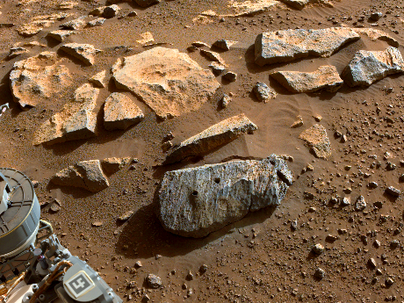
Accomplishments
Perseverance has successfully acquired paired rock samples
Staffed key leadership roles across program
Completed Delta ASM, finalized center roles
Completed numerous technical & programmatic trades
  CCRS Partial Jettison, SRL Dual Lander, MMRTG, etc
Procurement activity progress
  Spin Eject Mechanism RFP released
  CCRS EES Aeroshell study contract awarded
  Contract for Sample Retrieval Lander Aeroshell awarded
  Mars Spring Tire Prototype Delivery to ESA
  MAV Solid Rocket Motor long-lead procurement awarded
  Mars Ascent Vehicle Integrated System (MAVIS) Contract proposals received and in evaluation
  SRL/EES Thermal Protection System (TPS) material contract awarded
Rochette' After Perseverance Sampling: Sept. 7, 2021, PDT, shows two holes where the rover's drill obtained samples from rock nicknamed "Rochette." Credits: NASA/JPL-Caltech.

Slide 7
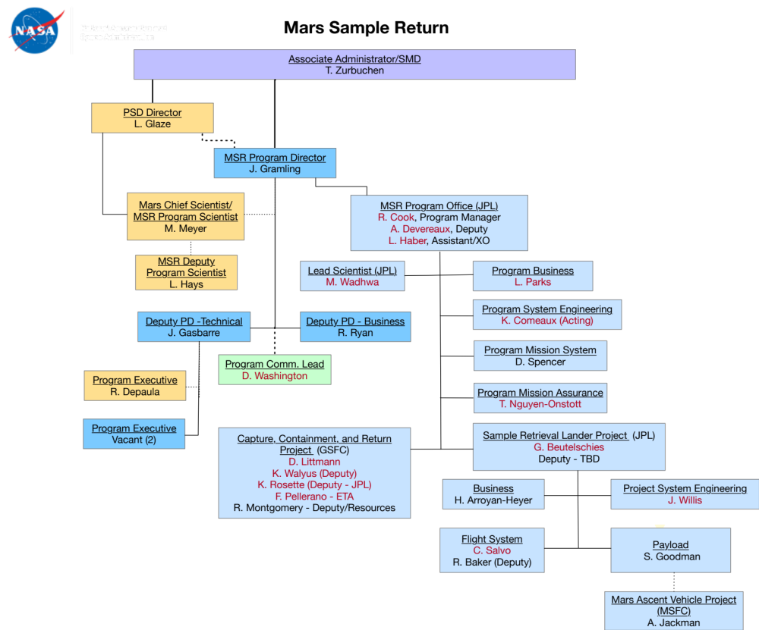
MSR Organization Chart (changes from MCR in red)
MSR/MEP Lead Scientist
M. Meyer

Slide 8
Campaign Major Trades/Study Status
COMPLETE
  CCRS Partial Jettison (reducing mass and complexity pressure)
  EES Delivery (optimized release timing and delivery error)
  OS Dimension/Tube spacing (minimize CCRS impact)
  OS Optical Properties (inform rendezvous requirements)
IN PROCESS
  Dual Lander/SFR Delivery
    Awaiting SRL architecture decision
  End-to-End Surface Sample Handling
    Sample Integrity (thermal, etc)
    STA End Effector/RSTA Glove Utilization
    RSTA acceleration environment requirement
  Break-the-Chain containment assurance (see next slide for highlight)
  OS Witness Plates

Slide 9
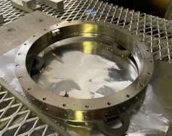
Trade Study Highlight: BTC Containment Assurance - Aseptic Transfer/Sealing
The program is currently trading two aseptic transfer/sealing approaches to complete the primary containment vessel (PCV) assembly around the Orbiting Sample (OS) container
  Baseline is use of brazing at joint
  Alternate is a heat-shrink fit (HSF) approach
Baseline autonomous brazing is TRL 4-5; efforts on track to demonstrate TRL 6 by CCRS PDR
Alternate approach, heated shrink fit, is in work to mitigate TRL development risk
  Relies on well-understood joining method and maintains the capability to sterilize the PCV joint
  Potential improvement in ground and on-orbit verification
Target completion for Trade Study: 30 October 2021
Brazing Development: 1-Way Full Scale Ring
2nd FS ring from August 2021:
He tight and sealed to < 4x10-10 atm.cc/s.

Slide 10
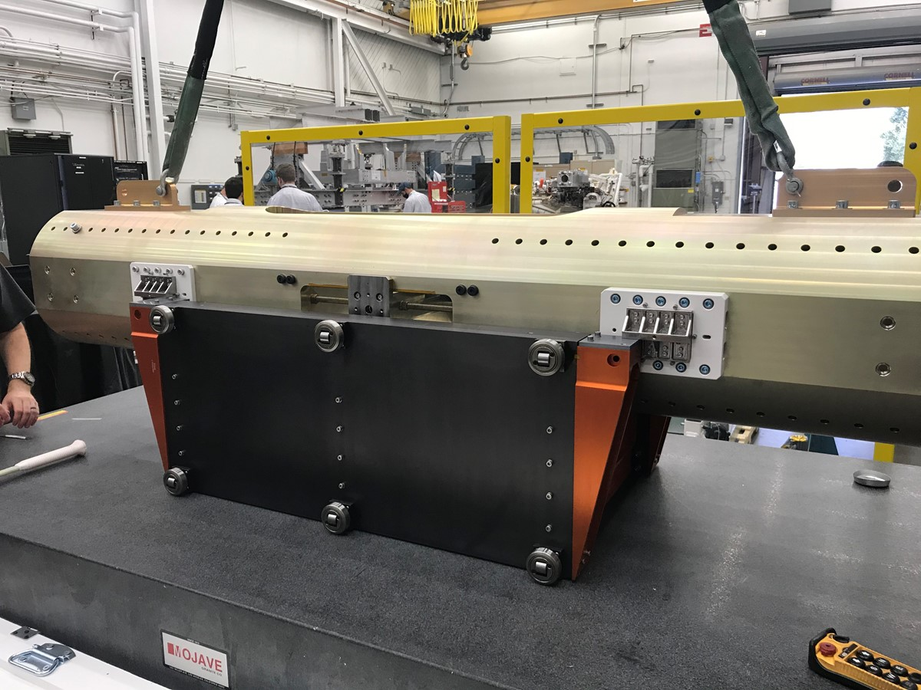
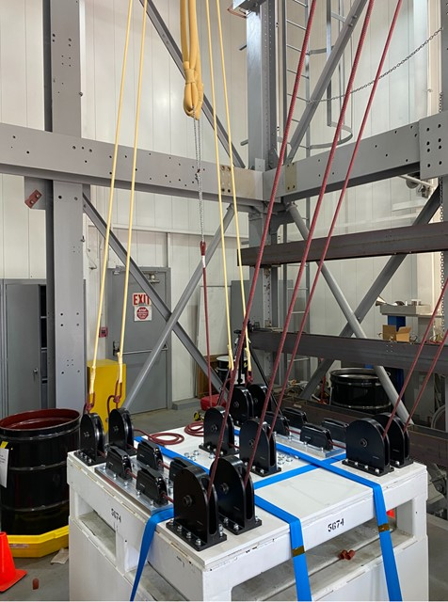
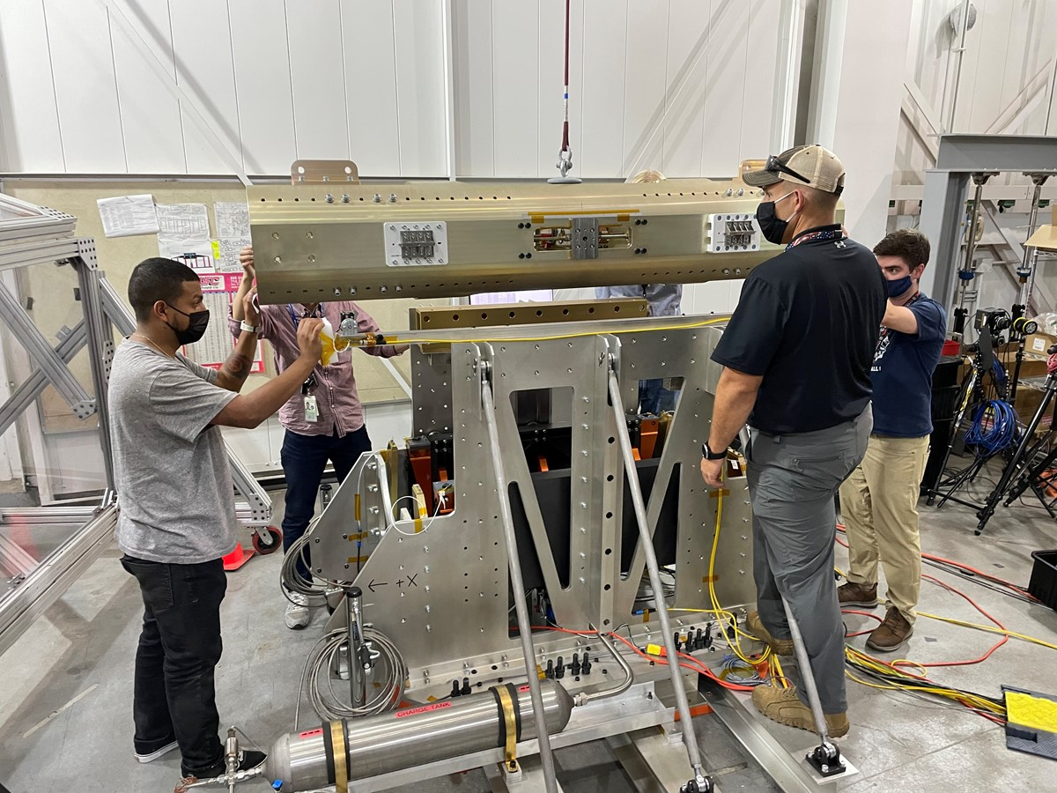
Development Highlight: VECTOR
What is it?
The Vertically Ejected Controlled Tip-Off Release (VECTOR) system “tosses” the MAV before ignition
This minimizes dynamic coupling with launch dynamics and plume interactions while increasing ground testability/verification
Overall
  Design continues to mature
  Held an architecture review that confirmed the basic VECTOR approach
  Held development review to ensure solid maturity plan by PDR
  Prototype version 1 has been built
Testing
  Using Building 280 with an MSL Z-Hangman structure utilizing a gravity offload and catch system
  Have started testing prototype with testbed (see next slide)
VECTOR Prototype with MAV Simulator
Gravity Offload and Catch System
Testing Underway

Slide 11
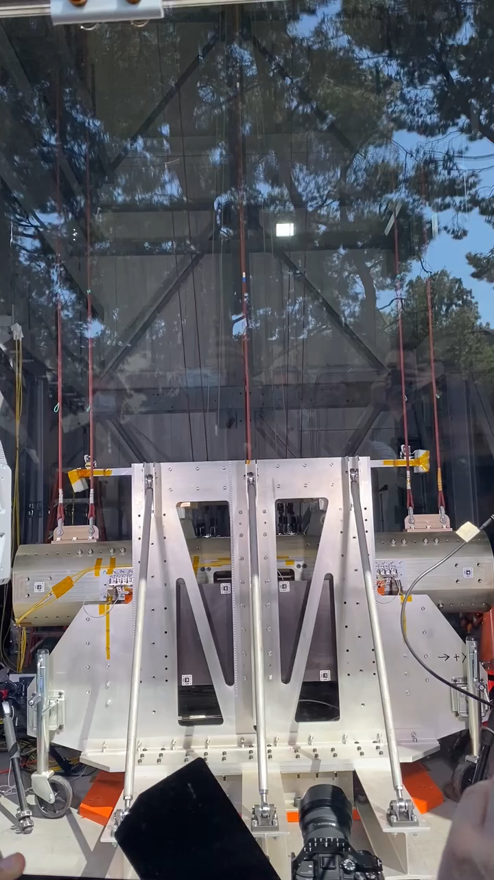
VECTOR Prototype Testbed

Slide 12
Summary
Perseverance is continuing sampling science operations after having acquired its first samples
Organizational responsibilities and Make/Buy decisions have been aligned consistent with recommendations by the IRB
Team continues to mature architecture in Phase A
  Close trades
  Demonstrate viability on technology and engineering developments
  Refine cost and schedule estimates with institutional commitments
  Continue refinement of mission design and planning
The President’s FY22 budget request funds the program consistent with IRB recommendations
The program has benefited from addition of experienced staff from M2020 and other recent missions

Slide 13
Acronyms
CM: Containment Module
CCM: Capture and Containment Module
CCRS: Capture, Containment and Return System
CONOPS: Concept of Operations
CP: Chemical Propulsion
CS: Cruise Stage
DOF: Degree of Freedom
EE: End Effector
EES: Earth Entry System (includes OS)
EEV: Earth Entry Vehicle
EP: Electric Propulsion
ERO: Earth Return Orbiter
ERM: Earth Return Module
GNC: Guidance, Navigation and Control
HEEET: Heatshield for Extreme Entry
Environments Technology
IRD: Interface Requirements Document
IDRA: Interface Definition and Requirements
Agreement
ITT: Invitation to Tender
JMIP: Joint Management and Implementation Plan
LMO: Low Mars Orbit
LRD: Launch Readiness Date
LV: Launch Vehicle
MAPS: Mars Ascent Propulsion System
MAS: Mars Ascent System
MAV: Mars Ascent Vehicle
MPA: MAV Payload Assembly
MEL: Mass Equipment List
MEP: Mars Exploration Program
MMOD: MicroMeteoroid and Orbital Debris
MRSH: Mars Returned Sample Handling
MSR: Mars Sample Return
OS: Orbital Sample
PICA: Phenolic Infused Carbon Ablator
PLV: Propulsion Landed Vehicle
PP: Planetary Protection
PPO: Planetary Protection Officer
QPM: Quarterly Progress Meeting
RSTA: Returned Sample Tube Assembly
RTA: Robotic Transfer Arm
SEP: Solar Electric propulsion
SFR: Sample Fetch Rover
SRL: Sample Retrieval Lander
SRF: Sample Receiving Facility
STA: Sample Transfer Arm
STS: Sample Transfer System
SOI: Statement of Intent
TAA: Technology Assistance Agreement
TGO: Trace Gas Orbiter
TM: Transfer Module
TPS: Thermal Protection System
TVC: Thrust Vector Control
TRN: Terrain-Relative Navigation
VECTOR: Vertical Ejection, Controlled Tip-off Rate launch mechanism
UTTR: Utah Test and Training Range

Slide 14


with us

