Slide 1
GMAO Simulated Data
Patricia Castellanos
Amir Ibrahim (616), Andy Sayer (616), Samuel Anderson (616), Cecile Rousseaux (610.1), Watson Gregg (610.1), Bryan Franz (616), Jeremy Werdell (616), Arlindo da Silva (610.1), Peter Norris (610.1), Zachary Fasnacht (614), and Robert Spurr (RT Solutions Inc.)

Slide 2
GMAO Level 1b Instrument Simulation
Gridded Model Inputs
Sample Geophysical Variables at Instrument Field of View and Resolution
“Ground Truth”
Mass extinction efficiency
Mass scattering efficiency
Scattering matrices
GOCART Aerosol LUT
Derive Optical Property Inputs to RTM
VLIDORT RTM
Isotropic Cox-Munk Surface Glint
Instrument Observables
[Satellite L1B]
Hyperspectral TOA Radiance

Slide 3
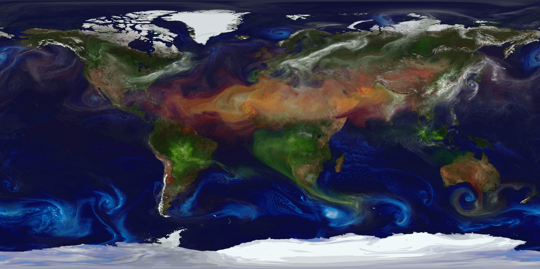
GEOS Global 7 km Nature Run (G5NR)
G5NR is a non-hydrostatic free-running simulation
30 min timestep
1.5 years
Includes GOCART aerosols, O₃, CO, and CO₂

Slide 4
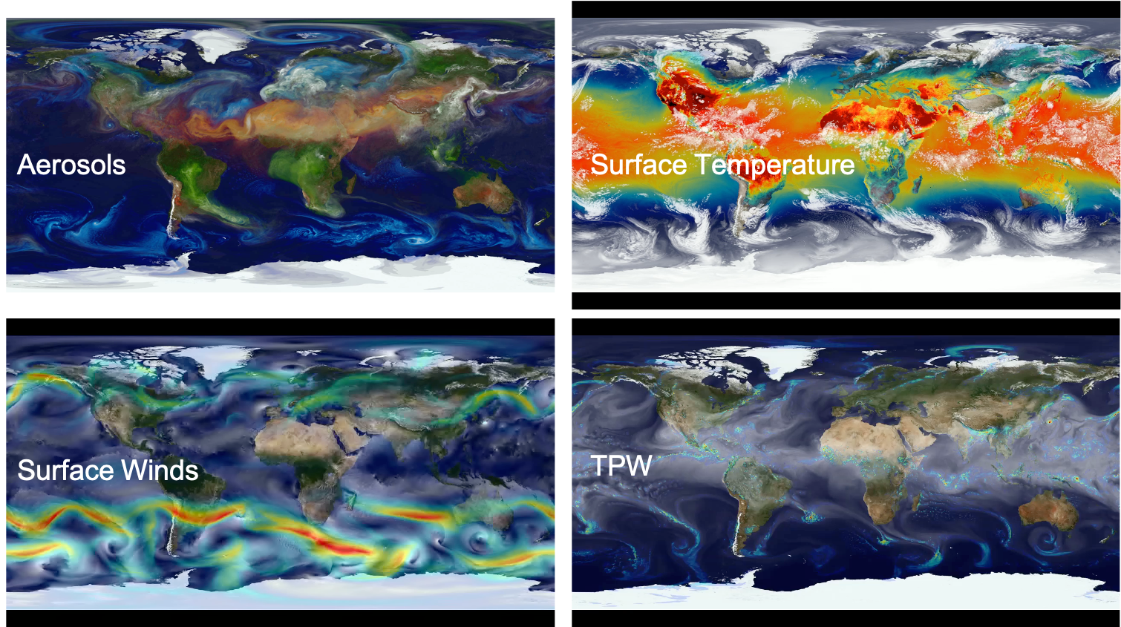

Slide 5
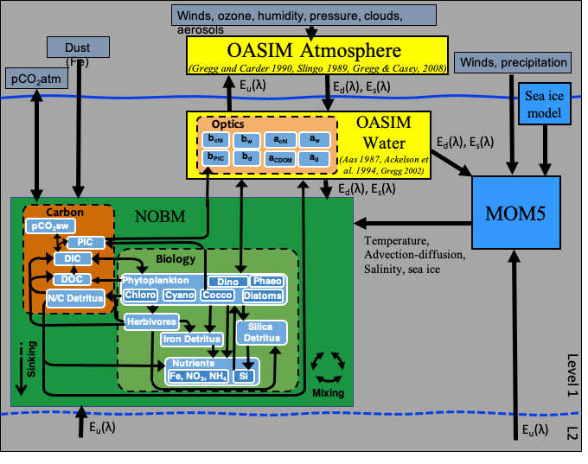
Global Ocean Radiance Simulation
Biogeochemical constituents were coupled to a global ocean circulation model
Distributions of ocean optical constituents were coupled with a radiative transfer model OASIM to estimate water-leaving radiances at 1 nm spectral resolution
Gregg & Rousseaux, Frontiers in Marine Science (2017)

Slide 6
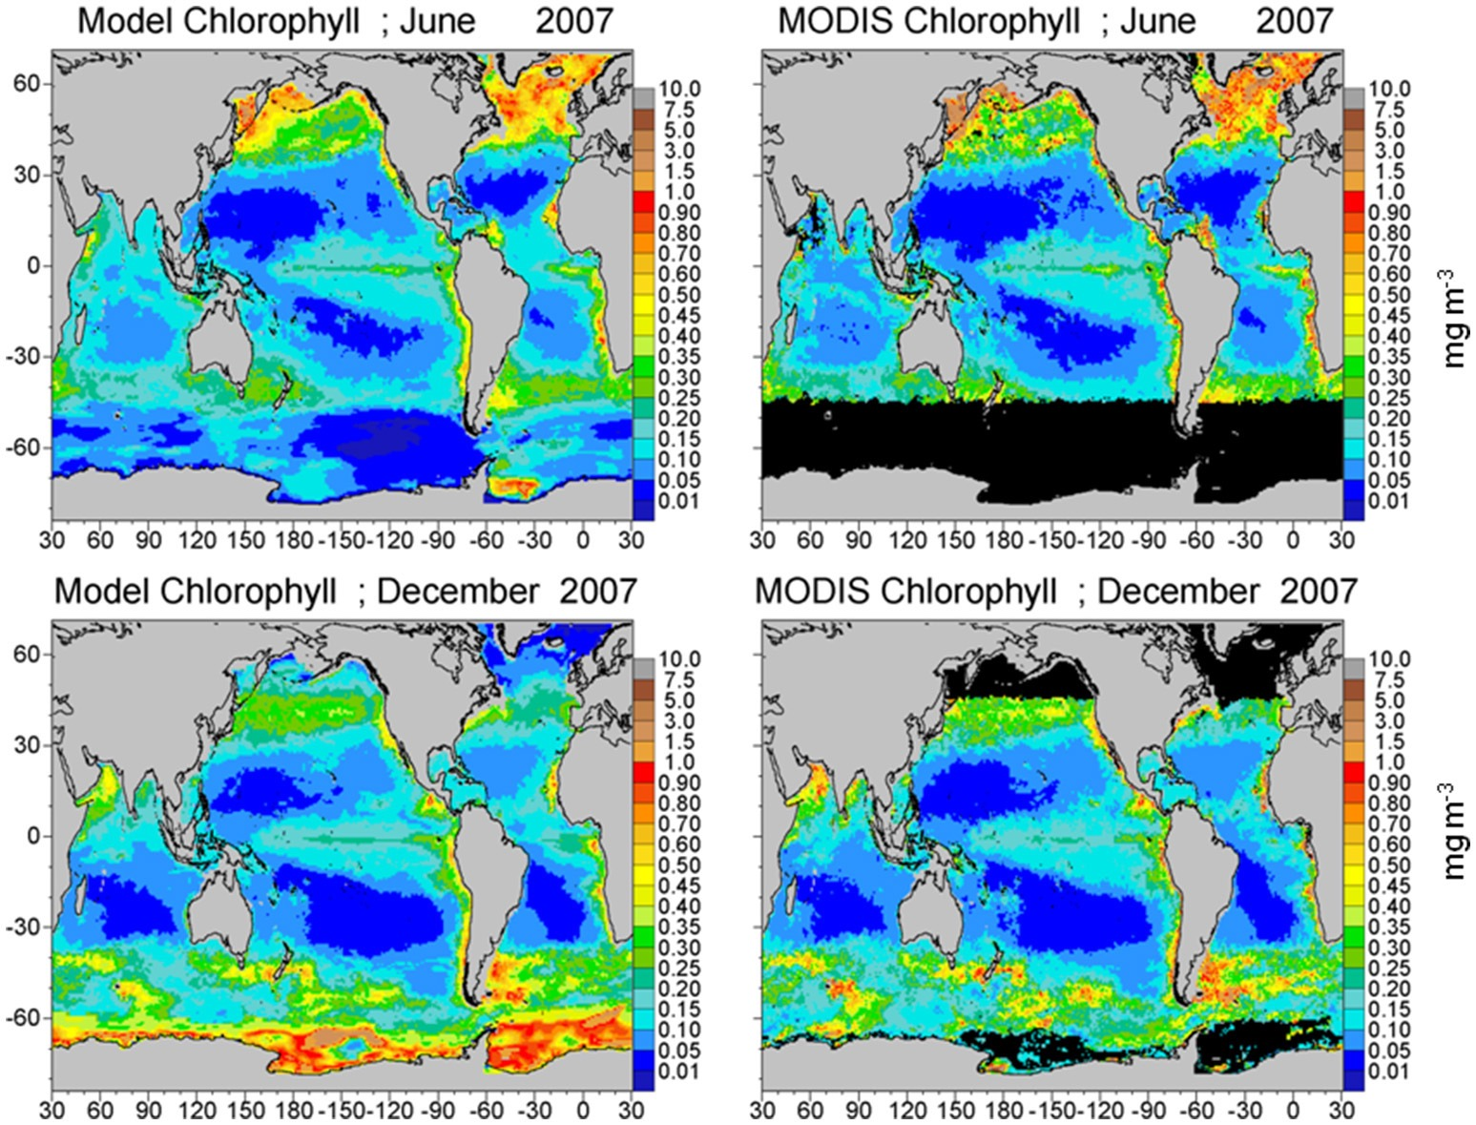
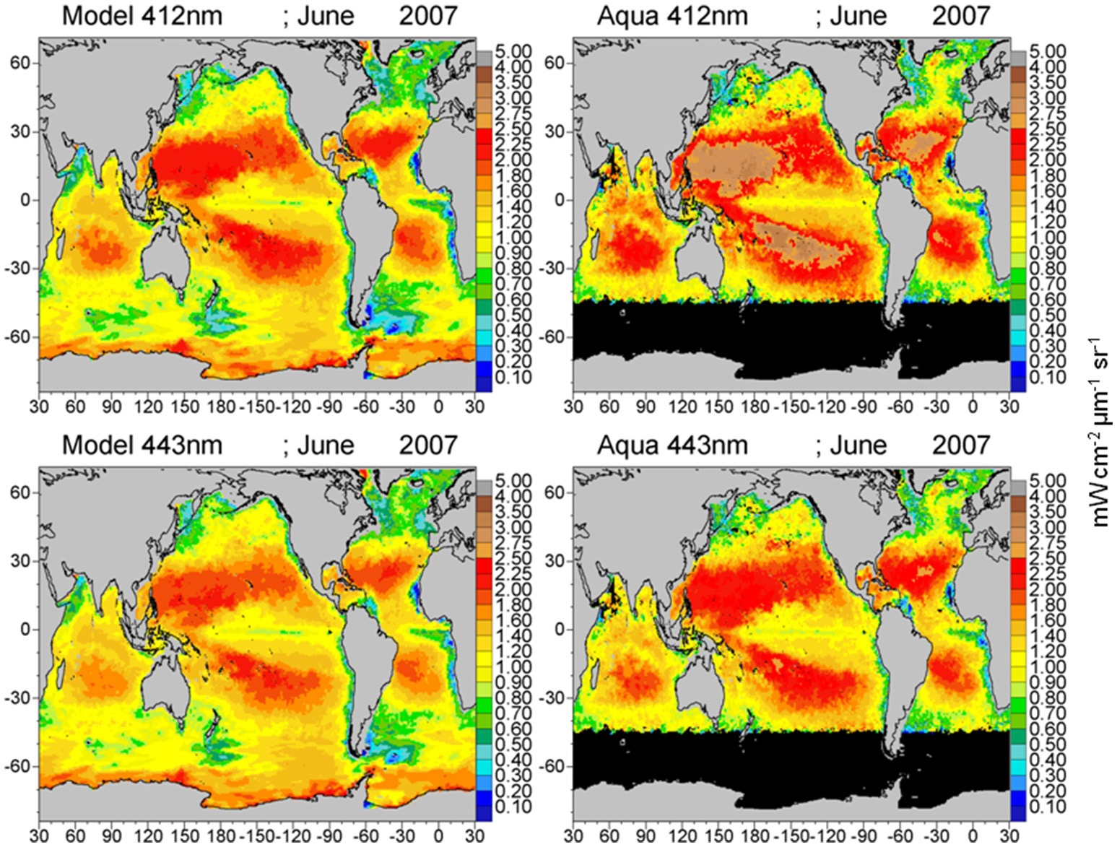
Global Ocean Radiance Simulation
Simulated and Observed Chlorophyll
Simulated and Observed Water Leaving Radiance

Slide 7
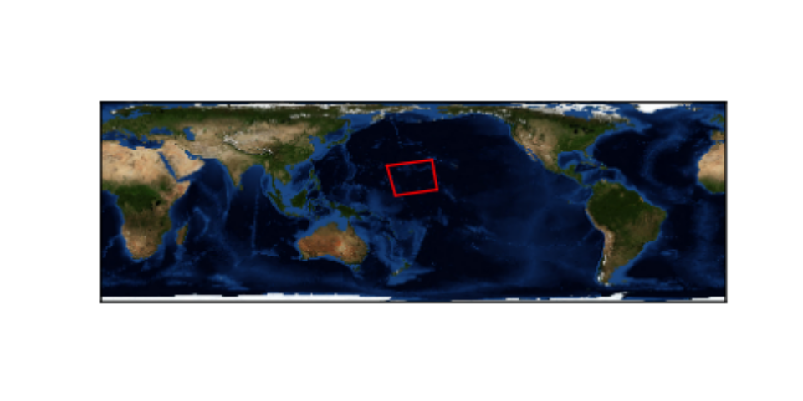
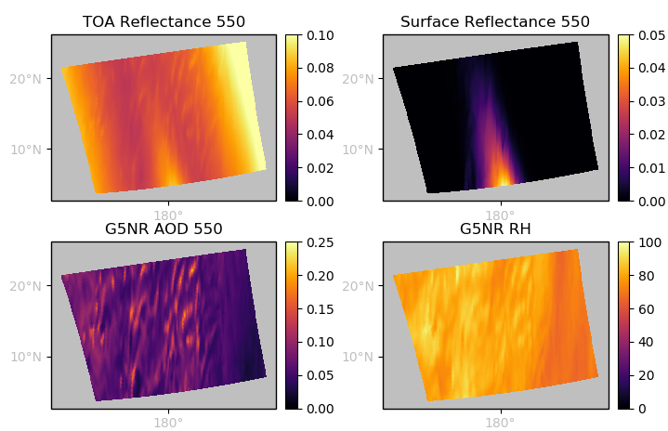
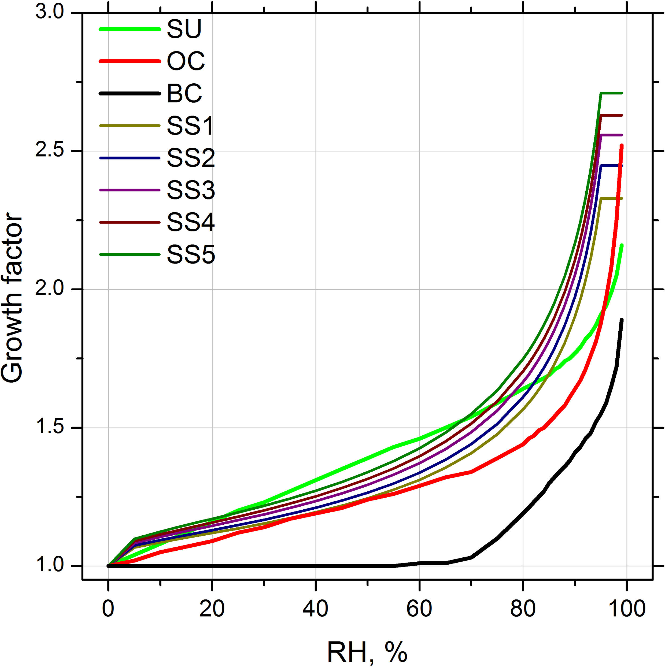
Simulated PACE L1B Granule (V1)

Slide 8
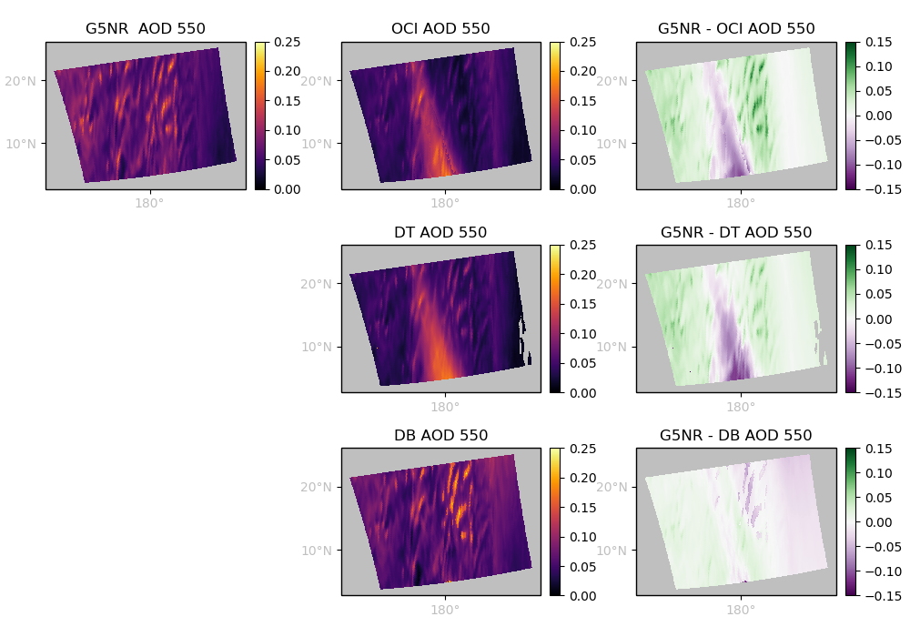
Simulated Data Applied to OCI Aerosol & Ocean Color Algorithms
GEOS Ocean & Atmosphere
Instrument Simulator
Simulated OCI TOA Radiance
Retrieval Model Assumptions
OCI Aerosol Retrieval/
Atmospheric Correction
True AOD
Retrieved AOD

Slide 9
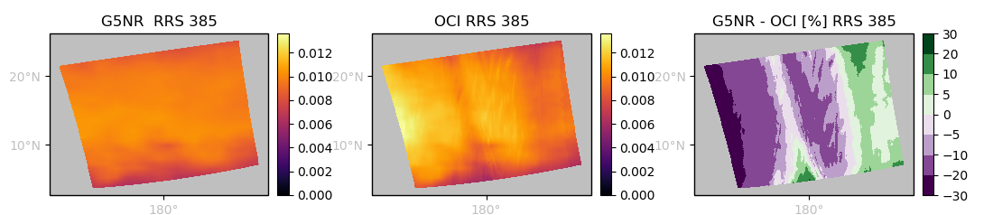
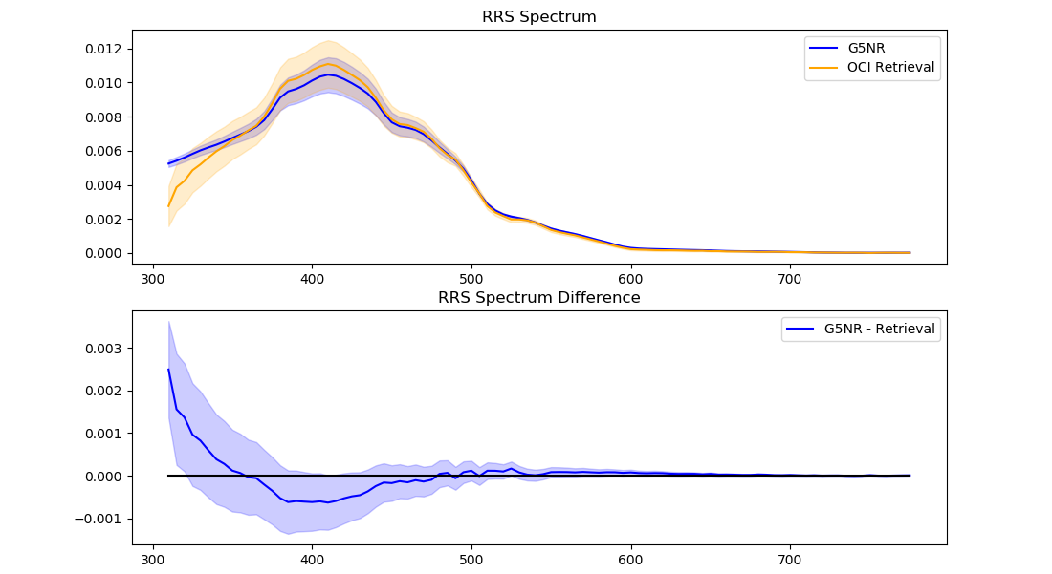
Ocean Color Retrieval

Slide 10
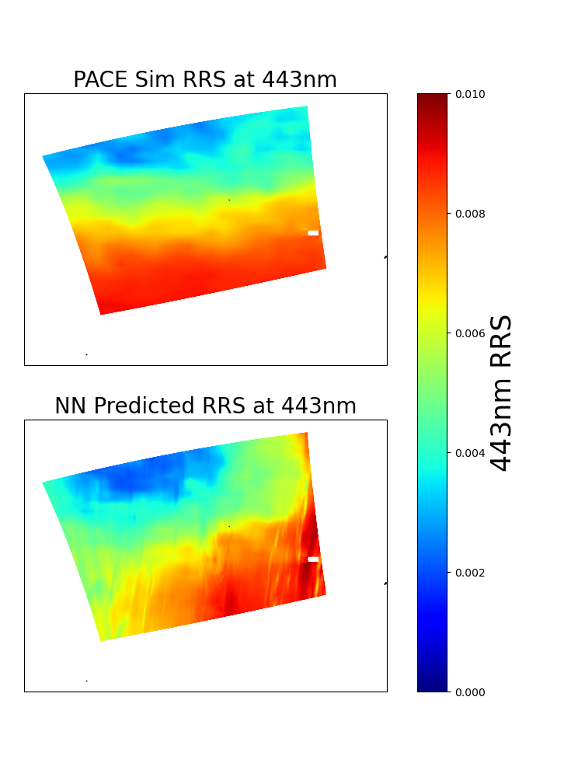
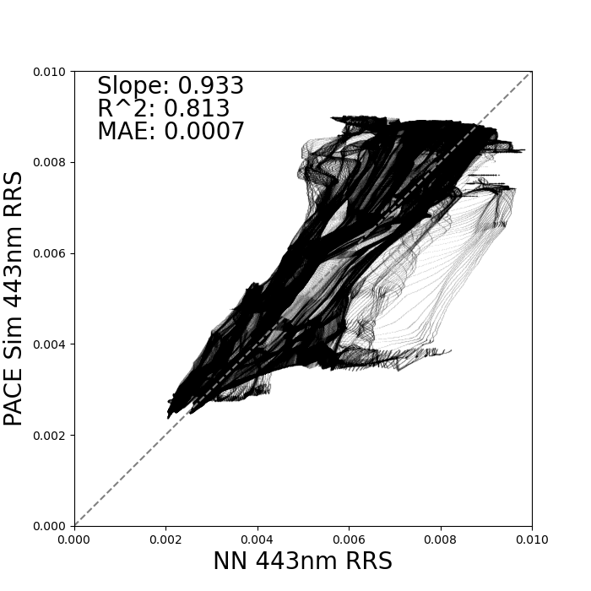
Applying GOME-2 NN to PACE Simulated Reflectance
Trained a neural network on the relationship between GOME-2 observations and MODIS RRS
Applied neural network from GOME-2 training to GMAO simulated observations
  Completely independent evaluation, no PACE simulated data in the training
  NN-Model does NOT include angles in training
Some error possibly due to NN learning GOME-2 calibration or lack of angles
Zach Fasnacht (614)

Slide 11
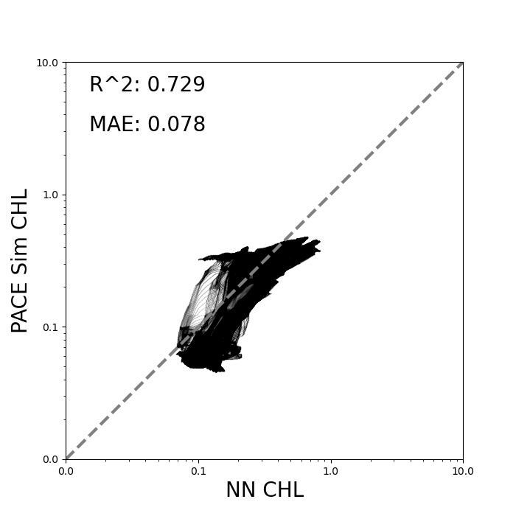
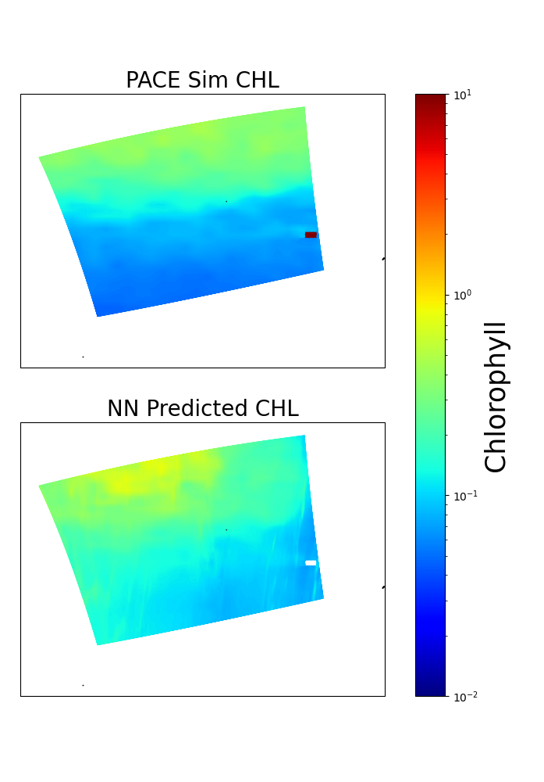
Applying GOME-2 NN to PACE Simulated Reflectance
Here the NN is trained to predict MODIS CHL from GOME-2 observations
NN was applied to the GMAO simulated observations
Zach Fasnacht (614)

Slide 12
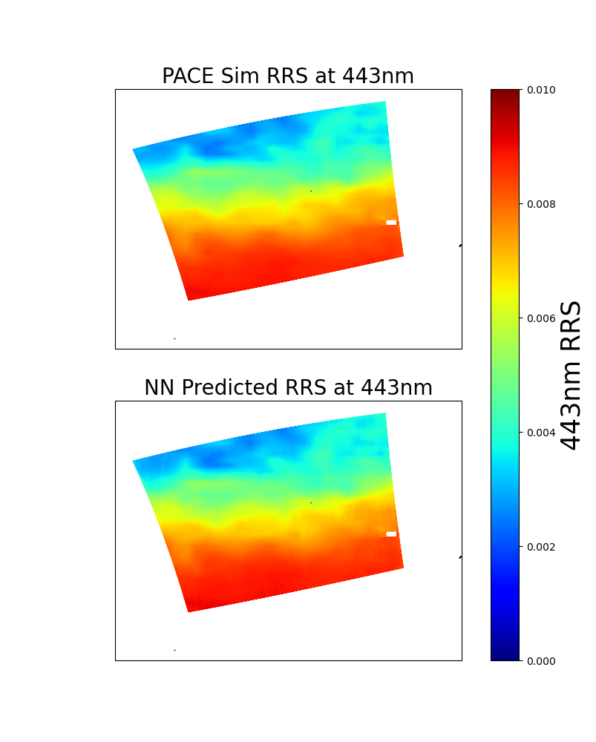
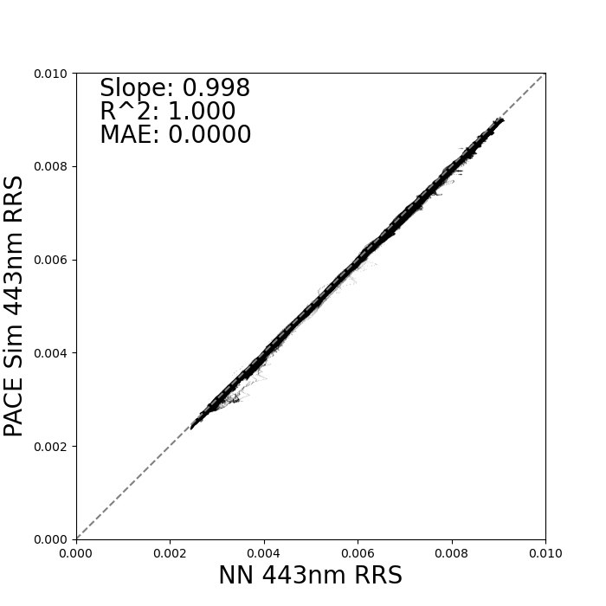
Neural Network Based on PACE Simulated Reflectance
Here NN was generated based solely on simulated reflectance
Only 5% of the data included in the training
Possible way forward to scale up these very expensive simulations
Zach Fasnacht (614)

Slide 13
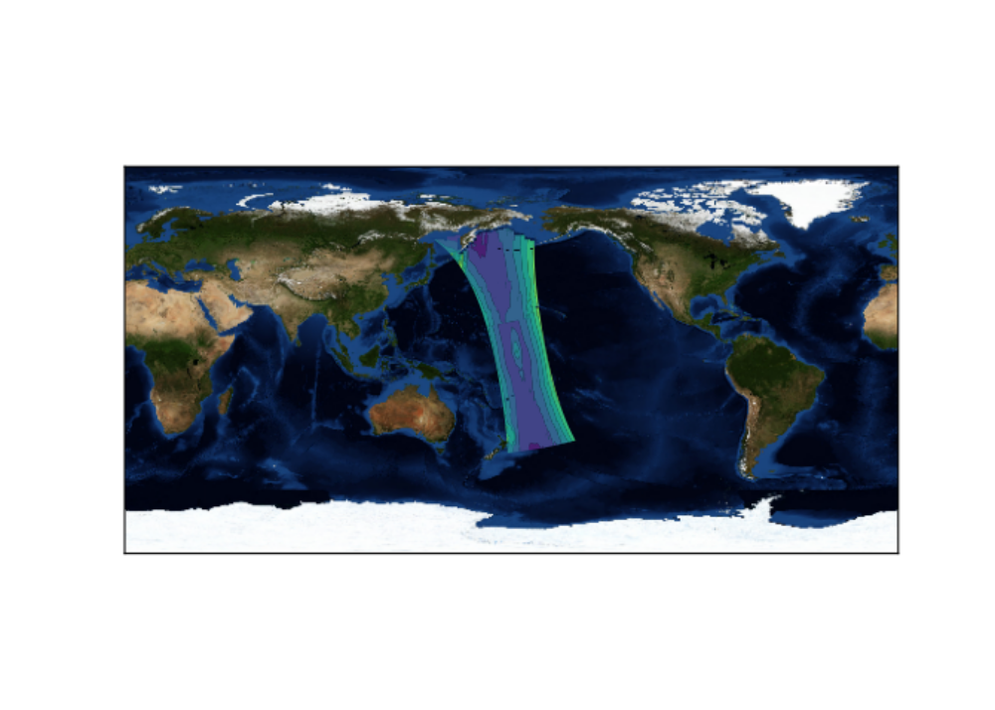
Data Availability
Data hosted on public website:
  https://portal.nccs.nasa.gov/datashare/G5NR/Ganymed/7km/c1440_NR/OBS/PACE/
  Organized by Levels
  LevelA: Raw inputs (very large datasets)
  LevelB: Inputs subsampled to PACE granule
    e.g. T, P, RH, aerosol mass profiles
  LevelC: RTM optical input/outputs
    e.g. Rayleigh optical depth, AOD, surface reflectance, TOA radiance
  LevelC2: TOA radiance in PACE L1B file format
Simulated 500 nm TOA Reflectance
OCI tilt
Known Issues
  Land-Sea hand-off bug, land areas masked out
  VLIDORT validation (R. Spurr) revealed bug in glitter reflection – requires update to v2.8.3

Slide 14
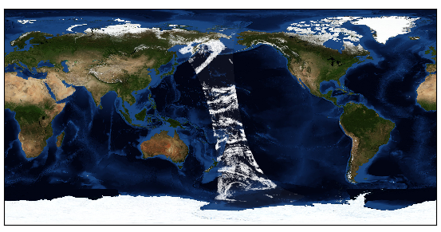
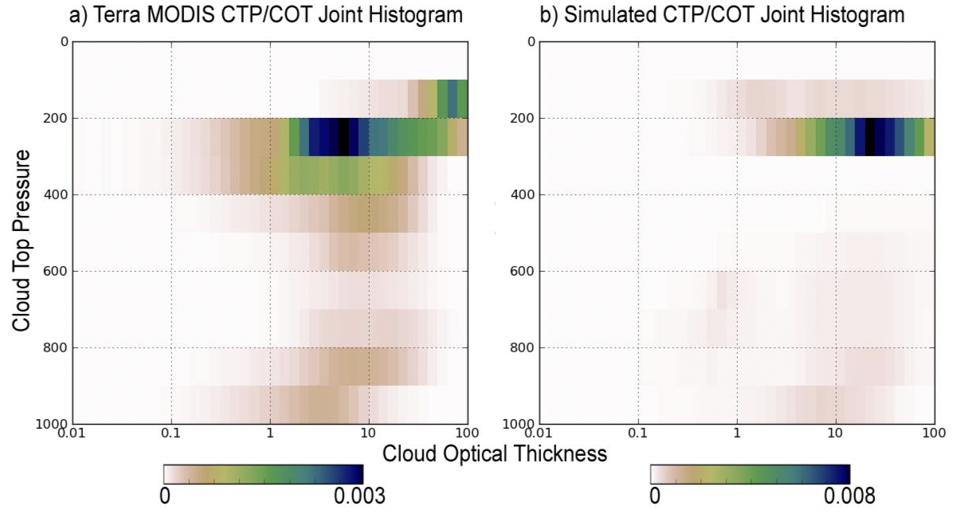
New Progress: Clouds
GMAO has developed a downscaling algorithm to create realistic cloud optical depth distrbituions from bulk moisture fields
Has been used in MODIS cloud retrieval studies (Wind et al. 2013)
1-orbit of Downscaled Cloud Optical Depth
Norris et al. “Representation of 3D heterogeneous cloud fields using copulas: Theory for water clouds”, QJRMS, 2008.

Slide 15
Summary & Plans
Nearly 1-orbit of cloud-free simulated OCI radiance data is available for testing/developing algorithms
OCI AC and AOD retrievals successfully demonstrated on simulated data
GOME-2 based NN applied to simulated observations show high correlation between predicted and simulated data
Downscaled cloud fields have been generated for orbit of interest, will be incorporated in next update
Other planned updates:
  Include MT_CKD trace gas absorption continuum
  Latest HITRAN 2020 coefficients

Slide 16
Backups

Slide 17
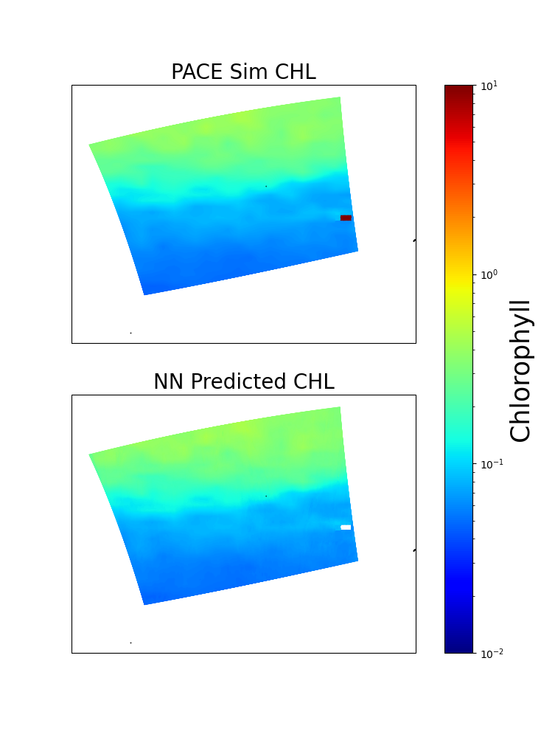
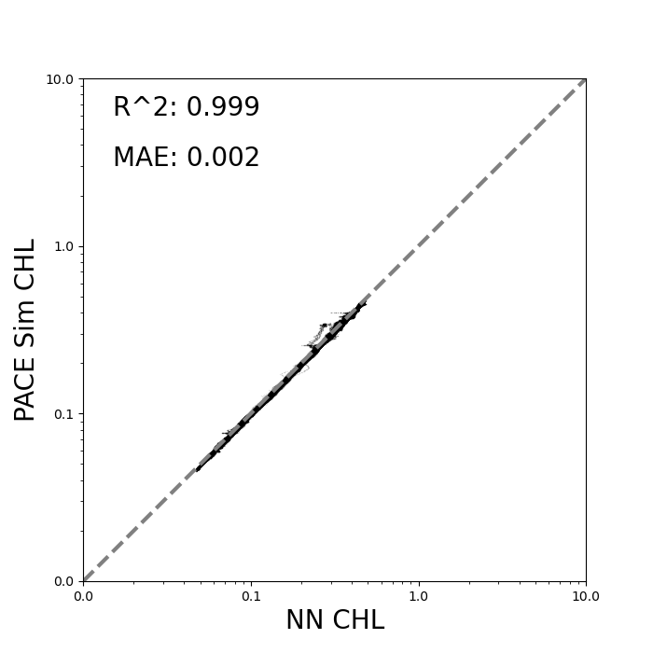
Neural Network Based on PACE Simulation
Here NN was generated based solely on simulated reflectance
Only 1% of the data included in the training
Possible way forward to scale up these very expensive simulations
Zach Fasnacht (614)

Slide 18
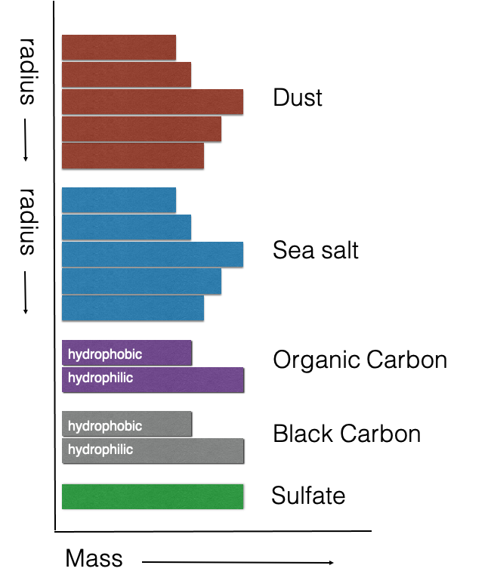
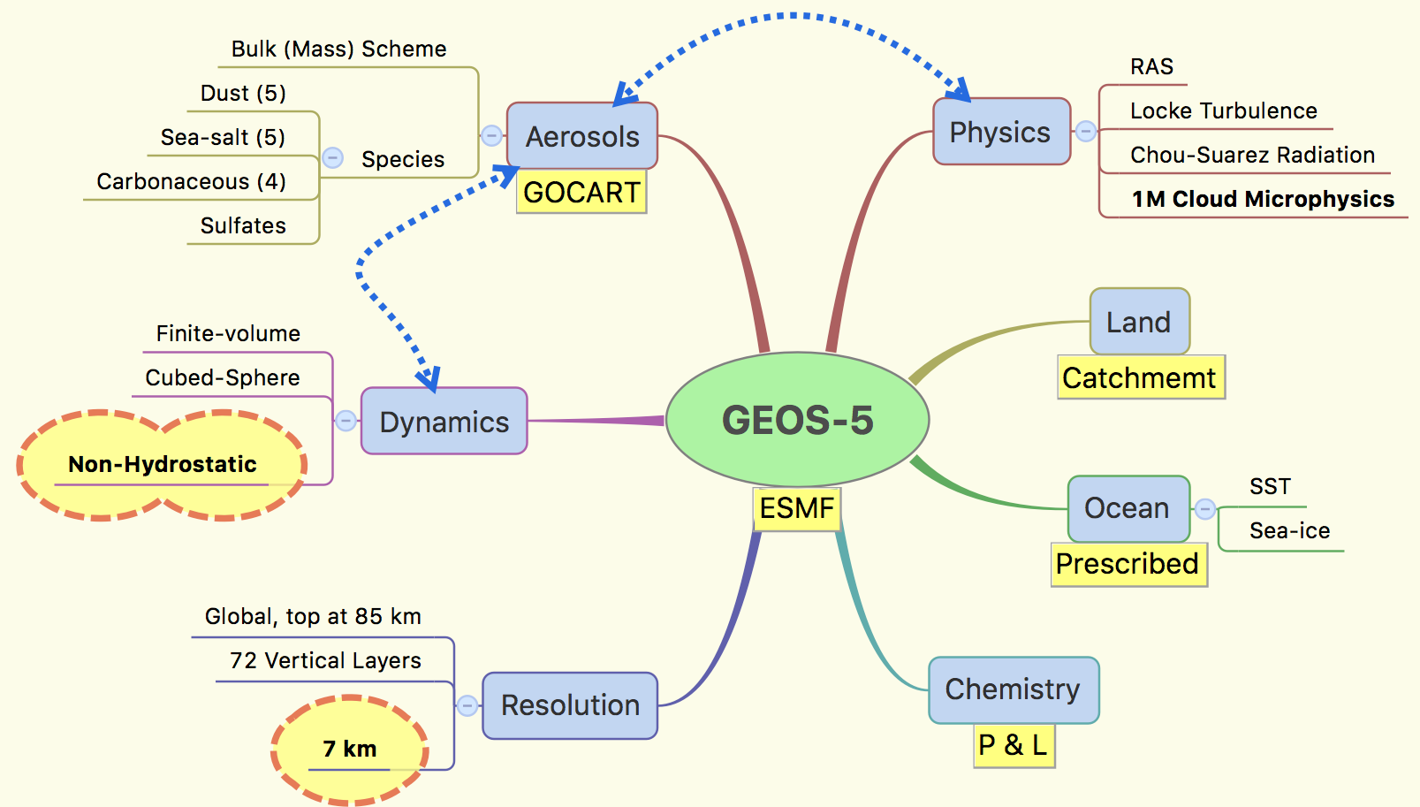
G5NR Configuration

Slide 19
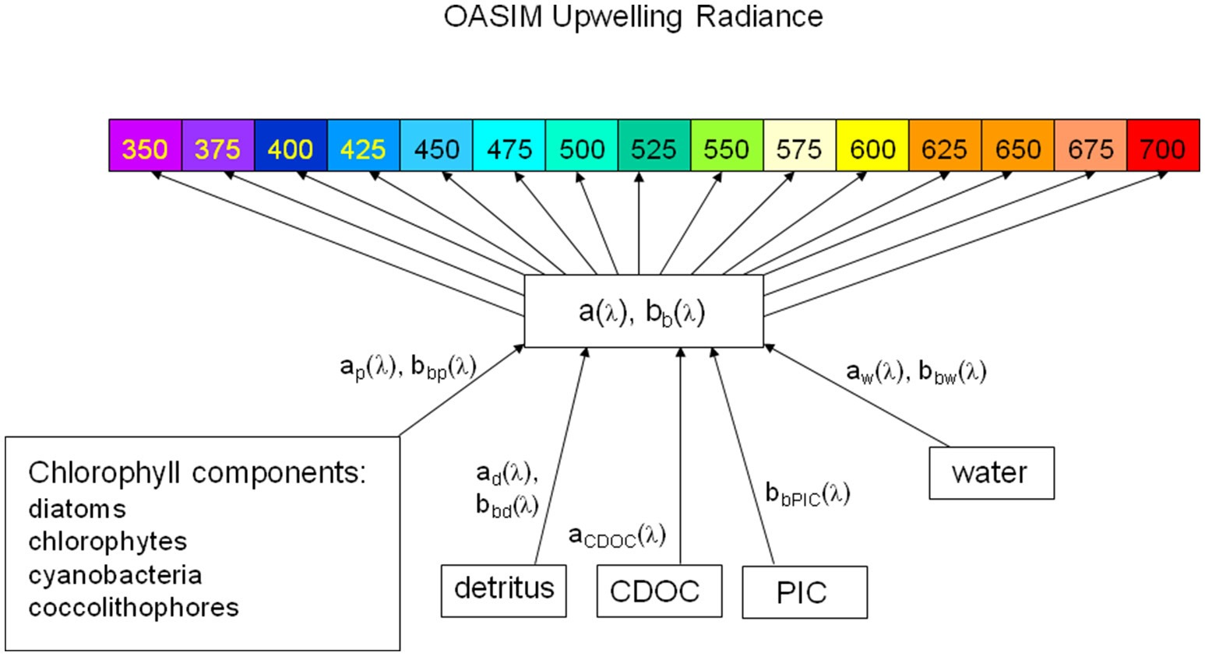
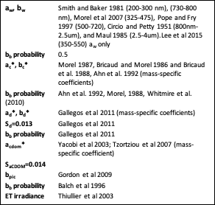
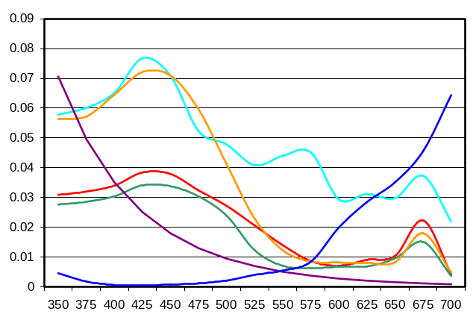
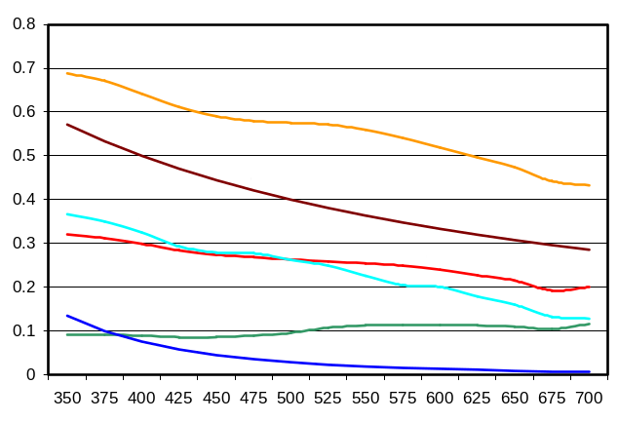
Global Ocean Radiance Simulation

Slide 20

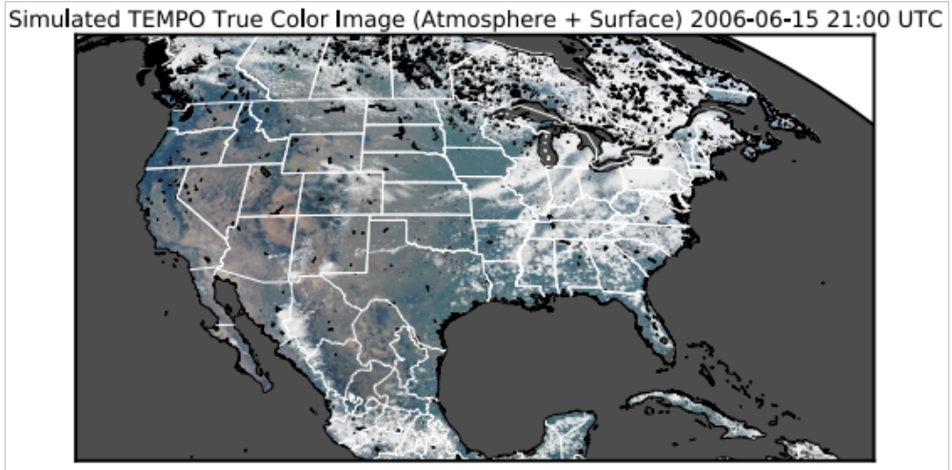
GMAO Instrument Simulator
Simulated TEMPO RGB Image
Detailed radiative transfer calculations in the presence of aerosols, clouds, and trace gases
Apply instrument characteristics (i.e., spectral response)
Create Simulated Observables:
  top of the atmosphere radiances
  backscatter
  etc.
Castellanos, et al. (2019)

Slide 21
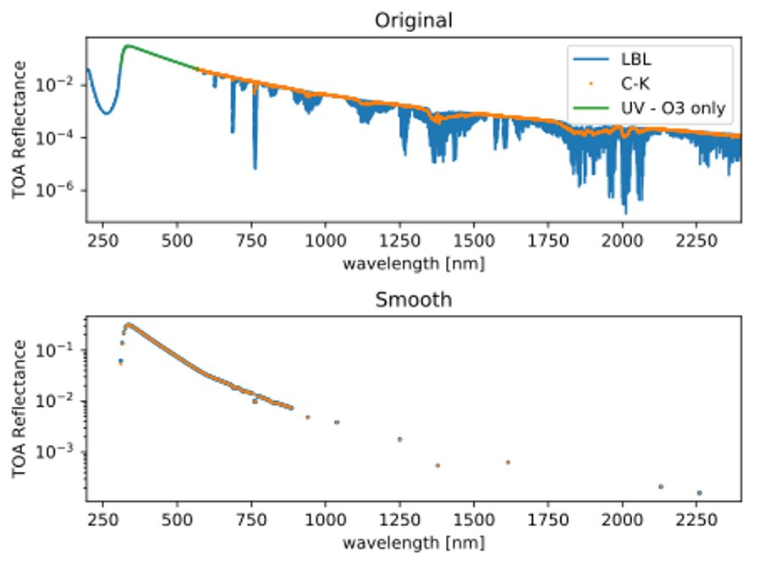
Details
Correlated-K approach > ~550 nm
  C-K coefficients developed from ATREM LBL absorption cross section
    HITRAN 2012
    CO₂, H₂O, CH₄, N₂O, O₂
    P, T: Standard atmosphere, 19 levels
O₃ from Pengwang Zhai 0.1 nm sampling of Serdyenko 2013 dataset
  Below ~550 nm, RSR weighted absorption cross section
  Above ~550 nm, interpolated to C-K bin center
CO, CO₂, O₃ and H₂O profiles from G5NR (dynamic)
  Resampled to P,T standard atomsphere levels
N₂O, O₂, CH₄ climatological constants
In total, ~1,000 spectral channels
  < 0.25% error compared to LBL

Slide 22
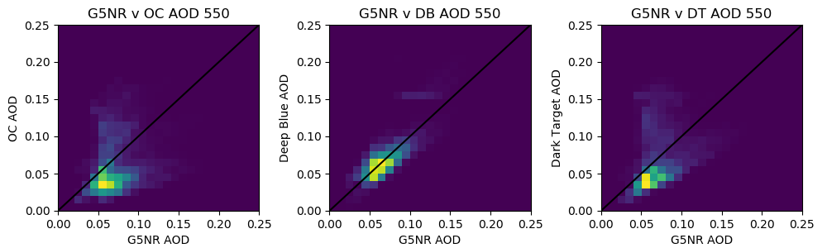
AOD Comparisons

Slide 23
More Details
Morel f/q factors applied to OASIM Rrs
Aerosol optical properties monochromatic at OCI band centers (<550 nm) or C-K bin centers (>550 nm)
ROD & depol ratio from Bryan Franz
  >550 nm
    https://oceancolor.gsfc.nasa.gov/fileshare/bryan_franz/bandpass/code/sources/hires/rayleigh_bodhaine.txt
  <550 nm
    https://oceancolor.gsfc.nasa.gov/fileshare/bryan_franz/bandpass/ocis.html

