Slide 1
Thermal Protection System
Development and Certification
Donald M. Curry
NASA Johnson Space Center
Tutorial on Ablative TPS
2nd International Planetary Probe Workshop
August 21-22, 2004

Slide 2
TPS Certification Approach
Certification of Thermal Protection System Has Historically Been Accomplished By Analysis Supported By Appropriate Ground Test Data
Analysis is Used as Flight Conditions Can Not Be Accurately Simulated on the Ground and It Is Not Feasible to Test for the Entire Spectrum of Flight Environments

Slide 3
Factors That Influence TPS Design
Maturity
Density
Aerothermal (Temperature)
Strength (Airloads/Vibroacoustic)
Outgassing
Oxidation Resistance
  Atomic
  Diatomic
Damage Tolerance/Impact Resistance
Repairability
Refurbishment
Long Term Space Exposure
Multi-use
Man-rated
Size Limits - Fabrication

Slide 4
COMPARISON OF SHUTTLE AND INTERPLANETARY TPS REQUIREMENTS
 | Shuttle | Lunar Return | Mars Entry/Return
PEAK CONVECTIVE HEATING (BTU/FT²-SEC) | 60 | 200 | 50 – 300
PEAK RADIANT HEATING (BTU/FT²-SEC) | <2 | 200 | 40-200
PEAK VELOCITY (KM/SEC) | 7 | 11 | 7-13
PEAK DYNAMIC PRESSURE (PSF) | 300 | 1000 | 250-1000
TURBULENT HEATING | YES | YES | YES
ENTRY HEATING TIME (SEC) | 1200 | <400 | <400
EXPOSURE TO ADVERSE ENVIRONMENTS - RAIN/WEATHER - AEROACOUSTICS (dB) - DEBRIS IMPACT - LAUNCH - ON-ORBIT/IN-FLIGHT | YES 160+ YES LESS | NO 146 NO MORE | NO 146 NO MORE

Slide 5
TPS Development Activities
Material Screening
  Used to select/evaluate materials and processes for further development
    Arc jet survivability tests
    Radiant heat thermal performance tests
    Room-temperature material characterization tests

Slide 6
Material Development/Selection
Environment Definition
  Induced
    Nominal
    Abort
  Natural
Material Characterization (Virgin/Char)
  Thermophysical Properties
    Density
    Thermal conductivity
    Specific heat
    Emittance
    Thermogravimetric test (Arrhenius constants)
    Pyrolysis gas specific heat/composition
    Heat of pyrolysis

Slide 7
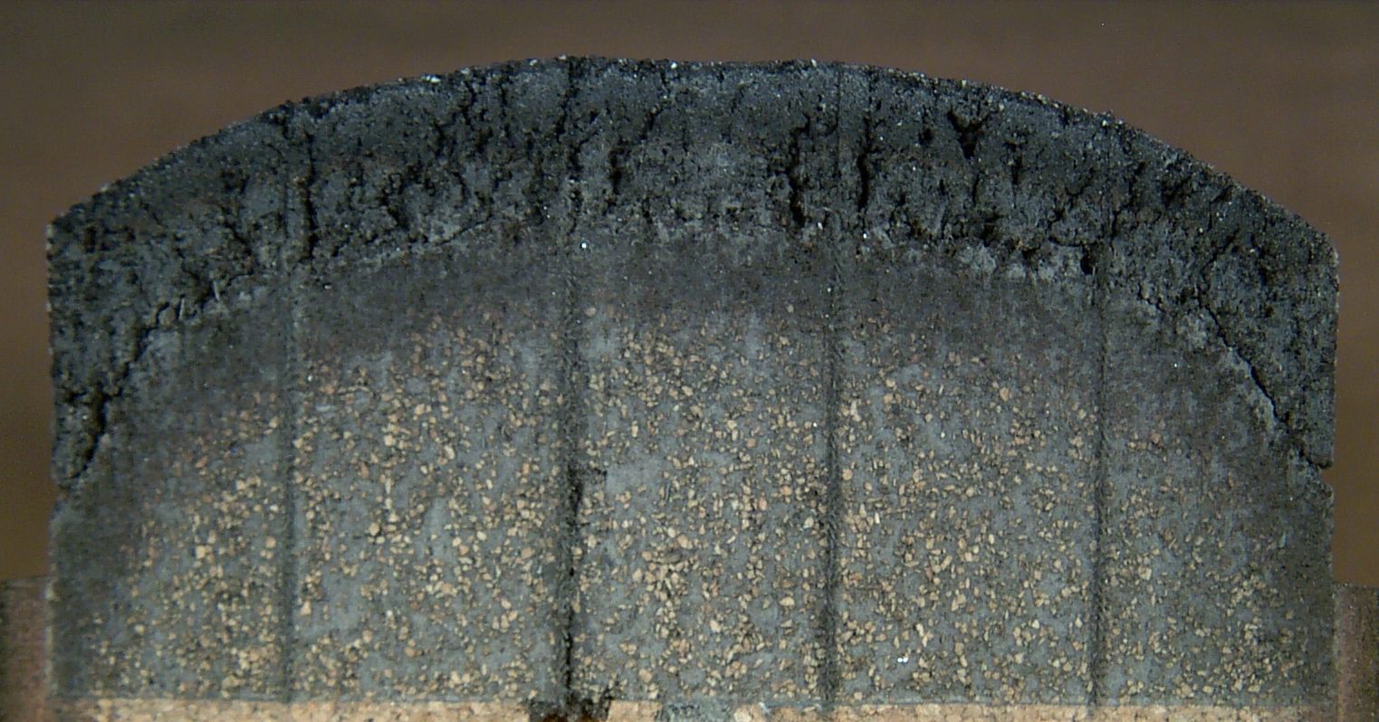
Typical Charring Ablator Cross-Section
Char Zone
Pyrolysis Zone
Virgin Zone

Slide 8
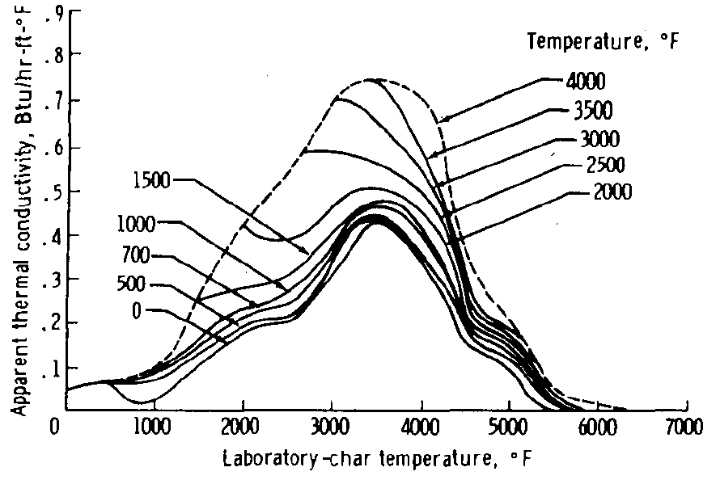
Char Thermal Conductivity

Slide 9
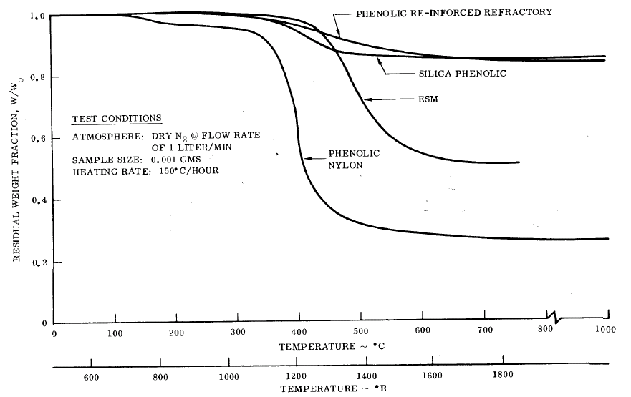
Thermogravimetric Results of Typical Ablators

Slide 10
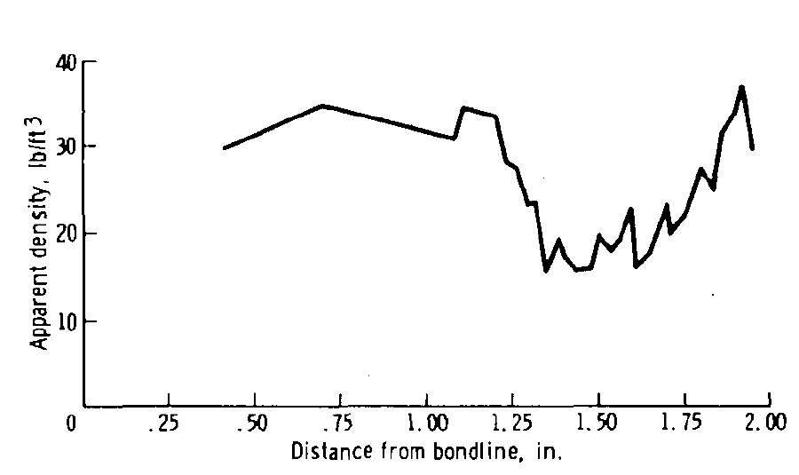
Char Densification - Deposition

Slide 11
Material Development/Selection
Mechanical Properties
  Tension
  Compression
  Flexure
  Shear
  Coefficient of thermal expansion
  Impact Resistance
Plasma Arc/Radiant Testing
  Surface Recession
    Oxidation
      Radiant
      Convective
    Mechanical
  Catalytic characteristics
  Material degradation
  Heat flux/temperature limits
  Pressure effects
  Nominal/Abort conditions
  Repairs

Slide 12
Material Development/Selection
Analytical Analyses
  Thermal/Structural
    Thermal response
    Thermal stress
    Airloads
  Degradation (oxidation)
  Mission Evaluation
    Nominal
    Abort

Slide 13
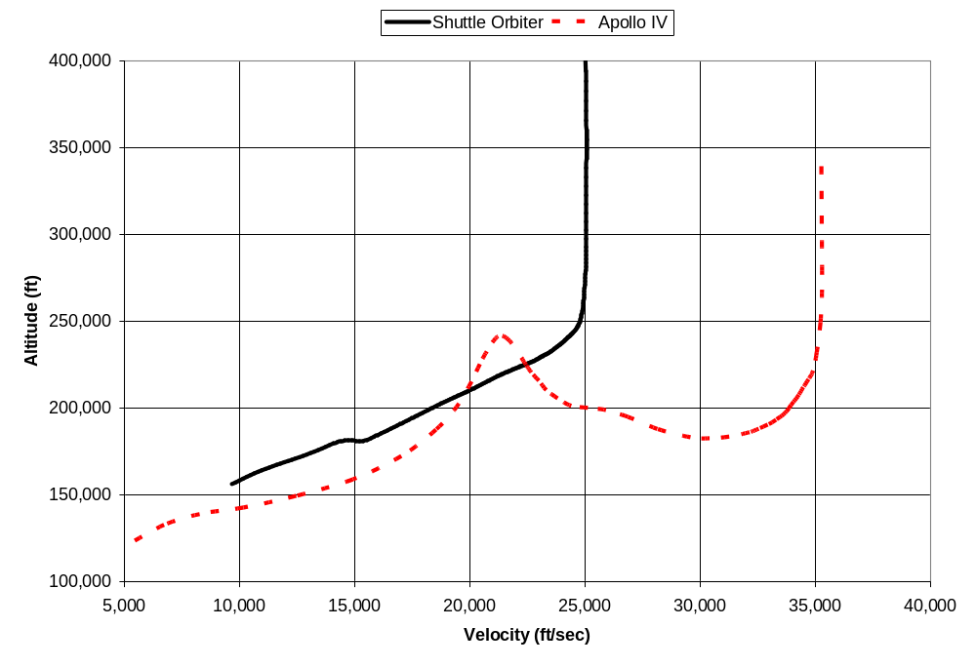
Reentry Trajectory Drives TPS Material Requirements
Lunar Return Velocity
35,000 fps (11 km/sec)
LEO Return Velocity
25,000 fps (7 km/sec)

Slide 14
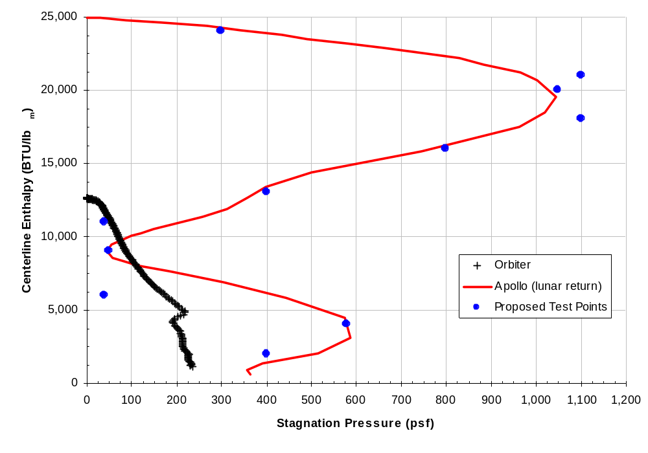
Entry Trajectory Enthalpy/Pressure Test Points

Slide 15
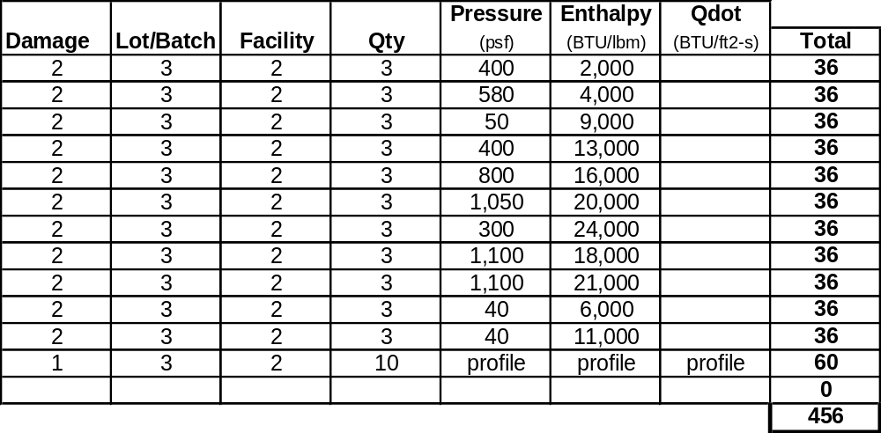
Ablator Arc Jet Test Matrix

Slide 16
Development Testing
Component level testing
  Thermal
  Structural
  Acoustic
Manufacturing processes
  Complex shapes
  Material system
  Repeatability
  Improved fabrication
Design/Installation
  Attachments
  Planform
  Close-out areas
Ground processing and repair
  Installation technique
  Field/factory repair
Non-destructive evaluation techniques
  On and off vehicle

Slide 17
Certification of TPS System
Scoping out the environment
  Temperatures – surface and structures
  Vibroacoustic/aeroshock
  Airloads
How the vehicle is designed
  Identify critical locations
    Temperature
    Loads
    Margins of safety
    Materials database
How the vehicle is built/assembled
  Critical processing parameters
  Inspection points/rigor
  Acceptance criteria
  Repairs/maintainability

Slide 18
TPS Environments for Certification
Natural Environments
  Temperature – atmospheric
  Thermal – vacuum
    Solar radiation – thermal
  Pressure
  Fungus
  Meteoroids
  Humidity
  Lightning
  Ozone
  Rain
  Salt spray
  Sand/dust
  Solar radiation – nuclear
  Wind
Induced Environments
  Temperature
    Ascent heating
    On-orbit and entry heating
  Pressure
  Acoustics
  Shock
  Random vibration
  Structural loads
    Limit and ultimate
  Acceleration
Miscellaneous Environments
  Life – full and limited
  Fluid compatibility

Slide 19
TPS Certification Process
Tests
  Thermal performance
  Aerodynamic flow
  Acoustic fatigue
  Strength integrity
  Material properties
Analysis
  Natural environments
  Induced environments
  Miscellaneous
Similarity
Commit-to-flight

Slide 20
Certification - Methods
Utilization of existing database
  Analytical methods
  Ground test results
  Flight tests
Ground-based testing TPS system concepts
  Ability to simulate environment
  Lack of correlation with actual flight environment
Analytical certification
  Verified models using available flight and ground test data
Flight test of entry system
  Forces disciplined design and fabrication
  Encourages acceptances of new (revolutionary) concepts
  Addresses complex problem of mutual interactions within system
  Acquires vital quantitative data not available through ground test

Slide 21
Certification – Some Key Issues
Design/Assembly
  Gap heating in joint regions between segments
  Seal performance at interfaces
  Prevention of hot gas/radiation leaks
  TPS penetrations
Materials
  Damage Tolerance/Impact Resistance
  Long term space exposure

Slide 22
Orbiter Reinforced Carbon-Carbon Certification Example

Slide 23
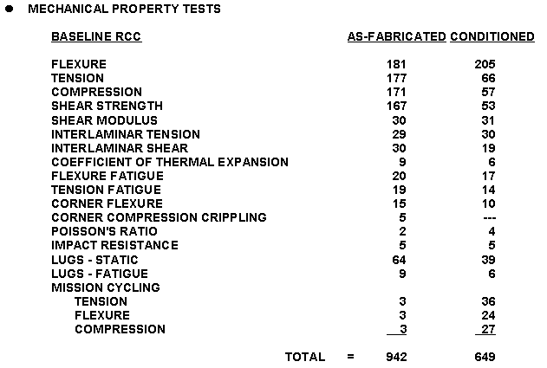
Design Allowable Tests

Slide 24
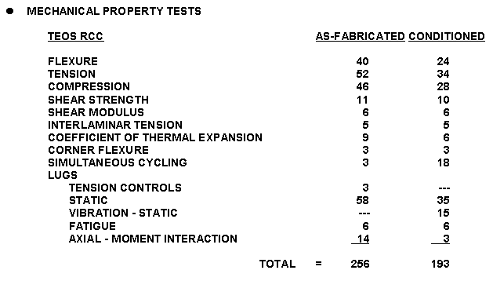
Design Allowable Tests

Slide 25
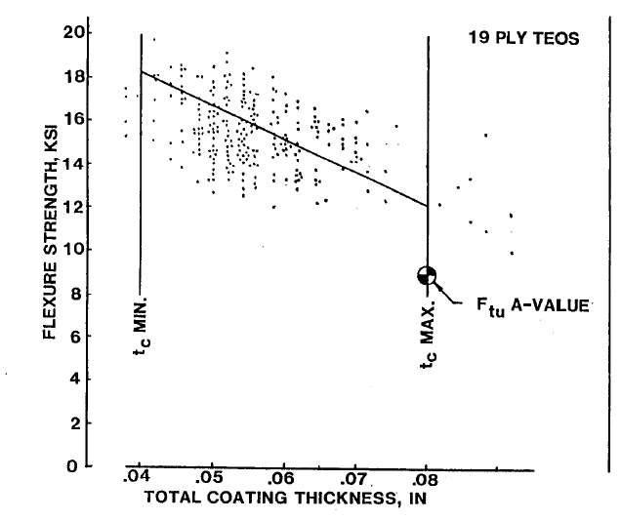
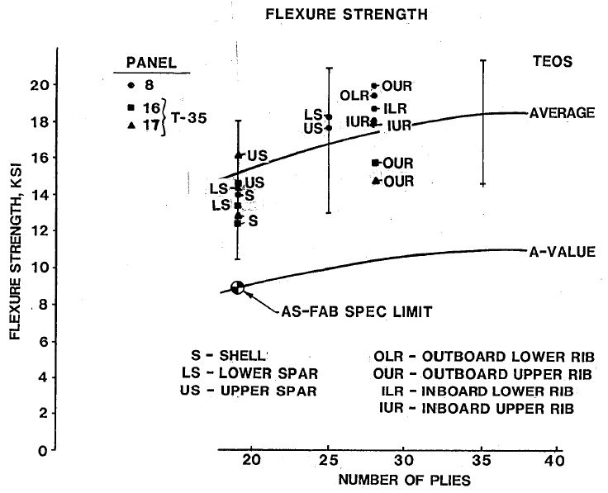
RCC Design Allowables
"A" basis RCC allowables are statistically calculated from mechanical test data per the general guidelines of MIL-HDBK-5B
  "A" strength allowables designate the 99% minimum strength with 95% confidence
  Over 2,000 specimens tested to define the mechanical properties used in design
  Testing done on baseline, TEOS and Type A RCC
  RCC design values included for as fabricated, mass loss and temperature effects

Slide 26
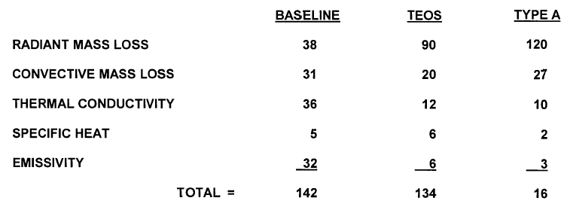
Material Thermophysical Property Tests

Slide 27
RCC/LESS Certification
Certification of RCC/LESS is accomplished by test verified analysis
Extensive test program used to verify analytical techniques
  RCC design allowables
    Mechanical properties
    Thermophysical properties
    Mass loss
Full scale hardware and integrated testing (Radiant Thermal, Airloads, Acoustics)
  RCC Shell Development Tests
  RCC/LESS System Qualification Tests

Slide 28
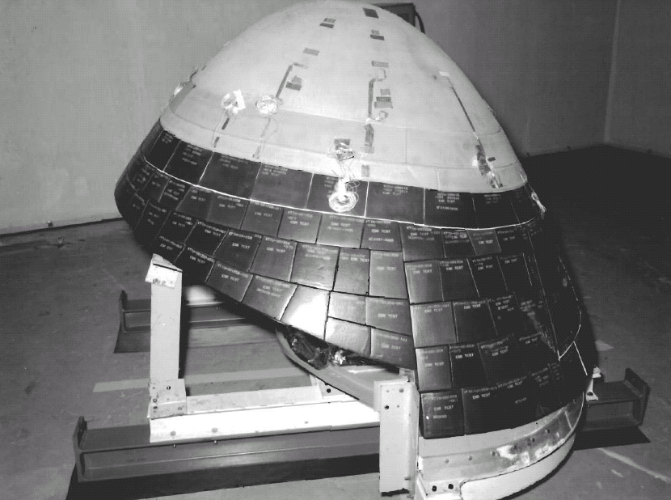
RCC Full Scale Nose Cap Test

Slide 29
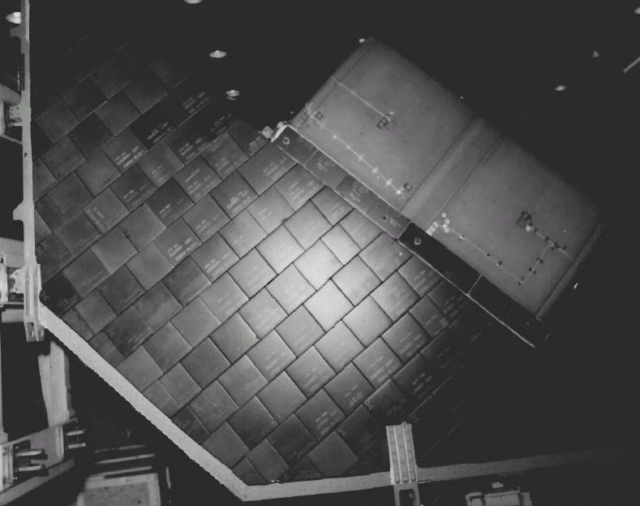
RCC Wing Leading Edge Full Scale Test

Slide 30
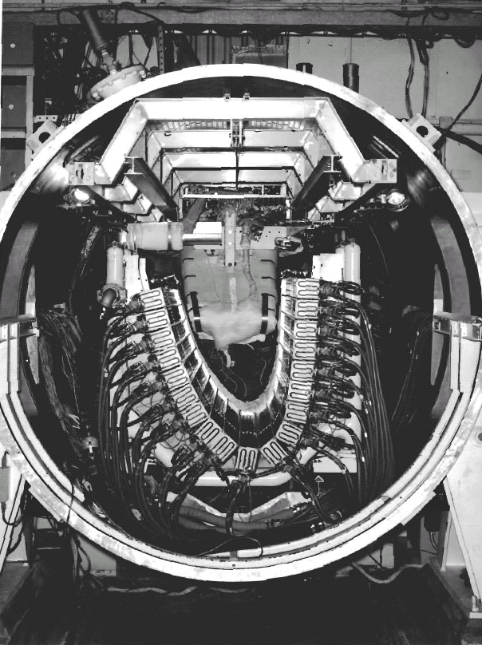
Full Scale Wing Leading Edge Heater Configuration

Slide 31
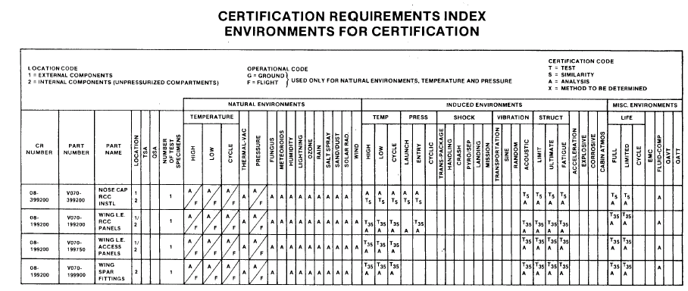
Orbiter RCC Certification Requirements

Slide 32
Summary
Significant advances have been made in the design, fabrication, certification and flight tests of entry systems (Mercury through Shuttle Orbiter)
Shuttle experience has identified some key design and operational issues
Attention to vehicle design, fabrication, and assembly

