Slide 1


CERES Data Management Team Working Group Report
Katie Dejwakh
Fall CERES Science Team Meeting
October 12, 2021

Slide 2
Outline
DMT Overview
Product Availability
Code Re-architecture
Systems & CM
DMT Activities

Slide 3
DMT Overview

Slide 4
Data Management Team (DMT)
Science research
DMT /
ASDC
User community

Slide 5
Data Management Team (DMT)
Science research
DMT /
ASDC
User community
Katie Dejwakh (NASA)
Walt Miller (SSAI)

Slide 6
Data Management Team (DMT)
Instrument
Denise Cooper
Thomas Grepiotis
Hunter Winecoff

Slide 7
Data Management Team (DMT)
Instrument
ERBE-like
Dale Walikainen
Jeremie Lande

Slide 8
Data Management Team (DMT)
Instrument
Clouds
ERBE-like
Sunny Sun-Mack
Ricky Brown
Steve Kohler
Yan Chen
Elizabeth Heckert
Rita Smith

Slide 9
Data Management Team (DMT)
Instrument
Clouds
Inversion
ERBE-like
Victor Sothcott
Igor Antropov

Slide 10
Data Management Team (DMT)
Instrument
Clouds
Inversion
SARB
ERBE-like
Tom Caldwell

Slide 11
Data Management Team (DMT)
Instrument
Clouds
Inversion
SARB
TISA
ERBE-like
Josh Wilkins
Cathy Nguyen
Ed Kizer
Beau Branch

Slide 12
Data Management Team (DMT)
Instrument
Clouds
Inversion
SARB
TISA
ERBE-like
FLASHFlux
PC Sawaengphokhai
Jay Garg
Hunter Winecoff

Slide 13
Data Management Team (DMT)
Instrument
Clouds
Inversion
SARB
TISA
ERBE-like
Systems
& CM
FLASHFlux
Nelson Hillyer
Tammy Ayers
Dennis Keyes
Joanne Saunders

Slide 14
DMT Continued / DMT Adjacent
PR Tool
Carla Grune
Elizabeth Heckert

Slide 15
DMT Continued / DMT Adjacent
PR Tool
Ordering Tool
Pamela Mlynczak
Churngwei Chu
Babak Samani

Slide 16
Product Availability

Slide 17
Edition 4 Terra & Aqua
Product | Platform | Processed Thru | Publicly Available?
BDS | Terra, Aqua | July ‘21 | Yes
SSF
SSF1deg-Hour
SSF1deg-Day/-Month
SYN1deg-1Hour/MHour | Terra+Aqua | June ‘21 watch for GGEO
SYN1deg-Day/-Month

Slide 18
Edition 4 Terra & Aqua
Product | Platform | Processed Thru | Publicly Available?
CldTypHist | Terra+Aqua | March ‘21 | Yes
FluxByCldTyp |  | July ‘21
EBAF |  | June ‘21
EBAF ToA |  | July ‘21
Notes:
GEO Clouds for July moving to DPO → CldTypHist would update through to July. Josh needs to approve PRs. May run DURING STM.
GEO clouds for CldTypHist are optional. CldTypHist is low-demand, so they haven’t run it yet. Tend to wait til everything’s there before they run it on the three-four month timeframe. i.e. Jan.-Mar.

Slide 19
Edition 1 S-NPP
Product | Platform | Processed Thru | Publicly Available?
BDS | S-NPP | July ‘21 | Yes
SSF
SSF1deg-Hour |  | Sep. ’19*
SSF1deg-Day/-Month
SYN1deg-Hour/MHour | Terra+S-NPP | Nov. ’17*
SYN1deg-Day/-Month
* L3 processing paused. Instrument in RAPS mode.

Slide 20
Edition 2 S-NPP
Product | Platform | Processed Thru | Publicly Available?
BDS | S-NPP | July ‘21 | No (early Dec.)
SSF |  | Dec. ‘12
SSF1deg-Hour |  | n/a
SSF1deg-Day/-Month |  | n/a
Notes:
Will run SSF1deg’s soon after we finish running SSFs. Didn’t want to pull old runs right now due to STM, therefore, haven’t kicked off any.

Slide 21
Edition 1B NOAA-20
Product | Platform | Processed Thru | Publicly Available?
BDS | NOAA-20 | July ‘21 | No (early Dec.)
SSF |  | n/a
SSF1deg-Hour |  | n/a
SSF1deg-Day/-Month |  | n/a
SYN1deg-Hour/MHour | NOAA-20 | n/a | Mid ’22
SYN1deg-Day/-Month |  | n/a

Slide 22
Forthcoming Data Product Editions
Edition 2A S-NPP
  Reprocessed first two years: 2012-2014
  Pace of C2 VIIRS data receipt driving schedule
  No L3 products from 9/2019 onward,
  while S-NPP in biaxial mode
  Available by Fall 2021
Edition 1B NOAA-20
  Improved Clouds!
  Will use Version 1.1 or 1.2 CrIS Fusion data for water vapor info.
  Available by Fall 2021
Notes:
Ed 2 S-NPP: Need CrIS Fustion data; assuming our test data is good enough that production can start immediately, will take two months of just Clouds processing. Gains and SRFs have been delivered through January 2021.
Ed 1 NOAA-20: Record starts from May 2018. Gains and SRFs have been delivered through March 2021.

Slide 23
DMT Activities

Slide 24
Deliveries Overview
  64 deliveries to configuration management team
  CATALYST:
    Close/re-open database connection – clear logs
    Accommodating FLASHFlux MOA, FSNRAD data
  Inversion: netCDF-4 SSF product
  FLASHFlux:
    MOA
    Clouds
  Clouds: Incorporating FSNRAD data
Notes:
Makes I/O a lot more robust.

Slide 25
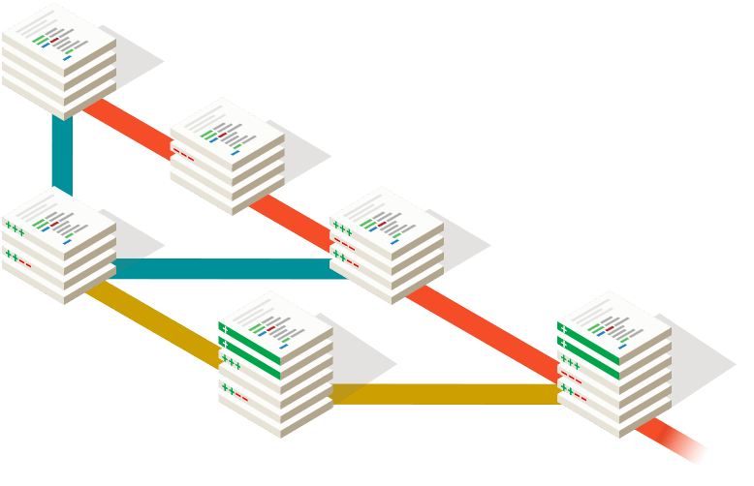


CERES WG Website Redesign
Before
Now
CERES
Dev
Test
Prod
CERES
Erbe-Web
Clouds
SARB …
Maintenance
Code update
Dev
Test
Prod
Maintenance
Erbe-Web
Dev
Test
Prod
Code update
Clouds
Dev
Test
Prod
…
Notes:
Before:
- All CERES WG code was on one repository and whenever there was a code update for any part of that, the whole website should put on halt for that update.
Now:
- Since every part is running on a separate pod with distinct repository then if there is a code update for any part, in this case the “Clouds” part of the “CERES WG”, the other parts of the CERES WG website don’t need to be on hold for that update.

Slide 26




CERES WG Website Redesign
Before
Now
CERES
Dev
Test
Prod
CERES
Erbe-Web
Clouds
SARB …
Maintenance
Code update
Dev
Test
Prod
Maintenance
Erbe-Web
Dev
Test
Prod
Code update
Clouds
Dev
Test
Prod
…
CERES
Dev
Test
Prod
CERES
Erbe-Web
Clouds
SARB …
Unique Technology Stacks
Dev
Test
Prod
Unique Technology Stacks
Erbe-Web
Dev
Test
Prod
…
FLASHFlux
FLASHFlux
Dev
Test
Prod
Notes:
Before:
- Using unique technology stacks for back-end and front-end was difficult. Also, adding a new part with different programming language and framework to whole system was a quite big challenge, in this case adding Flush Flux website to CERES WG websites with Python programming language.
Now:
- Using unique technology stacks for both back-end and front-end is easy and convenient without making bugs for other parts. In addition, adding a new part to CERES WG is very easy with no interruption for other working containers.

Slide 27





CERES WG Website Redesign
Before
Now
CERES
Dev
Test
Prod
CERES
Erbe-Web
Clouds
SARB …
Maintenance
Code update
Dev
Test
Prod
Maintenance
Erbe-Web
Dev
Test
Prod
Code update
Clouds
Dev
Test
Prod
…
CERES
Dev
Test
Prod
CERES
Erbe-Web
Clouds
SARB …
Unique Technology Stacks
Dev
Test
Prod
Unique Technology Stacks
Erbe-Web
Dev
Test
Prod
…
FLASHFlux
FLASHFlux
Dev
Test
Prod
Security scan
CERES
Erbe-Web
Clouds
SARB …
CERES
Dev
Test
Prod
Security scan/issue
Dev
Test
Prod
Security scan/issue
Security scan
Erbe-Web
Dev
Test
Prod
Security scan
Security scan
Clouds
Dev
Test
Prod
…
Notes:
Before:
- If there was an issue on any part of the code which would not satisfy the security scan then the whole websites should be on hold until that particular issue was resolved.
Now:
- Since each part of the CERES WG is running on a separate container, If there is an issue on any part of the website which does not satisfy the security scan then only the container for that part can be turned off without interrupting other parts until that issue is resolved.

Slide 28
Code Re-architecture

Slide 29
Code
re-architecture
Object-Oriented-"like” Interpolation & Averaging
Fortran
Object-Oriented Gridding
C++
Gridding containers, zones, regions
Property containers
TISA Code
JSON property configuration files

Slide 30
TISA Code – C++ Gridding
  JSON configuration extended:
  accept known property format → translate for TISA
  Cloud_Optical_Depth_Log" : {​​​​​​​
  "alternate_name" : "Cloud_Optical_Depth",
  "alternate_property" : "Cloud_Optical_Depth_Exp”
  }​​​​​​​,
  I/O library – handle GEOstationary satellites
  GEO-cloud-specific algorithm implementations:
  GEO → GGEO output
Notes:
Makes I/O a lot more robust.

Slide 31
TISA Code – C++ Gridding
  Modular C++ code easily enabled extension to GEOs
  Product-specific driver routines leverage library calls
Genericized reader
Product-specific pipeline
Gridding routines
Output for interpolation

Slide 32
TISA Code – Fortran Interpolation & Avg.
New cloud properties infrastructure:
  JSON configuration file – Edition 4 vs. 5 processing
  Unified “container” (Modern Fortran data structure)
    Possible inputs:
      netCDF4 hourly cloud properties (MODIS or GEO)
      HDF4 (legacy) hourly cloud layer properties
      1°x 1° hourly obs., binned, SSF zonal data
    Output: daily, monthly-hourly, monthly averaged
Notes:
Working on validating ALL cloud property results – only cloud fraction validated so far. Cloud fraction netCDF compares well. Against Ed 4.
Driven by JSON config. file – intricacies of averaging methods (Ed 4, first day of the month used last day of previous month, but last day didn’t use next day.) Ed 5 uses last day of prior month and first day of next month to do interpolation.
Many changes can be made in JSON config file. Specify algorithms.

Slide 33
TISA Code – LW Flux Computation
Longwave (LW) look-up table (LUT)
  Basis for LW flux computation
  Narrowband-to-broadband coefficients → fluxes
  netCDF4- API to read
solar zenith angles
Surface types
…
Coefficients
netCDF-4
LW_nb2bb_lut: (3 coeff, 7 surf. types, 2 SZA, 16 VZA, 4 PW, 6 radiance)
Notes:
Was ASCII. Standardized.
Typically 1D interpolating VZA, PW, or radiance.

Slide 34
TISA Code – SW Flux Computation
Shortwave (SW) look-up table
  Basis for SW flux computation
  Narrowband-to-broadband coefficients → fluxes
  netCDF-4 library to read TRMM ADM coefficients
Wind speed
Land clear
…
Ocean cloudy
netCDF-4
Notes:
In the works. Will handle like LW.
Was one, massive binary file.
Surface types + wind speed.

Slide 35
TISA Code
  Remaining Fortran:
    De-duplicated subroutines
    Removed unused:
      Variables
      Functions
      Files
  Decreased stove-piping
  Increased institutional knowledge sharing
Over 20% code reduction!

Slide 36


Clouds Code
  Current code containerized
  CI/CD pipeline incorporated
Code
Libraries
Jenkins

Slide 37
Clouds Code
  Team working in parallel
  Gradual, ”swap-in” approach
  Started with cloud mask:
    de-duplicated, removed code (retired sensor I/O)
    “growing” C++ outwards

Slide 38
Clouds Code – Cloud Mask Unit Testing
Cloud
mask.c
  Global variables
  Pass by reference, pointers

Slide 39
Clouds Code – Cloud Mask Unit Testing
  Create expected results from existing code run
  De-couple CERESmask.c, execute standalone
  Input: static test data files
  Compare to expected

Slide 40
Clouds Code – Cloud Mask Unit Testing
  De-coupling the code:
    Shorter, targeted test runs
    Easier to troubleshoot anomalies
    Easier to incorporate debuggers (GDB), CI/CD tool (Jenkins)
  Standalone test data & creation thereof:
    Keep test data in version control
    Generate test data wherever needed

Slide 41
Systems & CM

Slide 42
CATALYST
  Accommodating new subsystem: FLASHFlux
  Database connection improved

Slide 43
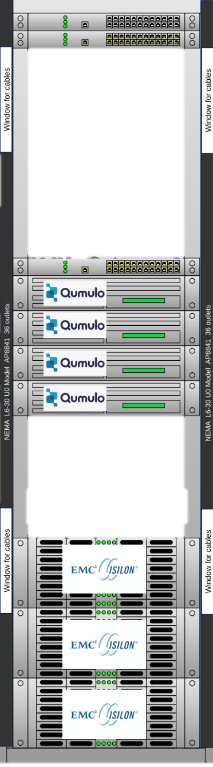
Systems
ANGe configuration for CrIS Fusion – V2
1.5 PB HPE Scale-Out NAS storage w/ Qumulo
and
1.5 PB Spectra-Scale tape library:
  Enable low-latency data for research
  De-couple project and DAAC hardware
  Efficient data back-up

Slide 44
Summary
Code and infrastructure modernization continue
Fall 2021 release:
  Ed1B NOAA-20
  Ed2A NPP

