Slide 1
LUNAR SURFACE CONCEPT OF OPERATIONS FOR THE GLOBAL EXPLORATION ROADMAP LUNAR SURFACE EXPLORATION SCENARIO
Presenter: Mr. Markus Landgraf, ESA, markus.landgraf@esa.int
Ms. Jennifer Reynolds, ESA, Jennifer.reynolds@esa.int
Mr. Naoki Sato, JAXA, satoh.naoki1@jaxa.jp
Mrs. Kandyce Goodliff, NASA, kandyce.e.goodliff@nasa.gov
Mr. Clark Esty, NASA, charles.c.esty@nasa.gov
Mr. Martin Picard, CSA, martin.picard@asc-csa.gc.ca
72nd International Astronautical Conference – October 27, 2021
72nd International Astronautical Congress, Dubai, United Arab Emirates. Copyright ©2020 by the National Aeronautics and Space Administration in all jurisdictions outside the United States of America. Published by the International Astronautical Federation (IAF), with permission and released to the IAF to publish in all forms.

Slide 2
Introduction
ISECG published an Updated GER Supplement on August 28th, 2020
  Lunar Surface Exploration Scenario Update
Updated scenario describes a phased approach to exploration of the Moon
  Phase 1 – Boots on the Moon
  Phase 2 – Lunar Exploration – Expanding and Building
  Phase 3 – Sustained Lunar Opportunities
Since publication, the ISECG IAWG has explored several concepts of operations
that could be implemented for this
updated scenario
  Driven by ISECG Lunar Surface Exploration Objectives
https://www.globalspaceexploration.org/wp-content/uploads/2020/08/GER_2020_supplement.pdf
ISECG – International Space Exploration Coordination Group – https://www.globalspaceexploration.org/
IAWG – ISECG’s International Architectures Working Group

Slide 3







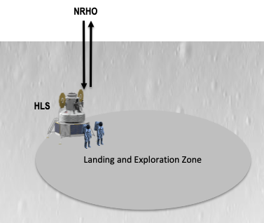
Mission Scenario and ConOps for Phase 1
Mission Sequence
KPLO
Luna 26
Gateway
Lunar Orbit
CLPS
CLPS
Chang’E-5
Chandrayaan 3
Luna 25
SLIM
CLPS
Chang’E-6
VIPER
LUPEX
Human Landing System
Unpressurized Rover
Cargo Lander
Lunar Surface
Science Payloads
Astronauts & EVA Suits
ISRU Phase 1: Prospecting & Demonstration In Lunar Environment
2020
2021
2022
2023
2024
Small cargo lander: Science equipment
Small cargo lander:
Science equipment
Small cargo lander:
Science equipment
Small cargo lander: Scientific mobility
Return to the Moon:
Two crew land – 6.5 day surface duration
South Pole Region
Phase 1 consists of a combination of human and robotic missions
Concept of operations based on NASA’s plans to land humans on the Moon
  Note that the exact concept of operations to prepare for the surface mission is yet to be finalized.

Slide 4
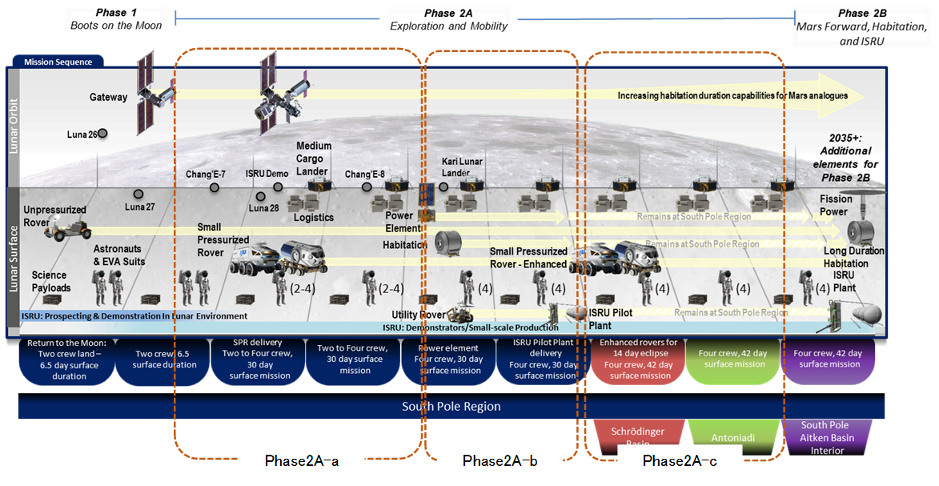
Mission Scenario for Phase 2
Phase 2 divided into four sub-phases
  Mission 2A-a: One Pressurized Rover at the South Pole
  Mission 2A-b: One Pressurized Rover & Fixed Surface Habitat at the South Pole
  Mission 2A-c: Two Pressurized Rovers at the South Pole for the first mission & off the pole for the following missions
  Mission 2A-d: Uncrewed Mission (not shown in chart)

Slide 5
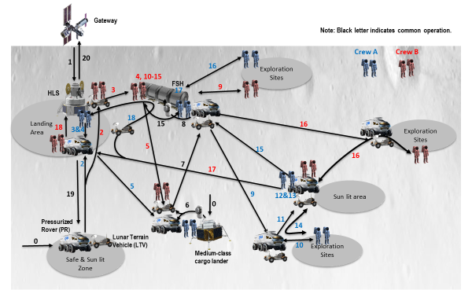
Phase 2A Concept of Operations
Process:
  Defined operational approach trade space, pros and cons, and selected current approach
  Set Ground Rules and Assumptions for each sub-phase
  Drafted concept of operations based on operational approach and GR&As
  Identified contingency cases
Representative conops for Phase 2A-a

Slide 6
Summary
Completion of conops for Phases 1 and 2A resulted in definition of functions and interface functions
Findings included additional functions needed to support contingency operations and benefit of global navigation system around the Moon
Forward work to continue refinement of the Phase 2A conops, contingency case identification, and initiate work on Phase 2B conops

Slide 7
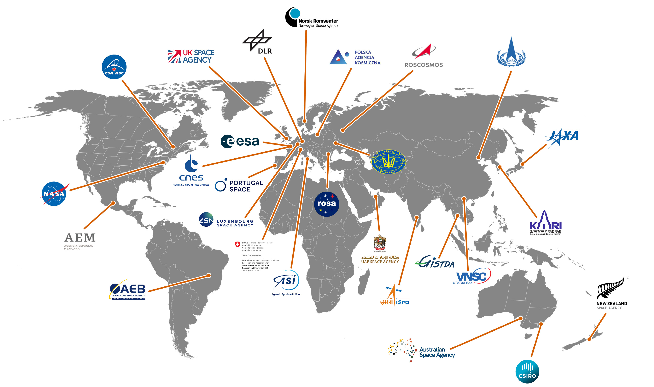
ISECG Agencies

