Slide 1
Imagery Systems for Lunar Exploration
Part 1 – Down Selecting an Imagery System
The Science and the requirements

Slide 2
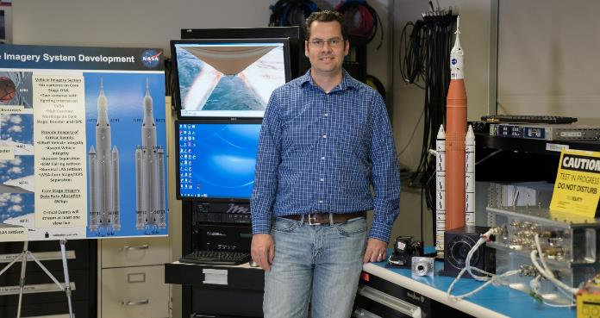
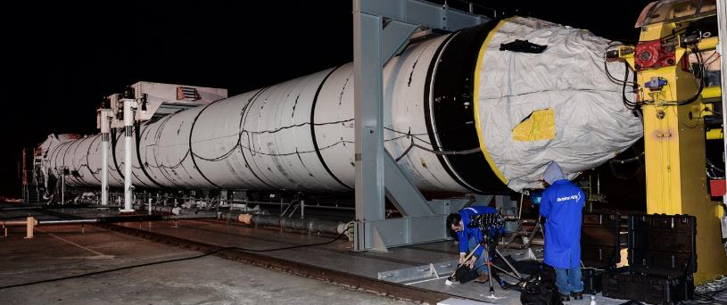

Jeremy Myers (NASA - MSFC)
Masters of Science in Mechanical Engineering - University of Tennessee (2001)
  Focus on Machine Design
  Minored in Education, Physics, Math
NASA – Marshall Space Flight Center (2001)
  20 years at NASA
  17 year career developing Launch Vehicle Camera Systems monitoring System Health
Graduate from ISU Interactive Space Program 2020 (ISP20)

Slide 3
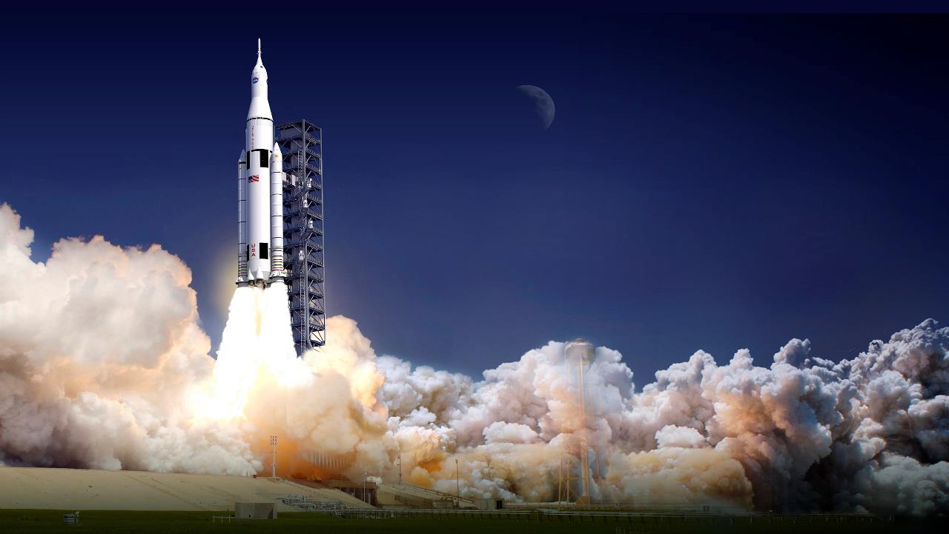
A History of Launch Vehicle Imagery Systems at NASA

Slide 4
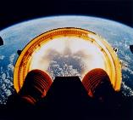
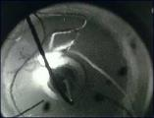
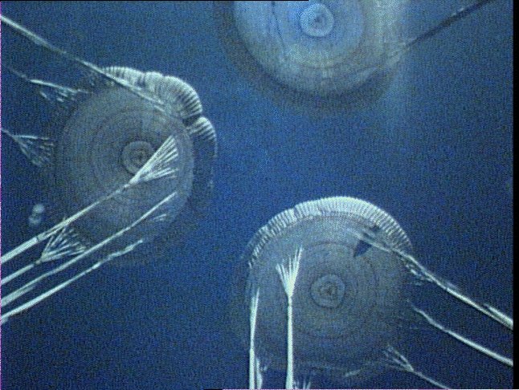
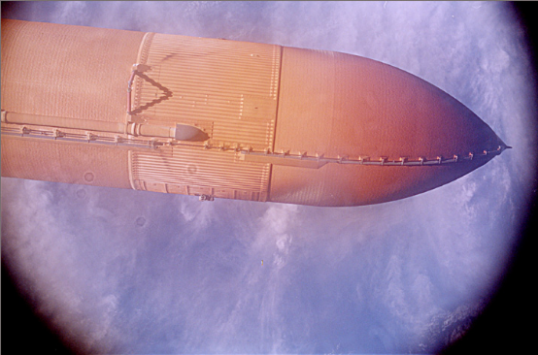
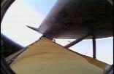
Overview
A Picture Is Worth a Thousand Sensors and a Video is Worth a Thousand Pictures.
Importance of Imagery in the History of NASA
Ground Based Imagery and its Limitations
Onboard Imagery Systems in the History of NASA
  Apollo Program
  Shuttle Program
    Pre and Post Columbia Accident Onboard Assets
  Ares I-X Program
  SLS Program
Challenges to Developing Imagery Systems
Requirement Development

Slide 5
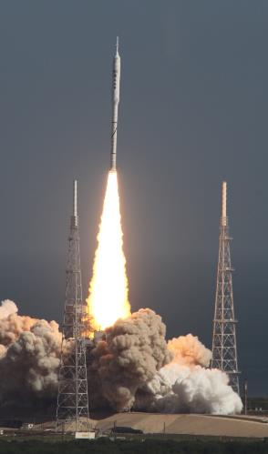
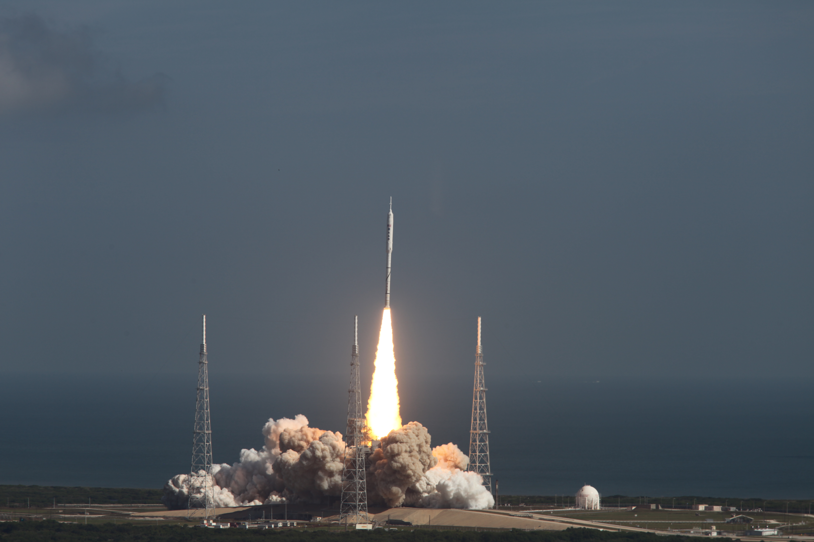
Use of Imagery at NASA
Engineering: In many cases, imagery is the only source of vital engineering data for assessing vehicle performance or anomalies. A key to root cause analysis in every NASA disaster has been imagery.
Situational Awareness: Imagery is used by Astronauts for real time onboard solutions (e.g., procedure troubleshooting, stowage questions, etc.).
Safety: Many crew medical and vehicle contingency scenarios require imagery to efficiently communicate.
Public Outreach: Public and congressional support – the vast majority of which is achieved with imagery – funds our program. NASA must protect its image for high tech innovation and be a good steward of public funding.

Slide 6
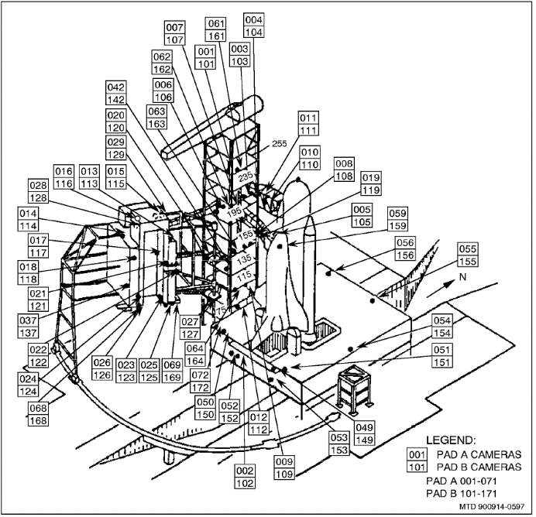
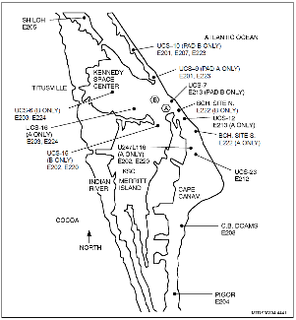
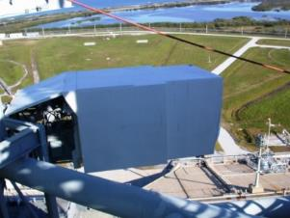
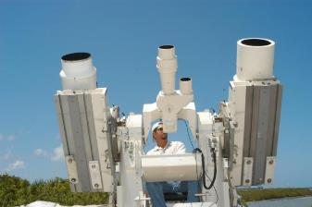
Ground Based Imagery at NASA
Multiple views provide variable coverage for a very dynamic event
  Large FOV for contingency analysis
NASA has invested in infrastructure to support analysis from ground cameras.
  Shuttle Program:
    Conversion to HD digital for quick look after Columbia accident
    Film is overnighted for development and then digitized
    Three NASA field centers, MSFC, KSC, JSC are all tied together with high speed intranet and mirrored servers
  SLS
    Complete conversion to digital (High Speed, HD, 4K)
Technology is always improving leading to the desire for improved assets.

Slide 7
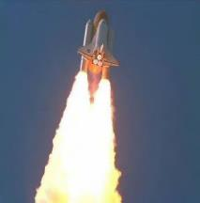
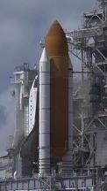
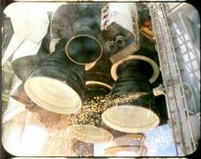
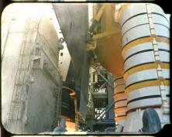
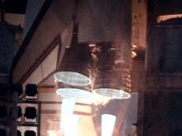
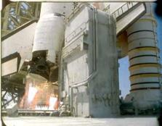
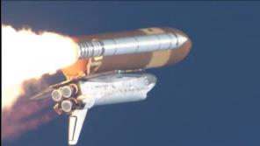
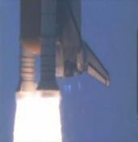
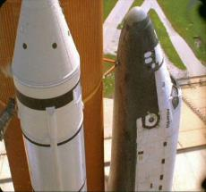
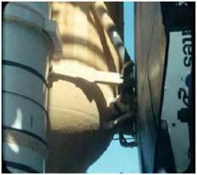
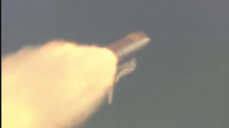
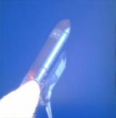
Samples of Tracking and Fixed Cameras
Tracking Cameras
Fixed Cameras
Short
Range
Mid
Range
Long
Range

Slide 8
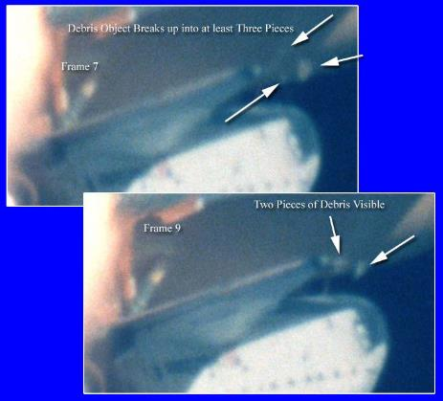
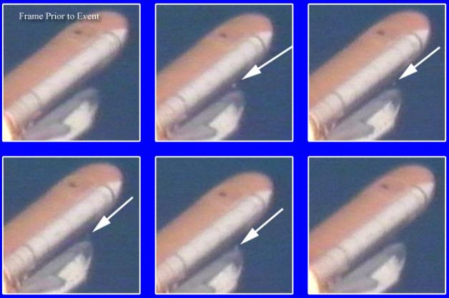
Columbia Accident Impact
Led modeling team to combine imagery and CAD models in the Columbia Investigation (2003)
Columbia Accident showed limitations of ground based imagery at altitude. It also showed the challenge of Standard Speed Video. (14 Frames of Video)
Investigation Board (CAIB) concluded there was a need for onboard high resolution cameras that monitor potential hazard areas.

Slide 9
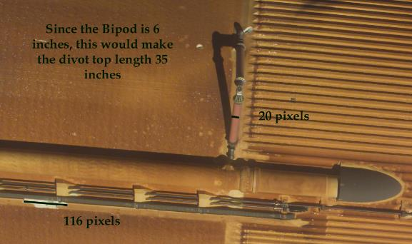
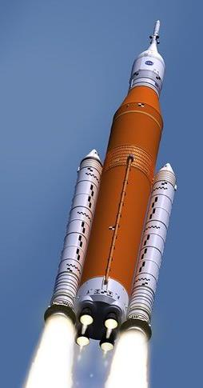
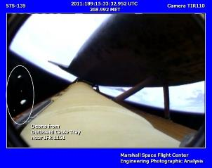
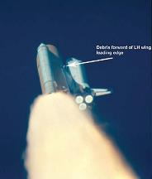
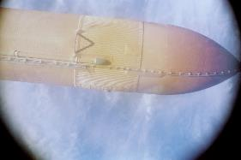

Example – Return to Flight
Image J for Measurements

Slide 10
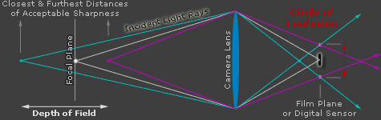
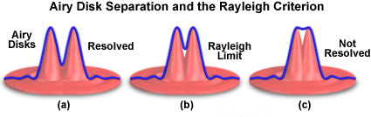
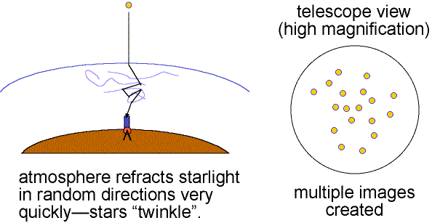
Challenges to Ground Based Imagery
Four Main Factors which limit resolution for ground cameras
      Pixel Size – size of photon receptor on sensor
      Circle of Confusion – Lack of perfect focus (small object far away) Depth of Field
      Airy Disk Limit – Caused by light diffraction. Limit of resolving a point source. (At altitude shuttle becomes like a point source)
      Atmosphere Impact – Atmospheric Turbulence, Clouds, Fog, Humidity

Slide 11
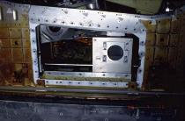

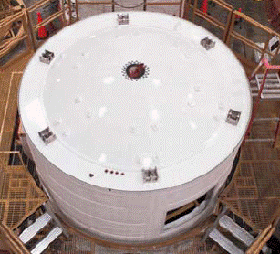
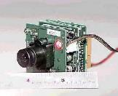
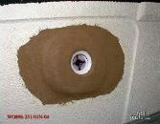
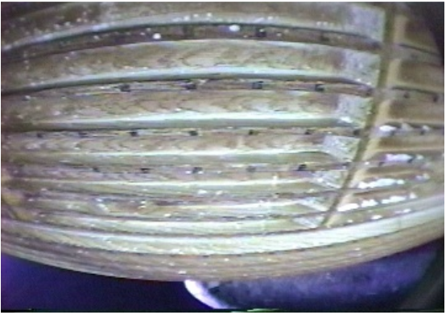
Onboard Cameras of the Shuttle Program
Original Shuttle Program Onboard Imagery was only to understand dynamics of Tank and Parachutes.
  Umbilical Well Camera Took Film DSLR Images of External Tank as it fell away.
  Film Cameras at 400 fps operated to watch parachutes deploy
External Tank (ET) Observation camera added later to understand “popcorn effect” on External Tank
  Design used a standard tape recorder connected to NTSC cameras to switch between parachute and ET Observation Video
Umbilical Well Camera
Parachute Camera
ET Observation Camera

Slide 12
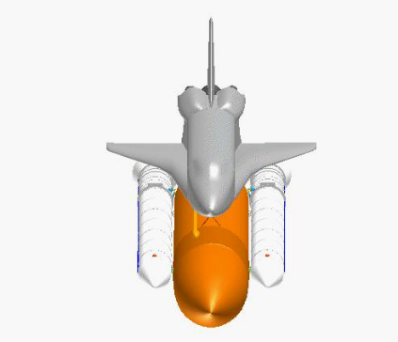
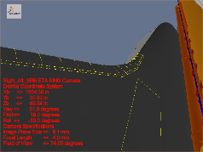
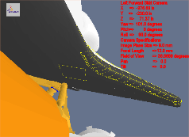

ELVIS Camera System
  Member of Enhanced Launch Vehicle Imagery System (ELVIS) design Team. (2005)
  Enhanced Launch Vehicle Imaging System (ELVIS) was the programs answer to the CAIB Report. Vehicle Based Upgrades:
  Provided real time downlink from a camera on External Tank (ET)
  Provided 2 new cameras on each Solid Rocket Booster which looked at overall vehicle health. Particularly Shuttle wing leading edge.
  Upgraded Umbilical Well Camera to be digital images which could be down linked. This allows near real time monitor of ET health.

Slide 13
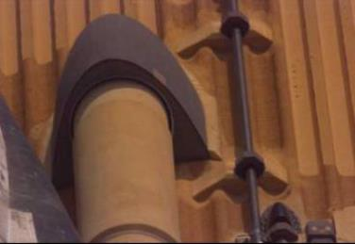
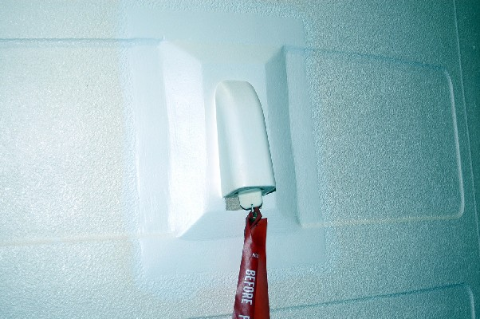
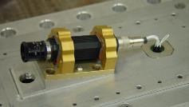
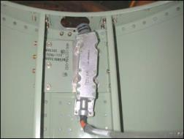
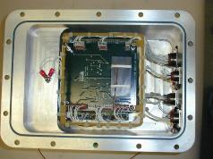
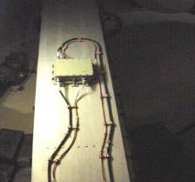



ELVIS Camera Hardware
Mounting Location
Forward Skirt
Camera
Camera
Onboard
Recorder
Encoder
ETA Ring Camera
Antenna
ET CAMERA
SRB CAMERA

Slide 14





Ares I-X High Speed Parchute Camera
Developed High Speed Parachute Camera (HSPC) which captured the parachute failure on Ares I-X flight (2009)
Bulkhead Camera Housing installed in Bulkhead
6) Internal Battery
1) Test Connector/
Shorting Plug for Flight
2) G-switch
3) Photo Cell
HSPC installed in Bulkhead Camera Housing
5) Case
HSPC installed in Bulkhead Camera Housing
HSPC
Bulkhead Camera Housing is N2 Purged
8) Lens
7) Camera
4) Dampener
9) Micro-Controller

Slide 15





SLS Onboard Imagery System
Fabrication and Quality Assurance Support
Avionics Team
Lighted Camera Assembly
Lighted Camera Assembly
Camera Control Unit
Enhanced Lighted Camera Assembly
Lead teams developing Imaging Systems for Space Launch System Flight Imaging Launch Monitoring Real Time System (FILMRS) (2013) & Enhanced FILMRS (EFILMRS) (2018)
National Aeronautics and Space Administration
6 X Camera Assemblies

Slide 16
Challenge of Crit 3 Modified COTS Design
  Challenge of Imagery Systems at the Program Level
  “I own a camera so I understand Imagery Requirements”
    Oversimplification leads to systems that meet no ones needs.
    True specifications and requirements extend beyond common knowledge
    Not all COTS meet program needs
    Spec Sheets are sales pitches
    Rugged for commercial systems is not rugged for space systems
  “You don’t need imagery to fly a rocket”
    The CAIB report mandated that onboard imagery be a part of future programs
    As a public agency it is imagery which often engages the public and lawmakers.
  Challenge of Requirement Development for Modified COTS
    Imagery state of the art is often changing. Improvements in technology often go beyond nice to have as they better fit program needs
      Bandwidth improvements lead to program reductions in cost
      Imagery improvements lead to better engineering data
      Public expects imagery to meet what they view as the current technology
    The capability of COTS to meet environments with customization is often a limit to their use in space flight
    The above items lead to an ebb and flow between hardware availability and program requirements.

Slide 17
Challenge of Crit 3 Modified COTS Design
  Challenge of Low Cost Crit 3 Imagery System Contracts
  Contracts do not work well with the ebb and flow of modified COTS requirements development
    Often the contractual cycle time to support this ebb and flow will not allow the use of COTS
  The amount of requirements to ensure a contract meets the intent of the program needs often leads to cost equivalent to a Crit 1 system
  The intent of do no harm while meeting program needs (with manageable risk) is not a natural fit for contracts.
  Challenge of Late Development of Level 2 Imagery Requirements
  Imagery requirements often evolve late in the programs design cycle after the vehicles design is matured
  These late requirement changes often lead to flux in requirements which can lead to many contract modifications.
  Since Imagery is often nice to have, the program is often wanting a quick look at the possibility of meeting these requirements.
  All of these items lead to great contract cost related to contract modifications or a decrease of scope in imagery requirements.
  The end result is the program does not receive what they had wanted.

Slide 18
Roadmap to Requirements
Acquire DATA on Camera Systems and Camera Limits
a)framerate
b)resolution
c)depth of field
d)field of view
e)light sensitivity
f)bandwidth
g)memory space
h)size/weight
i)camera locations
j)camera view CAD models
Program/Design Limitations
a) Protuberance
b) Environments
c) minimize cost
d) schedule limitations
Acquire Stake Holder Needs
a) Debris trajectories
b) Debris definition
c) Debris sources
d) Debris impact statistical information e) Known Events - Imaging timelines
f) Trajectory Analysis
Produce Requirements

Slide 19
Understanding Imagery Systems

Slide 20





UNDERSTANDING WAVES
Waves are ways that energy is transported
Mechanical Waves – Requires medium through which to travel
velocity = λν
The frequency (v) of a wave is the number of waves to cross a point in 1 second (units are Hertz – cycles/sec)
λ is the wavelength- the distance from crest to crest on a wave
Electromagnetic Waves – No medium required through which to travel
All Electromagnetic Waves travel at the speed (velocity) of Light
C = (3x10^8 M/s)
Spring Experiment
String Experiment for Electromagnetic spectrum
What is the longest wavelength you can create?
What is the shortest wavelength you can create?

Slide 21


UNDERSTANDING WAVES
Energy is based on Amplitude and Frequency
https://science.nasa.gov/ems/

Slide 22

ELECTROMAGNETIC SPECTRUM
Radio and microwaves are usually described in terms of frequency (Hertz)
Infrared and visible light in terms of wavelength (meters)
X-rays and gamma rays in terms of energy (electron volts).

Slide 23




FOCUSING THE EM SPECTRUM
NASA HEROS Project
X-Rays
Radio Waves
Arecibo Observatory, Puerto Rico
https://wwwastro.msfc.nasa.gov/research/hero/what_is_HERO.html

Slide 24



LENSES & OPTICS
Lens
Hubble Telescope
Optical Elements

Slide 25

SENSORS & DETECTORS
CMOS Sensor Located in
Camera Body

Slide 26


POWER
Internal Battery – External charging source.

Slide 27


Data Transmission
Wi-fi & Bluetooth
Video HDMI Output
Internal Storage – SD Card

Slide 28

STABILIZATION
Body Stabilization
Lens Stabilization

Slide 29

STABILIZATION

Slide 30


MECHANICAL STRUCTURE – OPTICAL BENCH
Hubble Telescope Optical Bench
https://www.nasa.gov/mission_pages/hubble/observatory

Slide 31
The Science of Lenses

Slide 32





LENS MODELING
A wave front propagates from a source
Perpendicular to the wave front are rays
As you travel further away from a source concurrent rays appear parallel.
Mirror
Lens
Ray Tracing Diagram

Slide 33



PIN HOLE CAMERA
h_{o}
h_{i}
Magnification
d_{o}
d_{i}
Pinhole Camera Experiment
How are distance and height related
Camera Obscura

Slide 34


THIN LENS EQUATION
Thin lenses are those whose thickness is small compared to their radius of curvature.
Thin Lens Equation
f= focal Length

Slide 35




FOCAL LENGTH
https://www.edmundoptics.com/knowledge-center/application-notes/imaging/understanding-focal-length-and-field-of-view/
©CanonUSA

Slide 36





APERTURE
Aperture represents the amount of light allowed to enter through the lens.
N= fnumber
Double the area would allow for double the light. This reduces to
$fnumberdoublelight$ = $fnumbercurrent∗\sqrt{2}$
Pinhole Camera Experiment
Make hole larger

Slide 37





DEPTH OF FIELD
Circle of Confusion
An aperture (4) can help increase depth of field at the image plane (5)
circle of confusion (c)
focal length (f)
f-number (N)
distance to subject (u)
Aperture diameter (D)
$$=\frac{2u^{2}c}{fD}$$
Hyperfocal distance a distance beyond which all objects are considered in focus
DOF Experiment
www.dofmaster.com/dofjs.html

Slide 38


VIGNETTE
Mechanical Vignetting – Caused by mechanical structure in the path of light
Optical Vignetting – Determined by lens characteristics and the lens image circle
Natural Vignetting – Distance traveled by light at at edges of a sensor
Excellent

Slide 39


CHROMATIC ABERATION
Transverse Chromatic Aberration – When various colors focus at various points in a vertical axis due to different wave lengths
Longitude Chromatic Aberration – When various colors focus at various points in a longitudinal axis due to different wave lengths
©EdmundsOptics

Slide 40
The Science of Cameras

Slide 41



Camera Sensor
The Sensor converts light energy to an electrical signal
  CCD – Charge Coupled Device
  CMOS – Complementary Metal Oxide Semiconductor
Sensor size determine the FOV of the camera
  4:3 and 16:9 are typical aspect ratios
©EdmundsOptics

Slide 42



Camera Sensors
The number of pixels and pixel size determine resolution capability of the sensor.
A Bayer Pattern is used to create color images from a monochrome sensor.
  Color filters limit the light hitting the sensor. This is extrapolated across the entire scene
  Three basic light colors RGB can produce all spectrums of light.
©EdmundsOptics
https://www.edmundoptics.com/tools/imaginglenswizard/

Slide 43


Resolution Activity
The absolute limiting resolution of a sensor is determined by its Nyquist limit. This is defined as being one half of the sampling frequency, the number of pixels/mm
F_{n} | Nyquist Frequency
D | Size of Pixel
Compare # of Pixels (Sensor Size), Focal Length, Distance
Activity to Resolve an item at various distances. Distance vs Resolution
Measure using Image J. and a resolution chart
Everyone can email their data to TA he will plots together, in the camera shoot out.
See that it is linear.
https://www.edmundoptics.com/knowledge-center/application-notes/imaging/camera-resolution-for-improved-imaging-system-performance/

Slide 44

SHUTTER SPEED
Shutter speed is the exposure time of the sensor. This controls the amount of incident light.
Mechanical shutters perform this action by mechanically blocking light from the sensor
Electronic shutters perform this action based on the readout of each pixel.
Global Shutter – The entire image is captured at once (CCD)
Rolling Shutter – The read out of the image is line by line. (CMOS)
Short Shutter Speed vs Long Shutter Speed Global Shutter vs Rolling Shutter

Slide 45




SENSETIVITY
Bit Depth represents the amount of data collected for each pixel
Dynamic Range is the ratio to the min and max luminance that can be captures
ISO described films sensitivity to light. In digital cameras it amplifies the signal, therefore decreasing the light required.
Increased ISO (gain) increases noise
Increased ISO (gain) decreases dynamic range
©KarlTaylorEducation

Slide 46

Exposure Activity
DARKER BRIGHTER
Can you expose an image appropriately?
CONTEST!
http://www.canonoutsideofauto.ca/play/

Slide 47






Camera and Lens Characteristics Test Charts
Spatial Frequency /
Color Aberration
Color / Resolution
Noise
Resolution
Distortion
Color Accuracy

Slide 48

Lunar Simulator
Lunar Test Setup.

Slide 49
System Level Considerations

Slide 50

HUMAN FACTORS
Wear Gloves and try using camera on lunar simulator.

Slide 51


END USER OF DATA
Donald R. Pettit (PH.D.) NASA Astronaut
https://www.nasa.gov/astronauts/biographies/donald-r-pettit/biography

Slide 52
Imagery System Budgets

Slide 53

COST & SCHEDULE
A budget must be created for any limited resource
  A project has a limited amount of money and time.
  Cost and Schedule are managed from a project standpoint.
  Engineering and Science will influence the project but cost and schedule always drives the final product. The goal is to prevent:
    “If we spend just a little more money, we could…
    “If we refine this design, it will only take a few more months…
    “If we refine this design, it could be perfect…
https://www.nasa.gov/offices/ipce/ipao/cost-schedule/index.html

Slide 54

DATA
A budget must be created for any limited resource
  Any project has a limited amount of data that can be downloaded and or analyzed.
  Data quality and quantity must closely be considered by the project.
  Scientists and Engineers often prefer large amounts of data.
  Projects recognize data is limited and must be budgeted.
  Lossless compression is the ideal solution, but still results in large data files.
  Compression examples:
Still Images
  PNG
  JPEG
  JPEG2000
  TIFF
  RAW
Video Codecs
  MPEG-1
  MPEG-2
  H.264
  H.265

Slide 55

H.264 versus H.265 Compression
Both codecs compare different parts for redundancy in the video frame
and motion prediction. H.265 allows for 33 directions of motion over
H.264 nine directions.
H.265 nearly doubles the compression of H.264 while maintaining video quality
H.264 allows for only 16 x 16 pixel macroblocks, while H.265 can have
from 4 x 4 to 64 x 64 pixel macroblocks.
H.265 also has an improved deblocking filter and sample adaptive offset
to reduce video artifacts.
H.264
H.265

Slide 56

Complex Video Reference

Slide 57

Complex Video PQR 6.98 – 2 Mbps

Slide 58

Complex Video PQR 3.11 – 8 Mbps

Slide 59

POWER & MASS
A budget must be created for any limited resource
  Power: All Energy is a limited resource. A method must be developed to manage.
  Mass: Distance mass is carried often relates to orders of magnitude of cost.

Slide 60
Requirements Development for a Lunar Based Imagery Systems

Slide 61

ARTEMIS PROGRAM

Slide 62



GATEWAY
The Gateway will be an outpost orbiting the Moon that provides vital support for a sustainable, long-term human return to the lunar surface, as well as a staging point for deep space exploration.

Slide 63


HUMAN LANDER SYSTEM (HLS)
The Human Lander System is being competed among commercial partners. The HLS will transfer crew safely to and from the moon surface.

Slide 64





Intravehicular Activity - IVA

Slide 65


Extravehicular Activity - EVA

Slide 66





The Apollo Lunar Cameras
70-mm Hasselblad Electric Camera
Westinghouse Apollo TV Camera

Slide 67

REQUIREMENT DEVELOPMENT
DEVELOP YOUR REQUIREMENTS FOR YOUR LUNAR CAMERA
Lens
-Field of View
-Focal Length
-Aperture
-Depth of Field
-Vignette
-Chromatic Aberration
Camera
-Resolution
-Shutter Speed
-Sensitivity
-Human Factors
Budget
-Mass
-Power
-Data
-Cost
-Schedule
Example:
Bad: The Camera should make people know the moon is awesome
Good: The Camera should capture video in 4K.

Slide 68
Market Search Based on Developed Requirements

Slide 69



MARKET SEARCH
Market Search to
Qualify 3 items

