Slide 1
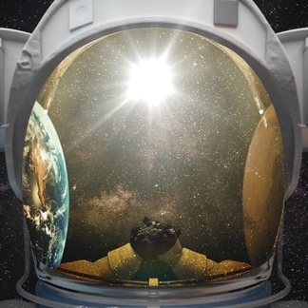
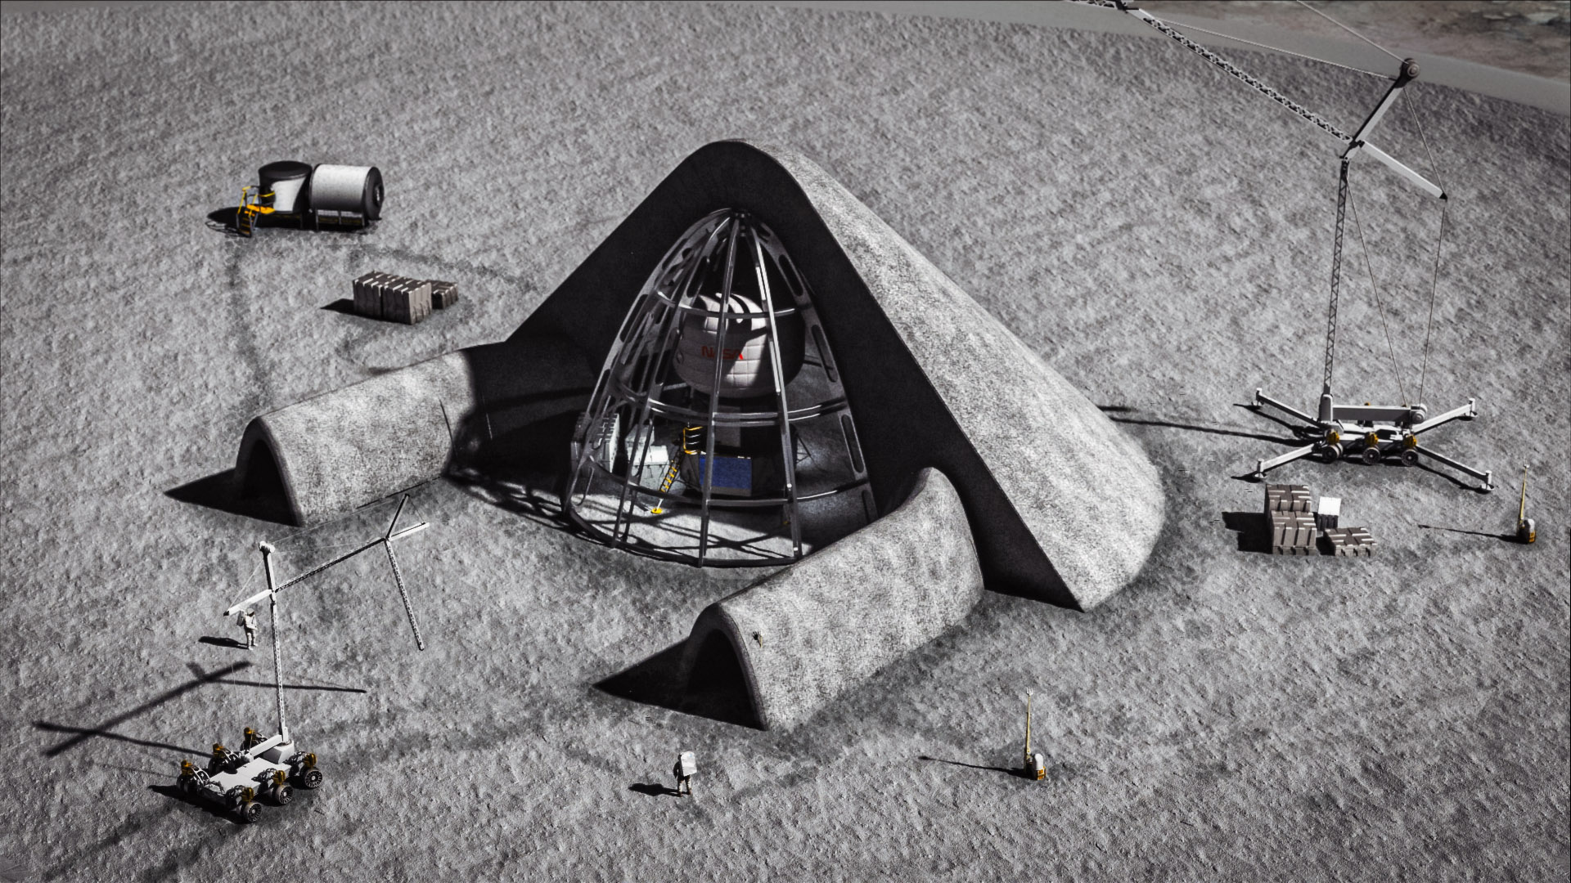
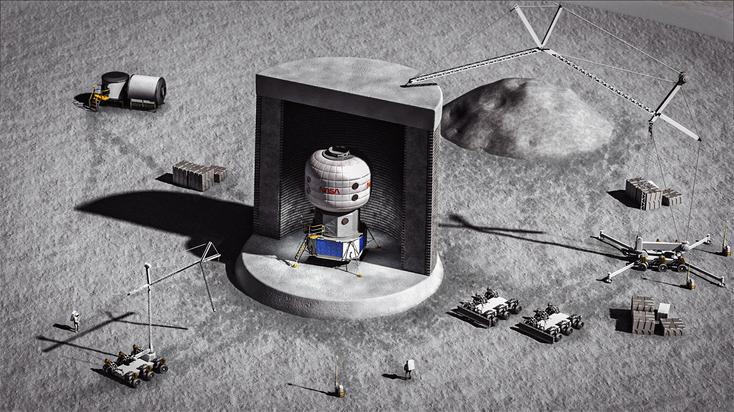
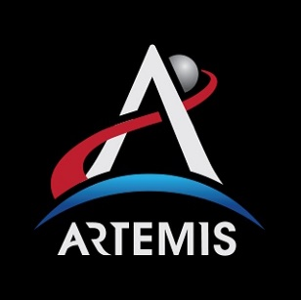
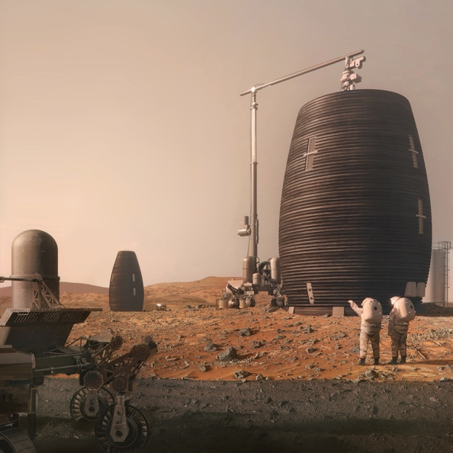
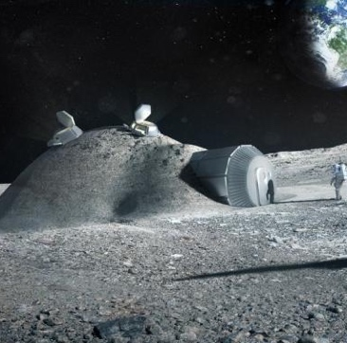
Protecting Crew and Surface Systems with a Long-Duration Lunar Safe Haven
Melanie Grande (Team Lead), Dr. Bob Moses (PI), Pat Cosgrove, Rob Mueller, Tracie Prater, Alex Blanchard
November 10, 2021
STMD Game Changing Developments (GCD) Program
Notes:
Presentation Focus:
Introduce game-changing Lunar Safe Haven concept
Explain that a rigorous/structured systems analysis method was implemented by LSH Seedling Study
Not just someone coming with one bright idea to advocate for
Provide an overview of the many concepts possible (instead of the single baseline) and decision analysis framework that can be used by NASA and others to:
Provide path for technology development
Compare concepts further in the future
Notes to self:
Better to describe the multiple best
Could be seen as a single concept that can evolve over time
Time dependence based on tech dev
Generations of the SoS, rather than a single static system
DART hat: speak of it in glowing terms, but not place to evangelize
ST wanted BLUF too…

Slide 2
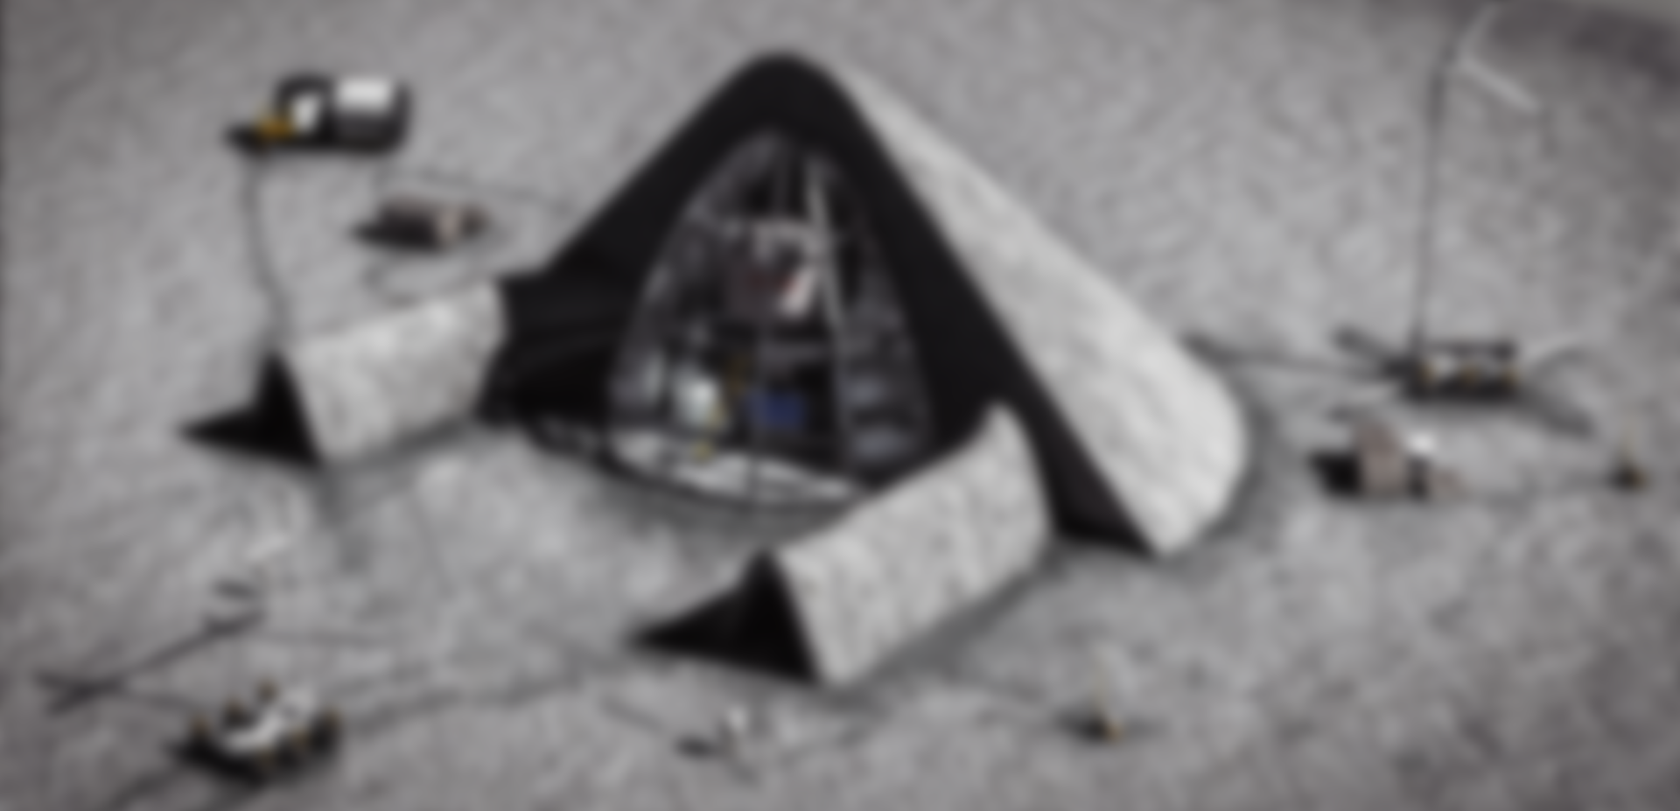
Lunar Safe Haven (LSH) Seedling Study Overview
Objective: Ensuring astronauts and their equipment are safe on the lunar surface
Deliverables:
Level Zero lunar construction requirements for a safe haven shelter
Trade Study of several concepts and identify current mission assets that could be used or leveraged
Outcomes:
The Lunar Safe Haven (LSH) Seedling Study has identified and evaluated high-value concepts that can be achieved in either the near-term (higher-TRLs) or long-term (lower-TRLs)
NASA and others can use the final recommended LSH concept and the decision analysis framework to:
Provide a path to future technology investments, and promote synergy with existing and proposed programs
Compare future concepts
Recommendations by the LSH Seedling Study are based on contributions from a multi-center team (LaRC, MSFC, and KSC)
Data has been collected from other NASA projects, OGA’s, industry, and academia on concept options and state of technology maturity

Slide 3
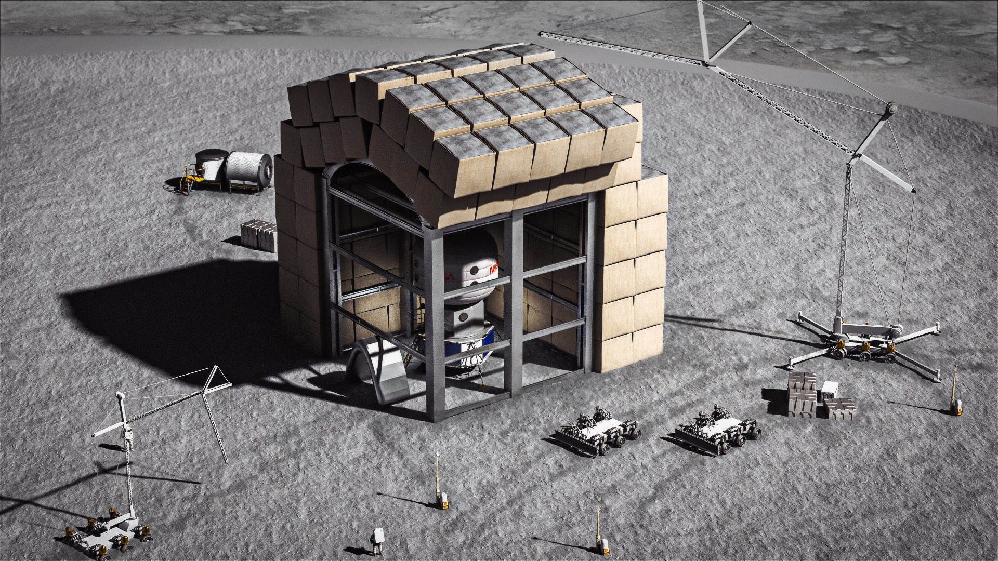
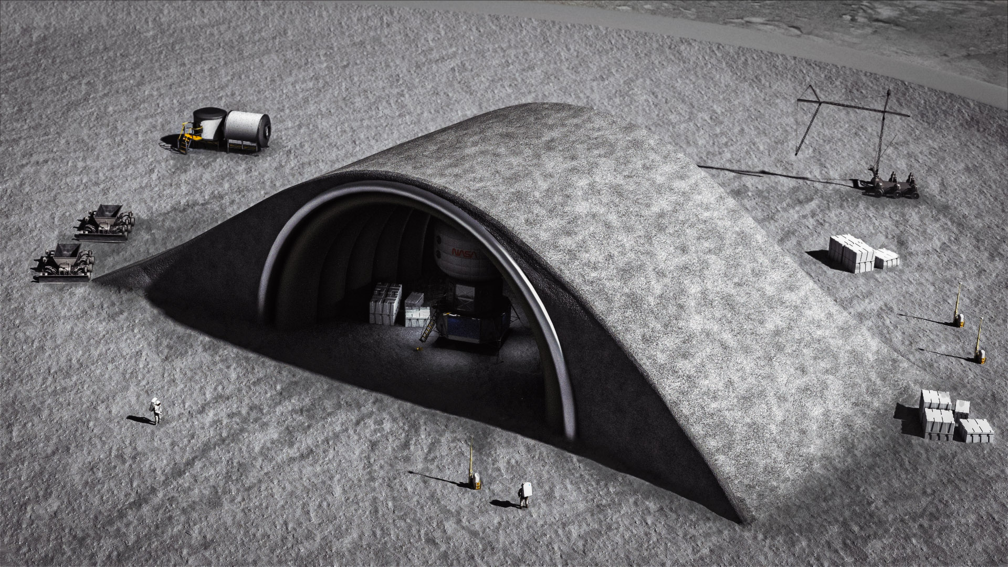
Background
In order to enable sustainable presence (~10 years) on the Moon, we must provide better protection for crew and surface systems from radiation, thermal extremes, and micrometeoroids (MM)
The Lunar Safe Haven is a game changing concept including a protective shelter, site preparation/construction/ assembly systems, and maintenance systems
With recent technology advancements, it is now reasonably achievable using in situ resource utilization (ISRU) and autonomous robotics
Protection for crew with access is possible to a level that mission architectures have been unable to provide to date
Protection for surface systems extends their lifetime, provides an area for servicing/maintenance, and potentially reduces rad-hardening and thermal control requirements
The LSH concept is scalable and evolvable, able to respond to various mission scenarios
The Lunar Safe Haven Study is leveraging the substantial work of the Artemis program, such as the progress in habitat and rover development
Images Source: NASA/LaRC
Notes:
The Need is here
The Capability is here
Wonderful convergence!
Because of the 3 system groups, the Lunar Safe Haven Seedling Study has examined NASA activities in site preparation, excavation, regolith transfer, surface construction/assembly/deployment, autonomy, robotic servicing/repair, advanced manufacturing, and in situ resource utilization (ISRU) for identifying the best approaches for implementing a safe haven shelter
The Lunar Safe Haven concept is “game changing” because it provides:
Protective shielding for crew to a degree that cannot be done via delivery from Earth, given constraints/costs of landing systems
Reasonably achievable using recently developed/matured technologies!
Protection with access, which directly burying habitats wouldn’t allow
Shielding for electronics that can be a game-changer for autonomy, avionics, and communications—e.g., by extending their lifetime and reducing rad-hardening and thermal control requirements
Protective shelter for mobile assets and potentially an area for servicing, both of which will extend their lifetime
Scalability, since various sizes of safe haven shelters are possible
Evolvability, since the safe haven concept is able to change and respond to new scenarios over time
The Lunar Safe Haven Study is leveraging the substantial work of the Artemis program, such as the progress in habitat and rover development
We are choosing to define “Lunar Safe Haven” to mean a continuous strategy for protection of crew and exploration systems

Slide 4
Requirements, Assumptions, and Common Features
Level Zero Requirements were developed by the LSH team to be synergistic with the NASA Artemis Plan and guide the trade study from a high level, including principles such as:
Protection is needed for crew and surface systems from radiation, micrometeoroid strikes, and the thermal environment on the lunar surface
Construction/assembly of a shelter needs to leverage as much as possible existing or high-TRL systems to support the activity in the late 2020s/early 2030s
Based on the Level Zero Requirements, the team developed more in-depth Ground Rules & Assumptions (GR&A)
GR&A assumed limited systems/infrastructure would be already present at Artemis Base Camp (ABC) for use in LSH operations
Next, several parameters were described for the baseline design that were constant across all concept alternatives:
Site Preparation: Small rovers should be used for soil analysis, resource assessment, and site mapping
Power: LSH systems must drive to and connect to the Artemis Base Camp (ABC) surface power source, such as via wireless charging

Slide 5
Overview of Modeling and Takeaways
The Lunar Safe Haven study included initial environmental effects modeling as well as substantial input from SMEs to develop ground rules and requirements for protection of crew and surface systems
While specific Artemis requirements for radiation dosage have not been defined, substantial NASA experience in space environmental effects and crew health can guide recommendations for radiation protection
Galactic Cosmic Rays (GCR) are a constant background source of radiation that impact long-term crew health
Threshold: Moderately low level of effective dose, <0.25 mSv/day (equivalent to 3 m regolith covering)
Goal: Earth-equivalent effective dose, <0.015 mSv/day (equivalent to 7 m regolith covering)
Solar Particle Events (SPEs) can cause acute radiation sickness and must be protected against
Threshold: (Dose is 150 – 250 mGy-Eq AND shelter requires no setup) OR (Dose is 50 – 150 mGy-Eq AND shelter requires 1-30 minutes setup)
Goal: Dose is less than 50 mGy-Eq during SPEs AND shelter requires no set-up time
Micrometeoroid impacts at the lunar south pole will mostly be fine-grained particles (mass 10⁻⁶ to 10⁻⁴ g), resulting in regolith on the order of 100 cm³ lost from the LSH shelter protective shield over 10 years
Further analysis is needed to account for meteor showers
From an initial look at the thermal environment, the LSH will protect assets from thermal swings, but the habitat will be essentially put in a man-made permanently shadowed region, which stays cold through the lunar day and night cycle
Extra power may be required to keep systems warm enough to function

Slide 6
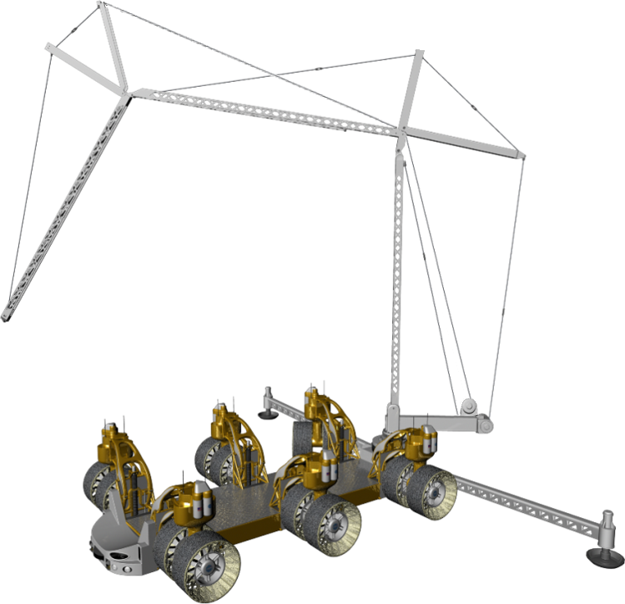
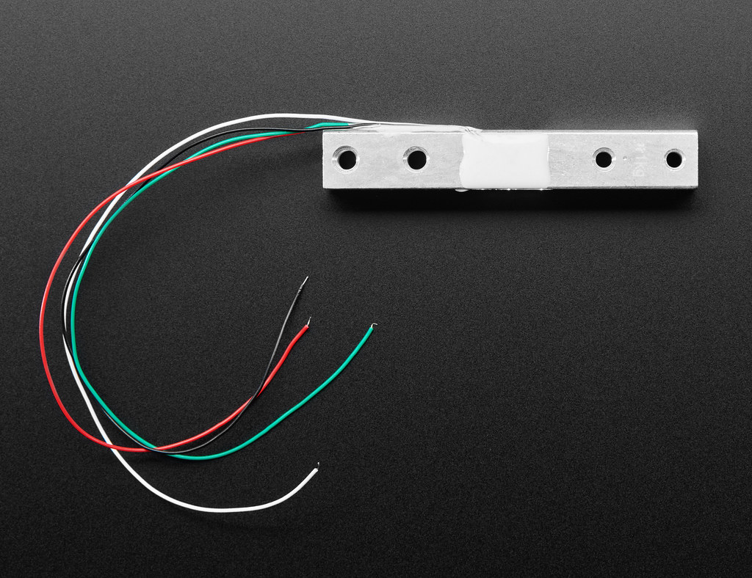
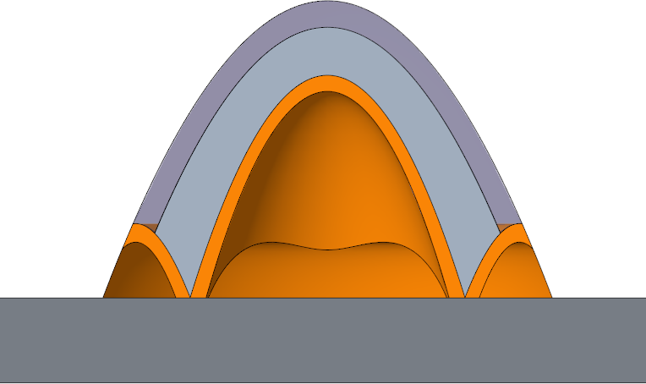
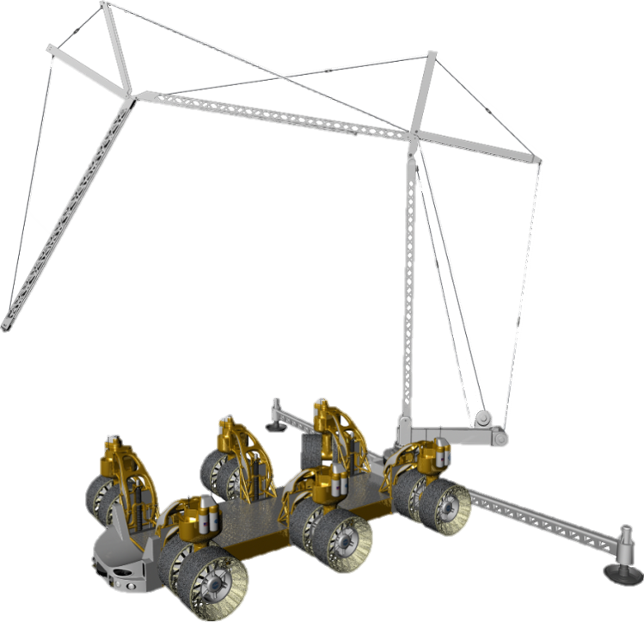
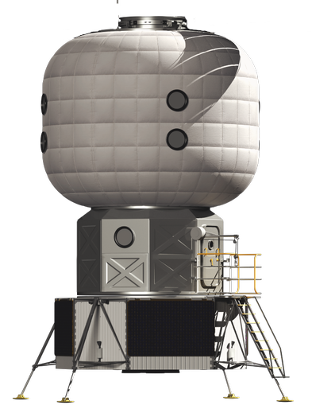
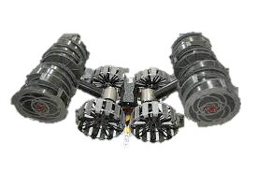
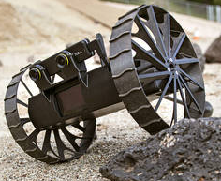
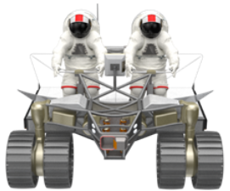
Concept Generation Overview
Concept Generation was the next step after outlining the scope via the LSH’s GR&A and common features
Each LSH concept includes 3 system groups:
Physical shelter design
Establishment Systems (Site Preparation/Excavation + Construction/Assembly/Deployment)
Maintenance Systems
A single “Baseline” concept was established to which other alternatives could be compared and the impact of changes could be evaluated
The Baseline does NOT necessarily represent our preferred option, but it does represent a reasonable solution
Physical Shelter Design (Baseline)
Establishment Systems (Baseline)
Maintenance Systems (Baseline)
Notional - Structure is under review
Vertical Construction/ Assembly System
Radiation and MM Shielding
Berms
Dual Purpose systems
Embedded and internal sensors
Possible Foundation
Excavation System
Small rover for inspections
Ground
Regolith Transfer System
Unpressurized Rover
Images Source: NASA
Images Source: NASA
Images Source: NASA

Slide 7
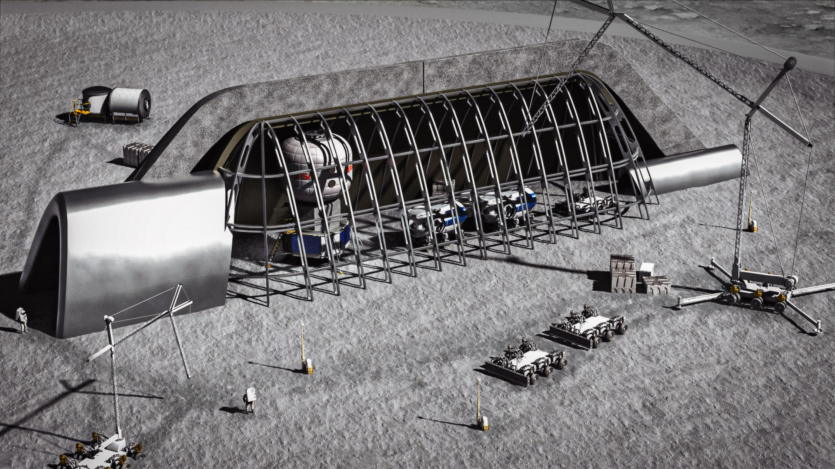
Concept Generation Results (1/2)
15 different concepts were defined by the team
Many alternatives were identified during brainstorming, but the team prioritized evaluation of 15 that were representative and also considered reasonably achievable within the 2020s or 2030s
Each concept after the Baseline (Concept 1.1) is a slight variation, where only one main design characteristic has been changed
Concepts 1.1-2.4 – Change Shelter Structure and Construction Method
Baseline: bulk regolith, and inner metallic structure delivered from Earth
Alternatives: regolith sandbags, whipple shield, inner metal structure scavenged from landers, inflatable beams, 3D printed regolith cement walls, sintered regolith walls
Concepts 3.1-3.2 – Change Establishment Systems
Baseline: Combination of LSMS, RASSOR, Chariot, LANCE, Compactor, Inspection Rover, and Rover with Robotic Arm
Alternatives: LTV copies, loader and dump truck combination
Images Source: NASA/LaRC

Slide 8
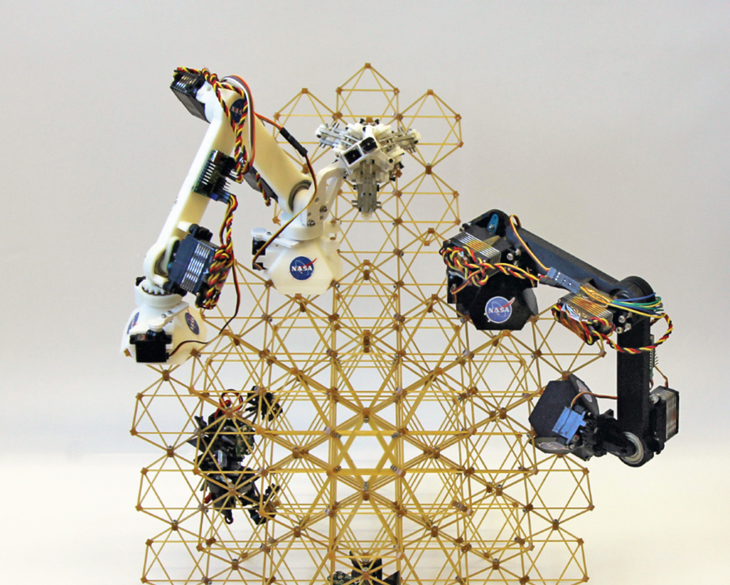
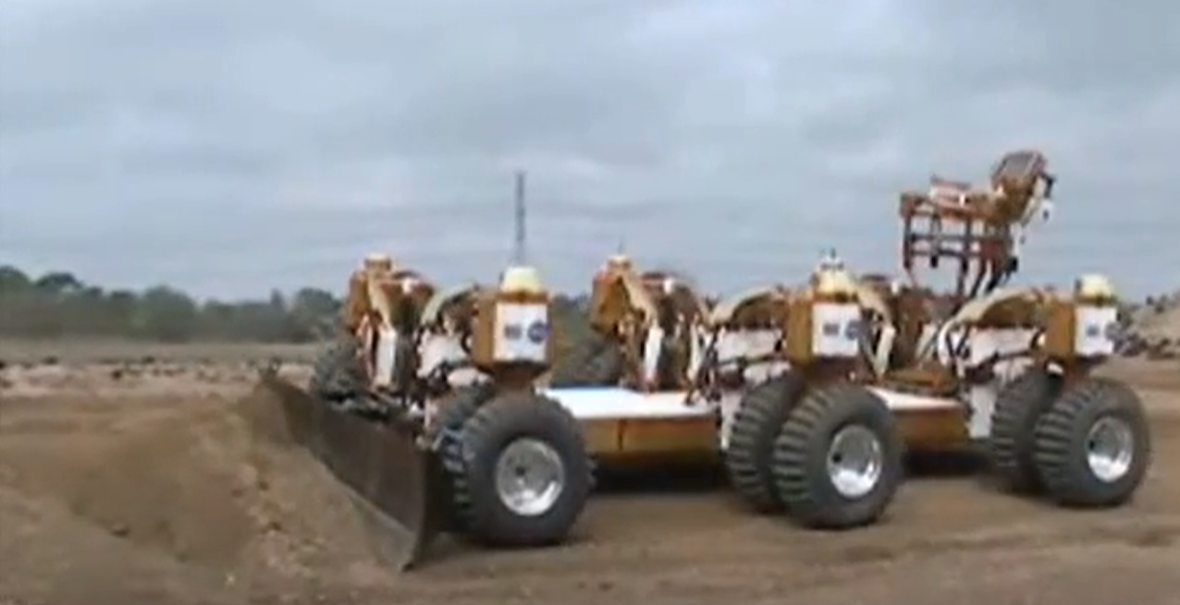
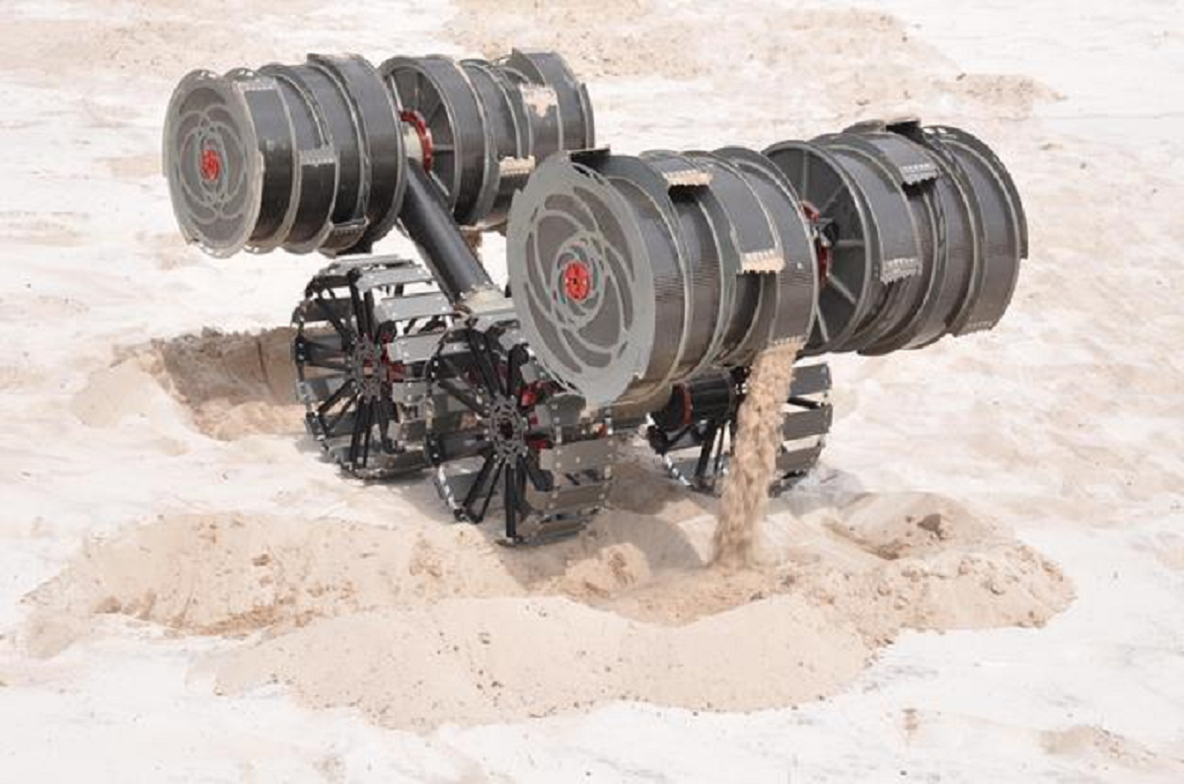
Concept Generation Results (2/2)
Concept 4.1 – Change Crew Involvement for LSH Sustained Operations
Baseline: robotics and/or sensors perform inspection and diagnostics
Alternative: crew performs manual inspections during crewed surface missions
Concepts 4.2-4.3 – Change Degree of Autonomy
Baseline: Semi-autonomous with crew supervision
Alternatives: fully autonomous, human operated/lower level of autonomy
Concepts 5.1-5.2 – Change Shelter Size and Dimensions
Baseline: Single shelter just big enough for the Foundation Surface Habitat (FSH)
Alternatives: single shelter with space for the FSH plus other vehicles/equipment, multiple shelters of various sizes
LSMS on Chariot chassis to move rocks and lift trusses into place
Image source: NASA
Mobile robots to assemble trusses (e.g., ARMADAS)
Image source: NASA
RASSOR, LANCE, and LSMS work together to pile regolith on top of shelter and form berms
Images source: NASA
New Compactor concept needed
Compactor on Chariot for rough compaction and grading
Small rover (e.g., A-PUFFER) for surveying, inspection, and V&V
Images source: NASA

Slide 9
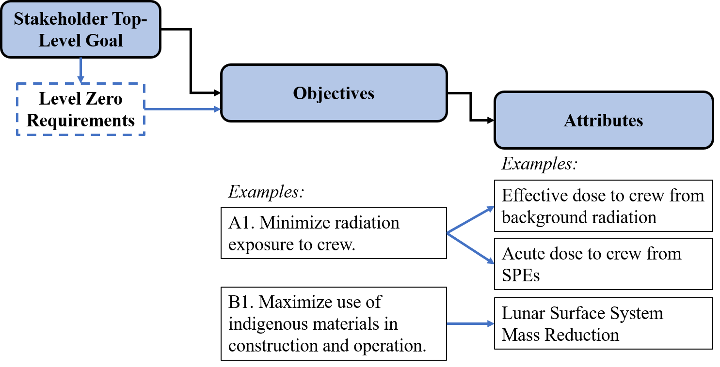
Concept Evaluation using Decision Analysis Method
Purpose: Characterize the Lunar Safe Haven trade space by quantifying the benefits, costs, and risks for each concept alternative, which together represents value to stakeholders
Method:
A) Identification of Objectives:
Definition: Define what you hope to achieve to meet the goal
B) Attribute Selection:
Definition: Measure that enables trade-offs between achieving relatively more or less on a given objective

Slide 10
LSH Objectives
Environmental
A1. Minimize radiation exposure to crew.
A2. Maximize energy absorption capability of the shelter from impacts for crew and other exploration systems, including impacts from micrometeoroids, the movements of external assets (e.g., mobility systems), and any resulting ejecta.
A3. Minimize accumulation of dust (fine and coarse) on LSH establishment and maintenance systems.
Operational
B1. Maximize use of indigenous materials in construction and maintenance.
B2. Minimize need for crew involvement during establishment and maintenance of the LSH.
B3. Maximize evolvability of the LSH establishment and maintenance concept.
B4. Balance resiliency and robustness of LSH concept as a whole.
B5. Maximizes available storage for exploration systems, science equipment, consumables, and contingency spares.
Programmatic
C1. Minimize investment costs.
C2. Maximize Mars extensibility.

Slide 11
LSH Decision Attributes
Category | LSH Attributes
Environmental | Effective dose to crew from background
 | Acute dose to crew during SPEs
 | Micrometeoroid (MM) Impact Protection Probability
 | Sensitivity of Damage Detection Systems
 | Protection against impact from external assets
 | Architectural Dust Mitigation
Operational | Lunar Surface System Mass Reduction
 | Maintenance Need from Crew
 | Training Need for Crew
 | Degree of Autonomy
 | Crew Situational Awareness
Category | LSH Attributes cont’d
Operational (cont’d) | Evolvability Composite Score
 | Fault/Degradation Identification
 | Resiliency
 | Complexity
 | Long Term Utility
 | Space Management
Programmatic | Total Lunar Safe Haven Architecture Investment
 | Technology Maturation Investment
 | Regolith as a Shielding Material
 | Autonomous Emplacement
 | Scalability for Mars
Notes:
The list shown here includes both quantitative attributes (e.g., effective dose), which can be precisely calculated using appropriate models) and qualitative, subjective attributes (e.g., evolvability), which must be determined subjectively by the team.

Slide 12
LSH Decision Attributes Results
Sub-teams approached different sets of concepts, defined additional details, and evaluated the decision attributes
Each attribute was evaluated on a scale from -2 to +2
Most attributes were defined where the Baseline Concept’s score = 0, and the other concepts are evaluated in comparison to the baseline (i.e., better = +2, worse = -2)
Note: “Evolvability” was defined with 3 scenarios, where each scenario scored from -2 to +2, resulting in max score of +6
The “Ideal” column shows the maximum possible scores for each attribute, for reference
A perfectly “ideal” concept may not be possible, but the maximum scores are a generally good indicator of where concepts might be able to be improved in future studies
Steering Team’s priorities for attributes were used to develop swing weights to get a weighted sum of scores
Weighted sums of the scores and the raw scores are guiding the down-select of the concepts (Still in progress)
Sample Table
 | Concept Alternative #: | Swing Weight | 1.1A | 2.1 | 2.2
 | Descriptive Concept Name: |  | Baseline | Scavenged from Landers | Inflatable Beams |  | "Ideal"
Category | Attribute | Value | Value | Value | Value |  | Value
A. | Effective dose to crew from background | 0.08 | 2 | 2 | 0 |  | 2
B. | Lunar Surface System Mass Reduction | 0.09 | 0 | 1 | -1 |  | 2
C. | Total Lunar Safe Haven Architecture Investment | 0.10 | 0 | 2 | 0 |  | 2
 | Un-Weighted Sum: |  | 10 | 8 | 1 |  | 36
 | Weighted Sum: |  | 0.37 | 0.33 | -0.27 |  | 1.638

Slide 13
SAMPLE: Concepts 2.1-2.4 – Change Shelter Structure Material Impact on Decision Attributes
 | Concept Alternative #: | Swing Weight | 1.1A | 2.1 | 2.2 | 2.3 | 2.4
 | Descriptive Concept Name: |  | Baseline | Scavenged from Landers | Inflatable Beams | 3D Printed Cement Structure | Sintered Regolith Structure |  | "Ideal"
Category | Attribute | Value | Value | Value | Value | Value | Value |  | Value
A. Environmental | Effective dose to crew from background | 0.08 | 2 | 2 | 0 | 0 | 0 |  | 2
 | Acute dose to crew during SPEs | 0.00 | 2 | 2 | 2 | 2 | 2 |  | 2
 | Micrometeoroid (MM) Impact Protection Probability | 0.00 | 2 | 2 | 2 | 2 | 2 |  | 2
 | Sensitivity of Damage Detection Systems | 0.00 | -1 | -1 | -1 | -1 | -1 |  | 2
 | Protection against impact from external assets | 0.00 | 1 | 1 | 1 | 1 | 1 |  | 2
 | Architectural Dust Mitigation | 0.00 | -1 | -1 | -1 | -1 | -1 |  | 2
B. Operational | Lunar Surface System Mass Reduction | 0.10 | 0 | 1 | -1 | -2 | 0 |  | 2
 | Training Need | 0.04 | 0 | -2 | -1 | 0 | 0 |  | 2
 | Evolvability Composite Score | 0.06 | 0 | 2 | -3 | -3 | 6 |  | 6
 | Complexity | 0.06 | 1 | -2 | 0 | -1 | -1 |  | 2
 | Long Term Utility | 0.04 | 1 | 1 | 1 | 1 | 2 |  | 2
 | Space Management | 0.03 | 0 | 0 | 0 | 0 | 0 |  | 2
C. Programmatic | Total Lunar Safe Haven Architecture Investment | 0.10 | 0 | 2 | 0 | -2 | 2 |  | 2
 | Technology Maturation Investment | 0.10 | 0 | -2 | -1 | -1 | -1 |  | 2
 | Regolith as a Shielding Material | 0.03 | 2 | 2 | 2 | 1 | 1 |  | 2
 | Autonomous Emplacement | 0.05 | 1 | 1 | 1 | 1 | 1 |  | 2
 | Un-Weighted Sum: |  | 10 | 8 | 1 | -3 | 13 |  | 36
 | Weighted Sum: |  | 0.37 | 0.33 | -0.27 | -0.63 | 0.57 |  | 1.638
The Concept 1.1A/Baseline will be discussed further on the next slide.
The attributes allowed the team to:
Both think through and quantify the benefits, costs, and risks that together represent value to stakeholders
Understand concepts have both pros and cons
Get an overall score (sum) to compare concepts

Slide 14
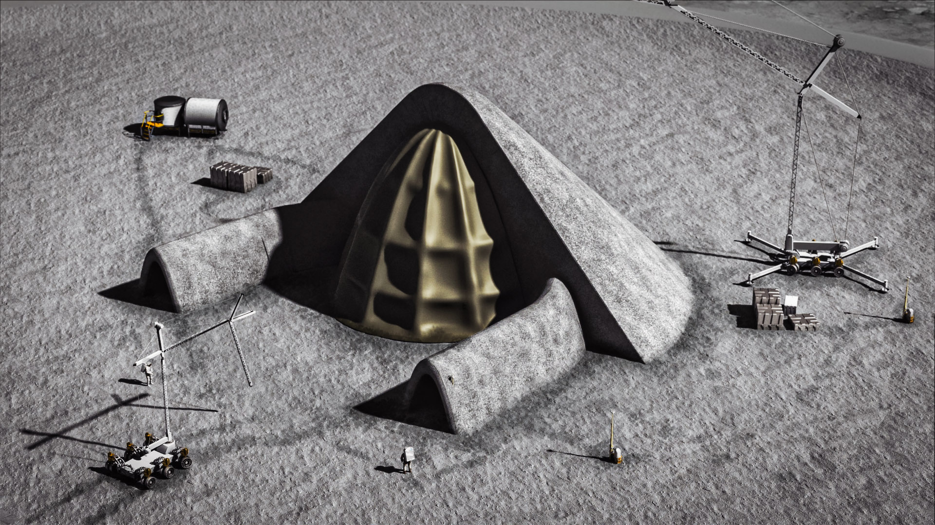
LSH Recommendation
Most LSH concepts reflected significant value for NASA stakeholders, but a concept needed to be down-selected that leverages the most existing or high-TRL systems to support lunar operations in the late 2020s/early 2030s
The LSH Seedling Study recommends the Baseline Concept (1.1A) since it is high-value and high-TRL
Metallic or composite structure delivered from Earth, assembled on lunar surface
Simple structure is covered in bulk regolith (example geometry shown in images, not final structural design!)
Low- to Mid-level of autonomy
Existing construction & maintenance systems, incl. LSMS, RASSOR, Chariot, LANCE, and A-PUFFER
Two other of the top-scoring concepts are recommended as evolvability pathways
Images Source: NASA/LaRC

Slide 15
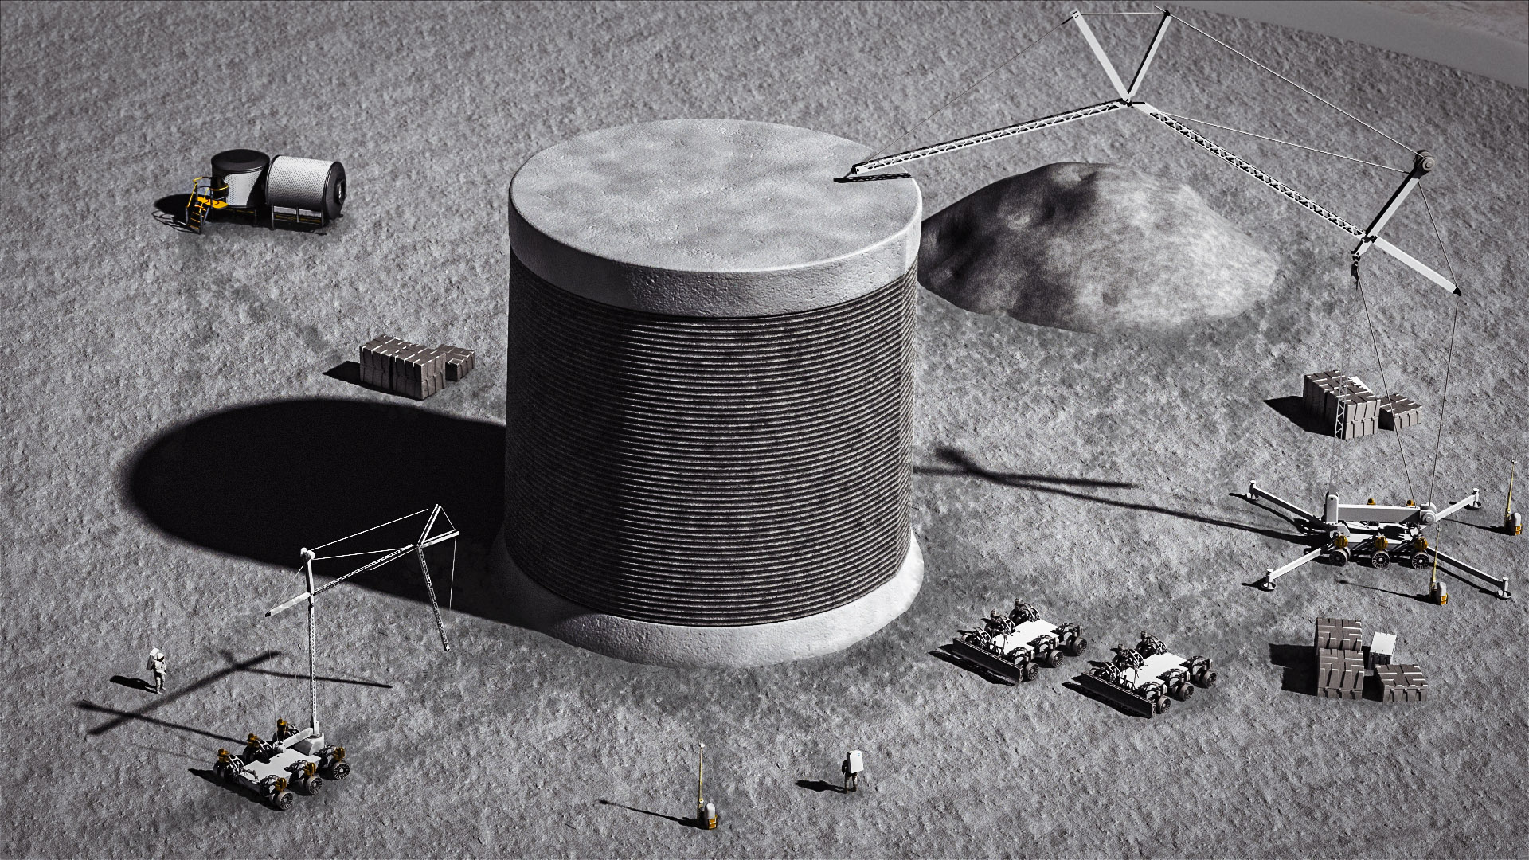
Evolvability of the LSH is Recommended Across Two Pathways
Construction Pathway:
Sintered Regolith Structure
LSH Concept 2.4
Sintering represents a high-value concept that maximizes use of ISRU, reduces the mass delivered from Earth, and is evolvable to many mission scenarios
Sintering is currently low-TRL, so continued technology investment and demonstrations are needed
Remaining challenges also includes power availability
Autonomy Pathway:
Advanced Levels of Autonomy
LSH Concept 4.2
LSH results showed that concepts with increasingly higher levels of autonomy have very high value (amongst top-scoring concepts)
Advance capability over time through technology investment, demonstrations, and validation on the surface
Autonomy is required for crewed Mars missions and should be validated on the lunar surface
Images Source: NASA/LaRC
Notes:
Evolve from Class II → Class III
Emphasize that ALL concepts have a mid level of autonomy, except in a few select concepts where we varied that

Slide 16
Lunar Safe Haven Study Takeaways
Lunar Safe Haven offers a remedy for crew health hazards including GCR and SPE radiation effects that mission architectures have been unable to provide to date (ref: AIAA-2018-5360)
We have evaluated both near-term and far-term concepts from an architecture level using rigorous systems analysis and mission planning using NASA’s Artemis plan as the framework
The LSH Study’s selected reference concept and decision framework are tools that NASA and others can use to assess/compare future ideas
We have examined cross-cutting capabilities in excavation, construction, ISRU, and autonomy
Architecture was designed to utilize ISRU to varying degrees
Lunar surface excavation, construction, and ISRU capabilities and current and planned equipment concepts suggest that implementing the GCR shielding necessary for long crew stays on the Moon and Mars is reasonably achievable
We evaluated the TRLs and capability levels required for the construction concepts proposed
We identified recommendations and requirements for future concepts and mission planning, for example: 3–7 m of regolith thickness is recommended for radiation protection, which will require approx. 3–3.5 t of construction equipment delivered to surface (not including excavation/ISRU equipment nor added structural mass)
The multi-center collaboration during the Study resulted in skills development and a build-up of interest/excitement in lunar construction
Notes:
#5: We trained a large number of people to be smart on lunar excavation & construction

