Slide 1



Developing Community Guidelines for Sharing Dataset Quality Information
International FAIR-DQI Community Guidelines Working Group
Ge Peng, lead
Sr. Principal Research Scientist, The University of Alabama in Huntsville
Earth System Science Center/NASA MSFC IMPACT
Information Quality Cluster of Earth Science Information Partners, Co-chair
WMO INFCOM Expert Team on Information Management, Chair
CEOS WGISS-52, October 21st, 2021, Virtual

Slide 2
Executive Summary
Dataset quality is more than data quality
Dataset quality information is needed but hard to curate
Sharing dataset quality information is desired but challenging
Global Earth science community has asked for guidelines on sharing dataset quality information and a guidelines document has been baselined
Notes:
key points of the presentation

Slide 3
WHO
1
WHAT
2
Agenda
WHY
3
4
GOALS
5
STATUS
6
OUTLINE

Slide 4
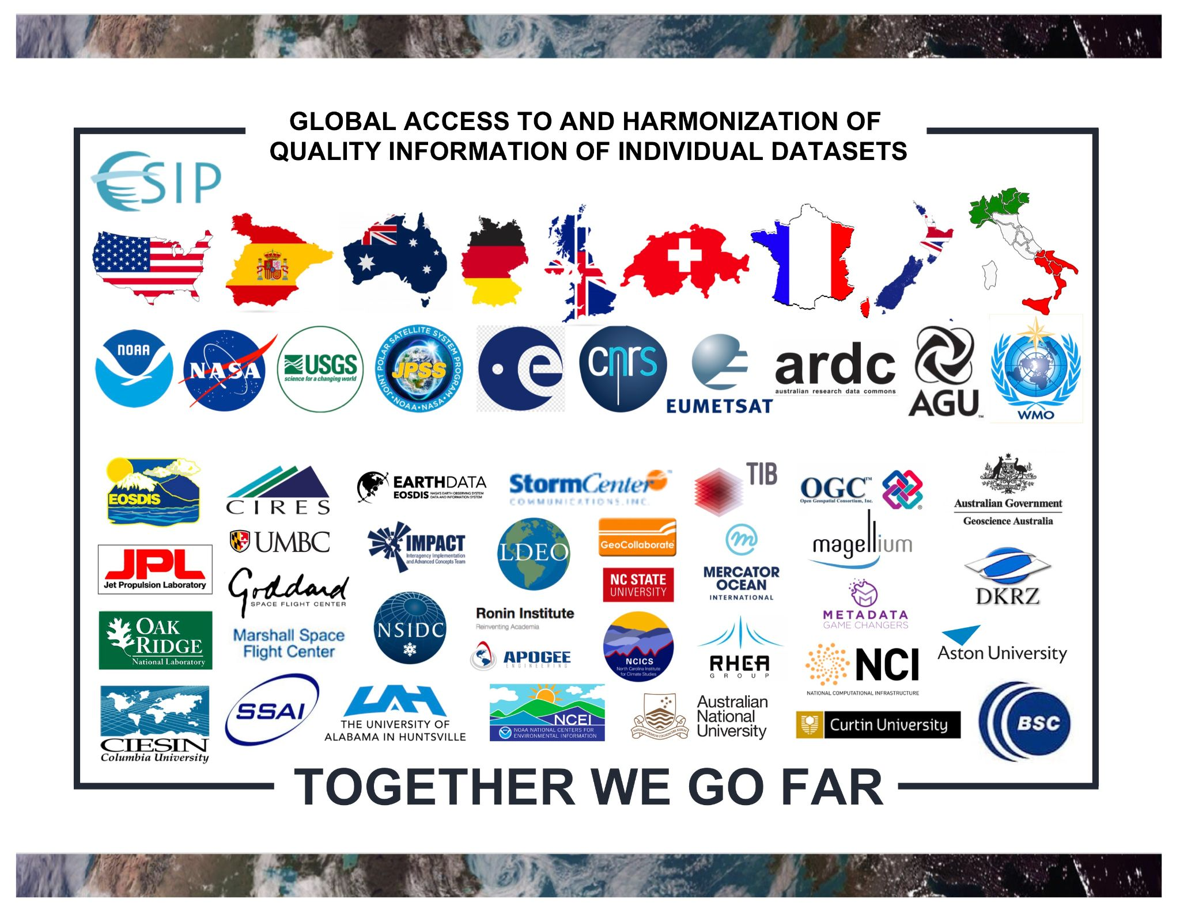
Who We Are
International FAIR-DQI Community Guidelines Working Group
Ge Peng, Carlo Lacagnina, Ivana Ivánová, Robert R. Downs, Hampapuram Ramapriyan, Anette Ganske, Dave Jones, Lucy Bastin, Lesley Wyborn, Irina Bastrakova, Mingfang Wu, Chung-Lin Shie, David Moroni, Gilles Larnicol, Yaxing Wei, Nancy Ritchey, Sarah Champion, C. Sophie Hou, Ted Habermann, Gary Berg-Cross, Kaylin Bugbee, and Jeanné le Roux
22 Global Interdisciplinary Domain Experts from 9 Countries
Data producers, publishers, and users;
Data, science, and technology stewards;
Data, information, systems, and service providers;
Standards and policy makers.
Notes:
Rich background and expertises

Slide 5
What Is Dataset Quality?
Quality of data (input and output),
Quality of metadata and documentation,
Quality of software and workflows,
Quality of procedures and processes,
Quality of infrastructure, tools, and systems.
Dataset Quality Information
Information about the state of
Dataset quality through the entire lifecycle of a dataset
Data production, data and information management, data publication and services, customer support and user engagement.

Slide 6
Why Are We Developing Guidelines?
Everyone would like to have quality information readily available
Community has asked for them
Curating dataset quality information is challenging
  Multi-dimensional problem
  Fitness for purpose
  Across domain knowledge integration
  Limited and sparse community standards or guidelines

Slide 7

Goals
Help data stakeholders to
Curate and disseminate FAIR dataset quality information,
Maximize the sharing of quality information about their datasets,
Allow for the maximum trust, reuse, and values of their datasets,
Demonstrate compliance to policies and mandates,
Enable global access to and integration of dataset quality information:
    Easily understandable to non-experts,
    Apple-to-apple comparison among datasets.

Slide 8
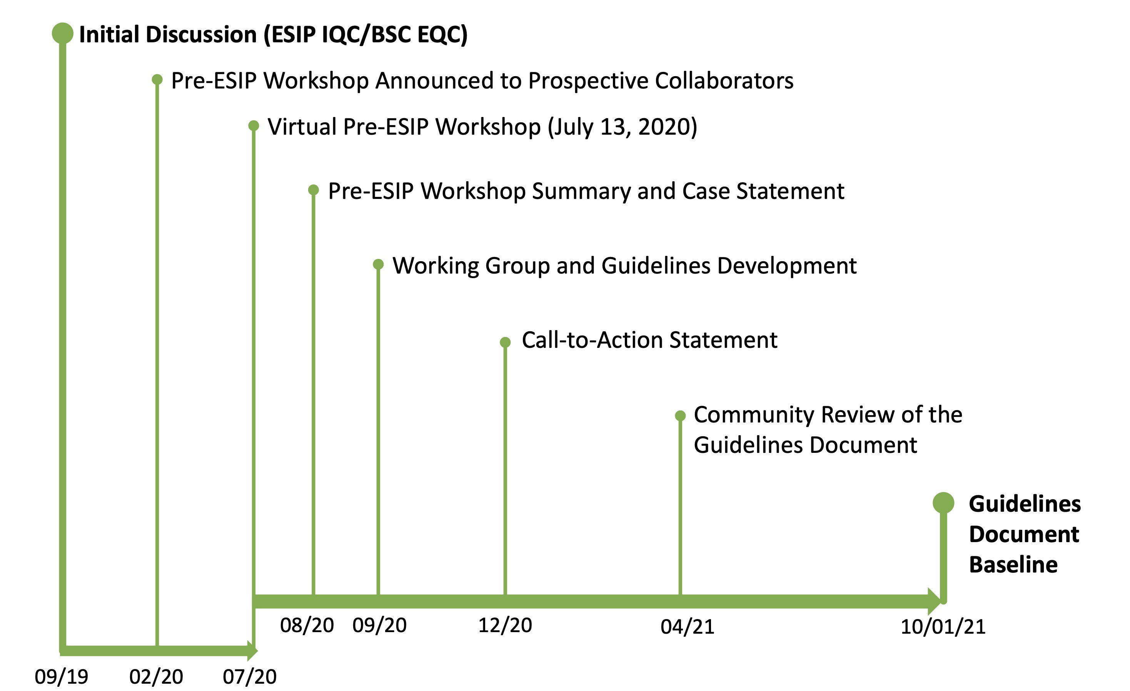

Current Status & Path Forward
Planning
Developing
Community Review
First Baseline
Discipline Diversity
Use Cases
Notes:
ESIP IQC: Information Quality Cluster of Earth Science Information Partners; BSC EQC: Barcelona Supercomputing Center Evaluation and Quality Control team -> Copernicus Climate Data Store;
a broader view and of the needs for Data Quality in diverse scientific environments

Slide 9
Outline of Guidelines
Guideline 1: Describe Dataset
  Ensure the dataset is findable and accessible
Guideline 2: Utilize a quality assessment model
  Ensure the assessment model is findable and accessible
Guideline 3: Capture the assessment method and results in dataset-level metadata
  Ensure the quality information is interoperable and reusable for machine end-users
Guideline 4: Capture the assessment method and results in a human-readable document
  Ensure the quality information is findable, accessible, and reusable for human end-users
Guideline 5: Report the dataset quality information
  Ensure the information is online, findable and readily (re)usable

Slide 10
Guideline 2 In Details
Guideline 2. Utilize a structured quality assessment model, e.g., in a form of a metric or matrix, that is:
2.1. versioned and publicly available with a globally unique persistent identifier (PID), such as a digital object identifier (DOI);
2.2. registered or indexed in a searchable resource that supports authentication and authorization, such as Figshare, Zenodo, GitHub, and Dryad;
2.3. retrievable by their identifier using an open, free, standardized and universally implementable communications protocol, such as Hypertext Transfer Protocol Secure (HTTPS).
Notes:
2.1 → F1; 2.2 → F4, A1.2; 2.3 → A1
DOI: digital object identifier; UUID: Universally Unique Identifier

Slide 11
Thank you!
Resources
Guidelines document: https://doi.org/10.31219/osf.io/xsu4p
Call-to-action statement paper: http://doi.org/10.5334/dsj-2021-019
Workshop Summary Report: https://doi.org/10.31219/osf.io/75b92
Contact Us
ge.peng@uah.edu
carlo.lacagnina@bsc.es
ivana.ivanova@curtin.edu.au

Slide 12
Backup Slides

Slide 13

Why Do We Need Dataset Quality Information
Needs
Decision-making
  Data use: Informing the reliability and usability of the dataset,
  Data trust: Establishing the trust between data providers and consumers, policy-makers,
  Influential data: Increase the value of the data for diverse users.
Compliance reporting support
  Consistently curated,
  Readily available and understood by humans and machines,
  Augmented understandability and clarity of data.
Support data and information sharing and reuse
  Interoperable dataset quality information also for utilizing Cloud and Machine Learning technologies,
  Promote global access and harmonization of quality information.

Slide 14

Challenges
Challenges
Multi-dimensional and cross-disciplinary with many quality attributes,
Different application requirements and ways to assess quality,
Curating dataset quality information requires cross-domain knowledge integration,
Limited and sparse community standards or guidelines on how to consistently curate dataset quality information.

Slide 15
Development Principles
Built by the community for the community:
    developed via an iterative process with continuous community engagement for feedback;
  Quality-attribute/aspect/dimension agnostic;
  Whole lifecycle approach;
  Assessment method and results should be findable, accessible, and reusable by both human and machine end users; and interoperable by machines.

Slide 16
Key Takeaways
Strong needs for developing community and practical guidelines
Quality information about data, metadata/documentation, workflows, etc., is important in:
  Establishing the trustworthiness of data and services,
  Increasing sharing and value of the data for diverse applications.
Improved sharing of dataset quality information takes the whole whole village!

