Slide 1
SMD Extended Payloads on ISS CoP Quarterly Meeting
Development Changes
NASA Langley Research Center
Jamie Nehrir
Mission Operations Manager
10/15/2021

Slide 2
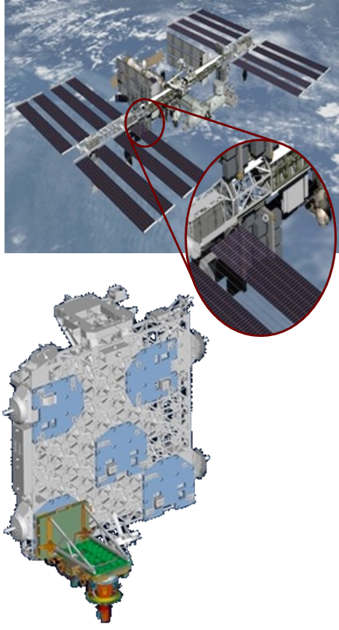
Project Overview
Mission Implementation
Partners | LaRC (Science; Project Management; System Engineering and Mission Design; SMA; I&T; Launch Support; Mission Operations; Science Data Processing and Delivery) JSC/ISSP (System Engineering Support, Hexapod Pointing System and ISS mounting adaptors, ISS Mounting Location, Launch Processing and Access to Space, Infrastructure and Telemetry Data)
Launch/ Installation | February 19, 2017 (SpaceX). Installed on ELC 4
Prime Mission | July 1, 2021-Present
Life | 3 years (nominal) / ISS manifest through 2024 for potential extended mission. (Note: SAGE III mission approved for funded extended mission through 2026).
Payload | Sensor Assembly (LaRC), Hexapod (ESA), CMP (LaRC), ExPA (JSC/ISS), ICE (LaRC), HEU (ESA), IAM (LaRC), DMP (LaRC), Nadir Viewing Platform (LaRC)
SAGE III on ISS directly supports NASA Strategic Goals to extend and sustain human activities across the solar system; expand scientific understanding of the Earth and the universe in which we live
Primary Science Objective:
Monitor the vertical distribution of aerosols, ozone and other trace gases in Earth’s stratosphere and troposphere to enhance understanding of ozone recovery and climate change processes in the upper atmosphere
sage.nasa.gov

Slide 3
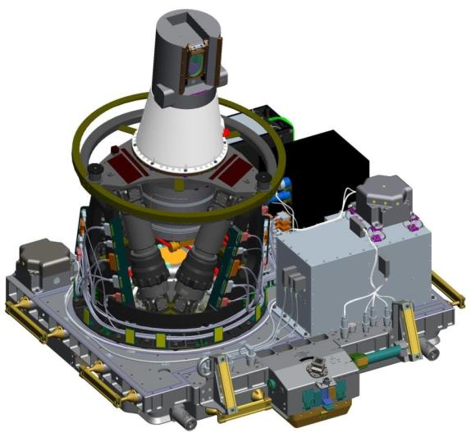
Technical Overview: Instrument Payload
Sensor Assembly (SA)
Instrument Control Electronics (ICE)
Hexapod Mechanical Assembly
(HMA)
Hexapod Electronics Unit (HEU)
Contamination Monitoring Package (CMP)
Contamination Monitoring Package
(CMP)
Interface Adapter Module (IAM)
Disturbance Monitoring Package
(DMP)
ExPRESS Payload Adapter (ExPA)

Slide 4
SAGE III Operations Team
Larger Operations Team Needed
  The SAGE III team works with a much larger operations team than is typical because of ISS activities
  While there are many benefits of being on the ISS, there are also some challenges that come with such an active platform that affect how we take science data
    Visiting vehicles
    Yaw maneuvers
    EVA’s
    GPS lock-ups

Slide 5
SAGE III Ops Protocol/Reactions to ISS Activities
Station Activity | Operations Response
Soyuz docking | Contamination Door is inhibited a minimum of 2 hours before activity
Progress docking | Contamination Door is inhibited a minimum of 2 hours before activity
Dragon 1 Capture | Contamination Door is inhibited a minimum of 2 hours before activity in addition the contamination door will remain shut for the duration of the Dragon stay
Cygnus Capture | Contamination Door is inhibited a minimum of 2 hours before activity
HTV Capture | Contamination Door is inhibited a minimum of 2 hours before activity
OPM to +XVV | Payload must be put into Non Science taking mode at least 30 minutes prior to the beginning of the Maneuver
OPM to –XVV | Payload must be put into Non Science taking mode at least 30 minutes prior to the beginning of the Maneuver
Large off nominal attitude changes | Payload must be put into Non Science taking mode at least 30 minutes prior to the beginning of the Maneuver
Main Engine Reboost | No response needed
Progress Reboost | No response needed
CST-100 | Contamination Door is inhibited a minimum of 2 hours before activity
Dragon 2 | Contamination Door is inhibited a minimum of 2 hours before activity in addition the contamination door will remain shut for the duration of the Dragon stay

Slide 6
ISS Activities
Through the life of SAGE III on ISS the operations team has grown comfortable with handling most of these activates with on board time tags to disable science taking mode or enabling/disabling the contamination window. This allows for must of the SAGE III commanding to be conducted during the nominal daily window.
  The operations team along with the HOSC just needs to be open about any slips or diversions from the ATL so actions can be taken if the timeline changes.

Slide 7
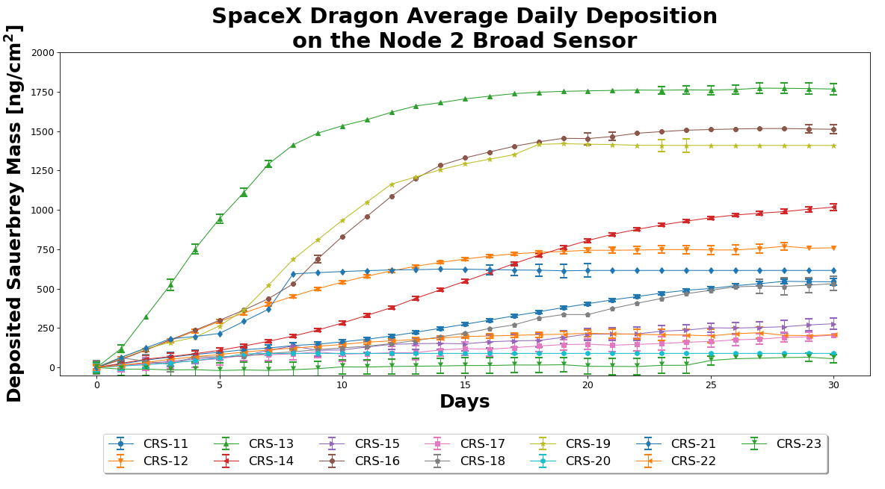
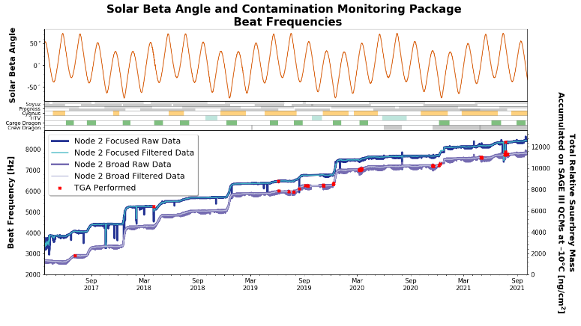
Contamination Rules for the SAGE III Payload
Contamination Rules for visiting vehicles
  For CRS visiting vehicle the contamination window is closed and all science data is collected through the window
  For all other visiting vehicles, the contamination window is closed prior to docking and for two orbits after.
  Since the instillation of MLM the operations team is waiting to determine when the contamination window can be opened.

Slide 8
Data Loss
Data Loss
  The SAGE III operations team redownlinks data about once a week (59 times in the last year) because of packet loss from ISS to the HOSC
    The SAGE III payload has 6.5 days worth of data storage on board that gets downloaded every day. (8-5 EST and then again from 4-5am EST)
    The ground system analyzes the packet stream and reports any missing data. The operations team will first try and downlink it again from the HOSC to see if the missing packets can be recovered.
    If any of the packets can not be filled in the operations team will use a daily command window to downlink the missing packets.

Slide 9
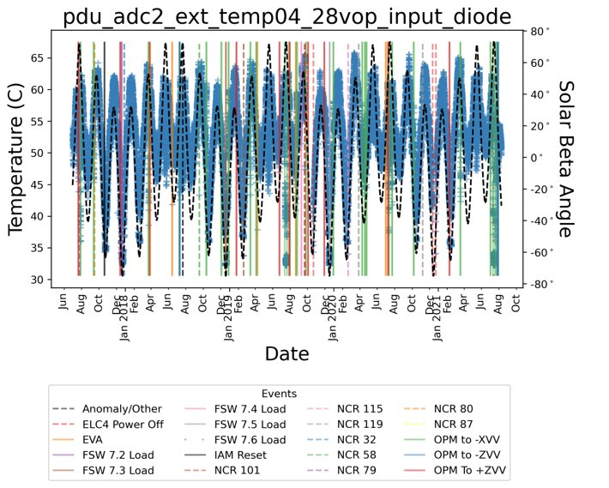
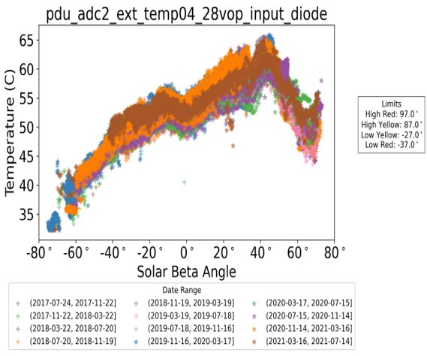
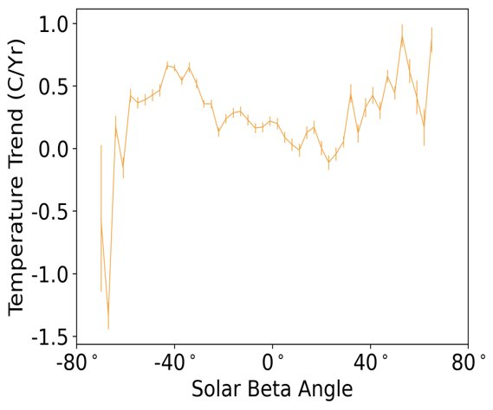
Payload Data Trending
The SAGE III Operations team has worked diligently to create trending tools to quickly analyze data and spot any parameters that might be off nominal
Below is the three different trend lines that get generated within a python Jupiter notebook. First is the data plotted with respect to time, second plot is the same data plotted with respect to beta, and finally the third plot is the slop of the data binned with respect to beta and then a trend line applied to it.

Slide 10
Questions?

