Slide 1


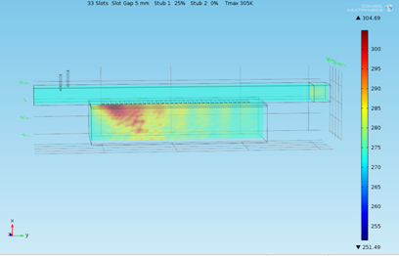
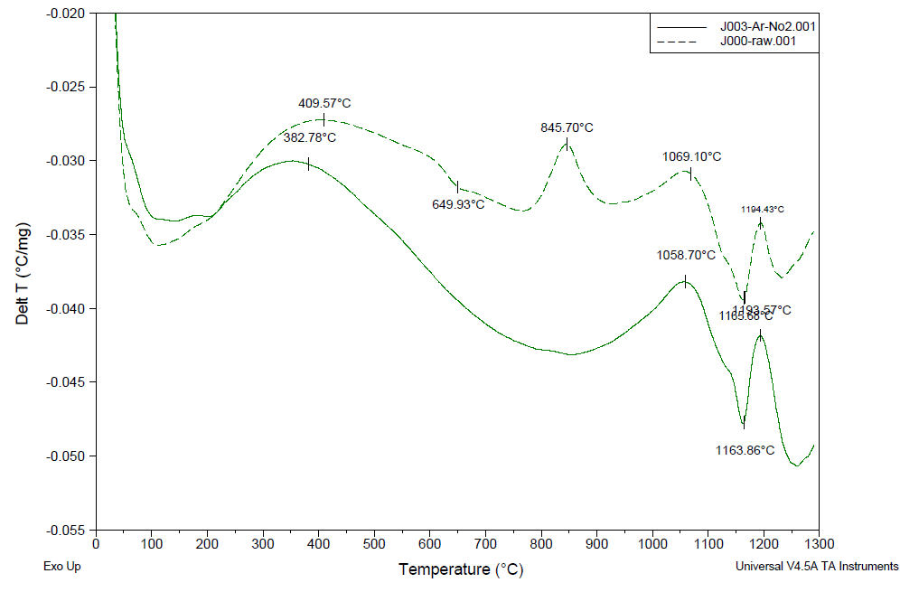
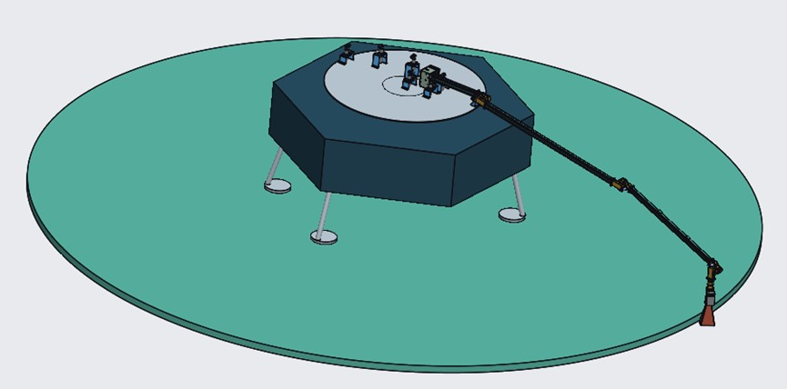
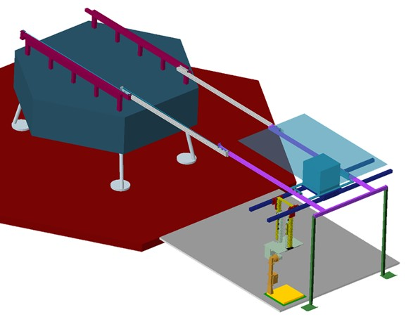
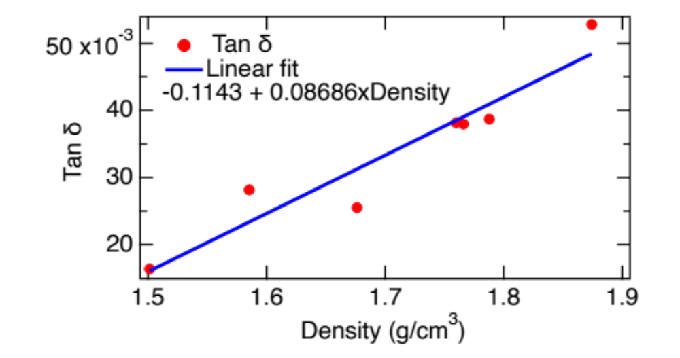
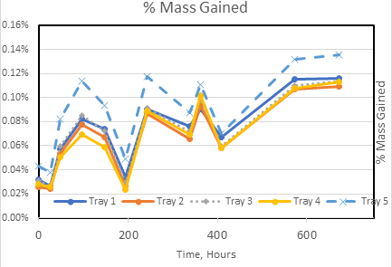

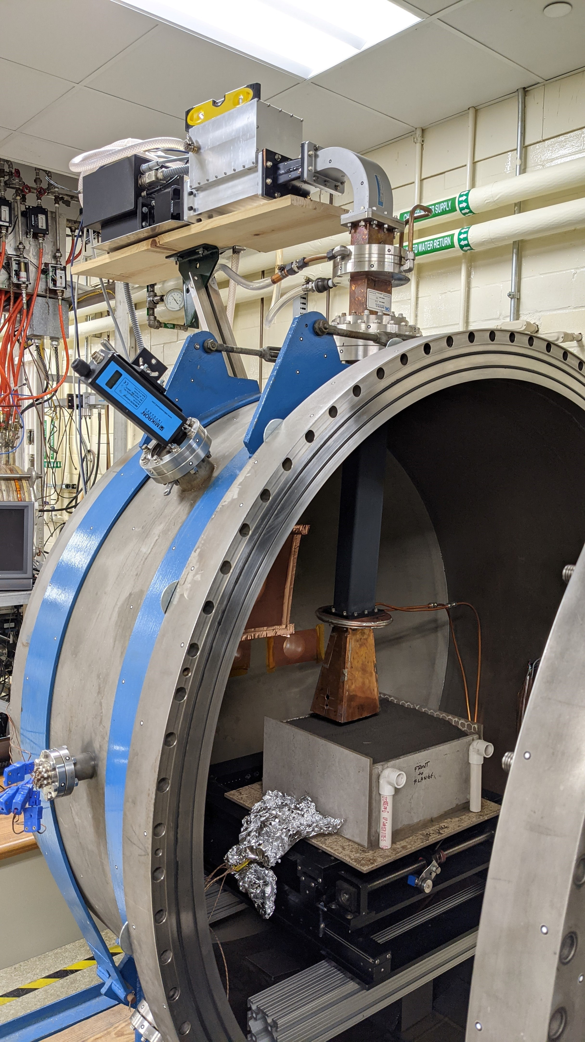
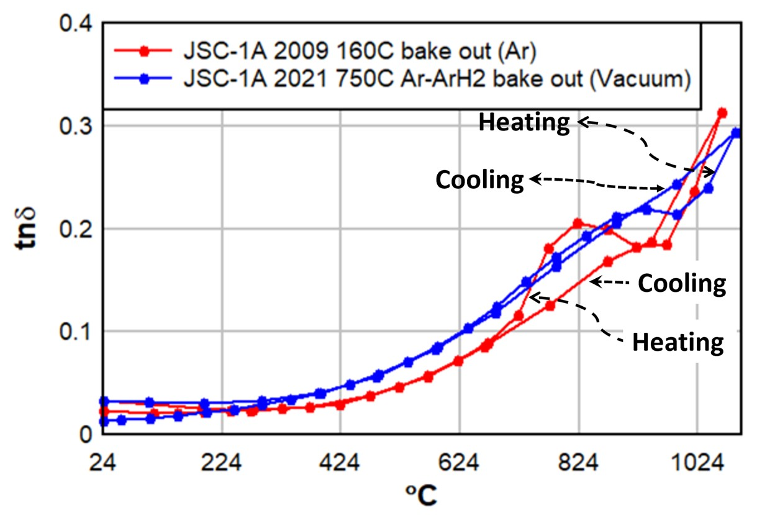
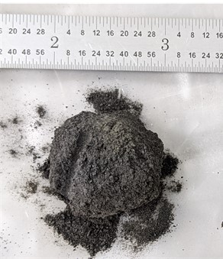
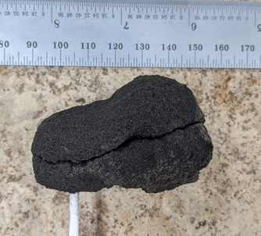
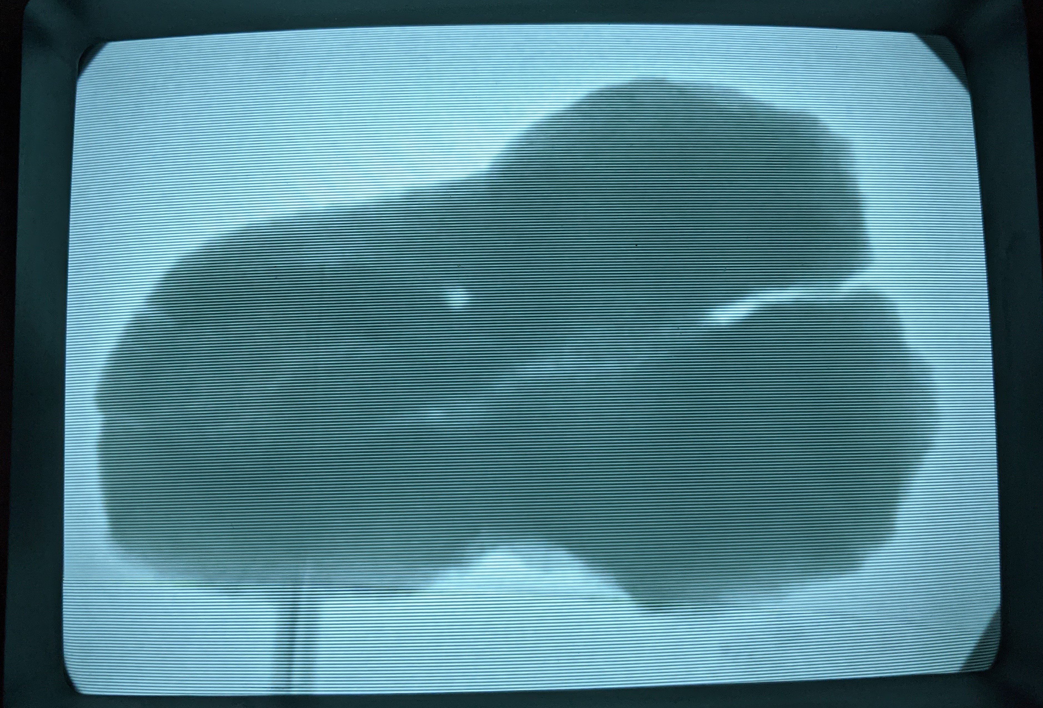
Microwave Structure Construction Capability Year 1 Accomplishments
M. R. Effinger¹, L. M. Albritton², B. D. Atkins¹, C. W. Bahr², M. B. Barmatz³, R.E. Boothe¹, R. W. Bruce⁴, A. O. Burt¹, S. E. Charnock², J. Dalton³, E. Ethridge⁴, I. M. Hanson¹, D. J. Hoppe³, J. N. Huleis³, R. Hutcheon⁵, J. F. Gerling⁴, W. Kaukler², H. Kimrey⁴, A. J. King⁶, S. Le Roy, ² S. L. Mauro¹, J. E. Morgan², T. Meek⁴, Q.H. Otte⁴, D. P. Popok², D. L. Rickman², Z.S. Roberts⁶, J. Sanchez², H. S. Shulman⁵, S. L. Stride³, T. J. Spence⁶, G. E. Voecks³, R. P. Wilkerson¹, F. Zhong³.
¹NASA Marshall Space Flight Center (MSFC), Huntsville, AL, ²Jacobs Engineering, Inc. Huntsville, AL, ³Jet Propulsion Laboratory, California Institute of Technology, Pasadena, CA, ⁴RWBruce Associates, LLC, Joelton, TN, ⁵DrHollyShulman, LLC, Belmont, NY, ⁶Radiance Technologies, Huntsville, AL.
Introduction
The Microwave Structure Construction Capability (MSCC) element, part of the Moon to Mars Planetary Autonomous Construction Project (MMPACT) was initiated in 2020. MSCC is responsible for creating horizontal and vertical infrastructure on the moon using microwave energy. Microwave sintering is being pursued since it is the only heating method to volumetrically heat the regolith. Advances were achieved in materials characterization and understanding, microwave sintering in vacuum with a lunar-like applicator and sample bed, microwave design and analyses, and conceptual design.
Simulant Characterization
Applicator Modeling
JSC 1A Differential Thermal Analysis
Leaky Wave Guide Microwave Coupling to JSC 1A Analysis
-0.025
No pre-treat
Wave guide with slots
-0.035
Delta T (°C/mg)
-0.045
750°C Argon
pre-treat
About 305K maximum temperature.⁴
-0.055
0
200
400
600
800
1000
1200
Temperature (°C)
Concept Design
Simulant Characterization
750C Bake out removes 845˚C peak⁵
Microwave sintering & thermal management focused
JSC 1A Loss Tangent (Tan Delta) @ 2.45 GHz
JSC 1A Mass gained after 200˚C bake out
radiator
magnetron
Assumptions: 6kW power to magnetron, 3kw waste heat, 1.5m² sintering area
Davit
radiator
applicator
magnetron
227 lbs (103.2kg)
Both the stowed and extended configurations stress results are under the materials limit stress.
Operational speed and acceleration when in the extended configuration may need to be limited to prevent excessive lateral deflections.^{1,2}
applicator
Weight – 221 lbs (100kg)
  55kg for the structure
  45kg for the microwave and instrumentation on end of arm
Max Stress – 163 MPa (Slightly Negative Margin)
Max Deflection –5.7 cm^{1,2}
MSCC Publications
• M.R. Effinger et al, “Microwave Sintering Lunar Landing Pad & Horizontal Infrastructure,” Moon Village Architecture Working Group Workshop, December 14, 2020.
• M.R. Effinger et al, “Microwave Sintering: Initial Scale-Up for Lunar Landing & Launch Pad Construction,” 2021 Joint Planetary & Terrestrial Mining Sciences Symposium & Space Resources Roundtable, Jun 8-11, 2021
• D. Rickman et al, “Basis of Creating a Microwave-Based Construction System for the Moon,” 2021 Joint Planetary and Terrestrial Mining Sciences Symposium and Space Resources Roundtable, Jun 8-11, 2021.
• R.W. Bruce et al, “Preliminary Considerations for Microwave Consolidation/Sintering of Lunar Regolith Simulant,” 55th Annual Symposium – International Microwave Power Institute (IMPI), Jun 28th-Jul 1st, 2021.
• H. Shulman et al, “Exploration of Scalable Methods to Fabricate Synthetic Lunar Minerals for Engineered Regolith Simulants,” LSSW Fundamental and Applied Lunar Surface Research in Physical Sciences, August 18–19, 2021.
• G. Voecks et al, “Understanding Pretreatment Processes of Lunar Simulant to Assist in Defining Material Characterization,” LSSW Fundamental and Applied Lunar Surface Research in Physical Sciences, August 18–19, 2021.
• R.P. Wilkerson et al, “Characterizing the effects of thermal profile and gas environment on the heat treatment of JSC-1A lunar simulant using combined thermogravimetry and mass spectroscopy,” LSSW Fundamental & Applied Lunar Surface Research in Physical Sciences, August 18–19, 2021.
About 100hrs to gain 50% of original mass loss⁶
Increased density leads to better microwave coupling, but not a driver at room temperature³
Microwave Sintering
JSC 1A Loss Tangent (Tan Delta) @ 2.45 GHz
Lunar- like applicator & sample bed sintering at ˜10⁻⁴ Torr (small scale sintering takes advantage of reflections from container walls)¹
Photo and X-ray images of dense, sintered JSC 1A specimen obtained in TVAC^{1,2}
750˚C Bake out removes peak after 750˚C⁵

