Slide 1
2021 OSAM State of Play
Dale Arney, Ph.D.
Chief Architect, OSAM National Initiative
This document has been approved for public release.

Slide 2
OSAM National Initiative
Develop a whole-of-nation architecture and strategy
Define future space infrastructure and architectures and foster a coordinated and targeted investment strategy across government, industry, and academia.
Steward future OSAM concepts and technologies
Define OSAM needs for future missions, assess the needs against existing commercial/government capabilities, and encourage standards to facilitate adoption.
Enable the adoption of OSAM into the state of play
Incentivize the infusion of OSAM in future space systems, establish interoperability standards, and influence future procurements.
POCs: Deborah Tomek (deborah.m.tomek@nasa.gov), Dr. Joel Mozer (joel.mozer@space.mil), and Dr. Byron Knight (knightby@nro.mil)

Slide 3
Capability Assessment Process
OSAM State of Play
Vision for an OSAM Ecosystem
Concept Maturation
Coordinated Investment Plan
Distributed Execution
“Where we are”
“Where we want to be”
“How we get there”
Notes:
GENERAL SLIDE TEMPLATE

Slide 4
The OSAM State of Play
Purpose: characterize the current state of OSAM capabilities
State of Play compiles and organizes past, present, and near future OSAM capabilities
Intended to be used broadly
Help mission designers incorporate OSAM technologies into their concepts
Create the starting point for technology development plans and roadmaps
Provide technologists a survey of the field they are developing
Will be updated periodically (target annually) as things change

Slide 5
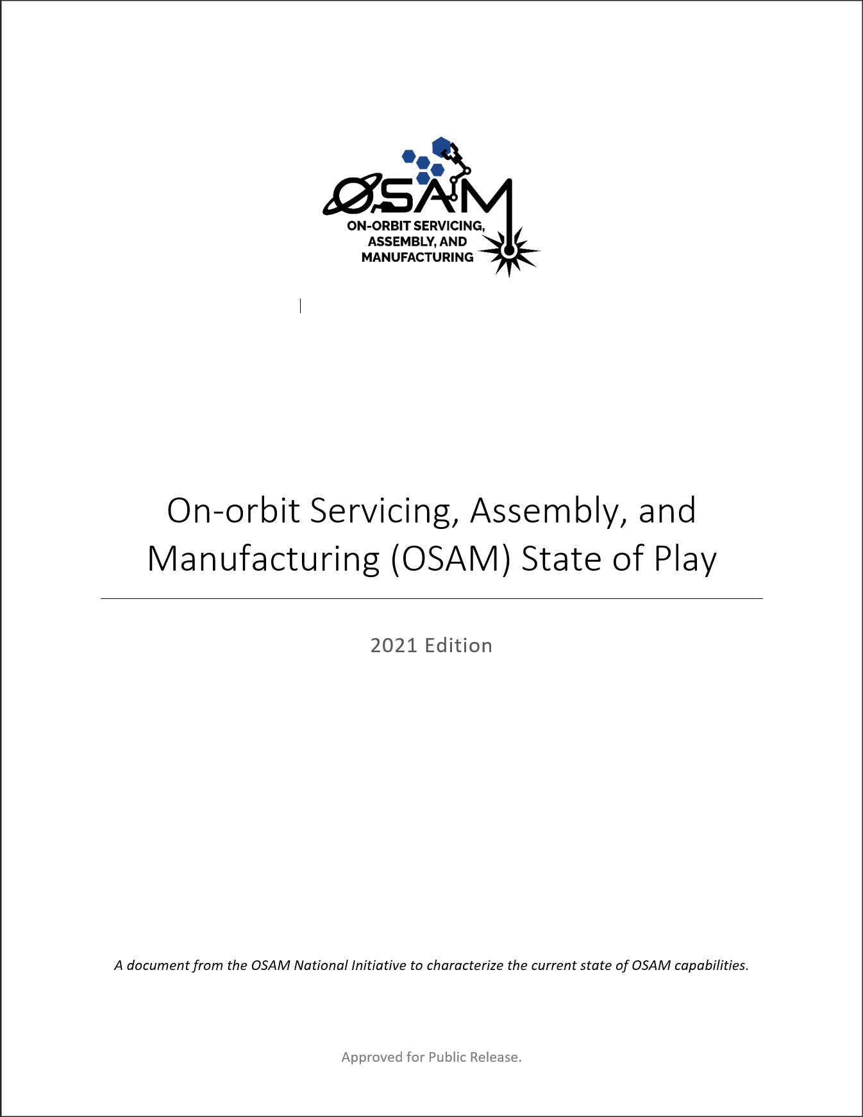
OSAM State of Play Overview
History of OSAM
Operational missions and flight demonstrations
OSAM Capability Areas
Divides OSAM capabilities into 11 capability areas
Describes the current state of those capability areas
OSAM Facilities
Select facilities from NASA (on and off Earth), DOD, FFRDCs, and academia
Appendix
Contains entries from the repository of previous and ongoing OSAM development activities and technologies

Slide 6
History of OSAM

Slide 7
OSAM Capability Areas
Robotic Manipulation
Rendezvous and Proximity Operations (RPO), Capture, Docking, and Mating
Relocation
Planned Repair, Upgrade, Maintenance, and Installation
Unplanned or Legacy Repair and Maintenance
Refueling and Fluid Transfer
Structural Manufacturing and Assembly
Recycling, Reuse, & Repurposing
Parts and Goods Manufacturing
Surface Construction
Inspection and Metrology
Notes:
Robotic Manipulation: Involves manipulating payloads and spacecraft subsystems with a robotic manipulator. Includes robotic activities such as driving/releasing bolts, cutting, placing modules, and assisted deployment.
Rendezvous and Proximity Operations (RPO), Capture, Docking, and Mating: Involves two spacecraft maneuvering in proximity to each other and could include connecting the two spacecraft together. Includes crewed or autonomous docking/berthing, remote inspection, and formation flying.
Relocation: Involves one spacecraft maneuvering another spacecraft into a new orbit or orientation. Includes boosting, repositioning, deorbit, debris removal, and life extension.
Planned Repair, Upgrade, Maintenance, and Installation: Involves adding or replacing components on a spacecraft that is prepared to receive those components. This is done to repair or upgrade that component, perform a maintenance swap-out, or install a new component that expands the capability of the spacecraft. Includes systems with modular interface connections and payload/component swap-out or upgrade.
Unplanned or Legacy Repair and Maintenance: Involves adding or replacing components on a spacecraft that was not intended to receive those components. Includes more complex operations to access the interfaces and make new connections.
Refueling and Fluid Transfer: Involves transferring fluid from one spacecraft to another. Includes cryogenic and non-cryogenic propellants/fluids and transfer in orbit or on a planetary surface.
Structural Manufacturing and Assembly: Involves creating or assembling structures in space to create spacecraft components or subsystems. Includes manufacturing (3-D printing, extruding, etc.) and assembly of structures with various interfaces, joining approaches, and precision.
Recycling, Reuse, & Repurposing: Involves the use of spacecraft components already in space in a new spacecraft. Includes recycling the material from old spacecraft parts for new manufacturing feedstock and reusing old spacecraft parts as-is in new spacecraft.
Parts and Goods Manufacturing: Involves creating spare parts, subsystems, and components for use in space or on a planetary surface. Includes internal (to a habitat) and external manufacturing with multiple materials and sizes.
Surface Construction: Involves excavating, constructing, and outfitting structures and infrastructure on a planetary surface. Includes horizontal (landing pads, roads, etc.) and vertical (power, habitation, etc.) construction, using regolith to build, and assembly of erected structures.
Inspection and Metrology: Involves observation of systems in space to understand their configuration, size and shape, or other features of interest. Includes free-flyer inspection, non-destructive evaluation, close (robotic) inspection, and space situational awareness.

Slide 8
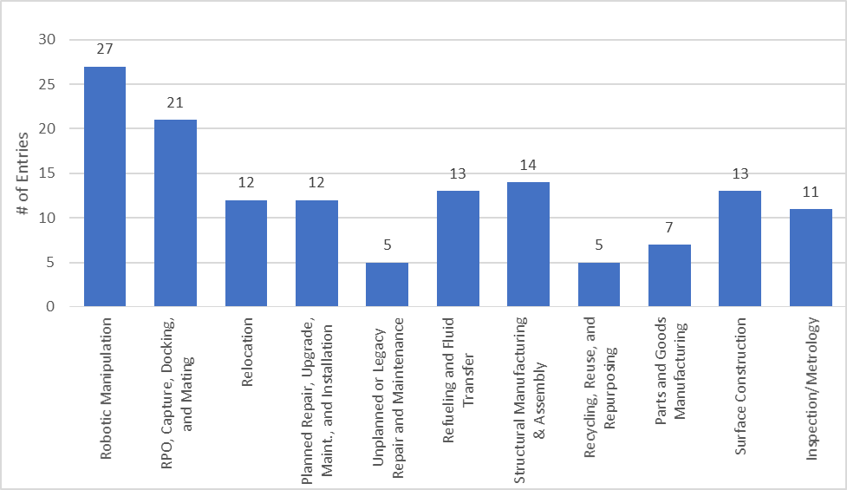
Data-Driven State of Play
140 Total Entries
117 Unique Entries
Notes:
Publicly available (no proprietary, CUI, or classified information)
Needed to have hardware (ground or flight), not just a concept/study
Opportunity to comment, suggest additions, suggest new ways to look at the data, etc.

Slide 9
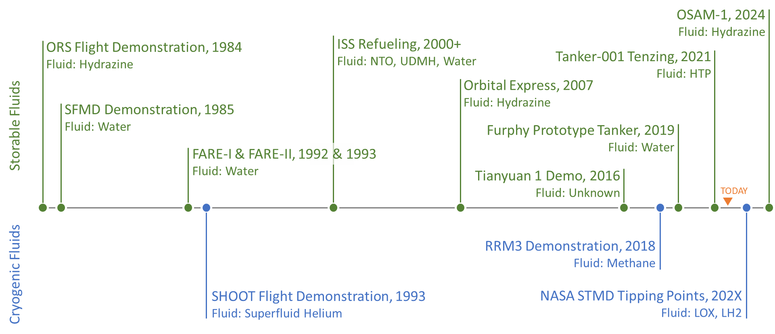
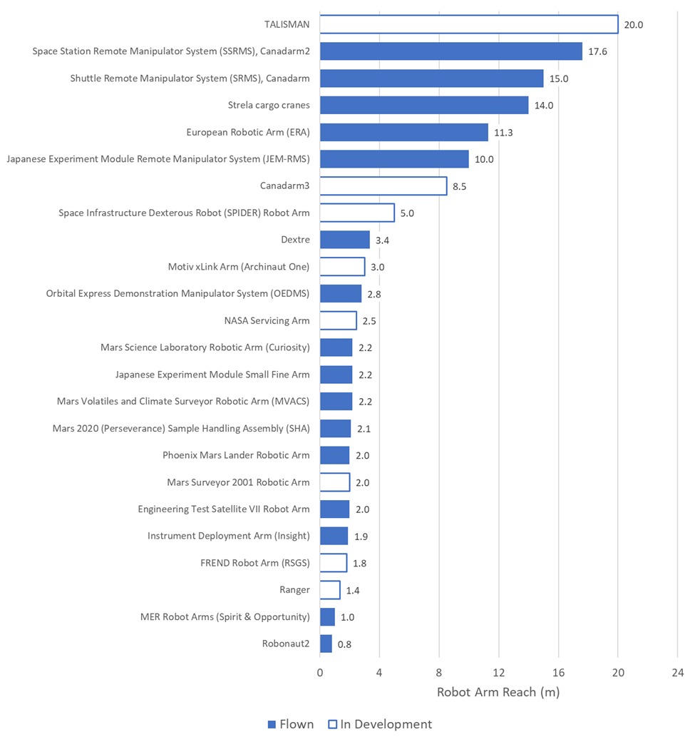
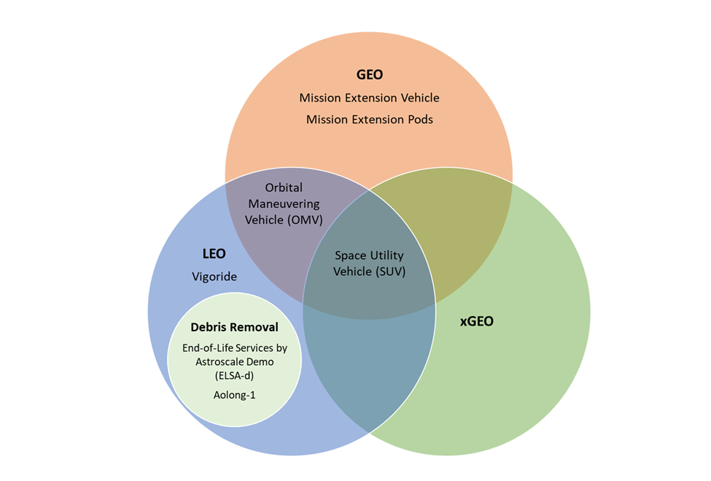
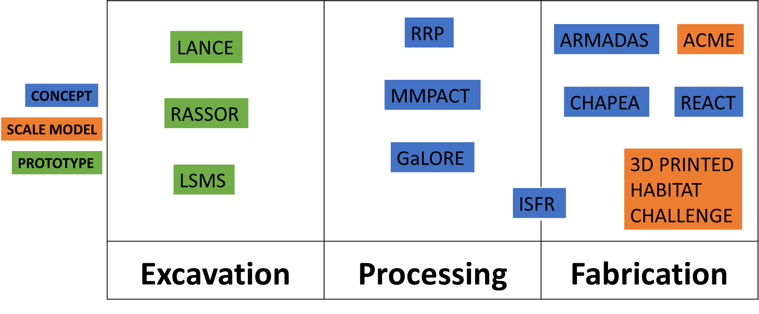
Sample Information from State of Play
Refueling and Fluid Transfer
Robotic Manipulation
Relocation
Surface Construction

Slide 10
Select OSAM Facilities

Slide 11
Closing
Download the document
https://nexis.gsfc.nasa.gov/osam/
Survey for comments, suggestions, and feedback
https://forms.gle/LPc8uG33phzVpVSE9
Contact Information
Dale Arney
dale.c.arney@nasa.gov

Slide 12
Space is vast. For the most part, when a satellite is launched, it's on its own, regardless of whether it ever needs assistance or not. It launches, operates, and is decommissioned alone, its lifespan limited by consumables, imperfect human design, the exceedingly harsh space environment, and technical obsolescence. But what if we could fix, upgrade, and augment existing satellites to enable more science for longer? Technically and economically feasible refueling, repair, and upgrade of satellites has remained elusive—until now. OSAM technology will enable more science by assisting existing telescopes, but also lay the groundwork for future endeavors once thought to be impossible.

