Slide 1
Recent Experimental Investigations in the Liner Technology Facility
Brian M Howerton
NASA Langley Research Center
brian.m.howerton@nasa.gov
(757) 864-8365
Notes:
Good afternoon, everyone. I’m Brian Howerton from Langley and I’ll be presenting some recent experimental work on acoustic liners by the Langley Liner Physics Team.

Slide 2
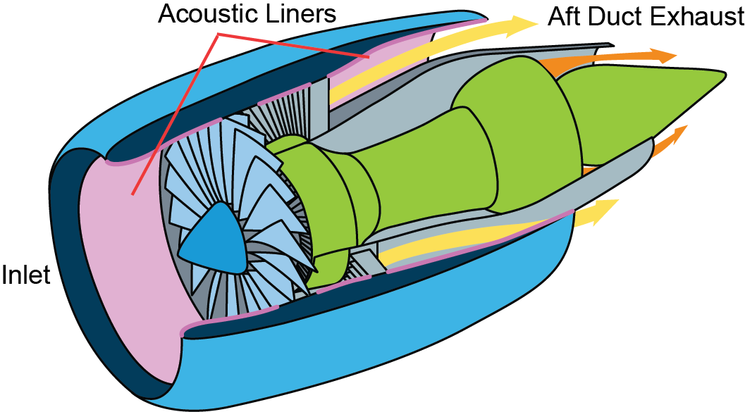
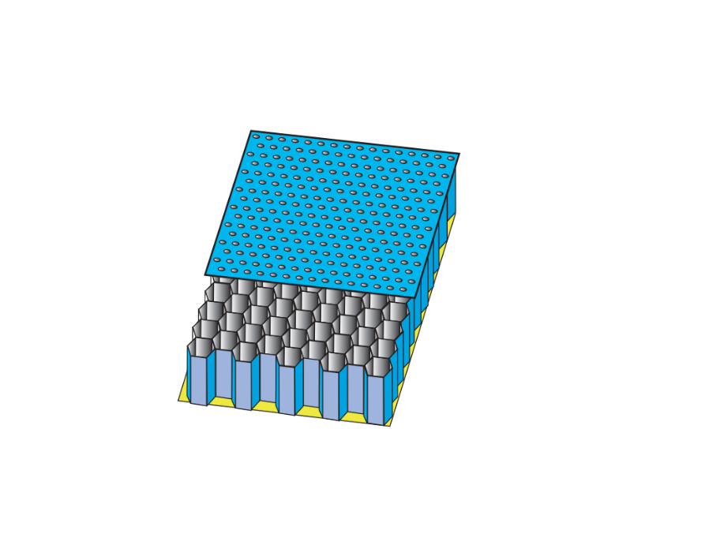
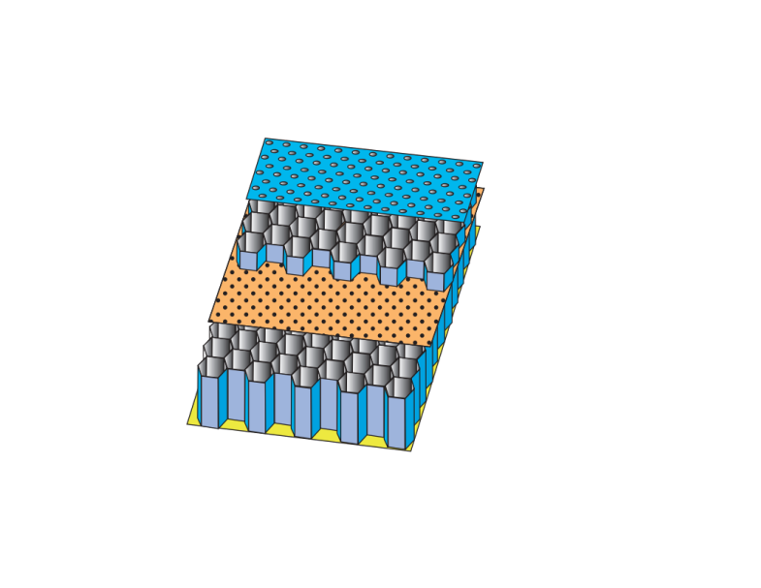
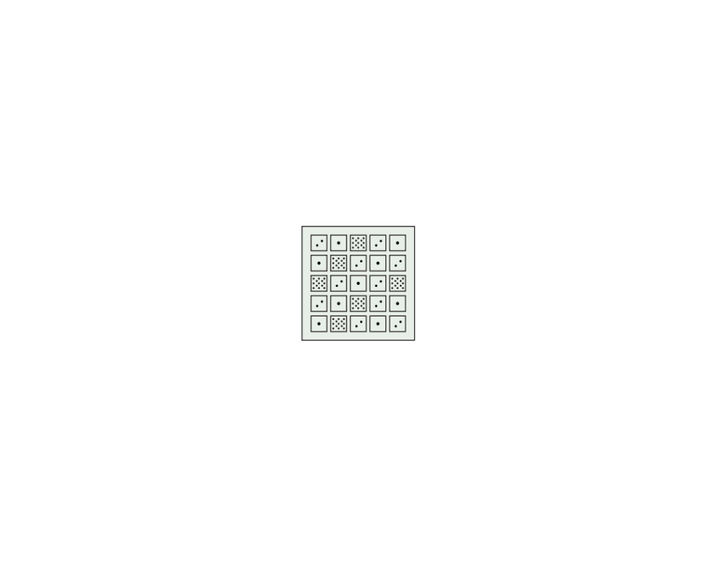
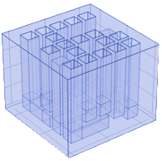
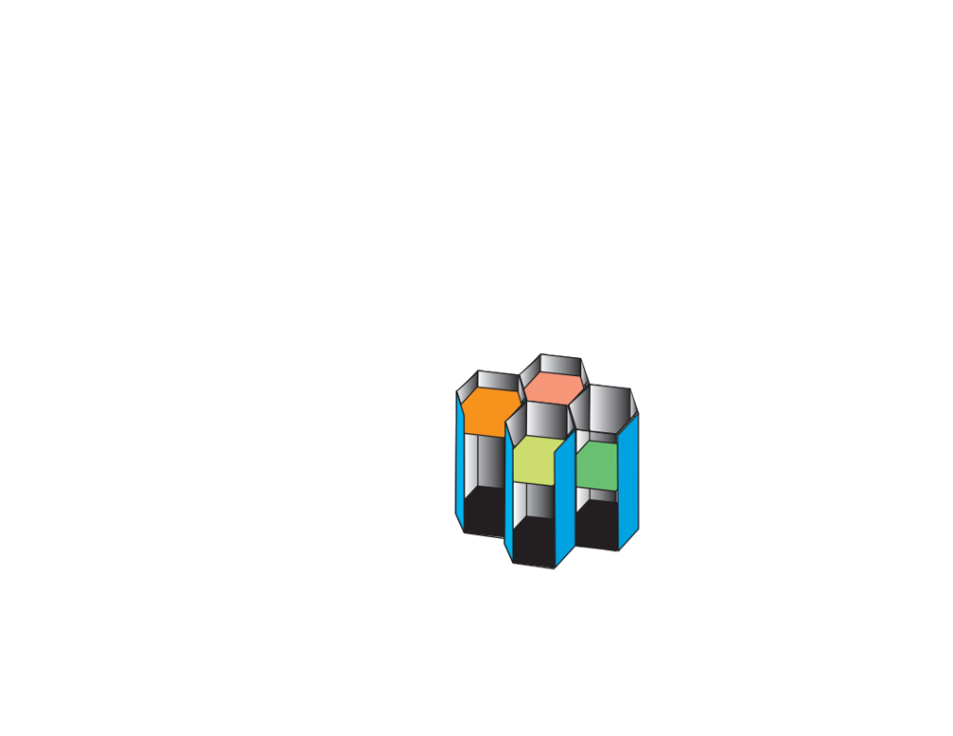
Background
Conventional Acoustic Liners
convert acoustic energy into heat and micro-vortices
Novel Liner Concepts
Variable facesheet
Bent chambers
Mesh cap MDOF
Liner Physics Team Goals
Develop evaluation tools and advanced acoustic liners to achieve increased noise reduction over a wider frequency range AND to reduce liner drag
Explore use of additive manufacturing and advanced robotics to enable advanced liner concepts
Notes:
For those of you not familiar with our group and as the name implies, we work to understand the physics of liners in order to develop acoustic treatments to reduce aircraft noise and the drag associated with those treatments. The goal is to not only come up with and experimentally evaluate liner designs and concepts like those shown here, but to also develop tools and methods for modelling and simulation so we can understand the benefits of liner use in various applications. Our productivity has been greatly enhanced by the rise of additive manufacturing and advanced robotics employed by us and our partners. These tools have made fabrication of the necessary test articles much more efficient and lest costly than even a decade ago allowing us to explore more ideas than ever before.

Slide 3
NASA LaRC Liner Physics Team
Structural Acoustics Branch:
Chelsea Dodge, Matt Galles, Matt Hayes, Brian Howerton, Mike Jones (lead), Doug Nark
Aeroacoustics Branch:
Martha Brown
On-site contractor support:
Max Reid, Larry Becker
Connections with NASA GRC Acoustics Branch
Notes:
The work detailed in the following slides was done by the folks shown here comprising of a mix of civil servants and contractors with Mike Jones as the lead. We also connect with our counterparts at Glenn for certain projects.

Slide 4
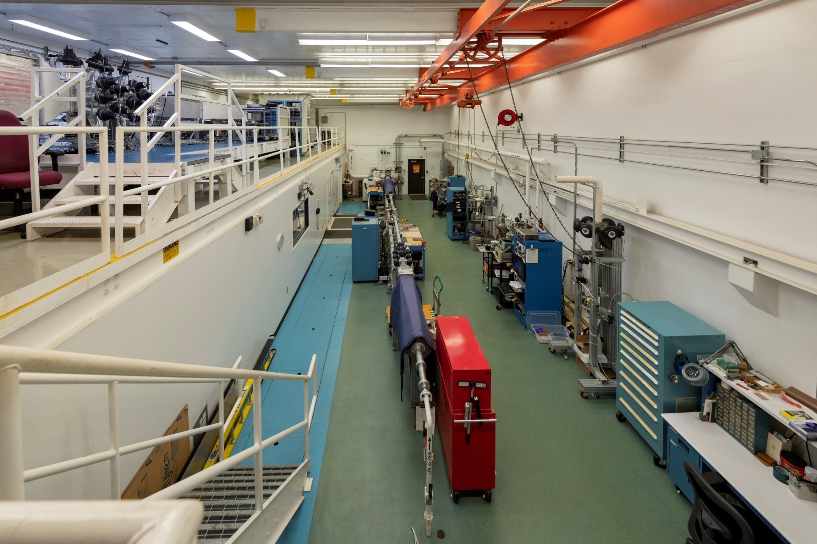
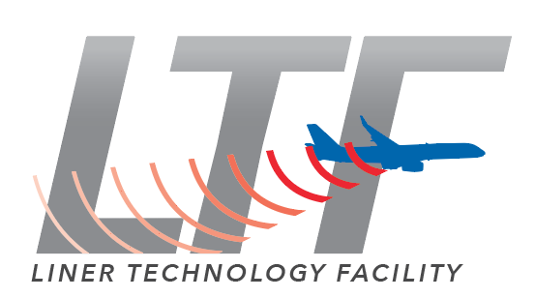
Liner Technology Facility
Raylometer
Normal Incidence Tube (NIT)
Grazing Flow Impedance Tube (GFIT)
Curved Duct Test Rig (CDTR)
4
1
Commissioned in 2009
~$10M investment
~20 tests/year
~$200k/year reimbursable work
TRL 0 → 4
3
2
Critical facility for US industry
Notes:
The experimental equipment for the team is housed in the Liner Technology Facility that has been operating for over a decade now. The four major rigs are numbered in the photo and allow us to determine the acoustic impedance characteristics of a liner under various conditions. We run, on average, 20 tests a year split between internal research, collaborative work with other centers and universities, and testing for industry. The industry testing under reimbursable SAA’s has recently averaged about 200k per year and has seen significant growth in the past decade. Our rigs work at relatively low TRL’s which have the advantages of being cheap to build samples for and operate. (CLICK) The lower TRL hasn’t put off our industry partners, though, which consider the LTF a critical facility for their noise reduction efforts.

Slide 5
Fundamental Research
Goal: Develop improved, lower-order acoustic liner modeling
Need improved modeling to enable efficient liner design optimization
Extend models to incorporate features of new concepts
Investigate the effects of variation in individual liner components (building-block approach)
  Facesheet perforations
  Core partition thickness
    Straight
    Bent
  Variable depth
Initial studies in the LaRC Normal Incidence Tube (NIT) for no flow
Allows rapid evaluation of full engine ‘what-if’ scenarios with various liner concepts
Notes:
The first part of this talk is going to focus on what I term ‘Fundamental Research’ where we’re looking to understand some aspect or component of liners and how that aspect affects overall acoustic performance. The next few slides will focus on efforts to improve the lower-order models we rely on to do liner design optimization. These models may lack the fidelity of something like a full up COMSOL simulation, but they are quick and can be accurate enough for initial designs where we may need to sift through thousands of variations in search for the most promising. We’re going to show some experiments done in the NIT from this ‘building-block’ approach for some liner components. What’s the payoff for all this? (CLICK) We want to use these models to rapidly evaluate full-engine ‘what-if’ scenarios using our liner concepts and the computational tools for source modeling and propagation developed by the group.

Slide 6
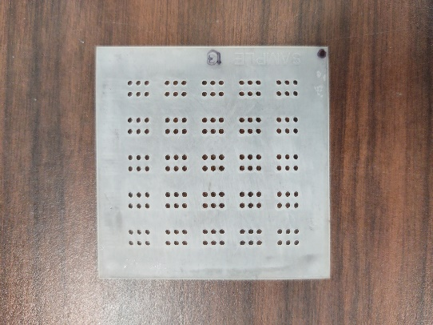
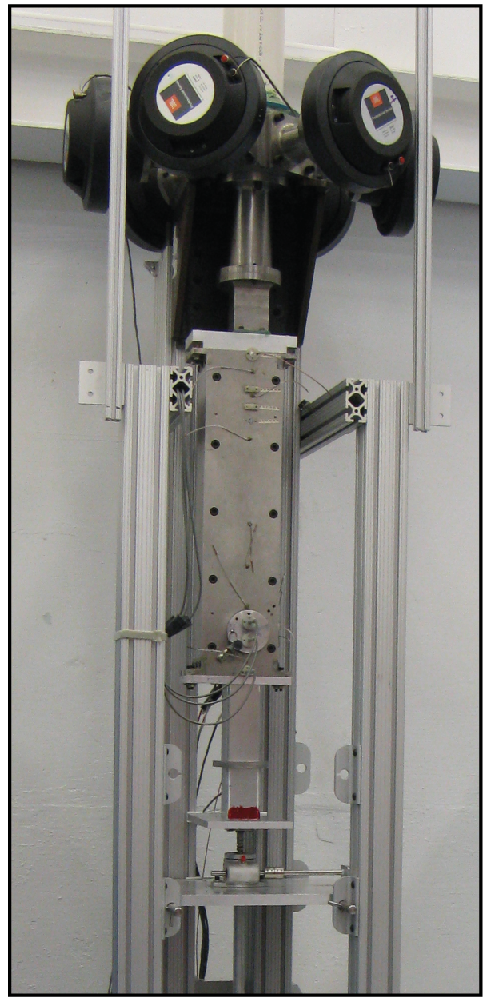
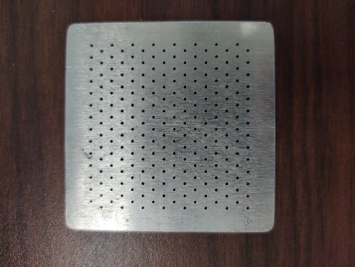
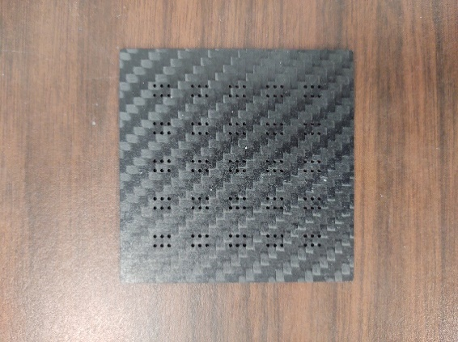
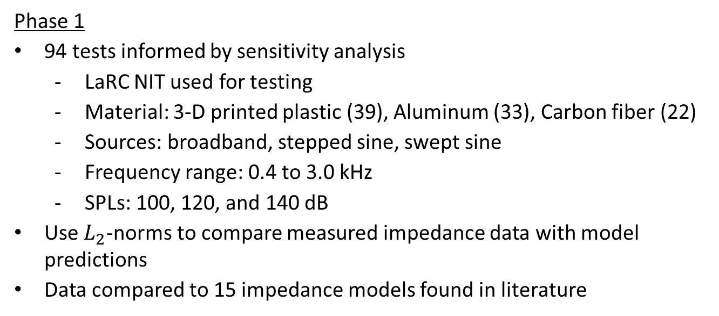
Fundamental Research – Perforate Model Database
Goal: An accurate facesheet impedance model for use when designing various liner concepts (conventional and novel)
Facesheets
NASA LaRC NIT
Phase 1
94 tests informed by sensitivity analysis
  LaRC NIT used for testing
  Material: 3-D printed plastic (39), Aluminum (33), Carbon fiber (22)
  Sources: broadband, stepped sine, swept sine
  Frequency range: 0.4 to 3.0 kHz
  SPLs: 100, 120, and 140 dB
Use $L_{2}$-norms to compare measured impedance data with model predictions
Data compared to 15 impedance models found in literature
Plastic
Aluminum
Current Observation: The Motsinger and Kraft model works best for the configurations tested so far
$$ζ=\frac{32μt}{ρc\left(σC_{D}\right)d^{2}}+\frac{u_{rms}}{2c(σC_{D})}+\frac{M_{C/L}}{σ\left[2+1.256\left(δ_{1}/d\right)\right]}+i\left\{\frac{k(t+εd)}{σ}−cot(kh)\right\}$$
Carbon Fiber
(Ikonics SAA)
  Motsinger, Kraft, “Design and Performance of Duct Acoustic Treatment: Aeroacoustics of Flight Vehicles; Chapter 14, Vol. 2: Noise Control,” NASA RP-1258, 1991
SDOF Liner
Notes:
The first study we’re doing is focused on figuring out the best facesheet perforate impedance model to use. In Phase 1, we’re testing a large number of facesheets in the Normal Incidence Tube at Mach 0 over a common core with variations in porosity, hole size, and material for multiple acoustic sources and levels. The Two-Microphone Method is used to determine the experimental acoustic impedance which is compared to predictions from 15 models culled from literature to see how well they match. (CLICK) So far, Motsinger and Kraft’s model compares best to the experimental results but that may change as we test and analyze more configurations. I also want to give recognition to Ikonics for manufacturing the carbon fiber facesheets under an SAA we have with them.

Slide 7
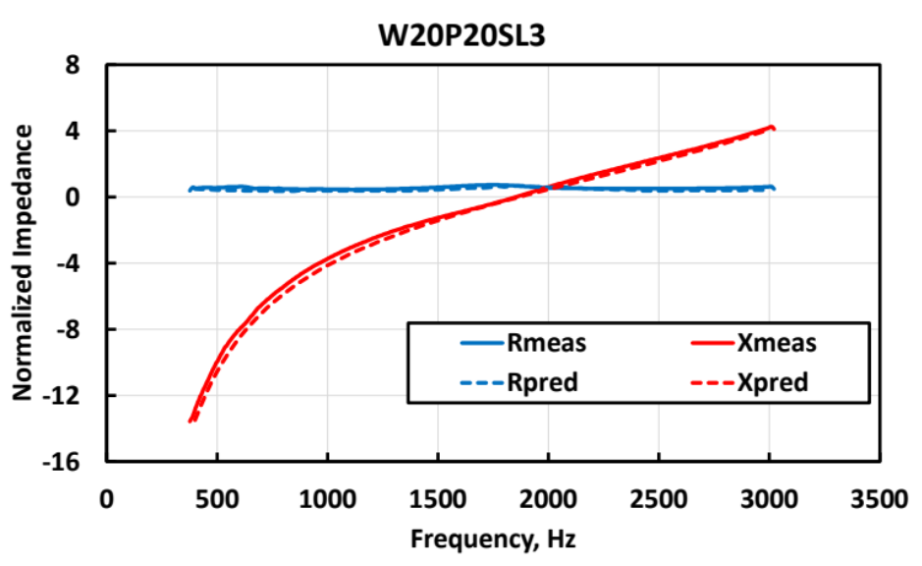
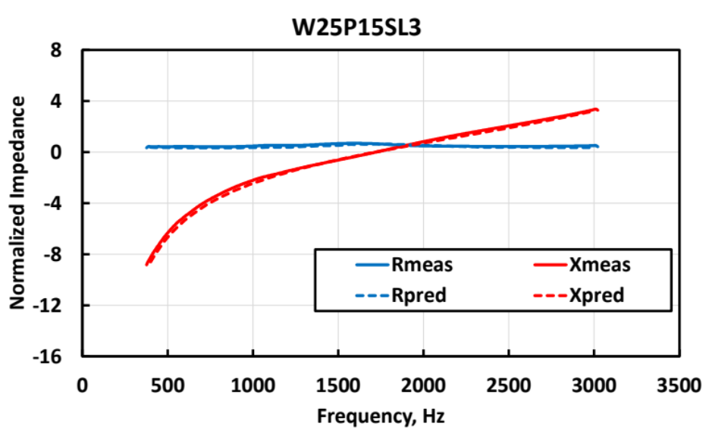
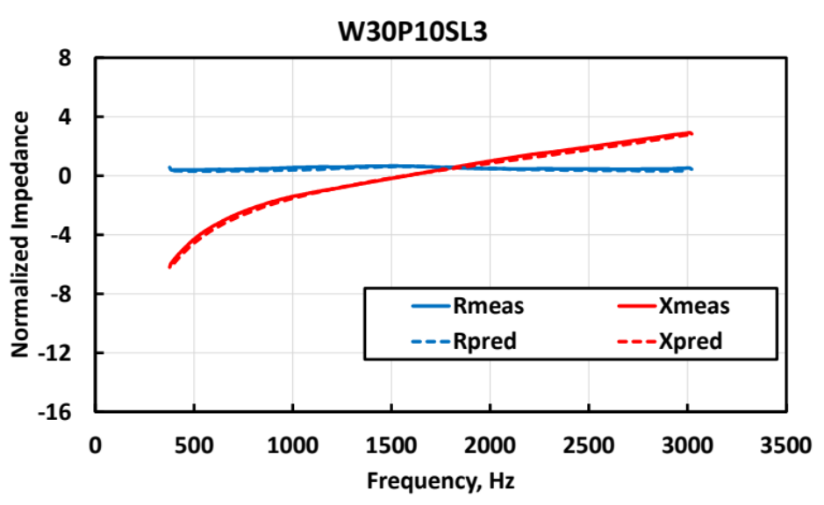
Fundamental Research – Partition Thickness (Straight)
Goal: Understand the effect of partition thickness on educed impedance of straight chamber cores
0.1 in
Samples tested in the NIT w/ common perforate facesheet
Good comparison between predicted/measured impedance spectra for each configuration (normal incidence, no flow)
Must account for change in surface porosity
Very noticeable effect (flattening) on reactance spectrum
Further review with ONERA
Res, meas
Res, pred
Rea, meas
Rea, pred
Sample Cores
0.15 in
0.2 in
0.1 in
Res, meas
Res, pred
Rea, meas
Rea, pred
Res, meas
Res, pred
Rea, meas
Rea, pred
0.15 in
0.2 in
Notes:
We’re also looking at the effect of cell partition thickness on educed impedance for straight chambered liner cores. On the lower left you can see the cores tested in the NIT using a common, conventional perforate facesheet. The plots on the right show the measured impedance spectra for each thickness as the solid lines with the corresponding predictions as dashed lines. The comparison between the two is very good as long as you account for the change in surface porosity as the partitions get thicker. Noteworthy is a general flattening of the reactance spectra with increasing thickness which can be favorable for absorption. We are also working with ONERA to investigate the effects of partition thickness on interactions between adjacent chambers.

Slide 8
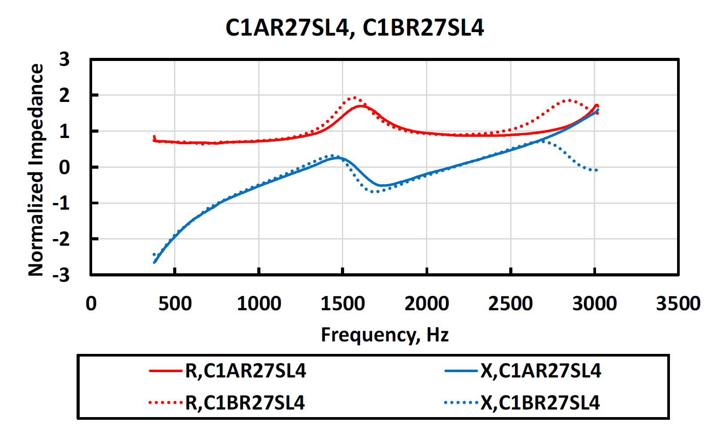
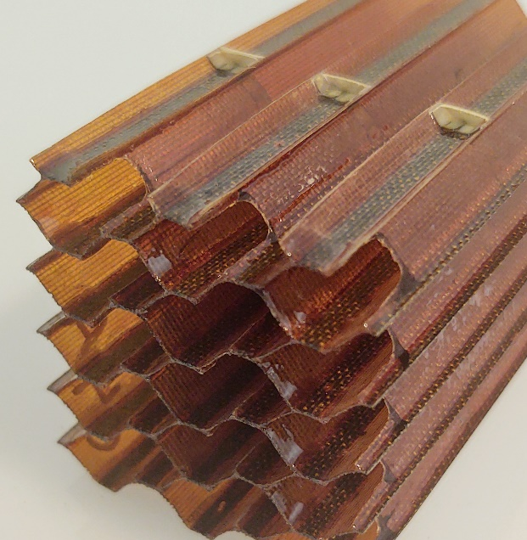
Fundamental Research – Partition Thickness (Bent)
Goal: Understand the effect of partition thickness on educed impedance of bent chamber cores
Samples tested in the NIT
Broadband and Swept-Sine source @ 120 and 140 dB
Thick-wall core → the effect is noticeable but predictable (good isolation between adjacent segments)
Thin-wall core → interaction effects observed between chambers, slot effect minimal except at high frequencies
Partitions removed
Thin-wall core, Mesh FS, 140dB
Res, Slotted
Res, No slot
Rea, Slotted
Rea, No slot
3-D Printed
Phenolic Honeycomb w/ slots
Notes:
Some of our liner concepts take advantage of bent chamber cores to efficiently package the longer chambers necessary for low-frequency absorption without resorting to excessively thick liners. Much of our initial research with bent chambers employed 3-D printed configurations with relatively thick partitions between chamber segments. These can be predicted well as long as you account for the surface porosity as mentioned before and include the Cummings correction for the bends. Working with our partners at Hexcel under a Space Act Agreement, we put together some thin-wall core samples from fairly standard phenolic honeycomb but removed selected portions of the partitions between adjacent channels at the bottom of the core to create a bent chamber. So think of them like strategically-placed drainage slots. The plot on the right shows some impedance results for configurations with and without the slots. It’s interesting to note how little effect the slots have until you get to the higher frequencies but we still get the benefit of the longer bent chamber.

Slide 9
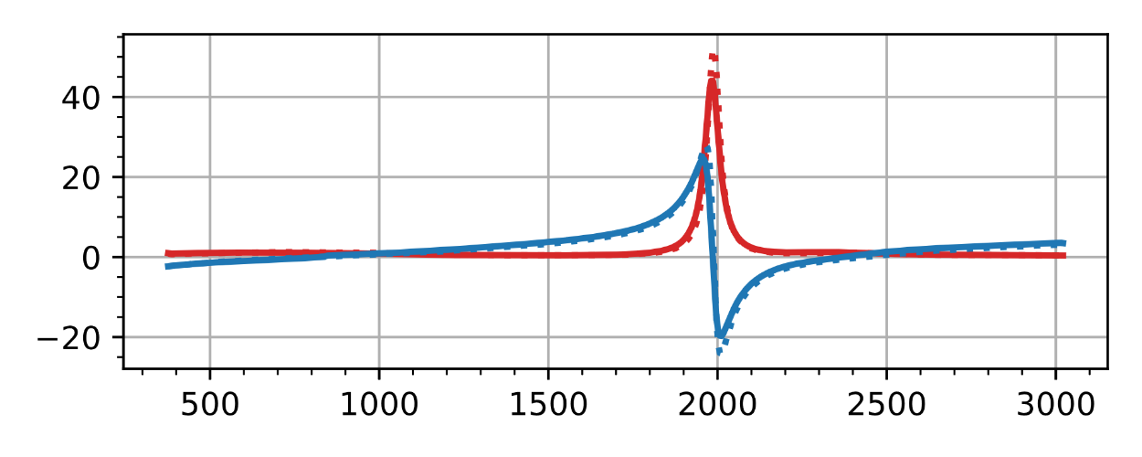
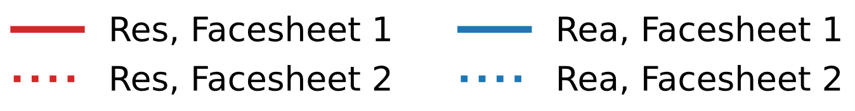
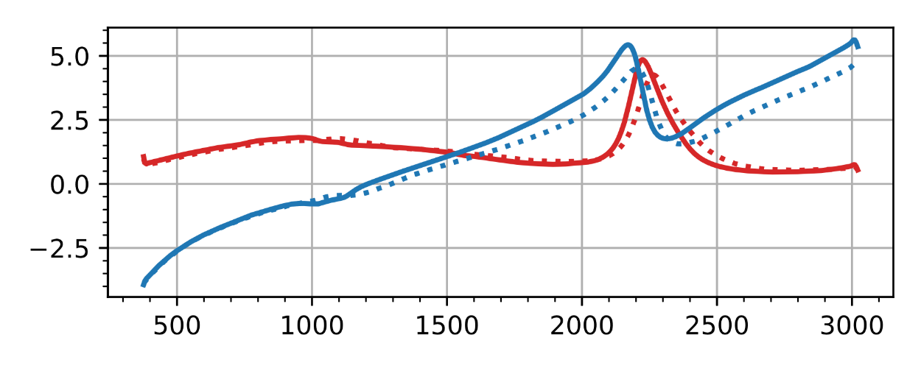
Fundamental Research – Variable Depth
Goal: Validate method of accounting for partition thickness in variable depth liners
Uniform Depth
NIT tests of 112 combinations (liner core, facesheet)
Six cores designed to target four frequencies
  Three variable depth (non-harmonic)
  Three uniform depth (single frequency)
One core targeting harmonic frequencies
  1000, 1500, 2000 and 2500 Hz
Four facesheet configurations tested
  No facesheet
  Wire mesh
  Two conventional perforates
Analysis to select samples for GFIT testing
Stay tuned…..
Normalized Impedance
1
1
1
1
1
Variable Depth
Normalized Impedance
1
2
3
4
4
Frequency (Hz)
Notes:
Now we want to look at the effect of partition thickness for variable depth liners. Matt Galles is working through a test plan now to evaluate a large number of core and facesheet combinations. The cores are designed to target various frequencies with and without harmonics and will be tested uncovered with no facesheet as well as with a linear wire mesh and two perforates to get some non-linear effects. The plots on the right are impedance spectra from some recent measurements with two cores (both uniform and variable depth) and a couple of facesheets to give you an example of what we’re seeing. Analysis will include comparison to predictions using transmission-line codes and a downselect to a few combinations that will be built and tested in the Grazing Flow Impedance Tube so we can incorporate flow effects. So stay tuned to find out what we learn.

Slide 10
Fundamental Research – SPL Effects
Goal: Determine if impedance educed in grazing flow can vary w/ liner length due to axial variation in SPL
Initial idea from ONERA
Questions to answer
  Bigger effect near resonance? (significant liner attenuation)
  More pronounced at lower Mach? (flow effects not dominant)
Test plan completed
  12”, 16”, and 20” liner lengths, same facesheet and core design
  Mach 0.0, 0.3, 0.5
  Tone source @ 120 and 140 dB SPL
12”
Liner samples
16”
20”
FLOW
GFIT
Notes:
Most conventional liners are weakly non-linear with SPL so local impedance should vary somewhat along the length as the sound is attenuated. Right now, when we educe a liner’s impedance, we assume it to be uniform over it’s axial extent even though we know that probably isn’t the most accurate answer. So we’re now looking to investigate this in detail to see when and how much this SPL effect matters. The topic brings up two fundamental questions: do we see a bigger effect near the resonant frequencies when the liner should be doing a good job attenuating the incoming sound and what happens when we introduce grazing flow? Are we going to see any variation diminish when Mach number is increased? The acoustic data for this has been acquired in the GFIT using samples with a common core and facesheet design but varying the liner length to get an axial SPL reduction.

Slide 11




Fundamental Research – SPL Effects(cont’d)
Impedance eduction approaches
  Assume impedance is uniform (i.e., hypothesis is invalid)
  Assume impedance variability can be approximated by a zonal description (e.g., split length into 3 zones)
Next Steps
  ONERA evaluation using impedance function that varies with axial location
  NASA evaluate data using more advanced zonal approaches
  Compare results to determine if/when SPL effects matter
uniform impedance
zonal impedance
$$ζ$$
$$ζ_{1}$$
$$ζ_{2}$$
$$ζ_{3}$$
Preliminary Results: Confirmed effect near resonance and at low Mach (M)
Notes:
We’ve taken this data and run it through our iterative Convected Helmholtz Equation-based eduction code (usually referred to as the CHE code) in two ways. First, the impedance was assumed to be uniform as we’ve always done and we get an answer that way. Then, we divided the sample into three axial zones and allow the code to solve for the impedance of each simultaneously. This zonal approach takes significantly more time to compute an answer due to the additional degrees of freedom the optimizer has to deal with, so it would be good to use this approach only when necessary. We’re still looking at the data (CLICK), but the initial results confirm an effect near resonance especially when the grazing flow Mach number is low. As part of our collaboration with ONERA via an International Agreement, they are exploring the use of continuously variable impedance models to evaluate this data.

Slide 12
Fundamental Research – IFAR
Goal: Study influence of acoustic source on educed impedance
IFAR (International Forum for Aviation Research)
Partners: NASA, DLR, FOI, JAXA, ONERA, TsAGI
NASA serves as lead – defines challenges for collaboration
Challenge → Evaluate the effects of source type, level, and location
Liner Configurations
CT57 (ceramic tubular, calibration)
CSQ3 (3-D resin, calibration)
IU2 (conventional perf, 2” depth)
IU2T (thick conv. perf, 2” depth)
Source Location
Upstream (aft duct)
Downstream (inlet)
Source Type
Tone
Broadband
Sine-Sweep
Tunnel Conditions
Mach = 0.0, 0.3, 0.5
Levels = 120, 140 dB
Upstream Drivers
(Aft mode)
Downstream Drivers
(Inlet mode)
FLOW
GFIT
Notes:
As part of our continued participation with the International Forum for Aviation Research, We’ve put together a new challenge looking at source effects on the educed impedance of a liner. The plan is to take four liners, two of our calibration liners that we’ve tested previously and two conventional ones used in previous IFAR challenges, and test them with a variety of source conditions. We’ll analyze the data with our methods and provide the measurements to the partners so they can apply their tools and compare the impedance results. The intent is to help the partners gain better understanding of each other’s processes and how to interpret their products. Testing is underway and should be complete by the next TWG.
Now that I’ve talked about our fundamental research to understand more about the components of liners, I want to show some of the full-up liner concepts we’ve been evaluating along with some selected results.

Slide 13
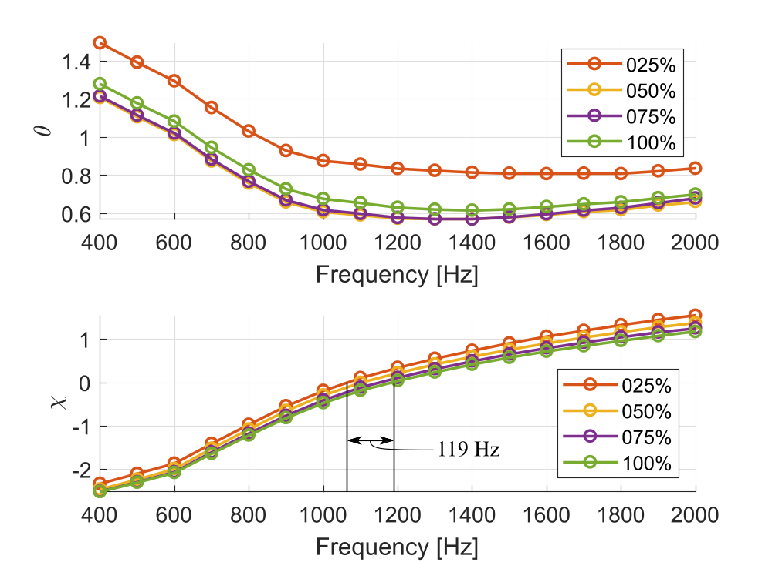
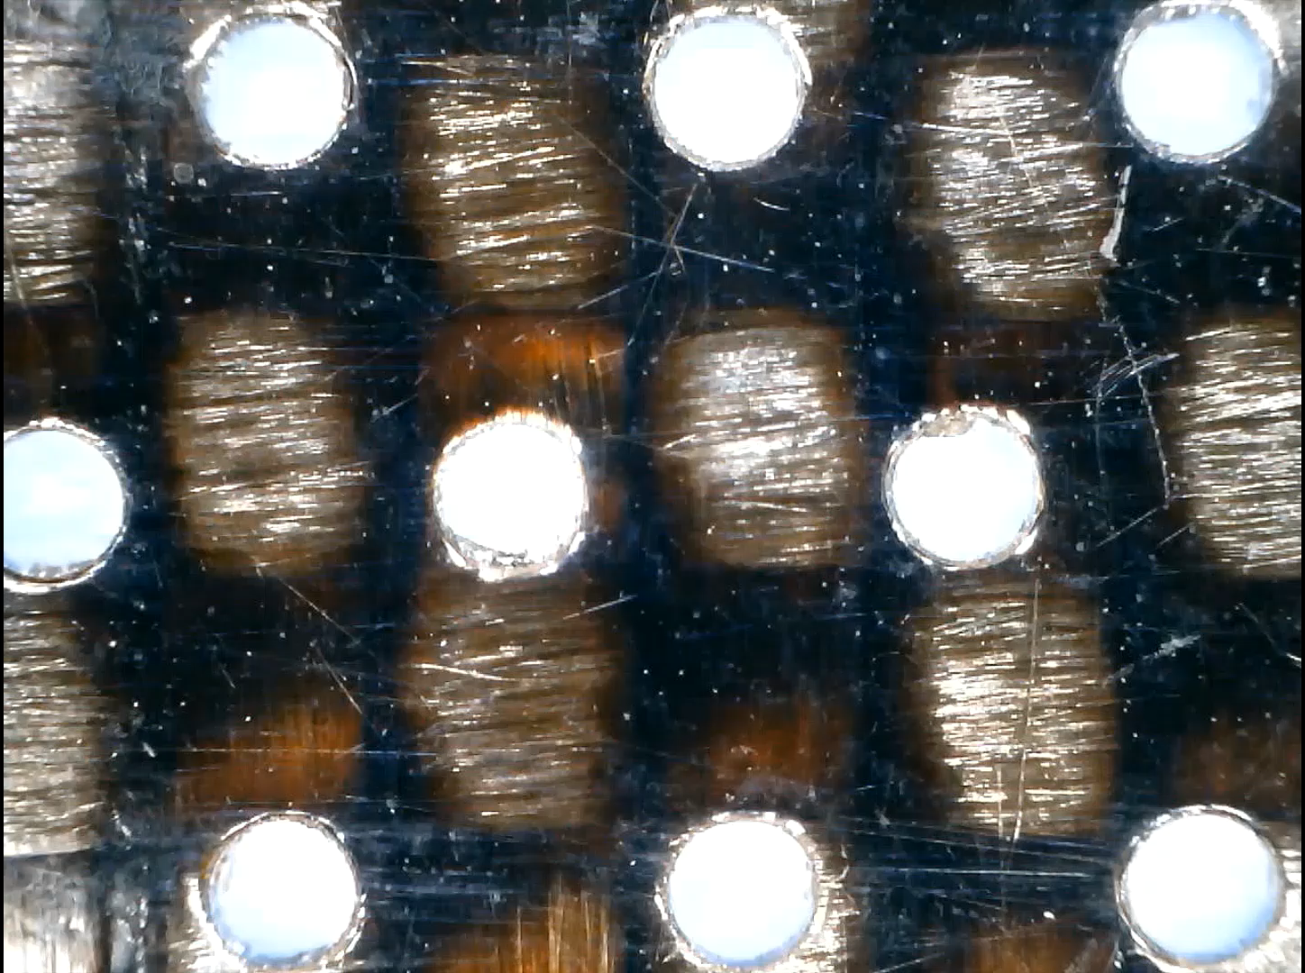
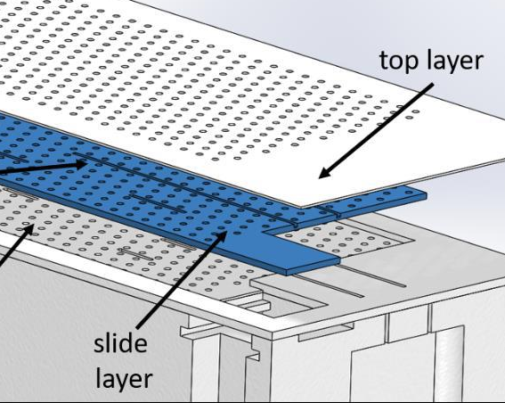
Concept Evaluation – Active Liner
Goal: Evaluate active liner to control impedance/reduce drag
Impedance variation w/ Perforate opening
Developed under NRA w/ Boeing-FSU
Controlled, variable-porosity facesheet, ~10% POA
Shape Memory Alloy (SMA) activated
Tested in GFIT, M=0.3, 120 and 140 dB, more to follow
Resistance
Active Liner sample
Preliminary result: Measurable effect on impedance, minimal effect on drag (no sound)
Magnification of FS perforation
Reactance
Resistance Factor vs. Perforate Opening
M=0.3, no sound
Notes:
One such concept is what we term the active liner developed in conjunction with Boeing and Florida State University under an NRA. The idea behind it is to use a controlled, variable porosity facesheet to alter the liner’s impedance spectra. The lower left image shows the implementation which is accomplished by stacking three perforate sheets with match-drilled holes and sliding the middle sheet, relative to the other two, using SMA wire. (CLICK) The video in the middle, taken with a microscope, shows the actuation to various perforate openings. We’ve tested this in the GFIT at Mach 0.3 with sound to determine the liner’s impedance characteristics as shown in the upper right figures. One can see that we get some noticeable changes in both resistance and reactance as the openings are adjusted. We also took some drag measurements with no sound as shown at the lower right. It was a little surprising that we didn’t see more variation in resistance factor as the porosity was varied but this could have something to do with the stacked facesheet construction which is atypical relative to conventional liners. (CLICK) Tests are ongoing for no flow and at higher Mach numbers so look for further results in the coming months.

Slide 14
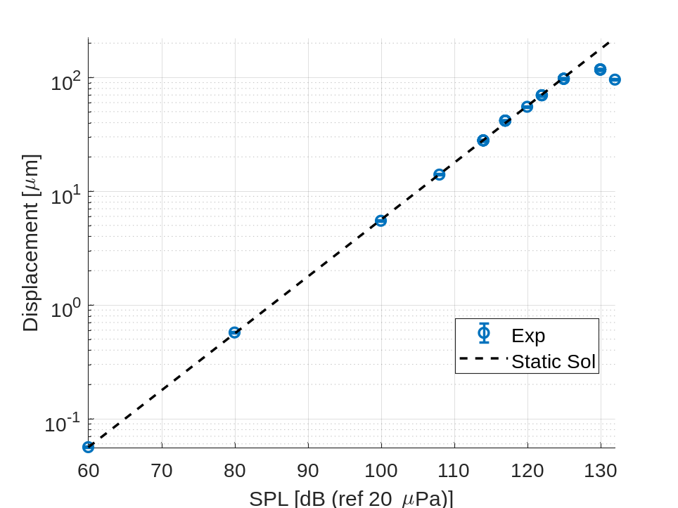
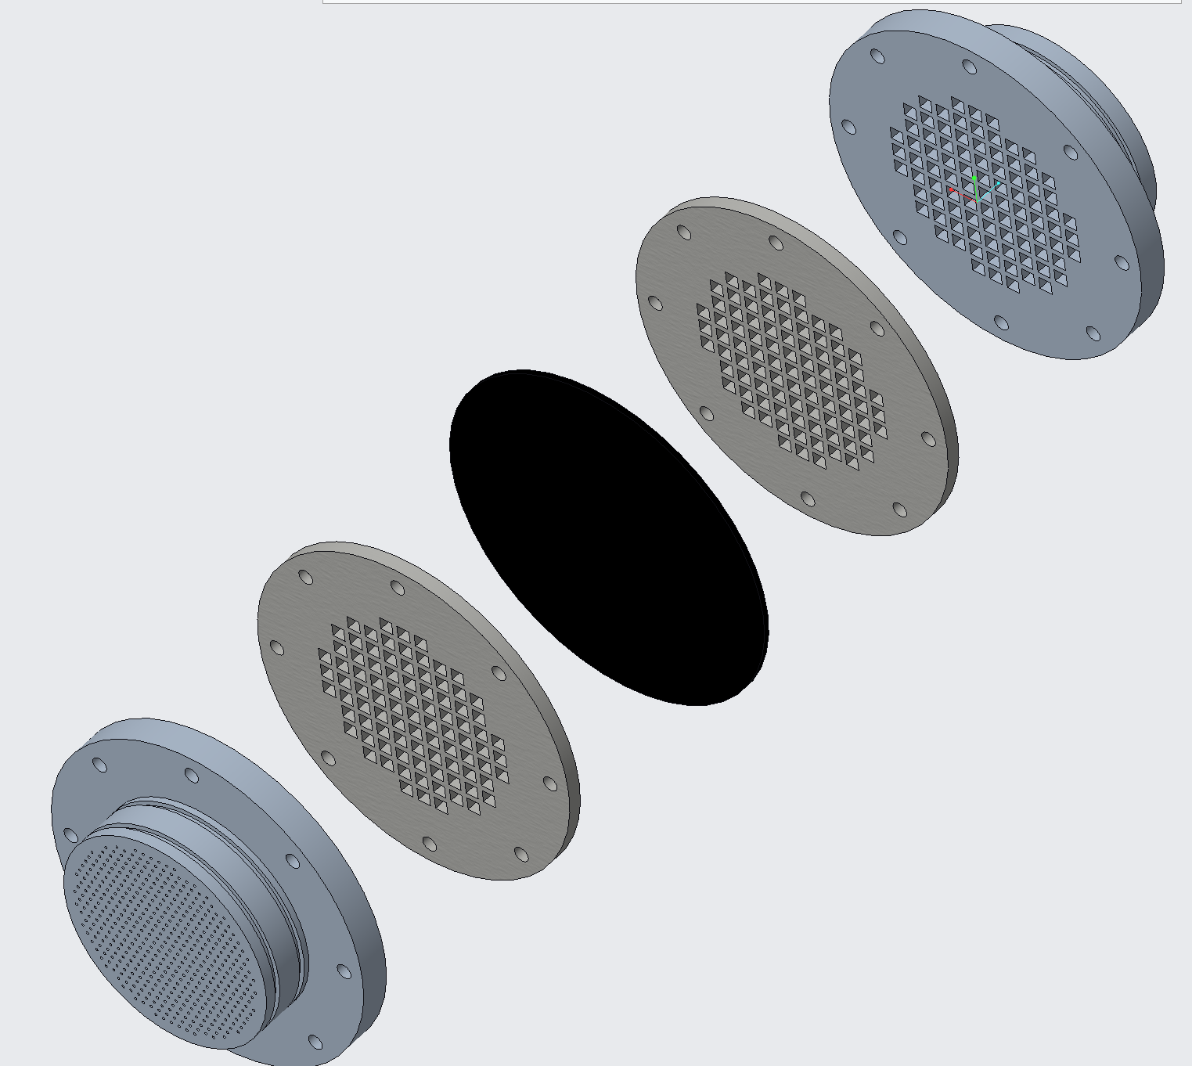
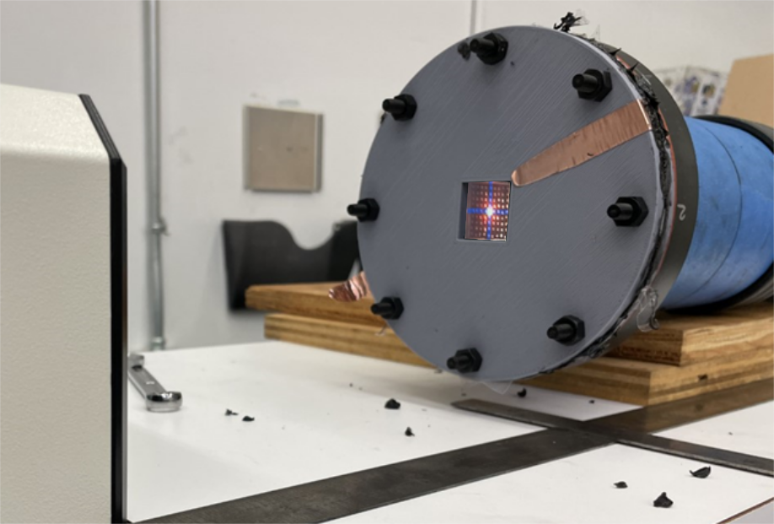
Concept Evaluation – DEAL
Goal: Investigate Dielectric Elastomer Acoustic Liner (DEAL) concept to actively vary liner impedance
Dielectric elastomer (DE) embedded septa
Impedance variation by changing elastomer compliance via voltage
Laser vibrometer tests to characterize elastomer response
Next Step → validate DE response model for DEAL optimization
Elastomer Displacement vs. SPL
Nonlinear
Embedded Dielectric Elastomer
Laser Vibrometer Testing
110 120 130
Backing Cavity
Backplate
DE
Backplate
Acoustic liner:
FS & Cavity
Notes:
Chelsea Dodge, in addition to her work on the Active Liner, has been looking at the DEAL concept whereby a dielectric elastomer embedded septum is placed in the core similarly to a 2DOF liner. The figure on the left is an exploded view of the components with the elastomer in the middle. By altering the compliance of the elastomer through the application of voltage, you can change the liner impedance characteristics. Right now, she’s doing laser vibrometer tests to measure the displacement of a sample piece of elastomer when subjected to acoustic excitation from the back side to characterize elastomer response. The plot on the right compares the measured displacement of the membrane to theory and shows good agreement until you get to higher sound pressure levels where things get nonlinear. The purpose of this data is to validate the elastomer response model she’s developed for use in optimizing the next version of DEAL.

Slide 15
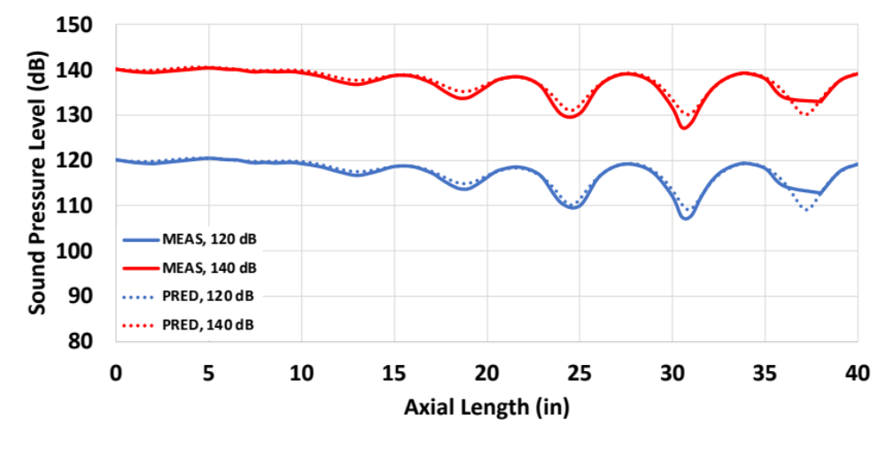
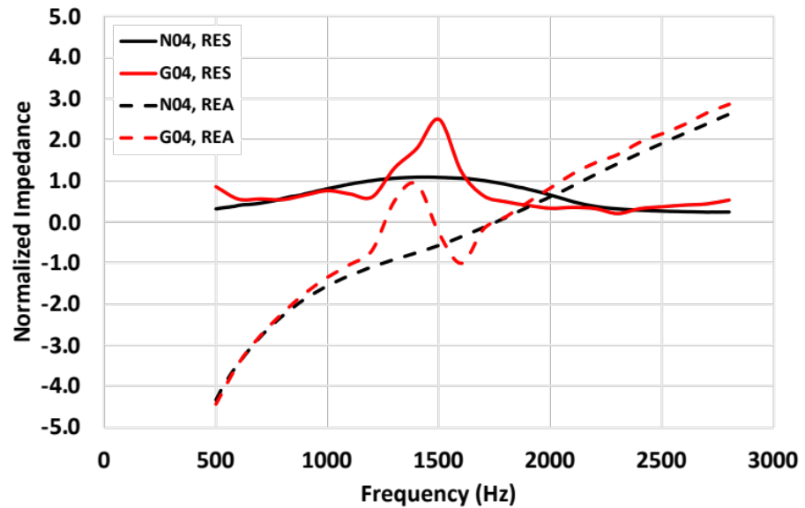
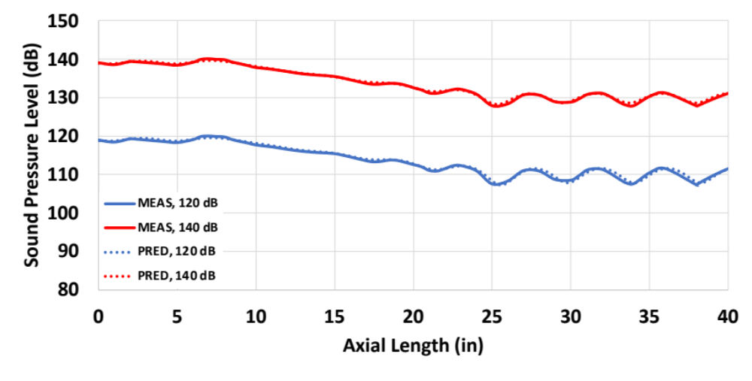
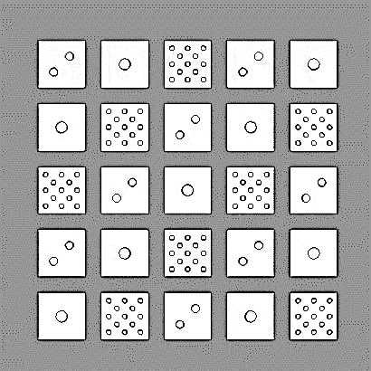
Concept Evaluation – Variable Facesheet
Goal: Predictably modify liner impedance via variation in facesheet porosity
Predicted vs. Measured SPL, M=0.3
Variable porosity/perforation over SDOF core
Tested in the NIT (no flow, normal inc.) and GFIT (w/ flow, grazing inc. )
Good comparison of measured data and predictions (CHE)
Brown et al. AIAA 2021-2243
Next step → use optimizer to explore performance limits
1000 Hz
liner
Sample facesheet
1500 Hz
liner
Cell-to-cell variation in porosity, hole size and distribution
Notes:
Martha Brown has continued her work on the Variable Facesheet concept reported on previously where she’s looking to alter a liner’s impedance characteristics by locally varying the facesheet geometry. What we’ve seen is that you can take a simple, uniform depth SDOF core and by changing hole size, porosity and hole distribution, get a much more ‘interesting’ impedance spectra as shown in the lower left figure. The black lines are for a uniform facesheet and core and give a spectra like one would expect. Applying the variable facesheet shown to the same core results in much different spectra. The nice thing about this effect is that we can do a pretty good job at predicting it even with flow. The right plots show a case at Mach 0.3 of measured data from the GFIT (solid lines) vs the dashed lines which are SPL predictions using a Prony-derived impedance and the convected Helmholtz equation for propagation. You can see that the agreement looks pretty good. Based on this, we want to employ an optimizer to explore the design space and determine how effectively we can alter impedance.

Slide 16
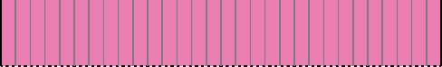
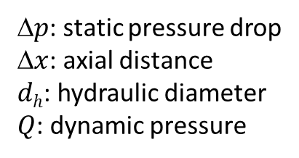
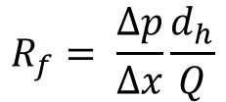
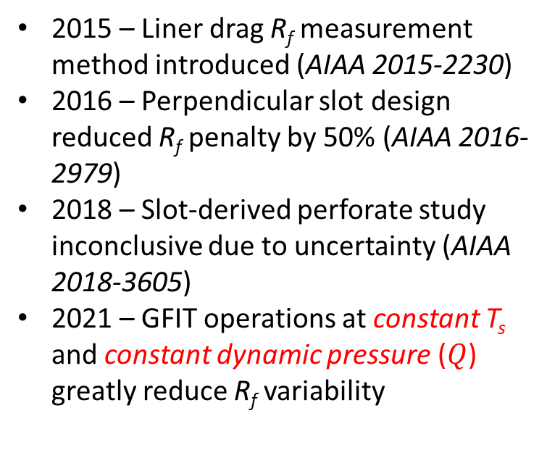
Test Technique Development – Liner Drag Uncertainty
Goal: Reduce drag measurement uncertainty to enable further evaluation of novel perforates
Constant Mach, Uncert. = +/- 4.23%
2015 – Liner drag R_{f} measurement method introduced (AIAA 2015-2230)
2016 – Perpendicular slot design reduced R_{f} penalty by 50% (AIAA 2016-2979)
2018 – Slot-derived perforate study inconclusive due to uncertainty (AIAA 2018-3605)
2021 – GFIT operations at constant T_{s} and constant dynamic pressure ($Q$) greatly reduce R_{f} variability
Resistance factor
$$R_{f}= \frac{∆p}{∆x}\frac{d_{h}}{Q}$$
2 days
Δ$p$: static pressure drop
Δ$x$: axial distance
$dh$: hydraulic diameter
$Q$: dynamic pressure
Constant T_{s} and Q, Uncert. = +/- 0.69%
2 weeks
FLOW
Liner
GFIT
Δx
Δp
Notes:
These next few slides are going to focus on improvements to the testing techniques employed in the LTF. So we’ve been working in the area of liner drag for some time now having implemented a way of measuring relative drag between liners via determination of their resistance factor shown by the expression in the middle of the slide. With it, studies have been done to report the effects of facesheet porosity, frequency and SPL variation, perforate hole size, and perforate shape on drag. This led to tests of perforate shapes that weren’t the round hole typically used in an effort to reduce the liner drag penalty between treated and untreated surfaces. Our best design uses slots with the long axis perpendicular to the flow and cut the penalty by 50%. We’ve tested other slot-derived designs but, statistically, were unable to discern any differences in the configurations due to measurement uncertainty. Recent work has shown that by operating the GFIT at a constant static temperature and dynamic pressure, we can reduce day-to-day uncertainty by a factor of 6 compared to using constant Mach. We plan to re-do the 2018 study to see if any of those perforate configurations yield additional drag reduction and look to see if previous data can be normalized via these parameters. These results will be published in an upcoming AIAA paper.

Slide 17
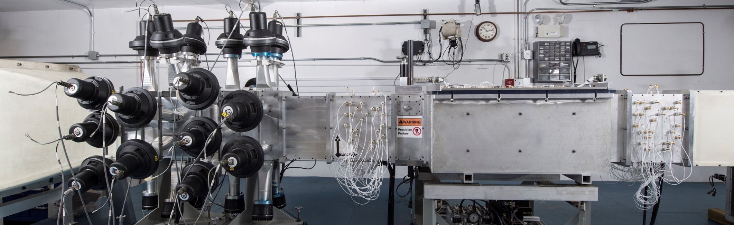
Test Technique Development – CDTR Calibration
Goal: Greatly decrease the time required to calibrate the Curved Duct Test Rig (CDTR) 158-microphone array
Drivers on @ 350Hz (plane wave)
Uses in situ method originally developed for the GFIT
Only one pistonphone calibration required (reference mic)
Determine duct exit impedance (TMM)
Original microphone array (electret)
Multifrequency calibration
Single microphone at a time
2-3 days for full array
Upgraded microphone array (condenser)
Single-frequency calibration
Simultaneous for all mics
5 minutes for full array
Calculate duct standing wave for SPL/phase @ each microphone location
SOUND
Upstream mics
Downstream mics
Measure SPL/phase @ for each mic
LINER
FLOW
Compare results and calculate corrections
Notes:
Over the past few years, we’ve been slowly gathering the resources to replace the CDTR microphone array which was experiencing some environmental degradation that couldn’t be repaired due to the design of its electret-based microphones. The new array uses condenser microphones of the same type we have in the GFIT and shouldn’t have those issues. An additional benefit of these new mics is the ability to implement a much simplified calibration method based on the approach we use in GFIT. Rather than requiring a laborious, multi-frequency calibration done one mic at a time, we can calibrate the entire array simultaneously, in-place with single-frequency excitation. The process starts by putting in a hardwall liner then turning on the drivers at 350 Hz to generate a plane wave. We then use a pair of microphones from the downstream array to acquire measurements with the Two-Microphone Method to determine the duct exit impedance. The exit impedance gives us a way to compute the standing wave pattern in the duct which provides the theoretically correct SPL and phase for each microphone location. Take data with the full array then compare the measured results to the theory to get the necessary corrections for each mic. There is some bookkeeping involved behind the scenes, but we can do in 5 minutes what used to take at least two days and that’s a big time savings.

Slide 18
Test Technique Development – Swept Sine w/ Flow
Goal: Extend the use of the Swept-Sine Method to the grazing flow environment (i.e. GFIT)
CT57 liner, 120 dB
M=0.3
Task with Vold, LLC
Adjustments made to improve spectral estimates
  re-sampled sweep signal as reference
    no flow noise
    analogous to Signal Extraction Method for tones
  adjust for reference phase delay
  account for axial frequency shift
  tuning of Vold-Kalman filter parameters
Incorporated constant source level at liner LE
New 64-bit version to allow for longer sweeps (more averaging)
M=0.5
Result: Swept-Sine validated for grazing flow up to M=0.5
Notes:
Since the last TWG, we’ve also done some work with Dr. Havard Vold under contract to extend the Swept-Sine Method of data acquisition and processing to handle the grazing flow environment of GFIT. Swept-Sine has been our preferred method in the NIT for a few years now because of the efficiency it offers without sacrificing accuracy. To deal with the flow noise present in the GFIT, some adjustments were necessary to improve spectral estimates and account for the microphone array layout. The plots on the right are impedance spectra from one of our calibration liners at 120dB acquired with the traditional Stepped-Sine approach compared with corresponding Swept results for two Mach numbers. The agreement is good especially away from the antiresonance condition near 2kHz. Not shown here is that agreement gets even better at higher SPL’s with their increased signal-to-noise ratios. (CLICK) So we feel comfortable using this method for grazing flow in the GFIT.

Slide 19
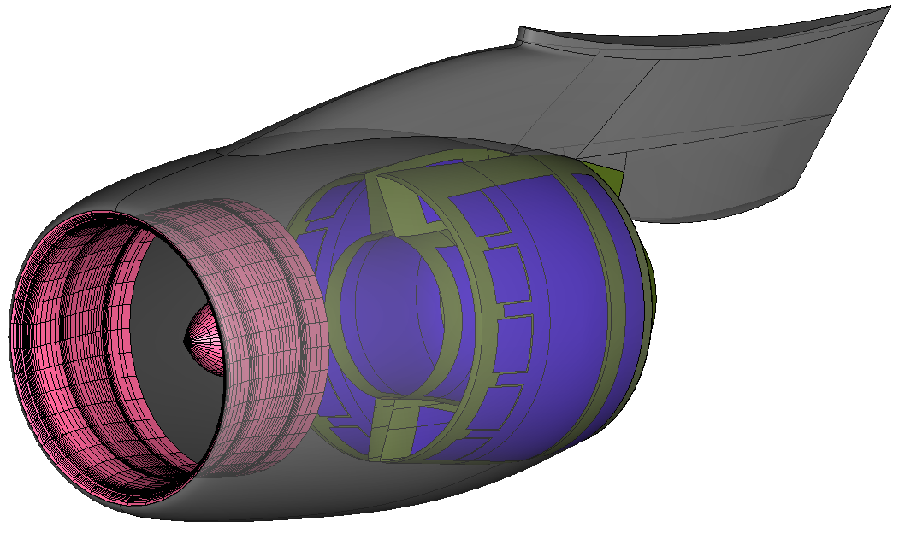
External – Boeing SAA
Goal: Acquire realistic engine nacelle geometry for use in liner optimization tool development
Realistic nacelle and flow path geometry for three engine classes
Apply liner optimization
  CDUCT LaRC for propagation
  Statistical Source Model for noise
  Lower-order liner models
Assess liner configuration benefits on representative geometry
Next steps → incorporate metrics for cost, weight, drag, etc.
Representative narrowbody engine nacelle
Also supports new ANOPP liner module development and system assessment uncertainty reduction
Notes:
Now that you’ve seen all this experimental work, here’s a freebie from the computational side. Through a Space Act Agreement with Boeing, NASA has been given the realistic nacelle and flow path geometry for three classes of turbofan engines (think small, medium and large). We’re pretty excited by this as we’ve never had such information before. With reason being that, now, we can use all the tools we’ve developed for liner optimization to apply our concepts in various configurations and assess the acoustic benefits. We also get to understand more about the locations and volumes available within the engine where treatment can be applied. Going forward, it would be good to include metrics for things like cost and weight to understand how that feeds into the producibility of a configuration. We also expect this engine data to help with our efforts in developing an new liner module for the ANOPP systems analysis tool and assist with understanding the interactions between various noise control technologies when applied throughout the engine so we can accurately determine the overall system benefits.

Slide 20

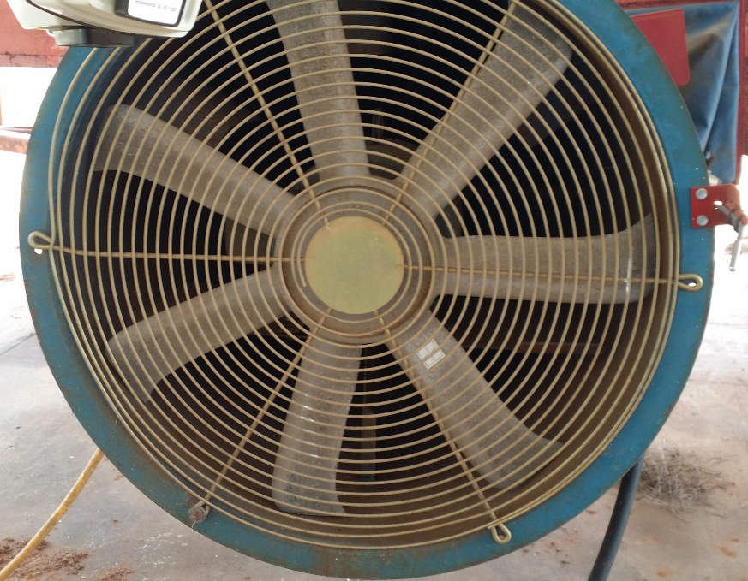
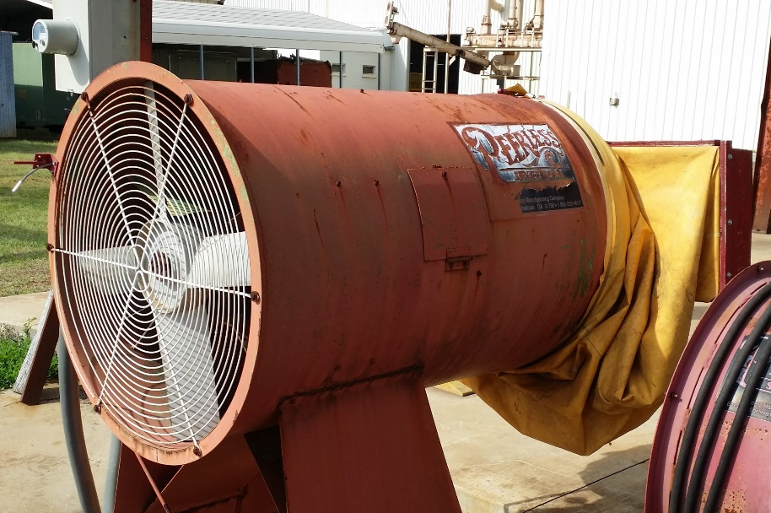
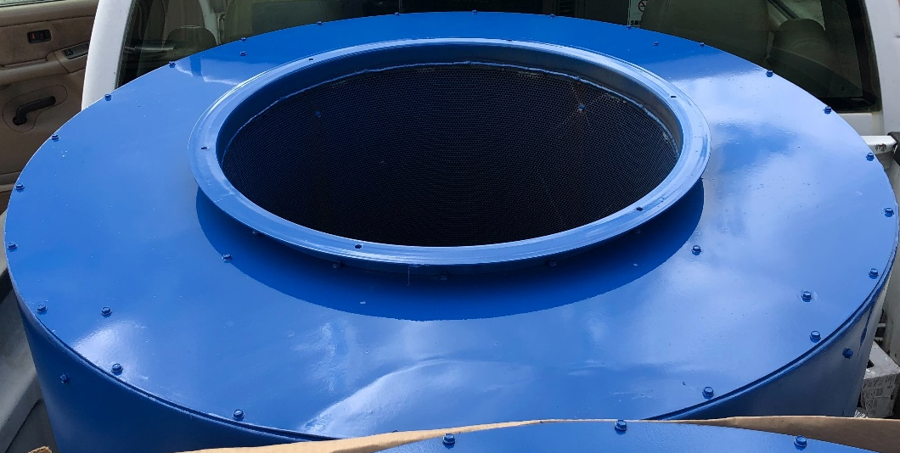
External – USDA
Goal: Reduce crop dryer fan noise to lessen community impact
Dryer Noise: Averaged FFT (uncalibrated)
Ducted electric fan combined with propane burner
Used to reduce crop moisture levels after harvesting (peanuts, soybeans, etc.)
Can be pedestal-mounted or portable (truck bed/towed)
Distribution points can have many running simultaneously and be near populated areas
tones
broadband
Crop Dryer Test Muffler
Notes:
A while back, we were contacted by the US Department of Agriculture’s National Peanut Research Laboratory regarding methods to reduce the noise generated by crop dryers used throughout the industry. The dryers have a lot of similarities to the engines we usually work on with their multi-bladed fans and a propane burners enclosed in a duct to blow heated air into trailers full of harvested peanuts and such. You can see examples of these in the photos below. Here’s what one sounds like in operation. (CLICK) Now imagine a dozen or more of these running simultaneously in close proximity to each other as is the case at the distribution centers where crops are brought for sale. These centers can be near populated areas and cause annoyance to the community. From the recording, one can hear the combination of tones and broadband as shown in the upper plot of the noise spectrum. This lead us to suggest some sort of bulk absorber as a first cut at a liner. The photo in the lower right shows a test muffler with a high-porosity perforated inner wall and a rather deep annular cavity to be filled with bulk material. We suggested packing it with used peanut hulls since they should be readily available. The plan is to test it on a dryer and make a fair number of noise measurements to get directivity and distance effects. Based on the results, we could offer some ideas for improvements. Certainly outside of our normal liner applications but an interesting problem.

Slide 21
Collaboration Invitation
Background
NASA, GE, Goodrich, and Boeing collaboration in early 2000s
Compared impedance spectra educed for similar liners with different test rigs and eduction methods
  perforate-over-honeycomb SDOF configurations
  flow impedance tubes
Since that study was completed
  improved measurement tools and new test rigs
  increased use of additive manufacturing and interest in novel liner configurations
Proposal for two collaborations
Experimental focus: compare current experimental tools, similar to earlier study
Computational focus: compare impedance eduction analyses using single data set
Provide confirmation to Mike Jones (michael.g.jones@nasa.gov) by November 30, 2021 if you have interest in participation in either of these collaborations (currently limited to USA entities)

Slide 22
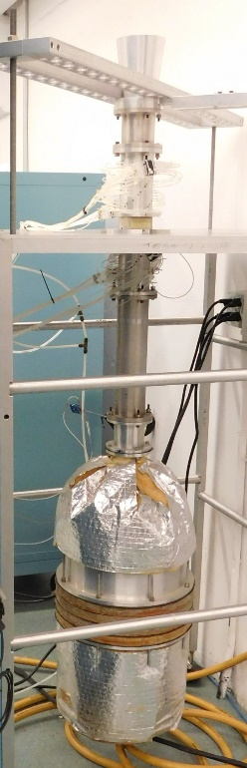
Experimental Focus
NASA provides design info for 3 to 5 liners (calibration, perforate-over-honeycomb, and wire mesh-over-honeycomb liners)
Partner builds liners to fit respective test rigs
Each partner conducts tests
  Use raylometer, normal incidence tube, and/or flow impedance tube
  Test conditions based on agreement between NASA and partners
NASA exchanges data with each participant where both parties tested same test points
Raylometer
Normal Incidence Tube
Grazing Flow Impedance Tube

Slide 23
Computational Focus
NASA provides acoustic pressure data and associated aero data from GFIT for up to 5 liners (possibly the same set of liners used for Experimental Focus)
Each partner processes data using their impedance eduction method to enable direct comparison
NASA exchanges data with each participant where both parties processed the same test conditions
  Educed impedance spectra
  Comparisons of predicted and measured acoustic pressure fields
Grazing Flow Impedance Tube

Slide 24

Notes:
Thanks for listening and I’ll be glad to answer any questions you may have.

