Slide 1
LISA Telescope
Technology Development Design
J. Livasª, R. Keski-Kuhaª
ªNASA-GSFC, 8800 Greenbelt Rd, Greenbelt, MD-20771, USA;
Mirror Technology Days
November 2, 2021

Slide 2
US Telescope Team
J. Livas ª, K. Boyce ª, A. Davis ª, R. DeRosa ª, P. Fulda ^{b}, J. Gleason ^{b}, T. Hardwick ª, W. Hayden ª, J. Howard ª, J. Ivanov ª, J. Kelly ª, R. Keski-Kuha ª, S. Kulkarni ^{b}, H. Legesse ª, J. Lehan ª, H. Li ª, G. Mathews ª, G. Mueller ^{b}, J. Sanjuan Munoz ^{b}, S. Sankar ª, L. Seals ª, Ada Uminska ^{b}, Andrew Weaver ª, Alexander Weaver ^{b}, M. Wilson ª
ª NASA-GSFC, 8800 Greenbelt Rd, Greenbelt, MD-20771, USA
^{b} University of Florida, Gainesville, FL, 32611, USA
Development Partner: L3Harris Corporation, Rochester, NY
Credited for the work on LISA Telescope Technology Development Design

Slide 3
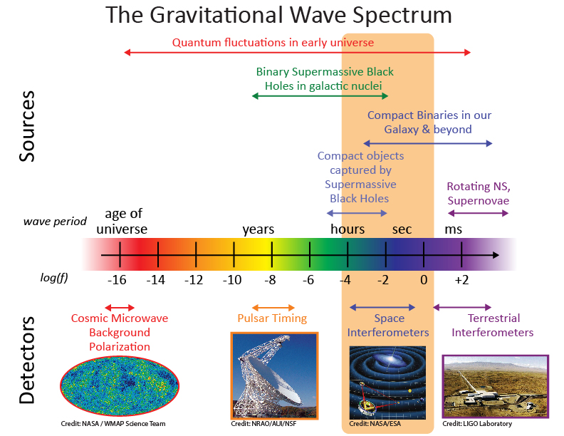
LISA Context
Why is LISA important?
Complementary to ground-based GW observatories
Rich array of sources both long-lived and transient
Observations with electromagnetic counterparts (ground and space) offer more complete understanding of the astrophysics
Sources are very high energy and therefore an important part of the Universe’s origin and evolution

Slide 4
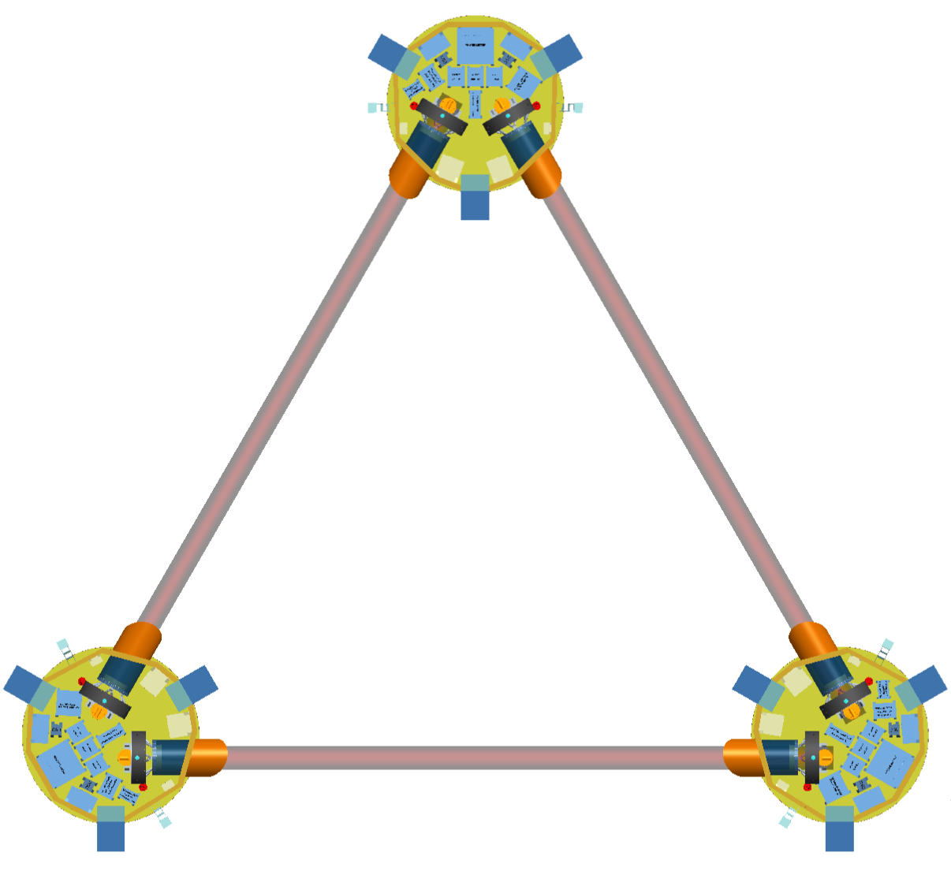

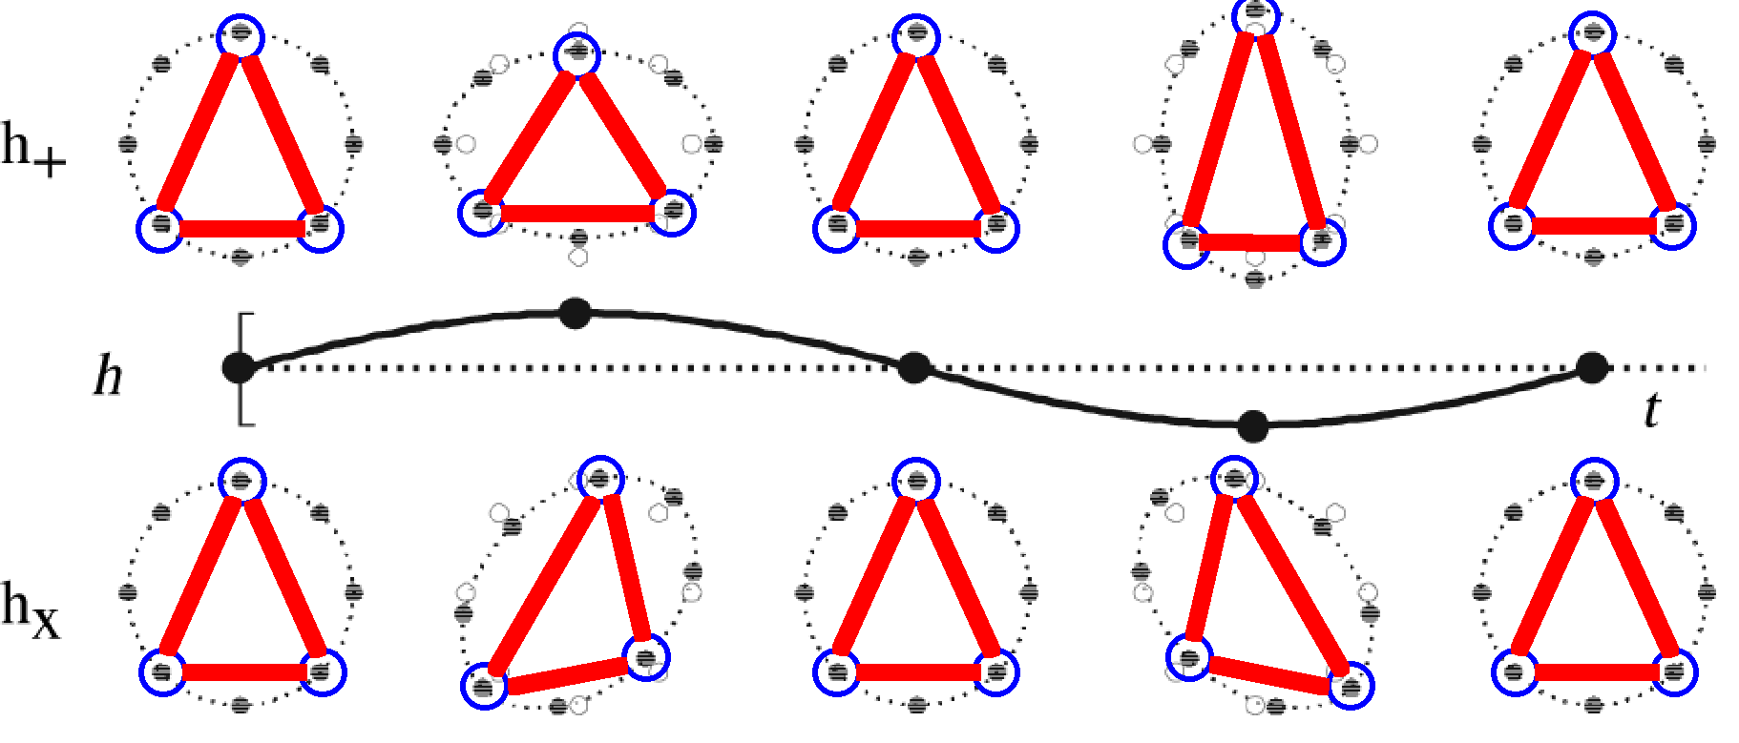
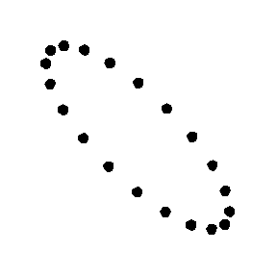
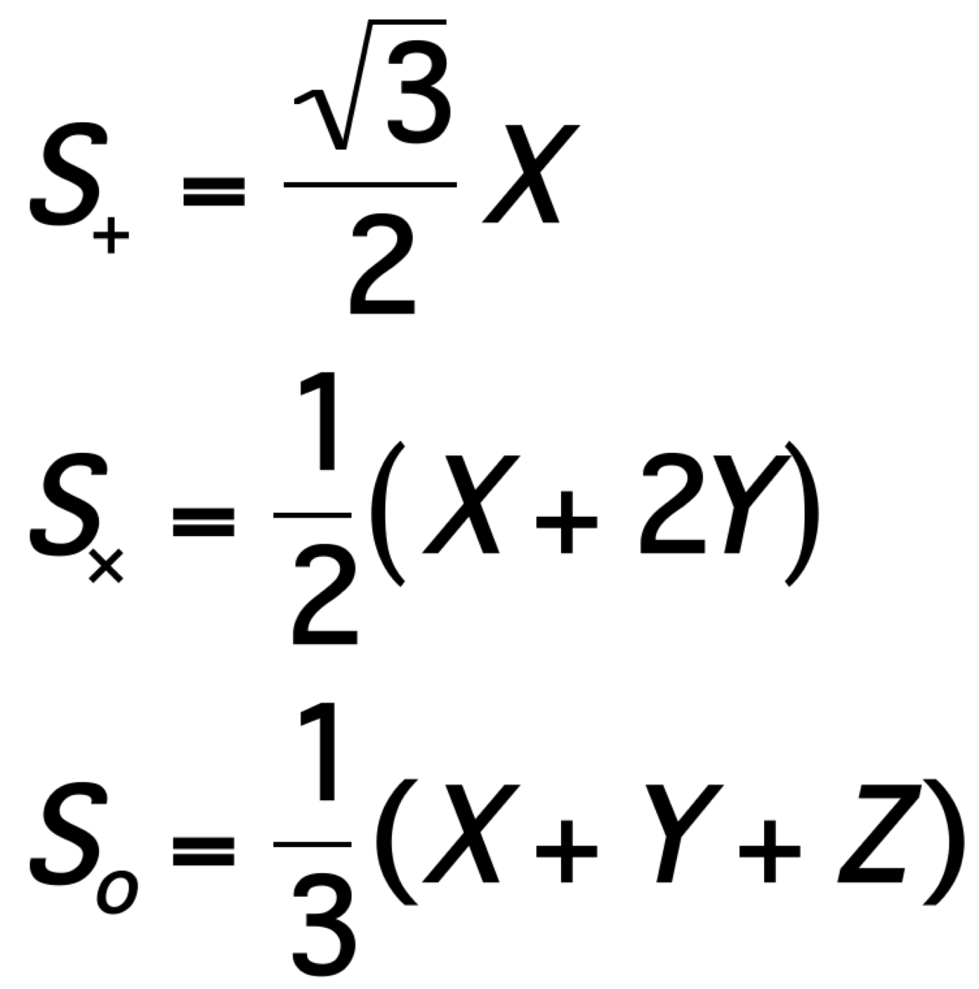
LISA Mission Summary
Mission Design
Three satellites in an equilateral triangle formation with arm lengths of ~2.5 million km.
Any two arms of this triangle represent a Michelson-type interferometer.
Gravitational waves deform space-time and can be detected as a change in the length of the interferometer arms (~ 10 pm/Hz^{1/2}).
Baseline 4 year lifetime + 6 years goal
    Limited by communications bandwidth
LISA Layout
Z
polarization
2.5 million km
+
X
“plus”
“cross”
“sagnac”
X
Y
Constellation Response
Heliocentric orbit
plus
2.5 X 10⁶ km
cross
Constellation Triangle rotates once per year as it orbits

Slide 5
LISA Mission Timeline
Date | Milestones
October 2013 | The “Gravitational Universe” selected as the science theme for the 3rd ESA flagship mission (L3)
June 2016 | LISA Pathfinder reports Sub-Femto-g test mass acceleration performance
October 2016 | Call for L3 mission proposals
June 2017 | Selection of LISA as L3 with a nominal 2034 launch
May 2018 | (ESA) Phase A kick-off
2018-2021 | LISA mission Phase A
Oct 2020 – Oct 2021 | Phase A Extension
<end 2021 | Formulation Review and Phase A end
>2021 | Mission Phase B
=<2024 | Mission Adoption
Adoption | Mission Implementation (Phase B2/C/D)
~2034 | Nominal Launch
Launch | Science operations (4 years (6 under consideration) baseline)
We are here

Slide 6
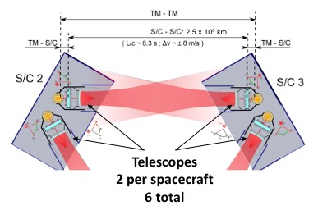
Telescope Functional Description
Efficiently deliver power on-axis between spacecraft (2.5 million km)
Simultaneous transmit and receive (TX/RX)
Afocal beam expander
  300 mm dia. large beam
  2.24 mm dia. on bench
  134X magnification
TM-TM
S/C - S/C: 2.5 x 10⁶ km
TM-S/C
L/c ~ 8.3 s, ∆υ ~ +/- 8 m/s
TM-S/C
Application is PRECISION LENGTH MEASUREMENT, not image formation
  Keep optical pathlength stable to ~ 1 pm/√Hz over the measurement BW
  Minimize phase noise from coherent transmitter backscattered light
  Minimize tilt to length (TTL) coupling
Notes:
The LISA Telescope is designed to enable a precision length measurement between two widely space test masses. The measurement budget between pairs of proof masses is roughly 10 pm/√Hz.
There are two telescopes in series with the measurement, so their optical pathlength must be stable to ~ 1 pm/√Hz over the measurement band.

Slide 7
Key Telescope Optical Specifications
Specification | Value | Units | Comments
Wavelength | 1064 | nm | nominal system operating wavelength
Conjugates | Afocal |  | Telescope is an afocal transceiver, i.e. object and image at infinity. Specifications generally assume ”receive” mode, where the entrance pupil is the “large” pupil in inertial space
Field of Regard for Acquisition | +/- 225 | µrad | Circular field of view
Field of view for Science | +/- 20 | µrad | Circular field of view
Wave-front error | < 35 | nm | wavelength/30 (telescope only)
Large Pupil diameter | 300+/- 1 | mm | Large pupil is associated with M1, inertial space
Small pupil diameter | 2.24 +/- 0.0075 | mm | Small pupil is located at the system stop on the optical bench
Base ray deviation from optical axis (large pupil) | < 10 | µrad | The “base ray” is the center-field center-pupil ray. Boresight error associated with the large pupil
Base ray deviation from optical axis (small pupil) | < 1.3 | mrad | Interface requirement with the optical bench
Tilt-to-length (TTL) | < 0.6 | pm/nrad | “as built” over the science FOV

Slide 8
Key Challenges/design drivers
Dimensional Stability
  Low CTE material and thermal stability at the 1 x 10⁻⁵ K/√Hz level, using thermal baffles fixed to the spacecraft that act as a passive thermal filter
  Spacecraft is stable at the 1 x 10⁻³ K/√Hz level per LISA Pathfinder experience.
Minimize Coherent backscattered light
  Adopt an unobstructed optical design and plan the design to accommodate contamination
  Low scatter coatings and dimensionally stable structure so scattered light phase is stable
  Keep spacing between the telescope and optical bench stable
Minimize Tilt-to-length (TTL) coupling
  Careful design to minimize pathlength differences with field angle (dOPL vs Field)
  Careful alignment of measurement axes (bench to bench and bench to GRS) such that spacecraft jitter does not couple to the length measurement (movable aperture stops help during integration)
  Wavefront errors projected into the far-field will also couple TX angular jitter into an apparent length signal (keep wavefront error low: WFE < 35 nm RMS = λ/30 at 1064 nm)
Notes:
Key challenges and design drivers for the telescope.

Slide 9
Key Interfaces
Optical
  Small pupil/stop on the optical bench
  Large pupil located at the center of mass of the test mass
  Careful mapping between the stop and the large pupil to minimize TTL coupling in the telescope itself
Mechanical
  3 pairs of bipod flexure interfaces to the MOSA Support Structure (MSS)
  Adequate mechanical clearance with the optical bench
  Designed for a fundamental mode of 115 Hz to accommodate worst case launch loads
Thermal
  Nested set of thermal baffles mounted to the spacecraft to filter thermal fluctuations to an acceptable level
  Sized to accommodate MOSA articulation
  Baffle to shield the optical bench
  Notional conduction paths through the bipod interface and from a cable harness to the optical bench
Notes:
Key challenges and design drivers for the telescope.

Slide 10
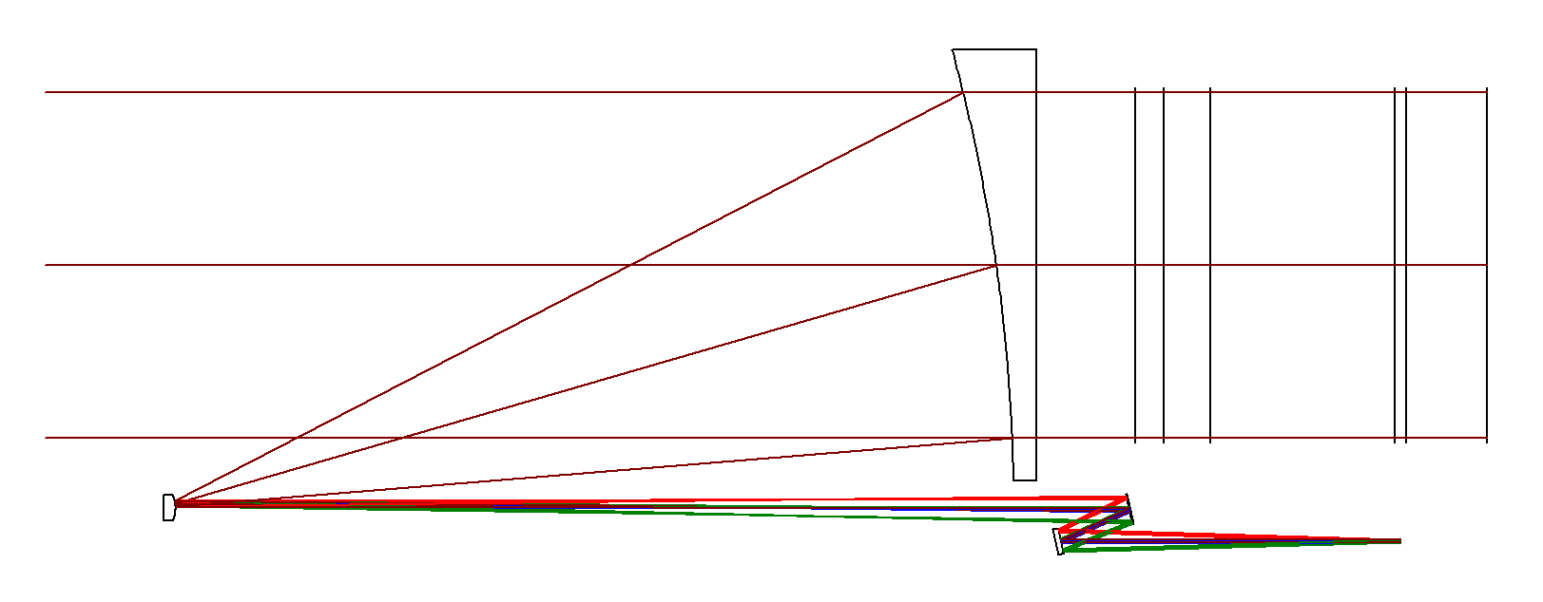
Baseline Optical Design
Optical Bench
M1
Center plane of Test Mass (TM), 410 mm to M1
Test Mass
Y
Beam folded onto bench
Large Pupil (∅300 mm)
M3
M2
X
Z
Small Pupil /stop (∅2.24 mm)
Global Origin M1 Vertex
M4
Global Coordinate System
Origin at M1 Vertex
Z-axis: parallel to optical axis (object and image space)
Y-axis: perpendicular to optical axis, within screen
X-axis: perpendicular to optical axis, into screen
 | Type | Conic | Radius (mm) | Clear Aperture (mm) | Edge Diameter (mm)
M1 | Parabola | -1 | -1475.246 | 345.3 | 365
M2 | Hyperbola | -1.0928 | -25.813 | 6.4 | 25.4
M3 | XY Polynomial | 0 | Infinity | 24.6 | 27.4
M4 | Flat | 0 | Infinity | 21.0 | 27.4
”freeform” optic
Notes:
Latest design layout. The telescope maps the small aperture STOP from the bench to the center of mass of the TEST MASS. The main unusual feature is M3, which is a generalized asphere, commonly called a “freeform” optic. The departure from a biconic is slight, and the additional degrees of freedom enable essentially zero pupil wander and tilt-to-length (TTL) coupling in the design. The primary is kept near F/1 to control cost and fabrication risk.

Slide 11
Pupil wander/dOPL vs. Field
TTL over Science FOV in pm/nrad
X 10⁻⁴
-20
8
0.4
Chief Ray Positions vs Fields at M1
Science FOV +/- 20 µrad
7
6
Chief Ray/delta X/Y with on-axis (mm)
5
Y Field Angle in µrad
TTL (pm/nrad)
0
4
Acquisition FOR +/- 225 µrad
3
-0.4
Acquisition Field of Regard in µrad
2
1
20
0
-20
0
20
X Field Angle in µrad
“Intrinsic” to the telescope optical path length variation nearly eliminated by design.
Design max over science field of view is 10⁻³ pm/nrad = 0.001 mm/rad.
Notes:
Shown is the near-zero “intrinsic” tilt-to-length coupling due to the telescope design by itself. The very low value, even over the complete Acquisition field of regard means that most of the tilt-to-length coupling is due to the residual misalignment between the optical bench, telescope and GRS. This residual misalignment will be partially compensated with adjustments on the optical bench during assembly.

Slide 12
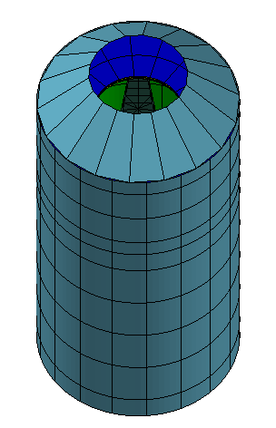
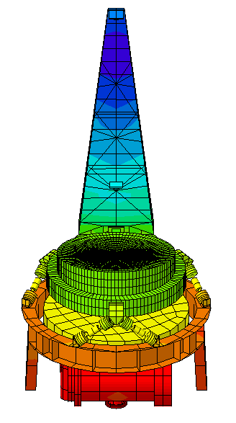
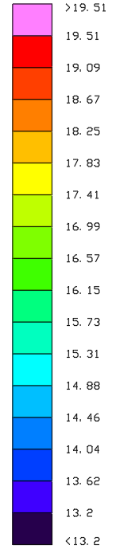
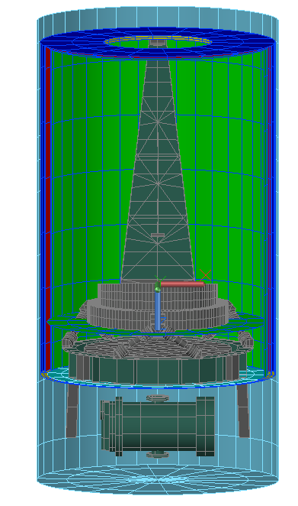
Thermal Model Summary
Outer Baffle: only the Primary Mirror sees space
3 Inner Baffles form a passive thermal filter
Steady State Temperature (C)
∆T ~ 3 C
Annulus baffle
∆T ~ 6.3 C
∆T ~ 1.5 C
Optical Bench
GRS
Mounted to the spacecraft
Adequate clearance for MOSA articulation

Slide 13
Design Update for Flight
Simulations at the University of Florida uncovered a geometrical Tilt-to-Length (TTL) coupling of relative angular motion between the bench and the telescope converted to pathlength by the off-axis moment arm of the offset between the large and small beam optical boresights
Not a ”new” noise, but has not been included in the noise budget explicitly to date
Size of the effect:
  OB-Tel distance
    δp = L_{offset} x δφ_{OB/TEL}
    L_{offset} = 240 mm
    δp < 1 pm/√Hz
    requires δφ_{OB/TEL} < 4.1 prad/√Hz
  Short arm
    δp = L_{short_arm} x (1- cos(δφ_{OB/TEL}))
    L_{short_arm} = 240 mm
    δφ_{OB/TEL} = 4.1 prad/√Hz
    δp = 2 x 10⁻²⁴ m/√Hz
    = 2 x 10⁻¹² pm/√Hz
Example: OB tilts
Optical Bench
M1
δφ_{OB/TEL}
L_{short_arm}
Test Mass
L_{offset}
δp_{short_arm}= L_{short_arm} x (1-cos(δφ_{OB/TEL}))
≈ (1/2) L_{short_arm} x δφ²_{OB/TEL}
Beam folded onto bench
M2
Small Pupil /stop
δφ_{OB/TEL}
δp_{OB/TEL}= L_{offset} x sin(δφ_{OB/TEL})
≈ L_{offset} x δφ_{OB/TEL}

Slide 14
Possible Solutions for Flight
Three classes of solutions:
  Build the telescope and the optical bench together so there is no relative motion.
      Technically feasible, but not practical programmatically: requires matching schedules, budgets, and development efforts across space and time
  Measure the motion and remove it in post-processing.
      Challenging technically (need to measure pico-radians/√Hz) and adds additional complexity
  Redesign the optical bench and the telescope to remove the offset
      An on-axis telescope design is not a realistic option for several reasons including thermal management and coherent backscatter
      Current unobstructed (off-axis) design can be reworked to have an on-axis interface
        4,5, and 6 mirror designs also studied
X
X

Slide 15
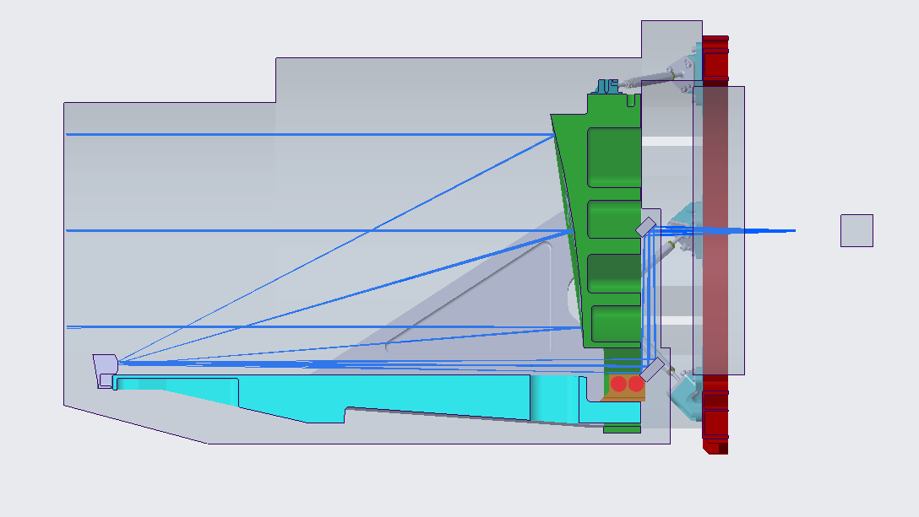
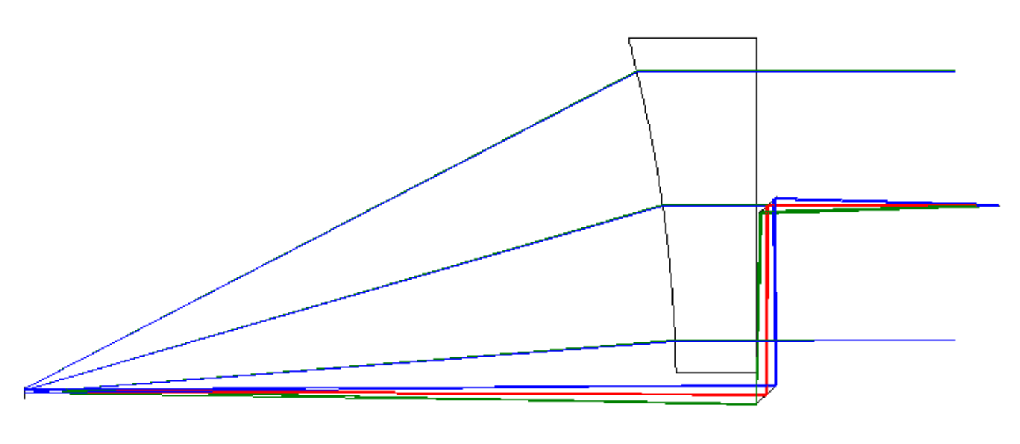
Recommended Design: 4-mirror, 2 freeforms
EDU Design
New Design Summary
M1
M1 unchanged from EDU
M2 very slightly stronger (25.8 → 25.75 mm y-radius)
M3, M4 XY-polynomials similar to the EDU M3 design
Pros:
  No change to the MOSA → “pin compatible”
  Compatible with the OB keep out zones
Cons:
  No flat (helps make alignment adjustments orthogonal)
(M1 mirror thickness is arbitrary)
M3
M2
M4
New Design Overlaid on current EDU design for comparison
New 4-mirror Design
OB keep-out zone
M1
M1
Optical Bench
M4
M4
Test Mass
Small pupil: routed on the bench to the position of the stop
M2
M3
M3
M2
(M1 mirror thickness here includes the mount)
Existing MOSA Mechanical Envelope (no change)
15

Slide 16
Impact on the Engineering Development Unit (EDU) Program
None. It is not practical at this stage:
  20 months into a 36 month program
  Most if not all of the parts have been fabricated or are in process
  New design requires further analysis for fabrication and alignment tolerances
The EDU program is intended to demonstrate TRL-6 before adoption
  Mono-material (low CTE glass or ceramic) construction
  Meet environmental launch requirements while maintaining alignment
  Not to implement a particular design
Plan was always to redesign for flight once requirements were known
  Other changes considered later as part of normal work
Main impact:
  Need to re-think the plans for optical pathlength stability testing at UF

Slide 17
Summary
Proposed design meets key requirements
    Excellent dimensional stability
    Extremely low coherent backscattered light
    Low “Intrinsic” tilt-to-length coupling
    Can accommodate dynamic stop placement during alignment
Alignment requirements are tight, but possible
Mechanical design with all-glass construction meets stiffness requirements
Identified an interface coupling that requires modifying the flight design
Other flight requirements still to be identified as part of Phase B
No change to the EDU program

