Slide 1
GEOS Mini-reanalysis for CAMP2Ex
Allie Collow, USRA/GMAO
Virginie Buchard, Pete Colarco, Arlindo da Silva, Ravi Govidaraju, Ed Nowottnick

Slide 2
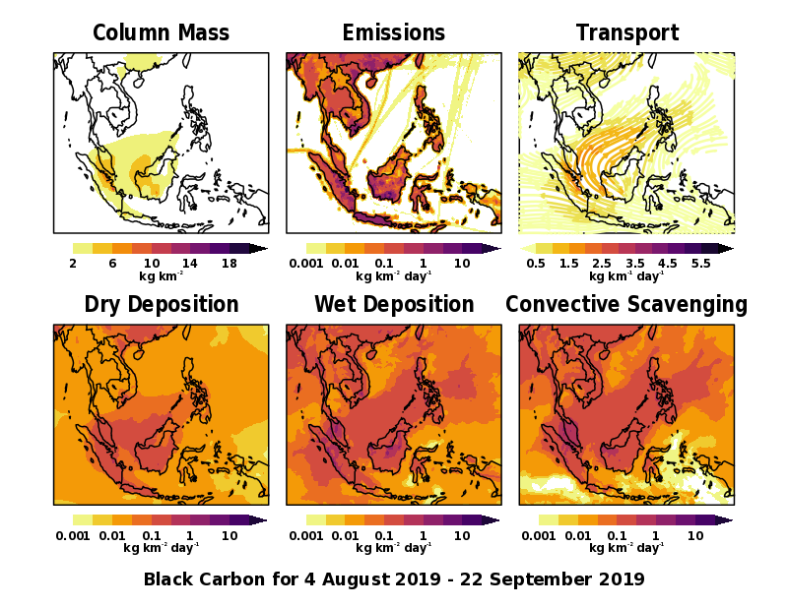
Overview
Goals:
To gain a positive impact on meteorology through improving aerosols within the system
Provide a physically consistent data set to assist with the analysis of CAMP2Ex observations
FP Available During Field Campaign (f522)
More Modern Version of FP (f525)
Replay Experiments
Final Mini Reanalysis
Substantial Model Updates: RRTM-G, new convection, shallow convection
Implementation of brown carbon/SOA, updated emissions
Assimilation of geostationary aerosol observations (GOES, Himawari)

Slide 3
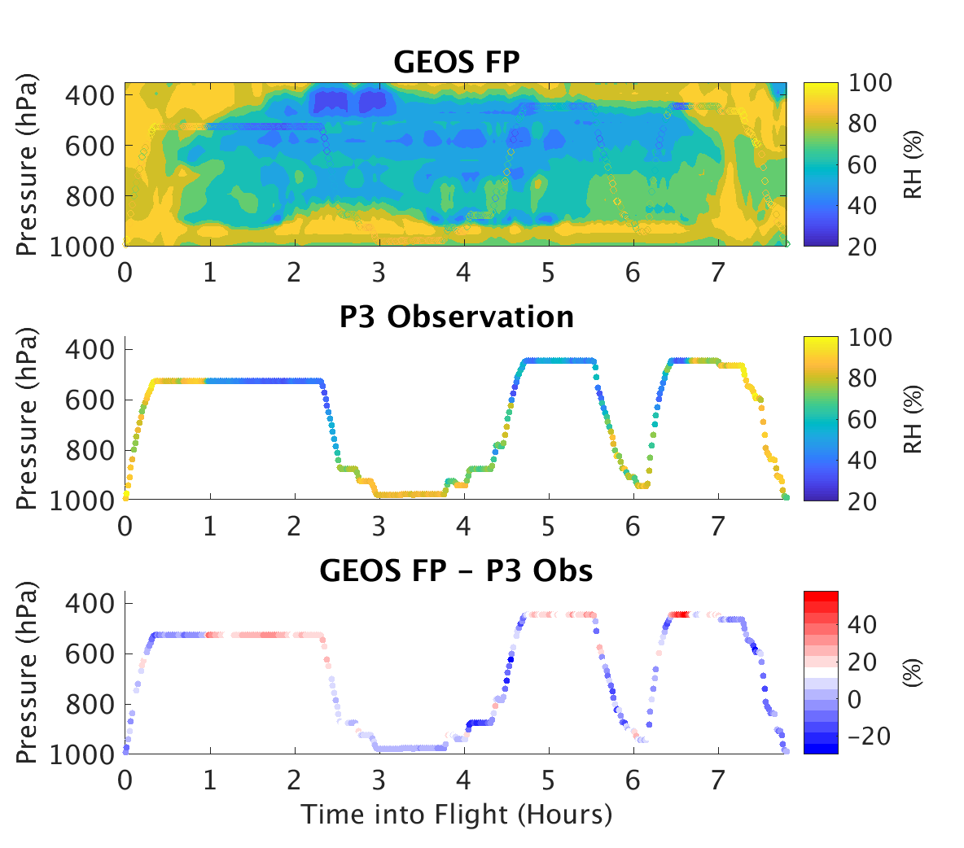
Available Data
0.25˚ simulations sampled along the trajectory of all CAMP2Ex flights
MERRA-2, “operational” version during the campaign, updated meteorology
https://portal.nccs.nasa.gov/datashare/iesa/campaigns/CAMP2EX/
GEOS FP 5.22= “R0”
Updated meteorology (GEOS 5.25) = “R1”
Coming soon: Final mini-reanalysis with Himawari AOD assimilation over ocean!

Slide 4
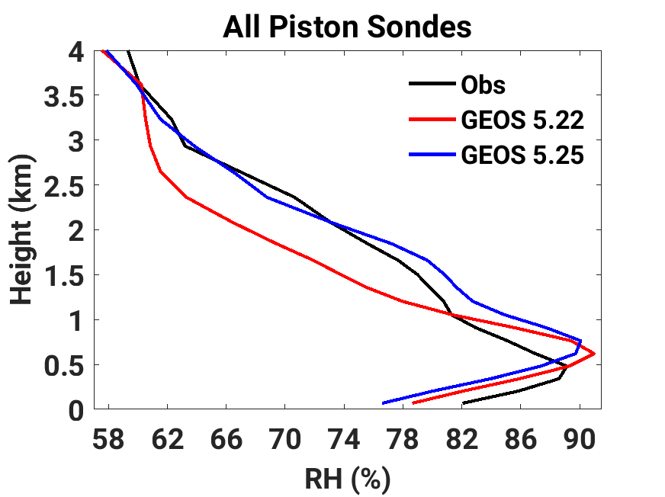
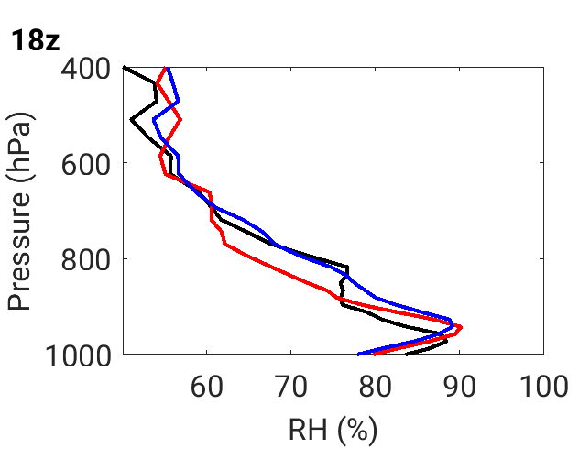
Impact of Meteorology Updates on Lower Troposphere Relative Humidity
Mean RH profile from all piston sondes compared to GEOS 5.22 and GEOS 5.25
Dropsondes NOT assimilated
Improved humidity above 2 km, cold bias introduced at ~1.5 km
Biases maximized at 18z and 0z, good agreement at 6z and 12z in GEOS 5.25
Both GEOS 5.22 and GEOS 5.25 are unable to capture the inversion present at 18z -> plan to further investigate diurnal PBL using PISTON HSRL

Slide 5
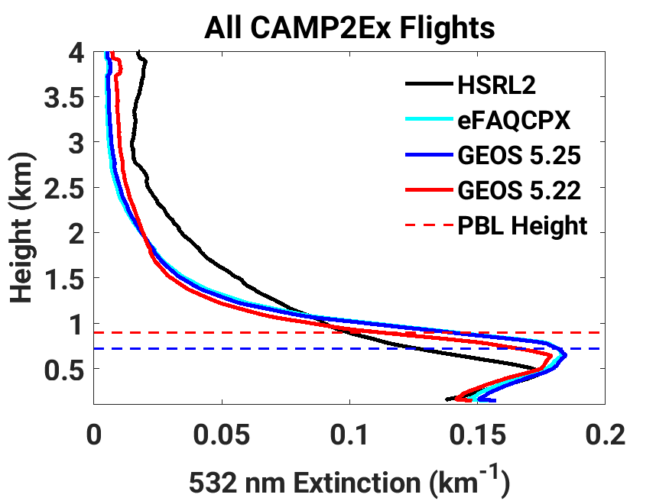
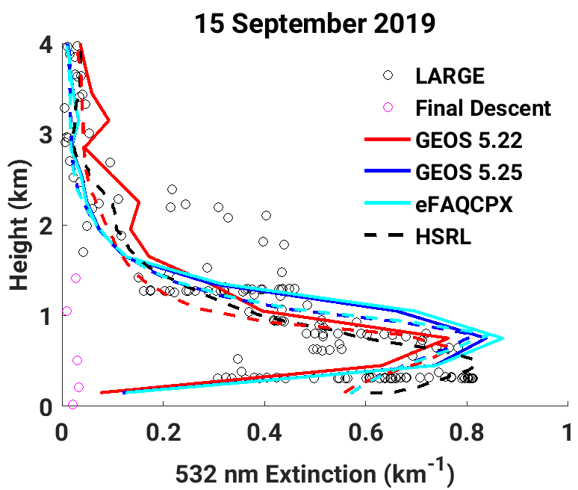
Evaluation of 532 nm Extinction Using the HSRL-2
All runs assimilate 550 nm AOD from MODIS
eFAQCPX introduces brown carbon and SOA
Bias in PBL height consistent with RH bias
Aerosol updates have a smaller impact than changes in humidity

Slide 6
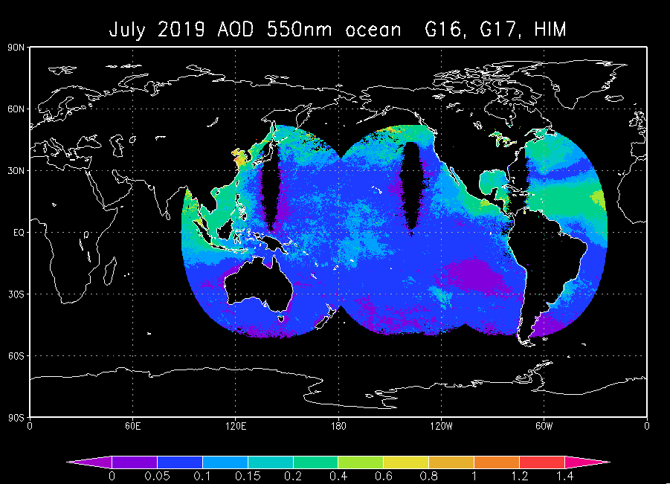
Assimilation of GEOSTATIONARY data over ocean (1)
System for Aerosol Analysis: Splitting
  2D-PSAS aerosol analysis with Local Displacement Ensembles (Randles et al., 2016)
    control variable: single-wavelength 2D – AOD (Aerosol optical Depth)
    observable: AOD observation at 550nm.
    ongoing experiment at C360 with MODIS NNR data and G16, G17 and Himawari data over ocean for the CAMP2Ex period. Filtering of data has been performed
    Himawari, GOES-17, GOES-16 over Ocean

Slide 7
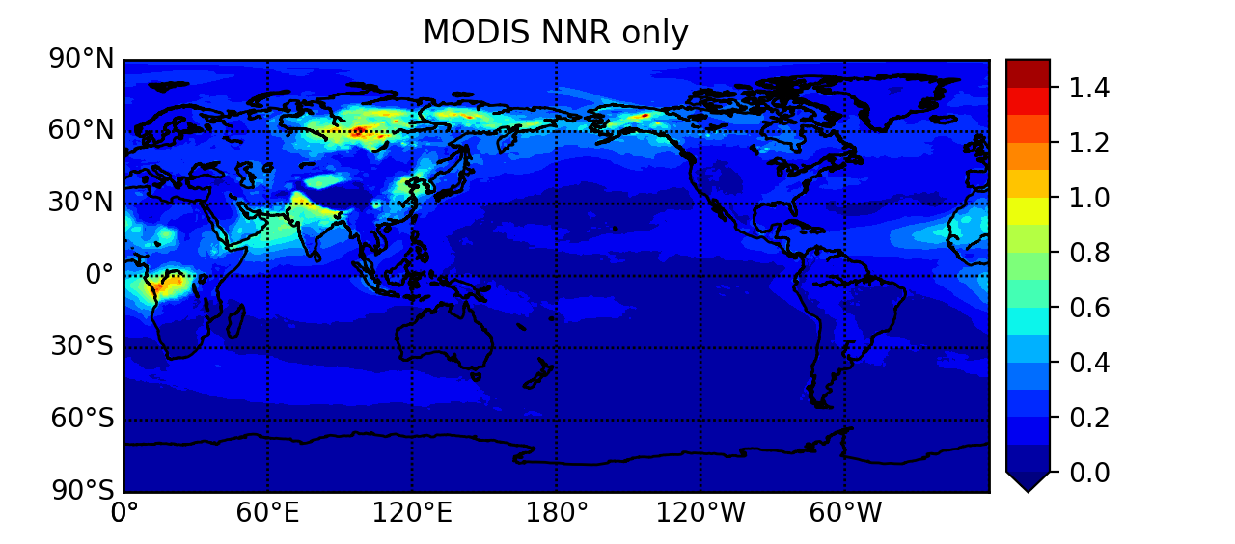
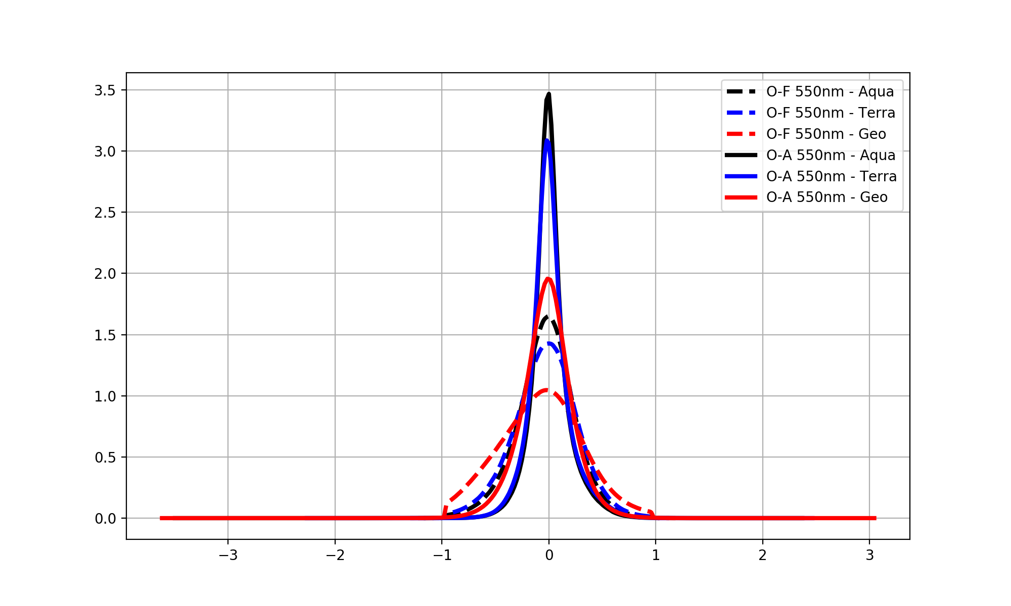
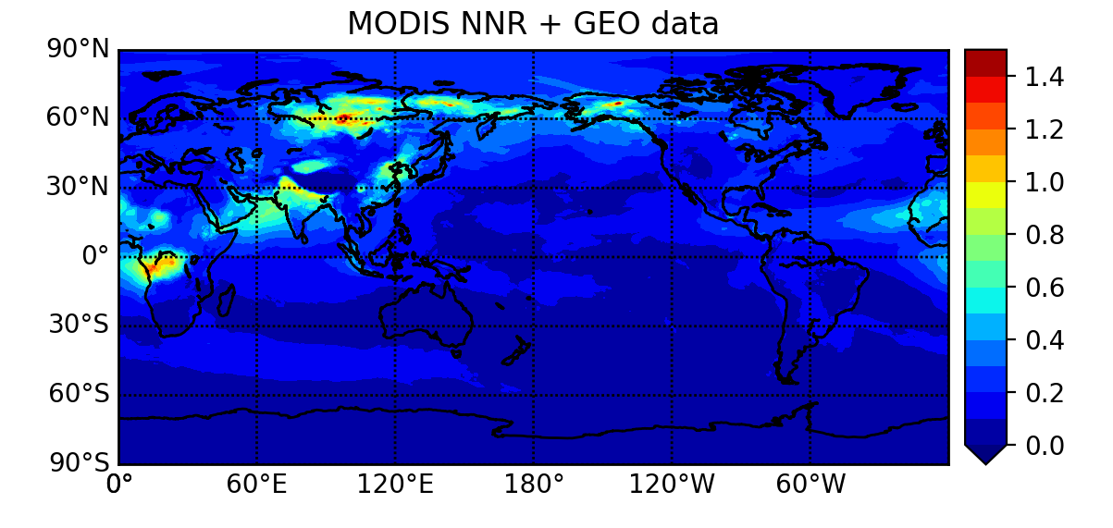
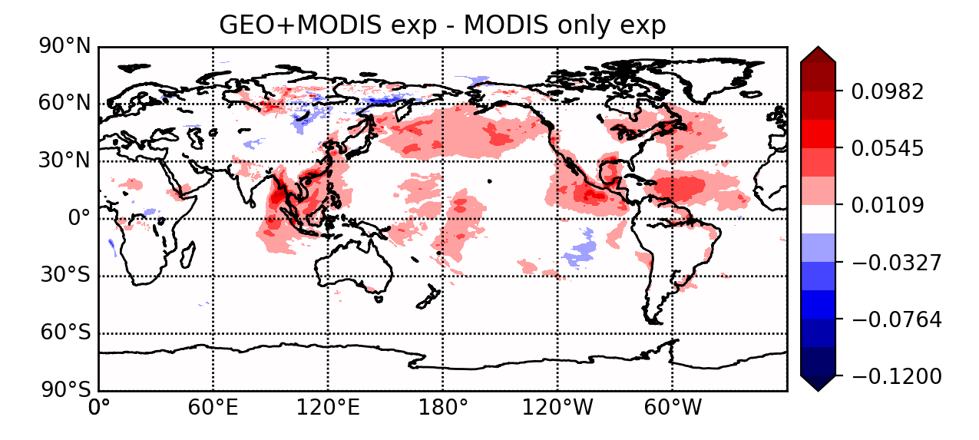
Assimilation of GEOSTATIONARY data over ocean (2)
Monthly mean AOD at 550nm for July 2019
Preliminary results:
(1) Control:
MODIS only
Innovation statistics: July 2019
(2) GEO + MODIS exp
Difference (2) – (1)
O-F (dashed line), O-A(continuous line)
Notes:
For the innovation statistic plot: this plot provides an information about the performance of the DA system.
What you compare is the PDF of Observation minus the model Forecast (in dashed line) to the PDF of Observation minus the Analysis (continuous line). You are interested to see if after analyzing the observations (log of AOD at 550nm), your model log of AOD gets closer to the observation values.
The plot shows for each type of instrument since we also assimilate MODIS (on AQUA and TERRA) in the experiment. So if you focus on the GEO (red, it combines the all 3 G16,G17 and HIM), you can see that the distribution of OMA (skinnier and taller) has a smaller deviation standard than the distribution of OMF (more spread out and shorter). That’s a sign that your system is doing the right thing.
The main point is your distribution (OMA, red continuous line) is skinnier and taller than OMF after analyzing the GEO observations.

Slide 8
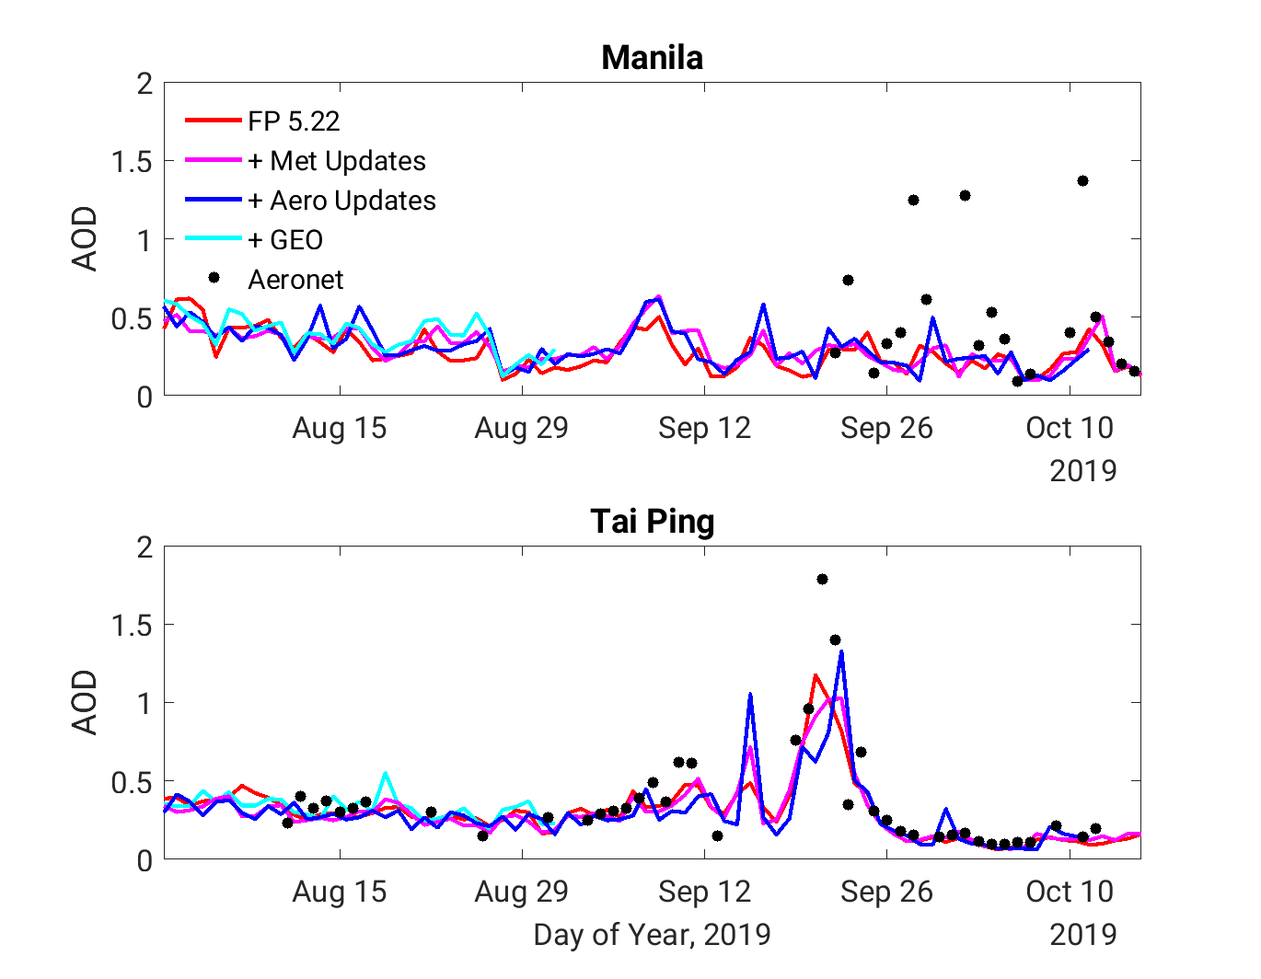
More Preliminary Results for AOD
Daily mean AOD
AERONET is not assimilated -> independent data for verification
All GEOS runs agree well
Slight hint of improvement with geostationary assimilation in mid August in Tai Ping
Still more to do
  Finish run
  Evaluate diurnal cycle
  Compare to flight data

