Slide 1



Engineering 6-Phosphogluconate Improves Grain Yield in Heat-Stressed Maize
Camila Ribiero, Hope Hersh, Tracie Hennen-Bierwagen, Alan Myers, Ken Cline, and Mark Settles

Slide 2

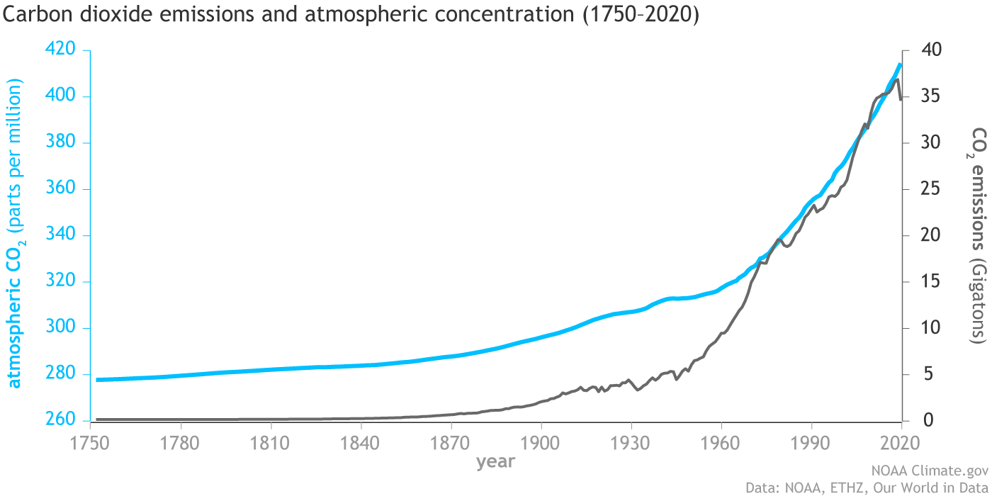
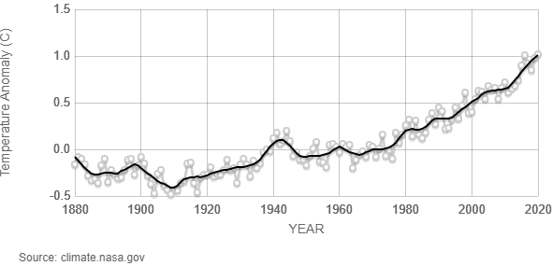
Climate change is threatening agricultural productivity
Emissions have increased CO₂ in Earth’s atmosphere by nearly 40% over the pre-industrial maximum.
Global temperatures have risen 1 °C over the 1951-1980 average.
Credits: NOAA, NASA

Slide 3
Heat stress impacts maize yield throughout reproductive development
High temperature stress can cause:
Increased anthesis-silking interval
Reduced pollen viability
Increased ovary abortion
Accelerated plant development
Reduced grain-fill

Slide 4
Heat stress impacts maize yield throughout reproductive development
High temperature stress can cause:
Increased anthesis-silking interval
Reduced pollen viability
Increased ovary abortion
Accelerated plant development
Reduced grain-fill
Example: Post-pollination heat stress by Boehlein et al (2019):
W22 inbred grown at 28°C day and 18°C night.
Hand pollinated to ensure maximal kernel set.
Apply heat stress starting 12 days after pollination (DAP).
28/18°C
38/28°C
Heat stress initiated at 12 days after pollination.
High temperature induced senescence ~10 days earlier.
Kernel weight reduced by 35%.
Boehlein et al. (2019) Plant J. 99:23-40.

Slide 5
Higher temperatures affect enzyme activity and respiration rate
As temperature increases, enzymes increase reaction rate up to the optimum temperature for catalysis.
Above the optimum temperature, an enzyme will denature and lose activity.
Two enzyme-based mechanisms for reduced yield:
Respiratory metabolism increases with higher temperatures reducing the amount of stored biomass in a seed.
Critical enzymes that are less heat stable will denature and disrupt metabolism at higher temperatures.
Optimum Temp.
Reaction Rate
Denatured enzymes
Increasing kinetic energy
Temperature

Slide 6
Central carbon metabolism has a critical role in maize kernel starch accumulation
ADP-Glucose
ADP-Glucose
STARCH
¹³C-glucose labeling studies show that only 20% of maize endosperm starch is synthesized via direct incorporation of sucrose or glucose.
Majority of glucose that is polymerized into starch is resynthesized from:
Glycolysis
Oxidative Pentose Phosphate Pathway (OPPP)
TCA cycle
Sucrose/
Glucose
Hexose-P
Hexose-P
OPPP
Glycolysis
Pentose-P
Triose-P
Triose-P
PEP
HETEROTROPHIC PLASTID
TCA
MITOCHONDRION
CYTOSOL
Spielbauer et al. (2006) Phytochemistry. 67(14):1460-75.

Slide 7
Heat stress alters OPPP metabolite levels in the endosperm
Metabolomics analysis of endosperm comparing non-stressed to heat stressed plants.
Heat treatment:
decreased levels of 6-phosphogluconate
increased levels of pentoses such as ribose and xylose
W22 inbred grown at 28°C day and 18°C night.
Hand pollinated to ensure maximal kernel set.
Apply heat stress starting 12 days after pollination (DAP).
Boehlein et al. (2019) Plant J. 99:23-40.

Slide 8
Heat sensitive metabolites are related to the second oxidative reaction of OPPP
6-phosphogluconate is the substrate for 6-phosphogluconate dehydrogenase (6PGDH).
6PGDH product is the ketopentose, ribulose-5-P, which is converted to aldopentoses.
In plants, the oxidative section of the OPPP is found in both the cytosol and plastid.
Maize has three 6PGDH isozymes:
  PGD1 & PGD2 are cytosolic
  PGD3 is plastidic
Sucrose
ADP-Glucose
BT1
ADP-Glucose
Starch
SH2, BT2
PPi
PPi
ATP
Glucose-1-P
ATP
Glucose-1-P
GPT
NADP
NADP
NADPH
NADPH
Glucose-6-P
Glucose-6-P
6-P Gluconate
6-P Gluconate
NADP
PGD3
NADP
PGD1, PGD2
NADPH
NADPH
Pentose-P
Pentose-P
Triose-P
TPT
Triose-P
NADPH
Malate
Malate
NADP
Cytosol
Heterotrophic Plastid
Spielbauer et al., 2013 J. Exp. Botany 64:2231–2242.

Slide 9
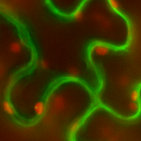
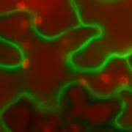
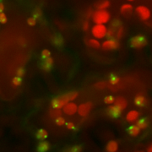
6PGDH isozymes in the cytosol and plastid are distinct protein families
Os06g02144*
ZmPGD1*
Populus 656743*
ZmPGD2
Spinach PGDc*
Sb10g001050
At3g02360*
Populus 837012*
CYTOSOL
PGD1-GFP
PGD2-GFP
PGD3-GFP
0.02
Cytosolic 6PGDH proteins are more closely related between eudicots and monocots than plastid-localized 6PGDH.
May represent a cyanobacterial origin of plastid-localized 6pGDH.
PLASTID
Os11g29400
At1g64190
ZmPGD3
At5g41670
Sb05g016740
Populus 799988
Spinach PGDp
Populus 640402
*PTS1 peroxisomal targeting sequence predicted
Spielbauer et al., 2013 J. Exp. Botany 64:2231–2242.
Ribeiro et al., 2020 PNAS USA 117:33177-33185.

Slide 10
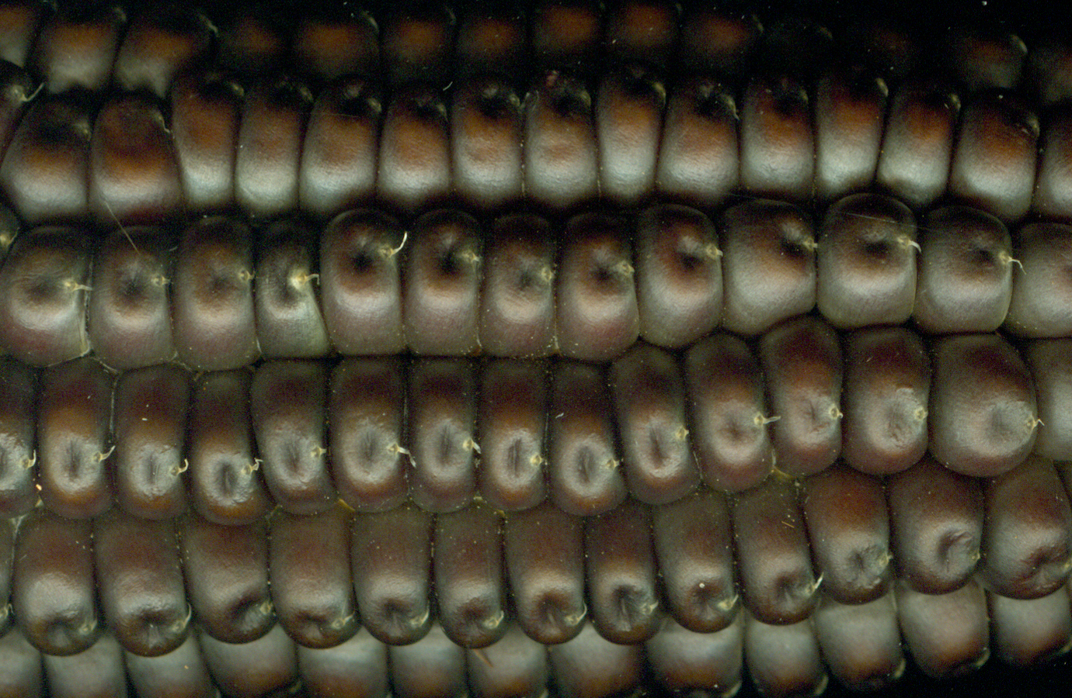
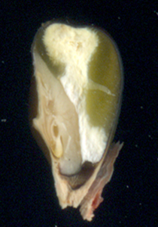
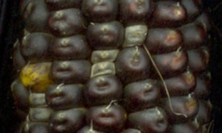
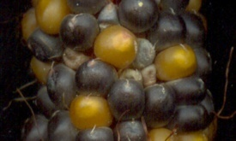
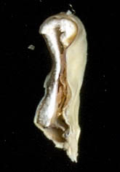
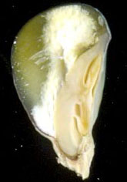
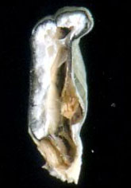
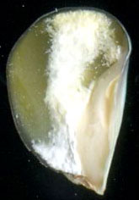
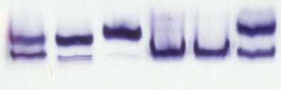
Plastid-localized 6PGDH (PGD3) is required for kernel development and grain-fill
pgd3-
umu1
pgd3-
umu2
200 bp
Chromosome 4: 18 438 040 – 18 436 118
pgd1-null has a frame shift at T470, inserts 37 codons
pgd2-125 has a missense at R460, changes to T
ATG
STOP
pgd1; pgd2
pgd3-umu1/+
pgd3-umu2/+
pgd3-umu2/+
pgd3-umu1/+
1 cm
3 mm
pgd1; pgd2
pgd3-umu1
pgd3-umu2
pgd1
pgd2
W22
PGD3
PGD1/PGD2
pgd3-umu1
normal
pgd3-umu2
normal
Settles et al., 2007 BMC Genomics 8:116
Spielbauer et al., 2013 J. Exp. Botany 64:2231–2242.
Ribeiro et al., 2020 PNAS USA 117:33177-33185.

Slide 11
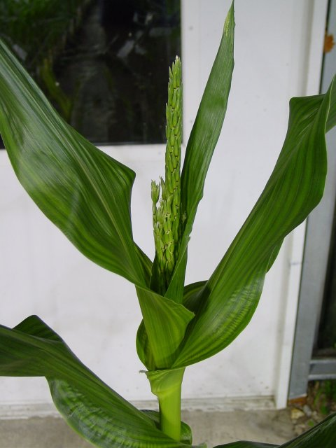
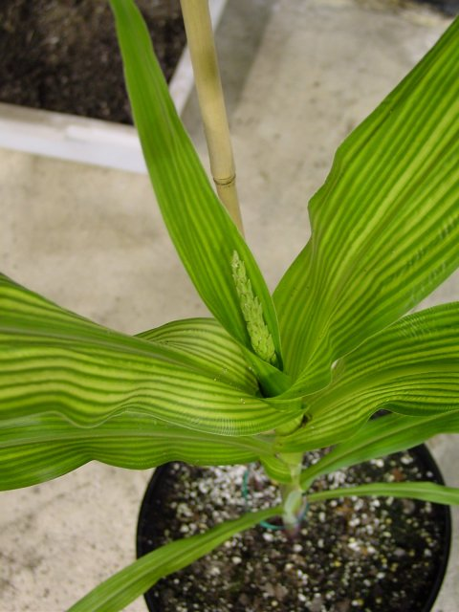
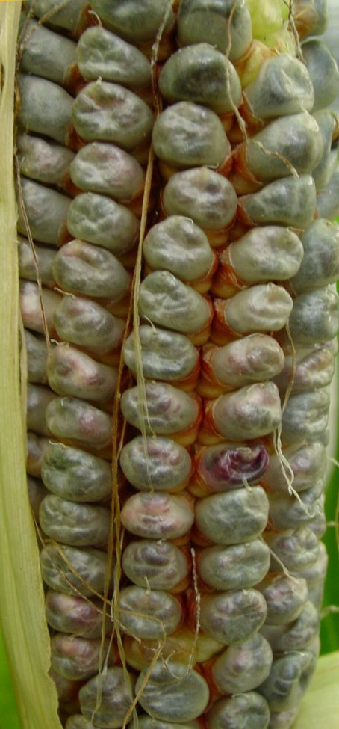
Homozygous pgd3 mutants can be rescued by tissue culture
<5% of pgd3 embryos develop shoots and roots in culture.
Rescued mutants grow slowly and have pale green leaves.
Mutants are fully fertile.
Normal sibling
pgd3-umu1
Settles et al., 2007 BMC Genomics 8:116

Slide 12
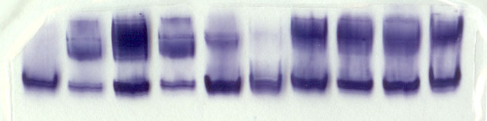
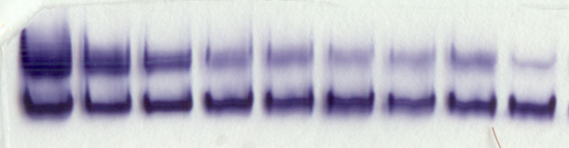
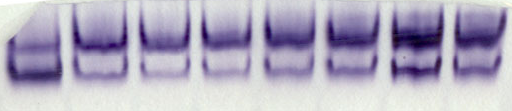
PGD3 isozyme activity is associated with sink tissues
Pre-emergant Leaf
Endosperm
Whole seed
Shoot apex
Immature ear
Embryo
Root
Leaf
Tassel
PGD3
Low PGD3 activity in leaves
PGD1/PGD2
0
3
6
9
12
15
18
21
24
cm
W22
Emerging leaf
PGD3
Leaf PGD3 activity is lowest in photosynthetically active leaf tissue.
PGD1/PGD2
6
8
10
12
14
16
18
20
DAP
PGD3 activity is detected throughout kernel development.
W22
kernels
PGD3
PGD1/PGD2
Spielbauer et al., 2013 J. Exp. Botany 64:2231–2242.

Slide 13
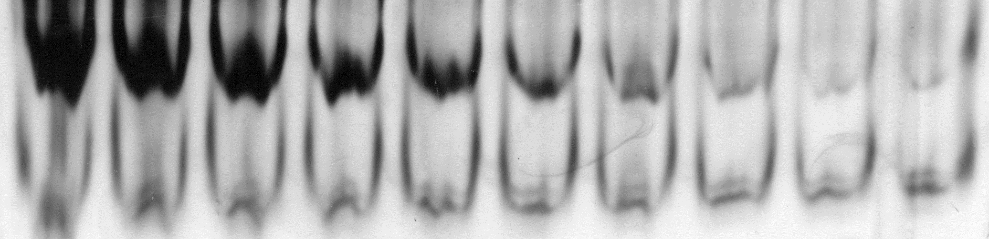
PGD3 isozyme activity is heat labile
5 μm
Min at 42°C
0
5
10
15
20
25
30
35
40
45
In vitro heat treatments of endosperm extracts show PGD3 isozyme activity is sensitive to heat.
PGD3
PGD1/PGD2
PGD1; PGD2; pgd3⁻
Spectrophotometric 6PGDH activity assays with mutants show cytosolic 6PGDH activity is stable.
pgd3 mutants only have cytosolic activity.
B73 inbred has all isozymes.
pgd1; pgd2 mutants only have plastidic activity.
PGD1; PGD2; PGD3
pgd1⁻; pgd2⁻; PGD3
Ribeiro et al., 2020 PNAS USA 117:33177-33185.

Slide 14
Cytosolic 6PGDH isozyme activity is heat stable
Gradient of 10 min in vitro heat treatments using mutants shows PGD1; PGD2 activity is stable up to 52°C.
pgd3 mutants only have cytosolic activity.
W22 inbred has all isozymes.
pgd1; pgd2 mutants only have plastidic activity.
Ribeiro et al., 2020 PNAS USA 117:33177-33185.

Slide 15
Synthetic biology approach to make plastid 6PGDH activity heat stable
Sucrose
ADP-Glucose
ADP-Glucose
Starch
PPi
PPi
ATP
Glucose-1-P
ATP
Glucose-1-P
NADP
NADP
NADPH
NADPH
Glucose-6-P
Glucose-6-P
6-P Gluconate
6-P Gluconate
NADP
PGD3
NADP
PGD1, PGD2
NADPH
cpWX1
PGD1
NADPH
Pentose-P
Pentose-P
cpWX1
PGD2
Triose-P
Triose-P
NADPH
Malate
Malate
NADP
Cytosol
Heterotrophic Plastid
Ribeiro et al., 2020 PNAS USA 117:33177-33185.

Slide 16
Plastid targeting of cytosolic PGD1 and PGD2
Wx1 cTP
300 bp
p27kDa γ-Zein
Pgd1 or Pgd2
Fuse the Waxy1 (Wx1) chloroplast targeting sequence to Pgd1 or Pgd2 open reading frames to create Wpgd1 and Wpgd2 synthetic genes.
Drive endosperm specific expression with the 27 kDa gamma zein promoter.
In vitro chloroplast import assay confirmed the Wx1 targeting sequence directs the PGD1 and PGD2 to the chloroplast stroma.
tNOS
+Thermolysin
Chloroplasts
Membrane
Precursor
Stroma
PGD1
PGD3
WPGD1
WPGD2
Ribeiro et al., 2020 PNAS USA 117:33177-33185.

Slide 17
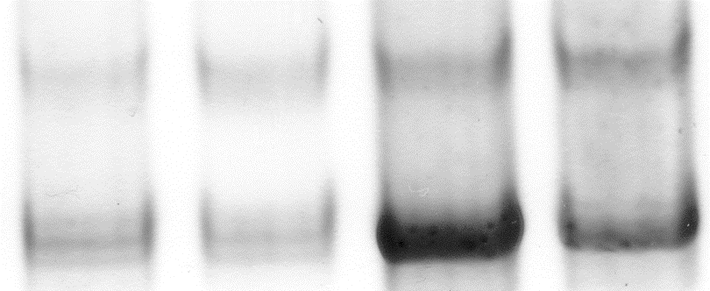
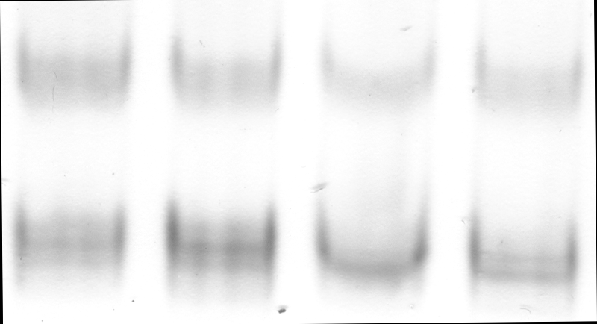
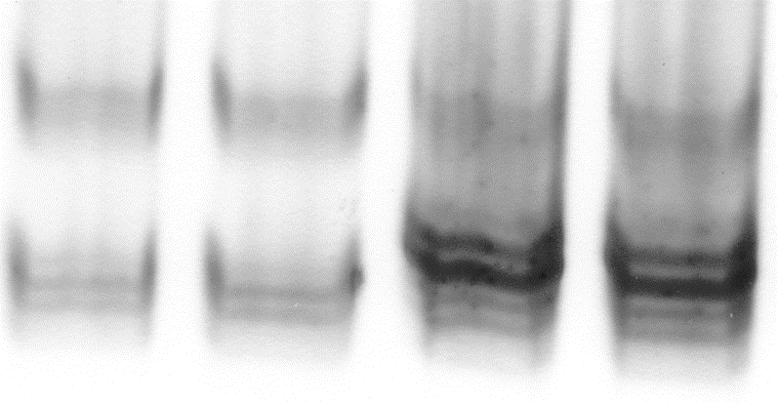
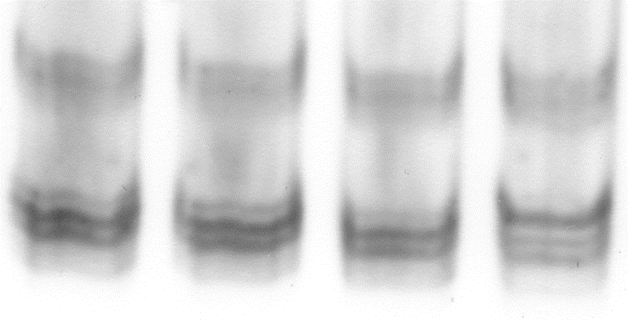
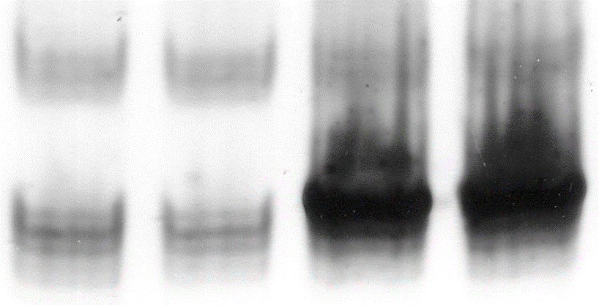
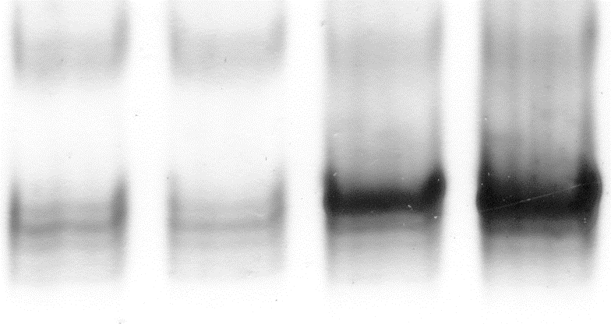
Wpgd T₁ transgenic kernels have increased 6PGDH activity
Normal
Wpgd
PGD3
Wpgd1-D
PGD1/2
Wpgd1-E
Wpgd2-A
Wpgd2-B
Wpgd1
Wpgd2
Wpgd2-D
Wpgd2-E
Ribeiro et al., 2020 PNAS USA 117:33177-33185.

Slide 18
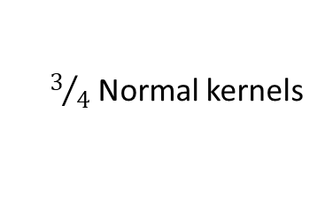
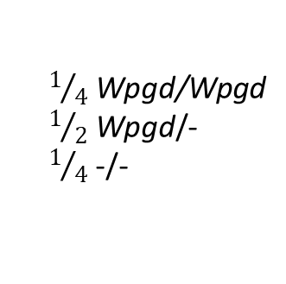
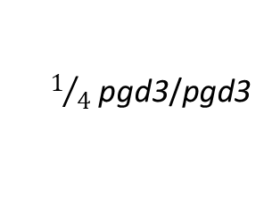
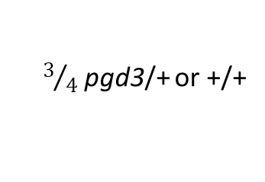
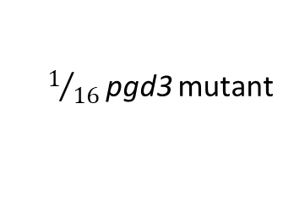
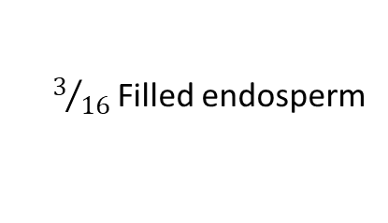
Do the Wpgd transgenes target 6PGDH to the plastid?
The pgd3 mutant had both defective endosperm and embryo.
PGD3 enzyme is active in both endosperm and embryo.
The Wpgd transgenes are expressed from an endosperm specific promoter.
Can the transgenes complement the pgd3 endosperm phenotype?
pgd3/+ ; -/- X +/+; Wpgd/-
pgd3-umu2
normal
¼ pgd3/+; Wpgd/- (select with PCR markers)
Endosperm
⊗
Embryo
$3/4$ pgd3/+ or +/+
$3/4$ Normal kernels
PGD3
$1/4$ Wpgd/Wpgd
$1/2$ Wpgd/-
$1/4$ -/-
$3/{16}$ Filled endosperm
$1/4$ pgd3/pgd3
PGD1/PGD2
$1/{16}$ pgd3 mutant
Ribeiro et al., 2020 PNAS USA 117:33177-33185.

Slide 19
Wpgd transgenes can rescue pgd3 mutant seed development
pgd3/+; Wpgd1-E/- ⊗
Four independent Wpgd events crossed to pgd3
Two classes of mutant kernels in all tests
All mutant kernels <25% of progeny; averaged 20.5%.
Partial grain-fill kernels represented 13.2% of kernels
3 mm
78.3% Normal
14.4% Subtle
7.3% Severe
pgd3/+; Wpgd2-G/- ⊗
3 mm
80.9% Normal
9.2% Subtle
9.9% Severe
Ribeiro et al., 2020 PNAS USA 117:33177-33185.

Slide 20
Wpgd transgenes can rescue pgd3 mutant seed development
pgd3/+; Wpgd1-E/- ⊗
10 cm
Subtle mutant kernels had the transgene and produced viable embryos.
Plants from complemented kernels showed the pgd3 mutant plant phenotype.
3 mm
78.3% Normal
14.4% Subtle
7.3% Severe
pgd3/+;
-/-
+/+;
Wpgd1-E
pgd3/pgd3;
-/-
pgd3/pgd3;
Wpgd1-E
pgd3/+; Wpgd2-G/- ⊗
10 cm
3 mm
80.9% Normal
9.2% Subtle
9.9% Severe
pgd3/+;
-/-
+/+;
Wpgd2-G
pgd3/pgd3;
-/-
pgd3/pgd3;
Wpgd2-G
Ribeiro et al., 2020 PNAS USA 117:33177-33185.

Slide 21
Wpgd transgenes can rescue pgd3 mutant seed development
Self-pollinations of rescued plants
10 cm
Complemented plants were homozygous for pgd3 and either:
Hemizygous for Wpgd and segregated for defective kernels
Or, homozygous for Wpgd and produced nearly all normal kernels
pgd3/pgd3;
1-E/-
pgd3/pgd3;
1-E/1-E
pgd3/+;
-/-
+/+;
Wpgd1-E
pgd3/pgd3;
-/-
pgd3/pgd3;
Wpgd1-E
10 cm
1 cm
pgd3/pgd3;
2-G/-
pgd3/pgd3;
2-G/2-G
pgd3/+;
-/-
+/+;
Wpgd2-G
pgd3/pgd3;
-/-
pgd3/pgd3;
Wpgd2-G
Ribeiro et al., 2020 PNAS USA 117:33177-33185.

Slide 22
Can Wpgd transgenes mitigate yield losses due to heat stress?
Inbred X Wpgd/-
2017 Field Trial in Citra, FL
Early (cooler) and late (heat stress) planting
Transgenic and non-transgenic replicates from sibling parents.
  Transgenics blocks were thinned to contain only transgenic plants
Weather data were recorded with an automated weather station.
Irrigation maintained equal water between planting dates.
Four of six transgenic events showed an average of 34% increase in heat resistant 6PGDH activity compared to non-transgenic controls.
Inbred X Wpgd/-
½ Wpgd/- ⊗ → transgenic blocks
½ -/- ⊗ → non-transgenic blocks
*
*
*
*
Wpgd1
Wpgd2
Ribeiro et al., 2020 PNAS USA 117:33177-33185.

Slide 23
Temperature data show increased nighttime heat stress in Planting 2
Planting 1
Planting 2
Grain fill 2
Grain fill 1
3/17
3/31
4/14
4/28
5/12
5/26
6/9
6/23
7/7
7/21
Air temperature data in 15 min intervals during the 2017 field season.
Grain fill period for planting 2 shows consistently higher nighttime temperatures.
Ribeiro et al., 2020 PNAS USA 117:33177-33185.

Slide 24
Temperature data show increased nighttime heat stress in Planting 2
Planting 1
Planting 2
Grain fill 2
Grain fill 1
3/17
3/31
4/14
4/28
5/12
5/26
6/9
6/23
7/7
7/21
Planting 2 was continuously above 22 °C from 8 to 32 DAP.
Essentially no nighttime cooling through the bulk of grain-fill.
Ribeiro et al., 2020 PNAS USA 117:33177-33185.

Slide 25
Wpgd transgenes mitigated yield losses in the heat-stressed field
Planting 1
Planting 2
p=0.85
p=0.007
Normal
Transgenic
Wpgd transgenes showed no differences in yield relative to non-transgenics in the cooler, planting 1.
Normal plots showed a 40% reduction in grain yield after heat stress.
In planting 2, Wpgd transgenes increased yield by 26% over non-transgenics.
Three events had >35% yield increases.
All yield increases were due to increased kernel number.
p=0.87
p=0.007
p=0.73
p=0.005
Wpgd1
Wpgd2
Wpgd1
Wpgd2
Ribeiro et al., 2020 PNAS USA 117:33177-33185.

Slide 26
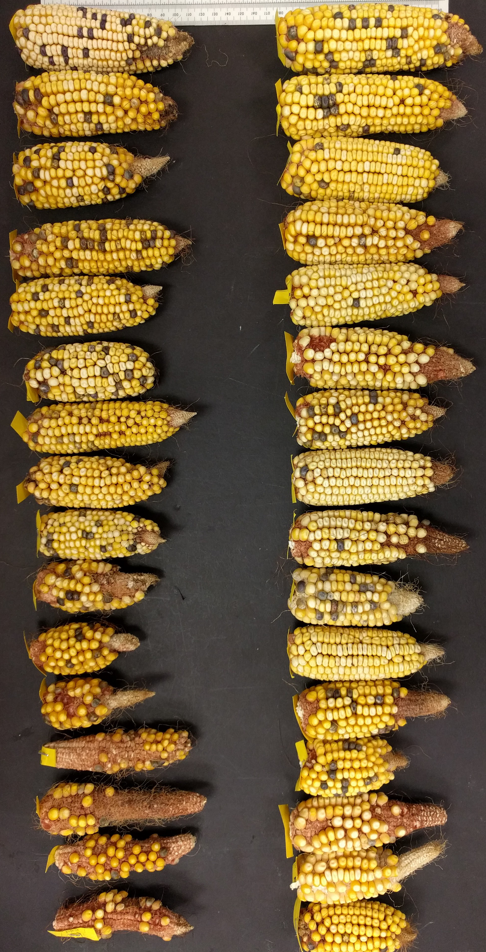
Wpgd transgenes mitigated yield losses in heat-stressed field
Planting 1
Planting 2
p=0.85
p=0.007
Kernel number increase is visible by comparing all first ears from individual plots in planting 2.
p=0.87
p=0.007
p=0.73
p=0.005
Wpgd1
Wpgd2
Wpgd1
Wpgd2
Normal
Wpgd2-C
Ribeiro et al., 2020 PNAS USA 117:33177-33185.

Slide 27
Hybrid field trial in 2020
B73 X Wpgd/-
Backcross transgenes into B73 or W22 to convert to 98-99% inbred genotype.
Generate B73/W22 hybrid seed
Early (cooler) and late (heat stress) plantings with identical management as the 2017 field trial
From 0-30 DAP, heat stress planting had >100 h more time above 33°C and >200 h less time below 22°C.
B73 X Wpgd/- F₁
B73 X Wpgd/- BC₁
B73 X Wpgd/- BC₂
B73 X Wpgd/- BC₃
B73 X Wpgd/- BC₄
Wpgd/- BC₅
⊗
¼ Wpgd/Wpgd X W22 → transgenic blocks
½ Wpgd/-
¼ -/- X W22→ non-transgenic blocks

Slide 28
Wpgd transgenes mitigate heat stress yield losses in hybrids
Planting 1
Planting 2
p=0.68
p=0.006
Wpgd1
Wpgd2
Wpgd1
Wpgd2
Wpgd transgenes showed similar heat stress mitigation as hybrids.
Heat stress reduced non-transgenic hybrid ear weight by 22%
6/7 transgenic events showed an average 17% increase in ear weight over non-transgenics.
Transgenic ear weights were not significantly different between planting 1 and 2.

Slide 29
Summary
Plastid-localized 6PGDH is a heat labile enzyme required for maize seed development.
Cytosolic 6PGDH isozymes are more heat stable.
Directing cytosolic 6PGDH to the maize endosperm amyloplast complements pgd3 mutants.
Directing cytosolic 6PGDH to the maize endosperm amyloplast mitigates part of the yield losses due to heat stress.
This synthetic gene strategy may be generalizable to mitigate heat stress yield losses:
  Plastid isozymes share a common evolutionary ancestor that is divergent from cytosolic isozymes in plants.
  Arabidopsis thaliana requires plastid OPPP for seed development.t (Andriotis & Smith, 2019 PNAS 30:15297-15306)
  Tomato cytosolic 6PGDH shows in vitro heat stability like maize PGD1 and PGD2. (Tanksley & Kuehn, 1985 Biochem. Genet. 23, 441-454)

Slide 30




Acknowledgements
Collaborators
Tracie Hennen-Bierwagen
Alan Myers
Lilla Römisch-Margl
Phuc Thi Do
Alisdair R. Fernie
Wolfgang Eisenreich
Alfons Gierl
Camila Ribiero
Hope Hersh
Gertraud Spielbauer
Li Li
Romain Fouquet
John Baier
Chi-Wah Tseung
Ken Cline
SCRI Awards:
2011-67003-30215
2018-51181-28419
PGRP Award:
0606607
Fellowship Award:
209426/2013-6

