Slide 1

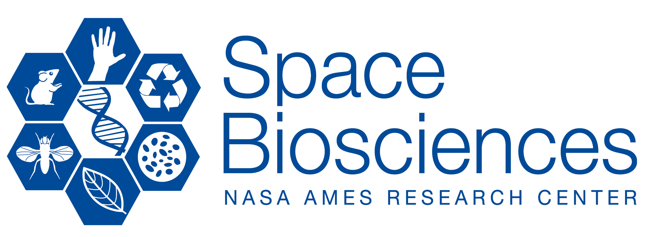
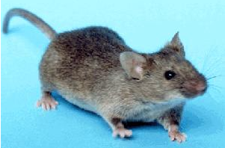
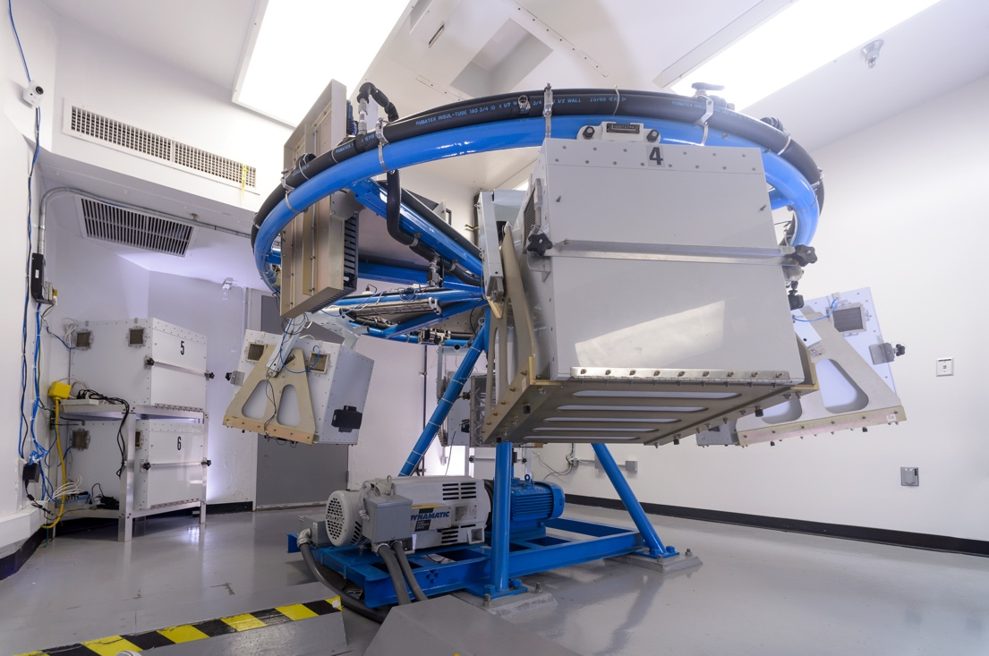
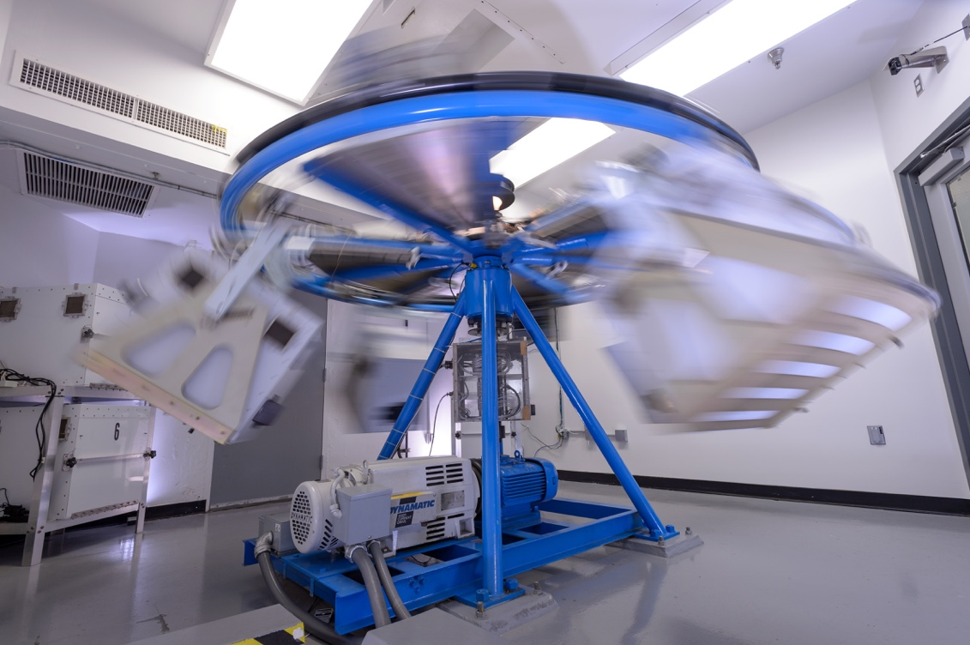
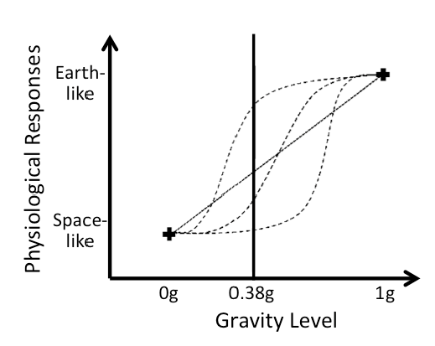
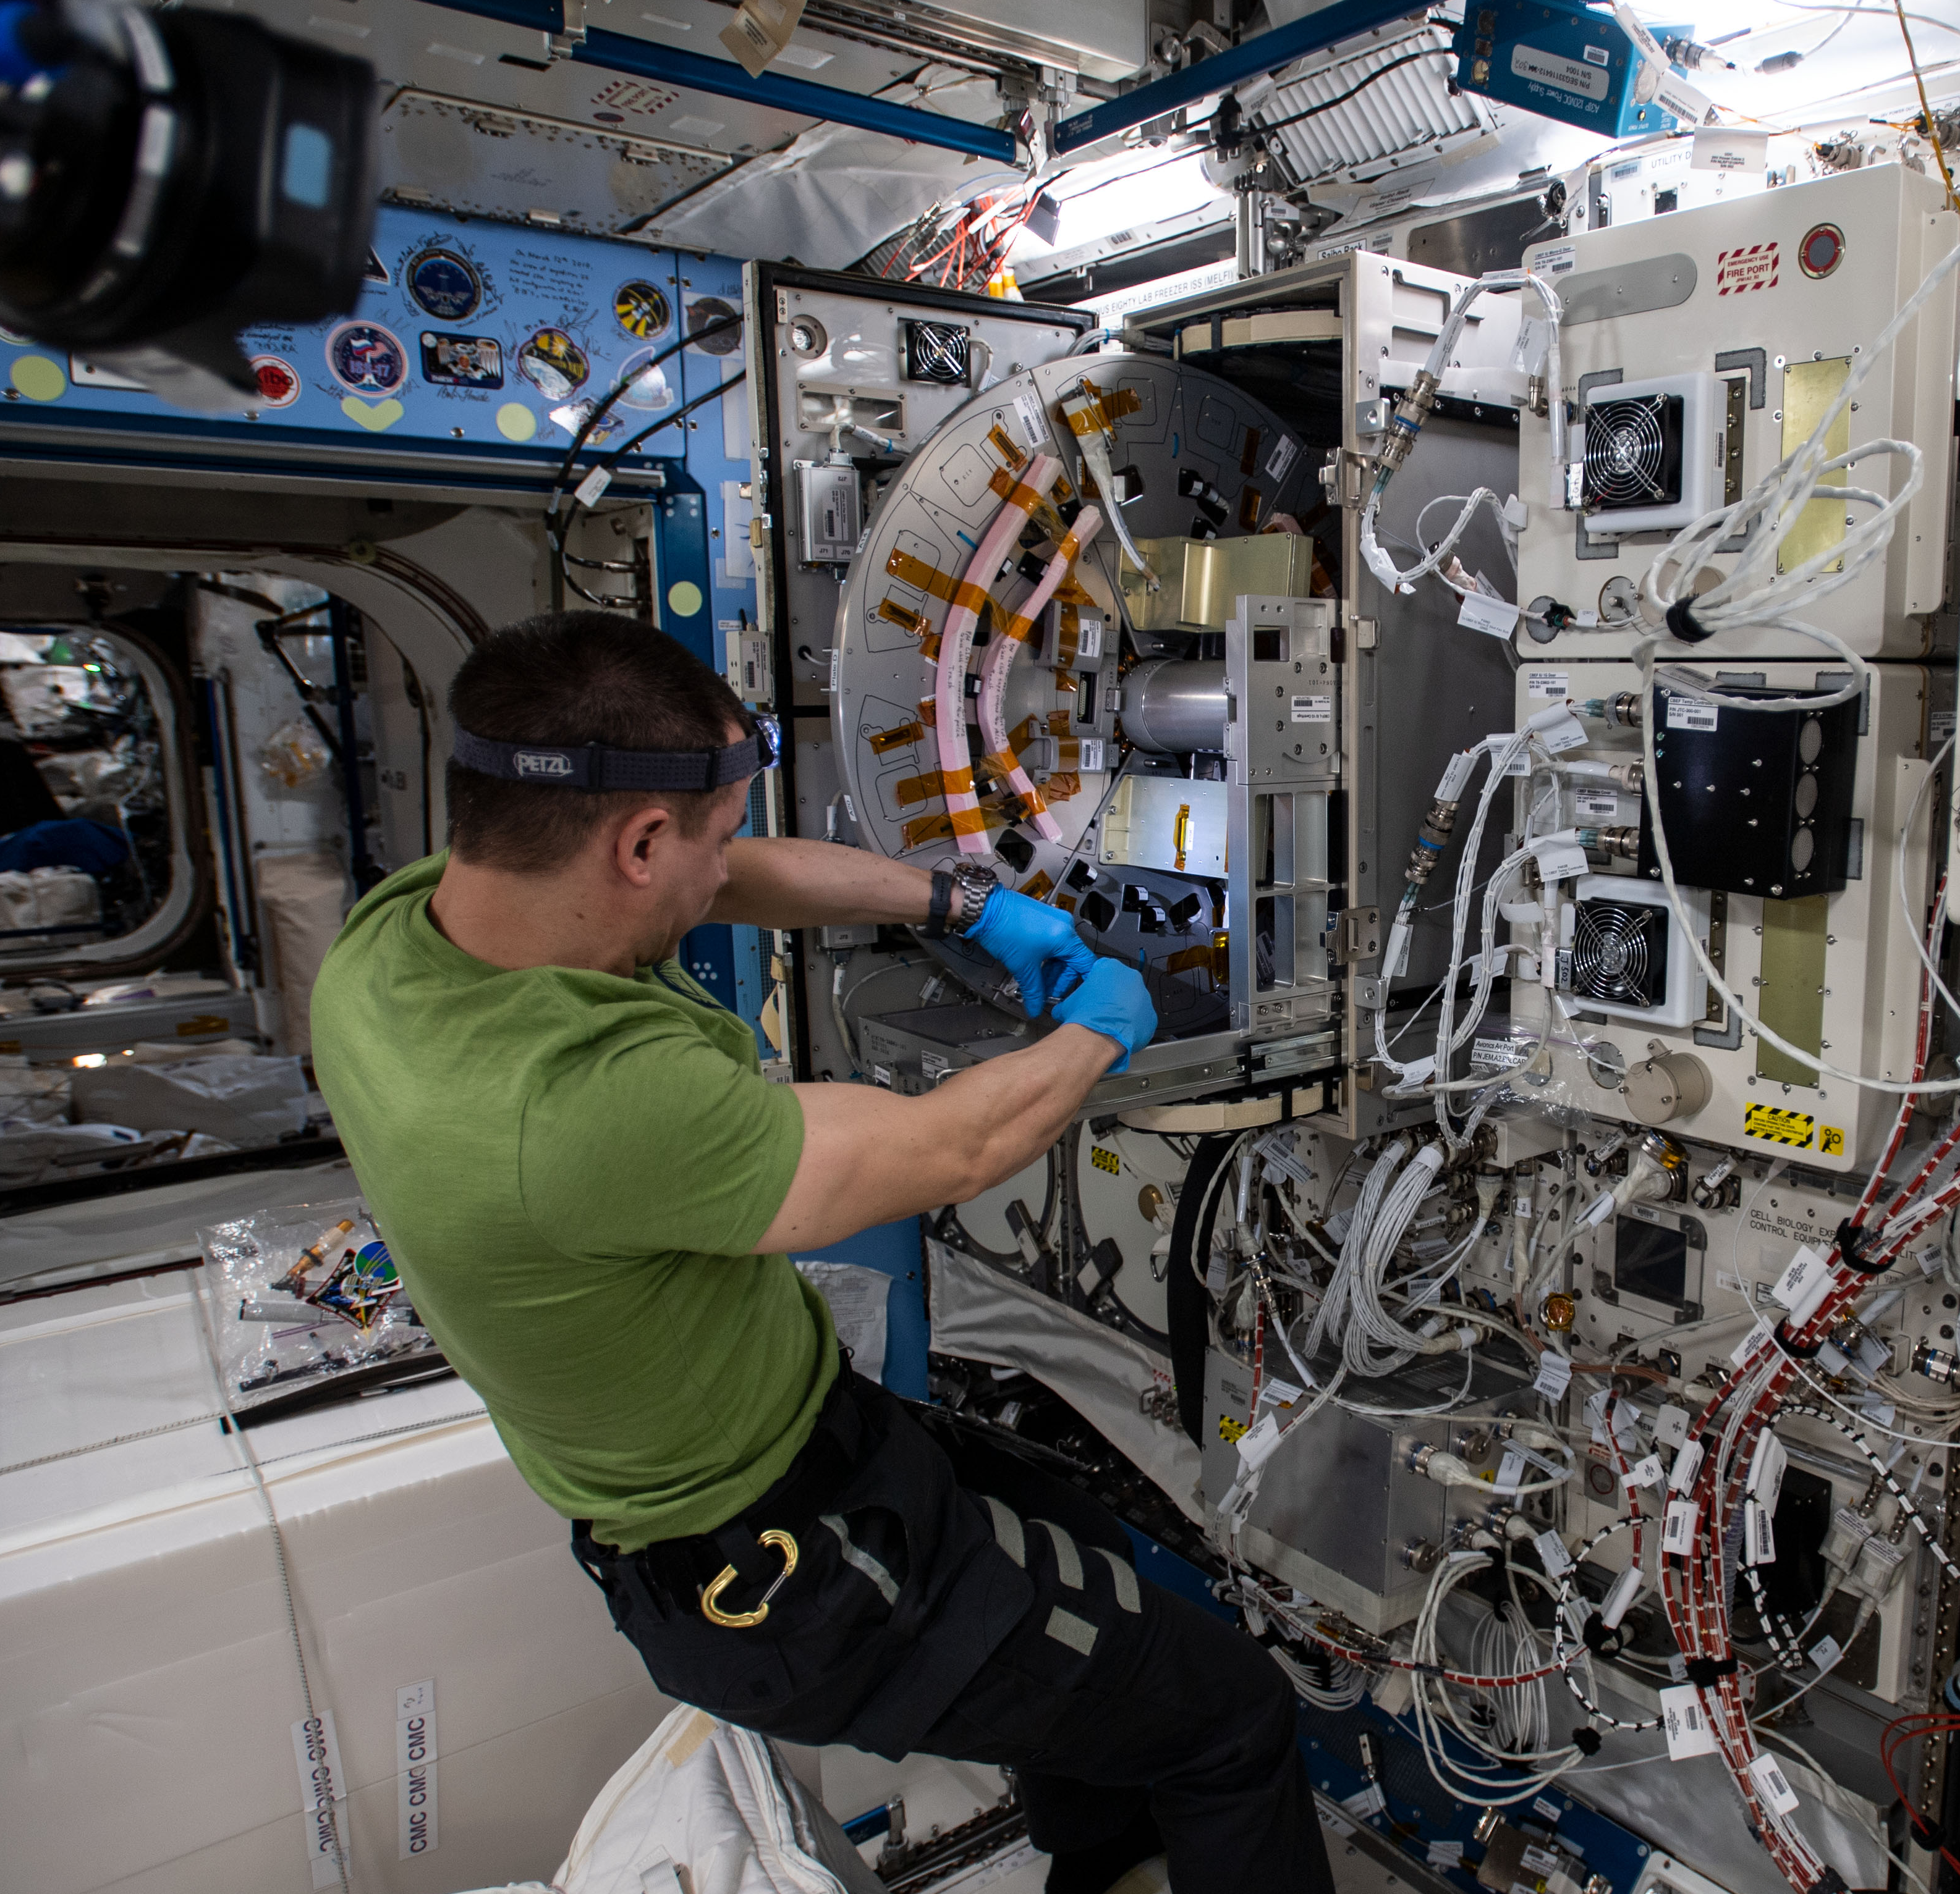
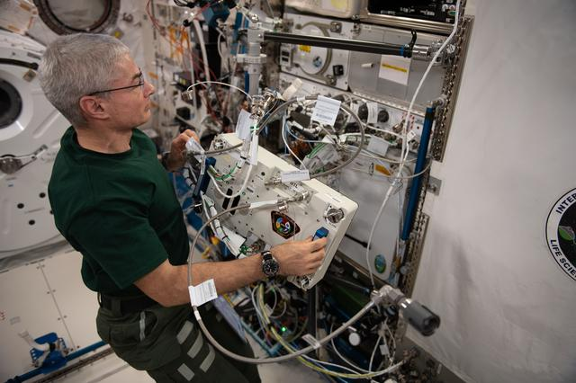
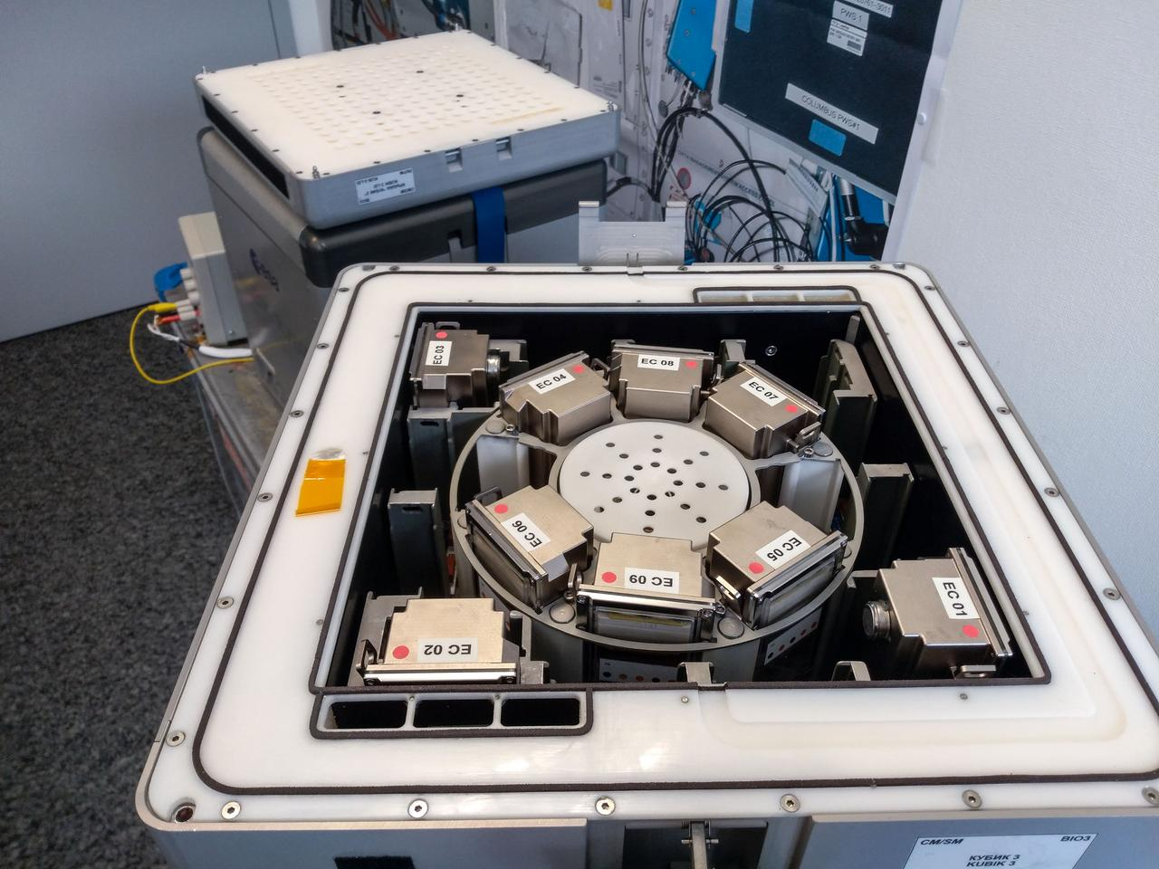
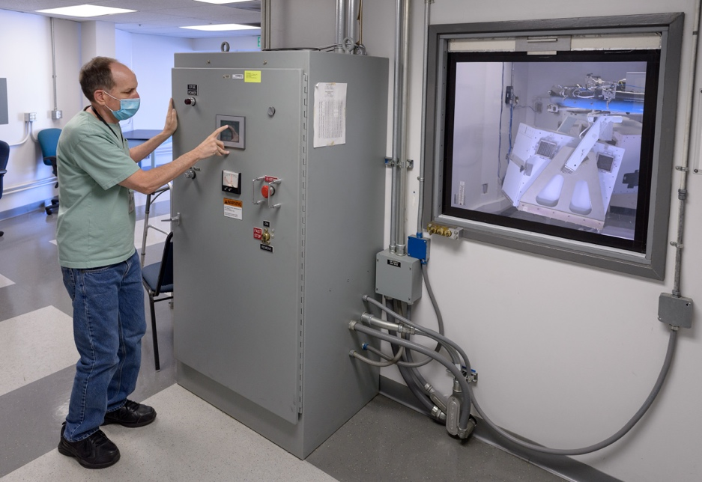
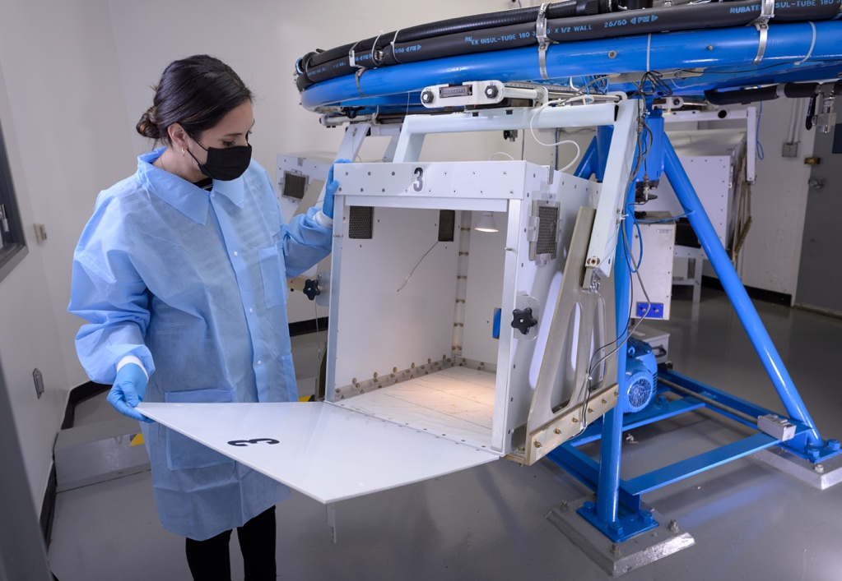
Hypergravity Facilities for Model Organism Research at NASA Ames Research Center
Marianne Steele¹, Hami E Ray², Medaya Torres³, Frances Donovan⁴
¹KBR; ²ASRC Federal Space and Defense; ³Bionetics; and ⁴NASA Ames Research Center, Moffett Field, CA
Abstract
1-Meter Radius Centrifuge
The Coriolis Effect, Cross-Coupled Angular Acceleration and Relationship to Centrifuge Radius
Gravity (g) is a fundamental force in the development of life on Earth. The physiological effects of changes in g-levels are one of the challenges faced in the exploration of Space, both for humans and other organisms. Ground-based hyper-g facilities can be used to study how life responds to different g-loads.
The centrifuges highlighted in this presentation are uniquely built for studies evaluating the effects of elevated g-forces on small model organisms ranging from microbes to plants to small animals. The g-conditions can be continuous or intermittent to examine homeostatic or threshold responses. Powered habitat enclosures include continuous data, video, and temperature monitoring. Experiments are controlled and monitored from an adjacent room. Residential staff expertise and resources allow researchers to conduct hyper-g studies that cannot be performed in any other NASA facility.
The 1.22-Meter Radius Centrifuge supports four specimen cabs, each adaptable to accommodate different types of experiments. Each of the specimen cabs can accommodate a variety of model organisms at various acceleration levels during a single experiment. The four ground control cabs, in addition to the four specimen cabs attached to the centrifuge, are located within the centrifuge room.
The 1-Meter Radius Centrifuge supports one to four specimen cabs, configured with one or two rotating arms to accommodate different types of experiments. Ground controls are performed in an adjacent room.
Review of prior centrifugation studies, comparison to space-flown centrifuges, and a discussion of the potential confounding factors of centrifugation (Coriolis, vibration, g-gradient), will provide a framework for developing future hyper-g research.
The smaller the radius, the greater the rotation rate and the greater the Coriolis effect on the specimen.
The Coriolis effect describes the pattern of deflection of moving objects when the motion is relative to a rotating reference frame. A smaller radius requires faster rotation to obtain the same force as a larger radius centrifuge and Coriolis is proportional to rotation rate. From human studies we know we must consider the effects of centrifugation on vestibular systems. While a person is rotating, a head rotation in any other plane will produce an apparent rotation in a direction unrelated to what is actually happening. This causes a sensation of tumbling, rolling or yawing that is due to cross-coupled angular acceleration. Cross-coupled angular acceleration is a phenomenon distinct from the Coriolis phenomenon, which refers to expected linear acceleration associated with translation within a rotating environment. From studies with humans, we know these forces not only cause visual disorientation, but they also act upon the balance of sensitive organs within the inner ear causing a loss of balance and creating a sense of vertigo. Gradient of force across the specimen also increases with shorter radius, which can create different stimuli on different physiological systems and make data interpretation difficult. These effects are all related to radius size and should be considered when undertaking centrifugation studies.
Head experiences slower rotational rate than feet – the shorter the radius the greater this gradient across the specimen increasing likelihood of difficult data interpretation.
Coriolis effects and cross coupled angular acceleration are known consequences of centrifugation and are of interest to understanding how biological specimens, including humans, adapt to centrifugation.
Centrifugation can induce vibration/noise into the surrounding environment and controls should take this into account.
Specimen care may require centrifugation to start and stop throughout a planned centrifuge run. The ramp up and down duration and intermittent exposures to g levels must be taken into account in study designs.
Centrifuges for research on plants, cells, and small animals available on the International Space Station (ISS) include the European Space Agency’s (ESA) Kubik, Japan Aerospace Exploration Agency’s (JAXA) Mouse Habitat Unit (MHU) in the Centrifuge-equipped Biological Experiment Facility-L (CBEF-L), and Techshot Inc. Multi-use Variable-g Platform (MVP). Hypergravity studies can work in conjunction with results from partial gravity studies to further elucidate pathways and mechanisms underlying responses to gravity.
The 1-Meter Radius Centrifuge can support one to four specimen cabs with adjustable rotating arms to accommodate different types of experiments. Each arm can support one to four specimen habitats. The centrifuge boasts a stationary central control and was built to mimic the JAXA centrifuge capabilities. Credits: NASA/Dominic Hart
Centrifuge Parameters
Parameters | 1.22-Meter Radius | 1-Meter Radius
RPM Range at 1-Meter Radius Configuration | 10-45 RPM | 0-60 RPM
RPM Range at < 0.5-Meter Radius Configuration | n/a | 0-90 RPM
Gravity Settings | 1-3G (potential to 4G) | 1-3G
Radial Position Range of Primary Enclosures | 93-162cm (with extensions) | <50-100cm
On-center Enclosure Volume | 0.03m³-0.06m³ | 0.03m³-0.06m³
Payload Capacity per Enclosure | 113 kg | 5 kg
Enclosure Dimensions | 51 cm x 64 cm x 61 cm | 29 cm x 29 cm x 54 cm
Enclosure Volume | 0.20 m³ | 0.05 m³
Temperature and Humidity | +16-28 C; <75% | +16-32 C; <75%
Specimen | Small animals, plants, tissue cultures | Small animals, plants, hardware
Exposure | Acute or chronic | Acute or chronic
Background and Introduction
Additional Considerations for Centrifugation Studies
The 1.22-Meter and 1-Meter Radius Centrifuges are located in the Life Science Acceleration Research Facilities at NASA Ames Research Center, Moffett Field, CA. Biological specimens can range from microbes to tissue cultures, plants, and small animals for acute or chronic exposure studies. Hypergravity studies, adding loading to test subjects through centrifugation or linear sled acceleration, have allowed greater than earth g responses to be measured and modeling for physiological responses to gravitational shifts.
1.22-Meter Radius Centrifuge
A.
B.
Importance of Centrifugation Studies
Examples of Centrifuges on the ISS
Altered Gravity research allows characterization of how life responds to different gravity loads. Questions include:
Are physiological responses like bone loss in microgravity or increased bone density seen in hypergravity due to a set threshold or is the response varying along a continuum?
How does adaptation occur? Are all systems affected? Are they affected equally?
Is there a gravity prescription for maintaining biological homeostasis? Could intermittent exposure to gravity be enough to maintain homeostasis?
What are the biological responses due to shifting from one gravity level to another level? What are the responses to intermittent gravity if provided via centrifugation? Via planetary surface exploration (Mars/Lunar)?
35-cm radius
19.5-cm radius
10-cm radius
C.
D.
NASA astronaut Mark Vande Hei works to relocate the Multi-use Variable-g Platform (MVP) inside the Kibo laboratory module. Credits: NASA
Theoretical physiological responses against g level. Adapted from Paloski 2014
NASA astronaut Andrew Morgan prepares the JAXA Mouse Habitat Unit-5 (MHU-5) in the Centrifuge-equipped Biological Experiment Facility-L (CBEF-L). Credits: NASA
Preflight imagery showing nine BioRock experimental containers each containing a bioreactor in the KUBIK centrifuge. Image Courtesy of: ESA
In space, crew experience gravitational shifts in the form of hypo/microgravity (below 1g) and hypergravity (above 1g) as part of launch and landing.
Future Direction
Future in-flight centrifugation studies will allow examination of the full potential of artificial gravity, the response to partial gravity loads (lunar, mars), and to intermittent gravity loads (microgravity followed by centrifugation followed by periods of microgravity again). Studies performed with the NASA Ames Research Center 1.22-meter radius and 1-meter radius ground-based centrifuges will build upon our current knowledge base and provide a preview of the potential results of a mission to moon or Mars, possibly even to find a centrifugation exposure that minimizes the negative impacts of spaceflight.
(A and B) The 1.22-Meter Radius Centrifuge supports four (4) specimen cabs capable of accommodating different experiments and a variety of model organisms under temperature control. The centrifuge can accommodate rotational and stationary controls. Ground control stationary cabs are located within the centrifuge room. (C) Experiment operations are monitored and performed from an adjacent room. Powered habitat enclosures include continuous data, video, and temperature monitoring. (D) Habitat enclosures can accommodate a variety of model organisms at various acceleration levels during a single experiment. Credits: NASA/Dominic Hart
Hyper-g studies create a knowledge base
of physiological and pathological responses, mechanisms, adaptation, pharmacological testing, and as an engineering test bed
Gravity Load (g)
Credit: NASA
POC: Parag Vaishampayan, Space Biology Portfolio Scientist, NASA ARC, parag.a.vaishampayan@nasa.gov
Fact Sheet: https://www.nasa.gov/sites/default/files/atoms/files/hgrfmo-fs-16apr2020_01_0.pdf
ARC SB Biosciences website: https://www.nasa.gov/ames/research/space-biosciences/ground-research-facilities
Days
Notes:
JAXA CBEF-L -- https://humans-in-space.jaxa.jp/en/biz-lab/experiment/facility/pm/cbef-l/
Radius – Fran (studies on the ground vs flight)
Marianne – concerns about adding non-ARC centrifuge information (JAXA CBEF-L). Focus on ARC, what we have, why it’s useful, etc

