Slide 1
Flying Blind:
Keeping Aircraft Safe Without a Pilot On Board
National Aeronautics and Space Administration
Aaron Dutle,
NASA Langley Research Center
Work contained in this talk was performed by various members of the Safety-Critical Avionics Systems Branch, including Evan Dill, César Muñoz, Anthony Narkawicz, Jason Upchurch, and others.
www.nasa.gov

Slide 2
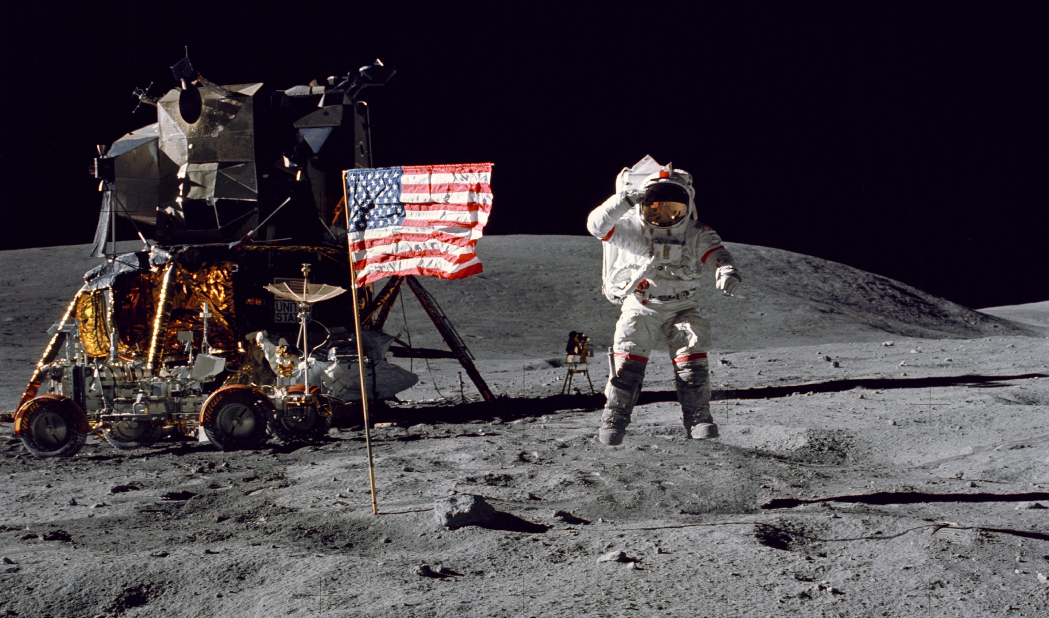
Just another day at the office…
Notes:
Most people think of only space exploration when they think of NASA

Slide 3
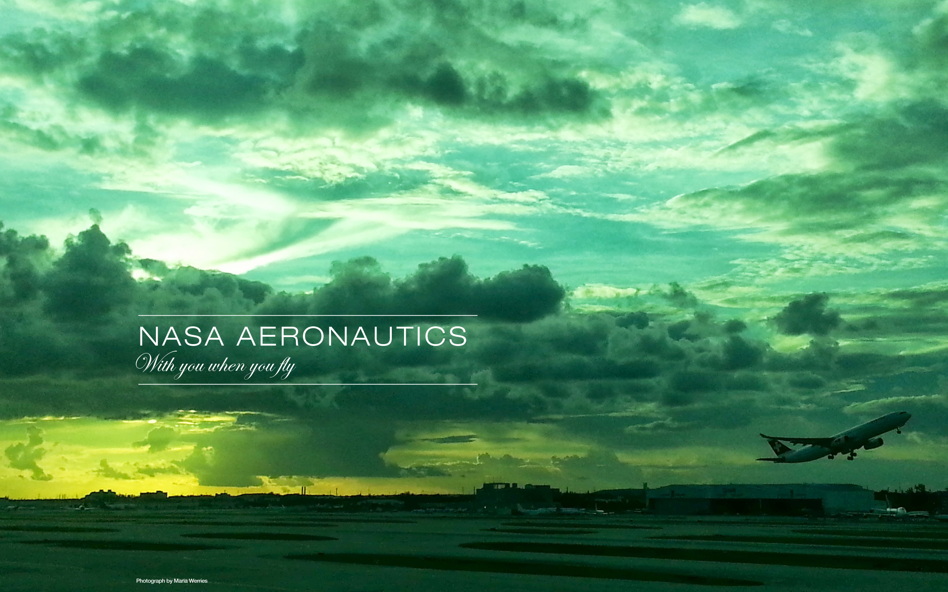
The First “A” is for Aeronautics
Notes:
Talk about the different ways that we work in aero. Computational Fluid Dynamics, green air travel, supersonic overland flight, on demand air travel, etc.

Slide 4
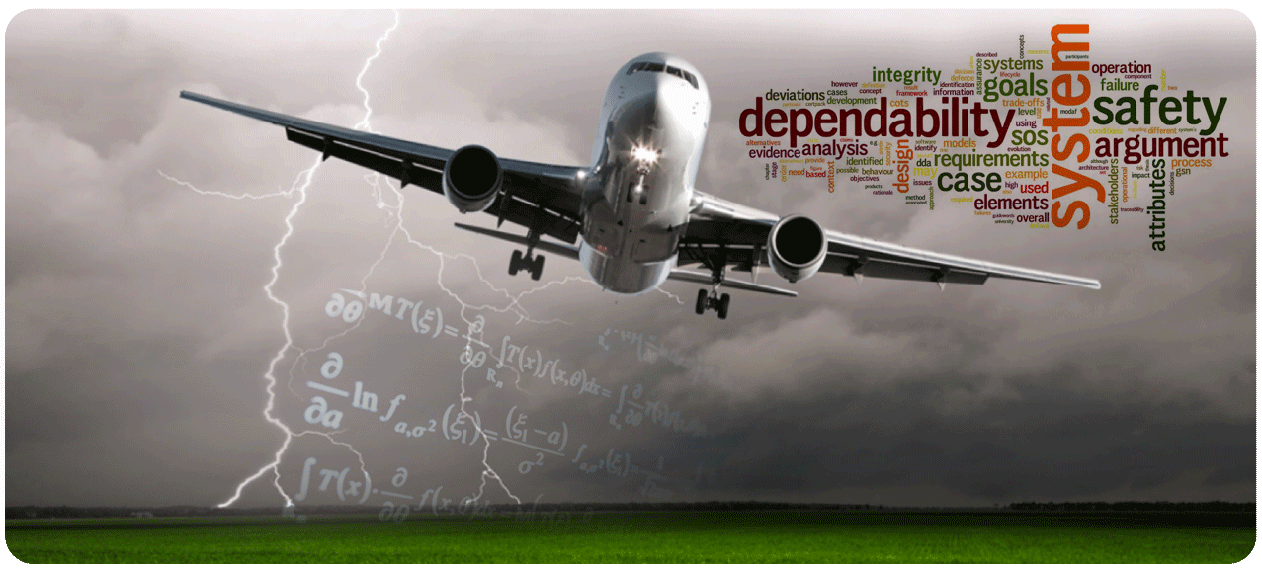
Safety-Critical Avionics Systems Branch
Notes:
When you put hardware or software on a plane, you have to be sure that it’s trustworthy.

Slide 5
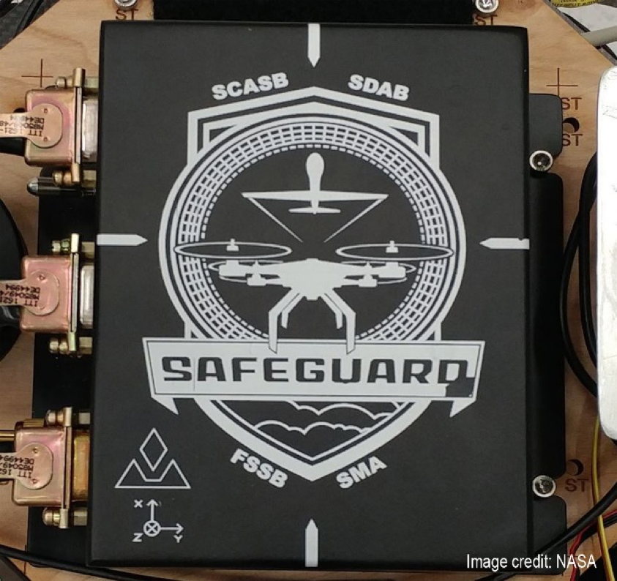
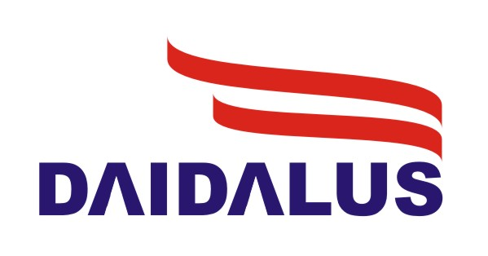
Outline for this talk
Safeguard: An independent Geofence for small drones.
DAIDALUS: A library of Detect-and-Avoid software for unmanned aircraft.
Formal Methods: The thing that makes these two systems different from others.
Where this is heading: The future of the airspace.
Detect and AvoID Alerting Logic
for Unmanned Systems
Notes:
When you put hardware or software on a plane, you have to be sure that it’s trustworthy.

Slide 6
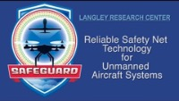

Slide 7
What makes Safeguard different?
Independent from on-board software.
  Can be reused on different platforms, with consistent results.
  Protects against bugs, malicious actions in software updates.
  Can even be independent of the position source used.
Rigorous development and verification.
  NASA class C software.
  “Formally verified mathematics…” coming up soon.

Slide 8
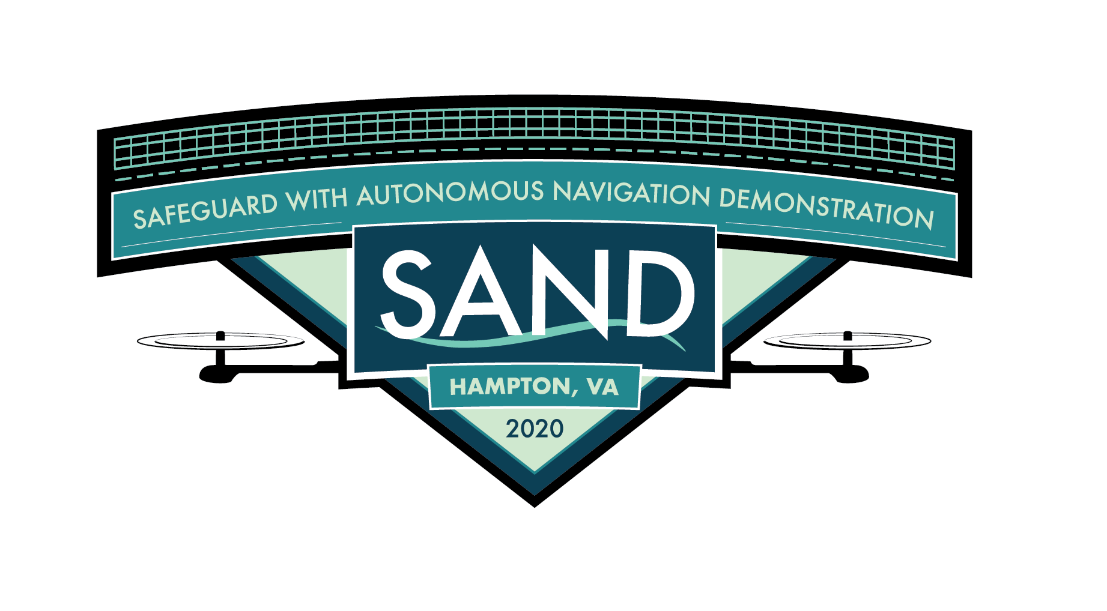
Where is Safeguard used?
Available for license through NASA (no major partner yet).
Used on our internal testing range, considered acceptable means of compliance by the Safety board.
A main component in a drone navigation development competition scheduled for 2020, (postponed due to COVID-19).
Some software components used in ICAROUS, a NASA–developed autonomous aircraft software platform.
Notes:
The basic mathematical idea behind a geo-fence.

Slide 9
Detect & Avoid Alerting Logic for Unmanned Systems
Notes:
The software system developed in the SCASB to provide situational awareness and maneuver guidance for unmanned aircraft.

Slide 10
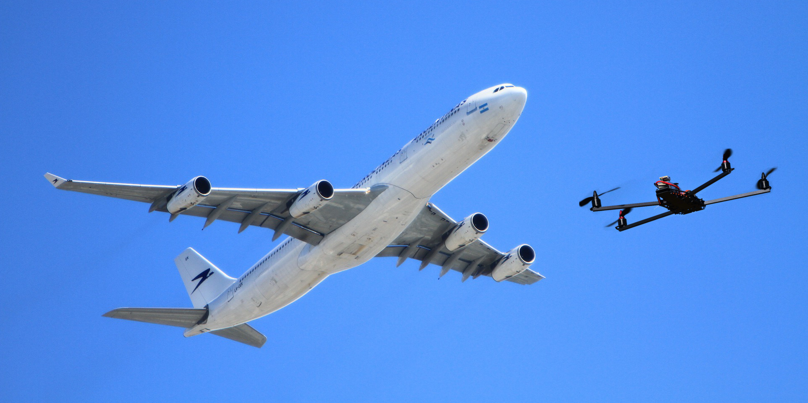
See and Avoid
Michael Huerta, Administrator, Federal Aviation Administration¹:
A bedrock principle of aviation is see and avoid. And if you don’t have a pilot on board the aircraft, you need something that will substitute for that, which will sense other aircraft, and we can ensure appropriate levels of safety.
1: http://www.pbs.org/newshour/bb/drone-industry-grows-faster-flick-joystick-regulation-lags/
Notes:
See and avoid becomes sense and avoid, then detect and avoid. Short mention of well-clear and its development.

Slide 11
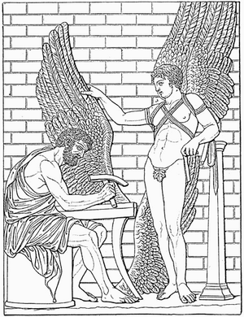
What’s in a name?
DAIDALUS is a reference to the Greek myth.
Daedalus advised Icarus not to fly too high, or his wings would melt in the sun, and not to fly too low, or his feathers would be soaked.
Image from http://www.wikipedia.org/wiki/Daedalus

Slide 12
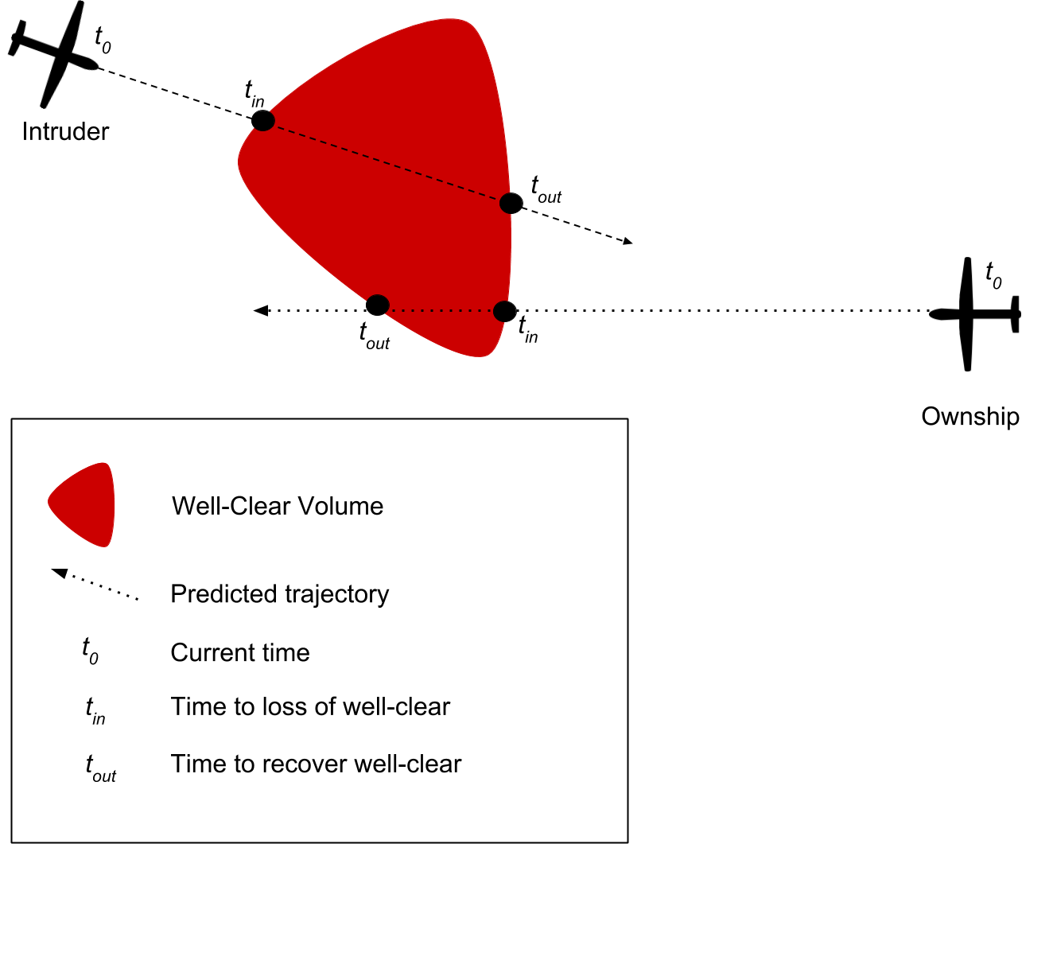
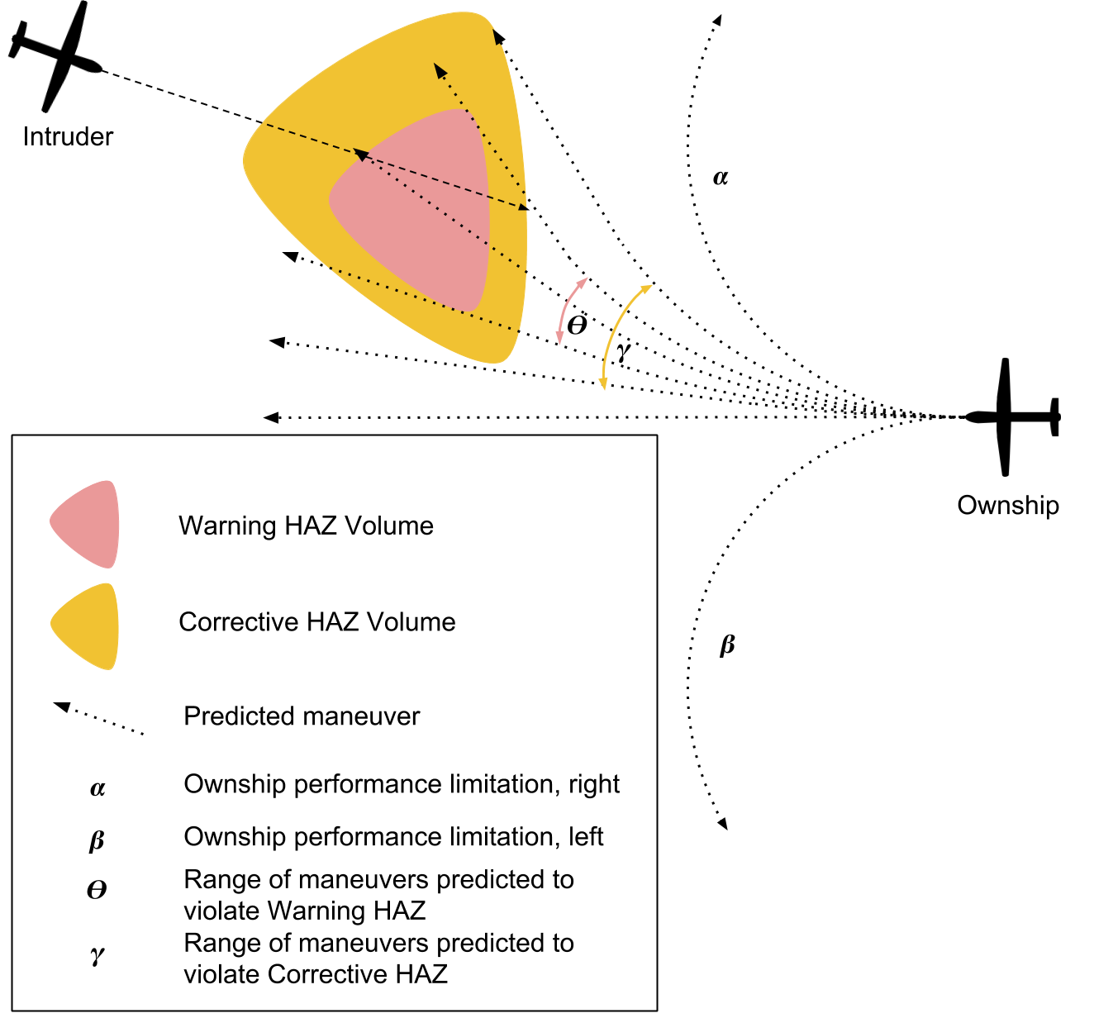
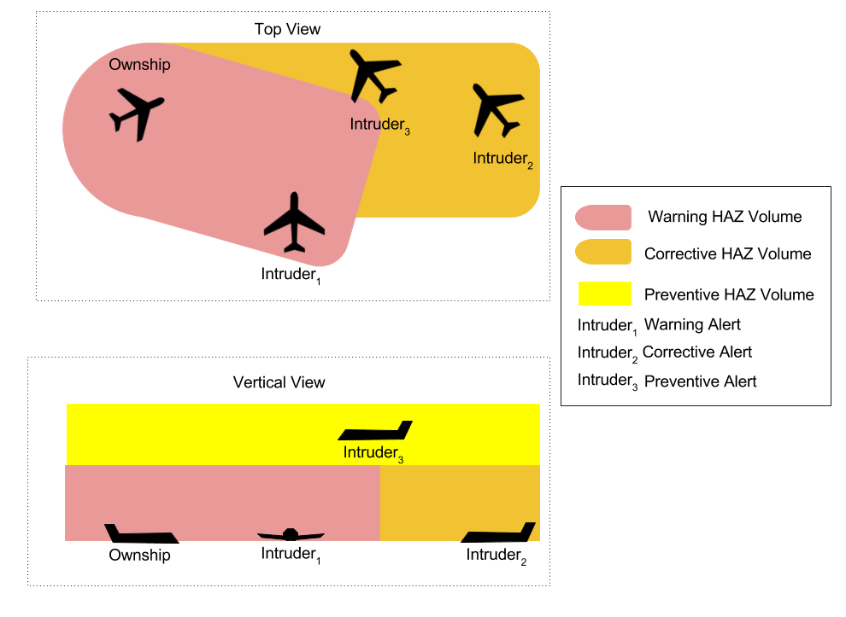
Advice from DAIDALUS
Detection determines the time interval where a loss of well-clear is predicted to occur
Maneuver Guidance finds ranges of maneuvers that lead to entering some hazard volume
Alerting computes a number indicating the severity of a potential loss of well-clear
Notes:
Provides maneuver guidance for turns, vertical speed, ground speed, and altitude. Provides different severity alerts for predicted violations of well-clear.

Slide 13
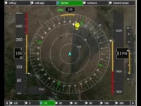
A remote pilot’s view from the ground

Slide 14
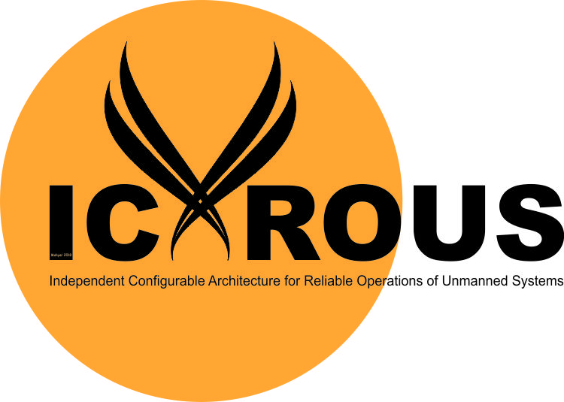
Where is DAIDALUS used?
As the reference implementation for Detect-and-Avoid in the US standards document maintained by RTCA special committee 228: DO-365 “Minimum Operational Performance Standards (MOPS) for Detect and Avoid (DAA) Systems.”
Internal to NASA for research and flight testing of Unmanned Aircraft.
By several government and industry partners as part of their own UAS systems.
As the DAA component of ICAROUS, a NASA–developed autonomous aircraft software platform.

Slide 15
What do these systems have in common?
Both NASA-developed, used in unmanned aircraft systems.
Both designed to keep aircraft away from some hazard.
Both developed using techniques from Formal Methods.

Slide 16
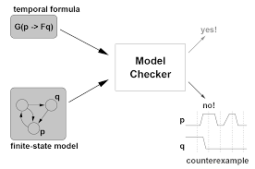
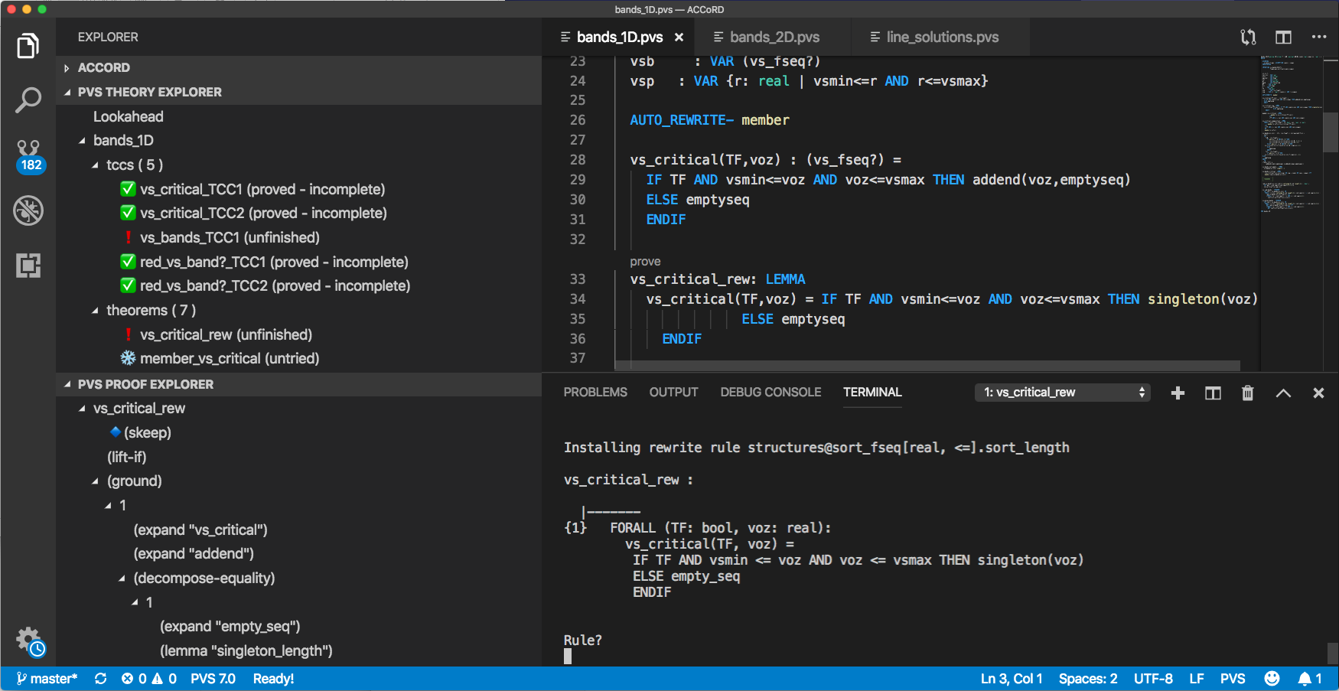
What is Formal Methods?
Formal Methods:
Mathematically rigorous techniques for verification.
Provide methods to examine ALL possible inputs.
Can establish correctness or safety properties.
Model checking
Some Formal Methods Techniques:
Interactive theorem proving
Static analysis
Model checking
Verified compilers
Runtime verification
Requirements analysis
Interactive theorem proving

Slide 17
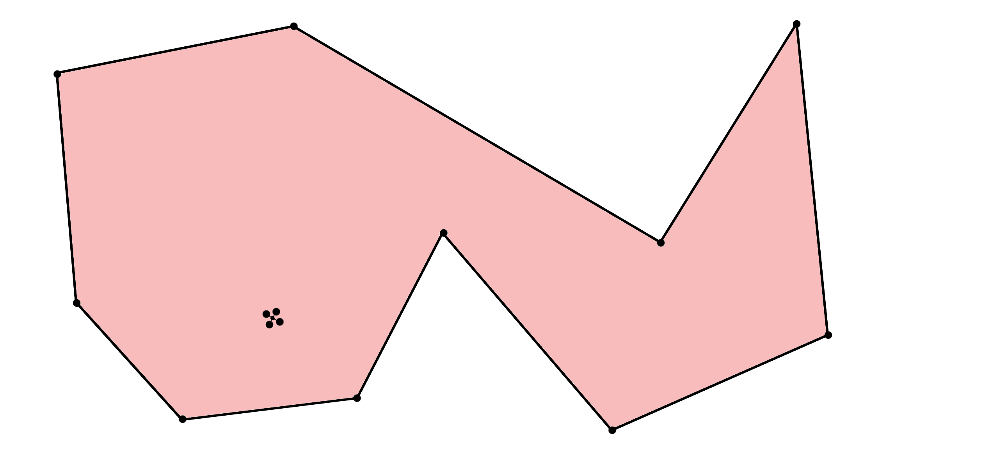
Geofencing: The Point in Polygon problem
Notes:
The basic mathematical idea behind a geo-fence.

Slide 18

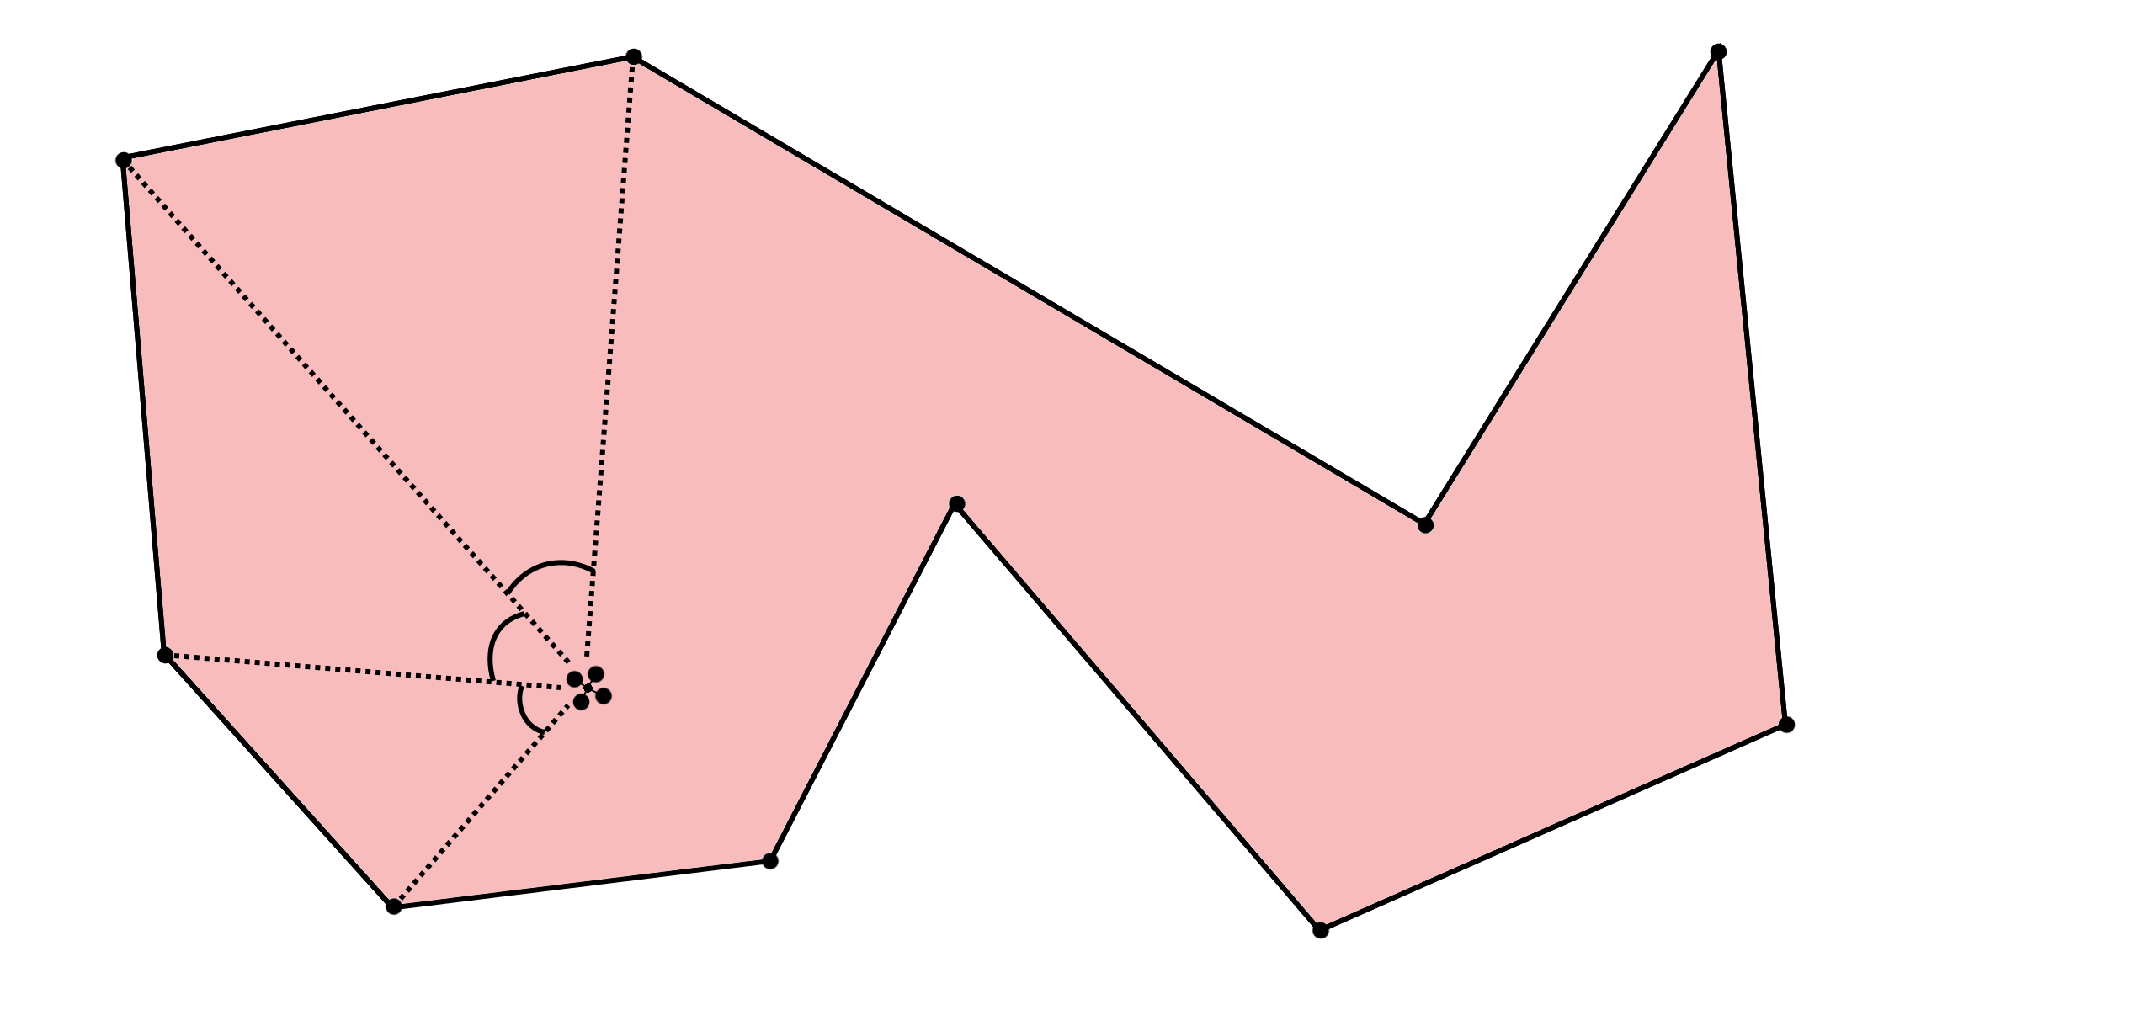
Two well-known methods:
Ray-casting:
Pick a direction and send out a ray.
Count the number of times it crosses an edge of the polygon.
Winding Number:
Travel along the edges, and add the angles formed.
Count the multiples of 360 degrees.
Notes:
Cast a ray out in any direction from the point of interest. If it crosses an odd number of times, it’s inside. If it crosses an even number of times, it’s outside.

Slide 19
Using an Interactive Theorem Prover (PVS)
Ray-casting:
Showed that the direction of the ray doesn’t change the answer.
If the point is away from the polygon, there is a ray that doesn’t hit it at all.
Winding Number:
Showed that this answer is the same as the ray-casting answer.
Equivalence of a simplified version counting quadrant crossings.
Notes:
Cast a ray out in any direction from the point of interest. If it crosses an odd number of times, it’s inside. If it crosses an even number of times, it’s outside.

Slide 20
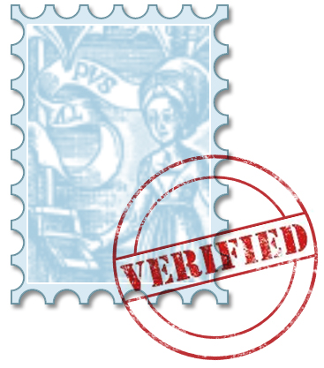
True things for DAIDALUS:
Each aircraft in an encounter will compute the same status. (Symmetry)
A detected violation will become an actual violation in the future.
Any maneuver that DAIDALUS computes
as being safe will avoid violations in the
future.
Notes:
Conclusion slide as well.

Slide 21
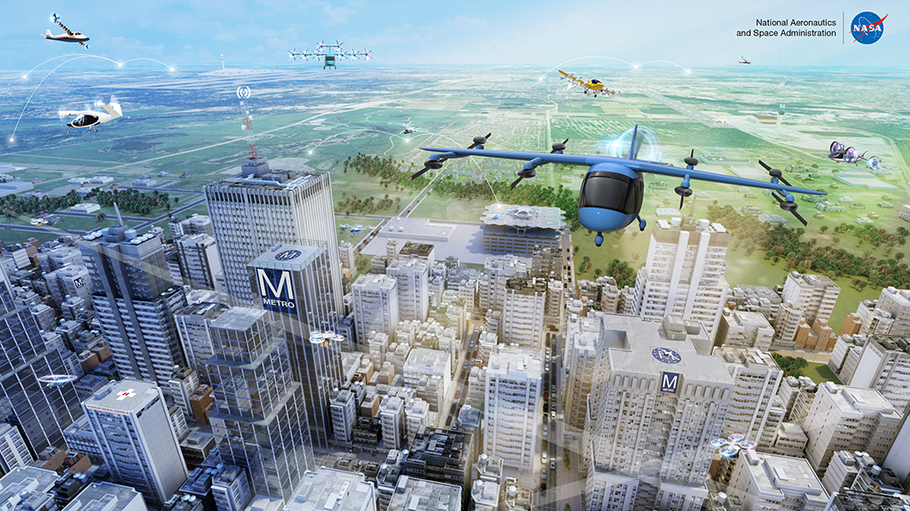
The future of Air Transportation…

Slide 22
Challenges for the future
Dependence on software
  The amount of software on aircraft has been increasing exponentially.
  New types of software (AI/ML) that we don’t know how to verify yet.
Autonomous aircraft
  Pilots have always been the final safety measure. What do we do without one?

Slide 23
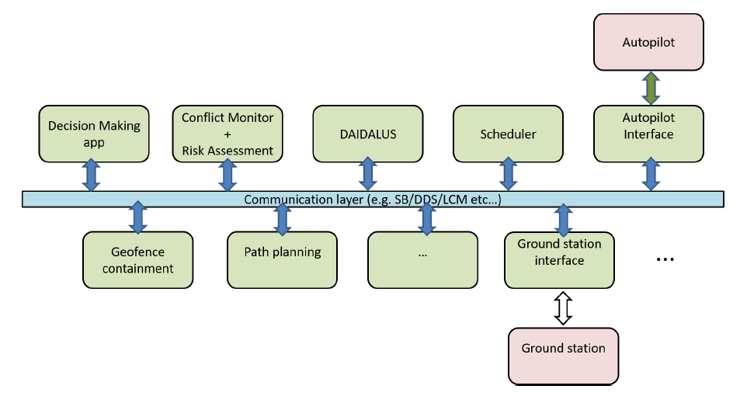
Formal Methods is part of the answer
Research in Formal Methods:
Directly verifying the behavior of Machine Learning Algorithms.
Bounding the behavior of unknown algorithms using Runtime Monitors.
Proving Safety properties of Cyber-Physical Systems.
Making software implementations robust to numerical errors.
Capturing and formalizing the requirements of a system (before and during design).
ICAROUS is a NASA-developed autonomous aircraft system. Elements in red have employed formal methods in design or verification.

Slide 24
SignOffPage
Thanks!
Notes:
NASA Presentation Sign-Off Page

