Slide 1
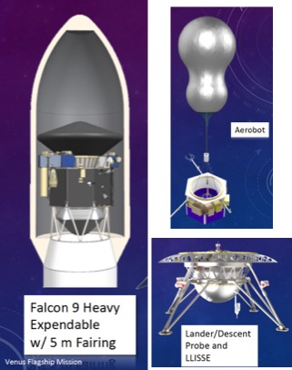
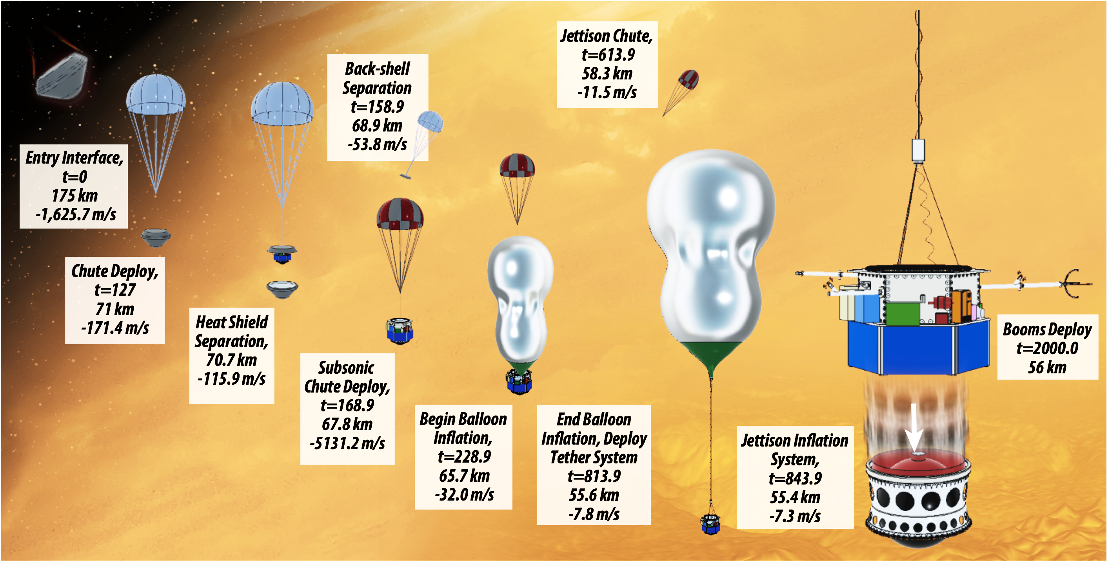
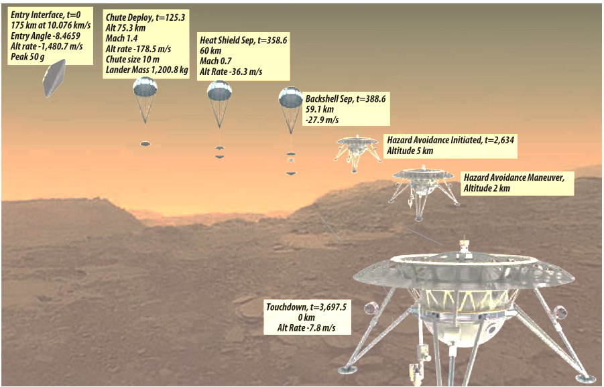
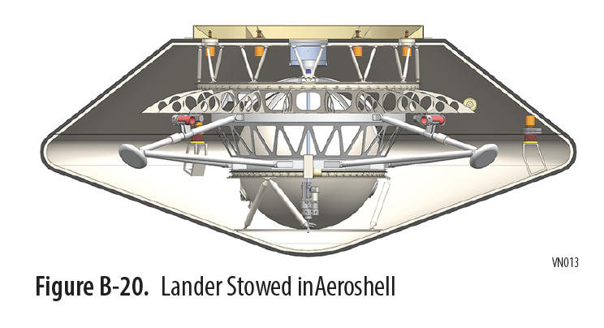
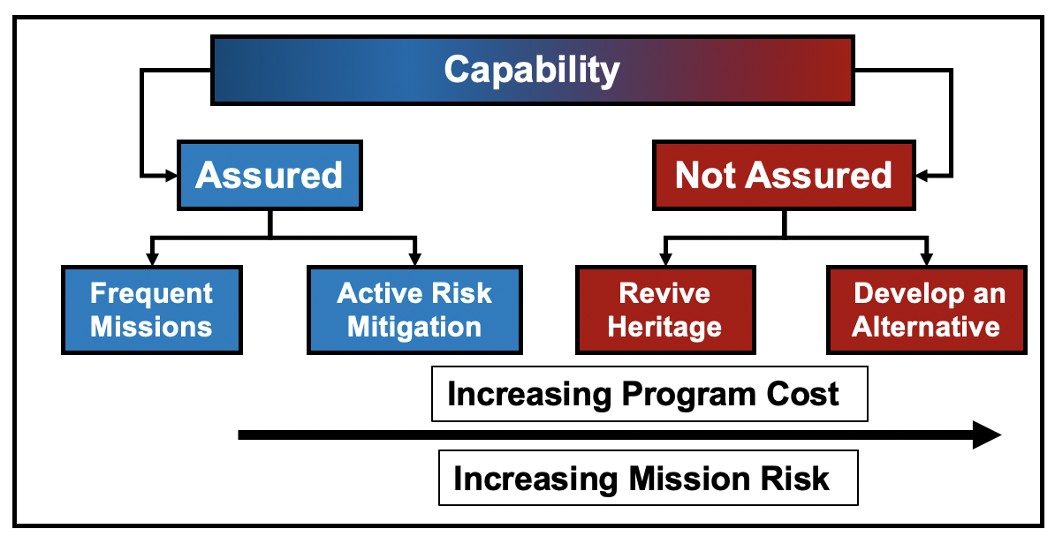
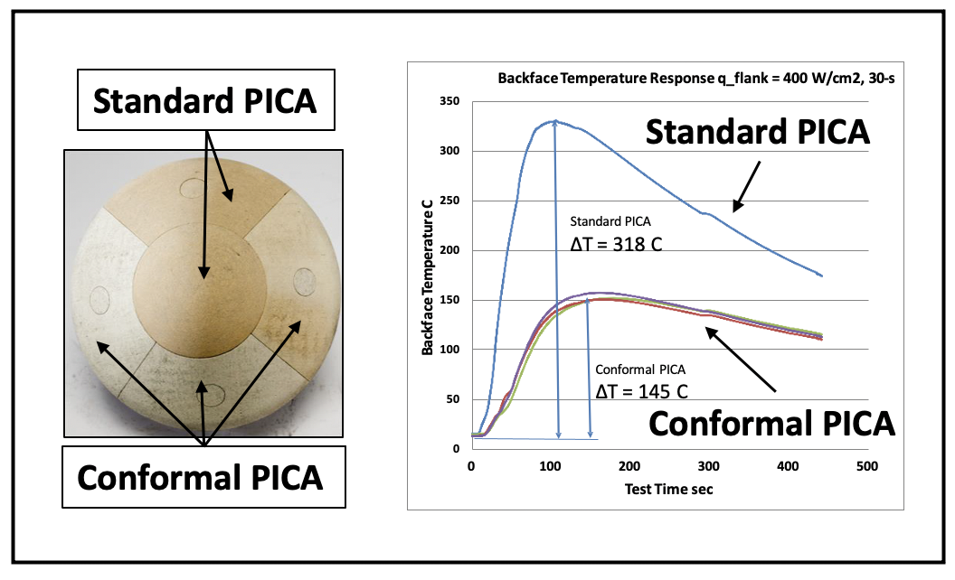
Robust and Mass Efficient Thermal Protection Systems for Future Venus Missions
E. Venkatapathy¹, M. Gasch¹, M. Stackpoole¹, S.Muppidi¹, and J. Morgan¹
¹ NASA Ames Research Center, Moffett Field, CA 94035
Introduction
2020 Venus Flagship Mission Study - TPS Highlights
Two cardinal requirements govern the selection and use of thermal protection systems (TPS):
  Robustness to assure mission safety during entry
  Mass efficiency to ensure science is maximized
Available ablative TPS options are few but capable for many destinations.
The recently completed VFM¹ study to assess the habitability of Venus baselined two aeroshells with a requirement of limiting entry g-load to < 50g in order to maximize the use of state-of-the-art instruments. A 70⁰ half-angle sphere cone was chosen for the large lander aeroshell in part to minimize TPS surface area and mass, and a 45⁰ half-angle cone was chosen for the aerobot due to its superior aerodynamic stability despite the TPS mass penalty.
3-D Woven and PICA-D are unique TPS materials, scalable in both aeroshell size and entry environment and have broad applicability. These two TPS materials are needed for future Venus in-situ missions.
Current Missions and TPS needs in this decade:
  MSR and Dragonfly have baselined 3-D Woven single-layer system and PICA-D respectively for their heatshield, and their TPS needs will be met by 2023 – 2025.
  Rocket Lab is studying 3-D Woven TPS for a small probe mission to Venus in 2023.
  Davinci+ baselined Advanced Carbon-Carbon (ACC), a derivative of Genesis (2001) TPS. 3-D Woven TPS could be a backup if needed. ACC is limited in demonstrated heat-flux capability and scalability.
The longer-term need for 3-D Woven and PICA-D is unknown until the next set of missions are selected under New Frontiers and Discovery and the missions will likely not launch until early 2030.
Capability Needed vs. SOA Ablative TPS
Heatshield TPS:
Preliminary TPS trades and detailed aerothermal analysis indicated both SL-HEEET and DL-HEEET are viable TPS options.
SL-HEEET, offering 30% mass savings, was baselined for both aeroshells.
For heatshields larger than 1.3m diameter, a tiled heatshield with seams is necessary for both DL-HEEET and SL-HEEET. While not-yet demonstrated, extending SL-HEEET capability to larger than 1.3m diameter can be done following the DL-HEEET seam approach.
It should be noted that ACC, currently the baseline for DAVINCI+, is a derivative of the Genesis TPS and will be heavier than SL-HEEET. Its applicability beyond ~ 1000 W/cm2 and at scales > 2 m is not yet established.
Backshell TPS: The VFM study baselined PICA-D for the backshell and did not perform trades. Based on our evaluation, C-PICA would provide an additional mass savings compared to PICA.
High-TRL TPS options available today
Figures taken from Ref 1.
Future Venus missions: Dual- and Single-Layer 3-D Woven TPS
HEEET, a TRL 6 material, was developed as a 3-D Woven dual-layer system (DL-HEEET)
  Only viable replacement for heritage Carbon-Phenolic and a substantially more mass efficient (~ 50% ) TPS than heritage Carbon-Phenolic
  HEEET enables precision science instruments that require lower G-load limits; for the same TPS mass as Carbon Phenolic, HEEET withstands larger heat-loads as aa result of trajectory tailoring to achieve lower G-load entries.
  Sustainment is a core need for 3-D Woven.
  While DL-HEEET is mature, an even more mass efficient option of 3-D Woven is a single-layer HEEET (SL-HEEET) version.
NASA demonstrated (TRL 5) that the insulating layer of HEEET (SL-HEEET) is very capable and can save significant mass compared to DL-HEEET owing to its lower density.
  Baselined for Mars Sample Return Earth Entry System, the single-layer 3-D woven system, called 3DMCP, is a single piece heat-shield with no seams at 1.3m diameter.
  For missions with larger aeroshells, (>1.3m), use of SL-HEEET as a tiled system will require seams. This is not yet demonstrated
  Rocket Lab planned to fly a small private mission probe (1/8th volume of Pioneer-Venus small probe) to Venus in 2023 and lowering entry system mass is key to accommodating science instruments. ARC analysis indicated that the SL-HEEET system will save 30% mass compared to DL-HEEET.
  Maturation, scaling, and sustainment are core needs to this system.
Aeroshell for the Lander (Ref 1.)
Results from TPS Sizing Studies for Lander and Aerobot
¹ Beauchamp, P., Gilmore, M. S., Lynch, R. J., Sarli, B. V., Nicoletti, A., Jones, A., & Segura, M. E., “Venus Flagship Mission Concept: A Decadal Survey Study,” 2021 IEEE Aerospace Conference (50100) (pp. 1-18), IEEE.
TPS Capability Sustainment – Why Worry?
NASA has dealt with TPS atrophy by recovering the capability or by developing new capability when needed. The process of recovery or alternate-development can easily take 5+ years and 10’s of M of $’s.
Under the competed announcement of opportunities (AO), mission proposers that need TPS, especially NASA-developed TPS, have neither the time nor resources to recover atrophied capability. The risks are high if proposers (un)knowingly propose using un-sustained TPS – it is untenable.
Avoiding atrophy includes all areas necessary to perform missions: tools, facilities, raw material, expertise, and trained personnel available to perform the needed functions. It resides both inside and outside of NASA.
With the lack of missions between 2025 and early 2030’s, the need for NASA-developed TPS, specifically 3-D Woven and PICA, will be non-existent. The (5–7) year gap between uses is significant and the next New Frontiers and Discovery proposal teams should be aware and be concerned.
NASA, as the steward for unique, NASA developed TPS technologies, needs to sustain the capability readiness of one-of-a-kind NASA-developed TPS capabilities for planetary missions.
An annual risk assessment followed by targeted risk mitigation steps in the ”gap-years” will assure TPS readiness for the next New Frontiers and Discovery mission proposers that are likely to launch missions in the early-to-mid 2030’s
Future Venus missions: PICA and Conformal PICA
PICA has undergone rayon supply chain problems and the commercial preform, a rigid Carbon Fiberform, is no longer made by FMI. Driven by near-term missions including MSR and Dragonfly NASA’s Science Mission Directorate Planetary Science Division ensured PICA manufacturing is in place for NASA missions. PICA-D (domestic) uses lyocell as a rayon replacement precursor and PICA-D is proven to be a drop-in replacement for PICA.
  PICA is a flight-proven material, both as single-piece (Stardust, OSIRIS-REx) and tiled systems (MSL, Mars2020).
  Sustainment is a core need for PICA-D.
Conformal PICA (C-PICA) is very similar to PICA in terms of manufacturing
  PICA uses rigid FiberForm and C-PICA uses compliant carbon felt - as a result, is easier to design and integrate. C-PICA is ~ 50% more mass efficient that PICA and less expensive.
  C-PICA is currently at TRL 5, completion of C-PICA maturation for large scale applications, will provide a mass efficient (~ 50%) and reduced cost alternate. When C-PICA is matured, PICA can serve as a backup.
  Skimmer missions like Cupid’s Arrow do not require 3-D Woven capability. Such missions can benefit from completion of the development of C-PICA.
  Maturation for all scales is the core need for C-PICA.
Summary and Recommendations
We seek VEXAG / Venus Science community advocacy:
  NASA capabilities for Venus in-situ missions need to be maintained through this decade to ensure Venus mission proposers are not unduly burdened or unable to propose due to potential for TPS atrophy.
      Without the capability assurance, next New Frontiers and Discovery Venus proposals will face insurmountable challenges to assure Risk Boards of the TPS technology readiness.
  NASA gets support to complete the technology development of SL-HEEET and C-PICA so that robust, mass and cost efficient TPS are in place for future missions. Until then, alternates (DL-HEEET and PICA) exist to enable missions.
      STMD invested in the development of C-PICA. C-PICA leverages PICA manufacturing and is 50% more mass efficient than PICA. Completing maturation of conformal PICA from TRL 5 to 6 is warranted as PICA has no alternate and C-PICA can also serve as a future replacement.
      For scales larger than ~ 1m SL-HEEET TPS can save 30% mass but a seam approach needs to be matured. SL-HEEET is also at TRL 5 and timely investment will have significant benefit to future Venus in-situ missions.
C-PICA, when arc jet tested side-by-side with PICA, showed is very efficient. The peak bond-line temperature of C-PICA is half that of PICA.
Notes:
Recent Accomplishments:
Manufacturing
Weaving scaled up to 12-inch width, 2-inch thickness
Successfully formed and resin infused a 1m vehicle nosecap from scaled-up weave
Resin infusion vessel modification completed by FMI
Seams
Completed seam arcjet testing in 1850 W/cm2 and 1.3 atm
Completed preliminary seam structural testing
Baselined seam design
MDU/ETU: composite carrier structure contract awarded
HEEET independent reviews (representatives from APL, Goddard, JPL)
ETU system requirements review (Sep 2014)
Design review (February 2015)
Thermal test plan review (June 2015)

