Slide 1
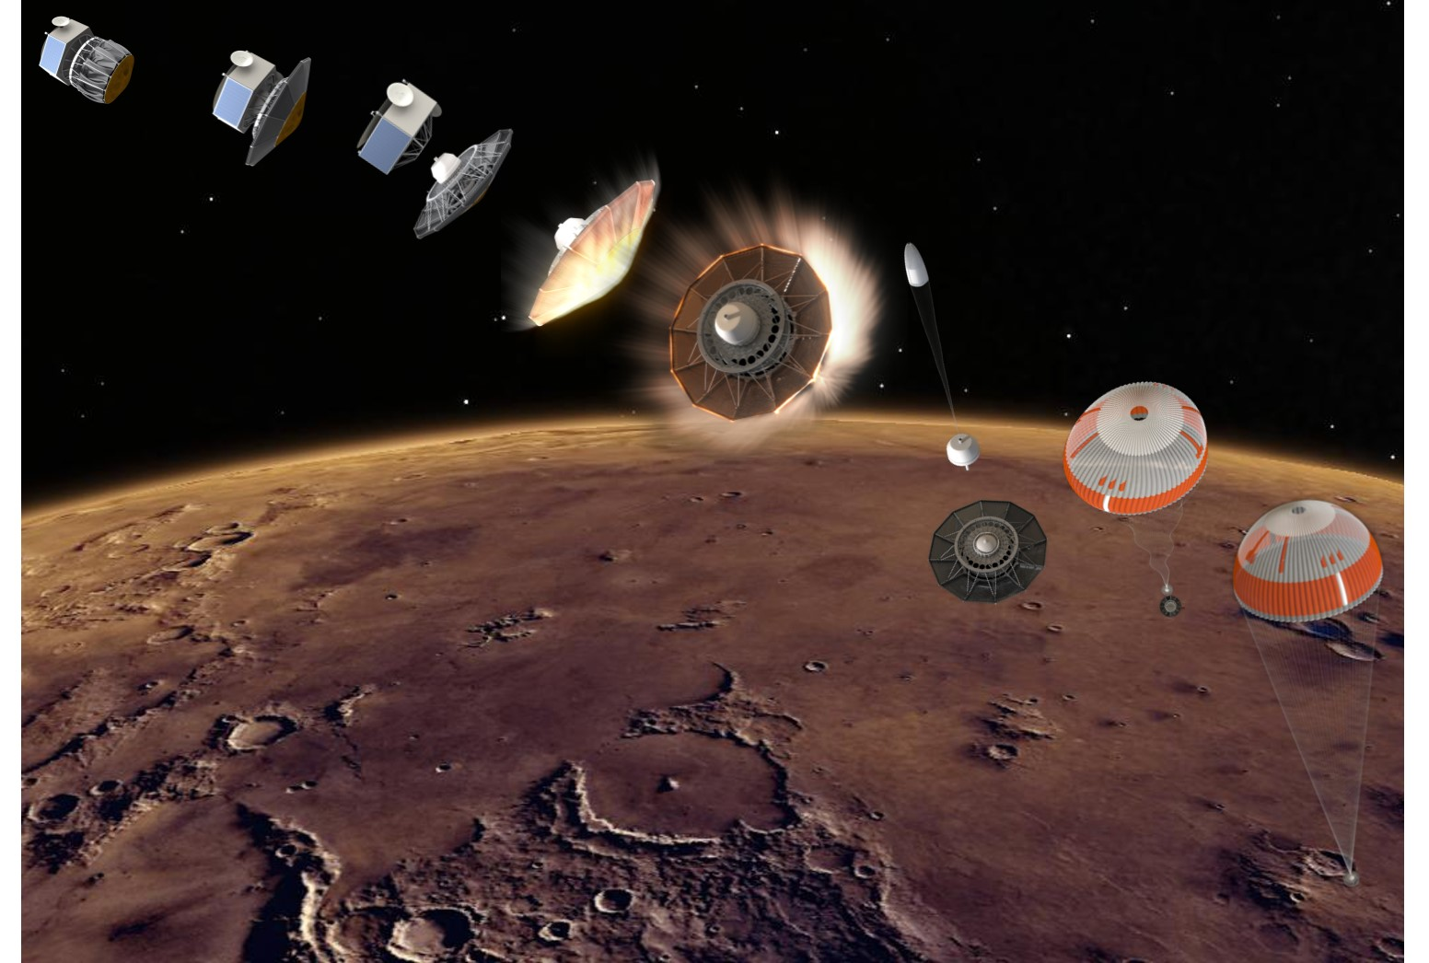
Enabling New and Innovative Low Cost Mars Science Missions with the Adaptable, Deployable, Entry and
Placement Technology (ADEPT)
Paul Wercinski and Ethiraj Venkatapathy
NASA Ames Research Center
January 2022
POC: Paul.Wercinski@nasa.gov. 650-776-9984

Slide 2
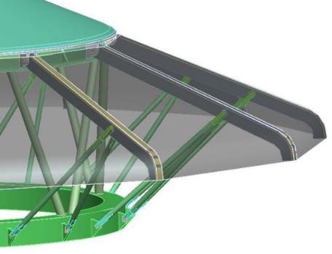
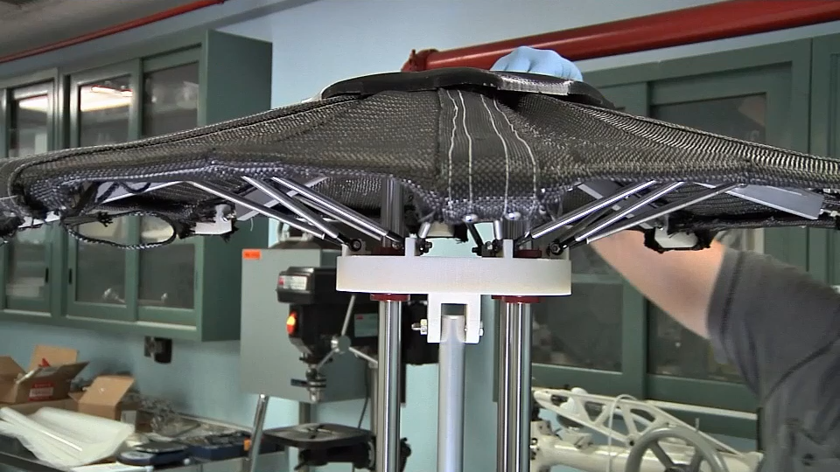
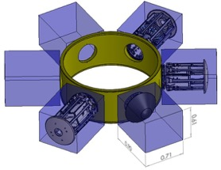
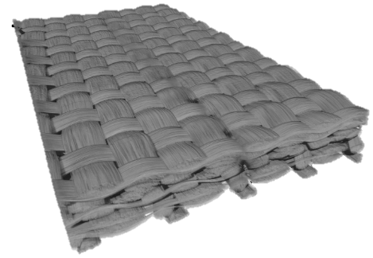
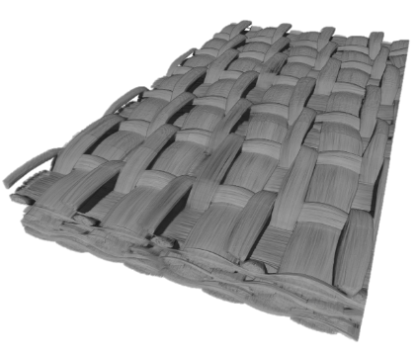
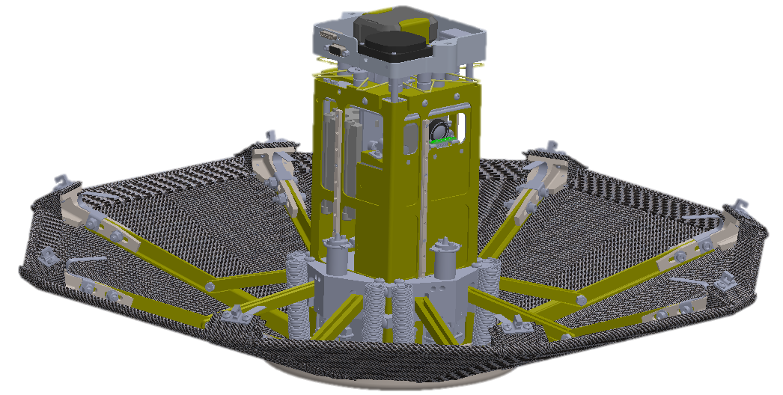
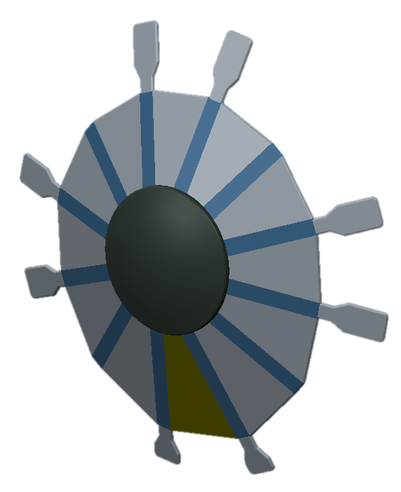
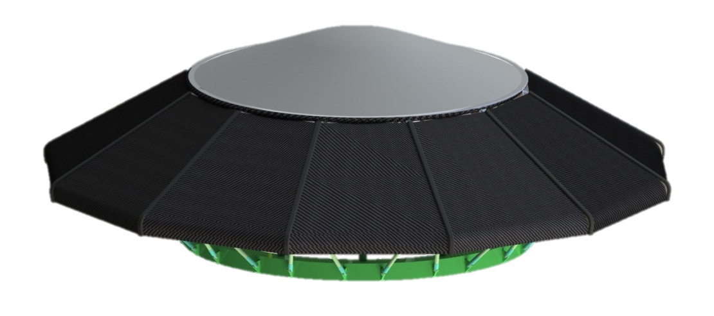
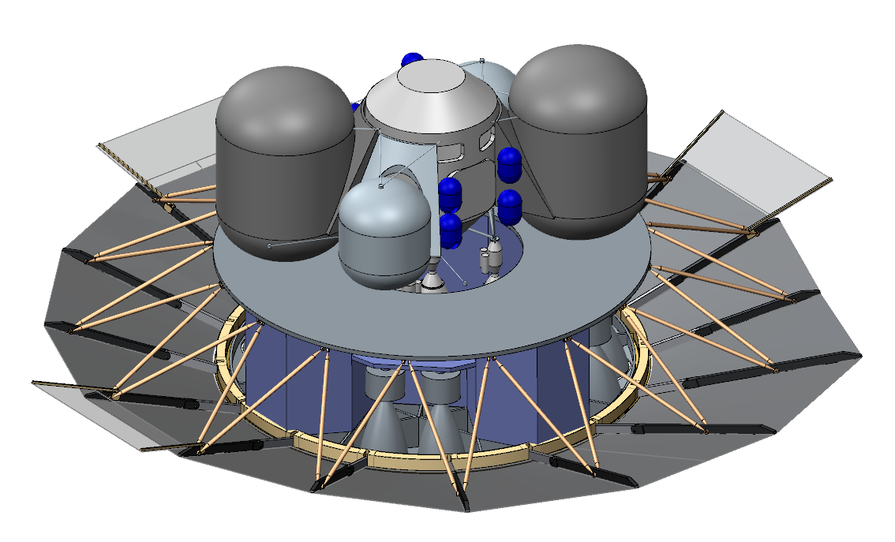
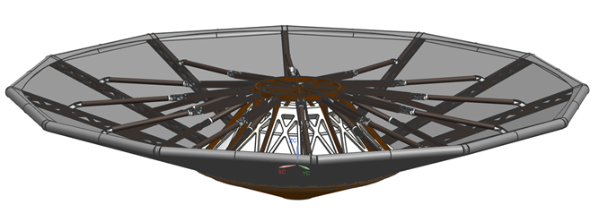
Adaptable, Deployable Entry and Placement Technology (ADEPT)
Rigid Nose
ADEPT’s Major Benefits:
Overcomes entry vehicle packaging and volume constraints in LV shroud or as secondary payload
Deployed configuration achieves low ballistic coefficient (M/CdA), reducing peak heating and dynamic pressure loads;
Woven carbon fabric, tested up to 250 W/cm², is suitable for extreme heating conditions including Venus science missions
Main Body
Ribs
“Umbrella-like” mechanical deployment
Struts
3D Woven Carbon Fabric
Front Surface
Aft Surface
ADEPT stowed in ESPA as secondary payload
 | SmallSat Class (1-3m Diameter) (Tech Demo or Secondary Payload) | Robotic Class (4-12m Diameter) (Discovery, New Frontier, Flagship) |  | Exploration Class (Human Mars)
Ballistic and Lifting Entry Vehicle Concepts
ADEPT Designs
SR-1
(2018 Flight Test)
ADEPT VITaL
(Venus Lander)
Project Pterodactyl
Ice Giant DMA Concept
Human Exploration 20mt Concept
1-3m Diameter 6m Dia. 12m Dia. 18m Dia.
POC: Paul.Wercinski@nasa.gov. 650-776-9984

Slide 3
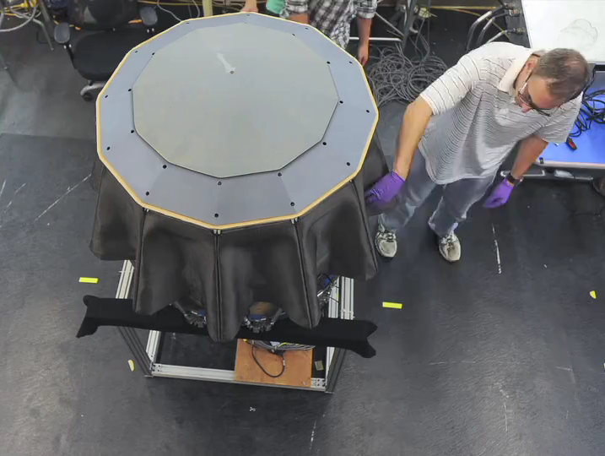
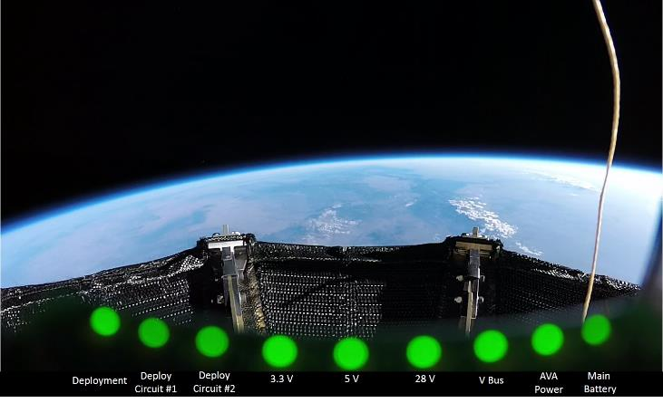

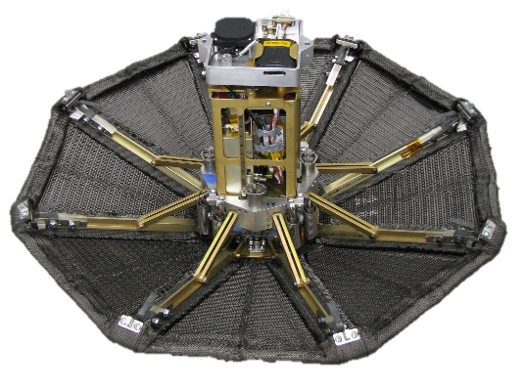
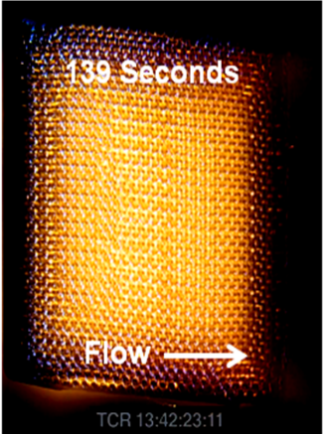
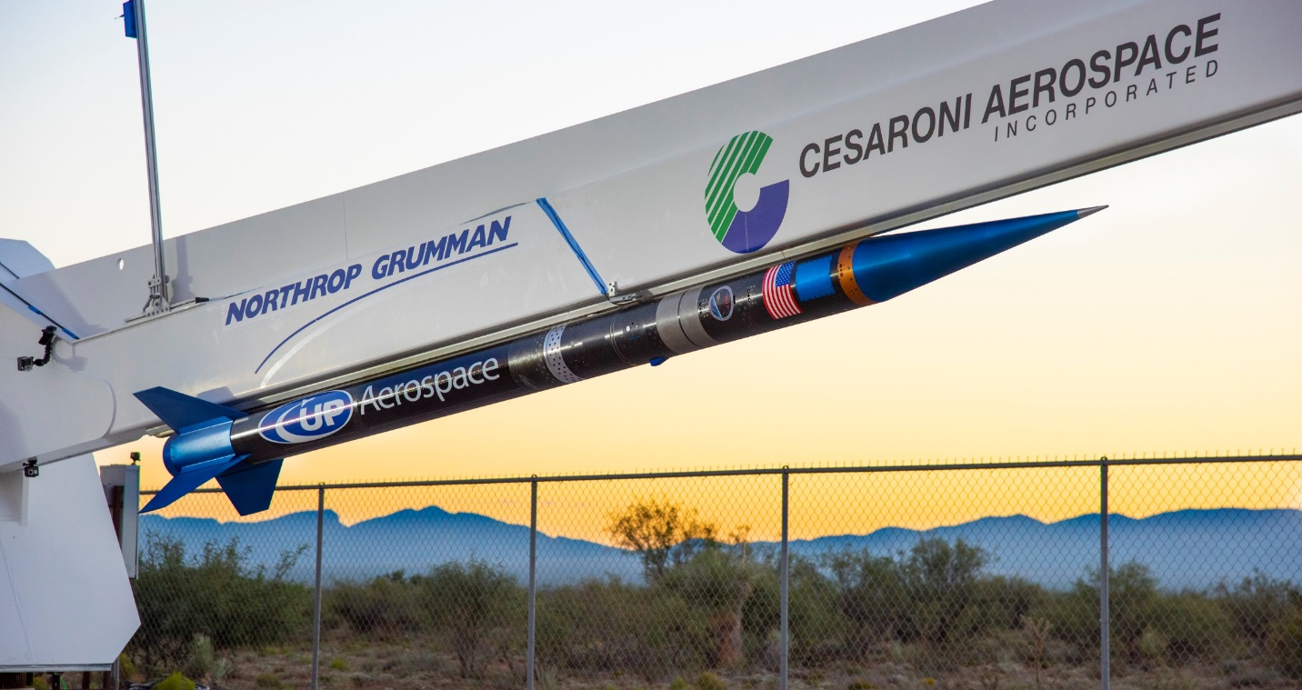
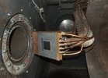
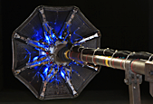

ADEPT Technology Maturation FY12-FY19
Video: 2m Ground Test Article
deployment
In-space deploy of Sounding Rocket 1 Test
Video: 35cm diameter sub-scale arcjet test
TRL
Wind tunnel test
BLAM arc jet tests
2012 | … | 2019...
Fabric-level arc jet test to 250 W/cm²
2012 | 2013
Fabric-level arc jet test to 250 W/cm² | Aeroshell deployment demonstration
2012 | 2013 | 2014 | 2015
Fabric-level arc jet test to 250 W/cm² | Aeroshell deployment demonstration | Distributed pressure loads (wind tunnel) & SPRITE-C system level aerothermal tests
2012 | 2013 | 2014 | 2015 | 2016 | 2017 | 2018 | 2019...
Fabric-level arc jet test to 250 W/cm² | Aeroshell deployment demonstration | Distributed pressure loads (wind tunnel) & SPRITE-C system level aerothermal tests |  | Develop 0.7m flight system SR-1 Flight Experiment |  |  | Mission concept development ➔Applications
Component
Subsystems
Integrated Systems
POC: Paul.Wercinski@nasa.gov. 650-776-9984

Slide 4
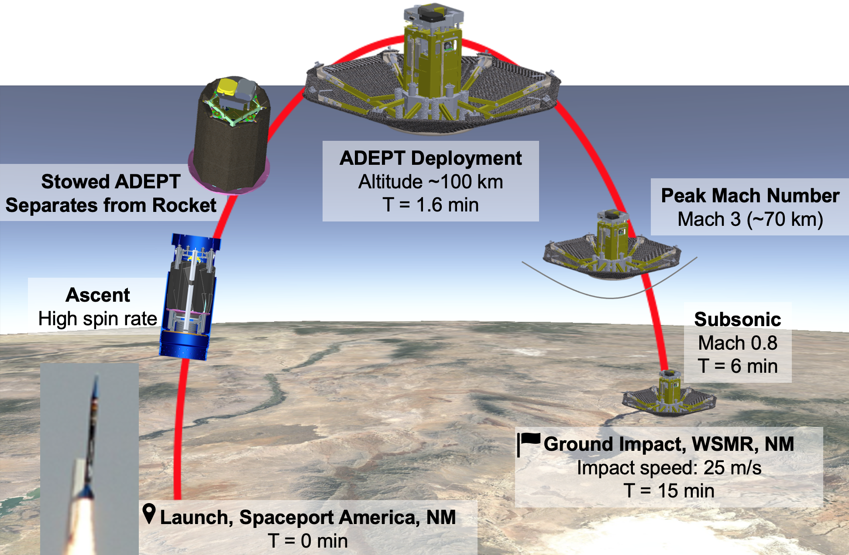
SR-1 Flight Test (Sept 12, 2018): Sub-Orbital Success
Exo-atmospheric deployment to the desired entry configuration (KPP-1)
Separation from LV without recontact
Demonstrated aerodynamic stability during entry, from Mach 3 → Mach 0.8 (KPP-2)
Maintained shape without flutter during entry/descent
Demonstrated survival of launch/ascent environments
Flight system packaged/stowed into LV payload envelope
POC: Paul.Wercinski@nasa.gov. 650-776-9984

Slide 5
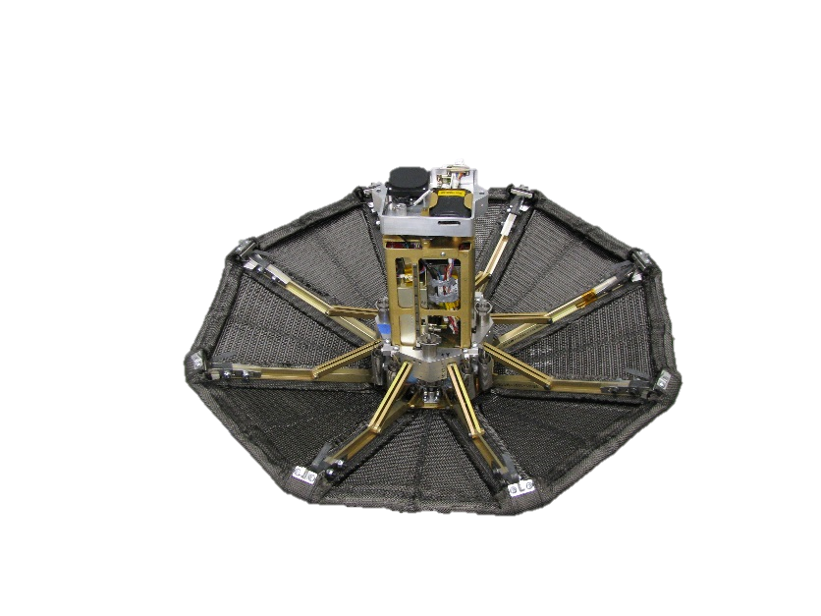
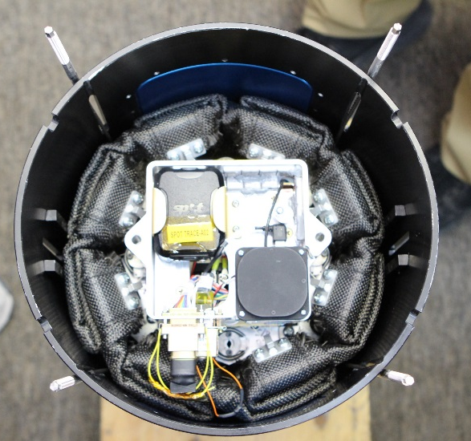
SR-1 Flight Article Description
Rib tip to Rib tip diameter- 0.70 m
Half cone angle (ribs)- 70 deg
Mass- 11.0 kg (24.3 lb)
β ~ 20 kg/m²
Xcg/D= 0.15
Aft Deck & Late Access Connectors
Instrumentation | Data/Function
AVA | Accelerometers, Rate Gyros, Magnetometer, GPS Tracking
NGIMU | Accelerometers, Rate Gyros, IMU Board Temp Sensors
LED Indicator Board | System Health Indicator Status
GoPro Video | 1080p, 60 fps video
C-Band Transponder | WSMR Radar Tracking
SPOT Trace | GPS Recovery Tracker
Separation Sensors | Power-on signal for deployment timer, C-Band & GoPro
Deployment Switch | Indicates full deployment
Rails
Rib Release Deck
Push-off Springs
Electrical Power System
Moving Ring
First-Stage Springs
Struts
Rib
Tips
SR-1 Stowed in LV
Stowed Diameter 0.24 m
Ribs
Four-Layer 3D Woven Carbon Fabric
Retention Cord Loops
Second-Stage Springs
DeploymentLatches
Impact Attenuation Foam
POC: Paul.Wercinski@nasa.gov. 650-776-9984

Slide 6
ADEPT Features, Benefits, and
Mission Opportunities for Mars EDL
Mechanically deployable system allows for robust, reliable implementation
  - Deployment for entry can occur at any time during in-space transit prior to planet arrival
ADEPT development focused on Venus entry as stretch goal. Mars EDL use is lower risk due to more benign entry conditions (eg. metal ribs, fewer layers of carbon fabric)
ADEPT’s carbon fabric aerothermal capability allows steeper Mars entry profiles (higher heating) thus reducing landing dispersion footprint
Low Ballistic coefficient design can eliminate high risk EDL events (e.g., supersonic chutes)
  High altitude deceleration results in benign aerothermal environment and g-loads
  Use of sub-sonic chute or other decelerator deployment prior to impact
  Possible to allow global landing site access, no MOLA elevation restrictions
ADEPT configuration can be tailored to mission landing requirements
  Possible to design for impact attenuation for semi-hard landing
  Demonstrated low L/D configuration with simple adjustment of rib deploy angles
  Deployed shape can be tailored for aerodynamic stability
POC: Paul.Wercinski@nasa.gov. 650-776-9984

Slide 7
ADEPT Bibliography
Venkatapathy, E., et al, “Adaptive Deployable Entry and Placement Technology (ADEPT): A Feasibility Study for Human Missions to Mars” AIAA Aerodynamic Decelerator Systems Technology Conference, May 23-26, 2011, Dublin, Ireland. AIAA 2011-2608
Arnold, J., et al., “Thermal and Structural Performance of Woven Carbon Cloth for Adaptive Deployable Entry and Placement Technology,” AIAA Aerodynamic Decelerator Systems Technology Conference, March 25-28, 2013, Daytona Beach, FL.
Arnold, J., et al. “Arcjet Testing of Woven Carbon Cloth for Use on Adaptive Deployable Entry Placement Technology.” IEEE Aerospace Conference, March, 2013, Big Sky, MT.
Yount, Bryan, C., et al. “Structures and Mechanisms Design Concepts for Adaptive Deployable Entry Placement Technology” AIAA Aerodynamic Decelerator Systems Technology Conference, March 25-28, 2013, Daytona Beach, FL.
Kazemba, C., et al, “A Versatile 3D-Woven Carbon Fabric for Broad Mission Application of ADEPT” International Planetary Probe Workshop, June 16-20, 2014, Pasadena, CA.
Smith, B., et al, “ADEPT for Secondary Payloads” International Planetary Probe Workshop, June 16-20, 2014, Pasadena, CA.
Yount, Bryan, C., Kruger, Carl, E., Cassell, Alan, M., Kazemba, Cole, D. “Deployment Testing of the ADEPT Ground Test Article. International Planetary Probe Workshop, June 16-20, 2014, Pasadena, CA.
Smith, B. P., Cassell, A. M., Kruger, C. E., Venkatapathy, E., Kazemba, C. D., Simonis, K. R., “Nano-ADEPT: An Entry System for Secondary Payloads,” IEEE Aerospace Conference, Big Sky, MT, March 2015.
Smith, B., et al “Nano-ADEPT Aeroloads Wind Tunnel Test” IEEE Aerospace Conference, 2016.
Cassell, Alan, M., et al. “System Level Aerothermal Ground Testing for the Adaptive Deployable Entry and Placement Technology.” International Planetary Probe Workshop, June 13-17, 2016, Laurel, MD.
Cassell, A. M., et al “Human Mars Mission Design Study Utilizing the Adaptive Deployable Entry and Placement Technology” IEEE Aerospace Conference, Big Sky, MT, March 2017.
Wercinski, P. F. et al., “ADEPT Sounding Rocket One (SR-1) Flight Experiment Overview,” IEEE Aerospace Conference, Big Sky, MT, March 2017.
Cassell, A. M., et al “ADEPT, a Mechanically Deployabe Re-Entry Vehicle System, Enabling Interplanetary CubeSat and Small Satellite Missions” SmallSat 2018, Logan, UT, August 2018.
Cassell, A., et al “ADEPT for Interplanetary Small Satellite Missions” Interplanetary Small Satellite Conference, 29-30 April, 2019, San Luis Obispo, CA.
Cassell, A. M., et al “ADEPT Sounding Rocket One Test Overview” AIAA Aviation Conference, Dallas, TX, 17-21 June 2019.
Korzun, A. M., Dutta, S., McDaniel, R. D., Karlgaard, C., Tynis, J. A., “Aerodynamics for the ADEPT SR-1 Flight Experiment,” AIAA Aviation Conference, Dallas, TX, 17-21 June 2019.
Cruz, J. R., Green, J. S., “Subsonic Dynamic Testing of a Subscale ADEPT Entry Vehicle,” AIAA Aviation Conference, Dallas, TX, 17-21 June 2019.
Tynis, J. A., Karlgaard, C., “Reconstruction of the Adaptable Deployable Entry and Placement Technology Sounding Rocket One Flight Test,” AIAA Aviation Conference, Dallas, TX, 17-21 June 2019.
Dutta, S., Green, J. S., “Flight Mechanics Modeling and Post Flight Analysis of ADEPT SR-1,” AIAA Aviation Conference, Dallas, TX, 17-21 June 2019.
D’Souza, S. D., Johnson, B. J., Okolo, W. A., Nikaido, B. E., Smith, B. P., “Pterodactyl: Developing a Design, Build and Test Capability for Non-propulsive Control Systems for Lifting Nano-ADEPT,” AIAA Aviation Conference, Dallas, TX, 17-21 June 2019.
7

