Slide 1
Expanding Biological Repository
Data Availability for Sharing
and Knowledge Discovery
Dr. Sylvain Costes
Project Manager for Ames Life Sciences Data Archive and Open Science Data Repositories
ASGSR, November 2021
Notes:
STILL

Slide 2





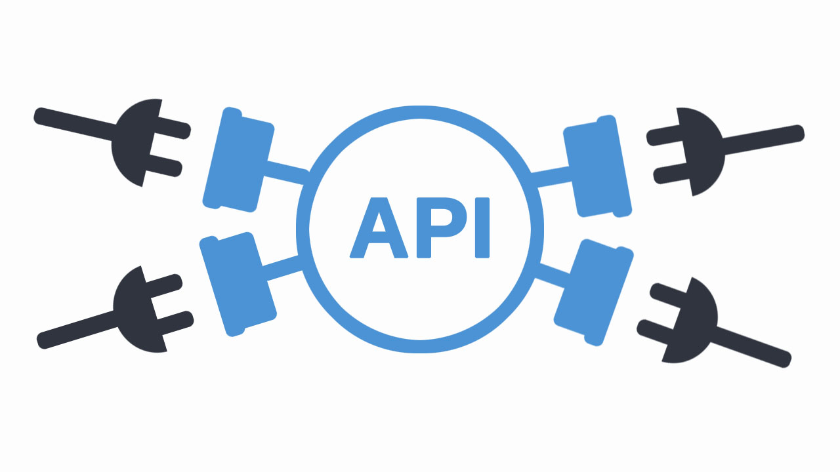





Open Science Data Repositories
Next Gen LSDA (JSC)
User Data Workspace
Environmental
Portal
Raw Data
Processed Data
Metadata
Visualization
Portal
Data
Portal
Multi-Project Submission
Portal
GeneLab & ALSDA
Modeling Portal (AI/ML/Meta-Analyses)
PI Processing
GeneLab Sample Processing
NASA Biological Institutional Scientific Collection (NBISC)
Analysis
Toolshed
New
Knowledge
PI/Missions/
Experiments
Pipelines
Interactive
Tutorial
2

Slide 3

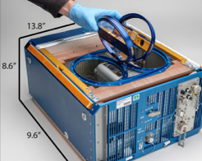



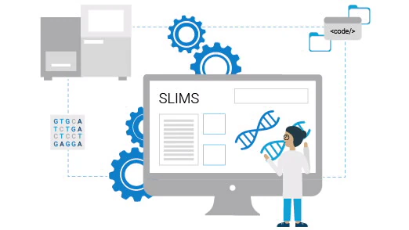
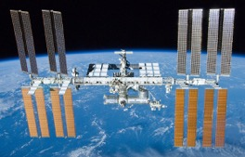
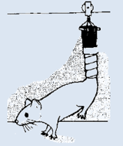
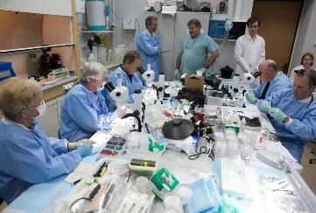
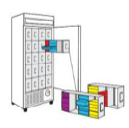

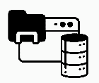

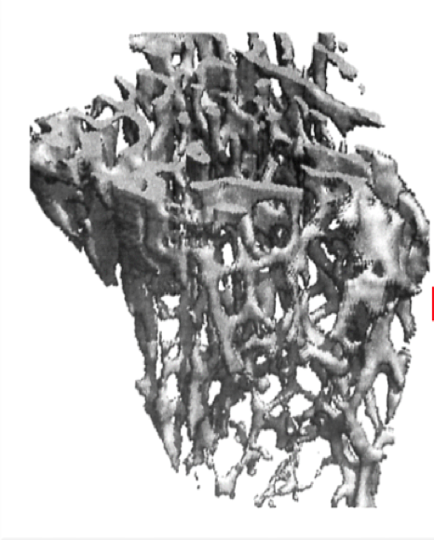
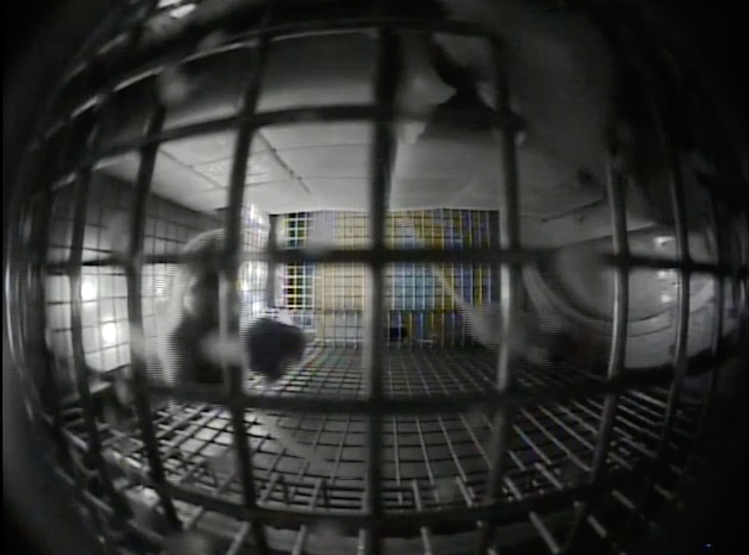

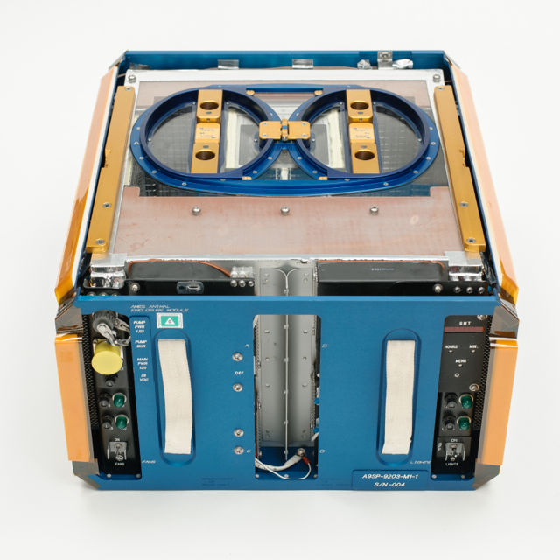
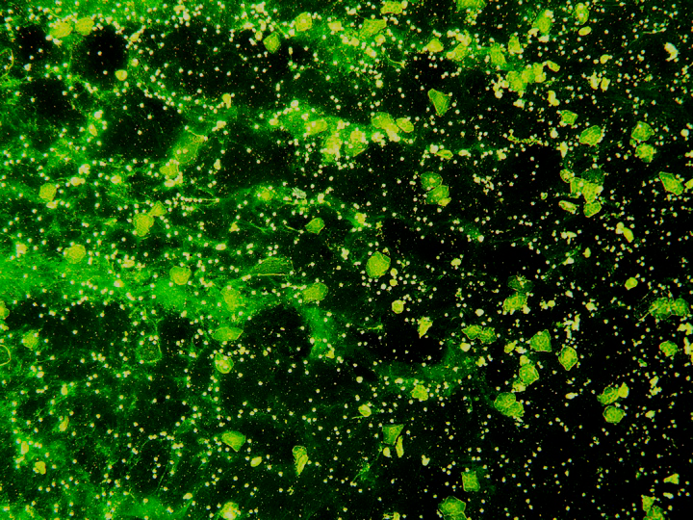


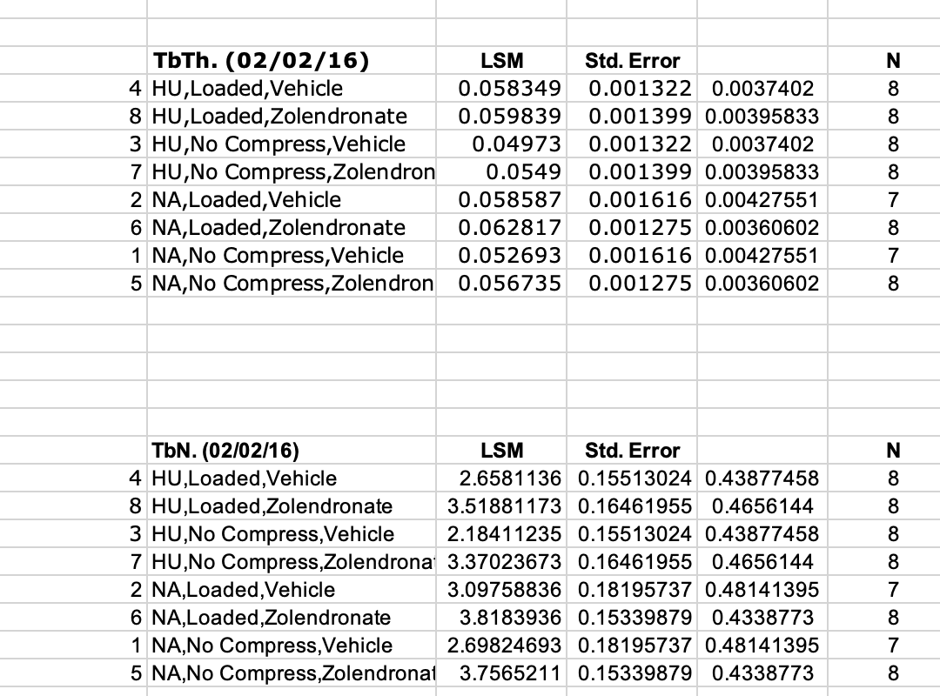
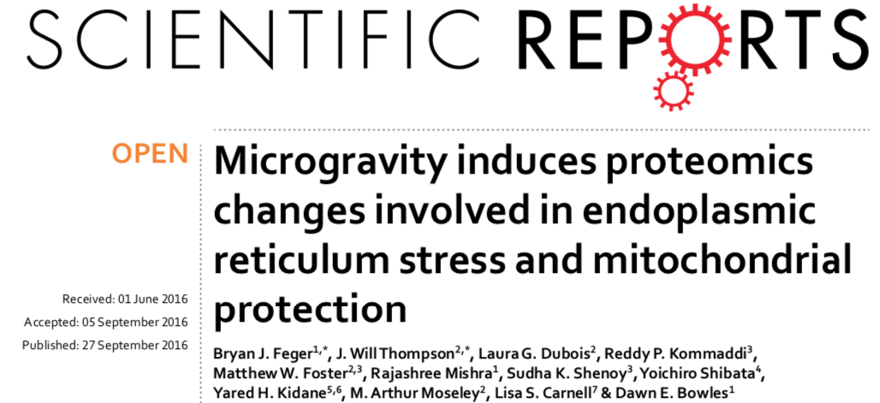
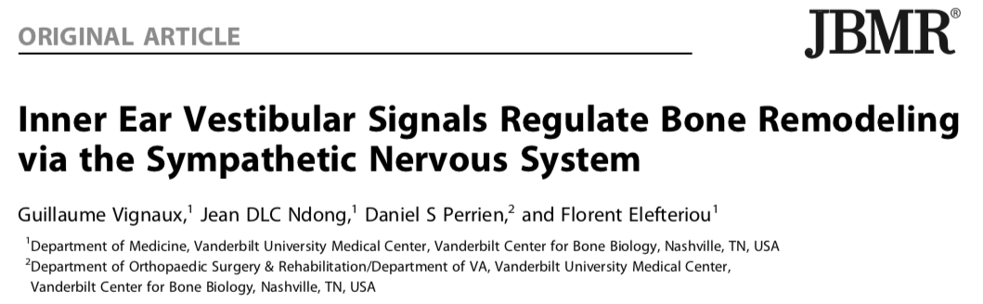

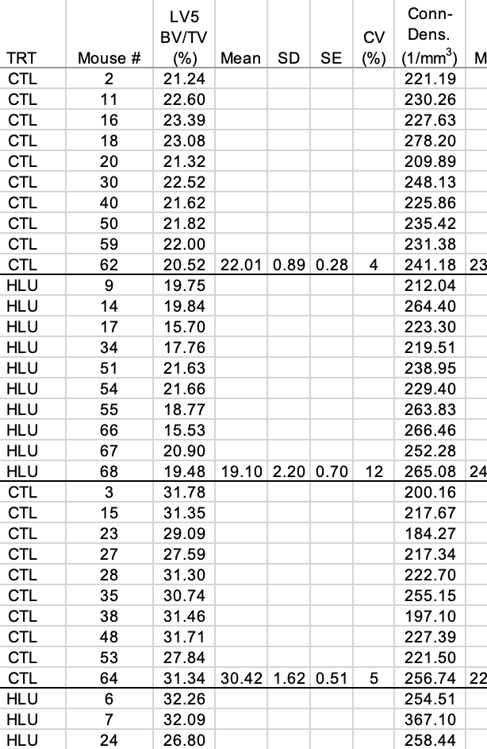
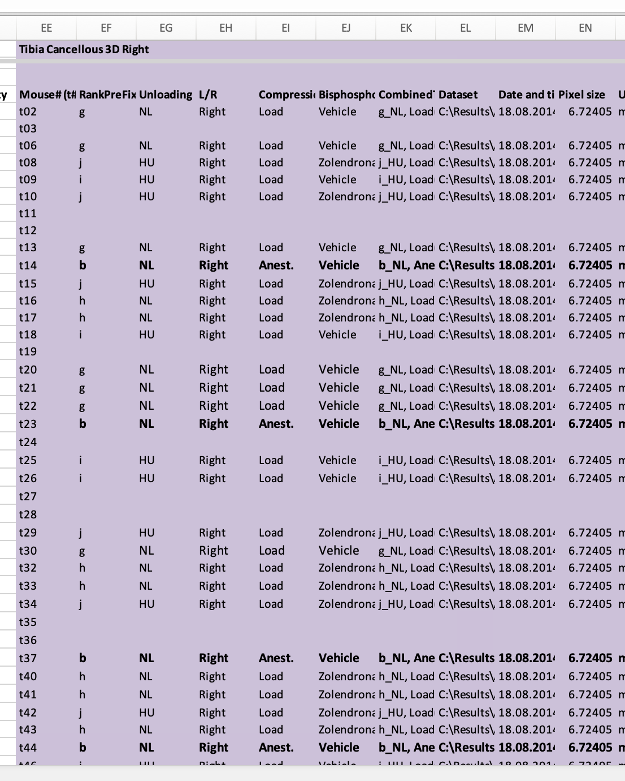
Data and Tissue Sharing
NBISC
NASA Biological Institutional Scientific Collection
(NBISC)
Specimens
Metadata
Tissue Sharing
Non-Human Biospecimens
NBISC Biospecimen Board
LBL PI SR Biospecimens
End-to-End SLIMS
BSP, NBISC, GL, ALSDA
Single Project Split to Separate the Focus and Requirements
Metadata
ALSDA
Assay, Sample Metadata
Data Sharing
Ames Life Sciences
Data Archive
(ALSDA)
OSDR Data Submission Portal
Assay Raw, Processed Data
Mission, Hardware Metadata
Data from HRP, SB PIs
Phenotypic-Physiological-Behavioral-Level Data
Federated with GeneLab (Omics-Level Data)
Environmental, Telemetry Data
(Images from Ronca et al., 2019 https://doi.org/10.1038/s41598-019-40789-y; Cells, Bone, RR Habitat, NASA-ARC)
3

Slide 4
FAIR and Open Databases: GeneLab and ALSDA
Multi-Project Data Submission Portal
FINDABILITY
Single point-of-entry for PI data submission.
INTEROPERABILITY
GUIDs
Rich Metadata
Indexing
Data Management Environment
Open Metadata
Open Vocabularies
Linked Data
Automate DSA, DMP with tools. End-to-end PI involvement
Data Federation
Data Identification Schemes
Data Migration to AWS Cloud
Metadata Acquisition Cost-Efficient , Quality, Volume
Metadata Configurations
Machine-Readable Data Transformation
Secure; long-term
ISATab model based. Structured sample and assay-level data.
Standardizing format for re-use.
Open Access
Open Authentication
Persistent Metadata
Integrated Credentialing
Data Provenance
Community Standards
ACCESSIBILITY
REUSABILITY
(Adapted from Berrios et al., 2018; PMID: 30815061)
Notes:
Re-order the appearance
Add F-A-I-R
Remove white boxes, replace with the light blue
Data Migratgion (F,A)
F, AI,R
I, R
DMP – F, I
DSA – F, (add to to DMP)
Sub – F, I

Slide 5

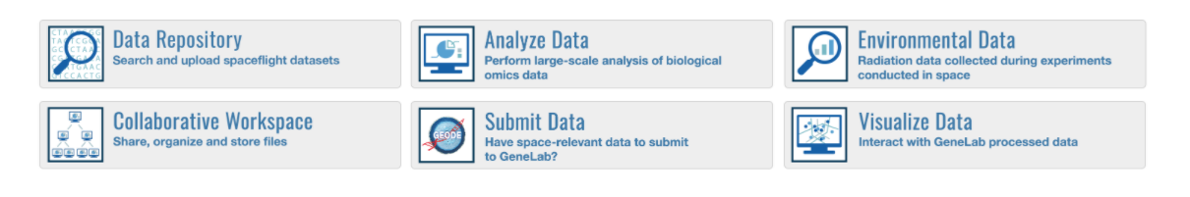
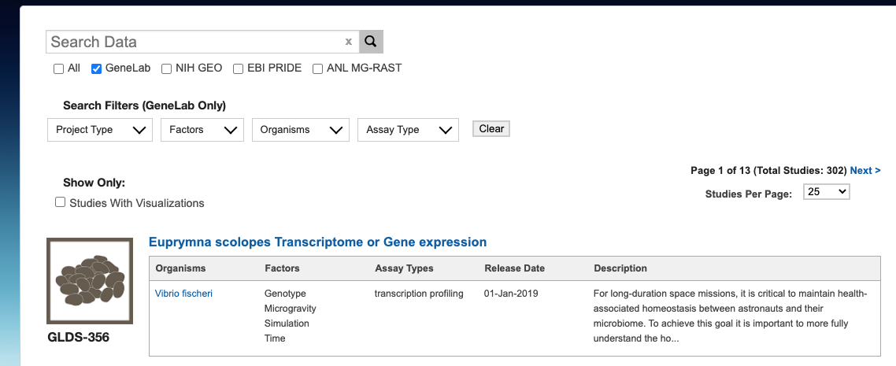

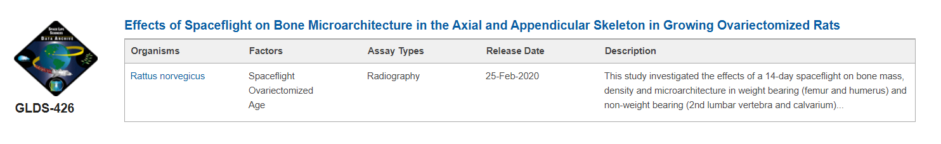
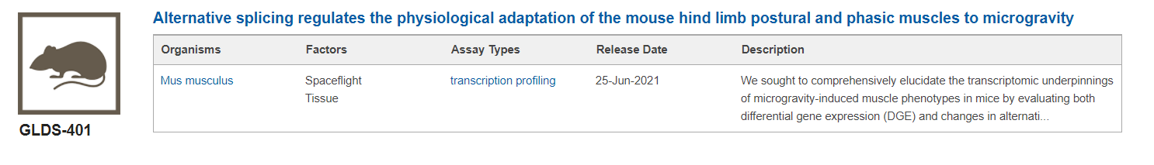
Multi-Project Submission Portal
Data Submission and Curation
Enhancing submission automation and “self-service”
Federated Search
Reduces curation resources required
“Rich”, transparent metadata
AI-ready through descriptive logics
Integrated with investigation workspace
Demonstration of cross-division application
ALSDA

Slide 6
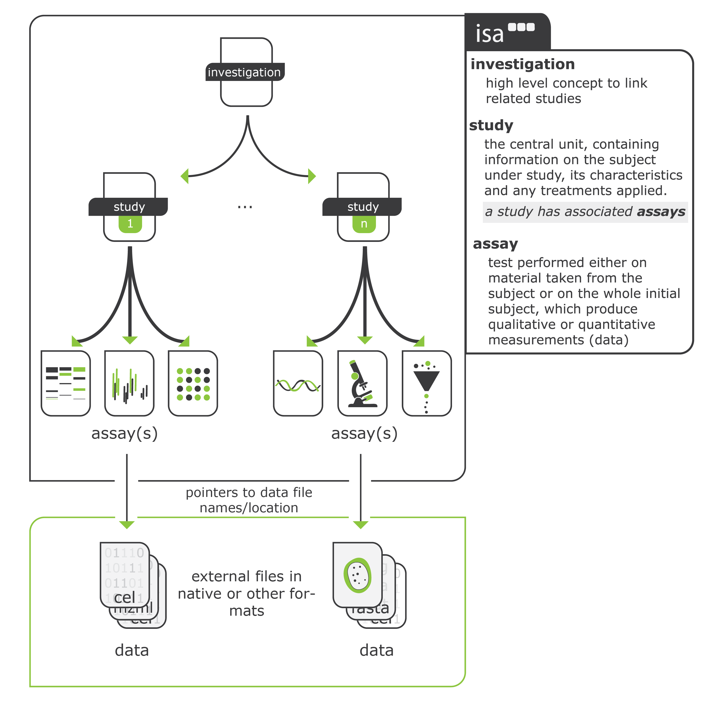
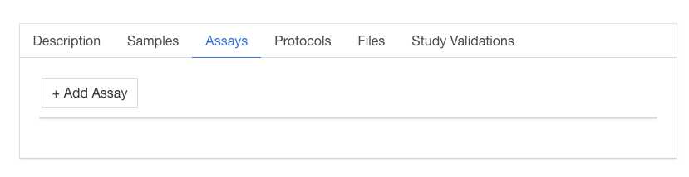
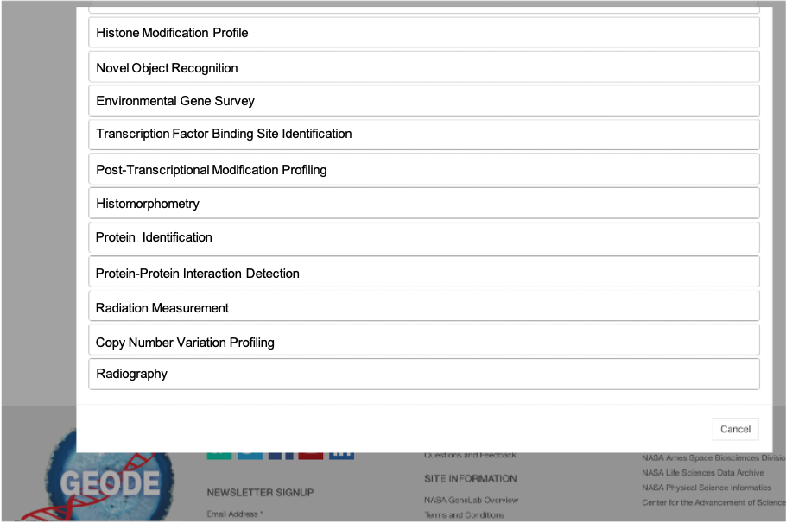
Samples & Assay Metadata
Investigation, Study (Sample), and Assay level (ISA Data Model)
Link multiple assays by sample name
Not limited to -omics assays
Configure metadata templates to include required fields
Machine-readable format – JSON
Adding Phenotypic Assays to Portal

Slide 7
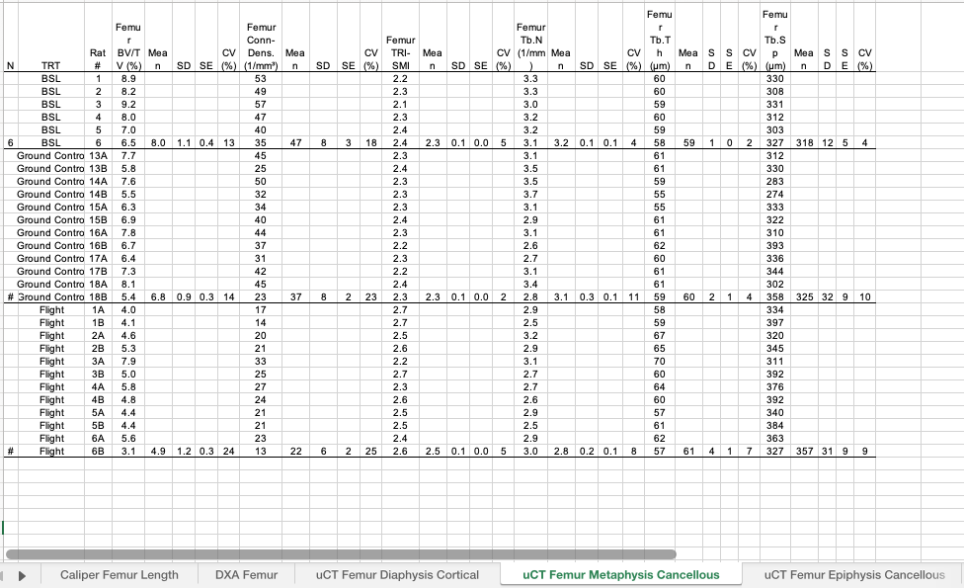
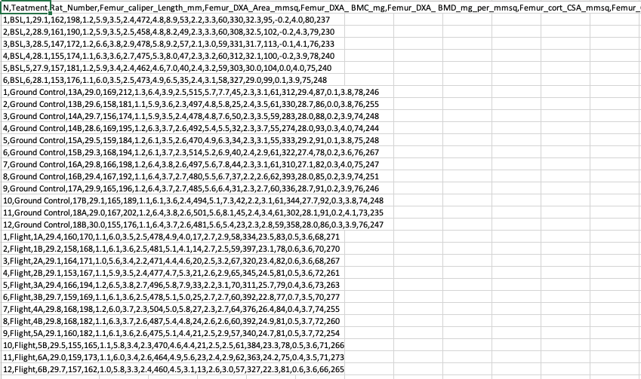
Data Reusability and Format Standardization
Original Submitted
Tabs, spaces, naming conventions
‘TidyData’ format for R, python, .csv
REUSABLE
Common data formats standardization is equal to reusable
TIDY DATA
“is a standard way of mapping the meaning of a dataset to its structure” –Hadley Wickham
Application

Slide 8
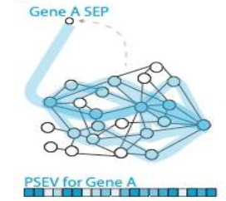
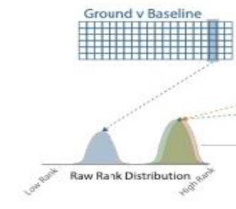
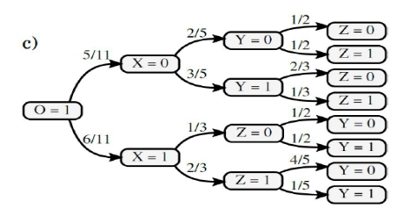


Data Reuse Example: Open Science Modeling Portal
AI ready FAIR data for modeling and risk assessment
NIH/PATIENT DB
Human phenotypes
Mission Scenarios’ Input conditions
BIOLOGICAL
MODELING PORTAL
Omics data
Heterogeneous
Data
+
Environmental
Data
Modeling Visualization
Portal
OPEN SCIENCE Submission
Portal
Physiological
data
ALSDA
Knowledge-based Predictor
(Image Credits: Nelson et al., 2021, https://doi.org/10.3390/life11010042; Genewein et al., 2020, arXiv:2010.12237v1 [cs.AI])
Notes:
CLEAN blue box

Slide 9

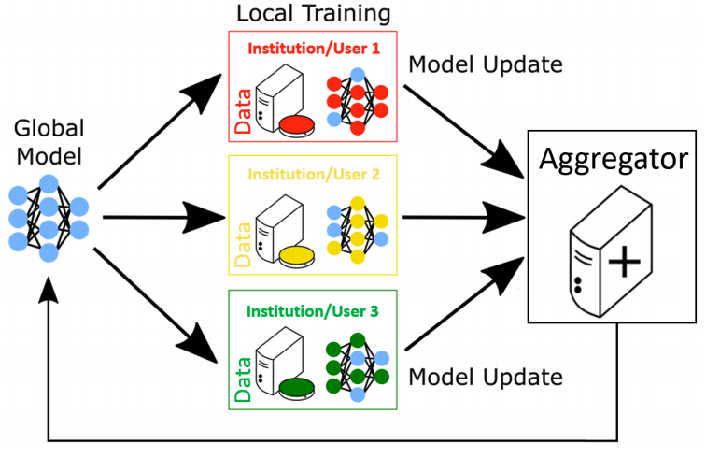


CRISP Federated Learning: Intel’s OpenFL Platform
Local Training
Physiological
Data
Model
Federated learning to train on difficult-to-access datasets: bring the model to the data.
Global model is sent to different institutions and trained on local data
Aggregator node combines model updates
Updated global model is sent back to institutions for further training
JSC
‘Omics
CRISP Model
Update
Global
CRISP
Model
Data
Model
GeneLab
Aggregator
Data
Model
Ames
ALSDA
Data
Model
CRISP Model Update
Clinical
Mayo
Clinic
Data
Model
Figured adapted from: Reina et al., “OpenFL: An open-source framework for Federated Learning”, arXiv 2021
Notes:
A key expansion of the CRISP platform this year is the capability for federated learning, which enables CRISP to train on difficult-to-access datasets by training the models locally at separate institutions without the need to bring the data to a centralized compute location. Intel’s open source OpenFL platform has been integrated with CRISP to allow this capability. The schematic shows the OpenFL workflow. The global model is sent to different institutions: in this case, we are modeling the different institutions as JSC with private astronaut physiological and omics data, Ames with GeneLab and ALSDA model organism data, and Mayo Clinic with private patient data. The model is trained separately on the data at each location, and the trained models are sent to an aggregator node to be combined into a global consensus model. The communications between the local nodes and the aggregator node take place over mutually-authenticated secure TLS connections. [NOTE: TLS is a cryptographic protocol that provides end-to-end security of data sent between applications on the Internet and is used for secure web browsing.] The updated model is then sent back to the local institutions for further training for a set number of rounds. The federated version of CRISP is designed to make it easier to gain causal insight using private or difficult-to-access biological or clinical data.

Slide 10
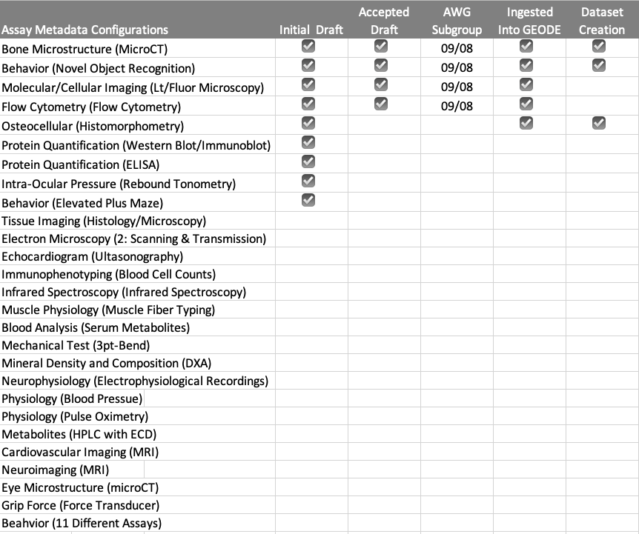



AWG – Feedback for Science Community Standards
Participants
  Majority SB, HRP Principal Investigators
  Other external computational, imaging, biological assay SMEs
Monthly meeting purpose
  Feedback on ALSDA metadata standards, submission portal, data mining/repository
  FIRST assay metadata parameter configurations
Participants excited about ALSDA, data submission, data reuse
  After 3 meetings, numerous PIs have contacted ALSDA to submit their data, ideas on data reusage/meta-analyses, feedback on metadata standards
AWG meets second Wednesday, of each month 8-9:30am PST
To join the ALSDA AWG: arc-dl-alsda@mail.nasa.gov
Assay Parameters Metadata Configurations; Science Community Standards
User Experience, Data collection, New Submission Portal, Data Formats Standardization for Reuse
Put the Data to the Test: Collaborative Analytical, Knowledge Graph, Data Science, and Meta-Analysis Studies

Slide 11


BPS Open Science Transformation
Future BPS Data Management Environment (DME)
Science Data Lifecycle
Solicitation
Proposal
Award
Execution
Closeout
Program Offices
Science Definition
Multiple repository submission support; Increased usability of data in analytics
Programmatic needs,
Data Submission,
& DMP Requirements
Missions leverage automated pipelines for delivery of mission data
Missions
Data
Proposal
Project Scientist/ Grant Manager
DMP
Automated updates to investigation plans and reports
Status
Status
Status
Proposers use new tool with more specialized, precise guidance to develop DMPs
Proposer
Principal Investigator
HPC
Data Analytics
API
Data
Experimental data captured into Open Science Cloud infrastructure
Repositories can improve data QC and curation, focus more resources on system improvements, tool development
DSA tool provides digital transformation of this document
BPS Open Science Data Repositories
Investigation
Workspace
Data Submission & Curation Tool
Federated Data Submission
(e.g. to NIH)
FAIR
Compliance
DSA Tool
GeneLab
DMP Tool
ALSDA
PSI
Notes:
Please note where the bottlenecks are
Pain points, etc… Being proactive instead postmortem approaches (reactive system)

