Slide 1
Crew Time Requirements in Future Space Greenhouses
What can we infer from current analog and space missions?
Lucie Poulet¹, Conrad Zeidler², Jess Bunchek³, Paul Zabe²l, Vincent Vrakking², Daniel Schubert², Gioia Massa⁴, Raymond Wheeler⁴
¹NASA Postdoctoral Program, USRA, Kennedy Space Center; ²DLR Institute for Space Systems; ³SURA/LASSO, NASA Kennedy Space Center; ⁴NASA Kennedy Space Center
American Society of Gravitational and Space Research 2021 Meeting

Slide 2
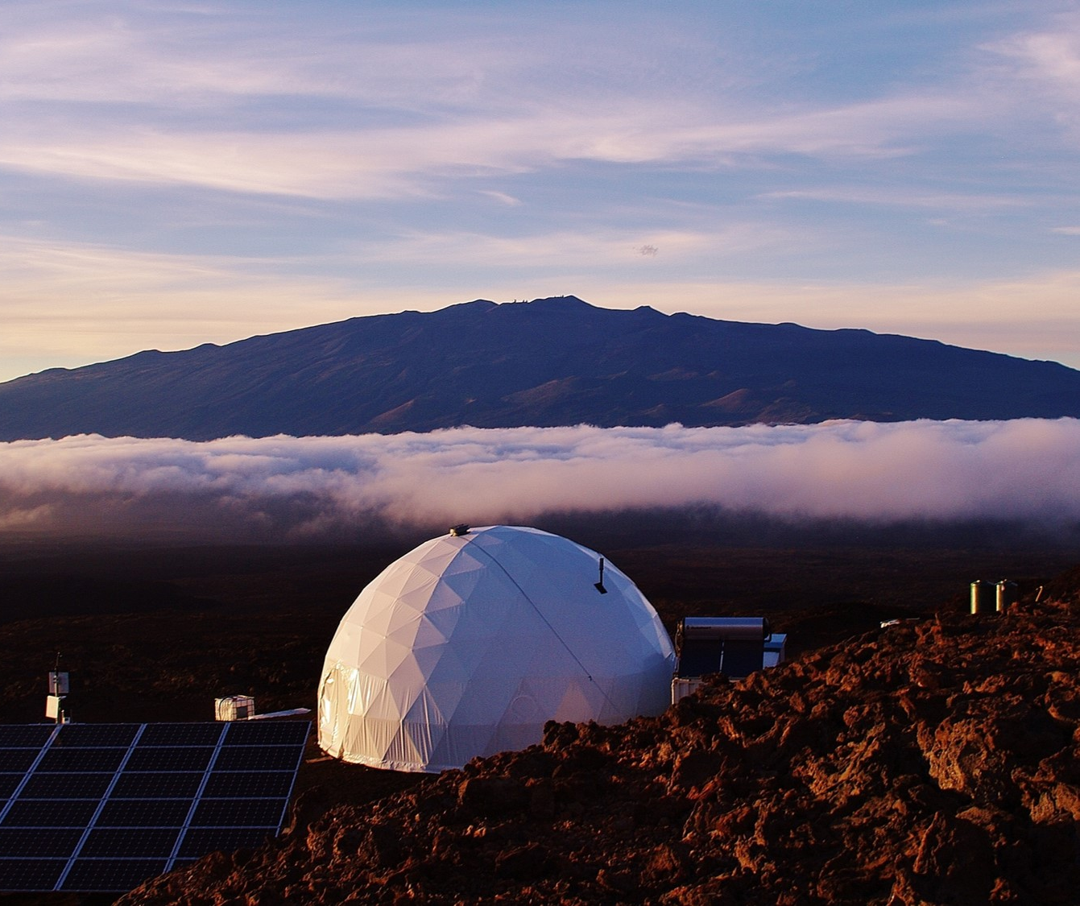
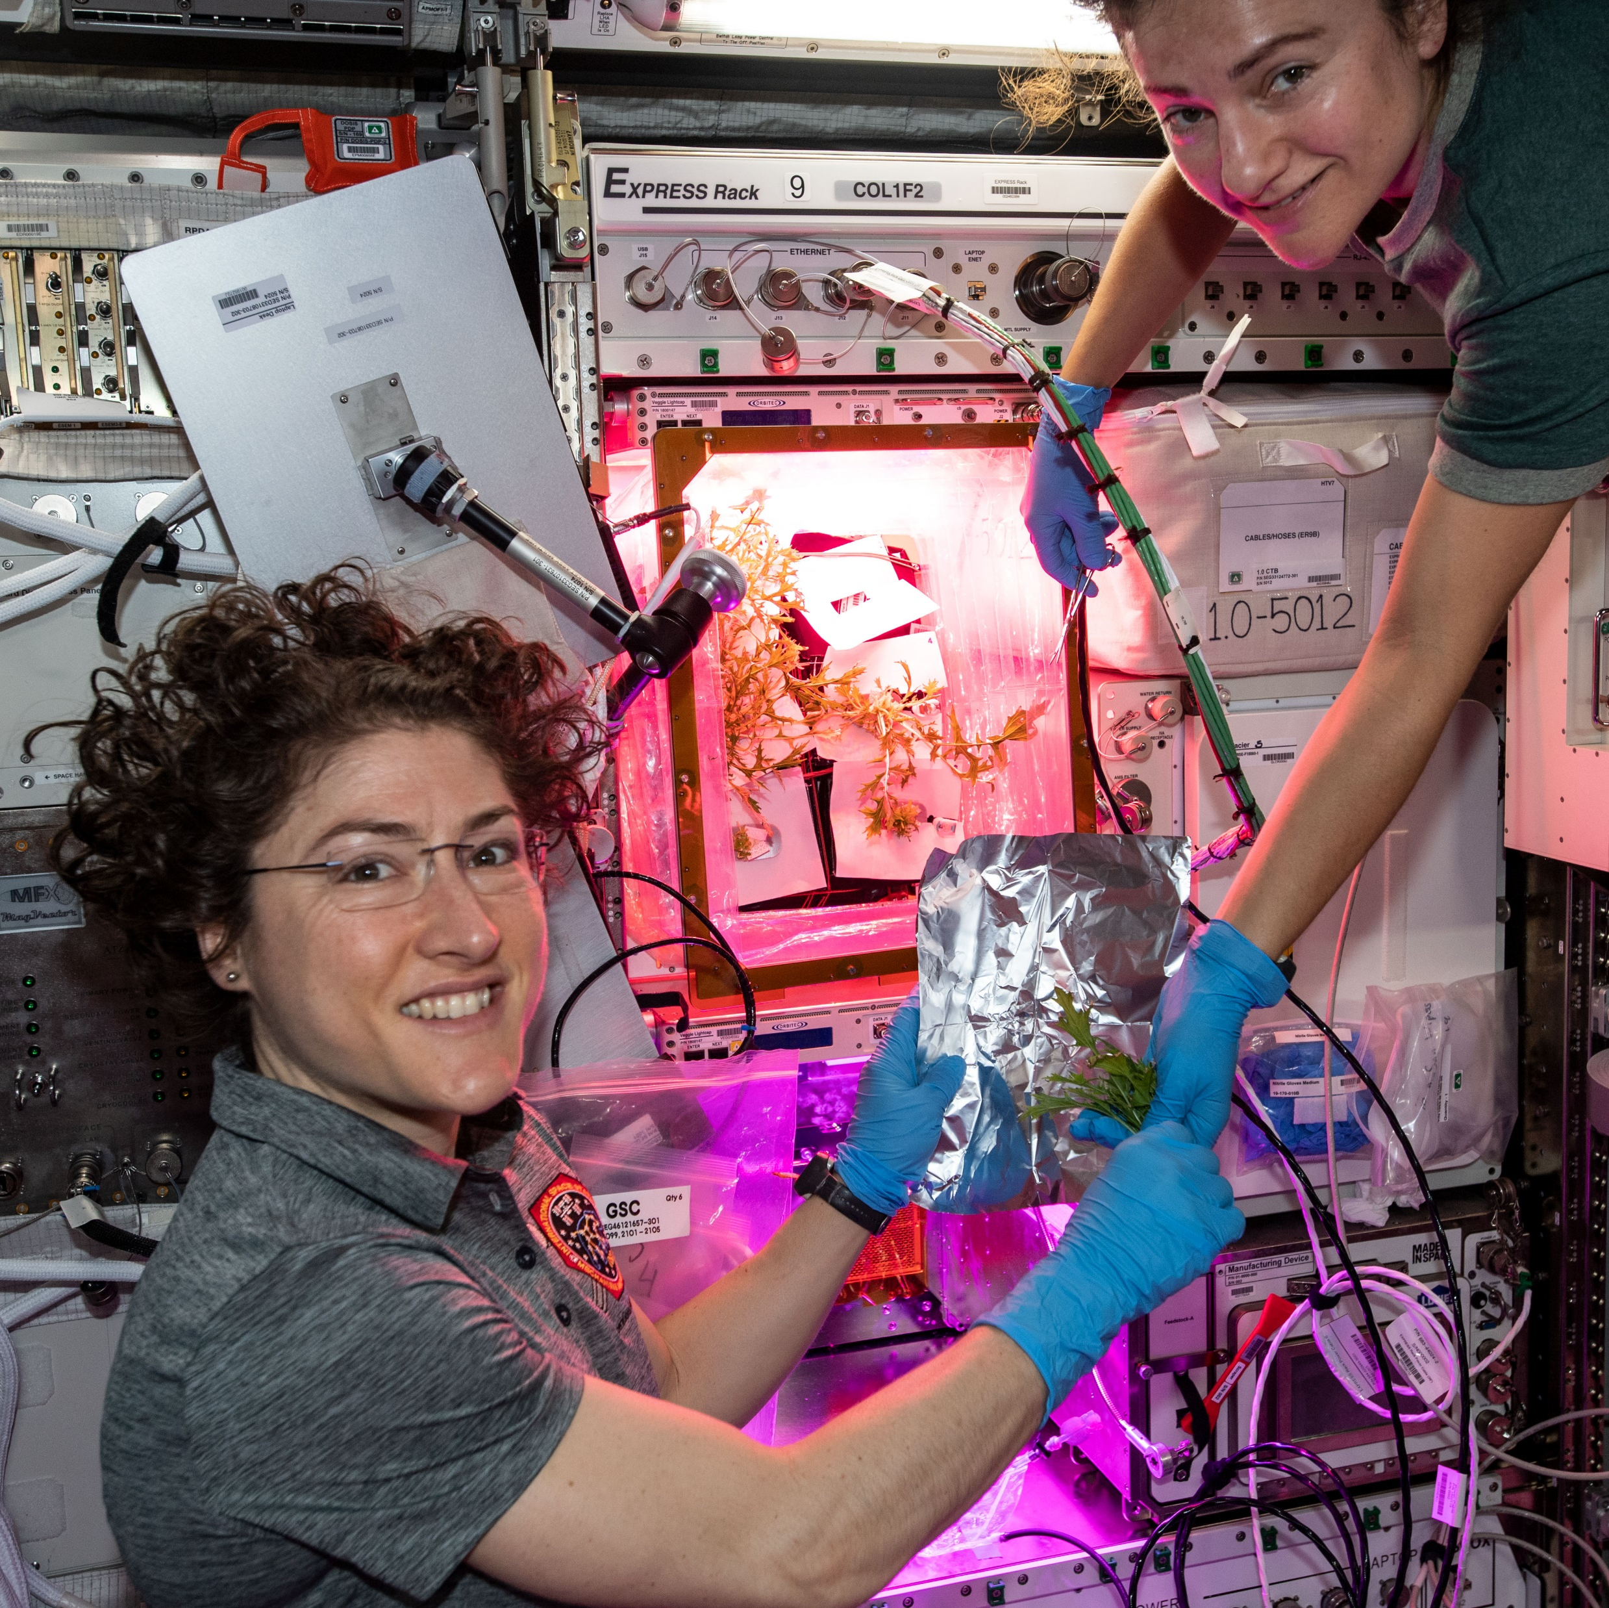
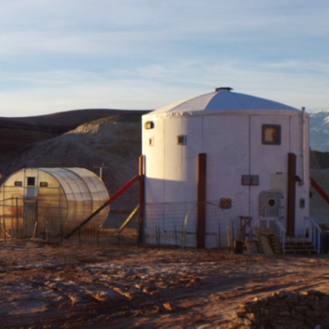
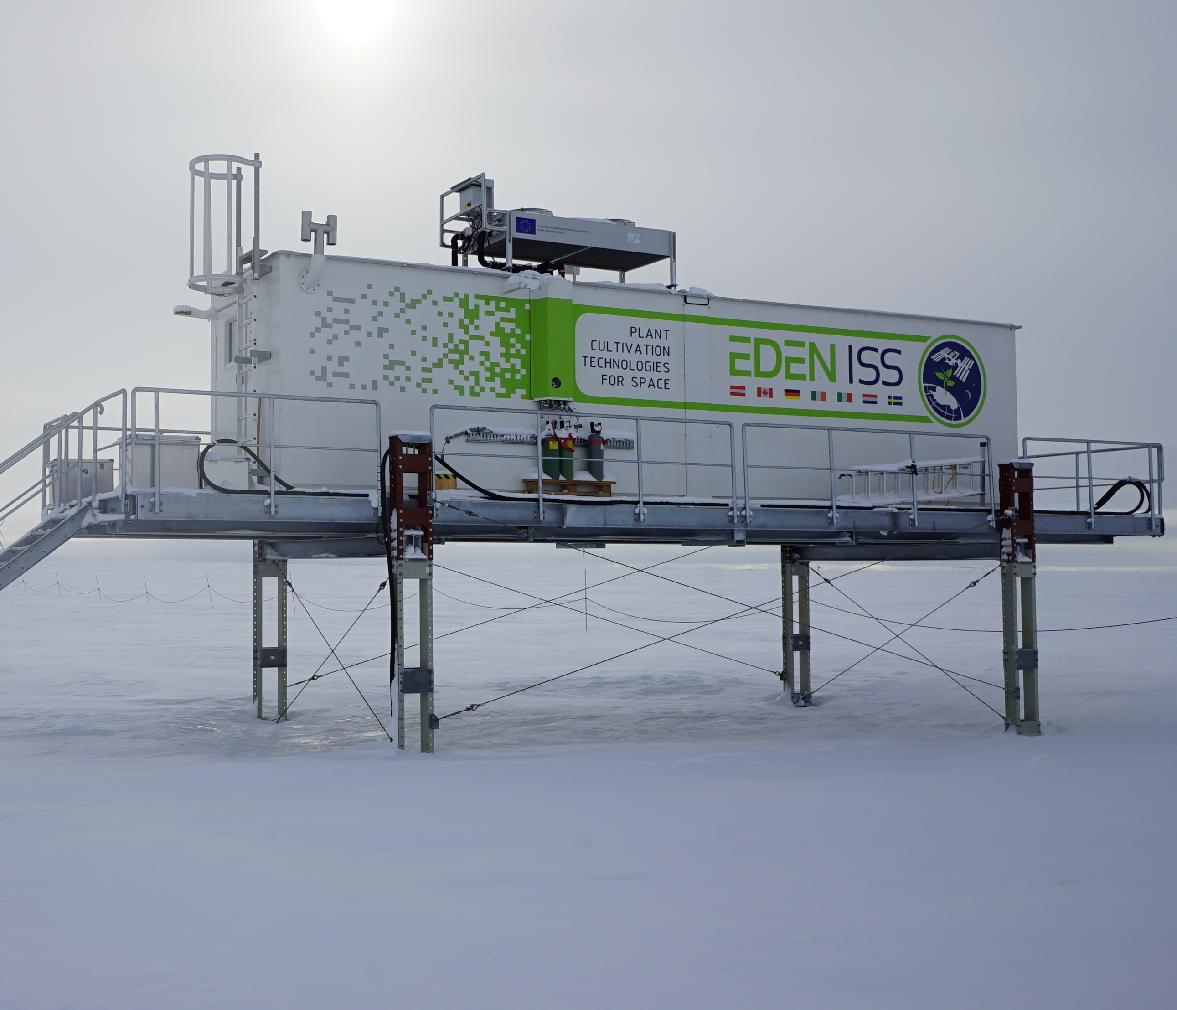
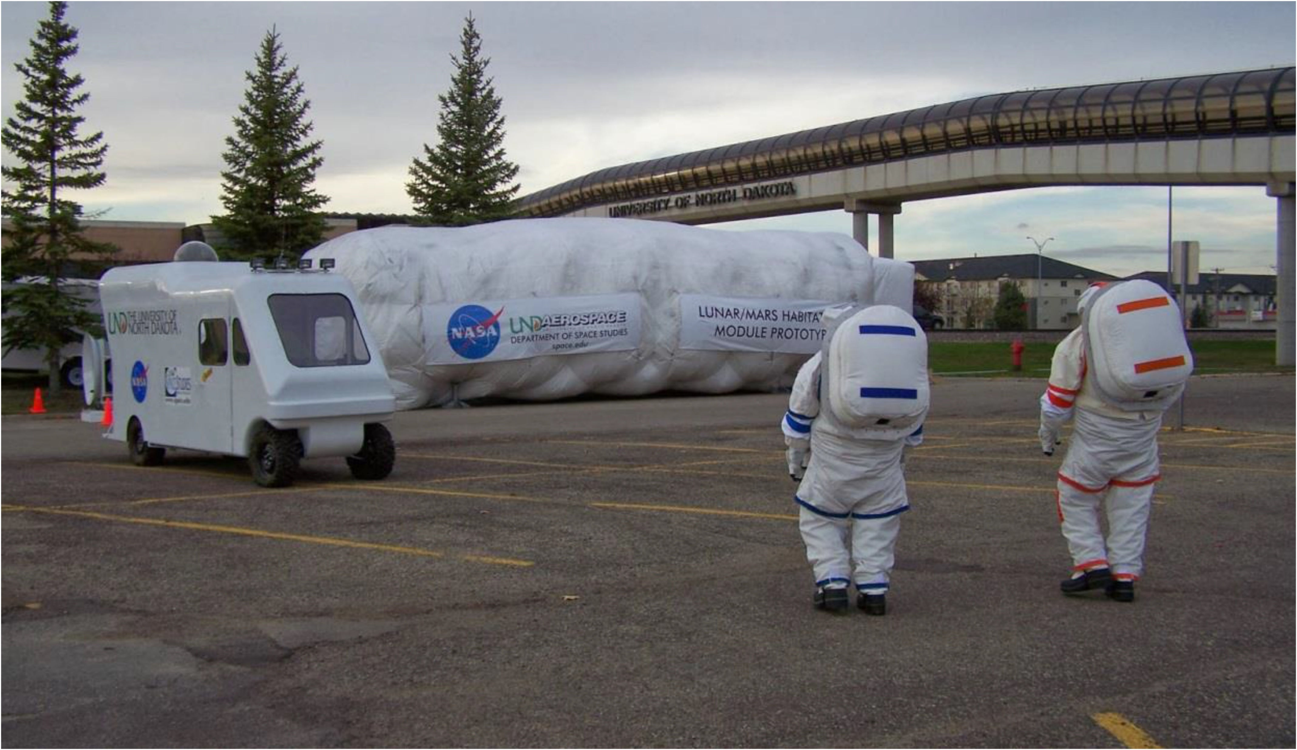
Context and Background
Crew time crucial for greenhouse modules design
Analog missions & Veggie
Retrospective study

Slide 3
Methodology: Overview
Category | Sub-Category | Activity | Sub-Activity
Work | Scheduled Operations | Plant Ops | Health Monitoring
 |  |  | Cultivation Ops
 |  |  | Harvest Processing
 |  | Upkeep Ops | Routine Ops
 |  |  | Maintenance
 |  | Utilization
 | Ops Prep and Conference | Work Prep
 |  | Public Relations
 |  | Conference (entire crew)
 |  | Tag-Up (individual)
Non-Work |  | Personal | Leisure Time

Slide 4
Methodology - Example: Plant Ops
Sub-Activity | Operation Type | Unit Operation
Health Monitoring | Environment | Temp., RH, CO2, g (per task)
 | Crop | Disease, pathogens (per task)
Cultivation Ops | Starting | Sowing (per m², per seed number)
 |  | Initiation (per m²)
 | Adjusting | Thinning (per m²)
 |  | Reorganization (per m²)
 |  | Pruning (per m²)
 |  | Trellising (per m²)
 | Enhancing | Pollination (per m²)
 |  | Fertilizing (per m²)
 | Harvesting | Leaves cutting (per m²)
 | Corrective Treatments | Nutrient addition (per m²)
 | Manual watering | Using a syringe (per m²)

Slide 5
Results: Veggie

Slide 6
Results: EDEN ISS

Slide 7
Results: Other analog missions
HI-SEAS
ILMAH
MDRS

Slide 8
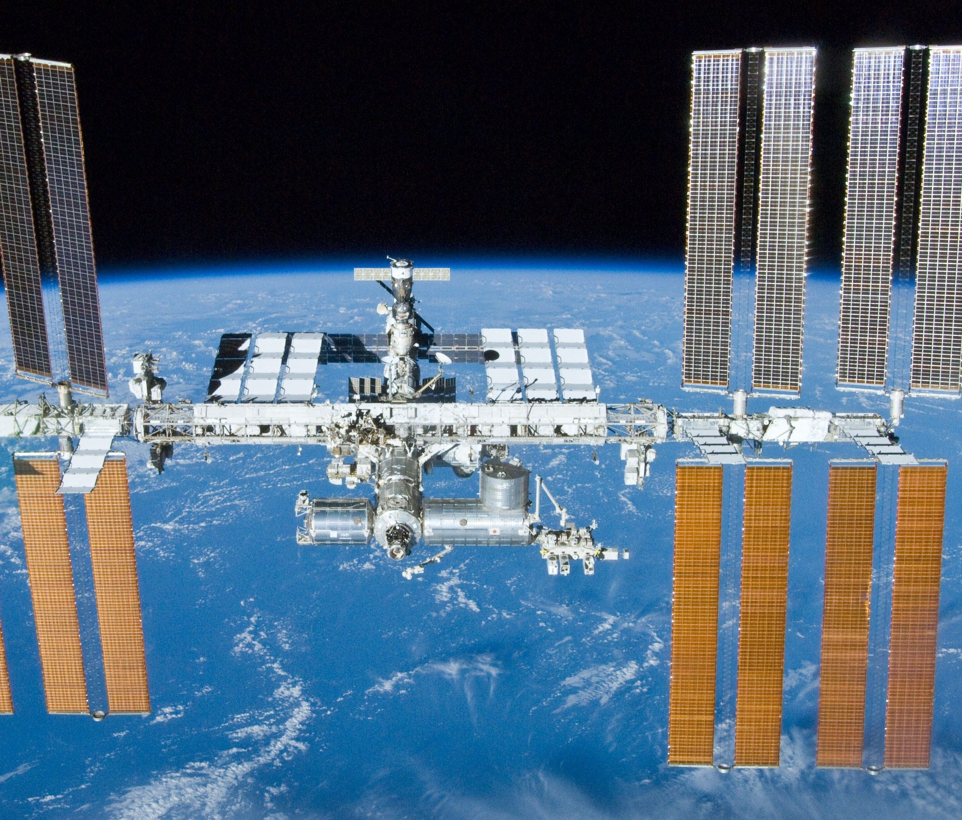
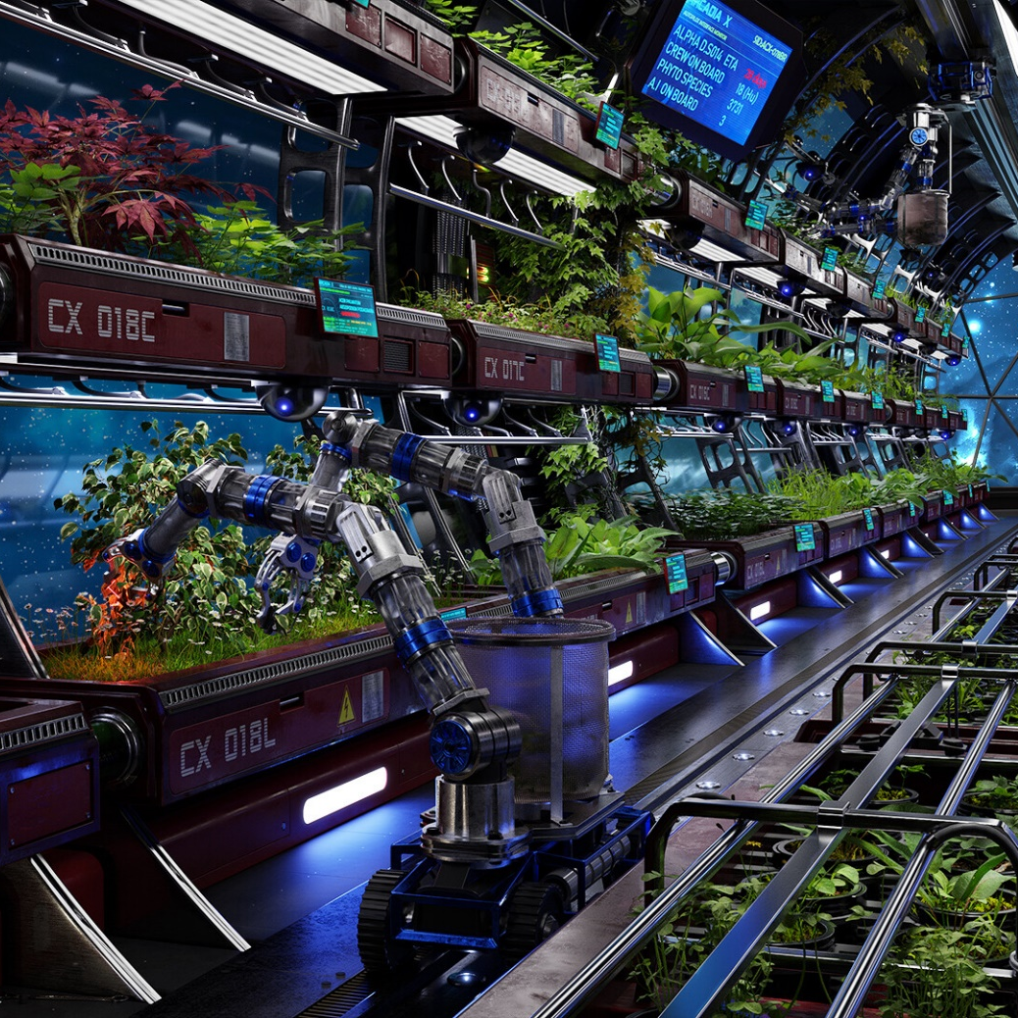
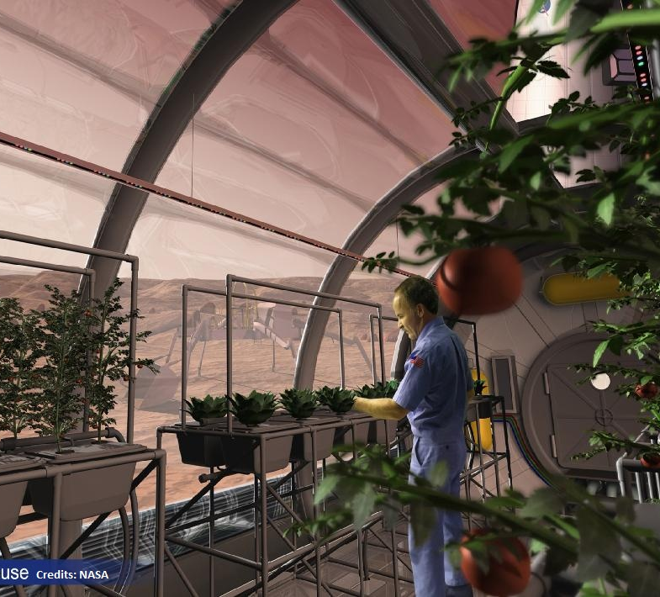
Scenarios
Reduced gravity / Microgravity
Communication delays
Crew autonomy
Available volume
Mission duration

Slide 9
Assumptions for future missions
 | Future Space Station | Interplanetary | Planetary Surface
Available crew time | Same as ISS | More than ISS | More than ISS
Type of crops | Leafy greens | Leafy greens | More diversity
Watering | More automation | More automation | Fully automated
Health monitoring | Fully automated | Fully automated | Fully automated
Sowing and harvesting | Mostly by crew | Mostly by crew | Fully automated
Cleaning and consumables | Mostly automated | Mostly automated | Mostly automated
Maintenance | Less than ISS | Less than ISS | More than ISS

Slide 10
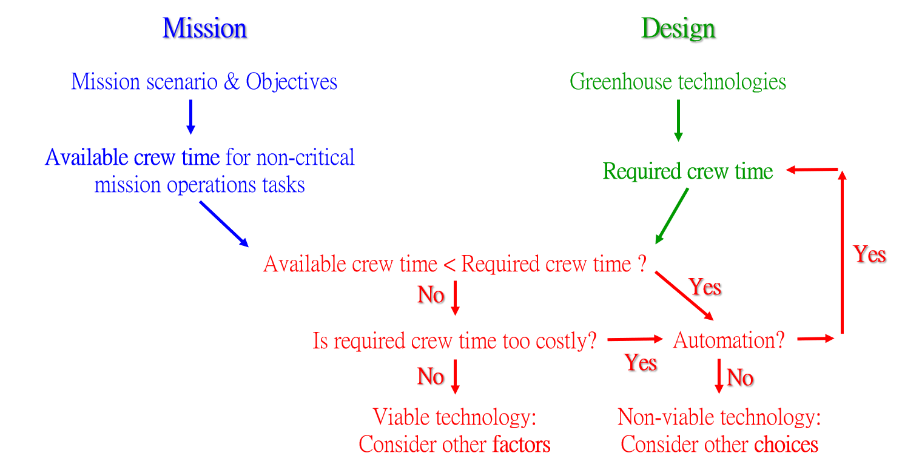
Using crew time in GHM design

Slide 11
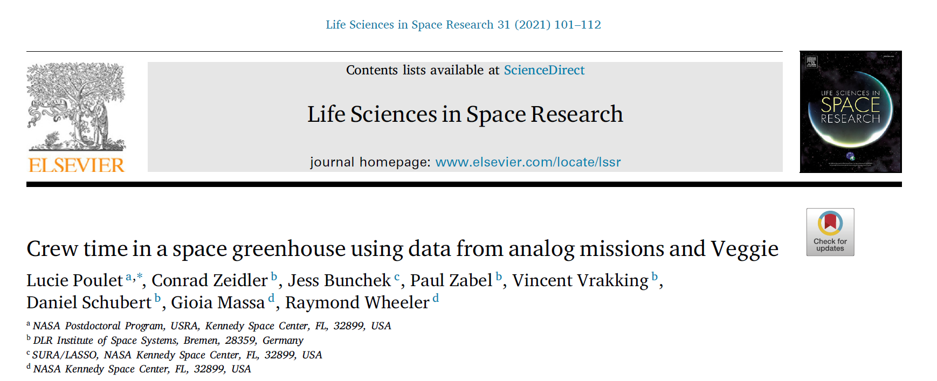
Want to learn more?

Slide 12
QUESTIONS?
Lucie Poulet, Conrad Zeidler, Jess Bunchek, Paul Zabel, Vincent Vrakking, Daniel Schubert, Gioia Massa, Raymond Wheeler

