Slide 1
Aqua Flight Operations Team Constellation Exit Maneuver Status
Aqua Flight Systems Manager
Thomas Rusu
(301) 614-5104
Thomas.rusu@nasa.gov
Updates since the May 2021 Aqua Exit Review in blue

Slide 2
Agenda
Section | Slide(s)
Aqua Spacecraft Status | 3
Spacecraft Component Status | 4
Aqua Instrument Status | 5
Prime and Backup Staffing | 6
Aqua Constellation Exit Status | 7
Battery Depth of Discharge (DOD) Tests | 8-10
Constellation Exit Maneuver Timing | 11-12
Risks | 13-17
Path Forward | 18
Activity Schedule | 19
Conclusions | 20

Slide 3
Aqua Spacecraft Status
All subsystems on Primary Hardware except as noted
Command & Data Handling (CDH) – Nominal
  Solid State Recorder (SSR), Has 136 Gbits capacity, full capacity available
Communications (COMM) – Nominal
  X-Band String - both strings working – full capacity available
  S-Band String - both strings working – full capacity available
Electrical Power System (EPS) – Good
  Battery Cell and Heater Controller performing nominally
  23/132 Confirmed string loss
Flight Software (FSW) – Nominal
Guidance, Navigation & Control (GN&C) – Nominal
  Minor drift in STA residuals – Monitoring – No impact to navigation seen
Propulsion (PROP) – Nominal
Thermal Control System (TCS) – Nominal
Instruments (INST) – Nominal
  HSB, AMSR-E, and AMSU-A2 RED, all other instruments are taking science

Slide 4
Spacecraft Component Status
Spacecraft Bus is in Excellent Health
Subsystem | Component | Design | Current | Capability | Comments
Elect. Power | Solar Array | 132 Strings | 109 Strings | 82.6% | 23 out of 132 strings appear to have failed. The latest failure occurred on 7/27/2021 and was confirmed during the 9/22/2021 EPS State of Health (SOH) Test
 | Battery | 24 Cells | 24 Cells | Full | Anomalous performance on BMA-2 Cell 4 in September 2005, returned to nominal within weeks.
Thermal | TCLs | 42 | 42 | Full | Nominal Performance
OBC's | CTC | 2 | 2 | Full | Nominal Performance
 | GNCC | 2 | 2 | Full | Nominal Performance
 | PC | 2 | 2 | Full | Nominal Performance
 | ISC | 2 | 2 | Full | Nominal Performance
Communications | X-Band String | 2 | 2 | Full | Nominal Performance
 | S-Band String | 2 | 2 | Full | Nominal Performance
C&DH | USO-1 | 2 | 2 | Full | Nominal Performance
 | USO-2 | 2 | 2 | Full | Nominal Performance
 | FMU/SSR | 136Gbits | 136Gbits | Full | Nominal Performance
 | C&T Bus | 2 | 2 | Full | Nominal Performance
 | S/C Support Bus | 2 | 2 | Full | Nominal Performance
 | PC Bus | 2 | 2 | Full | Nominal Performance
 | GN&C Bus | 2 | 2 | Full | Nominal Performance
GN&C | CSSA | 2 | 2 | Full | Nominal Performance
 | ESA | 2 | 2 | Full | Nominal Performance
 | MTA | 3 | 3 | Full | Nominal Performance
 | ODE | 2 | 2 | Full | Nominal Performance
 | RWA | 4 | 4 | Full | Nominal Performance
 | STA | 2 | 2 | Full | Monitoring a minor Star Tracker Residual Anomaly
 | SADA | 2 | 2 | Full | Nominal Performance
 | TAM | 2 | 2 | Full | Nominal Performance
 | VDE | 2 | 2 | Full | Nominal Performance
 | WDE | 4 | 4 | Full | Nominal Performance
Propulsion | DTM | 4 | 4 | Full | Nominal Performance

Slide 5
Aqua Instrument Status
Instrument | Health | Comments
AIRS | Excellent | Approximately 200 of 2378 channels are degraded due to radiation; however, they are still useful. Cooler-A Telemetry, frozen since a 3/28/2014 Anomaly, was restored during recovery activities performed on 9/27/2016.
CERES-Fore & Aft | Excellent | Cross-track and Biaxial modes fully functional CERES-Fore: shortwave channel failed on 3/30/05; the other two channels remain operational
MODIS | Excellent | 3 of 4 10-Watt calibration bulbs inoperable; no impact to science operations
AMSU-A1 | Fair | AMSU-A1 Anomaly on 6/21/2018 caused unexplained shift in Channel 14, but on 6/19/2019 the shift was unexpectedly reversed, and the Channel recovered.
AMSU-A2 | Failed | AMSU-A2 Anomaly on 9/24/2016 caused loss of Channels 1 and 2. The recovery attempts were unsuccessful
AMSR-E | Failed | Off since March 2016 (Major Anomaly October 2011)
HSB | Failed | Off since February 2003

Slide 6
Prime and Backup Staffing
Position | Aqua | Backup (Aura)
Flight Systems Manager | Tom Rusu (“Ru”) | Chuck Hudson
Communications | Jeremy Stanfield | Mark Bowen
Command & Data Handling | Josh Graves | Priya Bhagat
Flight Software | Andrew Slovak | Drew Loebig
Guidance, Navigation & Controls | Josh Bowman (Lead GNC), Ricky Burcat, Ava Afghahi
Power & Thermal | Mark Bowen | Ricky Burcat
Instruments | Jesse Treptow | Jacob Williams
EOS Conjunction Analyst (ECA) | Syed Hasan, Ian Crum

Slide 7
Aqua Constellation Exit
Constellation Exit Maneuvers (CEMs) and Perigee Lowering Maneuvers (PLMs) Baseline Plan
  CEMs: Tue/Fri burn pairs: Jan 11th & 14th (CEM1&2); Jan 25th & 28th (CEM3&4)
  PLMs: Every Tue/Fri starting Feb 1st – 9 burns (burns located at orbital midnight)
  +y-side sun exposure accounted for by adjusting burn location (35 degrees prior to apogee/perigee) and slew direction
  Waive-off and abort criteria has been developed to ensure mission safety
  Battery Depth-of-Discharge (DOD) tests conducted to ensure bus voltage does not result in a spacecraft transition during CEMs (see slide 8 for details)
Simulations were conducted during the summer of 2021
  CEM Full team simulation on July 15th
    Nominal case and thruster abort conducted
  CEM #2 Run-for-Record Product Validation Simulation on July 22nd
    Verified FOT maneuver products/tools

Slide 8
Battery DOD Tests
As a result of the May 2021 Aqua Exit Review, an On-Orbit Battery Discharge Test has been developed to understand the battery profile (specifically the battery/main bus voltage) behavior at higher than nominal Depth of Discharge (DOD) values
  Nominal on-orbit DOD = 12%
NG Space has recommended stepping DOD up to the estimated worst-case DOD for the CEMs
  Run-for-Record simulation – August 3rd
  17% test – August 10th; bus voltage = 29.93V
  20% test – August 17th; bus voltage = 29.85V
  23% test – September 14th; bus voltage = 29.76V
  25% test (conservative estimate) – October 26th; bus voltage = TBD
  Bus voltage yellow limit = 27.5V

Slide 9
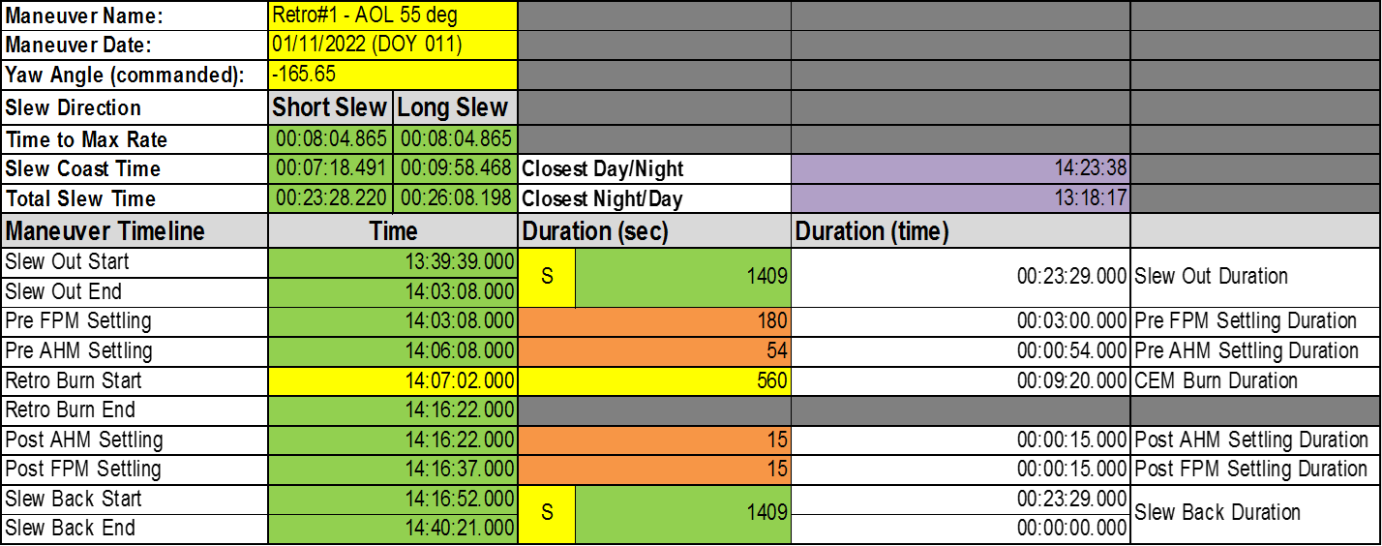
Aqua CEM 1 Timing
CEM 1 – January 11th, 2022
  Commanded Yaw Angle: -165.65⁰
  “Short-Short” slew option
  Slew out -165.65⁰; Slew back +165.65⁰

Slide 10
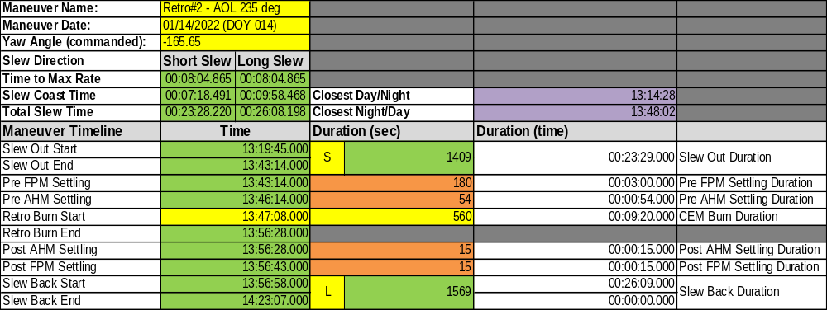
Aqua CEM 2 Timing
CEM 2 – January 11th, 2022
  Commanded Yaw Angle: -165.65⁰
  “Short-Long” slew option
  Slew out -165.65⁰; Slew back -194.35⁰

Slide 11

FOT Constellation Exit/Lowering
NASA Risk Matrix
5
Risk ID | Trend | Approach | Risk Title
A |  | M | Orbital Debris (RMM)
B |  | M | Instrument Sun Exposure
C |  | M | Spacecraft Sun Exposure
D |  | A | COVID19 Telework Configuration
E |  | R | RWA Failure
F |  | M | Spacecraft state transition
G |  | A | Thruster performance
LIKELIHOOD
4
3
2
A
C, E
B, D
F
G
1
1
2
3
4
5
CONSEQUENCES
Criticality
LxC Trend From Last Review
Decreasing (Improving)
Increasing (Worsening)
Unchanged
New Since Last Period
Approach
M - Mitigate
W - Watch
A - Accept
R - Research
High
Med
All risks have remained unchanged since the May 2021 Aqua Exit Review
Low
1 Very Low | 2 Low | 3 Moderate | 4 High | 5 Very High
0.1% < P_{T} < 2% | 2% < P_{T} < 15% | 15% < P_{T} < 25% | 25% < P_{T} < 50% | P_{T} Greater than 50%
No impact to full mission success criteria | Minor impact to full mission success criteria | Moderate impact to full mission success criteria. Minimum mission success criteria achievable with margin | Major impact to full mission success criteria. Minimum mission success criteria achievable | Minimum mission success criteria is not achievable.
Notes:
11

Slide 12
CEM Risk Table (1 of 4)
ID | Description | Status | L | C | CRIT
A | Orbital Debris Collision | New post-maneuver orbits introduce possible new events with debris that have not been seen in the past Predicted post-maneuver conjunction events may change if the retrograde maneuver performance is far off from planning, which can lead to surprise High Interest Events Realistic covariance data may not be used for the post-burn states, which makes the Pc accuracy difficult to assess Still need to evaluate what the Pc value and time to TCA criteria will be for waiving off a CEM Still need to evaluate if modifying planning of a CEM using CRMS (when post-maneuver HIEs arise) is a feasible CA approach | 2 | 5 | 10
G | Thruster Performance | Replanning will be needed based on hot/cold maneuver performance for any single maneuver FDS to replan weekly if the maneuver timing for CEMs #2-4 shift more than 10 seconds The FOT will schedule an additional 2 min contact buffer on each end of the maneuver contacts to account for any PLM replanning, which may shift up to a max of 3min 45sec before violating any thermal constraints Maneuver performance constraints have been implemented per NG Space recommendation as a result of the July 2020 Aqua Thruster test Should the attitude performance constraint be violated, the FOT will abort the burn and regain nominal attitude pointing via the RWAs An Anomaly Resolution Team will be convened to determine if switching to the redundant thrusters is needed (1 week lead time needed prior to on-orbit activity) | 1 | 4 | 4

Slide 13
CEM Risk Table (2 of 4)
ID | Description | Status | L | C | CRIT
F | Spacecraft State Transition | Full team simulation of Safe to Science Mode Recovery executed on 8/18/21 Full team simulation of Survival to Safe Mode Recovery executed on 9/15/21 As per the Aqua FMU reset; the Aqua Offline team has greatly increased their experience with conducting anomalies remotely The FOT System Engineering Team has also increased server resources to handle high User load during anomaly resolution activities | 1 | 3 | 3
B | Instrument Sun Exposure | The FOT/FDS has moved the burn location 35 degrees prior to apogee/perigee This has reduced the +y side sun exposure to remain within the CEM/PLM instrument constraints | 1 | 2 | 2

Slide 14
CEM Risk Table (3 of 4)
ID | Description | Status | L | C | CRIT
D | COVID19 Telework Configuration | The FOT has been under a mandatory remote telework directive since 3/16/2020 FDS, MMS (IST User), and EOSSIM remote access has been provided to the FOT for s/c activities and developmental work IAMs, DMUs, MLCs have all been conducted remotely since mandatory telework directive was implemented Should an anomaly occur during the CEM/PLM series, the anomaly resolution time would be increased due to the FOT subsystem engineers working off site. | 1 | 2 | 2
C | Spacecraft Sun Exposure | The spacecraft +y sun exposure analysis was conducted using the EOSSIM and high fidelity ETSF sim Results were reviewed with the Aqua Mission Director and NG Space Aqua CEM/PLM plan has been reviewed and approved by NG Space | 1 | 1 | 1

Slide 15
CEM Risk Table (4 of 4)
ID | Description | Status | L | C | CRIT
E | RWA Failure | Aqua performed the 2020 spring/fall IAMs on RWAs – wheel performance met the FOT’s expectations Should one RWA fail, the FOT will continue to finish the maneuver on 3 RWAs. Aqua can safely recover to nominal pointing based on EOSSIM and ETSF sim analysis Current trending yields that the RWAs are healthy; RWA IAMs have proven that Aqua can handle large angle RWA slews | 1 | 1 | 1

Slide 16
Path Forward
Although an updated Aqua exit plan has been approved by the A-train, the Aqua Mission Director has requested the FOT continue planning for the possibility of executing the January 2022 CEM/PLM campaign
  Easier to be fully prepared to execute the CEMs and PLMs and waive them OFF than it is to waive them ON
To successfully meet the January 2022 CEM/PLM requirements set by the FOT and the additional requirements as a result of the May 2021 Aqua Exit Review the following actions remain open
  Complete 25% DOD test
  PLM Run-for-Record simulation
  CEM #1 (short-short slew) Run-for-Record simulation
  CEM #2 (50-amp charge rate addition to maneuver script) Run-for-Record simulation
  Thruster swap Run-for-Record simulation

Slide 17
Aqua Exit Activity Schedule
Milestone | Status | Completion Date (targeted)
+Y Sunlight Exposure (Spacecraft & Instruments) | Closed
Nominal Maneuver simulations | Closed
Nominal Maneuver Baseline | Closed
Wheel Failure simulations | Closed
Fault Management Criteria simulations | Closed
Fault Management Patch delivery/verification | Closed
Abort simulations | Closed
Full Team simulations | Closed
CM maneuver products | Closed
CEM Product Validation Simulation | Closed
Battery DOD Tests | Open | October 2021
PLM Run-for-Record Simulation | Open | November 2021
CM Maneuver Planning/Execution SOPs | Open | November 2021
CEM Run-for-Record Simulations | Open | November-December 2021
Thruster Swap Run-for-Record Simulation | Open | December 2021
On-orbit exit maneuvers | Open | Starting January 2022

Slide 18
Conclusions
All Aqua A-Train Constellation Exit Activities have been identified and scheduled
All additional Simulations, Rehearsal and Reviews have been scheduled
  ALL CAN BE CONDUCTED REMOTELY
All reasonable Risks have been identified and are well understood
All Final Products to be placed under FOT Configuration Management Control
Aqua Flight Operations Team (FOT) is ready to proceed with the CEMs and PLMs pending the completion of run-for-record simulations

Slide 19
Abbreviations / Acronyms List
  AIRS – Atmospheric Infrared Sounder
  AMSR-E – Advanced Microwave Scanning Radiometer for EOS
  AMSU – Advanced Microwave Sounding Unit
  ARE – Array Regulator Electronics
  ASAT – Anti-satellite Weapon
  BEOC – Backup EOC
  CA – Conjunction Assessment
  CAM – Command Authorization Meeting
  CARA – Conjunction Assessment Risk Analysis
  CDH – Command & Data Handling
  CEF – CERES Fore
  CEM – Constellation Exit Maneuver
  CERES – Clouds and the Earth’s Radiant Energy System
  COTS – Commercial Off the Shelf
  CNES – Centre National d’Etudes Spatiales
  CRMS – Collision Risk Management System
  CVT – Constellation Visualization Tool
  DA – Data Analysis
  DAM – Debris Avoidance Maneuver
  DAS – Debris Assessment Software
  DMUM – Drag Make-up Maneuver
  DTM – Dual Thruster Module
  EA – EOS Automation
  EDT – Eastern Daylight Time
  EOC – EOS Operations Center
  EOL – End of Life
  EOM – End of Mission
  EOMP – End of Mission Plan
  EOPM – End of Prime Mission
  EOS – Earth Observing System
  EPS – Electrical Power System
  ESC – Earth Science Constellation
  ESMO – Earth Science Mission Operations
  FDS – Flight Dynamics System
  FDSS-III – Flight Dynamics Support Services III contract
  FOT – Flight Operations Team
  FSW – Flight Software
  FY – Fiscal Year
  GCOM-W1 – Global Change Observation Mission for Water (1)
  GMT – Greenwich Mean Time
  GN&C – Guidance Navigation & Control
  GPM – Global Precipitation Measurement
  GTE – Ground Track Error
  HIE – High Interest Event
  HQ – Headquarters
  HSB – Humidity Sounder for Brazil
  IAM – Inclination Adjustment Maneuver
  JAXA – Japan Aerospace Exploration Agency
  kg – kilogram
  km – kilometer
  L0 – Level-Zero
  m – meter
  min – minute
  MLT – Mean Local Time
  MMOD Micrometeorite Orbital Debris
  MOCA – Mission Operations Conjunction Assessment
  MODIS – Moderate Resolution Imaging Spectroradiometer
  MOU – Memorandum of Understanding
  MOWG – Mission Operations Working Group
  NASA – National Aeronautics & Space Administration
  OCO-2 – Orbiting Carbon Observatory-2
  Ops – Operations
  ORR – Operational Readiness Review
  PARASOL – Polarization & Anisotropy of Reflectances for Atmospheric Sciences coupled with Observations from a Lidar
  PLM – Perigee Lowering Maneuvers
  PMCOC – Post Maneuver Conjunction of Concern
  PROP – Propulsion
  PS – Project Scientists
  PVT – Pressure, Volume, & Temperature
  RMM – Risk Mitigation Maneuver
  RW – Reaction Wheels
  s or sec – second
  SA – Solar Array
  S/C – Spacecraft
  SEU – Single Event Upset
  SME – Subject Matter Expert
  SSR – Solid State Recorder
  TBC – To Be Confirmed
  TBD – To Be Determined
  TCS – Thermal Control System
  US – United States
  USGS – United States Geological Survey
  WRS – World Reference System
  V – Velocity

