Slide 1
Effective Emissivity of Nonisothermal Isogrid for Spacecraft Radiator Applications
Seth Abramczyk
November 19th, 2021

Slide 2
Abstract
Accurate knowledge of the optical properties of spacecraft components, especially external components, is critical for proper spacecraft thermal design. The effective emissivity of isogrid (an array of equilateral triangular cavities) is not well understood, which poses a challenge for spacecraft thermal management. In this thesis the effective emissivity of isogrid with a prescribed base temperature and nonisothermal walls is examined. The temperature profile of the cavity’s walls and the overall effective emissivity of the cavity are found using Thermal Desktop with Monte Carlo ray tracing. The effective emissivity’s dependence on the wall height, wall thickness, wall resistance, and surface emissivity are examined. The existence of a critical wall height, and the contributing factors to this critical height, are discussed. Comparisons between isogrid and cavities with different base geometries are made. A variable emissivity isogrid spacecraft radiator concept employing the cavity effect is proposed, and mechanisms for achieving this are discussed.

Slide 3
Contents
About me
Background
Effective-ε and Cavity effect
Spacecraft Thermal Control Overview
Spacecraft Radiators
Roman Space Telescope
Method
Thermal Desktop, RadCAD, and Finite Difference Method
Problem Description
Model Description
Model Parameters
Results/Conclusion
View Factors
Temperature Profile & Gradient
$ε_{eff}$ vs Wall Height
Critical Wall Height
Isothermal vs Nonisothermal Walls
Wall Nodalization
Wall Thickness
Wall Resistance
Edge Effects
Isogrid vs Other Geometries
Variable-e Isogrid Radiator Concept
Summary
Future Work

Slide 4
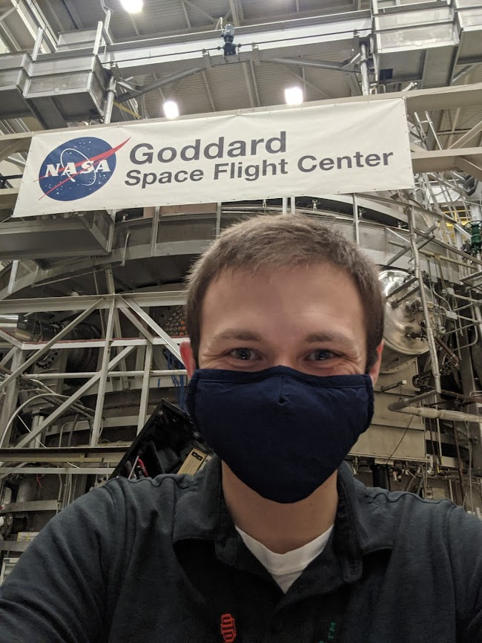
About me
Education
M.S. Mechanical Engineering – Expected 2021
University of Maryland Baltimore County
B.S. Mechanical Engineering – 2019
The University of Texas at Dallas
NASA Goddard Space Flight Center Pathways Co-op (2018 – Present)
Thermal Engineering Branch (2019 – Present)
Roman Space Telescope (2019 - Present)
SNOOPI & Dione CubeSats (2020 - Present)
MOMA (2019-2020)
Operations & Maintenance Branch (2018)
Notes:
Working on MS Mech Engineering UMBC (this is my thesis… duh)
BS Mech Eng at UTD
Pathways at GSFC
In TEB since 2019
In Operations & Maintenance Branch 2018

Slide 5
Effective Emissivity & The Cavity Effect
Radiant emission
$Q_{emission}=AεσT^{4}$
Emissivity ($ε$)
Ratio of radiant emission compared to that of a blackbody, $ε_{blackbody}=1$
$ε=\frac{Q_{emission}}{Q_{blackbody}}$
The Cavity Effect
Effective emissivity ($ε_{eff}$)
Emissivity from a cavity compared to a blackbody with the same cavity opening area
$ε_{eff}=\frac{Q_{cavity emission}}{Q_{blackbody}}≤1$

Slide 6
Spacecraft Thermal Control Overview
Thermal design goal of is to keep all components within temperature limits during worst case extreme hot & cold cases
Design for hot case and cold case extremes
All components have hot & cold temperature limits
Spacecraft steady-state energy balance
$Q_{rejected}=Q_{solar}+Q_{albedo}+Q_{IR}+Q_{internal}$
Heat is transported from dissipating components (electronics boxes, instruments, etc.) to radiators which reject the waste heat to space
Direct Solar
Internal generation
Albedo (reflected solar)
Earth IR
Rejected to Space

Slide 7
Spacecraft Radiator Sizing
Hot case: Radiators sized large enough to reject all waste heat without breaking hot temperature limit
Cold case: Heaters used to prevent breaking the cold temperature limit
$A=\frac{Q_{max}}{εσT_{hot}^{4}}$
$Q_{heater}=AεσT_{cold}^{4}−Q_{min}$
Radiator Sizing Example
Electronics box on radiator dissipation varies 10$W$ to 50 $W$; radiator temperature limits of -10°C to 40°C; $ε=0.9$; no environmental backloading; assume $T_{space}=0K$
Area for 50$W$ box dissipation at 40°C: 0.102 $m^{2}$
Heater power to for 10$W$box dissipation at -10°C: 14.9$W$

Slide 8
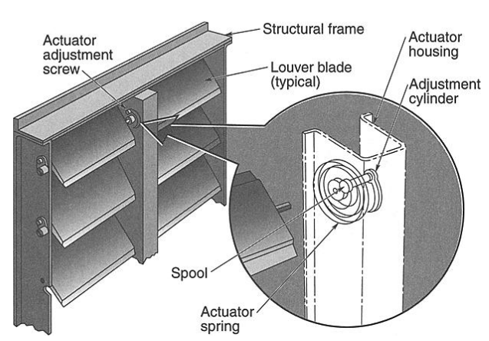
Variable Emissivity Radiators
Thermal control device which vary emissivity with temperature
$Q_{emission}=AεσT^{4}$
$A$ and $ε$ are only variables that can be varied
Louvers
Low-ε vanes cover a high-ε radiator surface
Vanes open/close via bi-metallic strips, covering and exposing high-ε surface
Low temperature
Vanes closed, low $ε_{eff}$, less heat dissipated
High temperature
Vanes open, high $ε_{eff}$, more heat dissipated
Able to maintain a setpoint temperature by tuning of bi-metallic strips
D. G. Gilmore et al., Spacecraft Thermal Control Handbook Volume I: Fundamental Technologies, 2nd ed. The Aerospace Press, 2002.

Slide 9
Variable Emissivity Radiator Sizing Example
Same problem as before, but $ε$ varies from 0.5 - 0.9
Area for 50$W$ box dissipation at 40°C and $ε_{max}=0.9$ is same as before: $A=\frac{Q_{max}}{ε_{max}σT_{hot}^{4}}=0.102 m^{2}$
Heater power to for 10$W$box dissipation at -10°C and $ε$=0.5: $Q_{heater}=Aε_{min}σT_{cold}^{4}−Q_{min}=3.6 W$
11.3 W (75.8%) heater power savings from using variable emissivity radiator
 | Typical Radiator | Variable-ε Radiator | Difference
Emissivity @ 40°C | 0.9 | 0.9 | 0.0
Emissivity @ -10°C | 0.9 | 0.5 | 0.4
Area | 0.102 $m^{2}$ | 0.102 $m^{2}$ | 0 $m^{2}$
Heater Power | 14.9 $W$ | 3.6 $W$ | 11.3 $W$

Slide 10
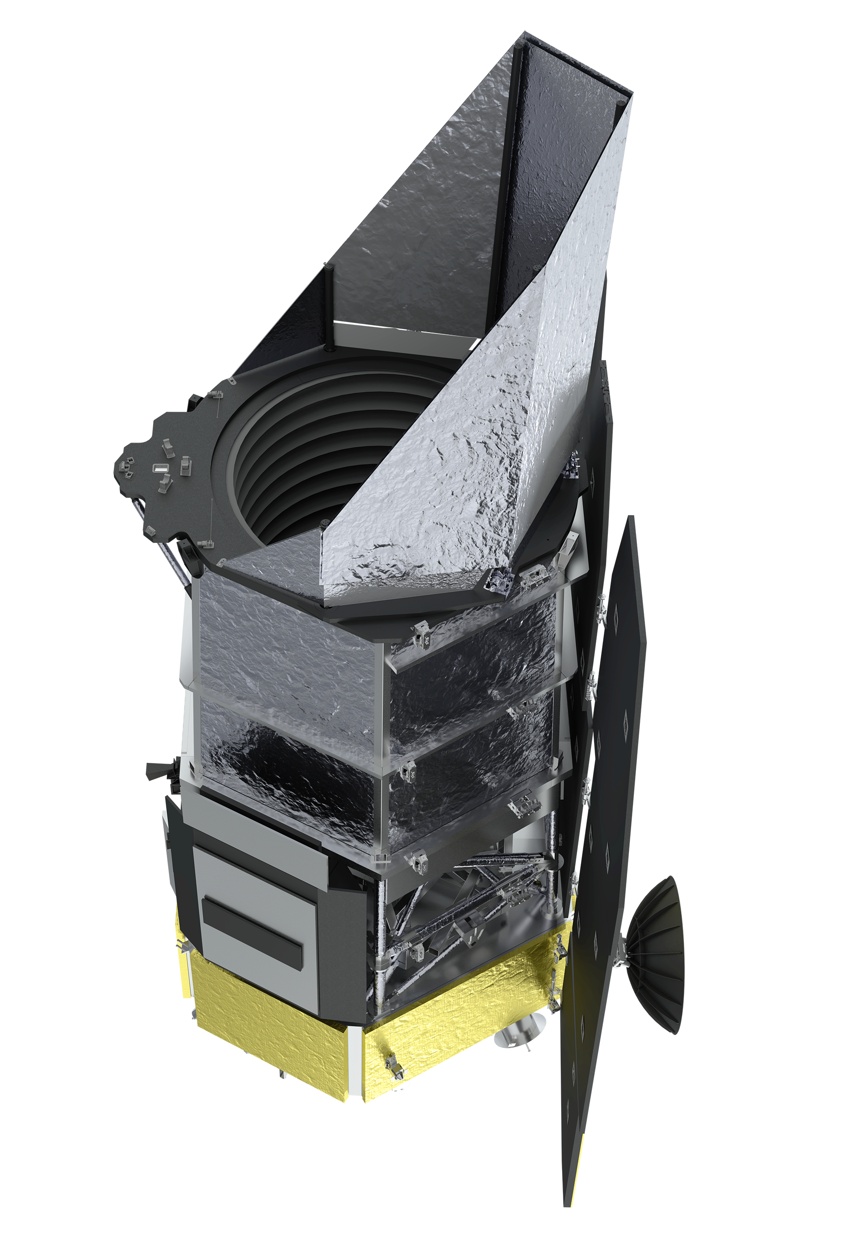
Roman Space Telescope Overview
Launching mid-2020’s, RST will explore:
Dark Energy
Unknown energy causing the universe to expand at an increasing rate. Dark energy makes up 68% of the total energy in the cosmos.
Dark Matter
Unknown matter that does not interact with normal matter
RST will look at weak gravitational lensing caused by dark matter
Exoplanets
Planets orbiting other stars
Will be detected by RST via microlensing, transiting, and possibly direct imaging
Compared to Hubble Space Telescope
Same resolution with 100x the field of view
“Over the first five years of observations, Roman will image over 50 times as much sky as Hubble covered in its first 30 years.”
NASA, “Nancy Grace Roman Space Telescope,” NASA Goddard Space Flight Center. https://roman.gsfc.nasa.gov/observatory.html.
H. L. Peabody, “Tracking Critical Thermal Metrics throughout the Life Cycle of a Large Observatory Thermal Model,” 2020.

Slide 11
Thermal Desktop & RadCAD
Thermal Desktop
Software package made specifically for spacecraft thermal analysis
Runs as an application within AutoCAD
Builds thermal R-C network and passes to SINDA to solve. Displays and analyses SINDA results.
Calculates radiation exchange factors via Monte Carlo ray tracing (RadCAD)
RadCAD
TD’s built-in Monte Carlo ray tracer
Used to calculate radiation exchange factors between surfaces
Thousands of rays shot from each node in random directions. Deposits energy onto each surface it hits based on the receiving surface’s properties. Each ray is propagated throughout the model until it reaches space or is fully absorbed.
T. D. Panczak, S. G. Ring, M. J. Welch, D. Johnson, B. A. Cullimore, and D. P. Bell, Thermal Desktop User’s Manual, 6.0. C&R Technologies, Inc., 2017.

Slide 12
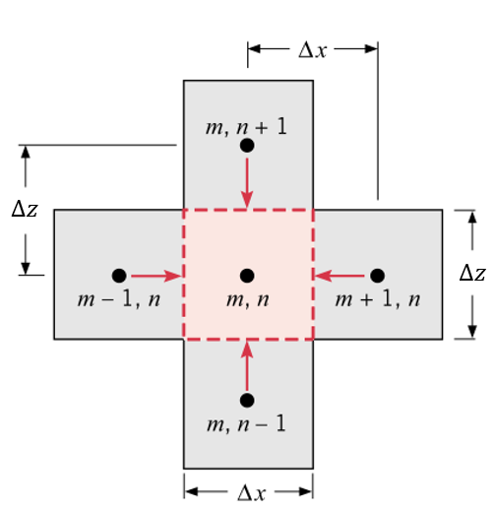
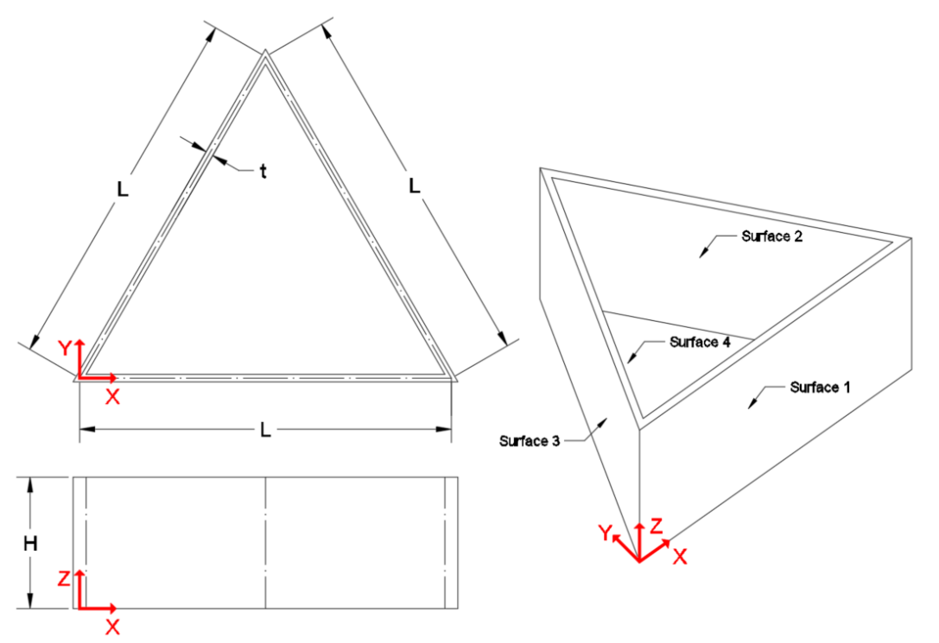
Finite Difference Method
General steady state 3D heat diffusion equation without internal heat generation
$k\left(\frac{∂^{2}T_{1}}{∂x^{2}}+\frac{∂^{2}T_{1}}{∂y^{2}}+\frac{∂^{2}T_{1}}{∂z^{2}}\right)=0$
Finite Difference Formulation
Assuming only 1 element in the thickness ($y$) direction
$Q_{cond}=\frac{kt∆z}{∆x}\left(T_{m+1,n}+T_{m−1,n}−2T_{m,n}\right)+\frac{kt∆x}{∆z}\left(T_{m,n+1}+T_{m,n−1}−2T_{m,n}\right)$
F. P. Incropera, D. P. Dewitt, T. L. Bergman, and A. S. Lavine, Fundamentals of Heat and Mass Transfer, 6th ed. John Wiley & Sons, 2007.

Slide 13
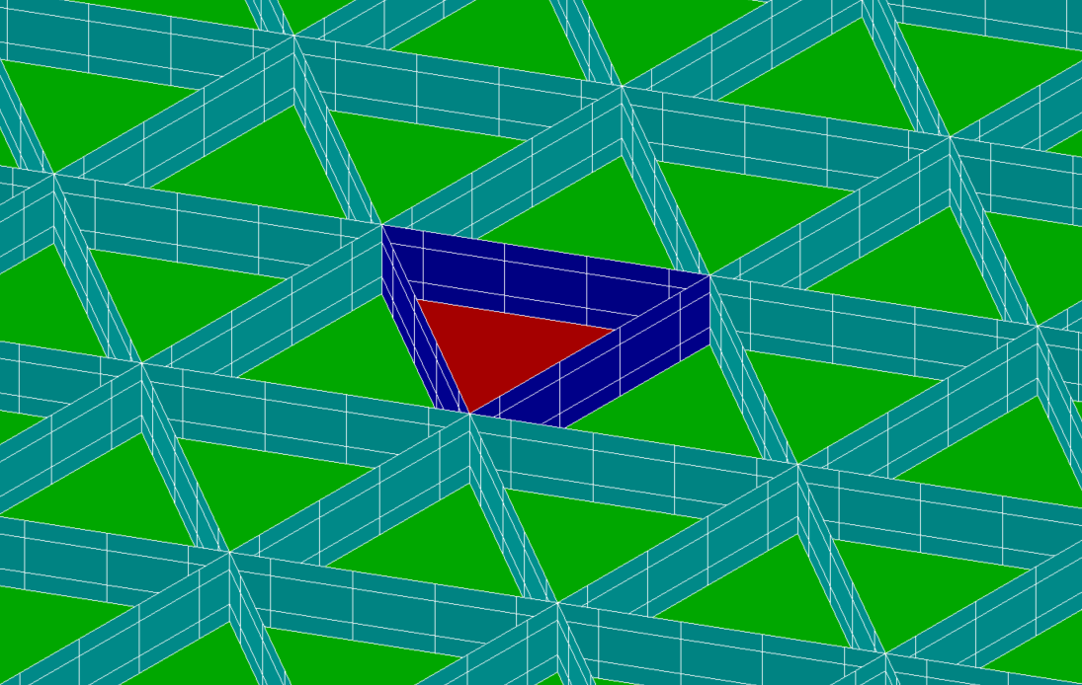
Problem Description
Isogrid
Array of equilateral triangular cavities
Assumptions
Single cavity within an arbitrarily large isogrid array
Array is in space with no radiative backloading from sun, earth, etc.
$T_{space}=2.7 K$
System is at steady state
Base of array is isothermal at prescribed temperature $T_{b}$
Cavity walls are isothermal through their thickness
Material & optical properties independent of temperature

Slide 14
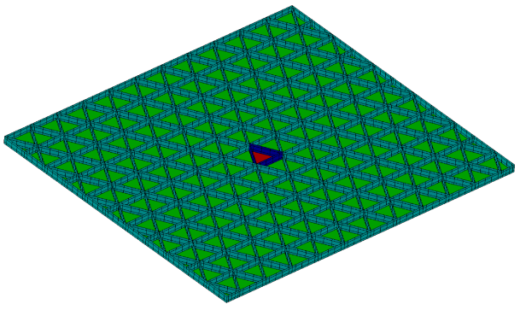
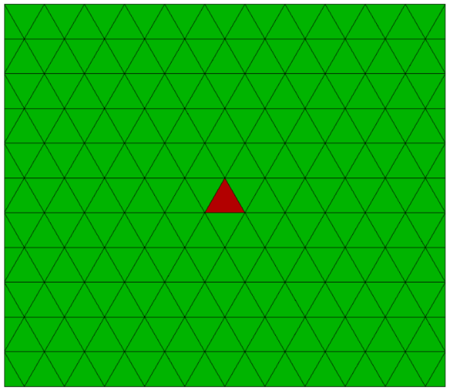
Thermal Desktop Isogrid Model
Made from thin finite difference elements with edge nodes
Base of array given boundary node at $T_{b}$
Array is 22x11 cells
Edge cells in at position $x=11$ are “half cells” (right triangles)

Slide 15
Model Parameters
Wall Height ($η$)
$η=\frac{A_{walls}}{A_{base}}=\frac{3LH}{L^{2}\sqrt{3}/4}=\frac{12H}{\sqrt{3}L}$
Non-dimensional
$η=3.46$is used throughout this thesis because it corresponds to when $H=L/2$
Wall Thickness ($λ$)
$λ=t/L$
Non-dimensional
Characteristic Wall Resistance ($R_{char}$)
$R_{char}=\frac{H}{k(tL)}$
$\left[R_{char}\right]=℃/W$
Notes:
Wall height (eta)
Ratio of inner wall area to base area
Wall thickness (lambda)
Ratio of thickness to length
Char wall resistance (Rchar)
Thermal resistance up wall (in Z direction)

Slide 16
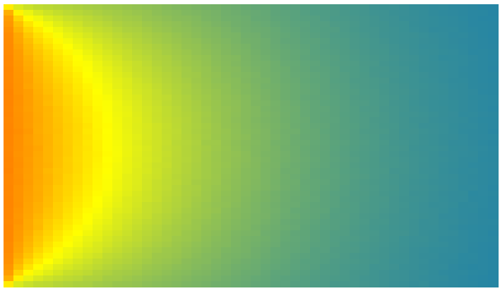
View Factor Across Surface 1
View factors found with RadCAD
View factors are highly variable across surface 1
At any given point:
$\sum_{n=2}^{4}{F_{1−n}}+F_{1−space}=1$
$$F_{1−2}$$
$$F_{1−space}$$
$$F_{1−3}$$
$$F_{1−4}$$
For η=3.46
Notes:
F1-2 & F1-3 are mirrored about X=L/2. Max is ~0.7 at X=0 and X=L
F1-space & F1-4 are mirrored about Z=H/2. Max is 0.5 at Z=H

Slide 17
Temperature Profile Across Surface 1
Highest temperature along $z=0$
At base temperature $T_{b}$
Lowest temperature at $x=L/2$, $z=H$
For $ε_{surf}$=0.7, $η$=3.46, $λ$=0.010
H
z
0
x
L

Slide 18
Temperature Gradient vs Wall Height
$ΔT=T_{min}−T_{base}$
Larger temperature gradient with increased wall height ($η$)

Slide 19
Characteristic Regions of $ε_{eff}$ vs Wall Height
$ε_{surf}$: Surface emissivity
$ε_{eff max}$: Maximum effective emissivity
$η_{crit}$: Critical wall height
$η$ for which $ε_{eff}=ε_{eff max}$
$η_{equiv}$: Equivalent wall height
$η$ for which $ε_{eff}=ε_{surf}$
Analogous to critical insulation thickness for a pipe
Critical Wall Height

Slide 20
Contributing Factors to Critical Wall Height
$Q_{total}=Q_{walls}+Q_{base}$
At $η=0$ (wall height = 0) entire contribution is from base
As $η$ increases
$Q_{base}$decreases
$Q_{walls}$increases, reaches a maximum, and begins to decrease

Slide 21
$ε_{eff}$ vs Wall Height Results (1/2)
Larger $ε_{surf}$ leads to
Larger $ε_{eff max}$
Larger $η_{crit}$ and $η_{equiv}$
$ε_{eff}≤1.0$
Because $ε_{eff}≤ε_{blackbody}$
$$λ$$ | $$ε_{surf}$$ | $$ε_{eff max}$$ | $$η_{crit}$$ | $$η_{equiv}$$
0.010 | 0.90 | 0.95 | 2.77 | 6.67
 | 0.70 | 0.88 | 4.16 | 18.73
 | 0.50 | 0.79 | 5.54 | >20
 | 0.30 | 0.68 | 6.93 | >20
 | 0.10 | 0.47 | 13.86 | >20

Slide 22
$ε_{eff}$ vs Wall Height Results (2/2)
$ε_{eff}/ε_{surf}$
Lower $ε_{surf}$ → larger relative increase in $ε_{eff}$
Lower $ε_{surf}$ has more “room to grow” until it reaches the $ε_{eff}≤1$ limit
$ε_{eff max}$ still lower for smaller $ε_{surf}$

Slide 23
Isothermal vs Nonisothermal Cavity Walls
Isothermal walls at $T_{b}$ vs nonisothermal walls
Isothermal ≡ nonisothermal for small $η$
Isothermal
As $η→∞$, $ε_{eff}→1$
Nonisothermal
Critical wall height phenomenon
As $η→∞$, $ε_{eff}→0$

Slide 24
Varying Wall Nodalization
Varied wall nodalization from 5x3, 5x5, 5x7, and 5x9 nodes
Increased Z nodalization better captures nonlinear gradients
More accurate gradients → more accurate $ε_{eff}$
Most plots shown for $η≤20$ because good agreement up to that point

Slide 25
Varying Wall Thickness
$λ=t/L$
Increased thickness → lower resistance → smaller gradients (more isothermal) → higher $ε_{eff}$

Slide 26
Varying Wall Resistance
$R_{char}=\frac{H}{k(tL)}$
Plot of $ε_{eff}$ vs $R_{char}$ looks like $ε_{eff}$ vs $η$
Because $R_{char}α η$

Slide 27
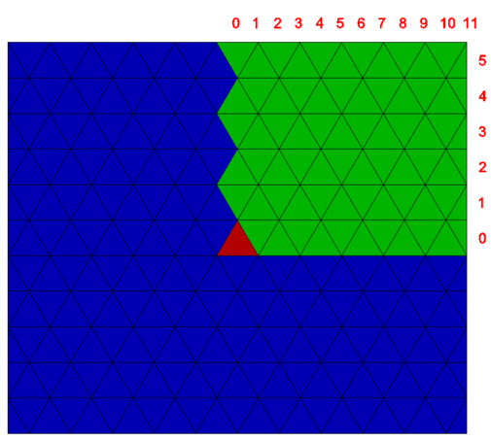
Edge Effects
Slight increase in $ε_{eff}$ for edge cavities at $x=11$ but not $y=5$
Because cavities at $x=11$ are right triangles, not equilateral
Have a different $η$ value for the same height
Higher $η$ → higher $ε_{eff}$
$$η_{right triangle}=\frac{\left(12+4\sqrt{3}\right)H}{\sqrt{3}L}≈10.93\frac{H}{L}$$
27

Slide 28
Isogrid vs Other Geometries (1/2)
Compared single cell of different geometries
For small $η$
No difference in $ε_{eff}$ because $Q_{base}≫Q_{walls}$
For larger $η$
$ε_{triangle}>ε_{square}>ε_{pentagon}>ε_{hexagon}>ε_{circle}$

Slide 29
Isogrid vs Other Geometries (2/2)
Triangle has largest perimeter/area ratio
For a given $η$
Larger P/A → smaller $H$ → lower $ΔT$ → larger $ε_{eff}$
Cavities shown at $η=2$

Slide 30
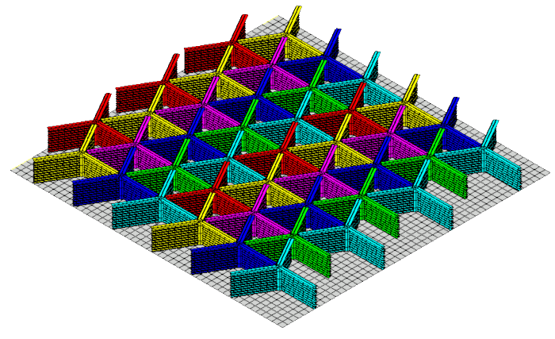
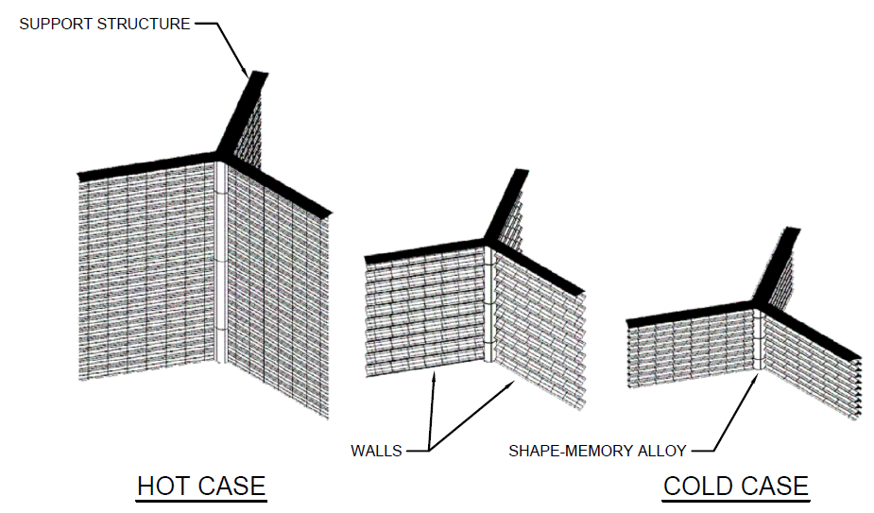
Variable Emissivity Isogrid Radiator Concept
Variable-ε radiator using the cavity effect
“Propeller” design
3 blades around central mast
Mast raises/lowers with temperature

Slide 31
Summary
Most other studies
Cylindrical cavity
Single cavity
Isothermal walls
If nonisothermal, then prescribed temperature profile
This thesis
Isogrid cavity
Arbitrarily large array of cavities
Nonisothermal walls
Solved for both temperature profile and effective emissivity
Parameters impacting effective emissivity
Wall height
Surface emissivity
Wall thickness
Wall resistivity
Critical wall height
$ε_{eff}$ peaks at some critical wall height
As $η→∞$, $ε_{eff}→0$
Proposed variable-ε isogrid radiator concept

Slide 32
Future Work
Verify results in thermal-vacuum chamber
Investigate $η>20$
Need finer nodalization on walls to capture large gradients
Isogrid on curved surfaces
Both concave and convex
Very common in the real-world
Effect of varying base temperature
If $T_{b}≈T_{space}$ → smaller gradients on wall → higher $ε_{eff}$?
If $T_{b}≫T_{space}$ → larger gradients on wall → lower $ε_{eff}$?
Directionality of emission from cavity opening
Cavity is likely not a diffuse emitter due to temperature gradients on the wall, even if each surface it itself diffuse

Slide 33
Acknowledgements
UMBC
Dr. Ruey-Hung Chen
Connie Bailey
NASA GSFC
Dr. Vivek Dwivedi
John Hawk
Rob Chalmers
Roman Space Telescope project
Committee Members
Dr. Ruey-Hung Chen
Dr. Ronghui Ma
Dr. Liang Zhu
Dr. Vivek Dwivedi

Slide 34
Backup Slides

Slide 35
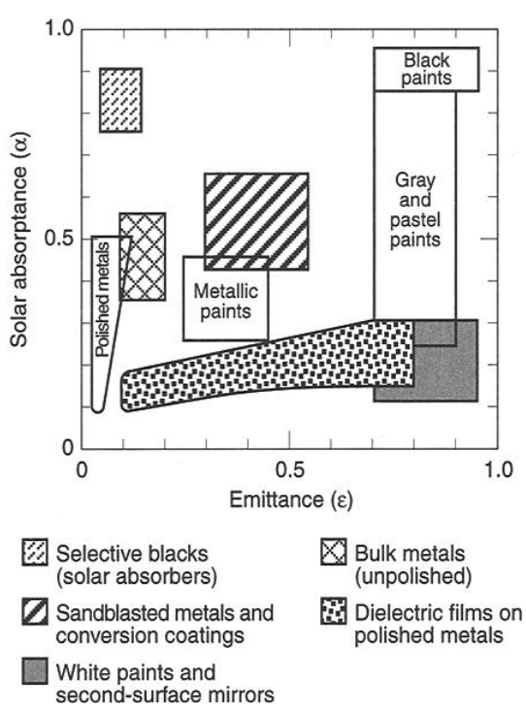
Spacecraft Thermal Control Coatings
$ε$ = IR emissivity
$α$ = Solar absorptivity
$$Q_{emitted}=AεσT^{4}=Aα\left({q"}_{solar}+{q"}_{albedo}\right)+Aε{q"}_{IR}+Q_{int}$$
D. G. Gilmore et al., Spacecraft Thermal Control Handbook Volume I: Fundamental Technologies, 2nd ed. The Aerospace Press, 2002.

Slide 36
Temperature Profile Across Surface 1

