Slide 1
Selection Factors for Space Crops
Gioia D. Massa¹, Matthew W. Romeyn¹ Grace L. Douglas², Ralph F. Fritsche¹, and Raymond M. Wheeler¹
1. NASA Kennedy Space Center
2. NASA Johnson Space Center
Special thanks to Karen McDonald, Robert Jinkerson, Devin Coleman-Derr, and Natasha Haveman

Slide 2
The Space Crop Production Vision
Ensure Food System Security on Long Duration Missions Beyond LEO
Near-Term Goal
Nutrient Supplementation of Prepackaged Food
Long-Term Goal
Caloric Replacement to Move Towards Earth Independence
Notes:
Ralph
Ensure Food System Security on Long Duration Missions Beyond Low Earth Orbit (LEO)
Food and nutrition are the first line of defense for crew health and performance
Provide safe, nutritious and acceptable fresh food
Add variety to crew diet
Enhance morale
* Food security is the condition in which crew have continuous access to sufficient safe and nutritious food which meets both their dietary needs and food preferences in order to maintain peak health and performance.
Nutrient Supplementation of the Prepackaged Food System - Needed for: Deep Space Transport
Fresh produce supplements vitamins (B₁, K, C) and bioactive compounds that degrade in the stored food system on multi-year exploration missions
“Pick-and-Eat” crops that require no processing and minimal preparation will provide variety, customization, and psychological appeal
Enable testing and demonstration of dependable crop production before reliance on system.
Limiting factors are vehicle resources mass, power, volume, water, air, crew time
Caloric Replacement to Facilitate Earth Independence - Needed for: Long duration Surface missions on the Moon and Mars
Reduce up-mass associated with pre-packaged food
In addition to “pick and eat” crops, include staple crops that require processing and preparation
Bioregenerative capability will be required for long duration surface missions

Slide 3


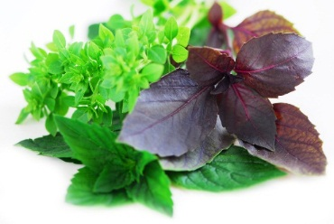
Space Crop Production Candidates
Salad
Leafy Greens
Tomato
Pepper
Radish
Strawberry
Green Onion
Pea
Carrot
Lettuce, Chinese cabbage, Swiss chard, Mizuna, Spinach
Staple Crops
White Potato
Sweet Potato
Rice
Wheat
Dried Bean
Soybean
Peanut
MINIMAL PREPARATION / COOKING
SIGNIFICANT PREPARATION / COOKING
CONSUMED FRESH WITHOUT PROCESSING
Herbs
Basil
Mint
Chives
Dill

Slide 4
Space Crop Production Challenges
Deep Space
Water
Recycling
Radiation
Pressure
Micrometeorites
Surface
Microgravity
Fluid movement
No convection
Dust
Partial gravity
Plant Size
High CO₂
Food Safety & Microbiome
Nutrient output
Sustainability
Abiotic stresses
Vehicle resources
Crew time
Waste
Productivity
Stress tolerance
Environmental optimization
Crop scheduling
Crop

Slide 5
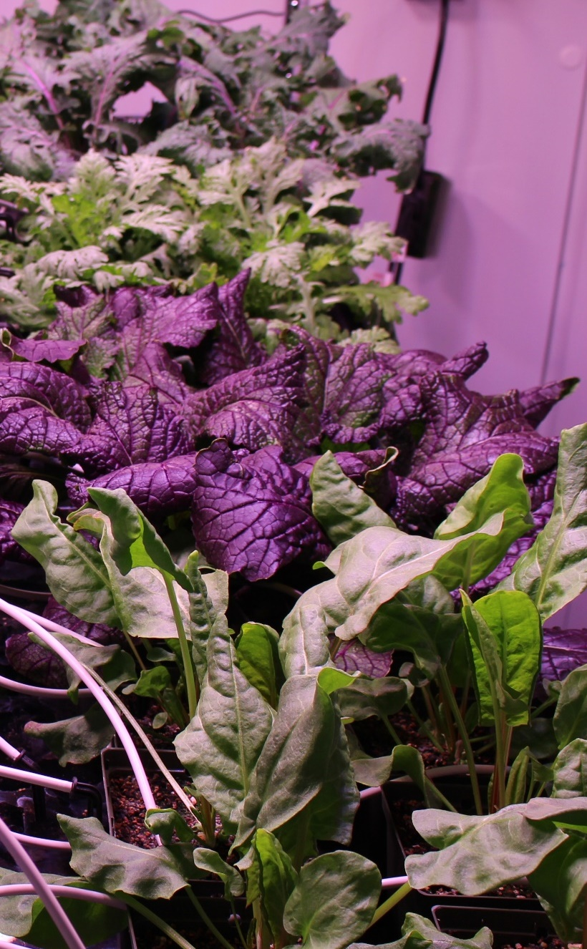
Selection Factors for Space Plants
Targeted breeding areas could fall into several categories:
Plant Growth and Development
Plant Physiology
Produce Nutrition
Produce Organoleptic Acceptability
Postharvest

Slide 6
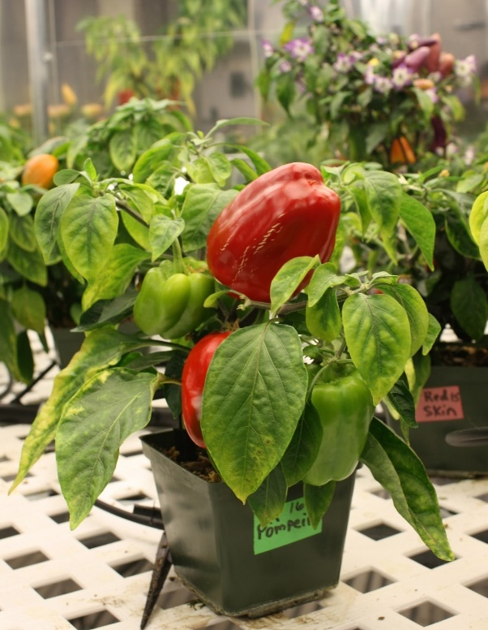
Plant Growth and Development
Compact size (low height and volume)
High yield
High edible/inedible biomass ratio (harvest index)
Reliable germination
Rapid growth to first yield
Uniform growth and development between individuals
Propagules with long shelf stability (seeds, cuttings)
Sustained production capability over long duration (e.g. repetitive fruiting, or cut-and-recut leafy production)
Low debris formation (leaves, flowers, pollen, seeds, etc., remain attached)
Custom microbiome of plant protective and growth promoting microorganisms

Slide 7
Plant Physiology
Stress tolerance (esp. water stress)
Ability to grow well under conditions of:
  Elevated CO₂
  Low relative humidity
  Uniform temperature of 20-23°C
  Narrow spectrum electric lights
  Short photoperiods (to save lighting energy) or long/continuous photoperiods (to speed growth)
  Tolerance of broad environment range
  Tolerance of reduce pressure
No dormancy requirements
Low or pleasing aroma
Low release of volatile organics
High sodium tolerance (e.g. urine recycling)
Preference for ammonia nitrogen sources (e.g. urine recycling)

Slide 8
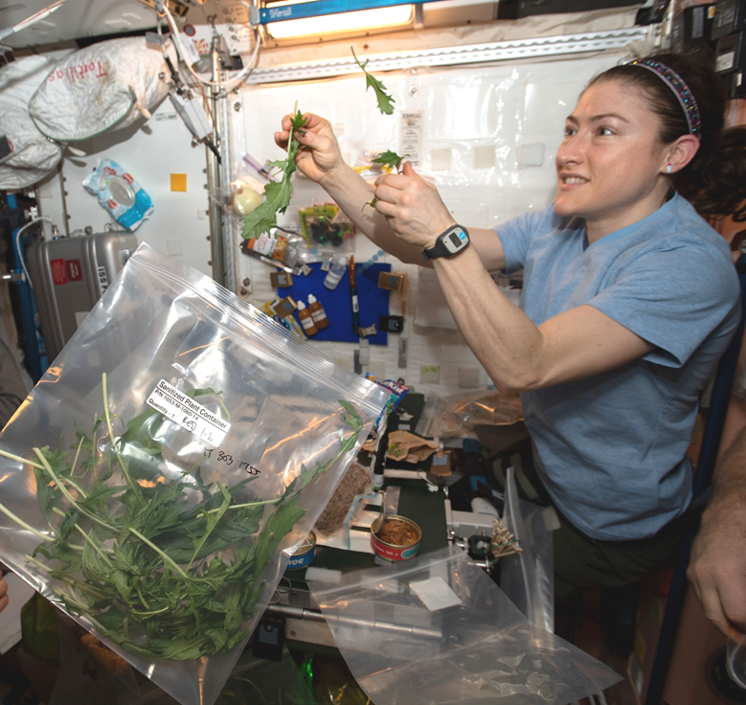
Produce Nutrition
High normal levels of antioxidants
High normal levels of beneficial phytonutrients (e.g. lutein, zeaxanthin, lycopene, phenolics, anthocyanins)
For fresh produce to supplement a packaged diet:
  High normal levels of Potassium and Magnesium
  Low normal levels of Iron
  High normal levels of Vitamins, especially C, B₁, and K
Low levels of antinutrients

Slide 9
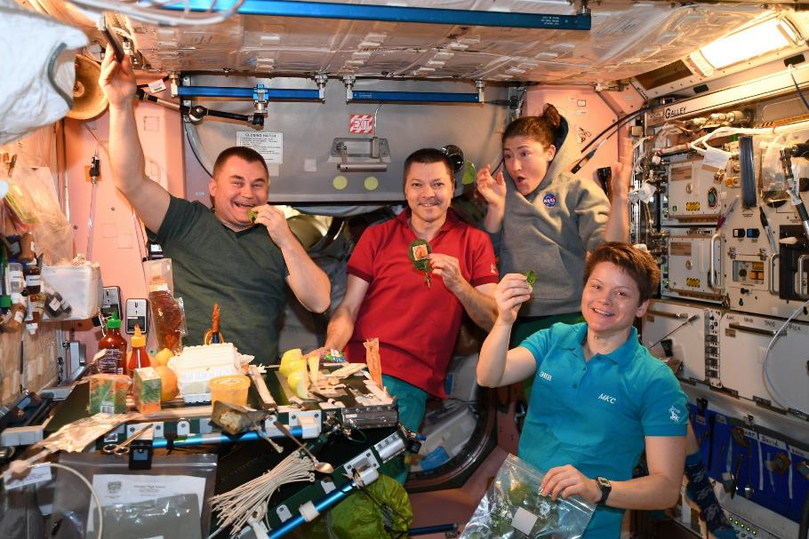
Produce Organoleptic Acceptability
Postharvest
Excellent flavor
Intense flavors
Good texture
Good appearance, color, aroma
Good produce shelf life or storage on the plant
Reduced processing (e.g. seeds easy to remove from seed coats)
Easy composting/digestion of inedible plant material for nutrient reclamation (and possibly less structure in micro/partial g)
Use of waste as resources for other food system components (e.g. fish, edible fungus, cellular ag feedstocks)
Other useful materials produced from waste (e.g. life support, shielding, building, fuel, medicinal compounds & molecular pharming)

Slide 10
A few examples of NASA-funded work in crop development and selection…..

Slide 11
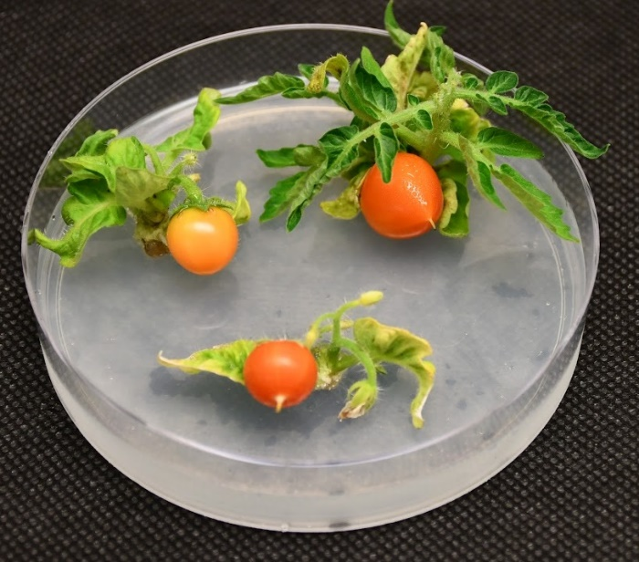
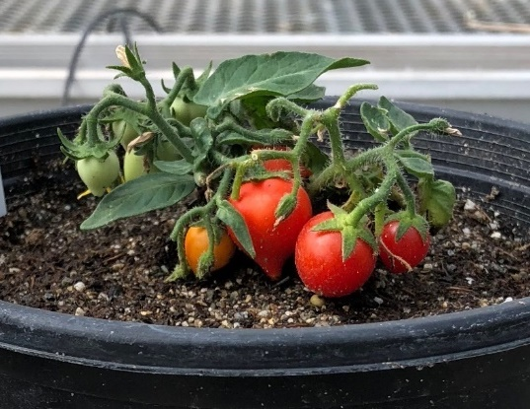
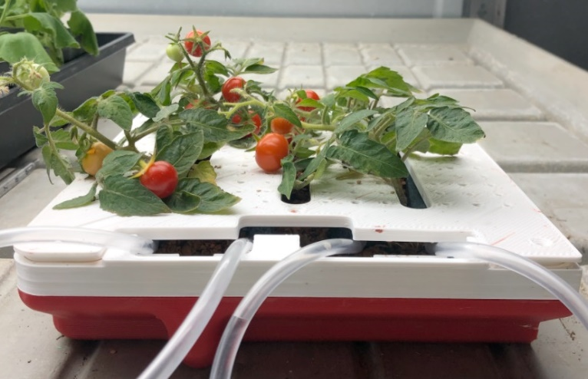



Small Plants for Agriculture in Confined Environments (SPACE) phenotype
SPACE tomato plants in vitro
SPACE tomato plants in soil
Gene editing a series of genes to make tomatoes rapidly flower and fruit resulting in extremely dwarf plants
Results in a high harvest index
Faster time to fruit
The SPACE phenotype can manifest from seeds or from tissue culture regeneration
SPACE tomato plants in APH analog
Robert
Jinkerson
Martha
Orozco-Cárdenas
Jinkerson 6-month Closeout
Notes:
Placeholder: Any current photos of the project demonstrating completion of project aims

Slide 12
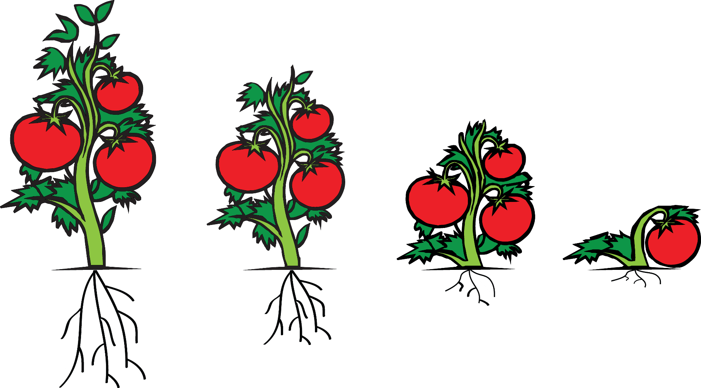
To reduce plant size for space flight applications a series of pathways can be altered and stacked
Gene targets:
Growth hormones
Flowering time
Determinacy
Stress response
Top-down approach: Reduce the non-edible portions of the plant by stacking mutations

Slide 13

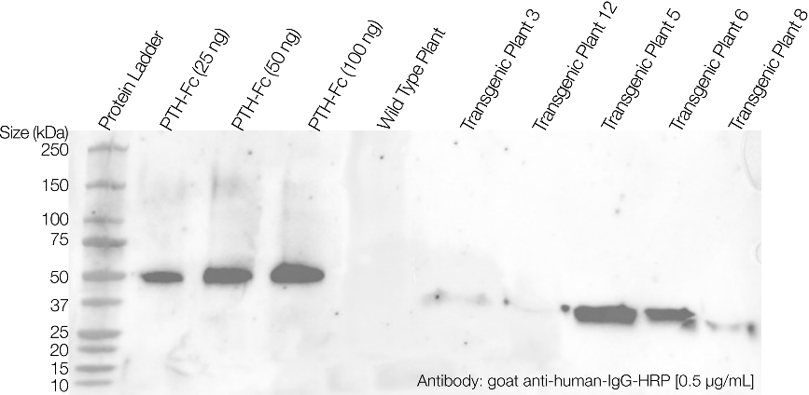
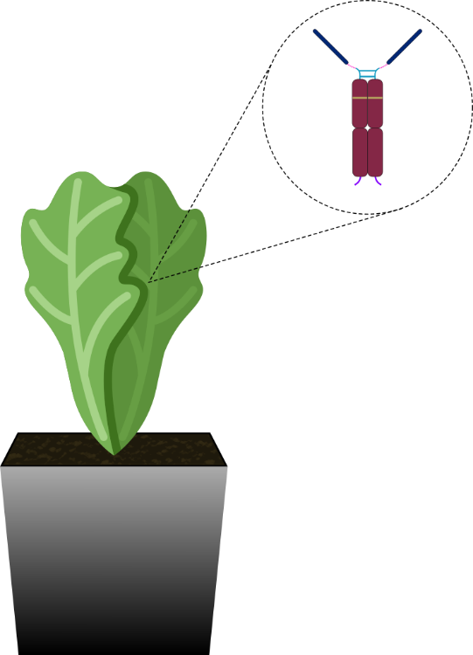
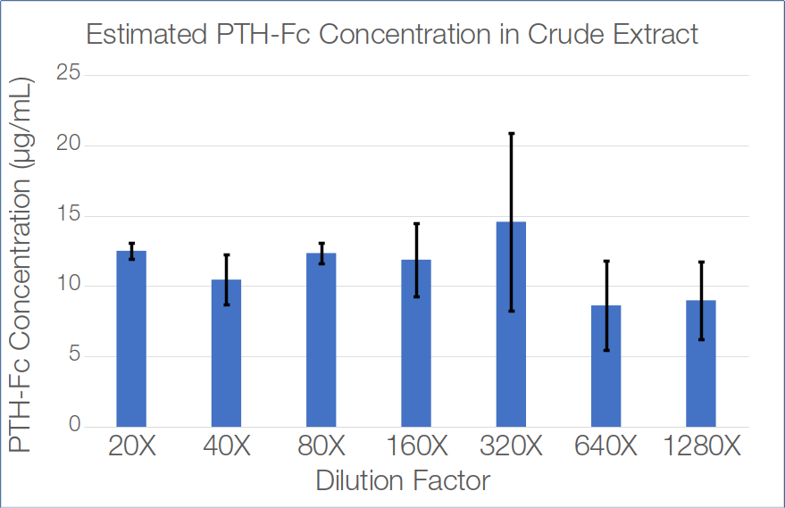
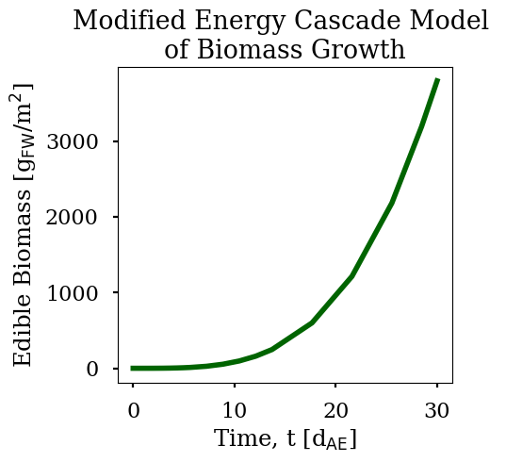
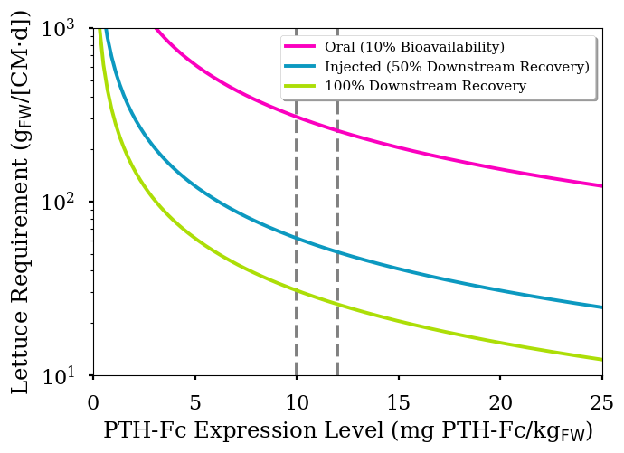
Transgenic Lettuce as a Pharmaceutical Factory
PTH-Fc Fusion Protein
PTH [1-34] is an FDA-approved treatment for bone mineral density loss (as Forteo®, dose 20 μg/day).
Transgenic lettuce is expressing the fusion protein PTH-Fc, which combines amino acids 1-34 of human parathyroid hormone with the fragment crystallizable (Fc) region of human IgG1.
Western blot and ELISA assays demonstrate the production of PTH-Fc in transgenic plants. The expression level of PTH-Fc is estimated to be ~10-12 mg PTH-Fc / kg fresh weight in Transgenic Plant Line 5.
PTH-Fc requirement: 292 μg/day
Both the growth of lettuce biomass and the requirements for PTH-Fc on a long-duration space exploration mission can be modeled. Together, the models enable integration into a reference mission architecture.
Current expression
range
NASA Center for the Utilization of Biological Engineering in Space

Slide 14
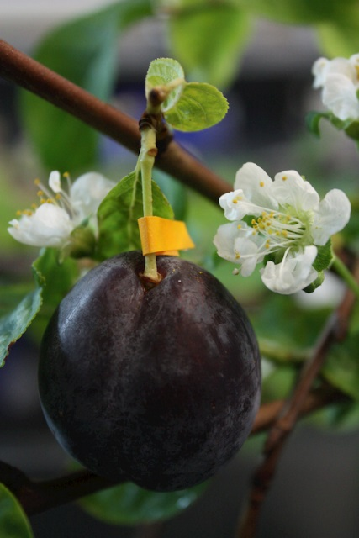
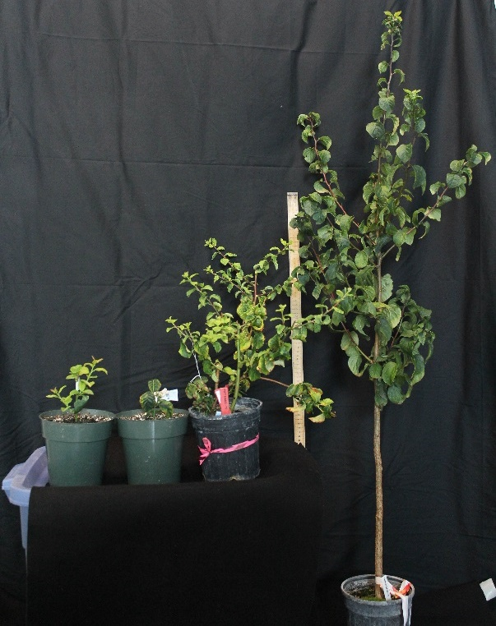
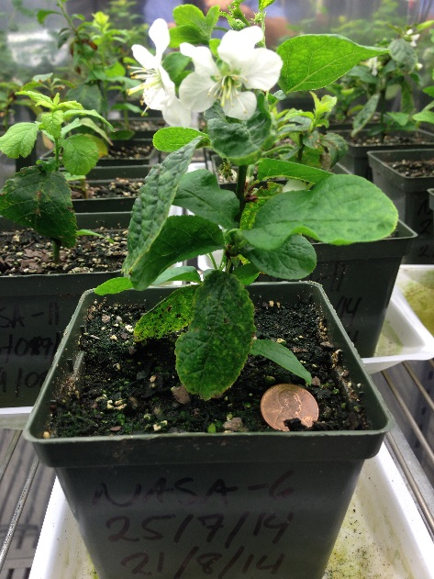
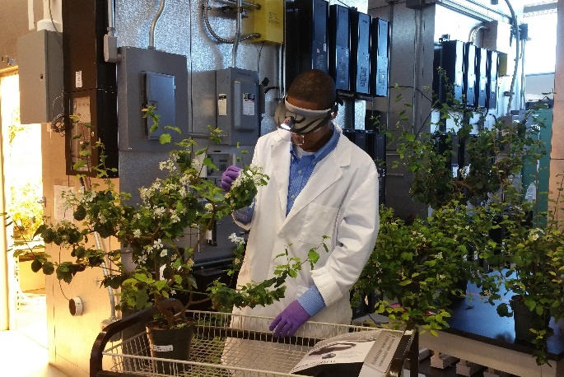
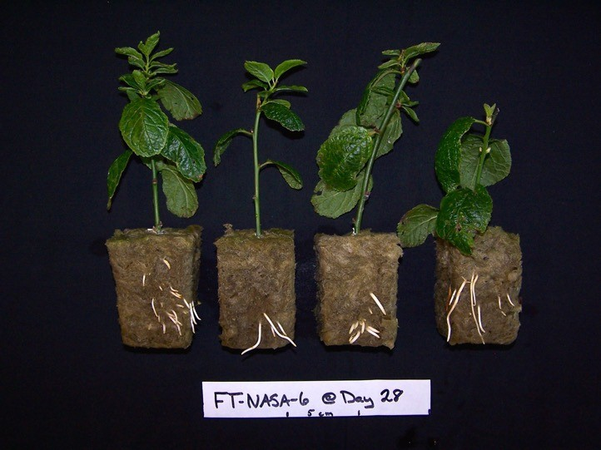
Dwarf Plum Testing
USDA-NASA Collaboration
USDA ARS Developed
Overexpressed FT1 gene
Grows from cutting
to flower to fruit in < 1 yr
& no dormancy requirement
Srinivasan et al., 2012, PLOS ONE; Graham et al., 2015 Grav. Space Research

Slide 15
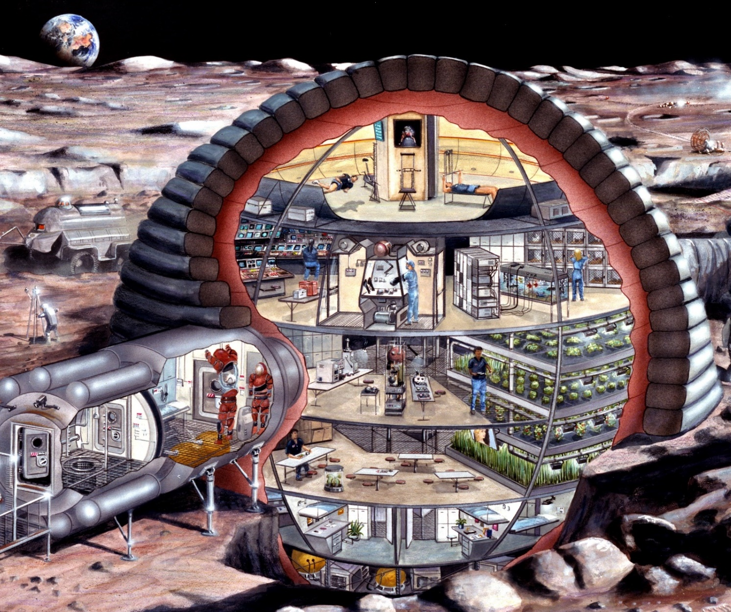
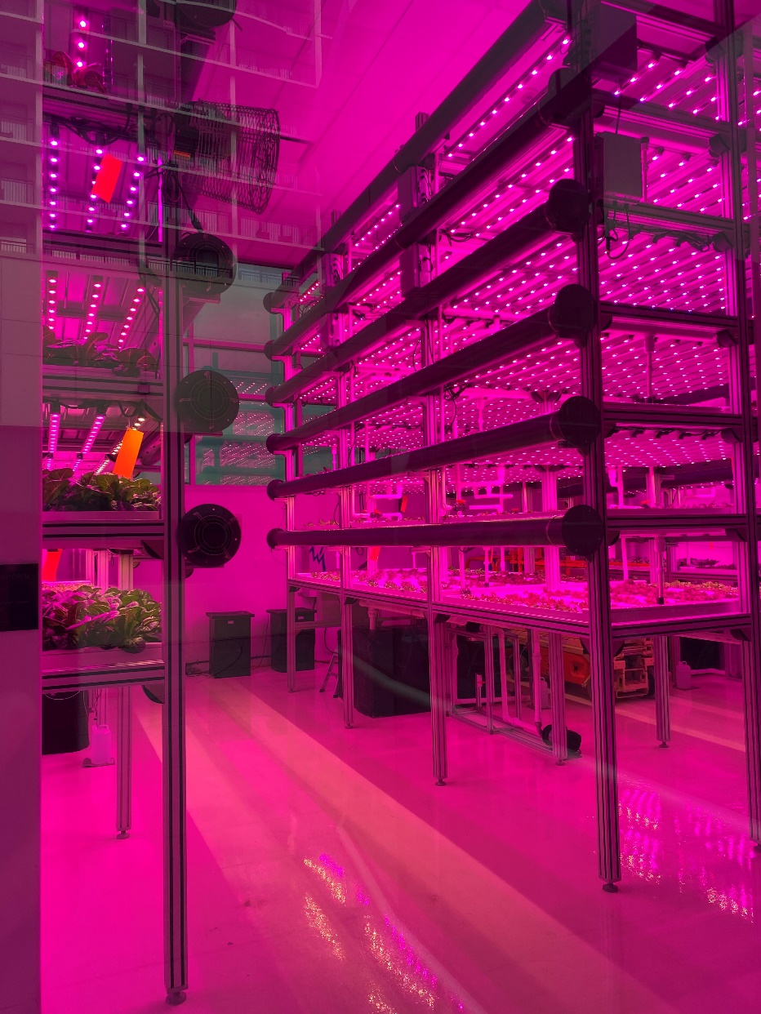
Thank you!

Slide 16
Backup

Slide 17
Proposed Crop Readiness Level
Level | Title | Description
1 | Basic Crop Testing | Identification of candidate crop at cultivar level. Preliminary assessment of morphology, yield, and propagation.
2 | Cultivar Screening | More focused testing of plant dimensions under optimal growth, propagation, pollination and germination requirements identified, harvest parameters quantified.
3 | Space-like Environment Testing | Testing at relevant spaceflight environmental conditions. For ISS-like environment: 3000 ppm CO₂, 22˚ C, 40-50% RH, LED lighting. Adverse physiological responses identified.
4 | Seed Sterilization | Identification of acceptable seed surface sterilization protocol.
5 | Flight-like Testing | Testing in flight or flight-analog hardware at flight environmental setpoints.
6 | Chemistry & Organoleptic | Elemental and mission-specific nutritional testing conducted under flight-like conditions. Organoleptic and sensory analysis conducted.
7 | Baseline Microbiology | Baseline microbiological and food safety characterization conducted under flight-like conditions.
8 | Grown in Space | Crop successfully grown to maturity in space.
9 | Consumed in Space | Sanctioned consumption of crops by crew in space.

