Slide 1
Diversity and Inclusion and the Human Research Program
Maneesh Arya, Ph.D.
Human Factors and Behavioral Performance
Human Research Program
NASA Johnson Space Center

Slide 2
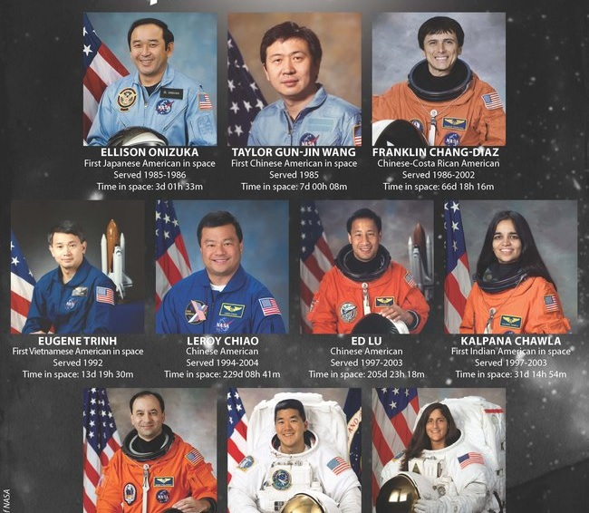

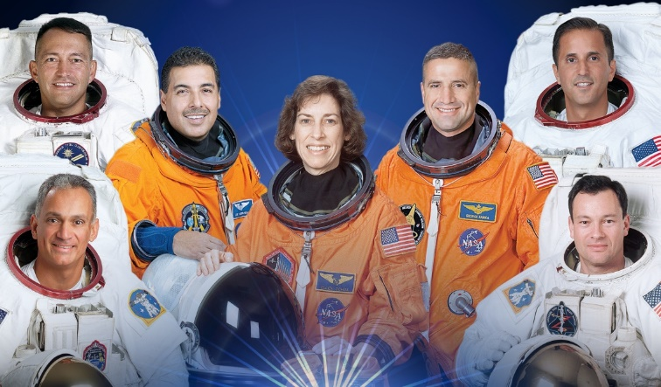
Value of Diversity and Inclusion
NASA has long recognized diversity and inclusion as vital components of mission success
NASA aims to foster an atmosphere of inclusion and respect for all to drive innovation, creativity, and engagement
NASA must attract, fully utilize, and retain the best talent to design creative and innovative technical and organizational solutions to achieve its mission
Agency stakeholders include the U.S. Congress, the commercial space industry, the American public, and ultimately all of humankind

Slide 3
HRP Diversity & Inclusion Initiative
Internal initiative exploring how HRP can improve and expand on D&I within internal, programmatic, and external avenues.
Purpose:
  Foster inclusion and innovation within the Human Research Program, and via a transparent, collaborative, and adaptive culture and environment where all team members feel heard, respected, and valued.
Goals:
  Be a resource and ally for HRP employees on the topics of D&I
  Offer employees access to leadership and professional growth opportunities and unique training on D&I topics
  Establish relationships with institutes that reaches past outreach – mentorships, tours, etc, and work towards implement MSI focused grants

Slide 4
HRP New Investigator Award
Introduced in 2014 as Basic Investigations for New Investigators in Omnibus Appendix
Intent is to solicit novel research ideas that might not be directly aligned with HRP’s identified risks from new investigators to HRP
Renamed in 2020 to New Investigator Award
Requests proposals focusing on any aspect of human adaptation to space flight
Particularly interested in innovative proposals and the potential for results to deliver new tools, techniques, or knowledge that could lead to novel breakthroughs
Funding opportunity is open to new investigators only
  PI must not have had HRP, NSBRI, NASA Established Program to Stimulate Competitive Research (EPSCoR), or TRISH funding in last ten years
  Does not apply to other team members

Slide 5
HRP Early Career Investigator Award
Introduced in 2020 as part of Omnibus Appendix to help more junior scientists contribute to the HRP mission
Restricted to PIs who have completed their terminal research degree or end of post-graduate clinical training, whichever date is later, in the last ten years and have not previously been a PI on HRP, NSBRI, NASA EPSCoR, or TRISH grant
Solicits research on any aspect of human adaptation to spaceflight
Award - $150,000 for one year
Eligible for a one-year costed extension dependent on exceptional progress and results

Slide 6
Minority University Research and Education Project (MUREP)
NASA provides financial assistance via competitive awards to Minority Serving Institutions such as:
  Historically Black Colleges and Universities
  Hispanic Serving Institutions
  Asian American and Native American Pacific Islander Serving Institutions
  Alaska Native and Native Hawaiian-Serving Institutions
  American Indian Tribal Colleges and Universities
  Native American-Serving Nontribal Institutions
Four pillars of investment and engagement:
  Research infrastructure and capacity building
  Curriculum development and service provider resources
  Student engagement
  Partnerships and sustainability

Slide 7
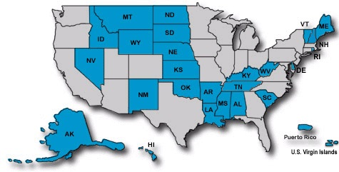
Established Program to Stimulate Competitive Research (EPSCoR)
Establishes partnerships with government, higher education and industry that are designed to eaffect lasting improvements in a state’s or region's research infrastructure, research and development capacity and its national R&D competitiveness
Program is directed at those jurisdictions that have not participated equably in competitive aerospace and aerospace-related research activities
Five federal agencies, including NASA, conduct EPSCoR programs

Slide 8
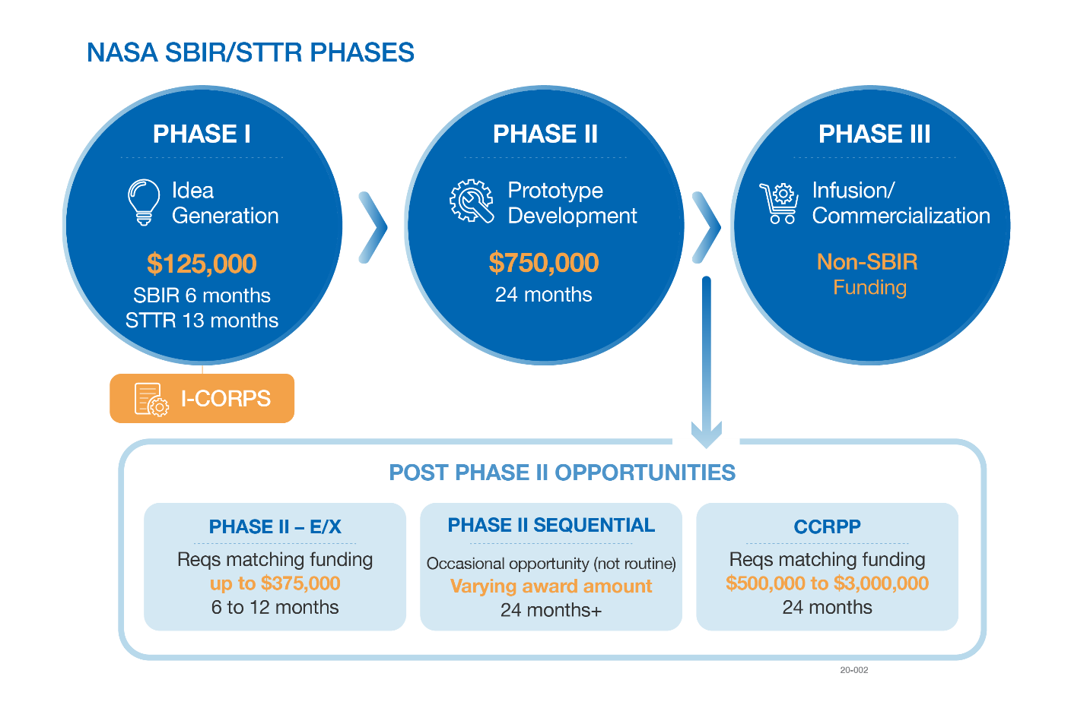
Small Business Innovation Research (SBIR)
Funds the research, development, and demonstration of innovative technologies that fulfill NASA needs as described in the annual Solicitations and have significant potential for successful commercialization

Slide 9
Resources
NSPIRES
  https://nspires.nasaprs.com/external/
Current HRP solicitation
  https://tinyurl.com/HERO21OVERVIEW
NASA MUREP
  https://www.nasa.gov/stem/murep/home/index.html
NASA EPSCoR
  https://www.nasa.gov/stem/epscor/home/index.html
NASA SBIR
  https://sbir.nasa.gov/

Slide 10


