Slide 1
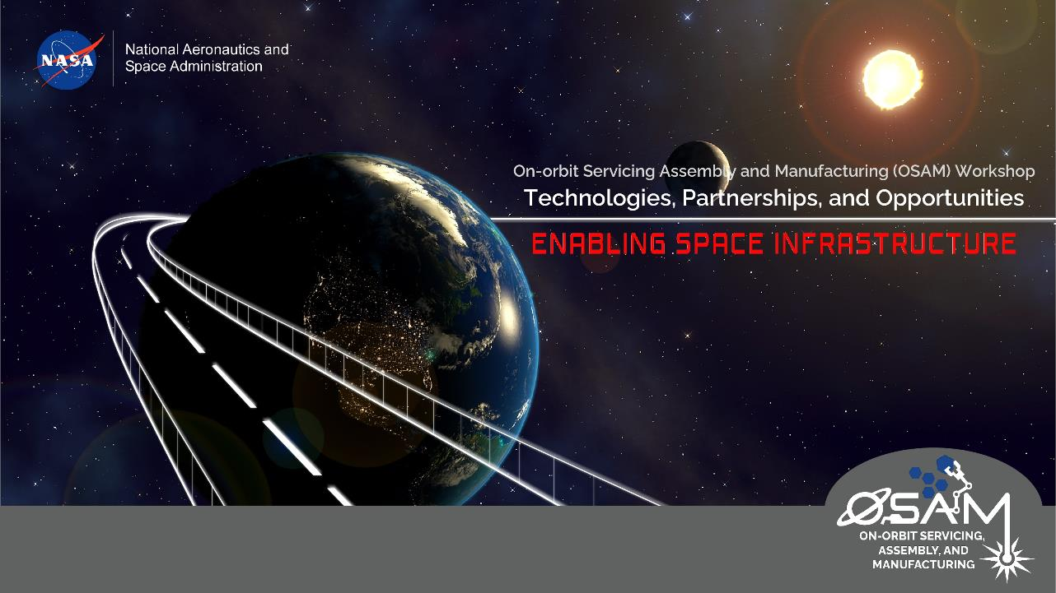
Autonomous Surface Excavation, Construction, & Outfitting (ECO)
B. Danette Allen, PhD
Senior Technologist (ST) for Intelligent Flight Systems
Deputy Lead for Autonomous Systems SCLT

Slide 2

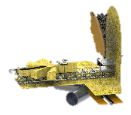
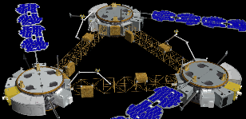

OSAM is a Big Umbrella → Assembly
Broader Definition of “Assembly”
In-Space Assembly
Persistent Space Assets
  Transport
  Observatory
  Platforms
Persistent Surface Infrastructure
  Habitats and Safe Havens
  Autonomous Mobility
  Launch and Landing
  Power and Data Distribution
Autonomy
Structures and Materials
Modeling and Simulation
System Architecture and Analysis

Slide 3
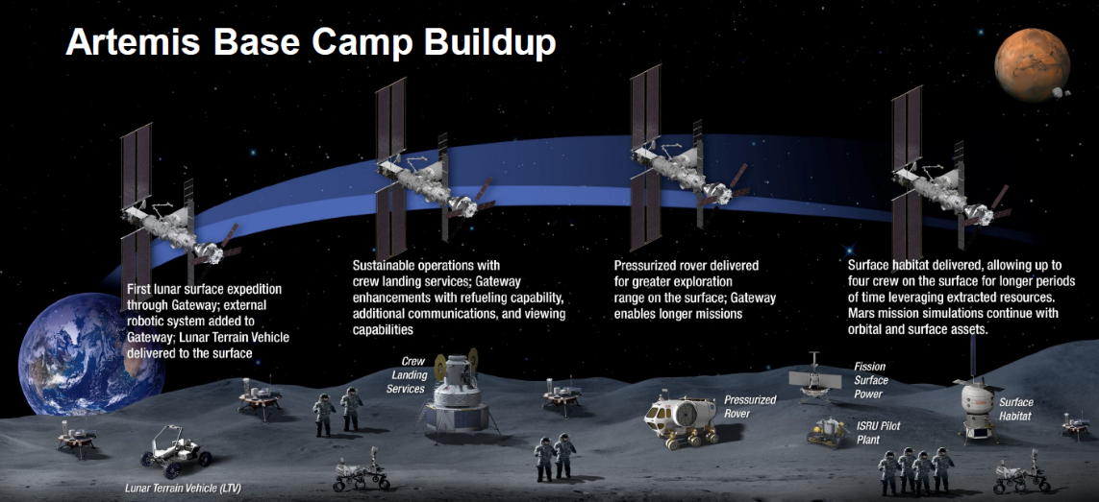

Artemis: Lunar Excavation, Construction, & Outfitting
Sustainable Off-Earth Living & Working
ECO
Construction
Excavation
Outfitting

Slide 4
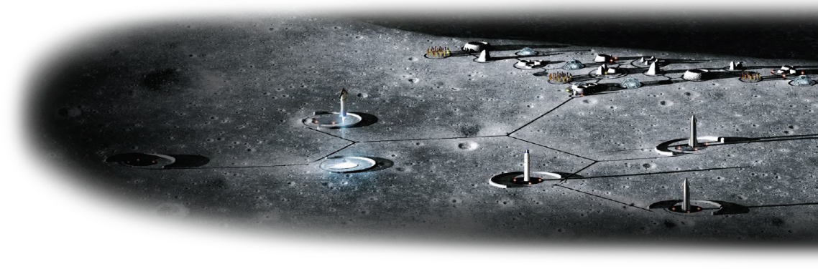
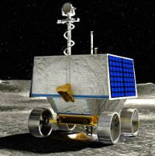
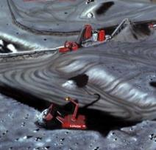
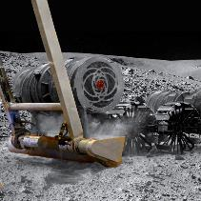
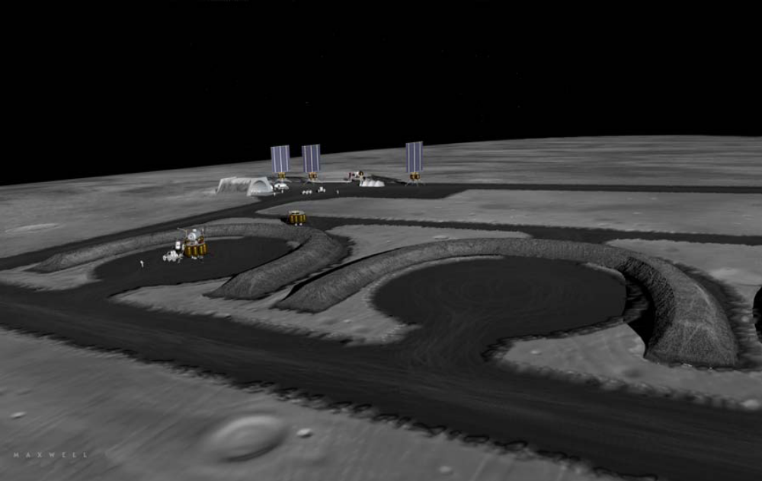
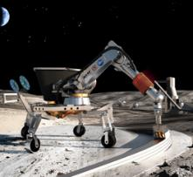
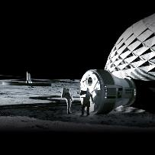
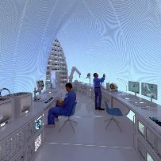
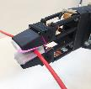

Autonomous Lunar Excavation, Construction, & Outfitting
targeting landing pads, structures, habitable buildings… utilizing in-situ resources
Credit: Dr. Mark Hilburger
Excavation for ISRU-based Resource Production
Sustainable Off-Earth Living & Working
Excavation for Construction
Construction and Outfitting
Notes:
GENERAL SLIDE TEMPLATE

Slide 5
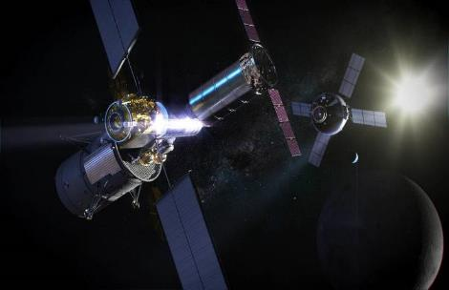


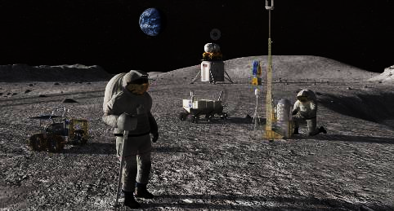
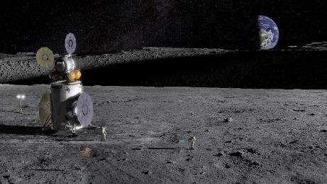
Performance, Pace, & Persistence
Autonomy

Slide 6

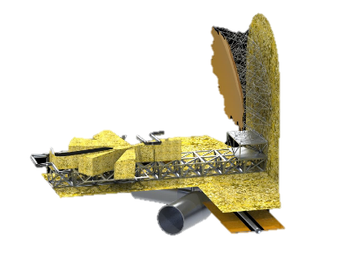
Autonomous In-Space Assembly of a 20m telescope
iSAT Study (2019)

Slide 7
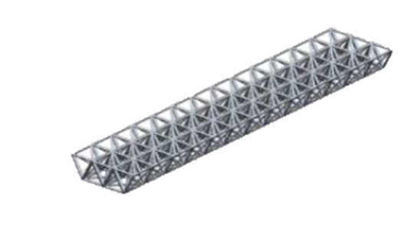
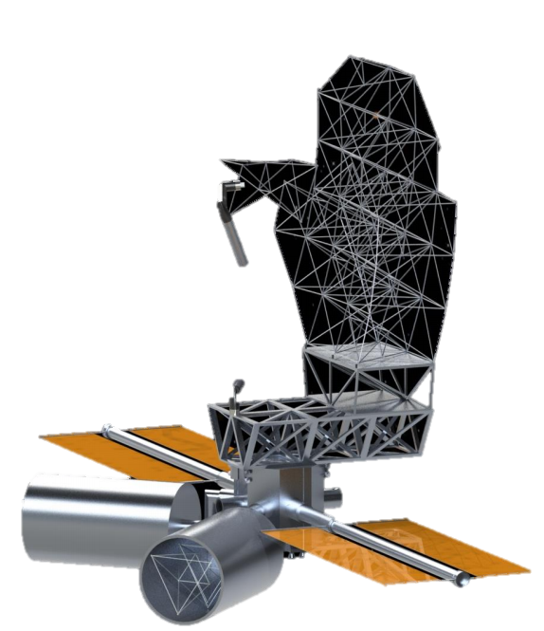


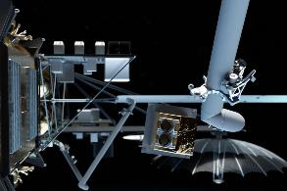
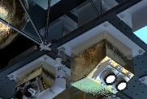
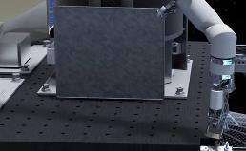
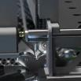
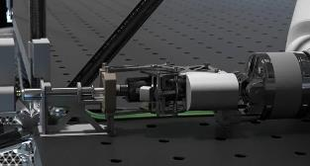
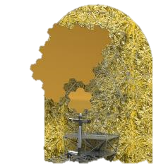

Autonomous In-Space Assembly of a 20m telescope
iSAT Study (2019)
Tri-Truss
Assembly of truss(es) to form primary mirror structure
①
Metering
Truss
③
Inertial
Transfer
⑧
②
③
④
⑦
Precision placement and joining of trusses/payloads
⑤
⑥
Wire Harness
and Fluid Line Placement
Installation of hexagonal mirrors on truss assembly
Connector Mating and De-mating

Slide 8
Autonomous In-Situ Assembly of a 20m telescope
Autonomous In-Space Assembly of a 20m telescope
iSAT Study (2019)
Tri-Truss
Assembly of truss(es) to form primary mirror structure
①
Metering
Truss
③
Inertial
Transfer
⑧
②
③
④
⑦
Precision placement and joining of trusses/payloads
⑤
⑥
Wire Harness
and Fluid Line Placement
Installation of hexagonal mirrors on truss assembly
Connector Mating and De-mating

Slide 9
Autonomous In-Situ
Assembly of a Lunar Base
iSAT Study (2019)
Tri-Truss
Assembly of truss(es) to form primary mirror structure
①
Metering
Truss
③
Inertial
Transfer
⑧
②
③
④
⑦
Precision placement and joining of trusses/payloads
⑤
⑥
Wire Harness
and Fluid Line Placement
Installation of hexagonal mirrors on truss assembly
Connector Mating and De-mating

Slide 10
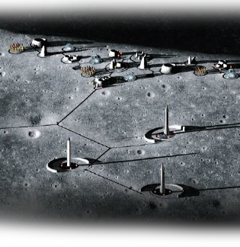
Autonomous In-Situ Assembly of a Lunar Base
iSAT Study (2019)
Tri-Truss
Assembly of truss(es) to form primary mirror structure
①
Metering
Truss
③
Inertial
Transfer
⑧
②
③
④
⑦
Precision placement and joining of trusses/payloads
⑤
⑥
Wire Harness
and Fluid Line Placement
Installation of hexagonal mirrors on truss assembly
Connector Mating and De-mating

Slide 11

Autonomous In-Situ Assembly of a Lunar Base
?
?
?
?
?
?
?

Slide 12
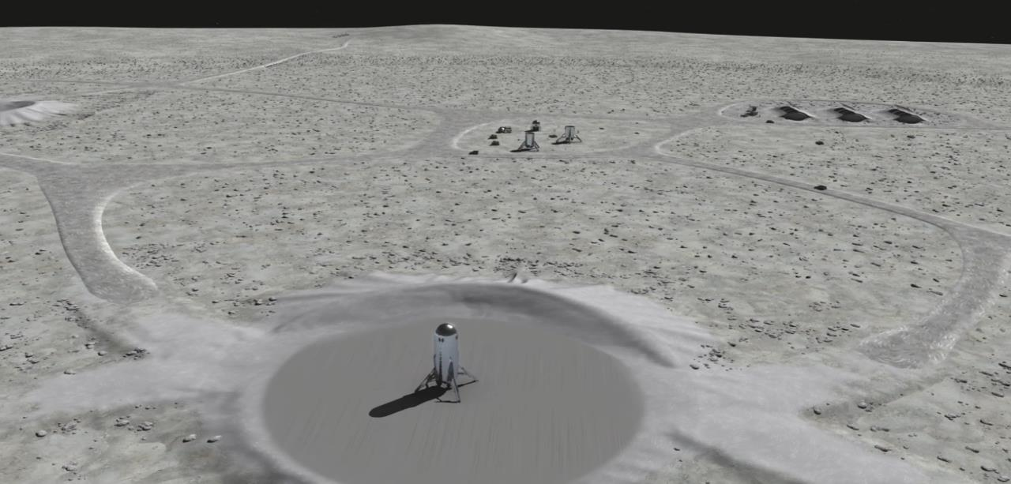
Autonomous ISA of a Lunar Base
?
?
?
?
?
?
?
?
?
?
?
?
?
?

Slide 13
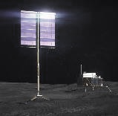
Autonomous ISA of a Lunar Base: Power/Comms
?
?
?
?
?
?

Slide 14
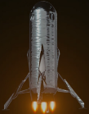
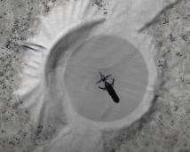
Autonomous ISA of a Lunar Base: Supplies
?
?
?
?
?

Slide 15
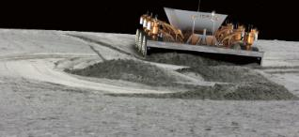
Autonomous ISA of a Lunar Base: Excavation
?
?
?
?

Slide 16
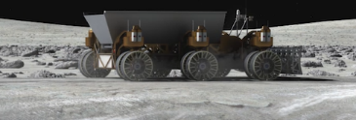
Autonomous ISA of a Lunar Base: Transport
?
?
?

Slide 17
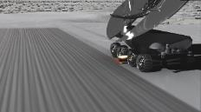

Autonomous ISA of a Lunar Base: Construction
?
?

Slide 18
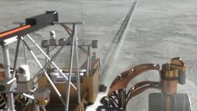
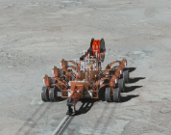
Autonomous ISA of a Lunar Base: Outrigging
?

Slide 19
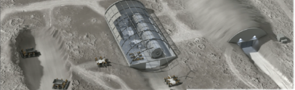
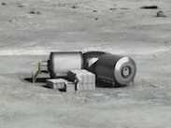
Autonomous ISA of a Lunar Base: Habitats/Havens

Slide 20

Autonomous In-Situ Assembly of a Lunar Base
Sustainable Off-Earth Living & Working

Slide 21

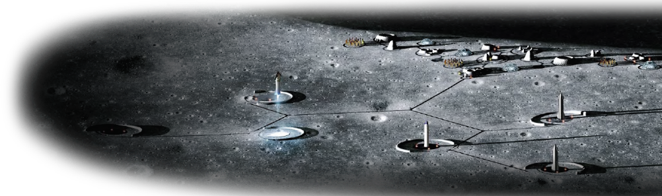
What about Autonomy?
In-Space Assembly ≈ On-Surface Assembly
→ In-Situ Assembly ←

Slide 22
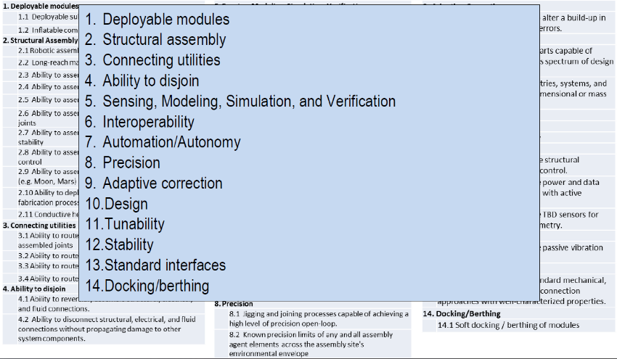
ISA Capability Needs
https://www.nasa.gov/sites/default/files/atoms/files/snt_partnership_1_-_aiaa_space_2018.pdf

Slide 23
ISA Capability Needs
Autonomy-enabling capabilities across all Capability Needs
https://www.nasa.gov/sites/default/files/atoms/files/snt_partnership_1_-_aiaa_space_2018.pdf

Slide 24
ISA Capability Needs
https://www.nasa.gov/sites/default/files/atoms/files/snt_partnership_1_-_aiaa_space_2018.pdf

Slide 25
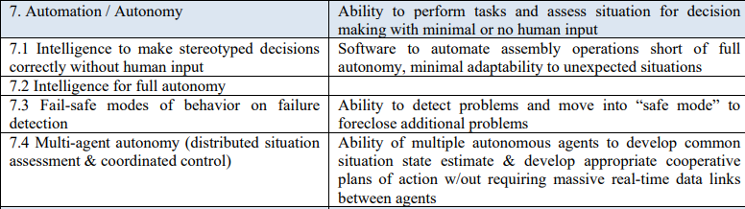
ISA Capability Needs
https://www.nasa.gov/sites/default/files/atoms/files/snt_partnership_1_-_aiaa_space_2018.pdf

Slide 26

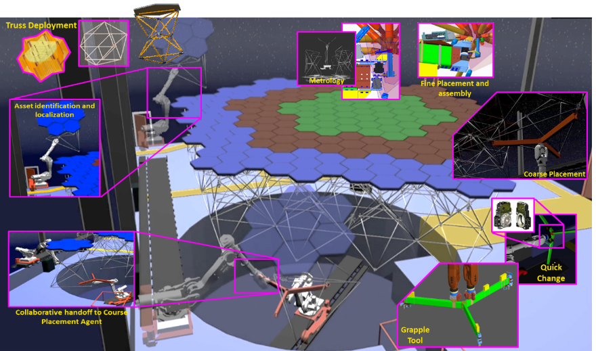
ISA Capability Needs – In Space
Autonomous Modular Assembly of 20m-class Path-to-Flight Mirror Backbone Structure w/ Simulated Mirrors and Wiring Harness

Slide 27
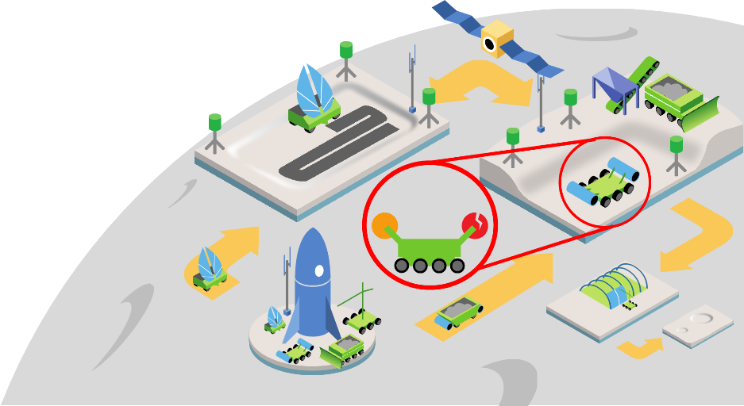







ISA Capability Needs – On Surface
MMPACT
ISC
Landing, Deployment, and Initialization
Site Survey and Navigation
Landing Pad Construction
Excavation
Inspection and Monitoring
Maintenance and Repair
Continuous Autonomous Tasking
Lunar Surface Excavation, Construction, and Outfitting (ECO)
Credit: Dr. Walter Waltz

Slide 28
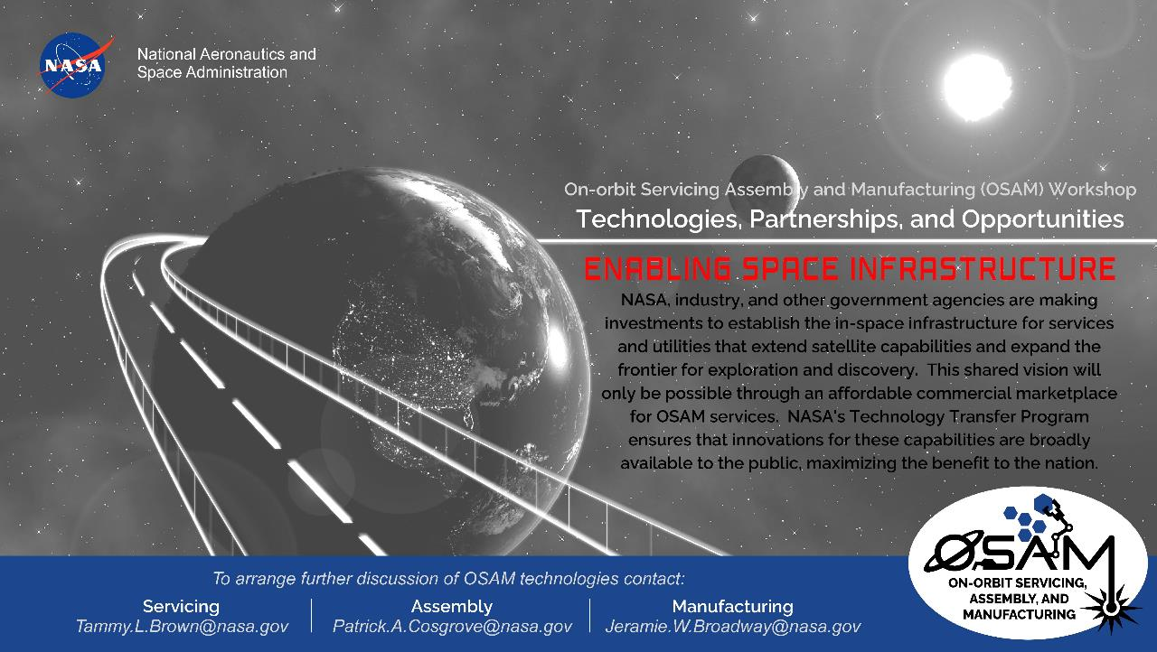
Autonomous Systems
danette.allen@nasa.gov
Space is vast. For the most part, when a satellite is launched, it's on its own, regardless of whether it ever needs assistance or not. It launches, operates, and is decommissioned alone, its lifespan limited by consumables, imperfect human design, the exceedingly harsh space environment, and technical obsolescence. But what if we could fix, upgrade, and augment existing satellites to enable more science for longer? Technically and economically feasible refueling, repair, and upgrade of satellites has remained elusive—until now. OSAM technology will enable more science by assisting existing telescopes, but also lay the groundwork for future endeavors once thought to be impossible.

Slide 29
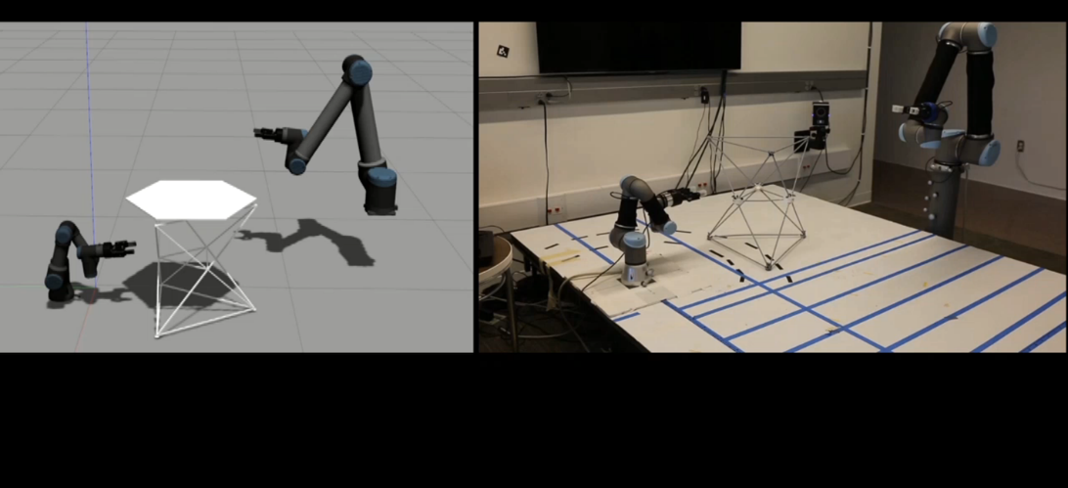
Questions?
Credit: Sherif Shazly
Autonomous Robotic Multi-Agent Collaborative Operations
Sim-To-Flight & Digital Twin
danette.allen@nasa.gov

