Slide 1

2021 NASA System Analysis Symposium
Introduction
Sharon Monica Jones, PhD
Manager, Systems Analysis and Decision Support
Portfolio Analysis and Management Office (PAMO)
NASA Aeronautics

Slide 2
Systems Analysis Symposium
Objectives
An annual gathering of NASA’s system analysis researchers, analysts and their colleagues to exchange results and views about strategic aeronautics related issues
To distribute results of strategic systems analysis studies to the NASA Aeronautics Research Mission Directorate (ARMD)
To obtain peer review about study assumptions and conclusions
To get feedback from the NASA Aeronautics community prior to writing final reports that support ARMD strategic planning activities
To generate ideas for possible future strategic studies needed by ARMD
Symposium Objectives

Slide 3


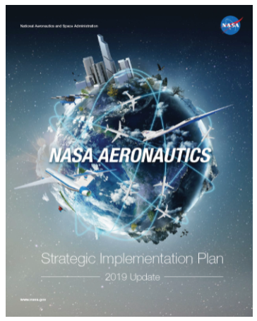







Aeronautics Research Mission Directorate
Strategic Overview
Strategic Implementation Plan
Mega Drivers
Strategic Thrusts
Safe, Efficient Growth in Global Operations
Innovation in Commercial Supersonic Aircraft
Ultra-Efficient Subsonic Transports
Safe, Quiet, and Affordable Vertical Lift Air Vehicles
In-Time System-Wide Safety Assurance
https://www.nasa.gov/aeroresearch/strategy
Assured Autonomy for Aviation Transformation

Slide 4
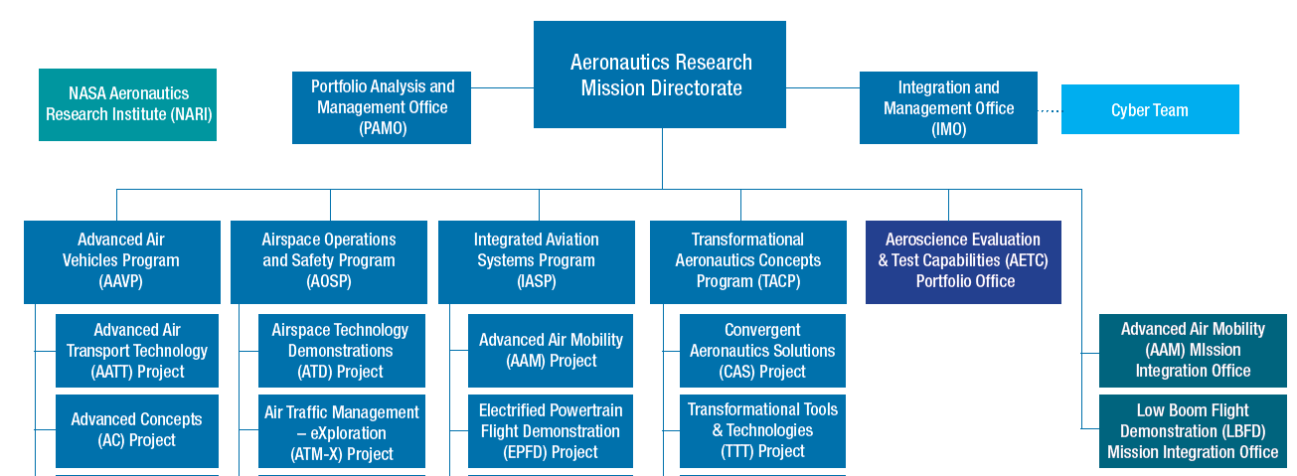
Aeronautics Research Mission Directorate
Where is PAMO in ARMD?
Portfolio Analysis and Management Office (PAMO)
Director
William Harrison
Strategy (PAMO-S)
Team Lead
Naseem Saiyed
Resources (PAMO-R)
Team Lead
Cathy Delaney
ARMD
Systems Analysis/
Decision Support
Dr. Sharon Monica Jones
ISAT Leadership Group
Dr. Sharon Monica Jones Phil Arcara (LaRC) Dr. Susie Go (ARC) Xiao-Yen Wang (GRC) | Dr. Eric Hendricks (GRC) Ty Marien (LaRC) Mark Guynn (LaRC) Jon Seidel (GRC)
Intercenter Systems Analysis Team (ISAT)
Team Lead
Dr. Eric Hendricks (GRC)

Slide 5
Systems Analysis and Decision Support
Strategic Systems Analysis Overview
SYSTEMS ANALYSIS =
OPERATIONS RESEARCH + POLICY ANALYSIS + DATA ANALYTICS
Strategic Systems Modeling and Analysis
To identify trends that may impact ARMD strategy
through the use of systems analysis models and methods
Strategic Portfolio Analysis
To use systems and portfolio analysis methods to identify strengths, alternatives and gaps in ARMD’s portfolio for strategic decisions
Strategic Data Analysis
To identify trends that may impact ARMD strategy
by analyzing aeronautics technology, business intelligence and/or aviation data
ISAT
Lead, Eric Hendricks
High Level Systems and Data Analysis
Lead, Sharon Monica Jones

Slide 6
Systems Analysis and Decision Support
Team Members
Intercenter Systems Analysis Team (ISAT)
Lead, Dr. Eric Hendricks and GRC POC
Systems Analysis and Conceptual Modeling Conceptual Level SMEs
LaRC POC, Fleet Analysis and Advanced Concepts (supersonic/hypersonic) Ty Marien Safety and Autonomy Dr. Ersin Ansel* Acoustics, Propulsion Jeff Berton* ATM/Airspace Paul Borchers and Jerry Smith Certification, MBSE, Electric Aircraft and Advanced Concepts Dr. Nick Borer and Nat Blaesser AAM/UAMs Dr. Michael Patterson* and Jerry Smith* Supersonics/Hypersonics, and Fleet Analysis Jon Seidel and Dr. Wu Li Propulsion, Fuels and Rotary Wing Analysis Chris Snyder
High Level Systems and Data Analysis
Lead, Dr. Sharon Monica Jones
Statistical Modeling and Analysis Top Down Systems Analysis
Data and Trend Analysis Bailey Ethridge (AMA) High Level Systems Analysis Dell Ricks (AMA) Safety, Multi-Modal and Manufacturing Systems Dr. Larry Barr (Volpe) Dr. Seamus McGovern (Volpe) Life Cycle Cost and Policy Analysis Jacob Wishart (Volpe) David Pace (Volpe) Max Litvack-Winkler (Volpe) Kendall Mahavier (Volpe) Gina Solman (Volpe)
*FTE support not provided by PAMO Systems Analysis/ISAT

Slide 7
Strategic Systems Analysis
Categories of Activities
Mega Drivers
What’s Next
Just In Time
Strategic systems analyses to support the two-year ARMD Strategic Implementation Plan (SIP) update cycle
Internal capability to answer strategic questions that are necessary for annual strategic planning discussions and other ARMD strategy tasks
Includes all types of strategic systems analyses
Investigates new concepts that yield compelling benefits in a particular focus area
Goal is to provide some benefit over state-of-the-art to motivate technical challenges and spur new approaches
Outputs include trends, scenarios, ideal characteristics and assumptions

Slide 8
Wednesday, November 10, 2021
Symposium Agenda
TIME | TOPIC | PERSON
10:00 AM – 10:20 AM | INTRODUCTION
10:00 AM – 10:10 AM | Welcome | Steve Clarke, ARMD Deputy Associate Administrator
10:10 AM – 10:20 AM | Objectives/Agenda | Sharon Monica Jones (PAMO), Manager, ARMD System Analysis
10:20 AM – 12:00 PM | ISAT
10:20 AM – 10:30 AM | Intercenter Systems Analysis Team (ISAT) | Eric Hendricks (GRC), ISAT Lead
10:30 AM – 11:00 AM | "What's Next" for Airworthiness Certification Regional Mobility | Nick Borer (LaRC)
11:00 AM – 11:30 AM | Strategic Systems Modeling and Analyses Global Demand Modeling Study High-Speed Market Studies | Ty Marien (LaRC) Jon Seidel (GRC)
11:30 AM – 12:00 PM | H2 / DeCarbonization Studies: History and Ongoing | Chris Snyder (GRC)
12:00 PM – 12:30 PM | LUNCH

Slide 9
Wednesday, November 10, 2021 (cont’d)
Symposium Agenda
TIME | TOPIC | PERSON
12:30 PM – 2:00 PM | HIGH LEVEL SYSTEMS ANALYSIS
12:30 PM – 1:00 PM | Just-in Time Systems and Market Analyses | Seamus McGovern (Volpe)
1:00 PM – 1:45 PM | COVID-19 Impact on Domestic Commercial Aviation: Multi-Modal Economic Analysis Policy Analysis | Max Litvack-Winkler (Volpe) Gina Solman (Volpe)
1:45 PM – 2:00 PM | BREAK
2:00 PM – 3:30 PM | PROGRAM AND MISSION LEVEL SYSTEMS ANALYSIS
2:00 PM – 2:30 PM | Analysis of the Electrical Grid for UAM | David Thipphavong (PAMO)
2:30 PM – 3:00 PM | Exploration of Operations Limits and Emissions For Early UAM Missions | Michael Patterson (LaRC) Dan DeLaurentis (Purdue Univ.)
3:00 PM – 3:30 PM | ARMD Model Based Systems Engineering/Analysis Overview | Eric Hendricks (GRC) Jesse Quinlan (LaRC)
3:30 – 4:00 PM | WRAP UP
3:30 – 4:00 PM | Closing Remarks | Eric Hendricks (GRC) Sharon Monica Jones (PAMO)

Slide 10
Systems Analysis Symposium
Meeting Logistics
Question and answer sessions
  Last five to ten minutes of each presentation time slot
  Questions can be submitted via conference i/o tool:
Presenters (MS Teams attendees)
  Please keep microphones muted
  Turn off camera when not speaking
  Use the “raise your hand” feature and wait to be acknowledged by Moderator
  Agency employees can access symposium slides on the internal ARMD SharePoint
https://arc.cnf.io/
(select the ARMD System Analysis Symposium session)

Slide 11

SignOffPage
Notes:
NASA Presentation Sign-Off Page

