Slide 1
Multi-Modal Economic Analysis of the COVID-19 Pandemic Exogenous Shock
ARMD Systems Analysis Symposium
Max Litvack-Winkler
Economist, Economic Analysis Division, Volpe Center
November 10, 2021

Slide 2
Background and Introduction
Volpe Center is conducting a COVID-19 Impact Study in support of NASA’s Aeronautics Research Mission Directorate
  Analyze COVID-19’s effect on various modes of transport and economic indicators, including insights on modal resiliency
This presentation illustrates results of passenger and freight multimodal trends in relation to economic indicators before and during the COVID-19 pandemic through Q1 2021
  Focus on the aviation market
Notes:
To provide some quick background before beginning the presentation, Volpe Center…
It is important to note these results are preliminary, the pandemic is still ongoing, and more trends will take shape as the pandemic continues

Slide 3
Agenda
Relationship between economic indicators and transportation activity
Overview of transportation activity in the 21st century prior to COVID-19
Impact of COVID-19 on transportation activity
Economic indicator/transportation activity analysis
Resiliency
Notes:
The agenda for this presentation is I will dissect the relationship between economic indicators and transportation activity, provide a high-level overview of transportation activity in the 21st century prior to COVID-19, and then discuss the impact of COVID-19 on transportation activity. I will then share a couple examples analyzing relationships between individual modes and economic indicators, before looking at resiliency and comparing passenger air travel recovery paths during 21st century recessions.

Slide 4
Transportation is a Derived Demand
Growth in Disposable Income and Employment
Increased Household Travel Demand
Higher Levels of Passenger Travel
Growth in GDP and Industrial Production
Increased Demand for Freight
Higher Levels of Freight Activity
Notes:
To start, we will look at the relationship between transportation and the broader economy. Transportation is a derived demand, meaning people demand transportation as a result of their demand for other things.
For example, households travel primarily for work, for recreational purposes like going out to eat, going to the movies, visiting friends/family, etc. Growth in personal disposable income and employment generally lead to increasing household travel demand.
Freight demand results from the consumption of goods, either by the consumer or as inputs to production. Reflecting this, freight activity will typically be higher during periods of economic growth, characterized by rising GDP and industrial production.

Slide 5
Modal Data Dictionary
Mode | Freight/Passenger | Data Metric | Source
Aviation | Passenger | Aviation Revenue Passenger Miles | Bureau of Transportation Statistics
Highway | Passenger | Vehicle Miles Traveled | Bureau of Transportation Statistics
Transit | Passenger | Estimated Unlinked Passenger Trips | American Public Transportation Association
Rail | Passenger | Rail Revenue Passenger Miles | Bureau of Transportation Statistics
Aviation | Freight | Air Revenue Ton Miles of Freight and Mail | Bureau of Transportation Statistics
Truck | Freight | Truck Tonnage Index | Bureau of Transportation Statistics
Rail | Freight | Rail Carloads and Intermodals | Bureau of Transportation Statistics
Maritime | Freight | Monthly Tonnage Indicator | Bureau of Transportation Statistics
Pipeline | Freight | Pipeline Movement | Energy Information Administration

Slide 6
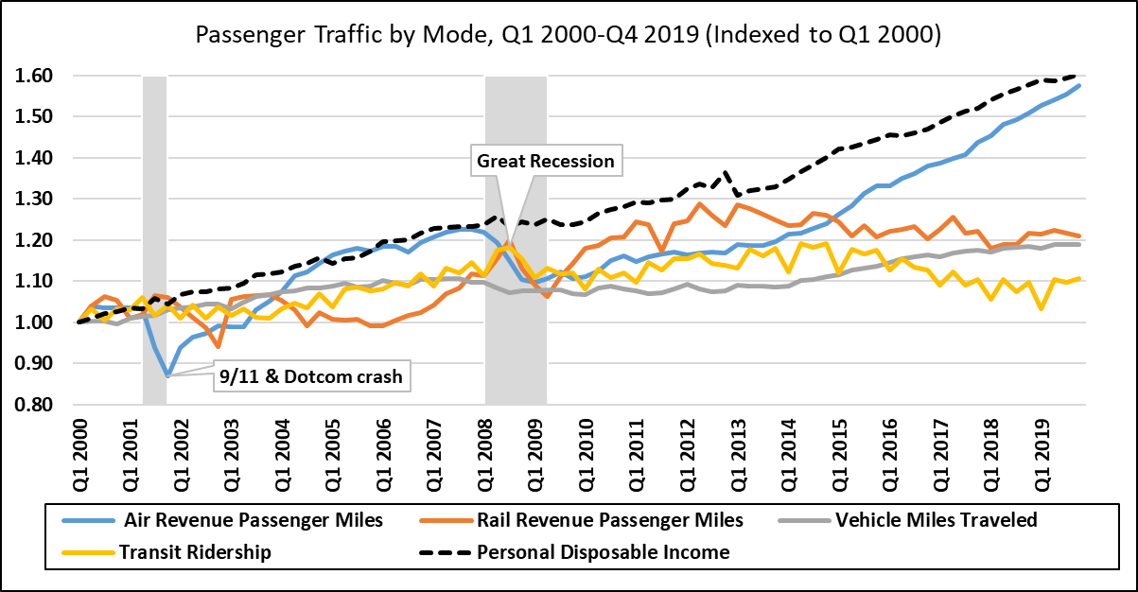
Modal Passenger Activity: Pre-COVID-19
Grey Bars Indicate Recessionary Periods
Notes:
This graph shows passenger modal activity pre-COVID, from 2000-2019, with the grey bars representing recessionary periods and the black dashed line reflecting personal disposable income. Overall, transportation tends to dip during recessions and rise during economic booms. However, individual modal markets can also behave independently.
-Aviation rises the most with a nearly 2.5% annual growth rate during this period, with particularly large growth after both 9/11 + the Dotcom crash and the Great Recession. Rail and VMT experience a roughly 1% annual growth rate, similar to population growth over the time period.
And Transit grows just over 0.5% annually. Transit and rail have been decreasing since 2015. There are a lot of possible reasons for that, but we won’t discuss that in this presentation

Slide 7
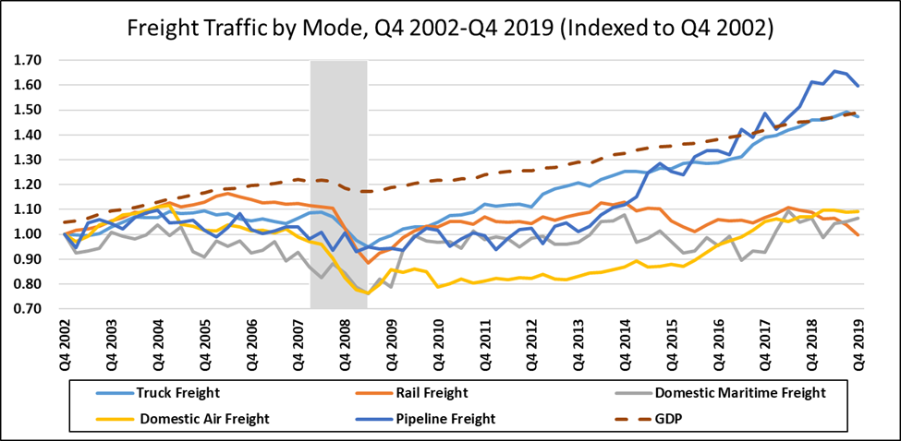
Modal Freight Activity: Pre-COVID-19
Notes:
This is the same graph but for freight, looking at truck, air, rail, pipeline, and maritime modes, with GDP represented by the dashed line. The graph starts in the 4th quarter of 2002 for data-specific reasons in the freight dataset. As with passenger travel, transportation activity tends to dip during recessions and increase during booms. Freight rose following 9/11 and the Dotcom crash before rising oil prices and plateauing GDP in 2006 caused small dips in activity heading into the great recession. After the Great Recession, freight rose overall until 2019, particularly truck freight, the dominant freight mode in the US, and pipeline freight, as the US became more reliant on natural gas instead of coal. The main takeaway here is that the relationship between freight and GDP largely held up over this time period.

Slide 8
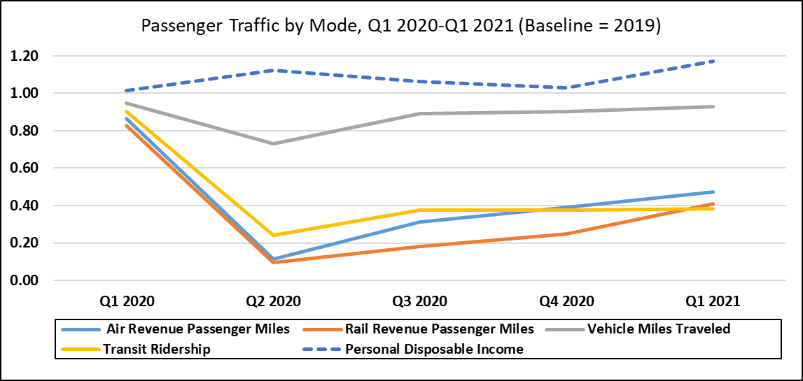
Modal Passenger Activity During COVID-19
Notes:
This graph shows modal passenger activity during COVID-19. As the graph shows, economic and transportation relationships broke down once we got into COVID-19. Passenger activity fell to historically low levels during the pandemic, even as personal disposable income increased due to multiple rounds of government stimulus. This dynamic is because of public health fears over the virus and government lockdowns.
-Transit, Aviation and Rail were particularly hard hit because they are shared modes. Demand for these modes fell as people feared catching the virus, especially early in the Pandemic.
-VMT was more resilient because it is used for short-range travel and is a personal mode of transportation, but overall these modes plummeted in activity.

Slide 9
Decrease in Modal Passenger Travel During U.S. Recessions
Recessionary Period | Air | Rail | Vehicle | Transit
COVID-19 Pandemic | -89% | -90% | -27% | -76%
Great Recession | -11% | -5% | -3% | -3%
9/11 & Dotcom Crash | -16% | -4% | 1% | -2%
Notes:
-This table compares passenger recessionary decreases during COVID-19, the Great Recession, and 9/11+the Dotcom Crash. The figures in the table reflect the percentage decrease between the peak from the year prior to each recession to the trough during each recession, which was the second quarter of 2020 for all modes during the COVID-19 pandemic. The largest drops across recessions are highlighted in red.
As you can see each mode experienced historically low drops during COVID-19, up to 20 or 30x larger than the drops during other recessions. The typical relationship between economic indicators like personal disposable income and transportation activity completely broke down, illustrating the unique nature of the pandemic and the emphasis placed on health and safety.

Slide 10
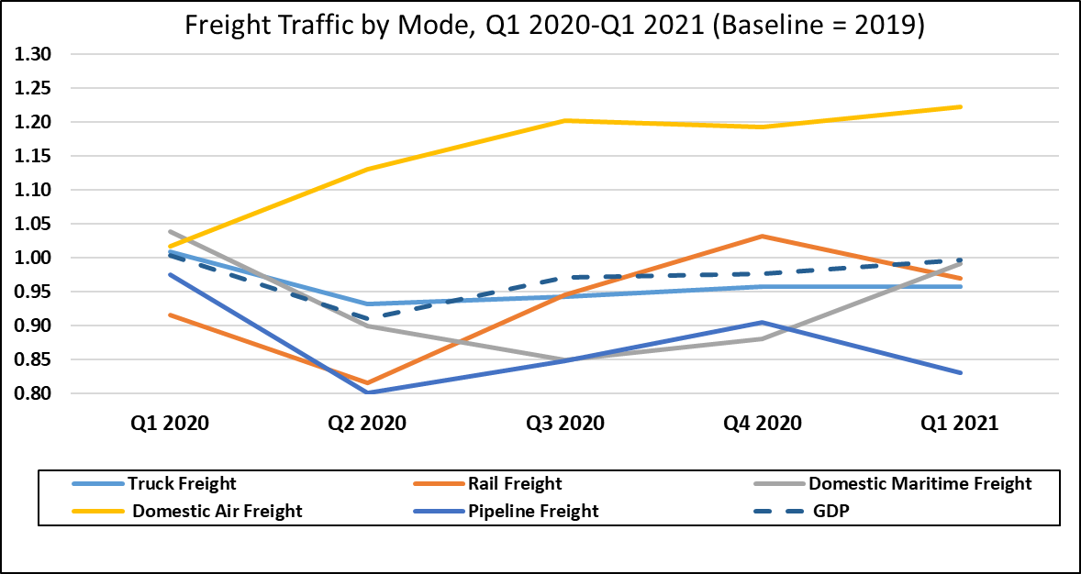
Modal Freight Activity During COVID-19
Notes:
Turning to freight activity during the Pandemic, most freight modes decreased in activity, but not at the historic levels passenger traffic did.
-A spike in online shopping demand and multiple rounds of government stimulus buoyed freight and allowed households to keep consumption high, even as high rates of COVID-19 and supply chain issues gripped the freight market. It is also worth noting the freight market was not restricted to the same level as the passenger market was. Air freight, in yellow, fared particularly well and we will touch on that later.

Slide 11
Decrease in Modal Freight Travel During U.S. Recessions
Recessionary Period | Air | Rail | Truck | Maritime | Pipeline
COVID-19 Pandemic | 2% | -8% | -18% | -16% | -20%
Great Recession | -25% | -11% | -22% | -22% | -10%
9/11 & Dotcom Crash | N/A | 0% | -3% | -7% | -4%
Notes:
-This table compares freight recessionary decreases during COVID-19, the Great Recession, and 9/11+the Dotcom Crash, with the largest decreases highlighted in red. This table shows that freight actually fared better overall during COVID-19 than during the Great Recession. The relationship between economic indicators and freight activity held up much better during the pandemic than the relationship between economic indicators and passenger activity.

Slide 12
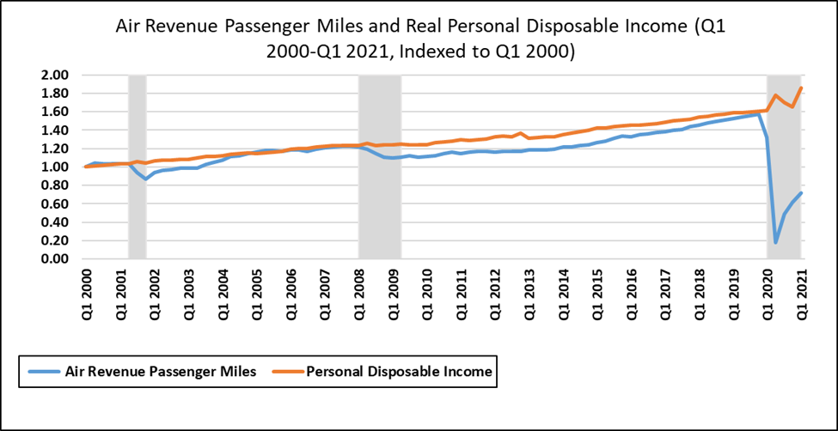
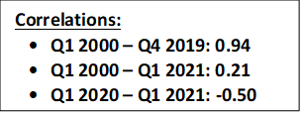
Passenger Air Travel and Real Disposable Income
Notes:
Now lets focus on an individual mode and look at the relationship between passenger air travel and real disposable income. Prior to COVID-19, the two metrics had a strong correlation of 0.94. During COVID-19, this relationship broke down and flipped to -0.50 as personal disposable income went up from government stimulus while passenger air travel decreased due to pandemic factors.

Slide 13
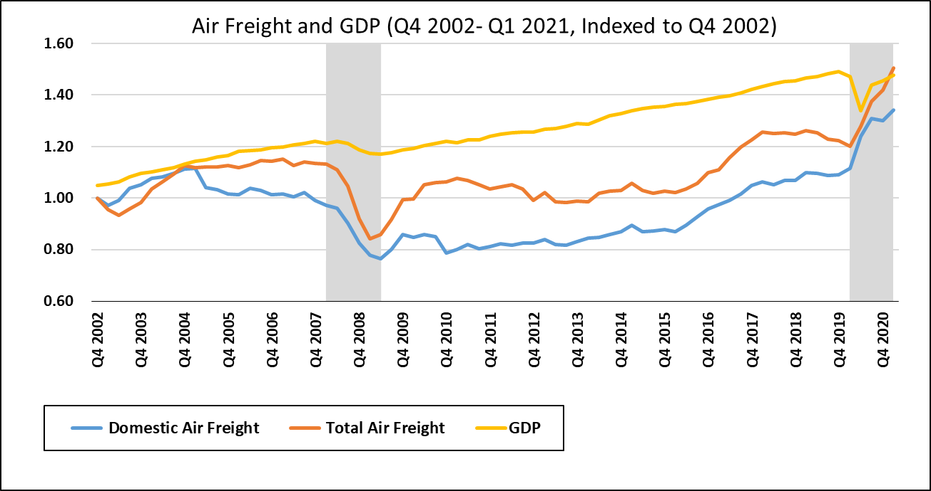
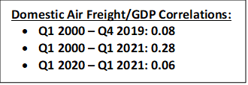
Air Freight and GDP
Notes:
This graph shows the relationship between air freight and GDP from 2002-2019, which was fairly complex during this time period. Domestic air freight is in blue and total air freight is in orange-red. Domestic air freight had a low correlation with GDP over the whole time period, largely due to the period after 9/11. Domestic air freight decreased from 2002-2007, even though total air freight and GDP both increased by 14%. This trend is explained by a structural change in the domestic airline industry that reduced freighter capacity, resulting in a decline in domestic air freight volumes even as the economy was growing. After 9/11, some legacy airlines shut down, reducing belly capacity on passenger aircraft and lowering total cargo volumes. Low-cost carriers capitalized on legacy airlines’ struggles, penetrating the market on domestic short-haul routes and offering low fares. In response to this, many legacy airlines shifted some flights to the international market, further reducing domestic freight capacity, while increasing international air freight capacity. Airlines also increased passenger load factors and started flying smaller regional jets to maximize revenues, lowering belly capacity and air freight volumes even more.
After the great recession, domestic air freight and GDP re-aligned with a strong correlation of 0.92 from Q4 2009-Q4 2019 until the onset of COVID-19 .
During COVID-19, domestic air freight increased 20% during 2020, outpacing GDP, with an especially large spike in Q2 2020. Air freight became a valuable mode for filling supply-chain gaps, transporting high-valued goods and inputs to production such as manufacturing parts and processing chips, and also time-sensitive medical supplies like personal protective equipment (PPE) and then vaccines later on in the pandemic. Mention Gina will go into more detail on policies that enabled this.
Overall, there was lots of structural change early in the time series, the relationship between air freight and GDP strengthened after the Great Recession, and then air freight outgrew GDP during the pandemic as it became well-positioned to fill supply-chain gaps.

Slide 14
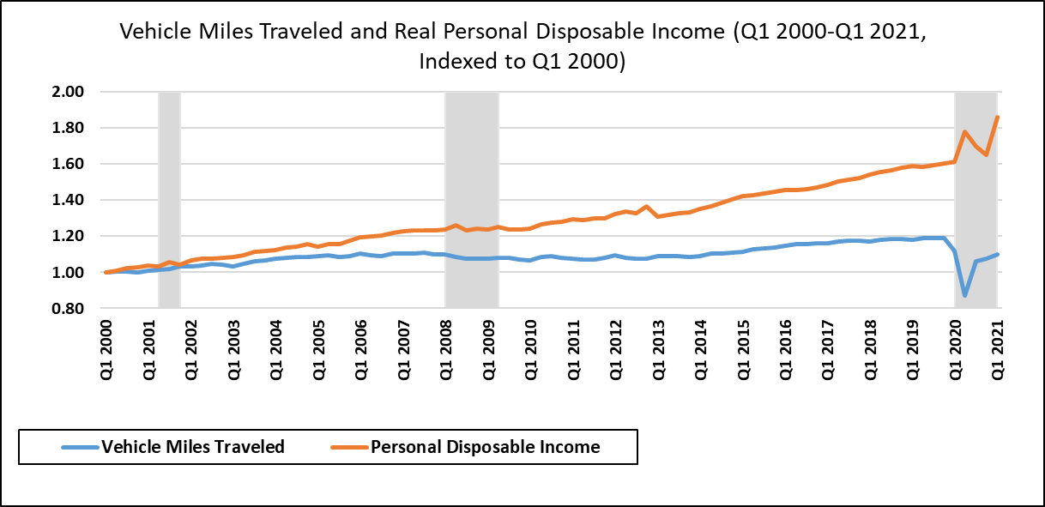
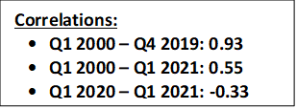
Vehicle Miles Traveled and Real Disposable Income

Slide 15
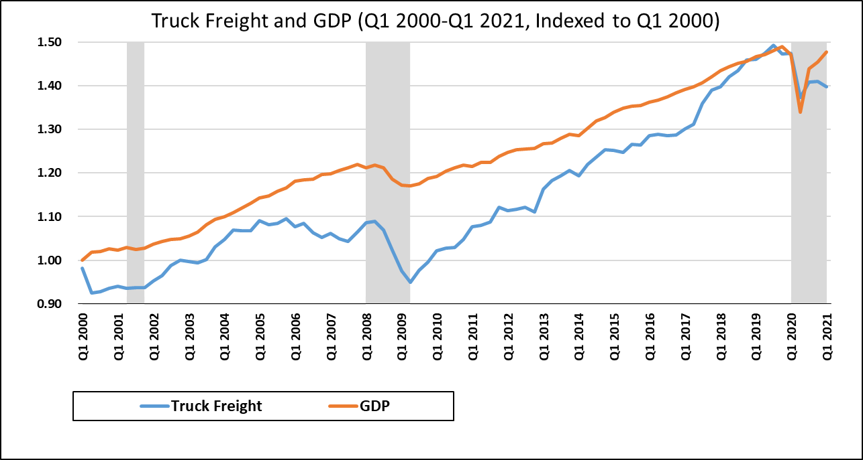
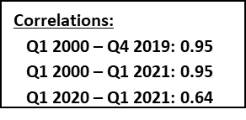
Truck Freight and GDP

Slide 16
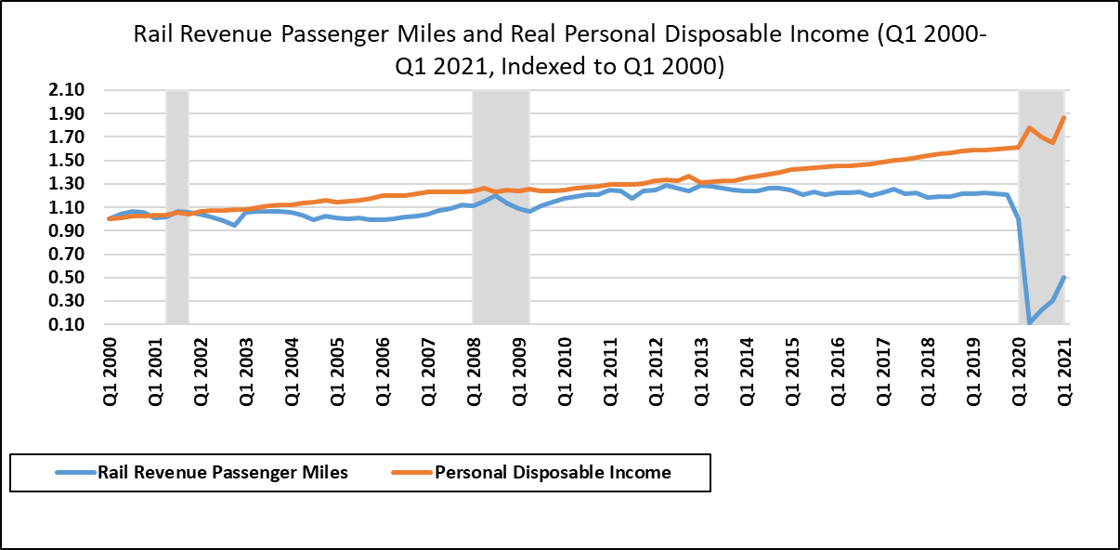
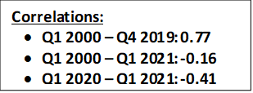
Passenger Rail Travel and Real Disposable Income

Slide 17
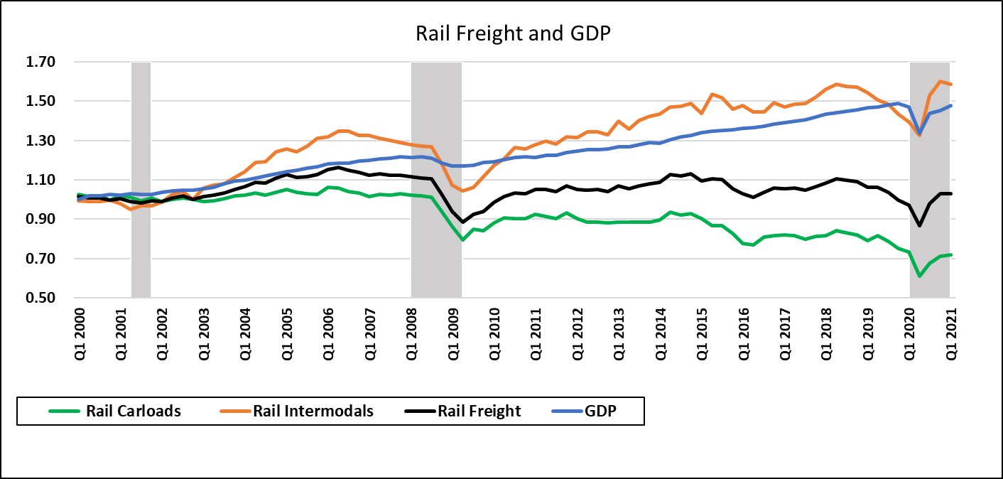
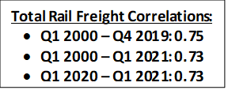
Rail Freight and GDP

Slide 18
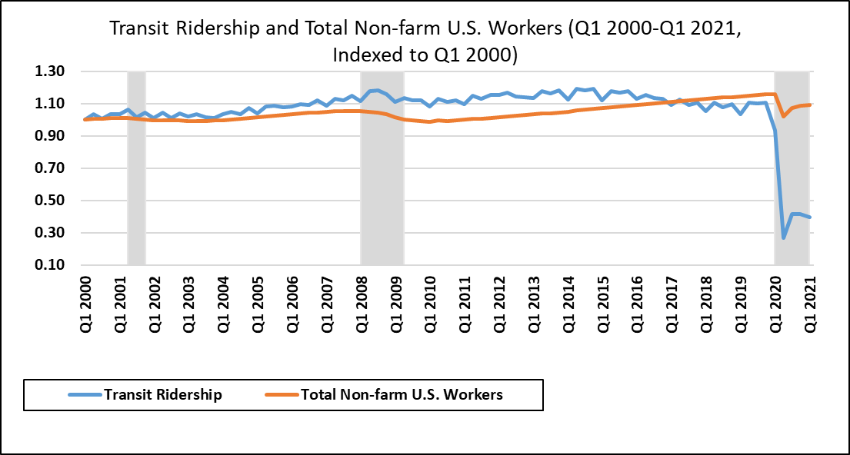
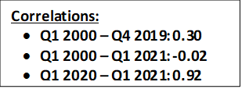
Transit Ridership and Employment

Slide 19
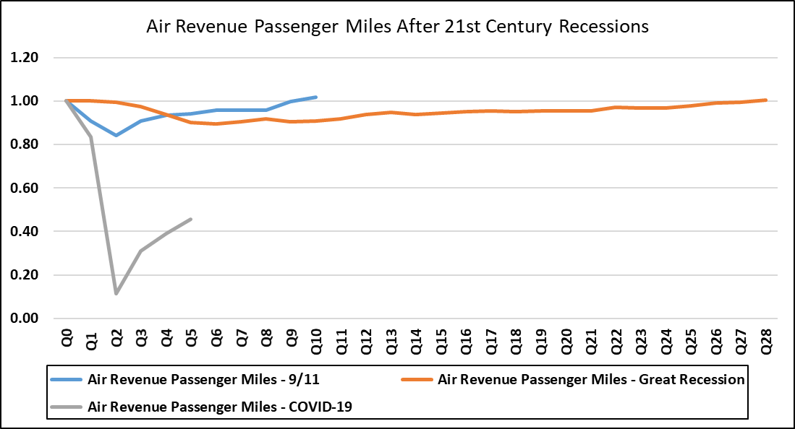
Resiliency: Air Travel Comparison After Recessions
Notes:
I am now showing a graph which compares the recovery paths air revenue passenger miles, or RPMs, after 9/11, the Great Recession, and COVID-19.
After 9/11, air RPMs, represented by the blue line, dropped nearly 20%, but recovered quickly, reaching pre-shock levels two years later.
During the great recession, air revenue passenger miles never dropped as much as they did during 9/11, but stagnated due to the length of the great recession. It took 7 years for passenger air travel to reach pre-recessionary levels.
This shows the unique nature of each recession, and that the underlying causes of the recession can greatly affect the recovery process of transportation modes.
The length and trajectory of the COVID-19 recovery is yet to be determined. Initially, passenger air travel trended towards a V-shaped recovery, but RPMs have since tapered off. Future variants, outbreaks, and cases are going to affect the recovery process, and an increase in remote conferencing may cause a permanent drop in business travel, in turn affecting air RPMs. There could be also be some divergence in international and domestic travel, which could cause structural changes in the market.

Slide 20
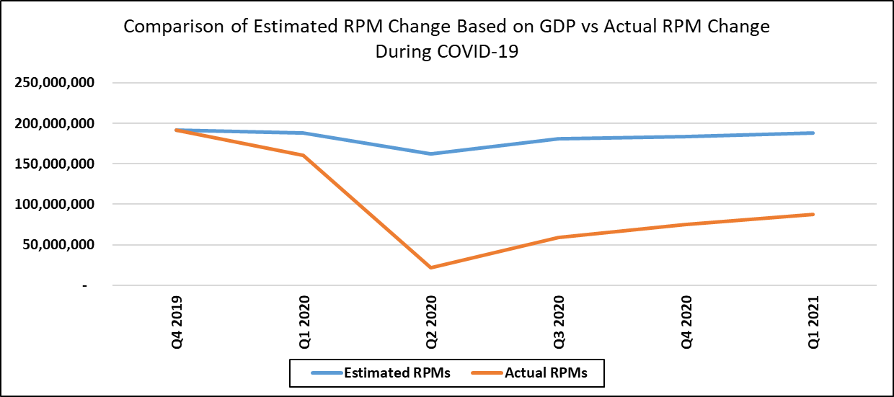
Resiliency: Estimated Air Travel vs Actual Air Travel Based on GDP Change
75% Difference Between Estimated RPMs and Actual RPMs

Slide 21
Summary of Correlations Between Economic Indicators and Passenger Transportation Before and During COVID-19
Relationship | Pre-COVID-19 Pandemic Correlation | COVID-19 Pandemic Correlation
Passenger Air Travel-Disposable Income | 0.94 | -0.50
Vehicle Travel-Disposable Income | 0.93 | -0.33
Passenger Rail Travel-Disposable Income | 0.77 | -0.41
Passenger Air Travel-Employment | 0.94 | 0.99
Vehicle Travel-Employment | 0.90 | 0.87
Passenger Rail Travel-Employment | 0.50 | 0.93
Transit Ridership-Employment | 0.30 | 0.92

Slide 22
Summary of Correlations Between Economic Indicators and Freight Transportation Before and During COVID-19
Relationship | Pre-COVID-19 Pandemic Correlation | COVID-19 Pandemic Correlation
Air Freight-Gross Domestic Product | 0.08 | 0.06
Truck Freight-Gross Domestic Product | 0.95 | 0.64
Pipeline Freight-Gross Domestic Product | 0.78 | 0.50
Rail Freight-Gross Domestic Product | 0.28 | 0.91
Maritime Freight and Industrial Production | 0.36 | 0.47

Slide 23
Key Takeaways
COVID-19 caused a breakdown in the passenger travel-economic indicator relationship
  Freight fared significantly better, and domestic air freight increased during COVID-19.
Both passenger and freight relationships weakened
High degree of uncertainty regarding modal recovery
  Pandemic is still ongoing
Notes:
To wrap-up, this slide highlights the key takeaways from this presentation. Overall, COVID-19 caused a breakdown in the typical relationship we see between passenger travel and economic indicators, as modal activity plummeted during the pandemic despite government stimulus increasing household disposable income. Freight fared significantly better, and domestic air freight even increased during the Pandemic due to its ability to fill supply chain gaps and transport time sensitive materials.
There is a high degree of uncertainty regarding modal recovery, as the pandemic is still ongoing. The relationship between travel and economic indicators up to this point in the pandemic is highly complex and different from previous United States recessions. However, the modal trends during the COVID-19 pandemic will inform future analysis of pandemics/recessions.
Overall, four of the seven passenger relationships examined in this analysis weakened during the pandemic, including three relationships with strong positive correlations that became negatively correlated
Three of the five freight relationships weakened during the pandemic

Slide 24
Future Research
Future analysis could be conducted following the conclusion of the pandemic and include:
  A full time series dataset
  Modal trends based on vaccination rates and virus outbreaks
  Complete analysis of recovery paths
  Long-term modal changes due to the COVID-19 pandemic (e.g. reduction in business travel, impact on transit ridership, etc.).
Additional research areas include:
  Break down transportation trends by region or State within the U.S.
  Study the pandemic’s effect on international travel.
  Examine transportation metrics within counties based on virus rates, vaccination rates, and economic activity.
Notes:
A more robust analysis could be made after the pandemic is finished and researchers have a full dataset to work with. It
It could include modal trends based on vaccination rates and virus outbreaks, a complete analysis of recovery paths, and any long-term changes to the modes due to the COVID-19 pandemic (e.g. reduction in business travel, impact on transit ridership, etc.).

Slide 25

Q+A Session
Project Manager: Seamus M. McGovern, Ph.D.
Aviation Systems Engineering Division
617-494-2054 | seamus.mcgovern@dot.gov
Presenter: Max Litvack-Winkler
Economic Analysis Division
617-494-3699 | max.litvack-winkler@dot.gov
John A. Volpe National Transportation Systems Center
United States Department of Transportation
55 Broadway | Cambridge Massachusetts 02142
www.volpe.dot.gov
Notes:
Thank you for listening to the presentation and I am happy to answer any questions.

