Slide 1
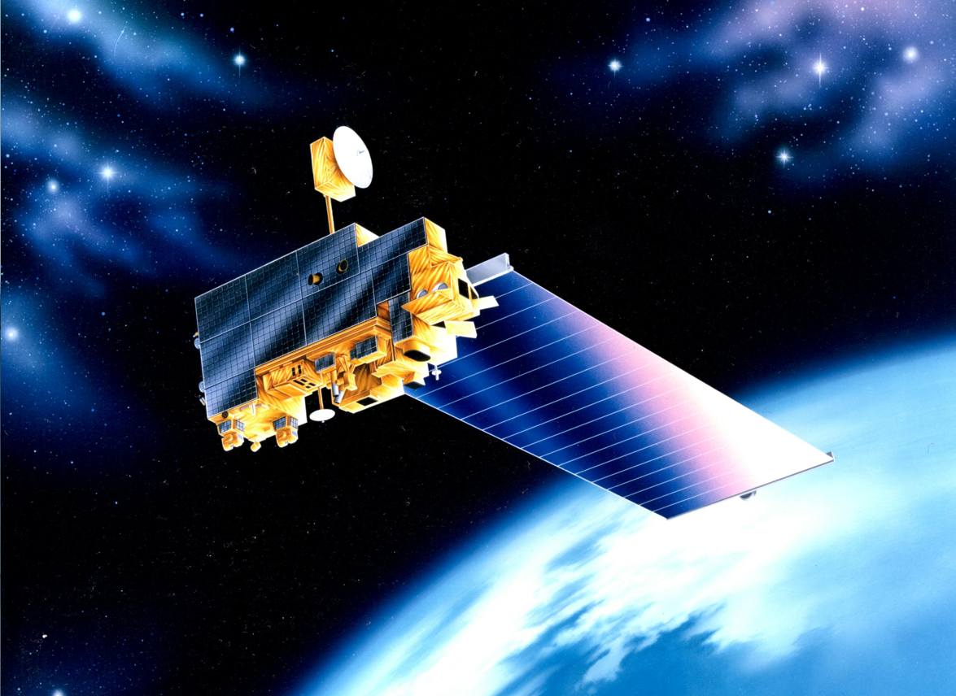
EOS Terra
Mission Status
Constellation MOWG
Virtual (GSFC)
November 15–18, 2021
Dimitrios Mantziaras
Terra Mission Director - Code 428
Phone: (301) 614-5234
Dimitrios.C.Mantziaras@nasa.gov

Slide 2
Topics
Mission Summary
Spacecraft Subsystems Summary
Recent Activities
Inclination Adjust Maneuvers
Conjunction History
End-Of-Mission Plan
Upcoming Activities
Summary
Backup Slides

Slide 3
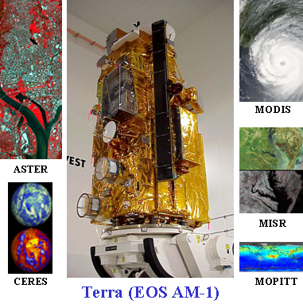
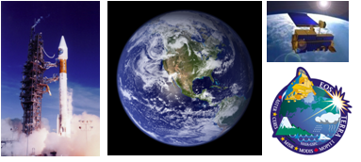
Terra Mission Overview
Terra Features
Launch Date: December 18,1999 (Atlas IIAS, VAFB)
Orbit: 705 km, Sun-synchronous polar, 98.2º Inclination, 10:30 AM MLT descending node
Instrument Payload:
  ASTER (SWIR, TIR & VNIR) - Advanced Spaceborne Thermal Emission and Reflection Radiometer (Japan)
  CERES (Fore & Aft) - Clouds and the Earth's Radiant Energy System (USA – Langley)
  MISR - Multi-angle Imaging Spectro-Radiometer (USA – JPL)
  MODIS - Moderate Resolution Imaging Spectro-radiometer (USA – GSFC)
  MOPITT - Measurement of Pollution in the Troposphere (Canada)
Project Management: Earth Science Mission Operations (ESMO)
Spacecraft Flight Operations: Contracted by GSFC to KBR team and supported by NASA NENs and TDRSS
Instrument Operations and Science Data processing: Performed at respective Instrument Locations where developed
Mission Duration: Successfully completed Prime mission of 5 years. Currently in Extended Operations.
Distributed Active Archive Centers: LP DAAC – MODIS, ASTER; Langley DAAC – CERES, MISR, MOPITT
Science
The primary objective of the Terra Mission is to simultaneously study clouds, water vapor, aerosol, trace gases, land surface and oceanic properties, as well as the interaction between them and their effect on the Earth’s energy budget and climate.

Slide 4
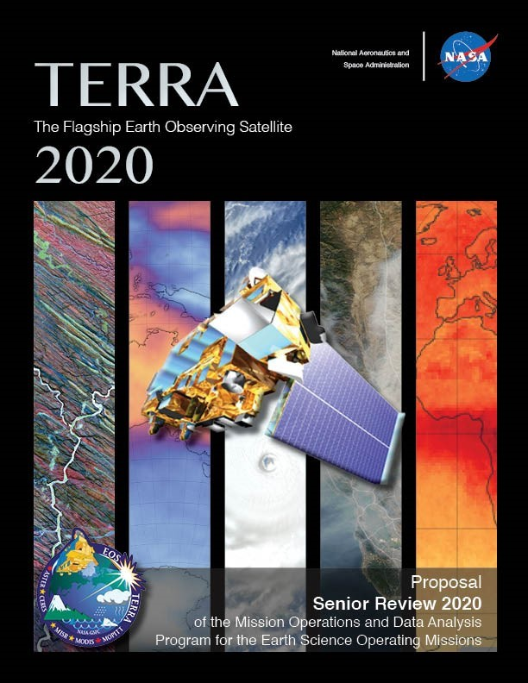
EOS Terra Mission Summary
2020 Inclination Adjust Maneuvers (Final)
  IAM #57 – February 20th, 2020
  IAM #58 – February 27th, 2020
March 2020: Mission Extension Senior Review Proposal Delivered to NASA HQ
  Mission extension through FY26 recommended
  Results from Panel Review received:
    Terra #1 Earth Science Mission – “The Senior Review Science Panel unanimously supports Terra's extension in FY 2021-2023 and FY 2024-2026 with the proposed over-guide budget.”
    “Terra is the most important Earth Observation mission of the 21st century.”
12/18/20: Terra 21-Year Anniversary
EOS Flight Operations Annual Review #15 –
Jan 26-27, 2021
Updated Phase-F and EOMP generated for delivery to NASA HQ (Mar/Apr 2021)
SSR Reset Executed Successfully – 09/22/21
12/18/21: Terra 22-Year Anniversary

Slide 5
Terra Spacecraft Status
All subsystems on Primary Hardware except as noted
Command & Data Handling (CDH) – Nominal
  Solid State Recorder (SSR) – holds ~1 orbit of data
  58 of 58 SSR Printed Wire Assembly now operational (All 16 offline boards were recovered)
    SSR Reset successfully performed on 09/22
Communications (COMM) – Nominal
  DAS Modulator Failure on 05/29/2008 (Operating on Redundant)
  Use K-Band primarily, X-Band as needed for Science Playback
Electrical Power System (EPS) – Good
  Battery Cell and Heater Controller Anomaly (10/13/2009)
  1 of 24 Solar Panel Failed (9/24/2000)
Flight Software (FSW) – Nominal
Guidance, Navigation & Control (GN&C) – Nominal
  IRU-B powered down due to rising temp and current trend (recommendation from Kearfott)
    Not used for nominal operations (IRUs A & C used for ops and no signs of degradation)
    Audit of all references to IRU-B completed, prime updates completed prior to turn-off, remaining items being worked
  Minor loss of sensitivity in SSSTs – updated tracker biases to compensate
Propulsion (PROP) – Nominal
Thermal Control System (TCS) – Nominal
Instruments (INST) – Nominal
  Only ASTER SWIR failed, all other instruments are taking science

Slide 6
SSR DMU Reset Summary
On 6/28/2021, the MISR buffer experienced a PWA failure with PWA #40
  The failure on the MISR buffer had the MISR IOT reduce their BAP observations
On 6/29/2021, the MODIS buffer experienced a PWA failure with PWA #47
  The failure on the MODIS buffer had put MODIS at further risk of data loss, after reducing observations for a PWA failure in 2020
The MODIS Buffer capacity was so low to warrant a SSR Reset
  An SSR Reset was believed to be able to recover the failed PWAs
    A 2001 Reset (triggered by SSR Halt Anomaly) successfully recovered the first PWA failure
  FOT had discussed with IOTs in 2019 what their capacity threshold was requiring an SSR reset
Prior to requesting approval to perform an SSR reset, the FOT looked into several alternatives to a reset
  Increased Contacts and reduced Science collection
  Neither were deemed sufficient to mitigate the data loss risk and science impacts
FOT prepared reset procedures
  Focused on SSR Data Memory Unit (DMU) reset
  Developed extensive script to perform reset then remap all Supersets
    Included various contingencies such as partial recovery of offline PWAs
  Several simulations were conducted in to validate procedures and get FOT familiar with the procedures.
Independent review boards/working groups were held in preparation for the reset (Approvals were received at all briefings)
  08/10/2021 - Terra SSR Reset Engineering Independent Peer Review
  09/13/2021 – ESMO Code 400 briefing - Reset of the Terra SSR
  09/15/2021 – ESMO Special Topic Briefing to Code 100
  09/17/2021 – NASA HQ Terra SSR Reset Briefing

Slide 7
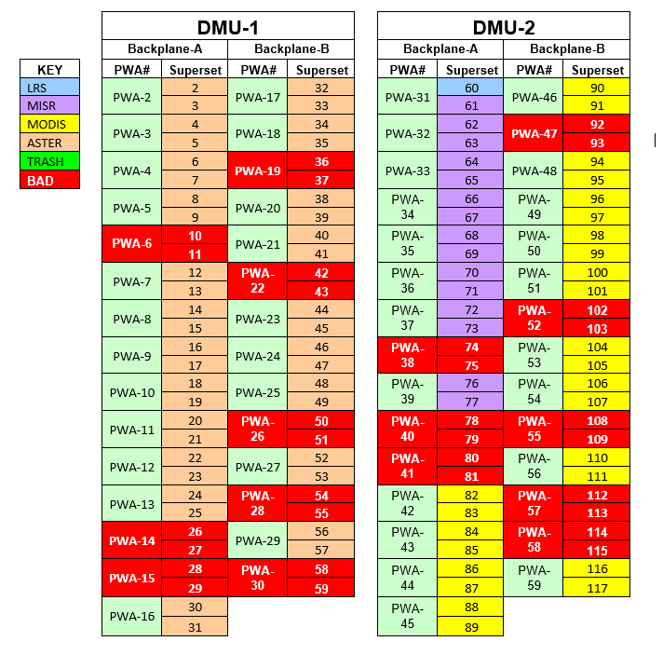
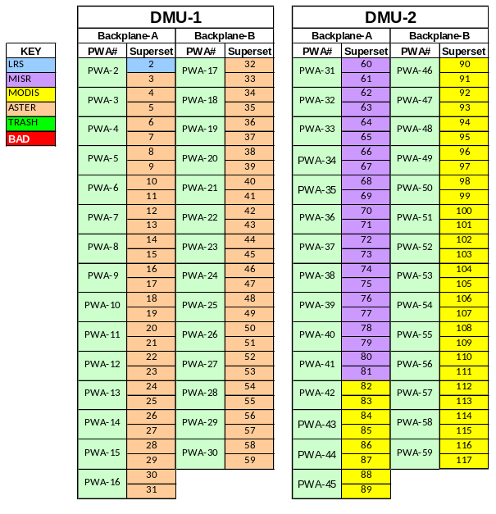
SSR DMU Reset Summary
The SSR DMU reset was executed on 09/22/2021 (DOY 265)
  DMU Reset Successfully recovered all 16 offline PWAs returning the SSR to launch capacity
  After all PWAs successfully passed the BIT (write/read) test each super set was individually placed back into its respective buffer in sequence
  The activity required Science Recording to be disabled throughout the activity
    Science Data Record Disabled : 265/11:14:14 – 265/22:53:58
  After the DMU Reset the FOT successfully performed the first post-reset Playback at 265/23:16, and over-night successfully recorded to all the remapped supersets
  Post-reset SSR performance has been health and nominal
MODIS/MISR/ASTER began increasing their planned observations starting October 1st, taking advantage of the recovered capacity
Pre-Reset Allocation
Post-Reset Allocation
MODIS | 26
MISR | 15
ASTER | 42
LRS | 1
Trash | 0
MODIS | 36 (+38%)
MISR | 22 (+47%)
ASTER | 57 (+36%)
LRS | 1
Trash | 0

Slide 8
Spacecraft Component Status
Subsystem | Component | Design | Current | Capability | Comments
EPS | Solar Array | 24 Shunts | 23 Shunts | 96% | Degradation is minimal. Fully capable of supporting mission thru 2020 unless future failures occur
 | Batteries | 108 Cells | 107 Cells | 99% | BBAT cell #50 failed on 10/15/09.
 | Batteries | 36 Heater Controls | 28 Heater Controls | 77% | BBAT heater control failed on 4 of 9 heater groups on primary, redundant, and survival. Battery cell charging/discharging and the remaining heater groups are preventing cells from freezing. PBAT heater control performance is nominal.
TCS | MOPITTCPHTS | 2 | 2 | Full | Performance is nominal
 | SWIR CPHTS | 2 | 2 | Full | Performance is nominal
 | TIR CPHTS | 2 | 2 | Full | Random temperature fluctuations. Performance within requirements.
SCC | SCC | 2 | 2 | Full | Performance is nominal
COMM | HGA | 2 | 2 | Full | MDA BITE failures occur 2-3/week due to SEU. Recoverable
 | X-Band | 2 | 1 | 75% | DAS Modulator 1 failed (50%). Solid State Power Amplifier redundancy still available (100%).
 | CTIU | 2 | 2 | Full | Performance is nominal
 | OMNI | 2 | 2 | Full | Performance is nominal
CDH | MO | 2 | 2 | Full | Drift rate changes have occurred since 10/3/10. Performance is within requirements.
 | SFE | 2 | 2 | Full | SFE SEU occur 1-2/year. Recoverable
 | SSR | 59 PWA | 59 PWA | 100% | Successful SSR Reset on 09/22/21 recovered all 15 previously offline Printed Wire Assemblies
GNC | IRU | 3 | 3 | Full | Performance is nominal. 2 for 3 redundancy
 | TAM | 2 | 2 | Full | Performance is nominal
 | SSST | 2 | 2 | Full | Minor loss of sensitivity in SSSTs – tracker biases updated
 | CSS | 2 | 2 | Full | Performance is nominal
 | ESA | 2 | 2 | Full | Performance is nominal
 | FSS | 1 | 1 | Full | Performance is nominal. Not currently used
 | RWA | 4 | 4 | Full | Performance is nominal. 3 for 4 redundancy
 | MTR | 3 | 3 | Full | Performance is nominal
Prop | REAs | 16 | 16 | Full | Performance is nominal
Instruments | ASTER - SWIR | 2 | 2 | 0% | Cooler is unable to maintain detector temperature. Science Data is unusable (Fully Saturated) and is no longer being recorded. Still collecting and monitoring Engineering data.
 | ASTER - TIR | 2 | 2 | Full | Performance is nominal
 | ASTER - VNIR | 2 | 2 | Full | Performance is nominal
 | CERES - Aft | 1 | 1 | Full | Performance is nominal
 | CERES - Fore | 1 | 1 | Full | Performance is nominal
 | MISR | 2 | 2 | Full | Performance is nominal
 | MODIS | 2 | 1 | 50% | Power Supply #2 failed, Formatter A degraded, cross-strapped. All Science is nominal.
 | MOPITT | 2 | 1 | 50% | Displacer B and Chopper Motor failed. Loss of redundancy only. All Science is nominal.

Slide 9
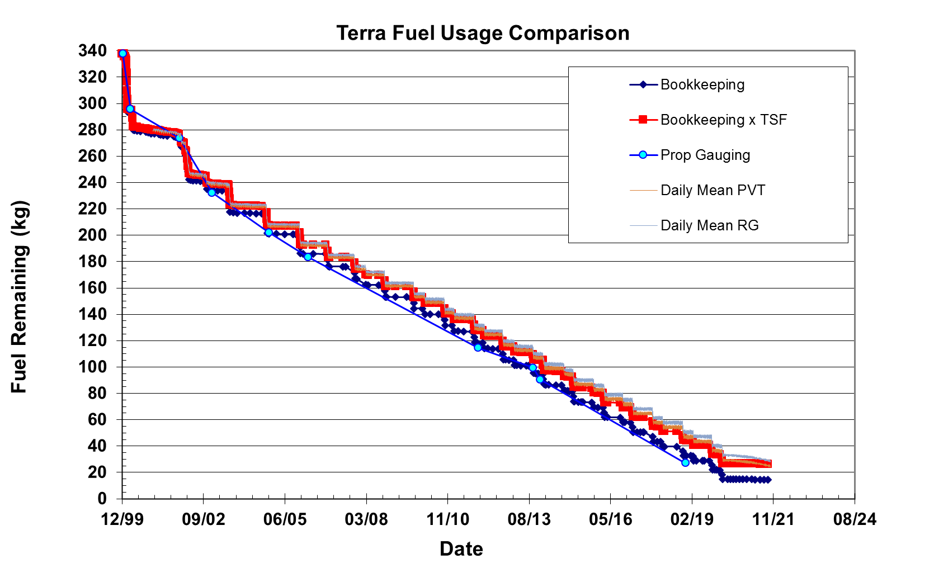
Lifetime Estimates
Fuel Remaining
Fuel Reserve = 12kgs

Slide 10
Recent Activities
  Propulsive Maneuvers
  Drag Make-up Maneuver (DMU) #123 executed on 09/17/20
  Drag Make-up Maneuver (DMU) #124 executed on 10/28/20
  Drag Make-up Maneuver (DMU) #125 executed on 12/16/20
  Drag Make-up Maneuver (DMU) #126 executed on 02/18/21
  Drag Make-up Maneuver (DMU) #127 executed on 03/31/21
  Drag Make-up Maneuver (DMU) #128 executed on 06/03/21
  Drag Make-up Maneuver (DMU) #129 executed on 07/21/21
  Drag Make-up Maneuver (DMU) #130 executed on 09/02/21
  Drag Make-up Maneuver (DMU) #131 executed on 10/27/21
  Calibration Maneuvers
  MODIS Roll #210 was waived on 09/09/20
    TDRS outage prevented set-up commanding
  MODIS Roll #211 executed on 10/06/20
  MODIS Roll #212 executed on 10/09/20
    First MODIS Roll using Earth View Door
  MODIS Roll #213 executed on 11/07/20
  MODIS Roll #214 executed on 12/05/20
  MODIS Roll #215 executed on 01/05/21 (Earth View)
  MODIS Roll #216 executed on 02/03/21 (Earth View)
  MODIS Roll #217 executed on 03/03/21
  MODIS Roll #218 executed on 06/28/21
  MODIS Roll #219 executed on 07/28/21
  MODIS Roll #220 executed on 08/26/21
  MODIS Roll #221 executed on 09/25/21
  MODIS Roll #222 executed on 10/25/21
  09/09/20: TDRS-171 outage due to weather
  (Impact to MODIS Roll #210)
  09/16/20: SFE Anomaly (HDI Card Error)
  10/05/20: SSR PWA Failure (PWA#41 in MODIS)
  10/07/20: Start MODIS Reduced observations 60/40 Night Day
  11/08/20: Start of MODIS ODS/STS Flexible Scheduling
  12/14/20: Lunar Induced Solar Eclipse #48
  01/10/21: SFE Anomaly (TMON-16 trip)
  03/25/21 – 04/12/21: MOPITT Hot Cal & Decontamination
  06/28/21: SSR PWA Failure (PWA #40 in MISR)
  (Reduced MISR Data Collection)
  06/29/21: SSR PWA Failure (PWA #47 in MODIS)
  (Triggered SSR Reset investigation)
  07/29/21: Terra IRU Gyro-B Power Off
  08/10/21: Terra SSR Reset Engineering Peer Review
  09/13/21: Code 400 SSR Data Memory Unit (DMU) Reset Briefing
  09/15/21: Code 100 SSR DMU Reset Briefing
  09/17/21: NASA HQ SSR DMU Reset Briefing
  09/22/21: Terra SSR DMU Reset (Recover of Failed PWAs)
  Recovered Launch SSR Capacity
  10/01/21: Instruments increased recording to historic values
  10/07/21: SFE Anomaly (TMON-16 Trip)

Slide 11
Inclination Adjust Maneuvers
(no change)
Inclination Adjust Maneuvers used to maintain nominal spacecraft mean local time (descending node) of 10:30 AM
  02/20/2020 IAM #57 (320 sec burn) executed successfully
  02/27/2020 IAM #58 (320 sec burn) executed successfully
Predictions indicate need to perform 3-4 maneuvers per year
  2017: (2 in Spring, 2 in Fall) -- COMPLETE
  2018: (1 in Spring, 2 in Fall) – COMPLETE
  2019: (1 in Spring, 2 in Fall) – COMPLETE
  2020: (2 in Spring, 0 in Fall) -- COMPLETE; last inclinations for Terra mission
Terra will no longer perform inclination maneuvers
DMUs will continue to be performed until Constellation Exit, which is scheduled for October 2022

Slide 12
Terra High Interest Events
Year | Jan | Feb | Mar | Apr | May | Jun | Jul | Aug | Sep | Oct | Nov | Dec | Total
2020 (T1-T4) | 2 | 0 | 1 | 0 | 0 | 1 | 0 | 0 | 1 | 0 | 0 | 1 | 6
Tier 3 | 1 | 0 | 1 | 0 | 0 | 0 | 0 | 0 | 0 | 0 | 0 | 0 | 2
Tier 4 | 1 | 0 | 0 | 0 | 0 | 0 | 0 | 0 | 0 | 0 | 0 | 0 | 1
2021 (T1-T4) | 0 | 0 | 1 | 0 | 0 | 2 | 1 | 1 | 0 |  |  |  | 5
Tier 3 | 0 | 0 | 1 | 0 | 0 | 0 | 0 | 0 | 0 |  |  |  | 1
Tier 4 | 0 | 0 | 0 | 0 | 0 | 0 | 0 | 0 | 0 |  |  |  | 0
Tier Definitions: T1 – Notify (email/phone), T2 – Conduct Briefing, T3 – Plan Maneuver, T4 – Execute Maneuver
2010: 5 HIEs – 1 DAM performed on 01/22/2010: Terra vs. 34700 CA on 1/23 @ 20:46z
2011: 20 HIEs – 2 DAM planned and waived off
2012: 19 HIEs – 1 maneuver waived off due to CA
2013: 17 HIEs – 7 that required significant action
2014: 24 HIEs – 6 that required DAM execution or nominal maneuver waive-off and replanning
2015: 33 HIEs – 8 that required DAM execution or nominal maneuver waive-off and replanning
2016: 11 HIEs – 0 that required DAM execution or nominal maneuver waive-off and replanning
2017: 8 HIEs – 1 that required DAM execution or nominal maneuver waive-off and replanning
2018: 6 HIEs – 2 that required DAM execution or nominal maneuver waive-off and replanning
2019: 9 HIEs - 5 that required DAM execution or maneuver waive-off and replanning
2020: 6 HIEs - 3 that required DAM execution or maneuver waive-off and replanning
2021: 1 HIE that required DAM execution or maneuver waive-off and replanning
  Terra vs. 37588 -- TCA @ 083/15:10:47; maneuver planned but ultimately waived-off due to Pc dropping off

Slide 13
ESMO RMM Planning Automation
ESMO updated its Close Approach (CA) Process Flow to move towards a more Automated approach
  Prepares for future increased object catalog w/ Space Fence
  Reduces workload for each event
  Keeps solution “at the ready” for short notice events
ESMO Flight Dynamics team developed an autonomous ephem generation tool
Ephems built off optimal and constrained cases solved for by the Collision Risk Management System (CRMS)
Ephems posted directly to SpaceTrack and sent to CARA for screening
  Delivery to CARA is now automatic based on logic built into the FDS ephem tool to whittle ephems down from maximum of eight generated to a maximum of five delivered
  Any other options needed can be sent manually
Screening results automatically compiled and outputted via an email report from CRMS
Auto Ephem Generation implemented in February 2017
Auto Ephem Delivery implemented in February 2018
ESMO has completed CARA Devolution Parallel Operations (Sept 2019) and now in an “interim” devolved state
  Updates to MOCA CONOPS being made match language/requirements in the new CARA NID
  CRMS Release 9 delivered and went operational on August 5th, 2021

Slide 14
Devolution Metrics
Satellite Name | # of Events | # of HIEs | # of Ephems Screened | # of RMMs
Aqua | 7004 | 36 | 230 | 0
Aura | 7442 | 25 | 145 | 6
Terra | 6256 | 18 | 199 | 2
Total | 20702 | 79 | 574 | 8
Stats from 10/1/2019 through 10/25/2021
ESMO has handled numerous events successfully in its quasi-devolved state

Slide 15
Retrograde Maneuver Preparation
Summer 2018 Terra was predicted to violate Ground Track Error (GTE) due to RMM execution March 2018
  FOT planned summer IAM with Retrograde (orbit lowering) component
  Summer IAM was not needed and was waived off
    Terra did not violate GTE limits as predicted
FOT developing pure retrograde capability
  Short Duration Retro : Complete
    Only executed to prevent GTE violation
    Performed in S/C night
    Design Complete -- ORR Held on 5/30
  Long Duration Retro : Complete*
    Constellation Exit and Deorbit Burns
    Executed in S/C Day and Night
    ASTER to be in Safe Mode
    Design Completion : December 2019
Reviewed retrograde plume risk with S/C Manufacturer, ETD and ASTER IOT
  No contamination concerns from retrograde plume
Terra Retrograde Capability - COMPLETE
All instrument configurations understood
*Reviewing all products for any updates needed due to IRU-B power off

Slide 16
Upcoming Activities
Upcoming Activities
MISR Bi-Monthly Calibration | 11/02/21
Terra FSSE CCB | 11/10/21 @ 1 pm
Terra MODIS Roll #223 | 11/24/21
51st ASTER Science Team Meeting @ Tokyo, Japan | 11/29/21 – 12/02/21
Terra Lunar Induced Solar Eclipse #50 | 12/04/21
Terra 22-year Anniversary | 12/18/21
Terra MODIS Roll #224 | 12/24/21
Constellation Exit Maneuvers | October 2022
Decommission Preparation | Ongoing

Slide 17
Future Maneuver Plans

Slide 18
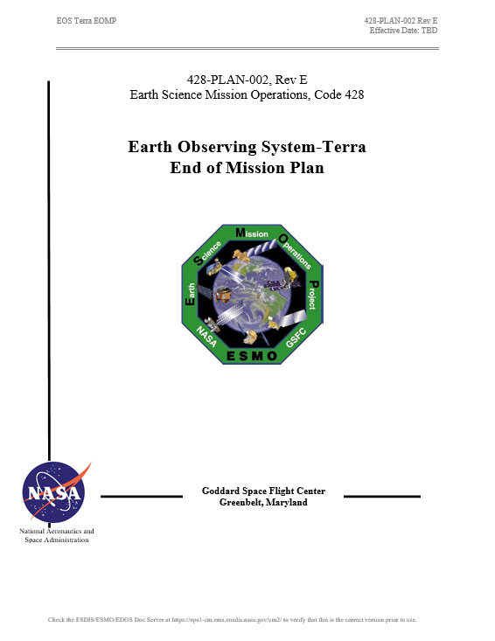
Terra End-of-Mission Plan
  Document Status
  Rev D - End-of-Mission Plan Document has been revised and under review cycle
  APPROVED - NASA HQ Signed in October 2018
  Rev E – Generated and working its way through signatures
    Minor updates to numbers based on 3 years since Rev D
  Content
  Terra will continue normal operations through October 2020
  Once all non-reserved fuel has been used, MLT will be drifted to 10:15 AM
  October 2022, Terra exits constellation
  Remaining fuel used to lower perigee prior to spacecraft passivation
  Exit plan is consistent with the current Constellation Operations Coordination Plan

Slide 19
Terra Lifetime Maneuvers
Updated based on Spring Lifetime Analysis – July 2021
Remaining Orbit Maintenance Maneuvers
Mission Year | Inclination Maneuvers | DMU Maneuvers | Fuel Used (kg) | Fuel Remaining (kg)
2018 | 1 Spring, 2 Fall | 4 | 10.783 | 44.998
2019 | 1 Spring, 2 Fall | 5 | 10.752 | 34.245
2020 | 2 Spring, 0 Fall | 3 | 6.890 | 27.066
2021 | 0 Spring, 0 Fall | 6 | 0.344 | 26.503
2022 | 0 Spring, 0 Fall | 5 | 0.402 | 26.101
Constellation Exit and Deorbit Maneuvers
Mission Date | Maneuver Type | Fuel Used (kg) | Fuel Remaining (kg)
10/12/2022 | CEM #1 | 3.384 | 22.717
10/19/2022 | CEM #2 | 3.365 | 19.352
3/11/2026 | PLM #1 | 3.347 | 16.005
3/18/2026 | PLM #2 | 3.328 | 12.677
3/25/2026 | PLM #3 | 3.311 | 9.366
4/1/2026 | PLM #4 | 3.293 | 6.073
4/8/2026 | PLM #5 | 3.277 | 2.796

Slide 20
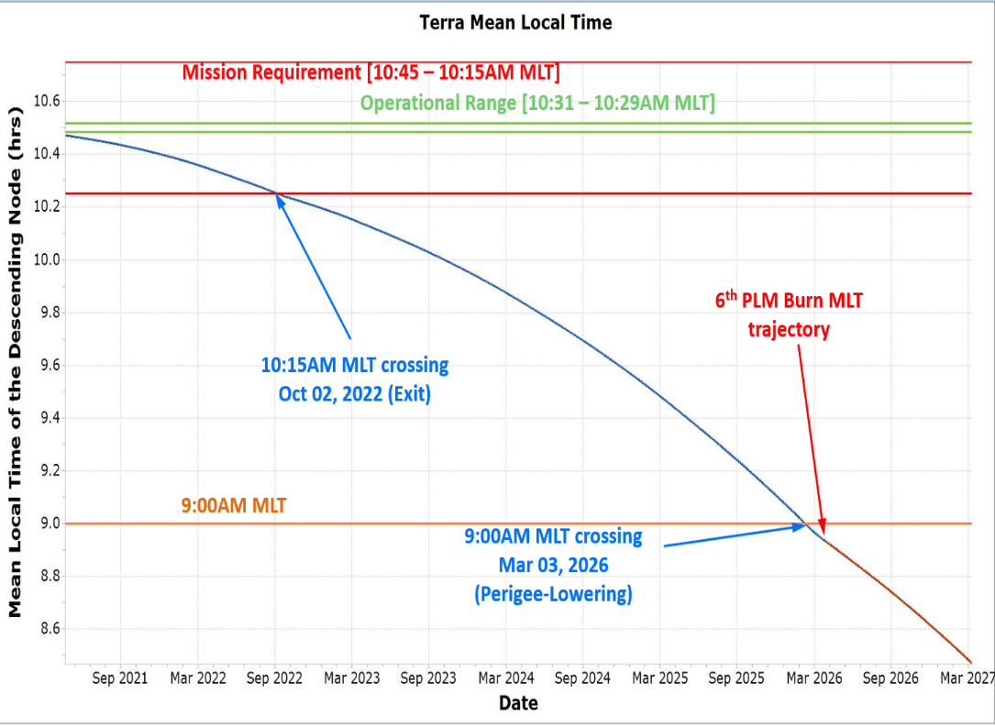
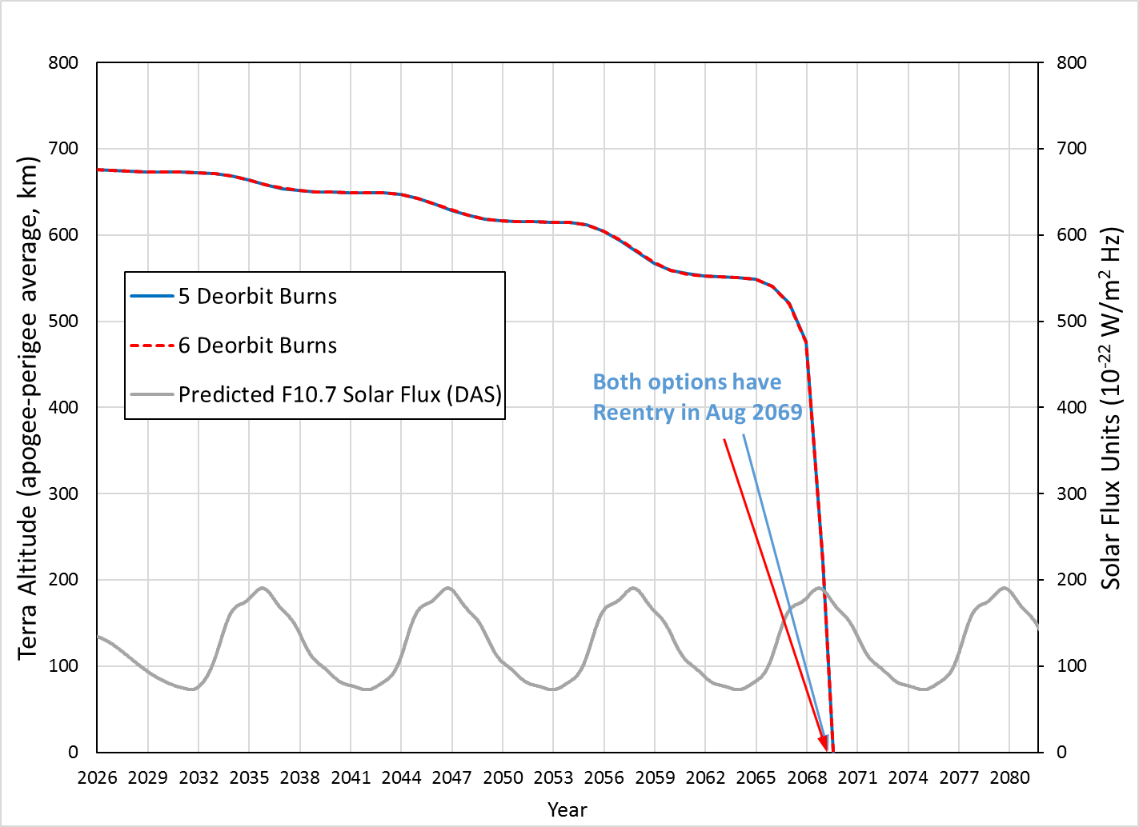
Terra Lifetime Maneuvers
MLT and Altitude Predictions
Decommissioning Plan | Exit Year | Deorbit Year | De-orbit Burns (#) | Apogee at Depletion (km) | Perigee at Depletion (km) | End of Mission (EOM) | EOM to Reentry (years) | Reentry Date
Baseline 5 x 320-sec PLM burns | 2022 | 2026 | 5 | 690.05 | 662.20 | 2026.17 | 43.47 | 2069.644
Baseline plus 6th 1.264-sec PLM burn | 2022 | 2026 | 6 | 690.04 | 662.18 | 2026.17 | 43.47 | 2069.641
Updated based on Spring Lifetime Analysis – July 2021

Slide 21
Summary
  Terra remains very healthy 21+ years into the mission
  Data Capture percentages continue at ~100%
  Collision Avoidance events continue to be part of routine ops
    CRMS and Devolved operations is working very well
  EOMP (Rev D) officially approved/signed – October 2018
    Rev E should be getting close to having all signatures
  Plan is for Terra to Exit Constellation in October 2022 and end mission in March 2026
    Exit Review for Terra during next MOWG (May 2022)

Slide 22
Questions

Slide 23
Additional Slides
  Fuel Usage
  Final Orbit Altitude
  Orbit / Inclination / MLT Maintenance
  WRS Ground Track Error
  OSMA Waiver Email

Slide 24
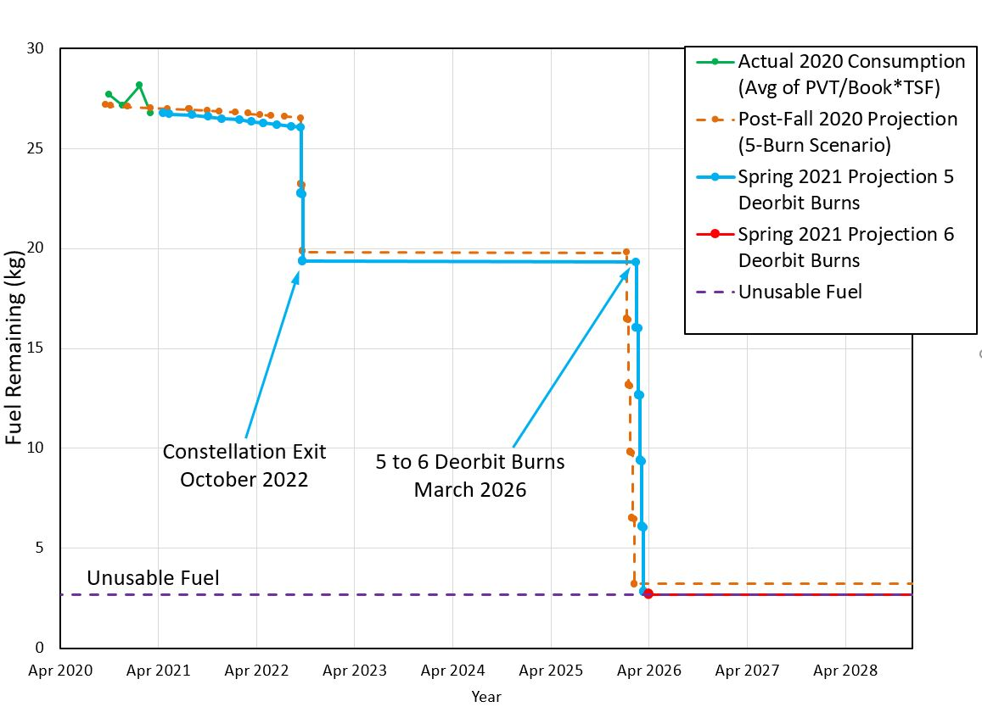
Terra Fuel Usage

Slide 25
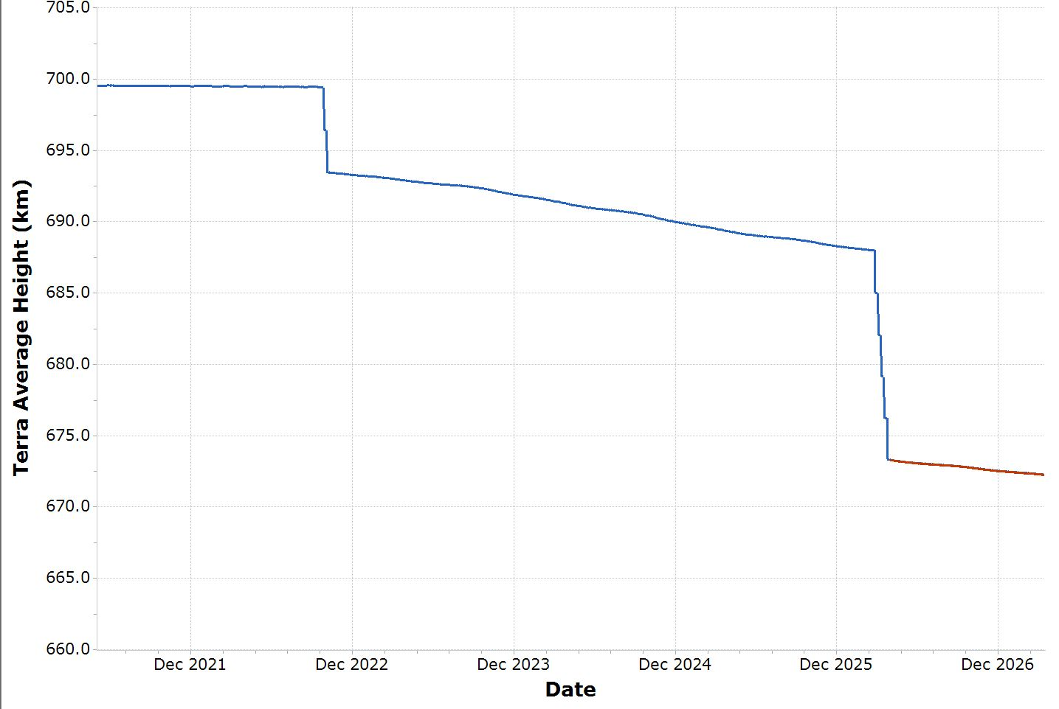
Final Average Height
(semi-major axis minus Earth radius)
Exit to 693.5 km
Oct 2022
Deorbit (5 PLMs) to 673.3 km
Mar 2026
The previous Lifetime analysis (issued Jan 2021) predicted a Terra exit height at nearly the same value (694.1 km before) as the exit height shown here (current exit height is approximately 0.6 km lower)
The current final heights are lower than the previous lifetime (677.1 km before) due to update in the drag analysis and end exit height.
Current Deorbit end heights are very similar due to very small partial final PLM (1.614 sec)
Deorbit to 673.2 km after 6th Burn

Slide 26
Orbit/Inclination/MLT Maintenance
Requirement: Mean Local Time (MLT) maintained between 10:15 and 10:45 measured at the Descending Node.
Goal: Maintain Terra mean local time of the descending node (MLTDN) below 10:31.
Constraint: OCO-2 has requested Terra maintain a MLT less than 10:31 for the duration of its lifetime to maintain a safe separation at the poles.
Requirement: Maintain WRS-2 ground track error, 0 +/-20 km.
Requirement: Maintain Frozen orbit with Argument of Perigee at 90 degrees +/-20 and Eccentricity of 0.0012 +/- 0.0004.
Constraint: Maximum burn duration limited to 320 seconds by spacecraft manufacturer. Complete yaw slews and inclination maneuvers during spacecraft orbital night. Maneuver close to spring and fall equinox to maximize efficiency.

Slide 27
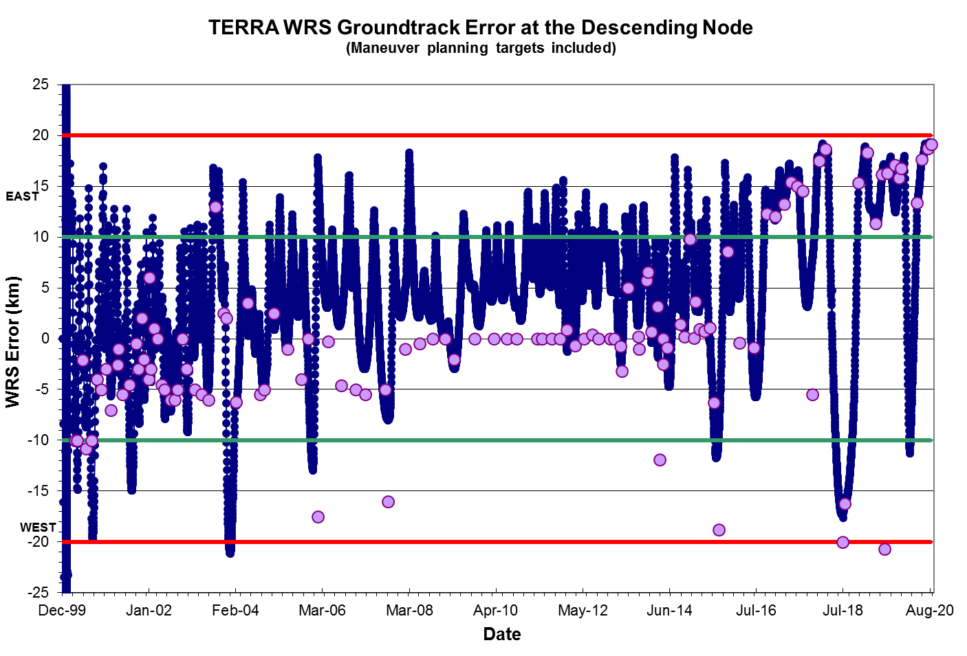
WRS Ground Track Error (GTE)

Slide 28
OSMA Official Direction
From: Aleman, Suzanne M. (HQ-GD000)
Sent: Wednesday, November 02, 2016 11:37 AM
To: Yuhas, Cheryl L. (HQ-DK000) <cheryl.l.yuhas@nasa.gov>
Cc: Liou, Jer-chyi (JSC-XI411) <jer-chyi.liou-1@nasa.gov>; Hull, Scott M. (GSFC-5920) <scott.m.hull@nasa.gov>
Subject: FW: Terra need for Orbital Debris waivers
Hi Cheryl,
I received you voice mail regarding the question on whether a waiver is needed for the 25 year rule for TERRA.
I consulted with J. C Liou on this question we have concluded that a waiver is not needed. Please see the e-mails below.
Please let me know if you have any questions.
Best regards,
Sue Aleman
NASA HQ OSMA
MMOD Program Executive

