Slide 1


National Aeronautics and Space Administration
Advanced Air Mobility (AAM)
Parimal Kopardekar, Director, NASA Aeronautics Research Institute
October 26, 2021
www.nasa.gov
1

Slide 2
National Aeronautics and Space Administration
Airspace system should be ready when vehicles are ready
2

Slide 3
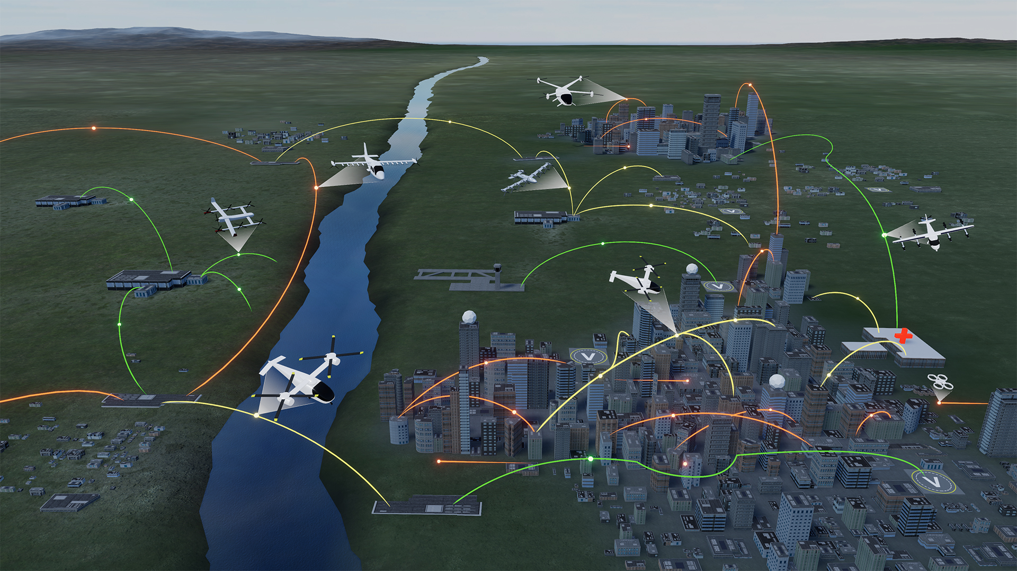


Advanced Air Mobility (AAM)
On Demand
Air-Taxi
Rural Operations
Urban Operations
Regional
Network
Inter-City
eVTOL
Cargo
Delivery
Cargo
Delivery
Airport
Transfer
Medical
Transfer
Distribution
Center/Warehouse
High Density
Corridor
Air
Ambulance
Fleet
Operations
Inter-city
eVTOL
Small
Package Delivery
Cross-metro
Transfer
Safe, sustainable, affordable, and accessible aviation for transformational local and intraregional missions
3

Slide 4
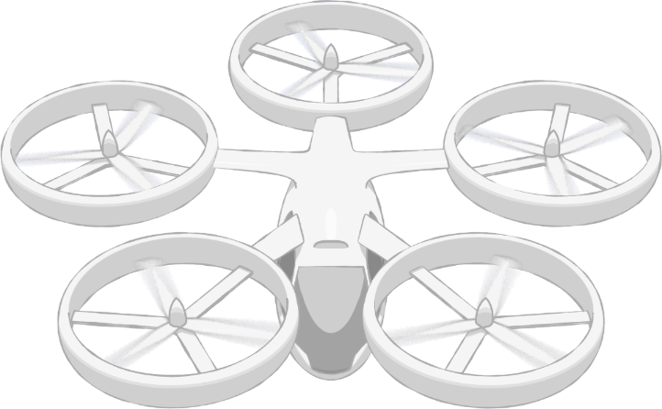
NASA AAM Mission Priorities
Human Response to Noise
Regional M&S Capabilities, & Supply Chain
Community Integration
xTM Architectures
Operational Rules, Roles, & Procedures
Comm, Nav, Surveillance, Information
UAM Supplemental Data Services
In-time Aviation Safety Management System
Community Integration
Airspace System Design & Implementation
Airspace & Fleet Operations Management
Source and Fleet Noise
Vehicle Propulsion Reliability
Environmental and Failure conditions
Distributed Electric Propulsion
Vehicle
Development & Production
Individual Vehicle Management & Operations
Automated Flight and Contingency Management
m:N, Pilots to Operators
Assured Automated Architectures
High Density Vertiplex
Aircraft & Aircrew Barriers
Airspace Barriers
Community Integration Barriers
National Campaign
Systems and Architecture Requirements
4

Slide 5
NASA ConOps
Mature State UAM
TTX/ NextGen Focus Area
Aircraft
Airspace
Operations
Infrastructure
Community
UML-6
Ubiquitous UAM Operations with System-Wide Automated Optimization
MATURE STATE
UML-5
High Density and Complexity Operations with Highly-Integrated Automated Networks
UML-4
Medium Density and Complexity Operations with Collaborative and Responsible Automated Systems
INTERMEDIATE STATE
UML-3
Low Density, Medium Complexity Operations with Comprehensive Safety Assurance Automation
UML-2
Low Density and Complexity Commercial Operations with Assistive Automation
INITIAL STATE
UML-1
Late-Stage Certification Testing and Operational Demonstrations in Limited Environments
FAA Regulatory Framework
5

Slide 6


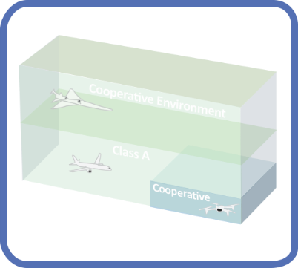
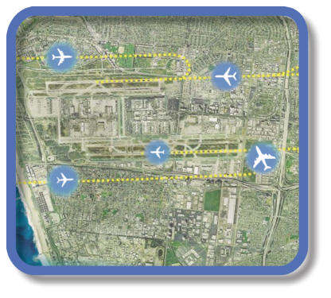

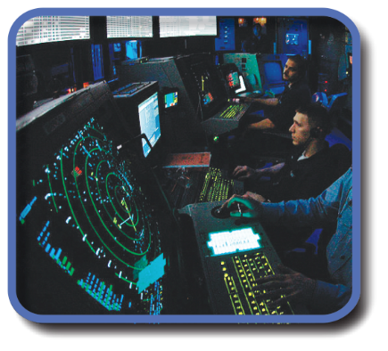
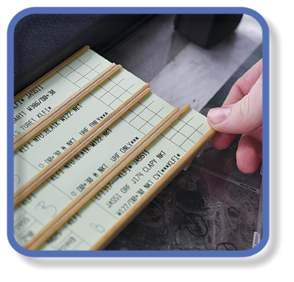




Evolution of Airspace Operations and Safety
+ Complexity, scalability,
and dynamic adaptation
+ Service oriented
architecture for
tailored mission
oriented services
+ Efficiency and
proactive planning
+Density
Safety
S-curves
Highly-Automated
ML/AI – based dynamic, robust
performance and safety
Trajectory
Know & exchange
current and planned a/c positions
Collaborative
Connected,
performance-based,
collaborative ATM
Radar
Know the current and estimate planned a/c positions
Machine-to-machine
interactions and humans collaborate
Procedural
Estimate the current and planned a/c positions
Introduces 3rd-party
service providers
Digital Transformation of ATM
Human-centered safety monitoring, assessment and mitigation
Automated in-time safety
monitoring and alerting services
Integrated predictive risk
mitigation across domains
Automatically-assured adaptive
in-time safety threat management
Human-centered safety monitoring, assessment and mitigation
Epoch 1
Epoch 2
Epoch 3
Epoch 4
(~2035)
Epoch 5
(~2045)
6

Slide 7
CANSO CATS Vision
Current State of the Art
  ATM system limited
  Enable new entrants’ operations seamlessly
  Leverage advances in technology – ML, IOT, Cloud services
Total System Performance: sustainability, scalability, safety, interoperable, etc.
Paradigm shift is needed
  Flexibility – Airspace design
  Management by exception where possible
  Automation to support humans
Performance-based and dynamic: UTM inspired!
  Cooperative, digital, managed-by-exception, service-oriented architecture – Share and Care

Slide 8
National Aeronautics and Space Administration
Innovating in aviation while respecting its safety tradition.
Contact: Parimal.H.Kopardekar@nasa.gov
8

