Slide 1

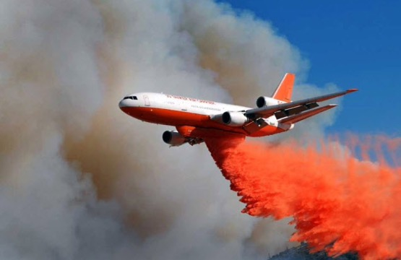
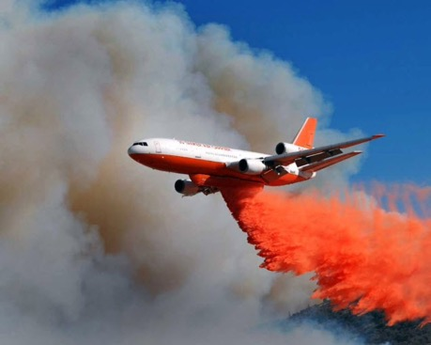
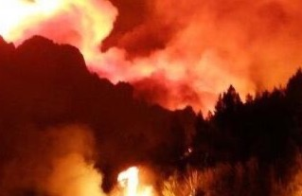
Wildfire Mitigation
Parimal Kopardekar, PhD
Director, NASA Aeronautics Research Institute (NARI)
Parimal.H.Kopardekar@nasa.gov
1

Slide 2
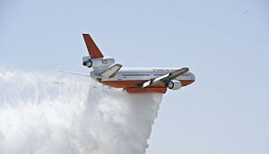
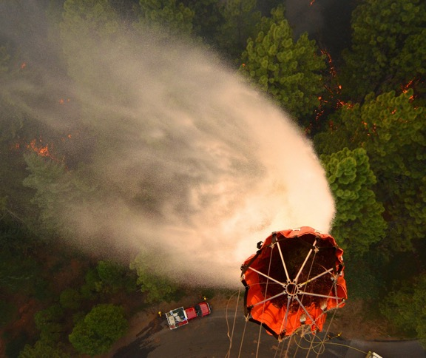
Outline
Wildfire Impacts
Current State-of-the-Art
Relevant Areas: Current Operations and Challenges
Key Areas of Impact
Summary

Slide 3
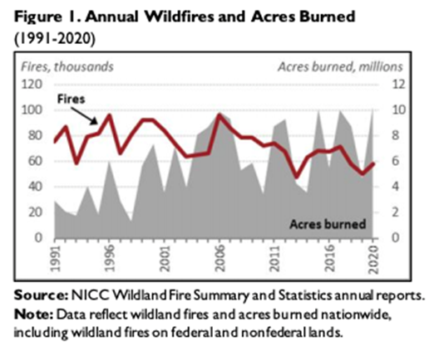

Wildfire Impacts
Total suppression costs
  5-year average $2.351B
  10-year average $1.910B
10-year average
  20,510 fires
  1,048,649 acres
2020 Statistics
  58,950 fires and 10,122,336 acres
2021 Statistics (as of 8/2/21)
  34,014 fires, and 3,079,748 acres
https://fas.org/sgp/crs/misc/IF10244.pdf
https://www.nifc.gov/fire-information/statistics
Wildfires contribute to climate change and climate change increases likelihood of wildfires
Notes:
For 2021 statistics emphasize that fire season has begun early and typically most fires are in the August-Oct timeframe

Slide 4
Current State-of-the-Art
NASA, in collaboration with US Forest Service, conducted a workshop to understand the state-of-the-art, needs, and opportunities to improve wildfire management
  Identify the needs and challenges of stakeholders at various decision cycles from planning, prediction, detection, tracking, mitigation, suppression, and post-fire remedial efforts
  154 attendees from other government organizations, academia, industry, and NASA
Main Findings
  Lack of persistent surveillance for fire detection and tracking
  Lack of persistent communications
  Lack of persistent aerial operations particularly under poor visibility
  Lack of airspace technologies to enable multiple types of aircraft operating simultaneously
  Lower aircraft safety record than other areas of aviation
  Lack of adequate coordination among multiple government agencies
  Need a clear plan to mature research for operational use in the field
Findings offer insights where research and development could make a significant impact
Notes:
Communications at fire fighting locations is not reliable and not always possible
Rogue drone operations result in grounding of aerial fire suppression missions-“If YOU Fly, We CAN’T”
~25% of aerial accidents due to Loss of Control, ~25% due to Controlled Flight Into Terrain, and ~15% due to Weather*
Aerial fire suppression is largely limited to visual meteorological conditions (only 4-6 hours/day)
All aerial assets are not utilized due to lack of airspace coordination
Lack of consistent data management and models – particularly harmonized, integrated decision-making in the hands of users
Lack of adequate coordination among multiple agencies for cohesive strategic plan

Slide 5
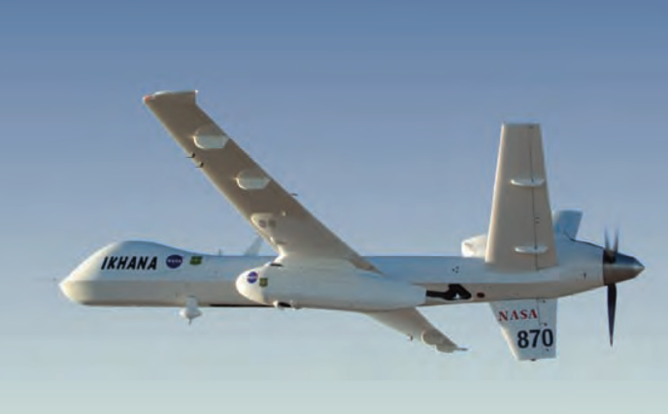
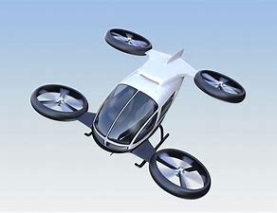

Relevant Areas: Current Operations and Challenges
Detection Tracking, Surveillance, and Prediction
  Surveillance - infrequent satellite or aircraft observations (satellite every 4 hours)
  Fire detection accuracy is not precise enough for effective targeting
  Few models for tracking and predicting fire progress, many are unreliable
Better sensing is needed, difficult to observe through cloudy conditions
Data and model fusion is limited
Aerial Suppression Support
Duration of aerial firefighting limited to daylight, clear visibility (4-6 hours/day)
Airspace operations is manual and workload intensive; only a few aircraft allowed at a time
Not able to accommodate drones in the same airspace as other aircraft
Lower aircraft safety record in aerial firefighting than other areas of aviation
Notes:
Communications at fire fighting locations is not reliable and not always possible
Rogue drone operations result in grounding of aerial fire suppression missions-“If YOU Fly, We CAN’T”
~25% of aerial accidents due to Loss of Control, ~25% due to Controlled Flight Into Terrain, and ~15% due to Weather*
Aerial fire suppression is largely limited to visual meteorological conditions (only 4-6 hours/day)
All aerial assets are not utilized due to lack of airspace coordination
Lack of consistent data management and models – particularly harmonized, integrated decision-making in the hands of users
Lack of adequate coordination among multiple agencies for cohesive strategic plan

Slide 6
Key Areas of Impact
Unified concept of operations
  Support development interagency concept of operations to ensure consistency of operational priorities, technology adoption, and programmatic alignment for national needs
Airspace management for near 24x7 continuous operations
  Airspace operations system-in-a-box for common situational awareness
  Enable simultaneous and coordinated operations of diverse vehicles
Sensing, data fusion and models integration for better prediction
  Increase access to reliable surveillance data and fire prediction models for in-time decision-making for planners and firefighters
  Develop advanced sensor fusion and fire prediction models
Notes:
Under an interagency banner NASA could develop a unified conops but we have to have someone else to create that banner, give top cover

Slide 7
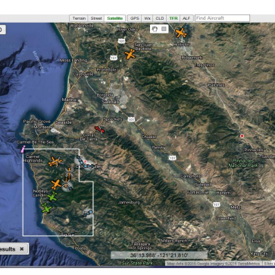
Key Areas of Impact
Aircraft capabilities for safe operations in adverse environments
  Expand operational envelope with aircraft technology for terrain avoidance and aircraft state management
Persistent, integrated, diverse manned and unmanned airspace operations
  Integrated system requirements, design and prototype for persistent surveillance and operations with multiple diverse vehicles for increased aerial response to wildfire
Prior research in airspace, aircraft, sensing, surveillance, communications,
and data management is highly relevant

Slide 8
Summary
Wildfires will continue to be an increasing risk to the environment and our communities.
Science surveillance and data collection depends on integration of unmanned aircraft systems
Interestingly, it is UTM and UAS related operationalization challenge inside temporary flight restriction
Sensor and surveillance capabilities will continue to be employed in disaster response
UTM/ATM technologies are critical to support science missions, as well as maintain continuity of suppression

Slide 9
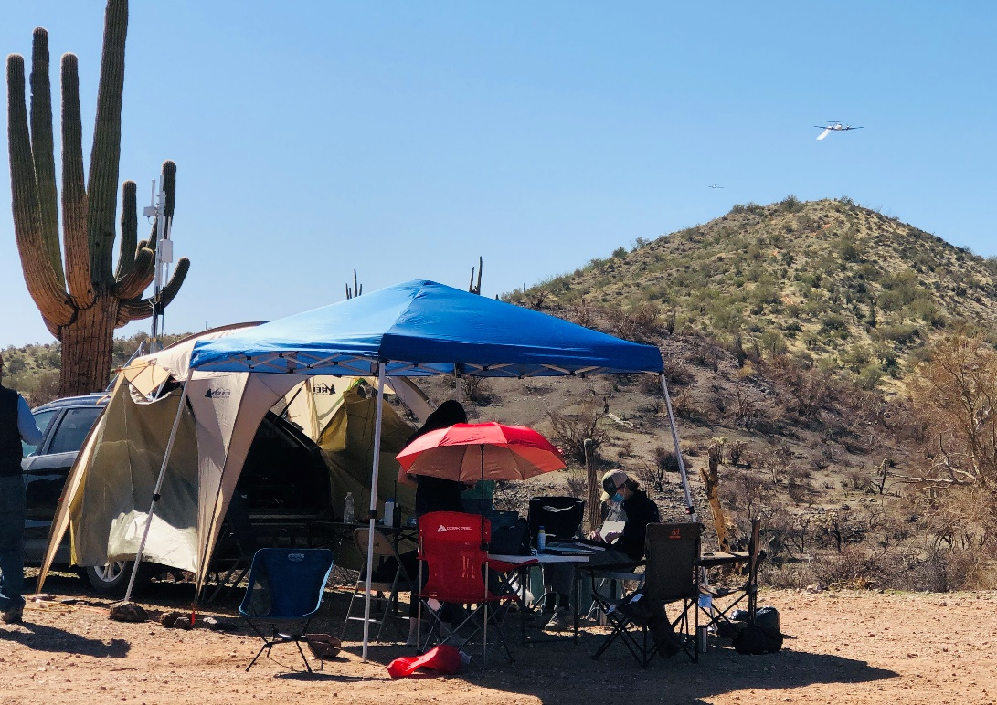
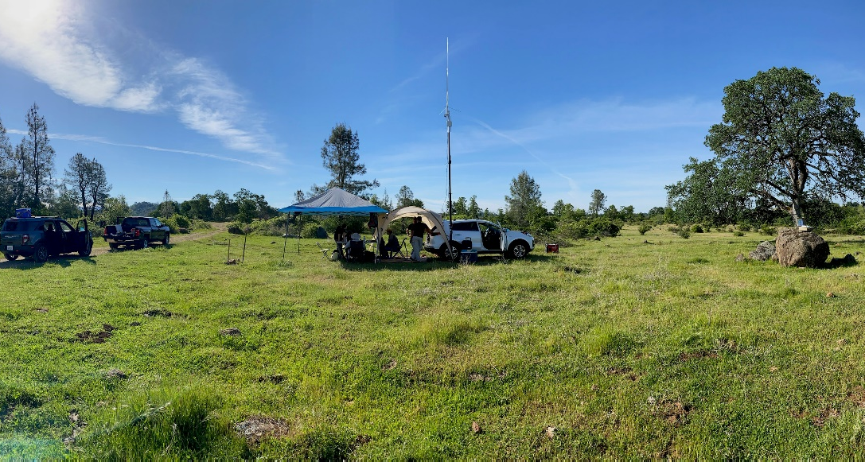
Scalable Traffic Management for Emergency Response Operations (STEReO)
Prototypes of key capabilities…
  (1) UTM-in-a-box, (2) connectivity, (3)Tools and interfaces for airspace coordination and asset tracking, (4) Operation awareness display hosted on a mobile device
…were field-tested across two partner-hosted training exercises:
US Forest Service; Mesa, AZ (8 days)
National Aerial Supervision Training Academy (NASTA)
CAL FIRE; Redding, CA (8 days)
CAL FIRE Aerial Supervision Academy (CASA)

