Slide 1




Three-dimensional in situ observations of polycrystalline microstructure evolution during directional solidification of transparent alloys aboard the ISS and quantitative comparison with numerical modeling
Kaihua Ji¹, F.L. Mota², Y. Song¹, T. Lyons³, L.L. Strutzenberg⁴,
R. Trivedi³, N. Bergeon², A. Karma¹
¹Northeastern University
²IM2NP, Aix-Marseille Université
³Iowa State University
⁴Marshall Space Flight Center
Notes:
Enter speaker notes here.

Slide 2
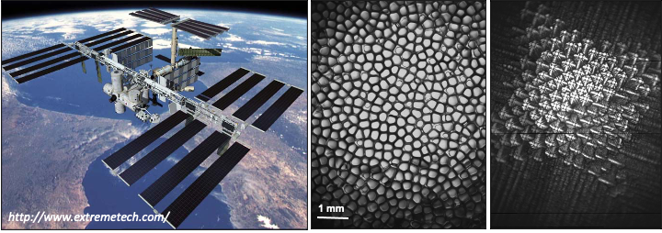
Outline
Microgravity experiment: DEvice for the study of Critical LIquids and Crystallization - Directional Solidification Insert (DECLIC-DSI).
Phase-field modeling with massive parallel implementation.
Experimental observations and modeling of sub-boundaries.
Experimental observations and modeling of macroscopic curvatures
Summary.

Slide 3
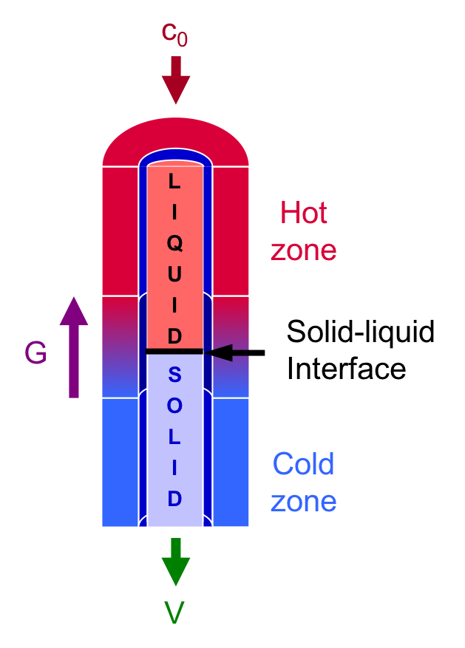
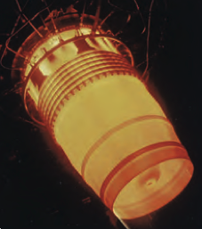
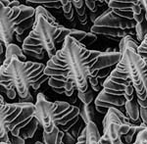
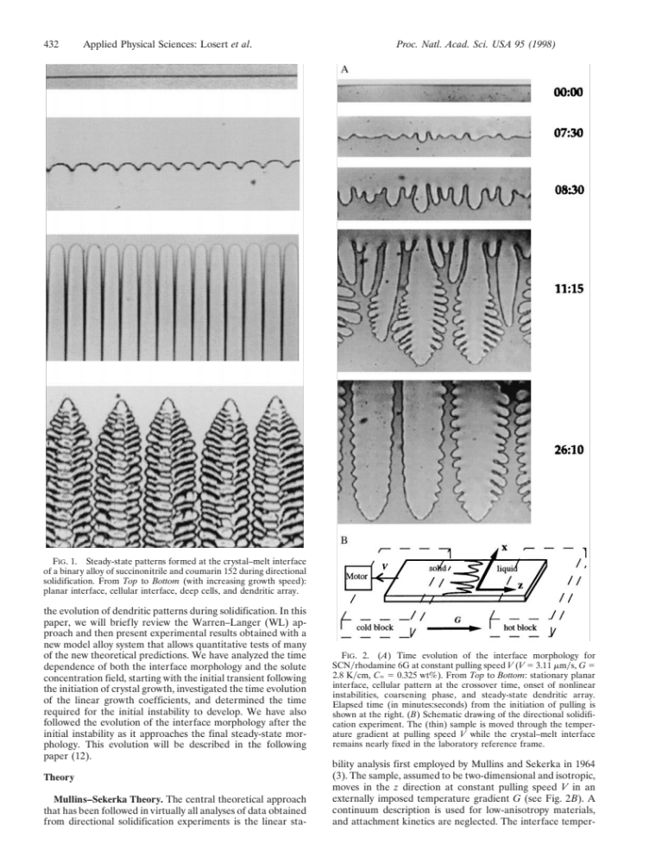

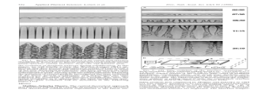
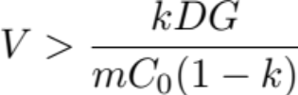
The system – directional solidification
Microstructure formation under well-controlled growth conditions (G, V, C0)
Temperature gradient G
Growth velocity V
Solute concentration C0
Giamei (2013)
Losert, Shi, and Cummins (1998)
Constitutional supercooling
David et al. (1992)

Slide 4
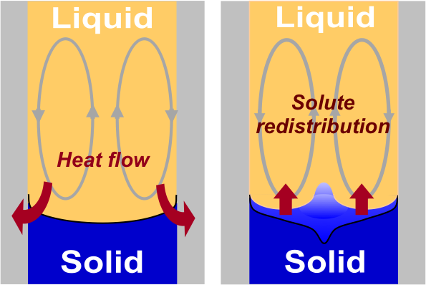
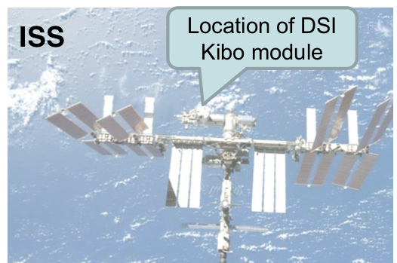
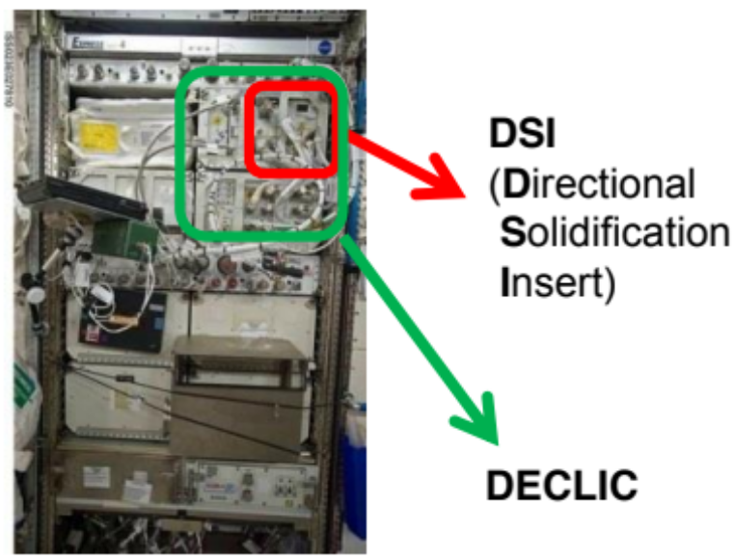
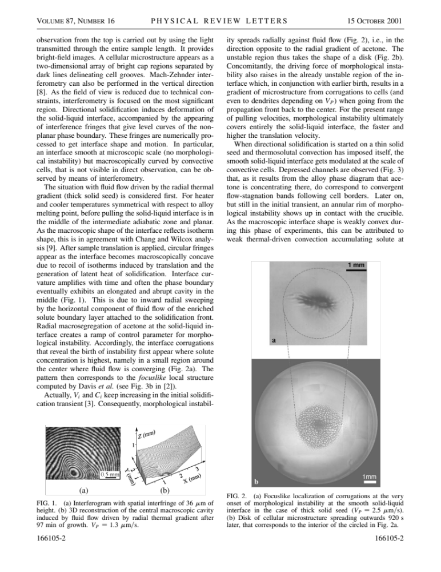
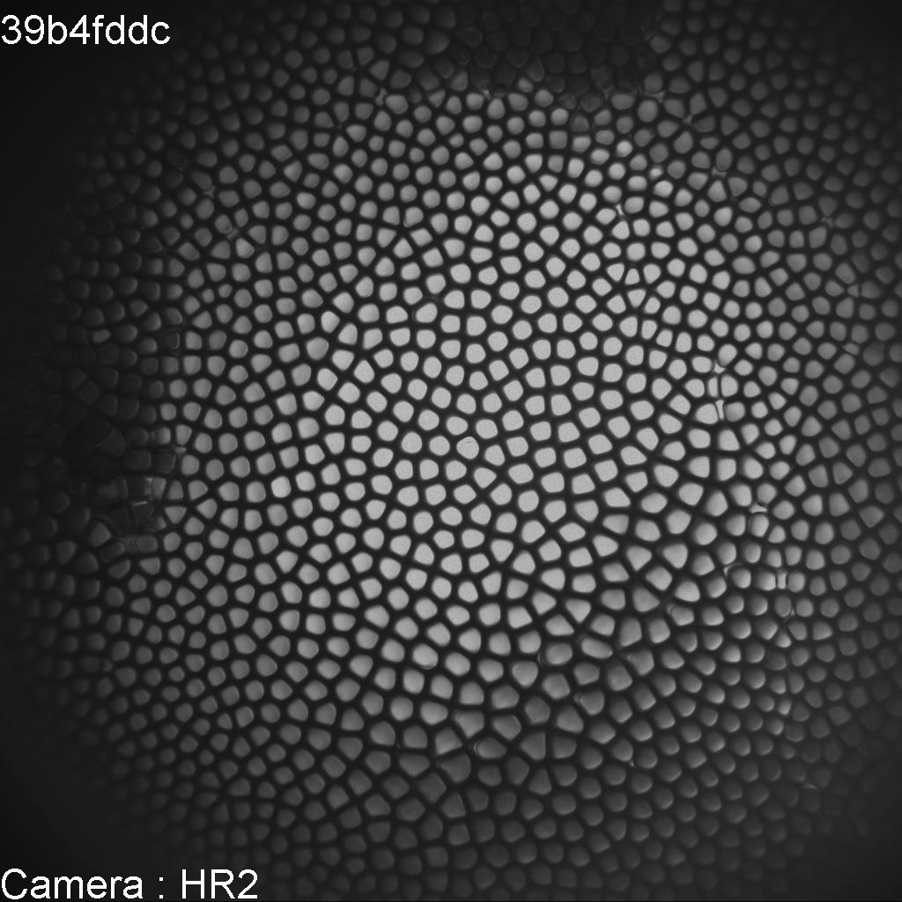
Microgravity experiments
Gravity-induced convection
Microgravity experiment
Two campaigns:
1) Microgravity experiments from 2009-2011 dedicated to cellular regime (DSI).
2) Microgravity experiments from 2017-2018 dedicated to dendritic regime (DSI-R).
Microstructure heterogeneities
Jamgotchian et al., PRL (2001)

Slide 5
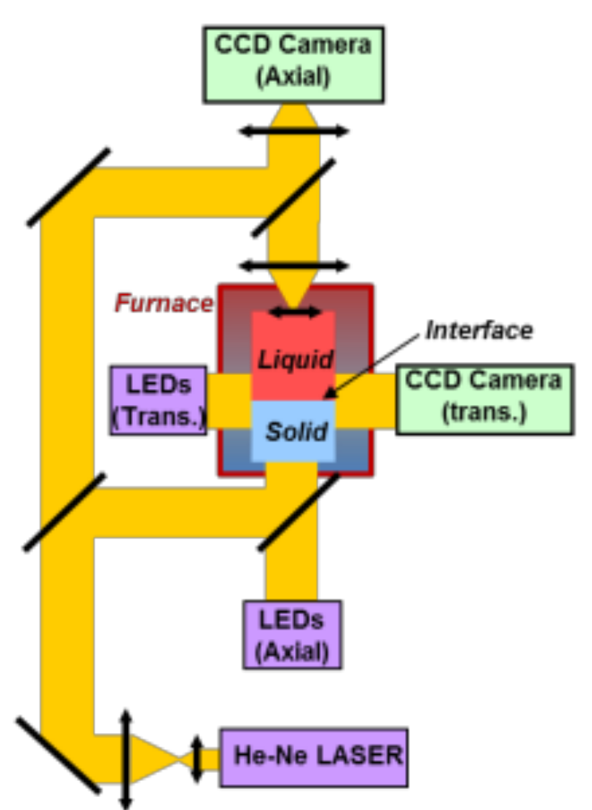
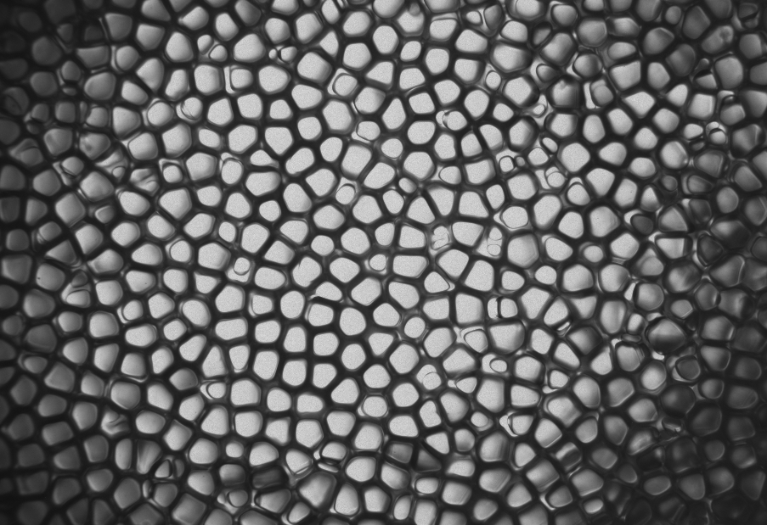
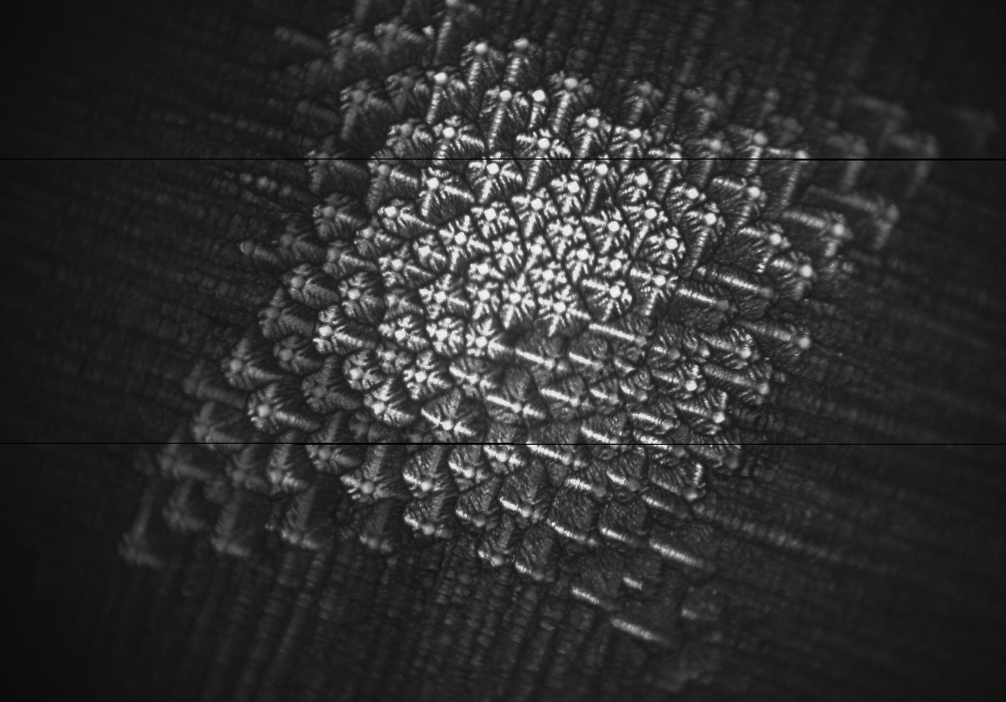
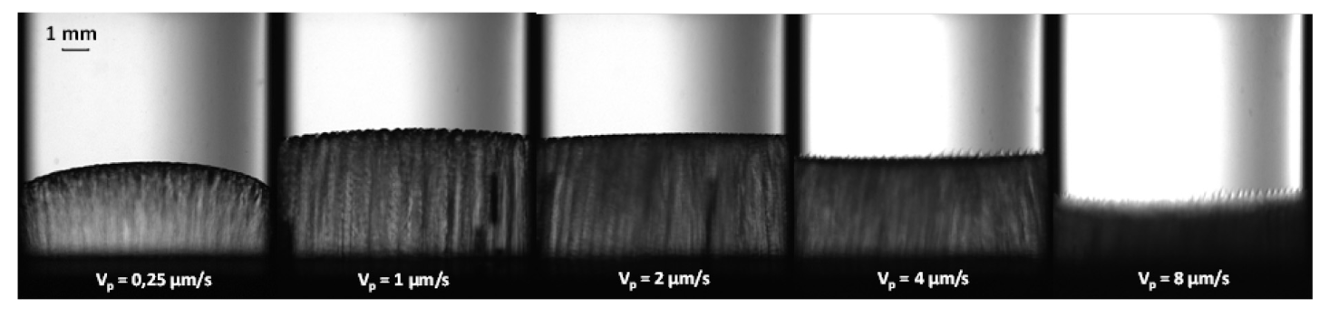
In situ observations
The DECLIC-DSI setup enables to observe the solid-liquid interface from top and transverse views.
Vp = 1 μm/s
G = 19 K/cm
1 mm
Vp = 30 μm/s
G = 12 K/cm
SCN-0.24wt%camphor
Mota et al., 70th International Astronautical Congress. 2019.
SCN-0.24wt%camphor, G = 12 K/cm
Mota, F. L., et al. Acta Materialia 85 (2015): 362-377.

Slide 6
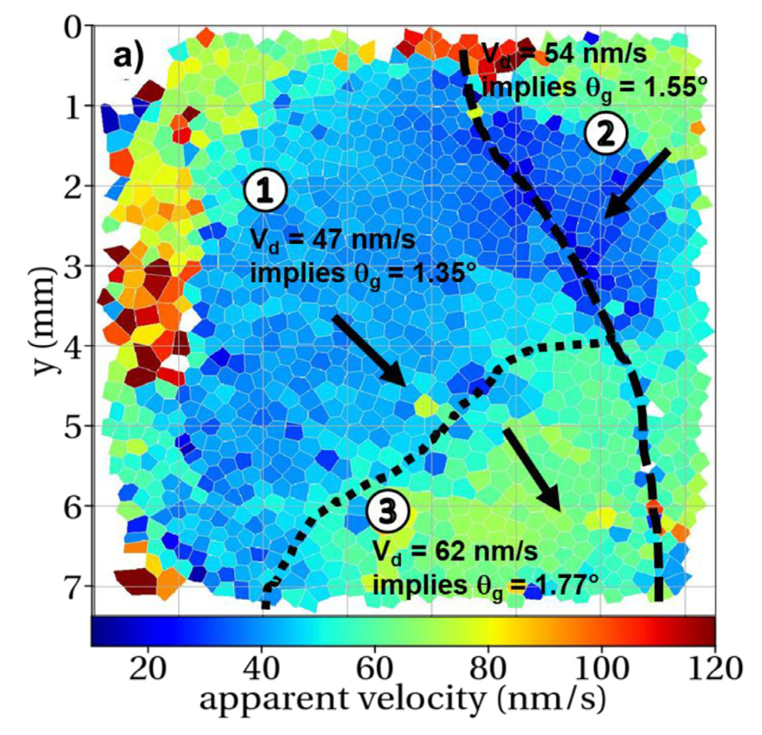
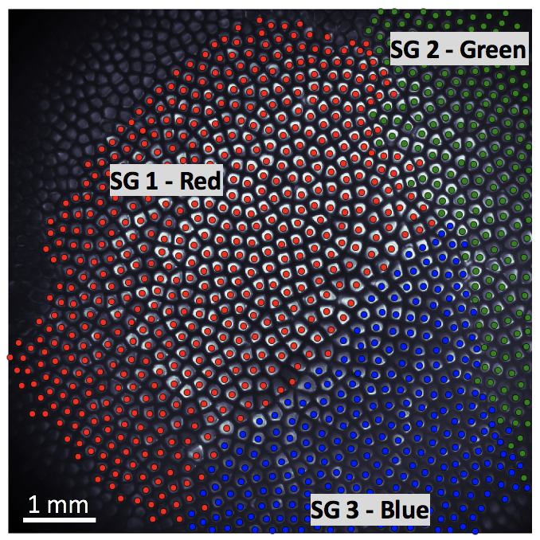
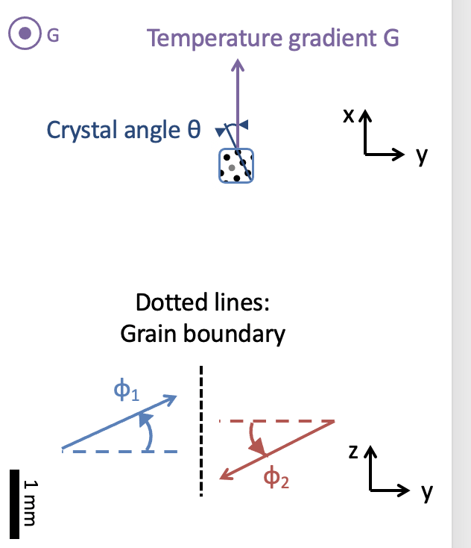
Observations of polycrystalline microstructure
The polycrystalline microstructure can be identified from the top view, where several grains grow at different orientations.
Different grains have different crystalline orientations and drifting velocities.
Mota, F. L., J. Pereda, K. Ji, Y. Song, R. Trivedi, A. Karma, and N. Bergeon. Acta Materialia 204 (2021): 116500.
SCN-0.24wt% Camphor, G = 19 K/cm, V = 2 μm/s

Slide 7
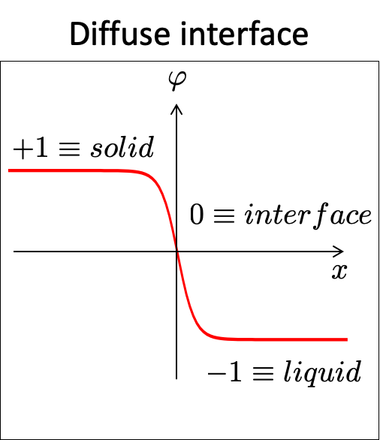
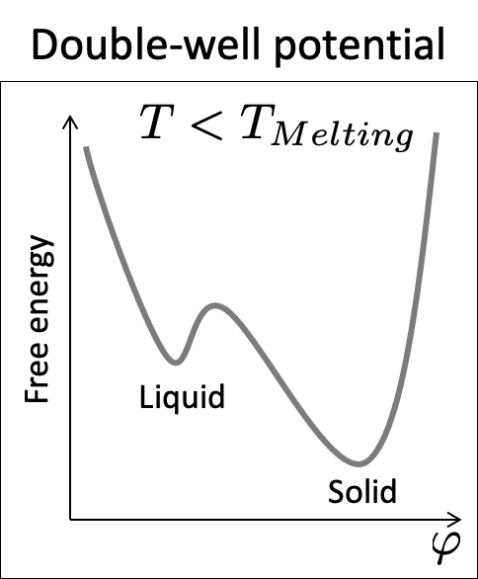
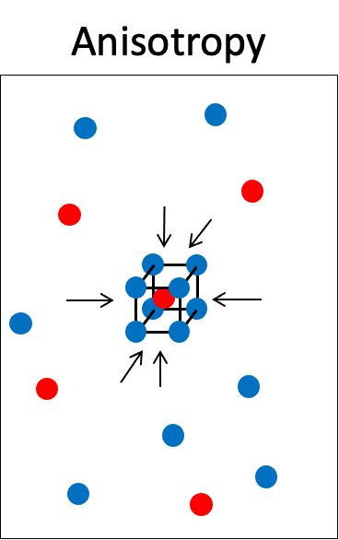
Phase-field model for alloy solidification
Phase field (order parameter)
[Langer, Directions in Condensed Mat. Phys. (1986)]
[Collins and Levine, Phys. Rev. B (1986)]
Anti-trapping current
[Karma, Phys. Rev. Lett. (2001);
Echebarria et al. Phys. Rev. E (2004)]
Thin interface (W >> d0)
[Karma and Rappel, Phys. Rev. E (1998)]

Slide 8
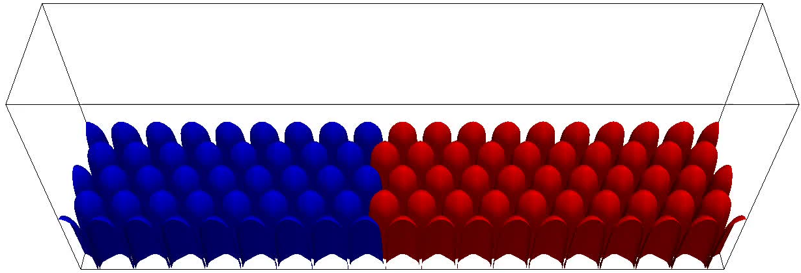
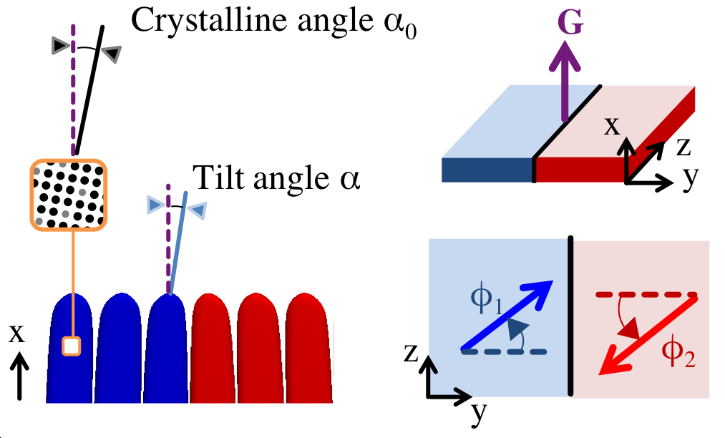
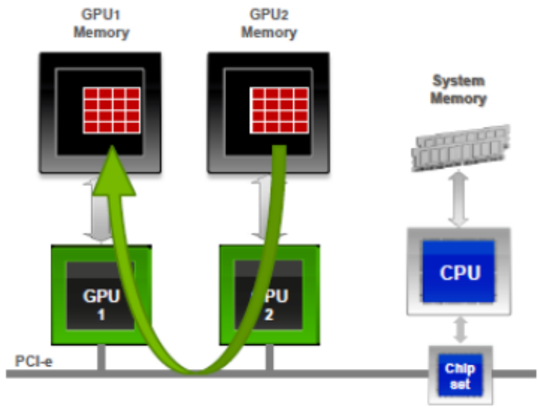
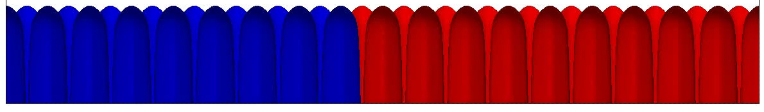
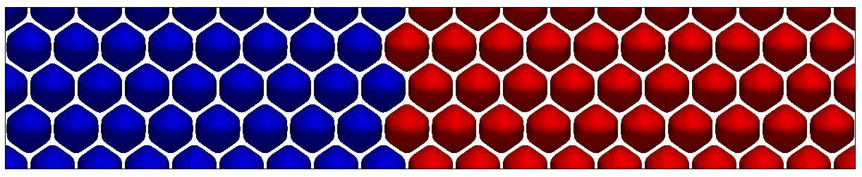
Massively parallel simulation
3960 μm
760 μm
Simulation geometry
Grid dimensions: 600×1586×306 ≈ 300 million, over 4 million iterations!
Simulation of SCN-0.24wt% Camphor, G = 19 K/cm, V = 2 μm/s over 4 hours
Multi-GPU intra-node communication

Slide 9
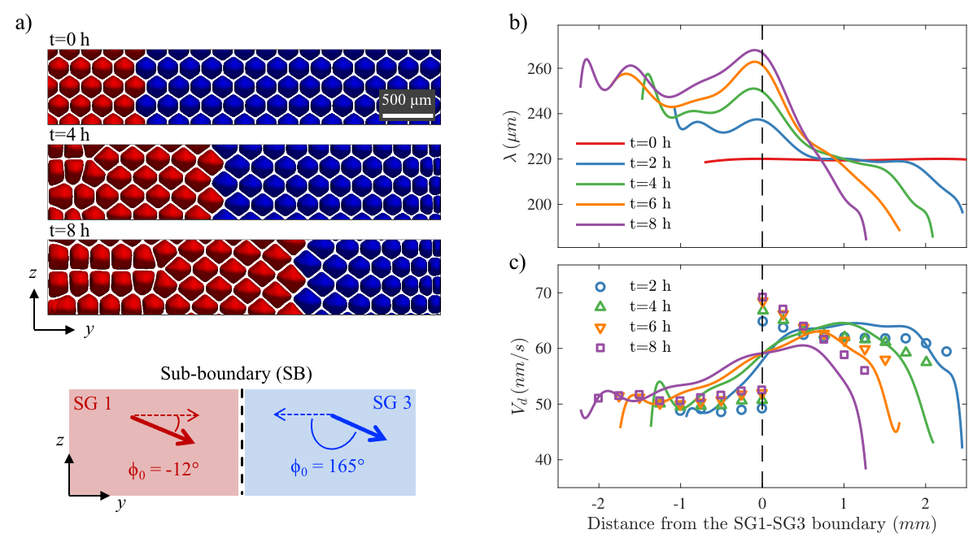
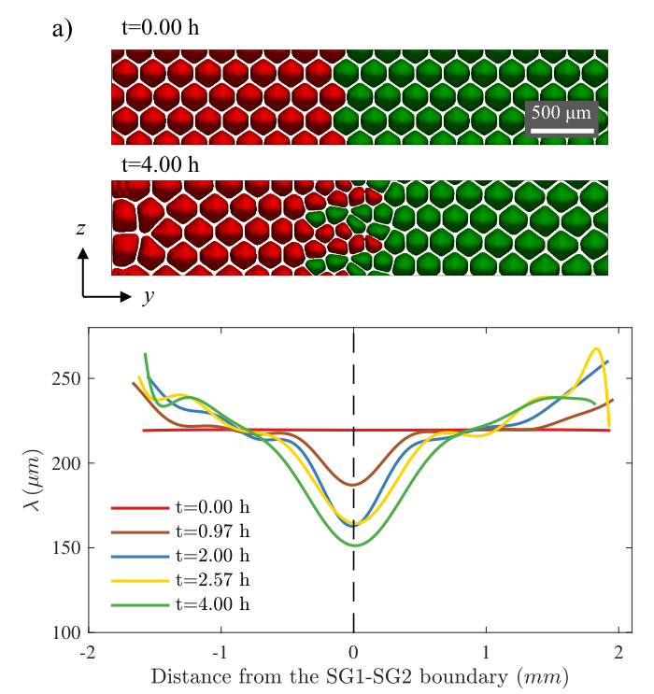
Effects of sub-boundaries
Primary spacing evolution near a divergent sub-grain boundary.
Primary spacing evolution near a convergent sub-grain boundary.
Mota, F. L., J. Pereda, K. Ji, Y. Song, R. Trivedi, A. Karma, and N. Bergeon. Acta Materialia 204 (2021): 116500.

Slide 10
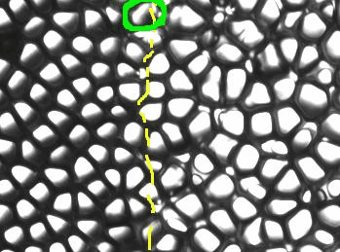
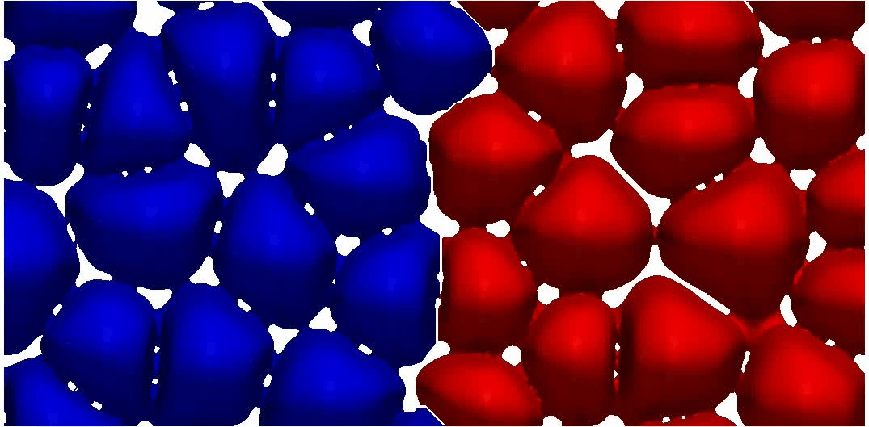
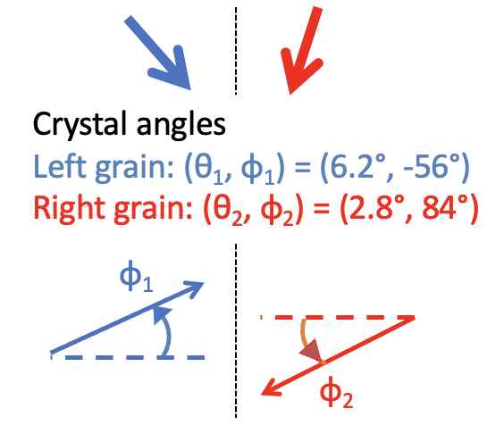
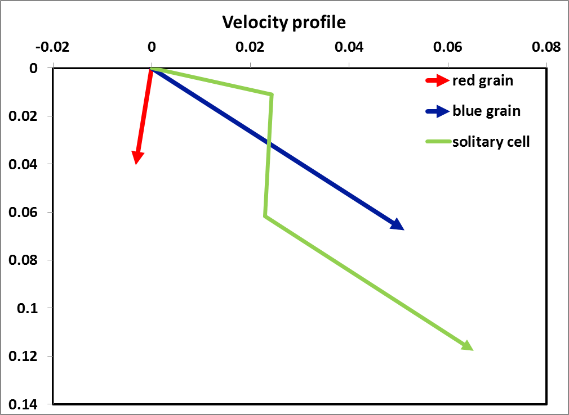
Comparison of experiments and simulations
Experiment
V = 1.5 µm/s, G = 19 K/cm
Simulation
633 μm
Drift velocity of the solitary cell:
Vd [μm/s] = 0.027, 0.054, and 0.07 as it moves from the initial position.
Y. Song, F.L. Mota, D. Tourret, J. Pereda, K. Ji, B. Billia, R. Trivedi, N. Bergeon, A. Karma, in preparation.

Slide 11
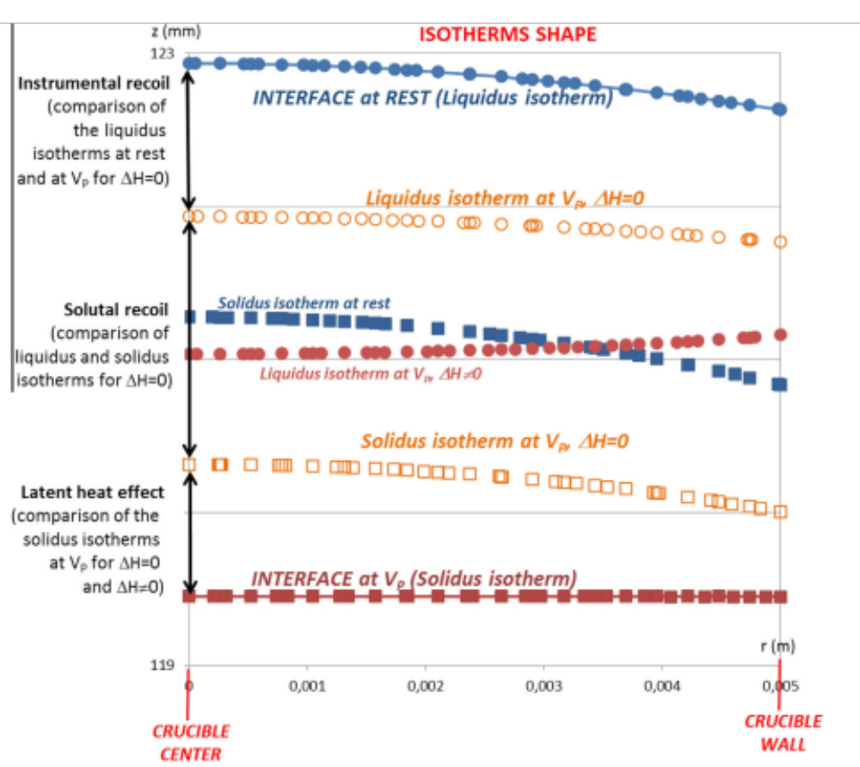
Macroscopic curvature of the interface
The amplitude of curvature depends on the growth velocity.
Mota, F. L., et al. Acta Materialia 85 (2015): 362-377.

Slide 12
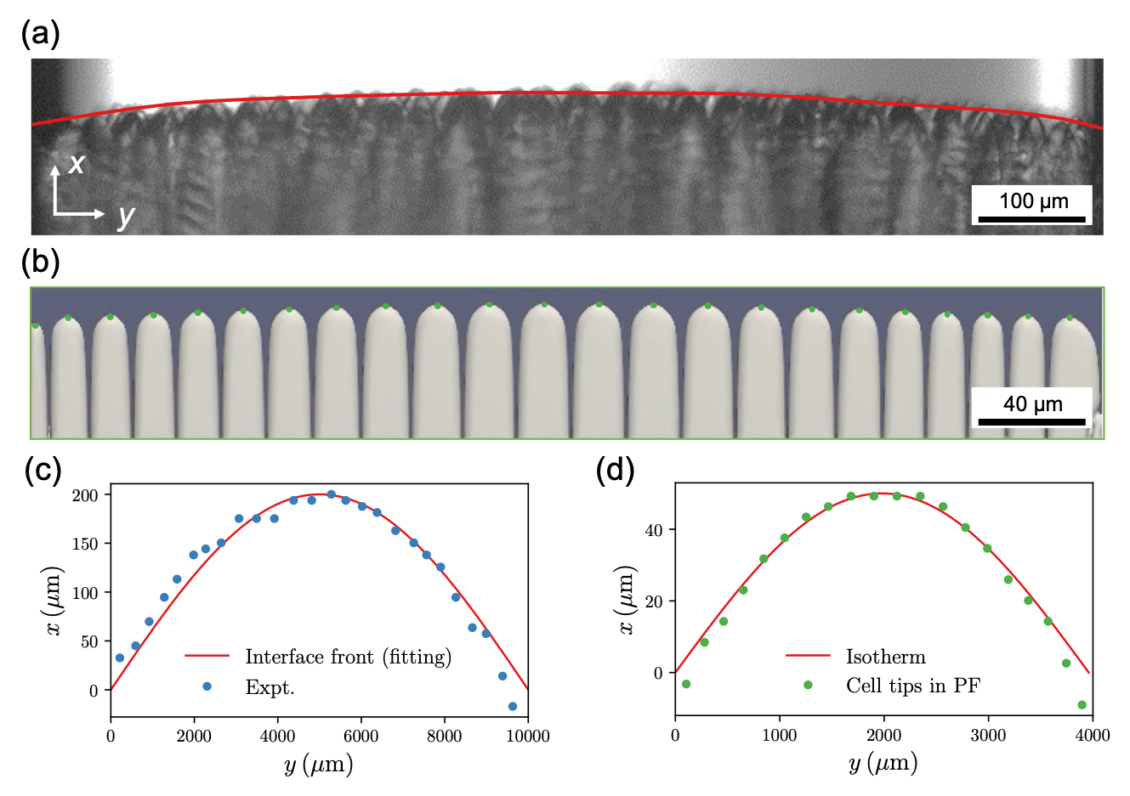
Modeling the macroscopic curvature
A macroscopically convex interface from a side view during the DECLIC DSI-R experiment with Vp = 1.5 μm/s and G =12.5 K/cm.
PF simulation in a thin-sample geometry with a convex interface.
The interface front in the experiment (dots) can be well-represented by a sine wave.
The locations of cell tips (dots) in the central region agree well with the isotherm (line) at the steady state.

Slide 13
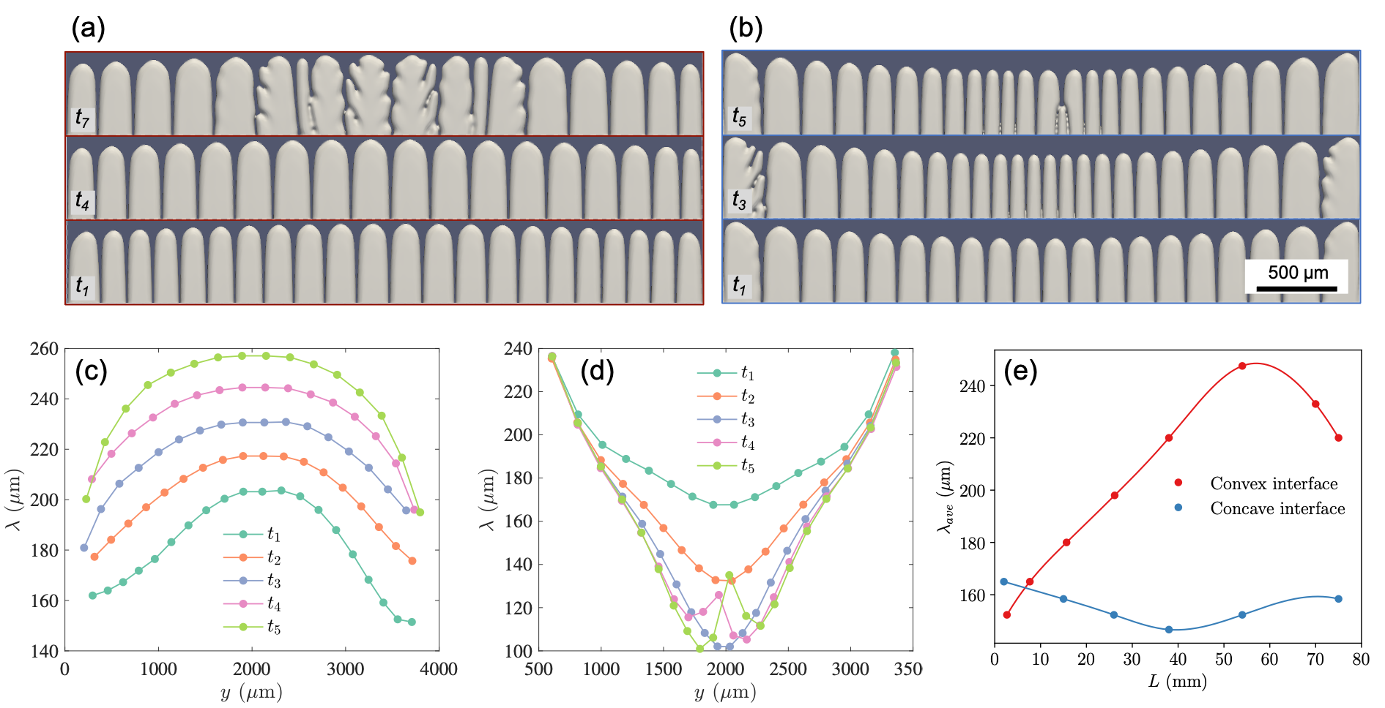
Effects of macroscopic curvatures
The spacing evolution can be affected by macroscopically (a) convex or (b) concave interfaces.
Simulations for SCN-0.24wt% Camphor, G = 19 K/cm, Vp = 2 μm/s

Slide 14
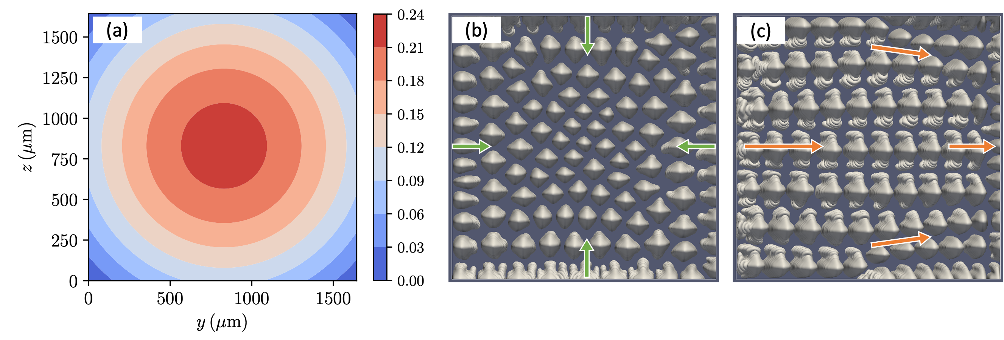
Modeling curvature effects in 3D
The radial temperature profile in a 3D sample.
Effect of a concave interface.
Combined effects of the curved interface and misorientation (10°).
Simulations for SCN-0.46wt% Camphor, G = 12.5 K/cm, Vp = 6 μm/s

Slide 15
Summary
Experiments using the DECLIC experimental setup aboard the ISS provide us with a unique opportunity to observe the dynamical formation of spatially extended 3D patterns under diffusive growth conditions.
Quantitative phase-field simulations with massive parallel implementation can model the microstructure evolution at experimentally relevant time and length scales.
Both the divergent and convergent grain boundaries can affect the primary spacing distribution during directional solidification of binary alloys, even for the low angle sub-boundaries.
The interfaces with macroscopic curvatures were frequently observed in the DECLIC experiments. Even a weak macroscopic curvature can affect the global behavior of growth interfaces.

Slide 16







Acknowledgement
Kaihua Ji, Y. Song*, A. Karma
Northeastern University
F.L. Mota, N. Bergeon
Aix-Marseillé Université
T. Lyons, R. Trivedi
Iowa State University
L.L. Strutzenberg
Marshall Space Flight Center
This research is supported by NASA through awards 80NSSC19K0135 and NNX16AL77G, and CNES through the MISOL3D project (Microstructures de SOLidification 3D).
* Currently at Lawrence Livermore National Laboratory

Slide 17
Thank you
for your attention

