Slide 1
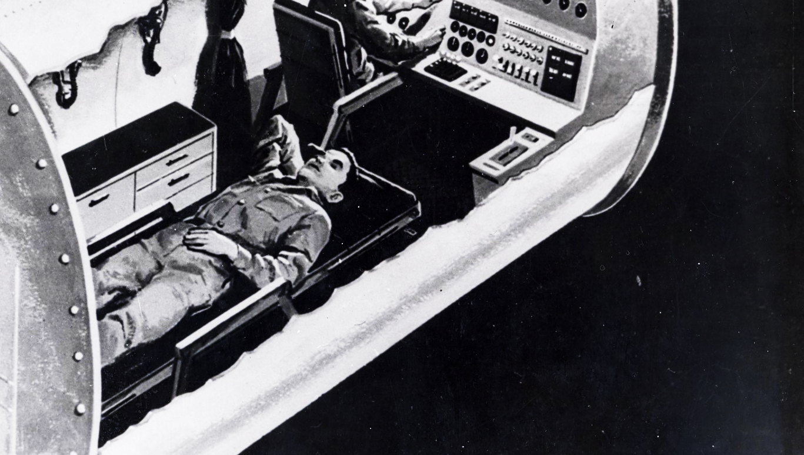
My Life as a
NASA Test Subject
Joe McMann January 2018 Rev. October 14, 2021

Slide 2

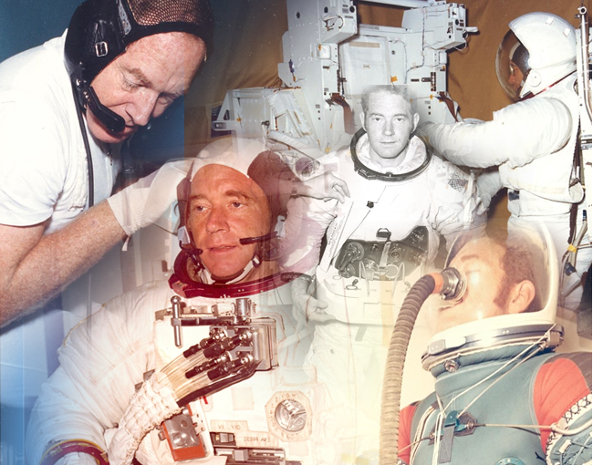




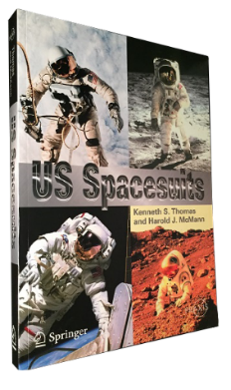
Joe
McMann
Graduated in 1959 with BS in Chemical Engineering from Univ. of Notre Dame
1959-1961: Application Engineer for Liquid Carbonic, Chicago, IL
1961-1997: Project Engineer, and manager with NASA JSC – associated with environmental control systems and space suit systems-acted as test subject, real-time support engineer, subsystems manager, technical manager
1997-2002: Technical Specialist for Hamilton-Sundstrand – associated with space suit failure resolution - development of urine measurement system – teaching failure recovery planning – mentoring
2002 – present: Consultant to NASA and industry – co-authored “US Spacesuits” with Ken Thomas, formerly with Hamilton Sundstrand – participant in JSC Spacesuit System Knowledge Capture initiative – acted as consultant to Spacesuit Water Intrusion Mishap Investigation Board – NASA Engineering and Safety Center representative - Consultant on new spacesuit development
Most memorable EVA-related achievement: Was test subject for every EVA system for which he had responsibility: Gemini, Skylab and Shuttle/International Space Station (ISS) EVA Space Suit Life Support Systems

Slide 3
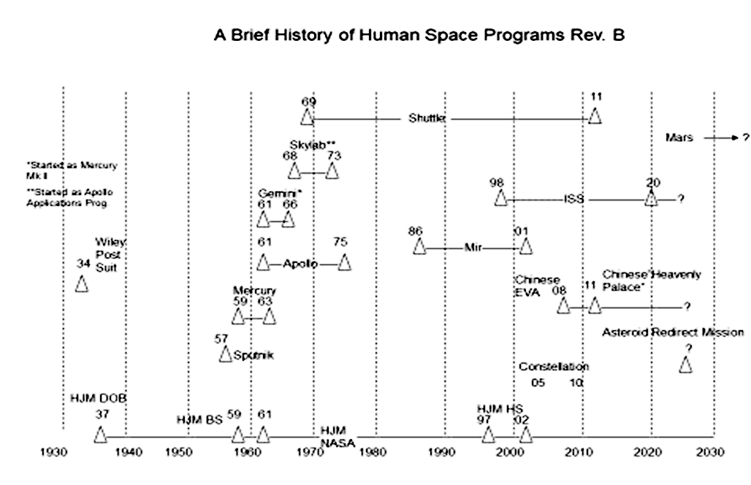
Ed White EVA 6-3-65

Slide 4
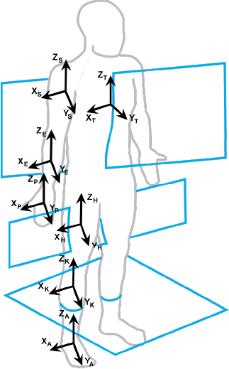
What is a NASA test subject?
Needs to be able to undergo long periods of discomfort, and pain
Needs to be in good physical shape
Someone who acts in place of an astronaut
Tries out the item or activity first
Helps identify and correct problems before the crew sees them
Needs to know when to say “STOP”.

Slide 5
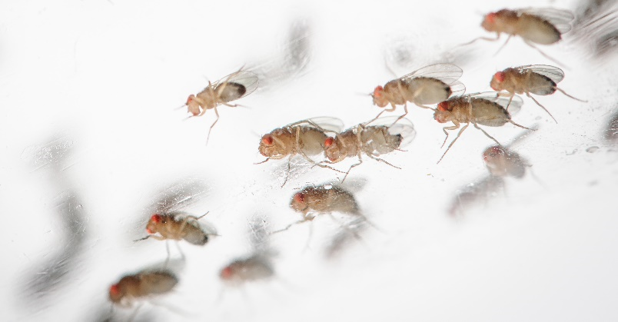
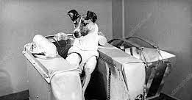
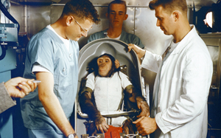
Before Mercury, US and Russia launched animal subjects such as monkeys, mice, dogs and fruit flies
Wait a Minute…
Are Only Humans Allowed to be NASA Test Subjects?
Laika
Laika, a Russian dog was launched on a one-way trip onboard Sputnik 2 in November 1957 – she died in orbit
Ham
In January 1961, 71 days before Yuri Gagarin’s flight, a chimp named Ham made a suborbital flight for the US
(he’s the one in the middle)

Slide 6
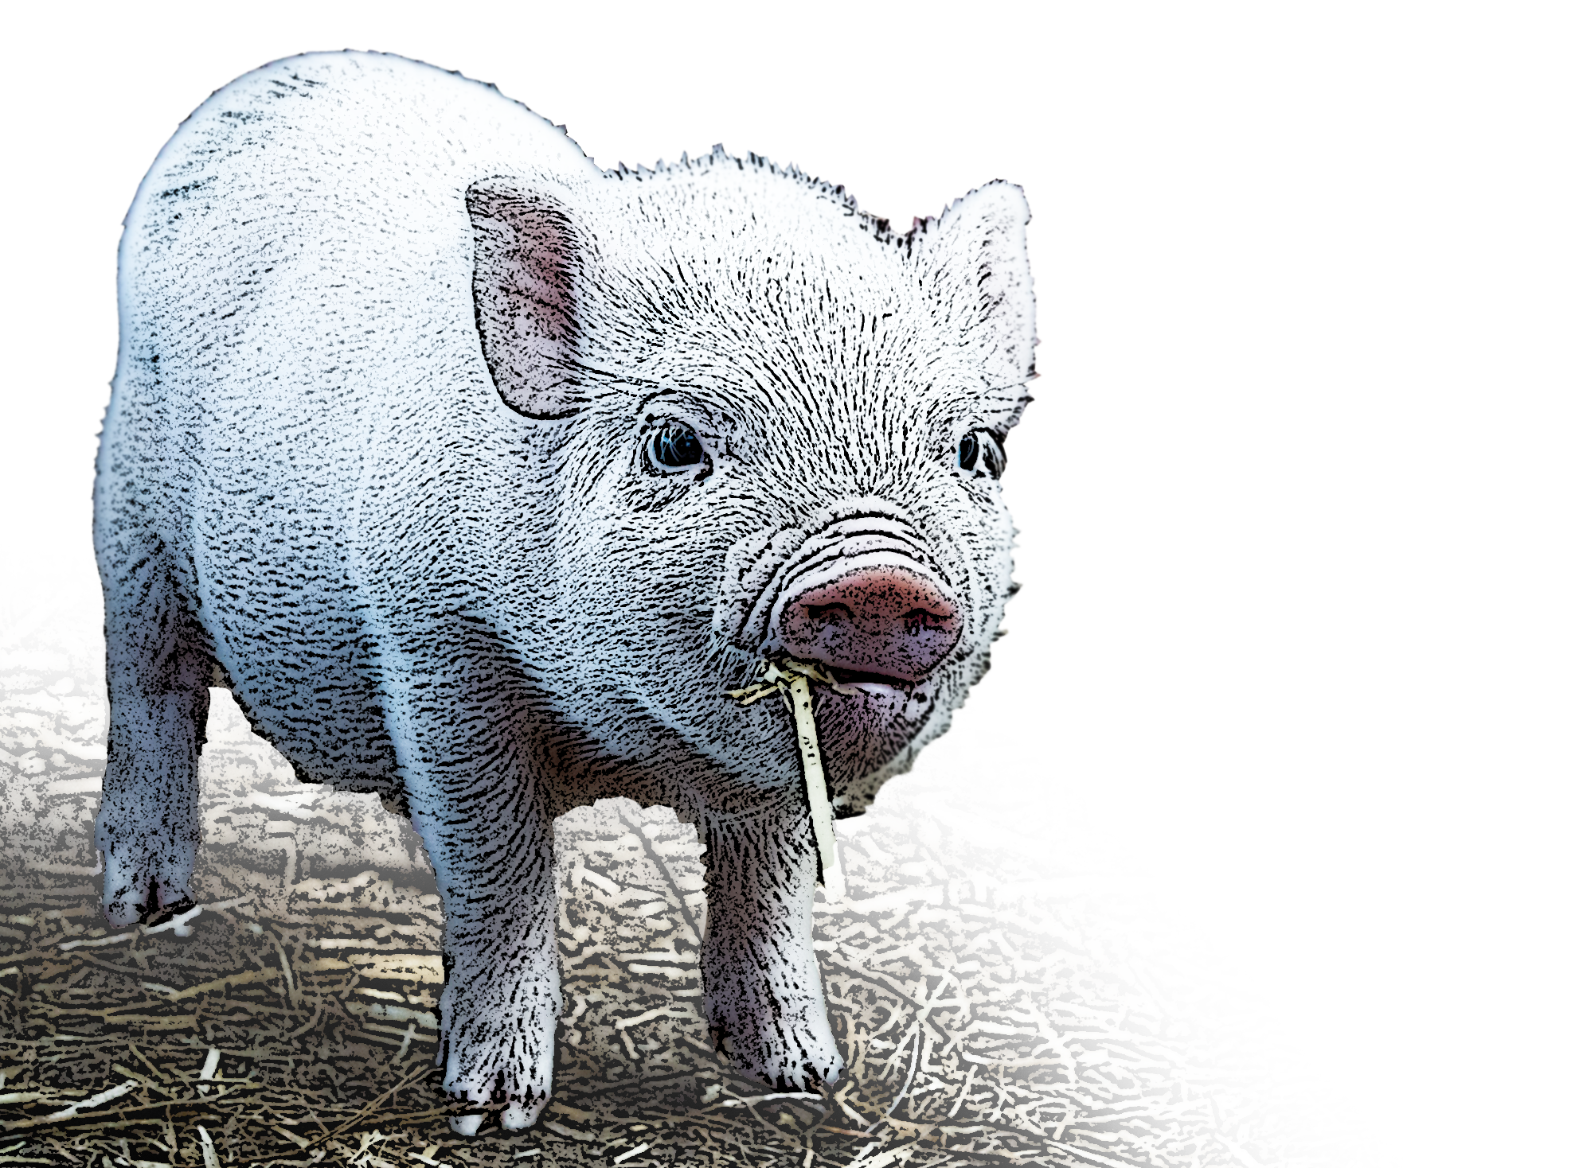
Not Every Proposed
“Animal-naut” Made the Cut…
NASA, in its biomedical wisdom, decided that a pig would be a suitable test subject
  They have the same thoracic and abdominal organs as humans
  Pig valves have been used in humans for 30 years
Accordingly, a porcine-compatible capsule was designed, and a sketch is shown on the following slide

Slide 7
Pig-a-naut Saga…
You sold us a defective pig.
NASA went to a farmer, and purchased a pig
They then proceeded to instrument the pig and place it in a specially designed couch
They gleefully instrumented the pig and started to gather data
The pig promptly died
Incensed, NASA returned to the farmer and said that he had sold them a defective pig
He denied this, and asked them exactly what they had done, and they explained
What did you do to the poor pig?

Slide 8
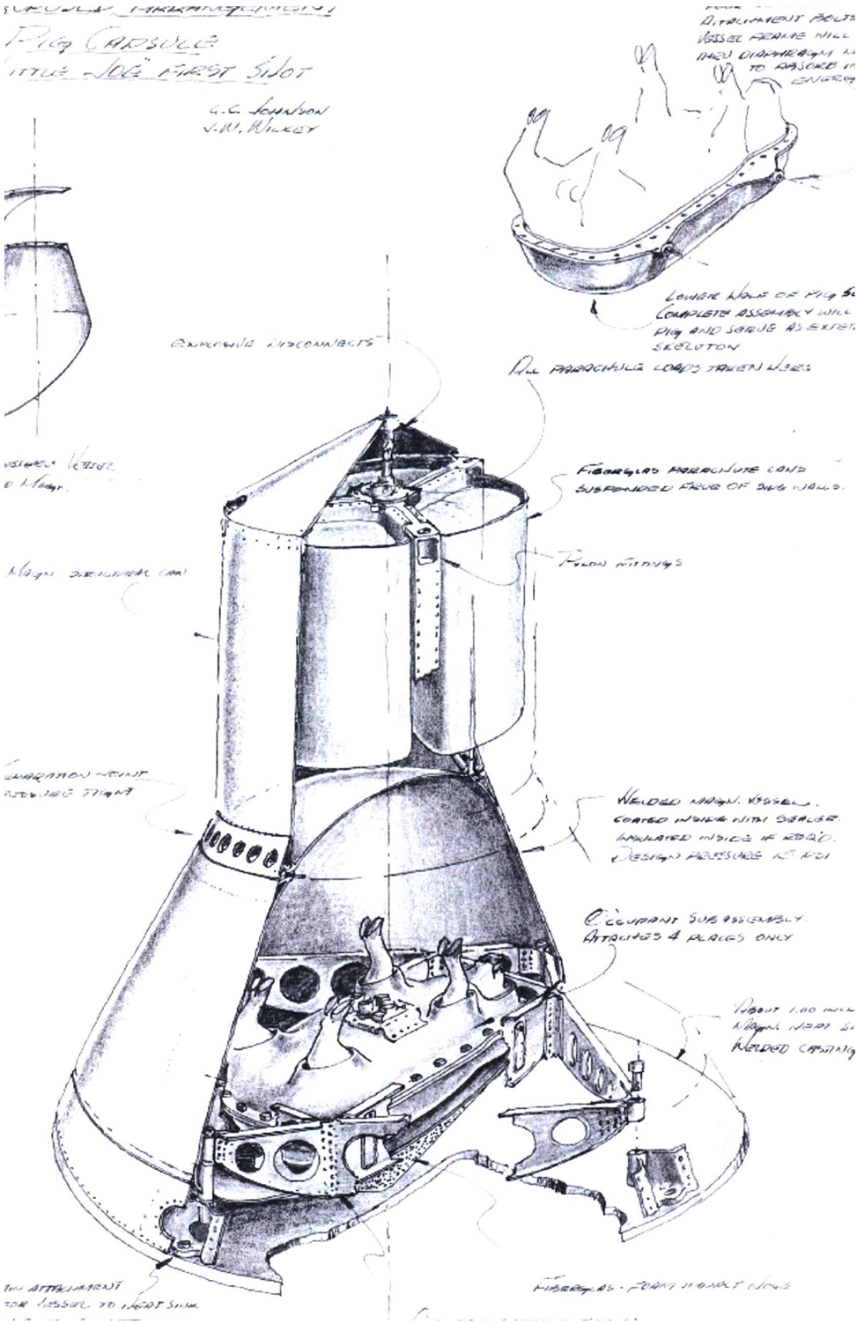


A Real Pork-Barrel…
Notational idea of porcine test subject

Slide 9
A Pig’s Gotta Know His Limitations….
The Farmer replied…
You dummies! You can’t put a pig on his back for a prolonged time ‘cause he’ll suffocate!”*
* I can’t find corroboration of this, but I know that we never flew a pig!

Slide 10

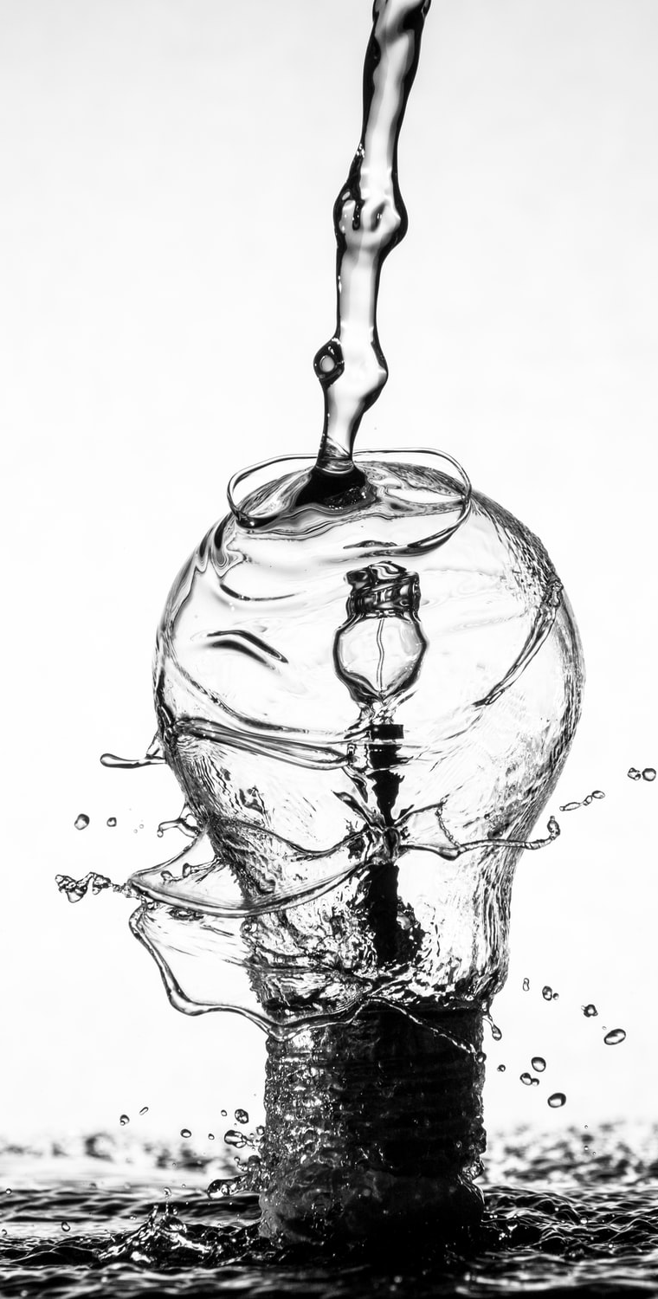
How About Non-living Test Subjects?
Testing of spacesuits’ mobility and dexterity by humans turns out to be largely subjective
  Some subjects find tasks easy to do; others have more difficulty
  A NASA manager decided that he would pursue a more quantitative approach
  A contract was let to produce an articulated dummy, which would have the capability to give accurate force measurements
The following slide shows the resulting product – an electro-hydraulically-operated robotic, anthropomorphic “dummy”

Slide 11
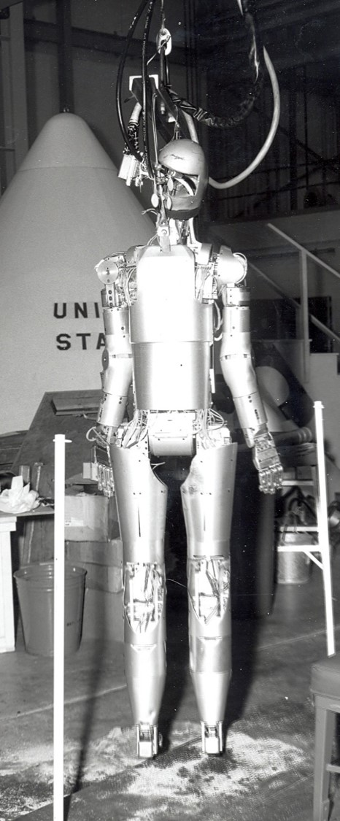
Articulated Dummy….1965
Dummy controlled from console, not shown
Sawdust sopping up leaking hydraulic fluid

Slide 12
Sounded Like a Good Idea at the Time….
There were two major problems:
  When the operator told the dummy to raise an arm, it raised a leg
  When the operator told the dummy to raise a leg, it raised an arm
  Hydraulic fluid leaked all over the place
    This would ruin the spacesuit test articles
It was decided to live with human evaluators

Slide 13
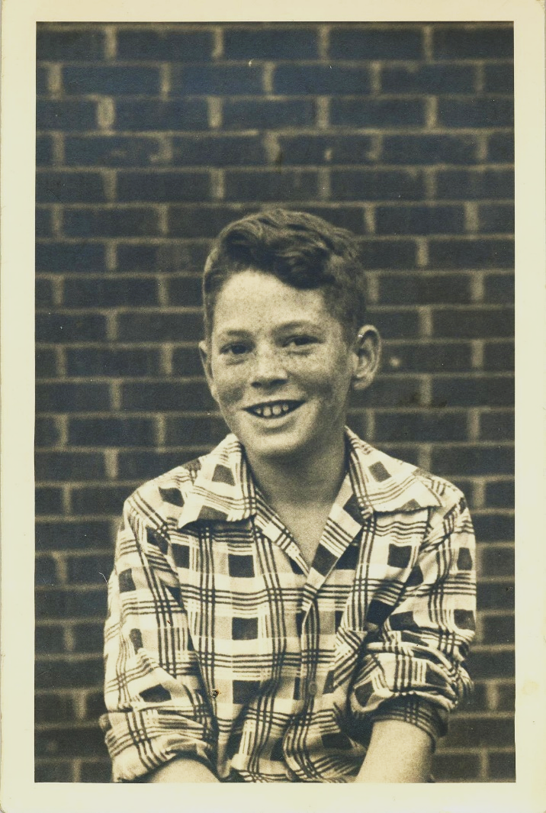
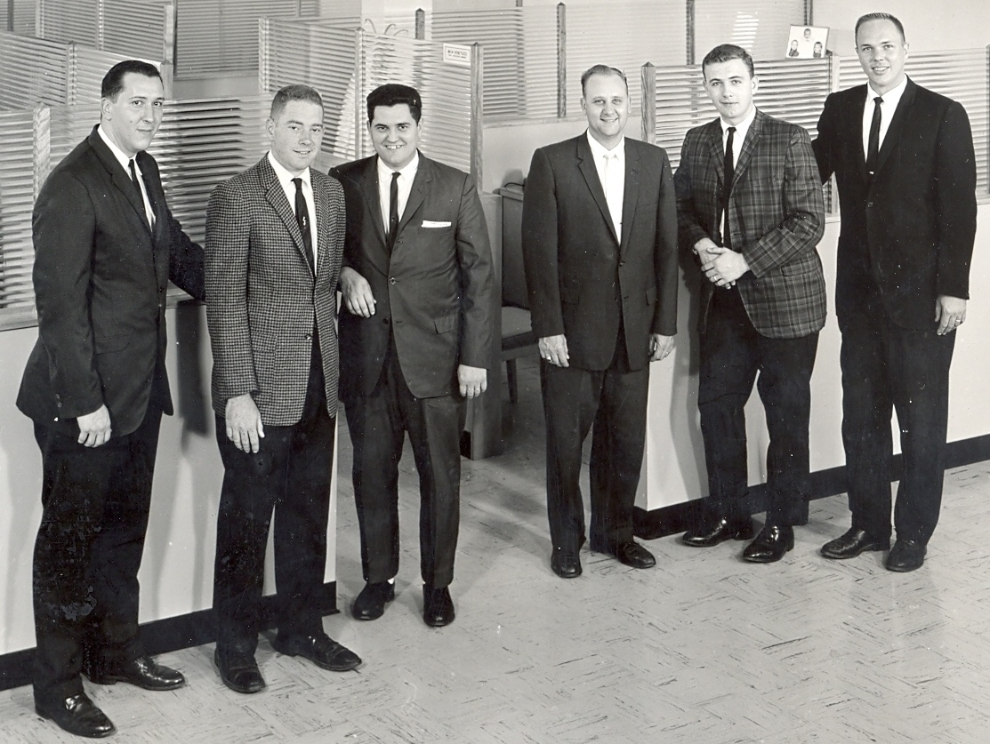
My Path to NASA…
1950
1960 – at Liquid Carbonic

Slide 14
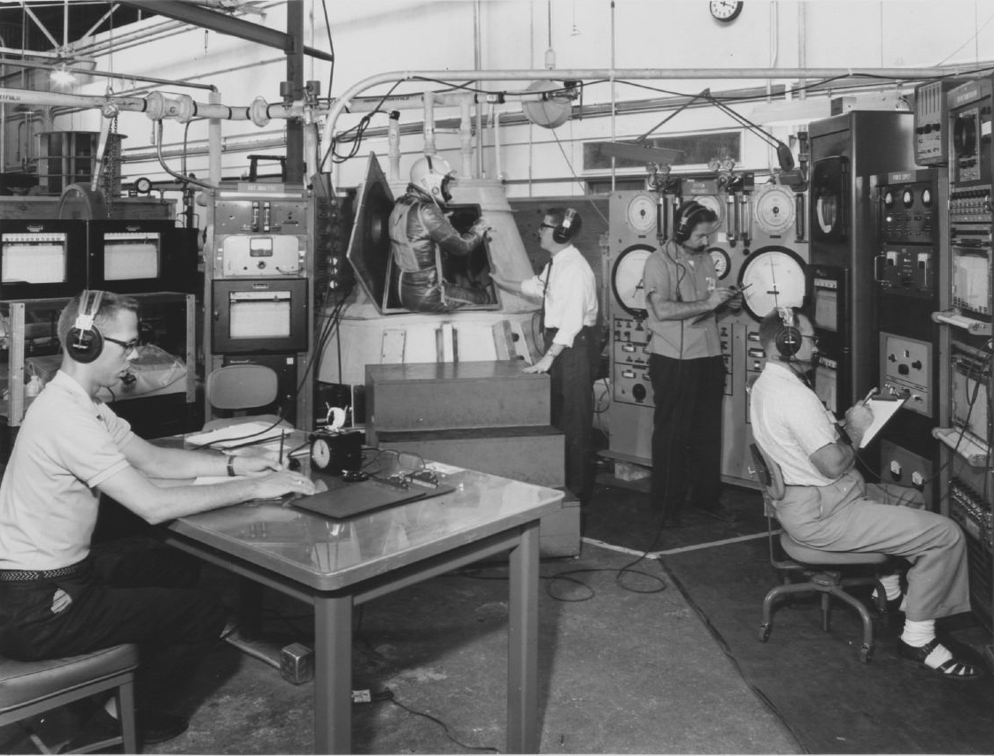
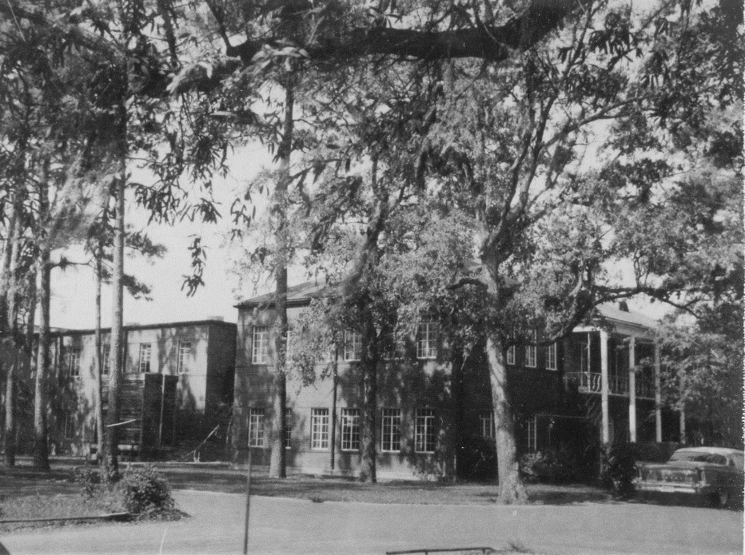
The Move to Houston - 1962
The Lane-Wells Building – one of 17 occupied by NASA throughout Houston before the Johnson Space Center was opened in 1964
NASA S-62-3680
Mercury test capsule

Slide 15
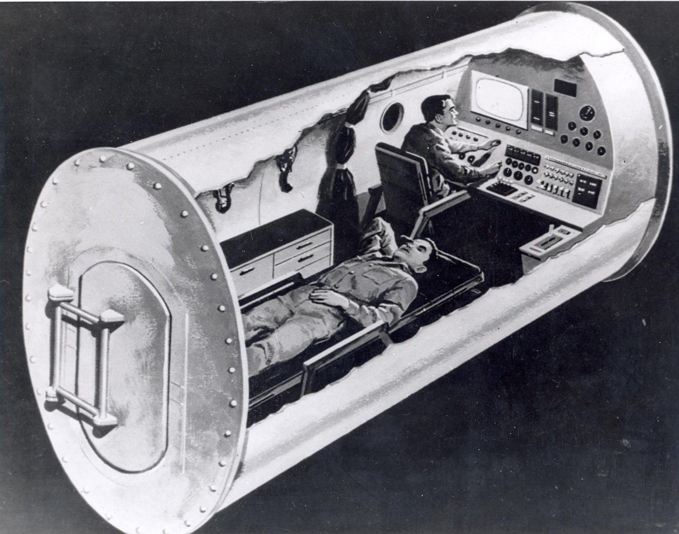
Altitude chamber at Brooks AFB, San Antonio - 1962
“Psycohomotor” panel
Port for attaching “torpedo tube” to insert food, etc.

Slide 16
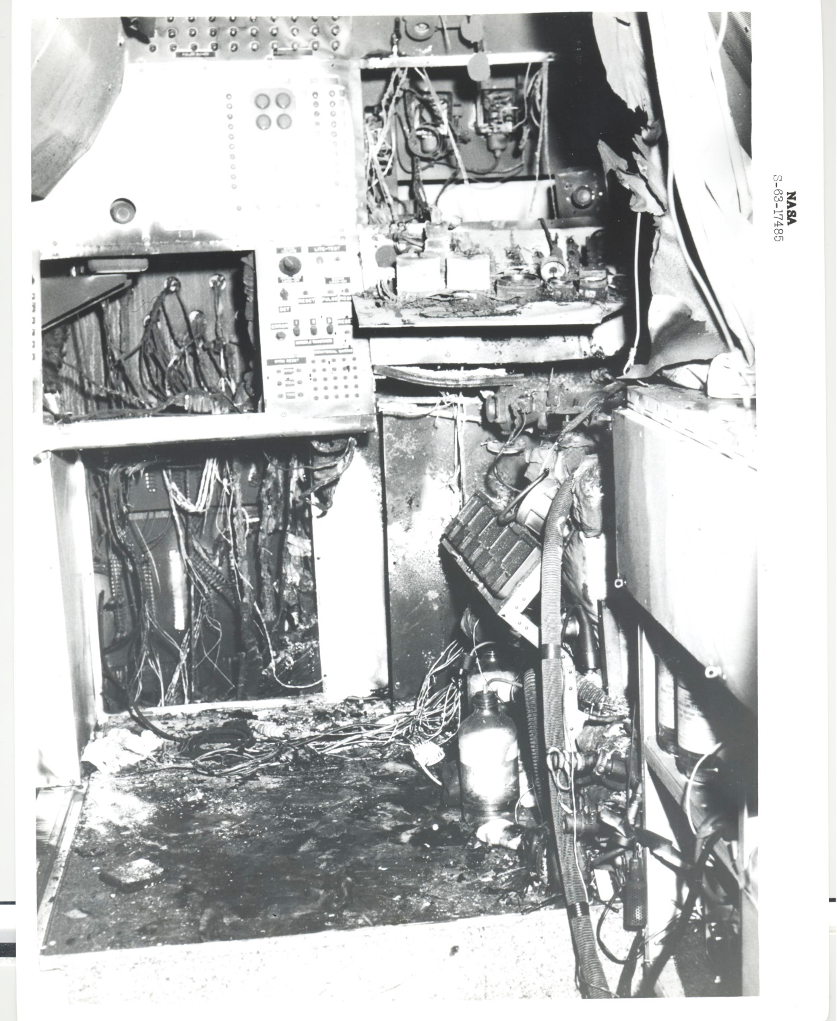
Flash fire on Sept. 9, 1962 (day 13 of 14-day test in 5 psia pure oxygen)
Fire started in psychomotor panel and resulted in smoke inhalation and temporary lung damage to two Air Force test subjects in partial-don suits

Slide 17
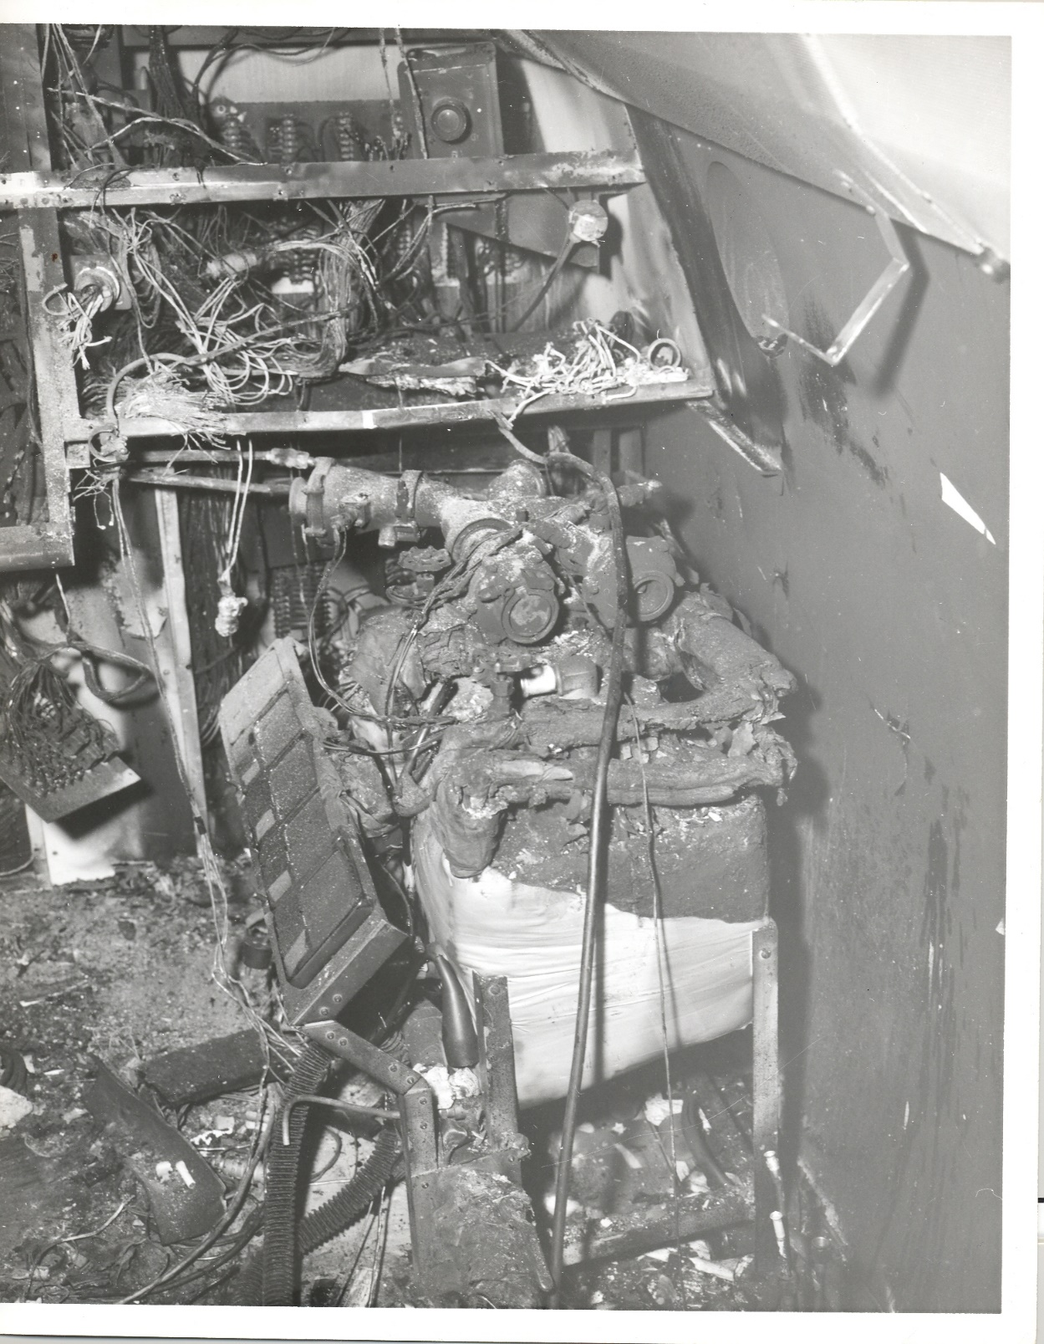
Four Project Mercury suit ventilating compressors furnished by NASA and used to ventilate the two test subjects

Slide 18
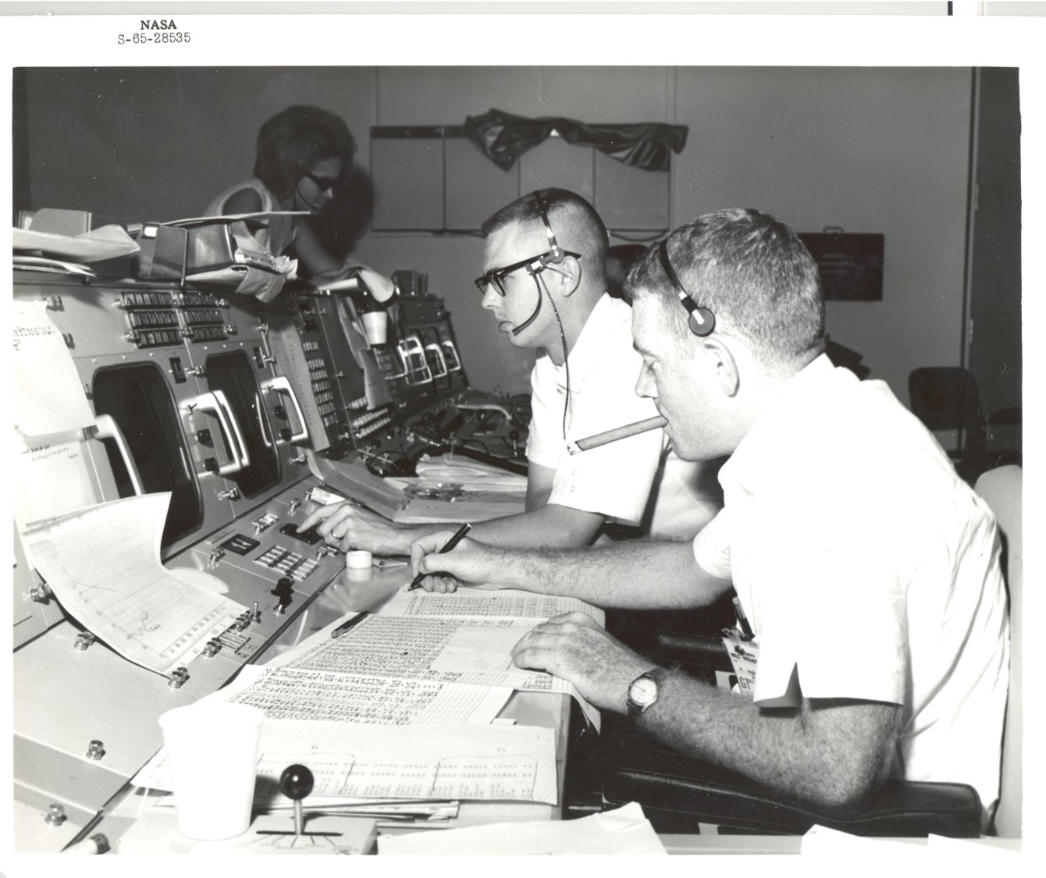
Gemini Mission Control Staff Support Room – 1965
(Dutch Masters Panatela)

Slide 19
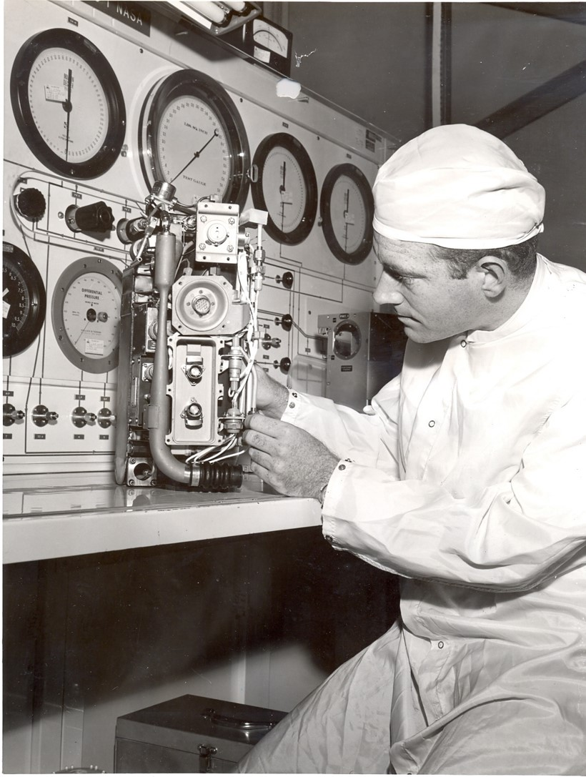
With Gemini Extravehicular Life Support System (ELSS) chestpack – 1966
This picture was staged – they were very nervous about letting me into the lab

Slide 20
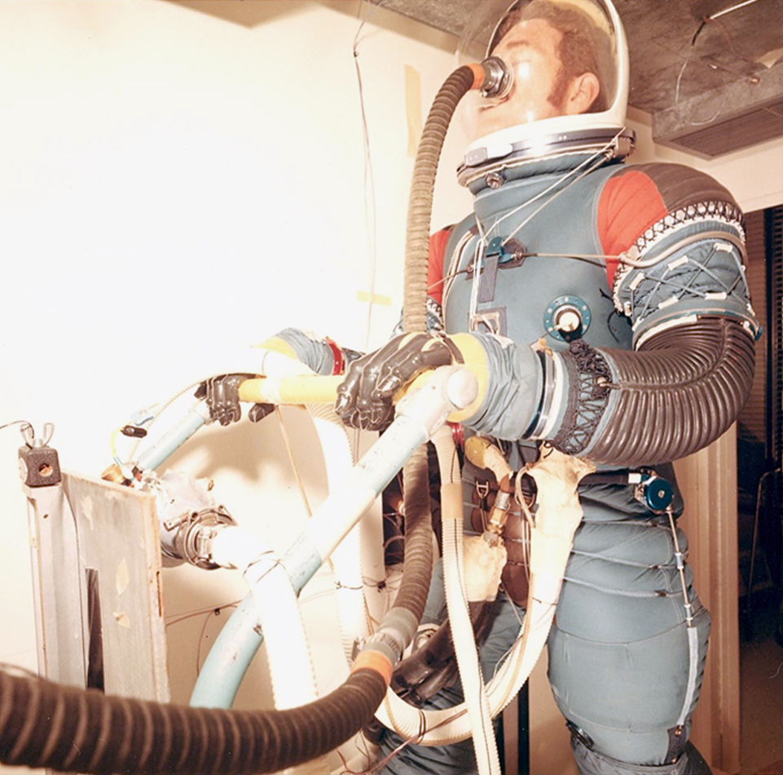
Testing Early Apollo Suit on treadmill – 1969
Oxygen intake and carbon dioxide generation were measured to give a calculation of metabolic rate vs treadmill speed and heart rate

Slide 21
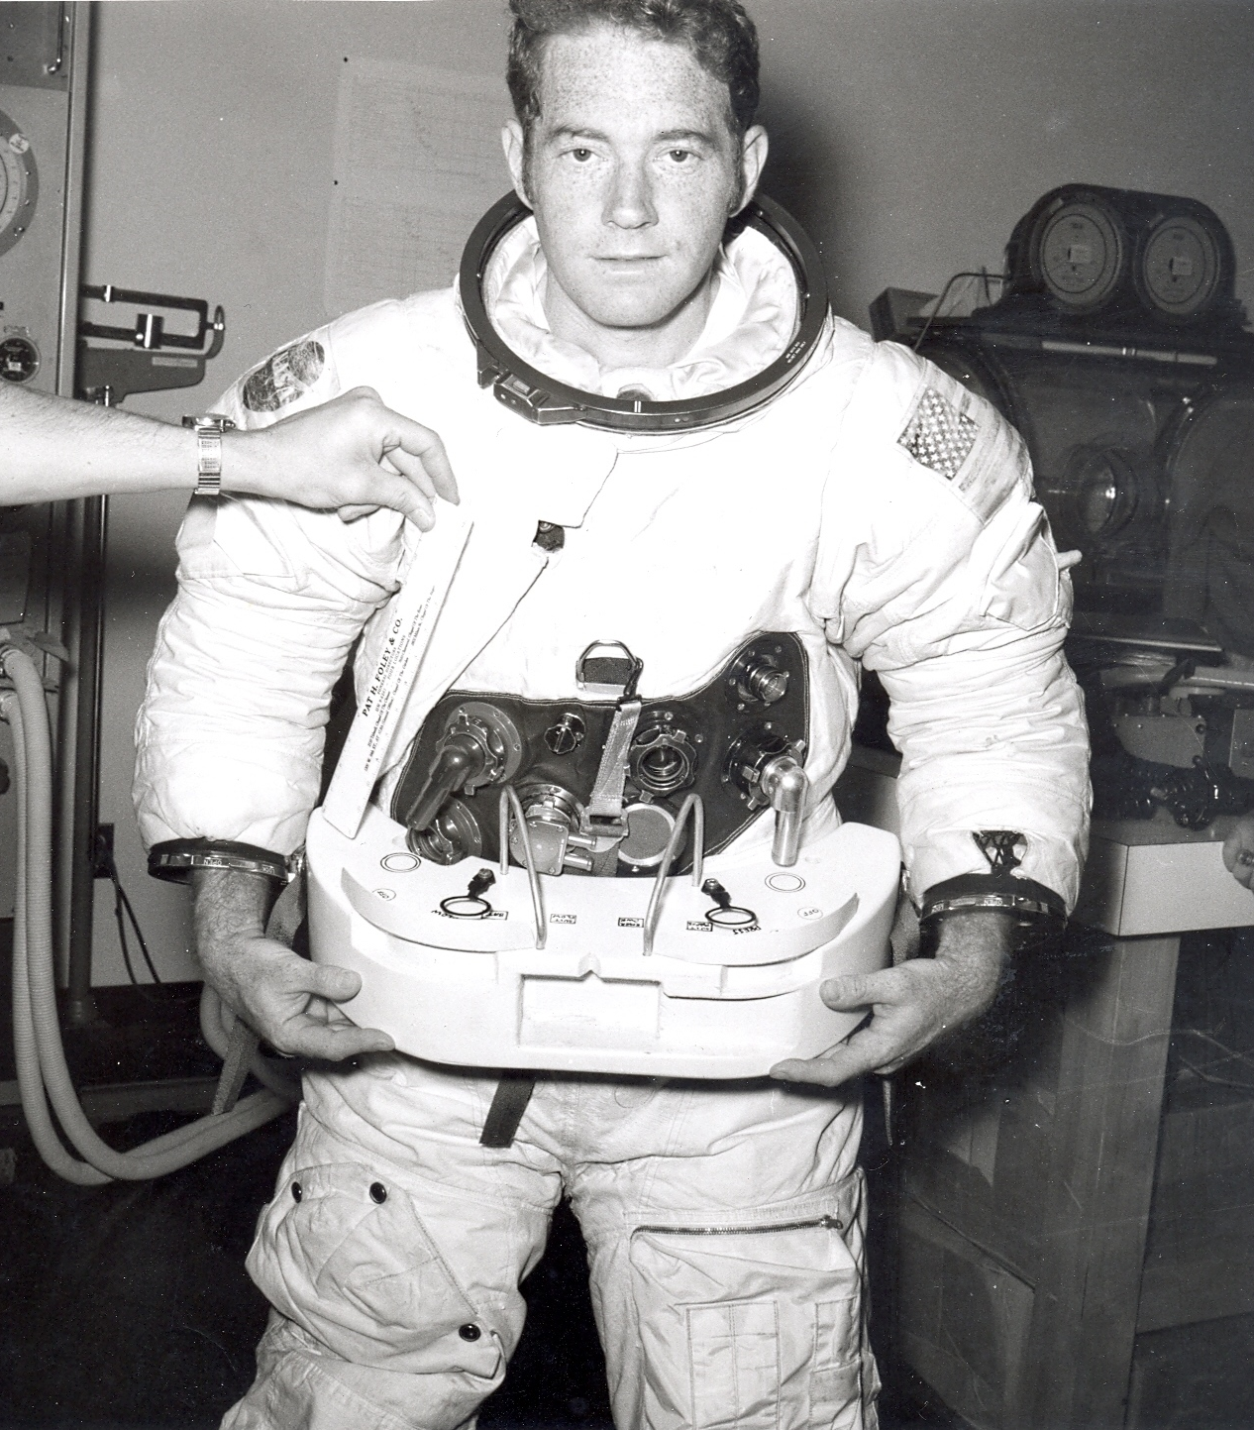
Evaluating early concept of Skylab Astronaut Life Support Assembly - 1970

Slide 22
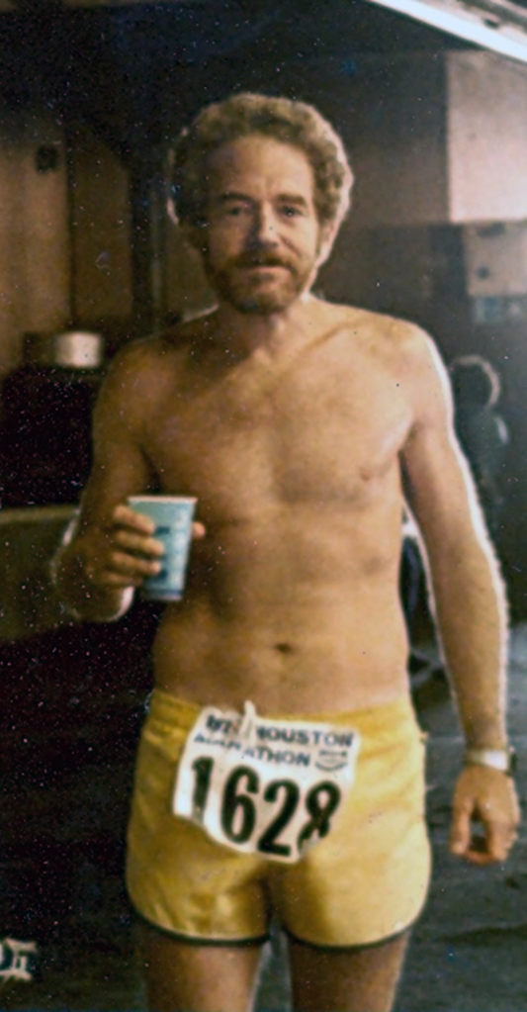
…staying in shape…taken after the Houston Marathon, January 1979

Slide 23
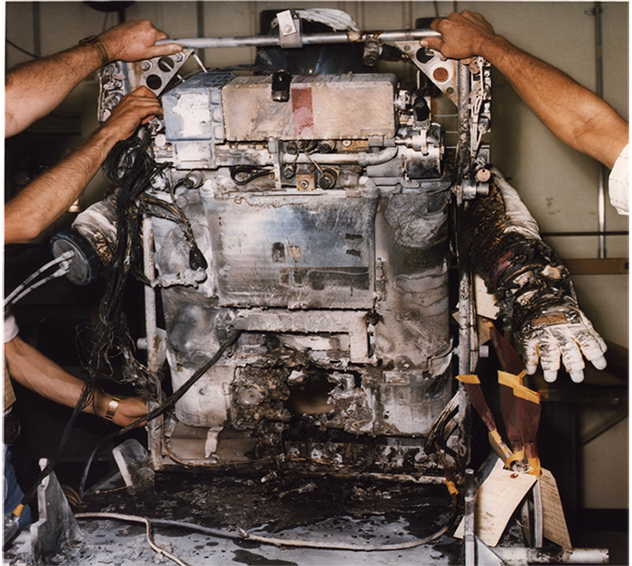
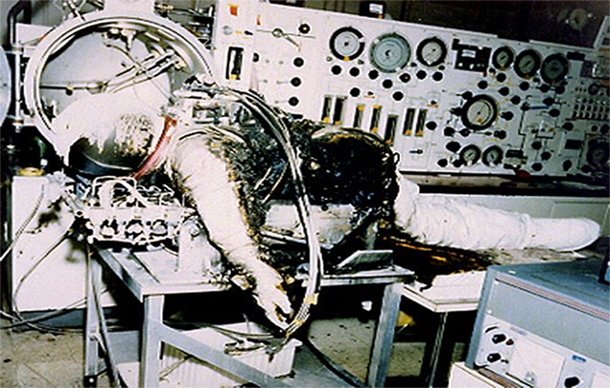
Aftermath of Shuttle EMU fire – April 1980
The next time that this system was to be used was for a manned test….I was the backup test subject

Slide 24
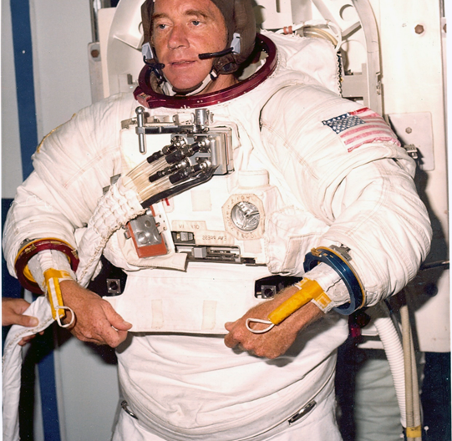
Preparing for thermal vacuum test of Shuttle Extravehicular Mobility Unit (EMU) - 1981

Slide 25
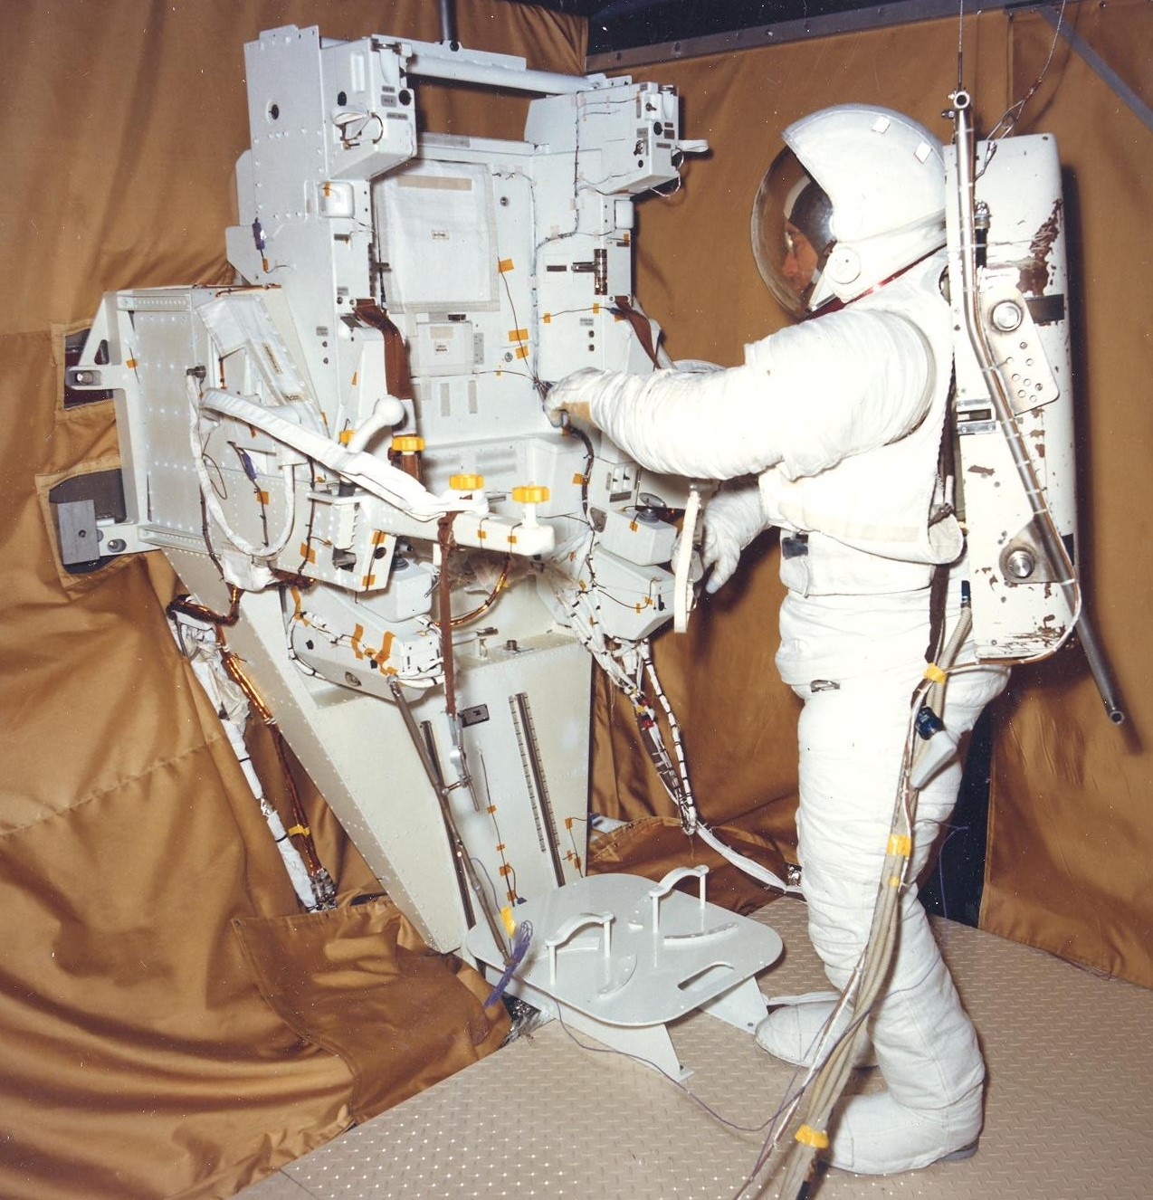
Dry run for test with Manned Maneuvering Unit (MMU) in thermal vacuum chamber - ~1982
The next day, I performed the test at vacuum

Slide 26
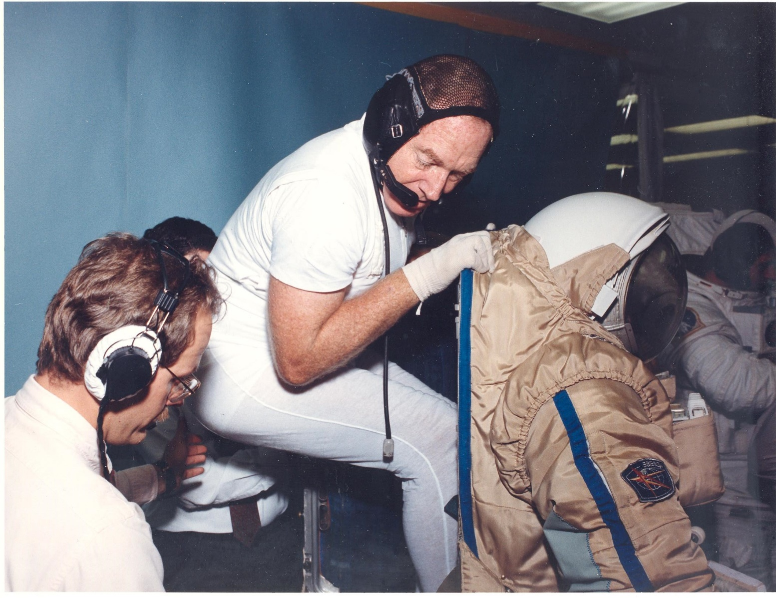
Donning Russian Orlan Space Suit - ~2000
The advanced suit that NASA is working on has a rear entry

Slide 27
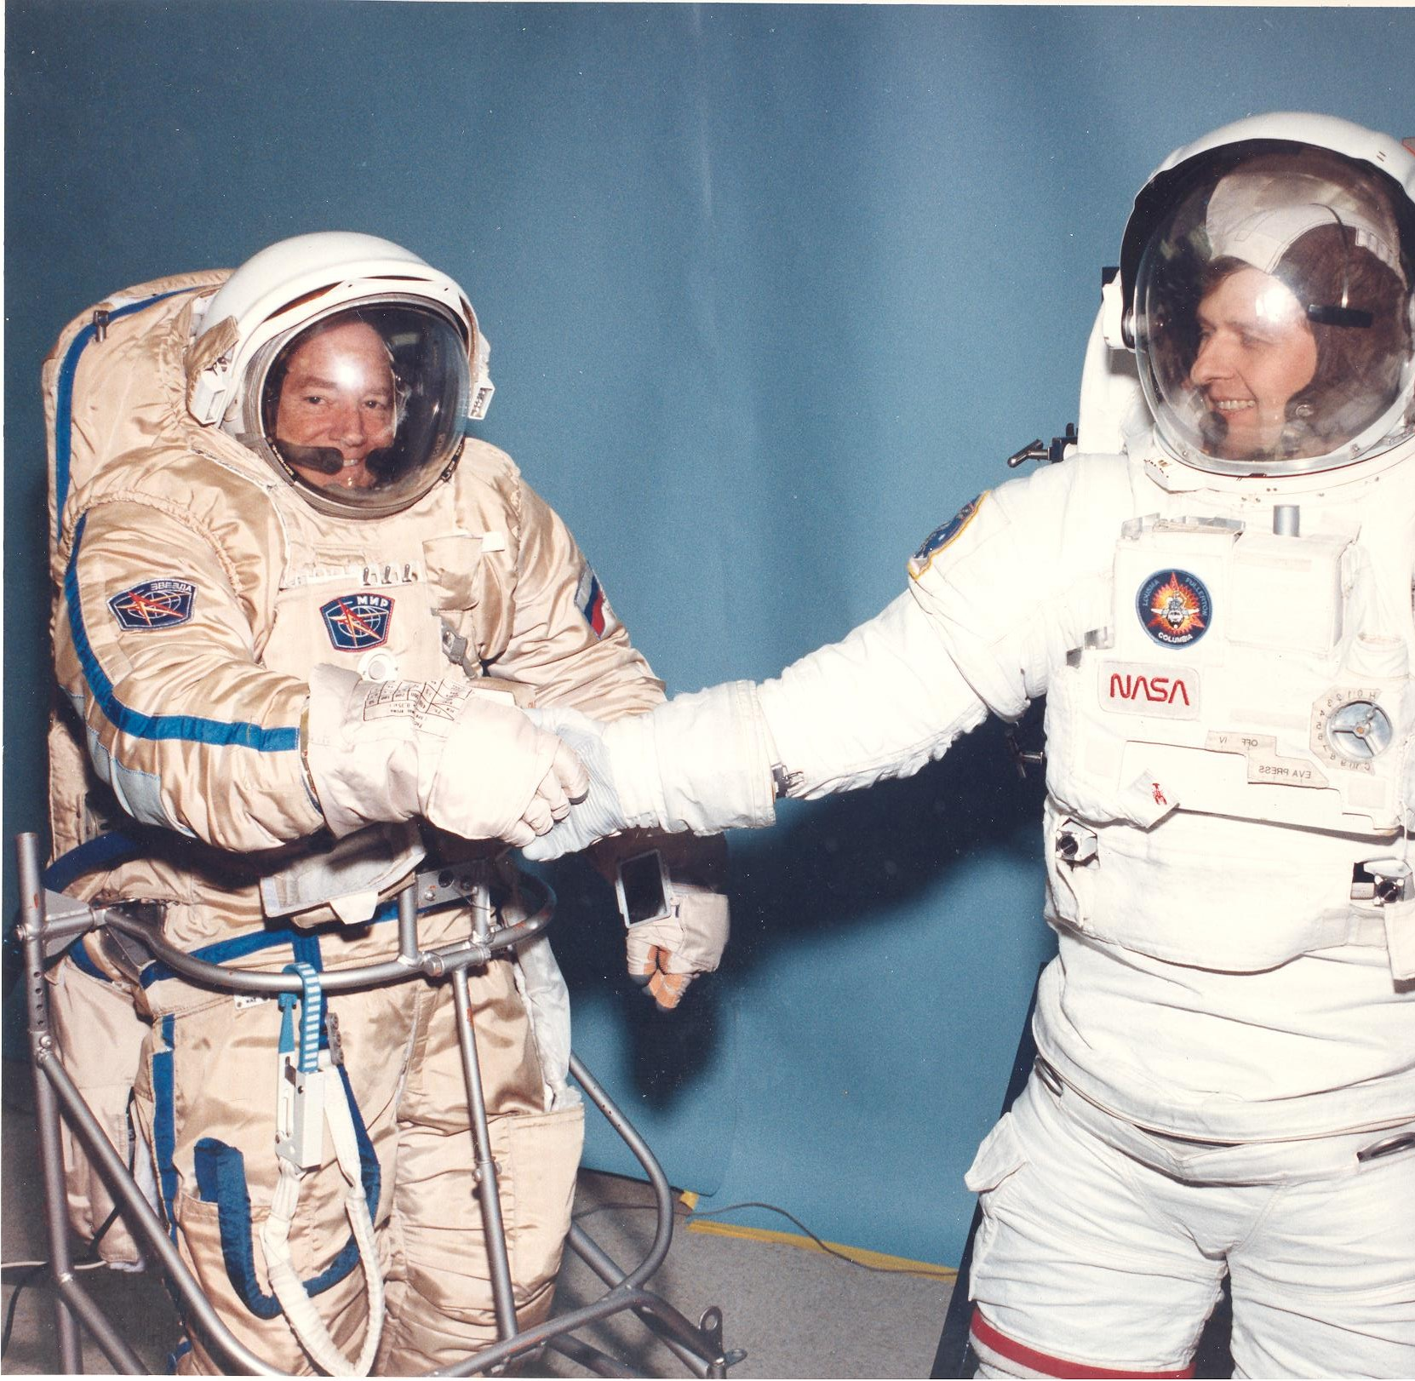
Joe in the Orlan;
Russian in the Shuttle EMU - ~2000

Slide 28
Wrap-up…
Was test subject for about 18 years
Tested every system for which I was the responsible engineer
Got the “bends” (DCS) twice during testing to develop the pre-breathe protocol for Shuttle and used on ISS
Tested in both simulated space cold and heat at vacuum
Flew 0-G aircraft to evaluate systems
Learned to never let them know I was having fun

