Slide 1
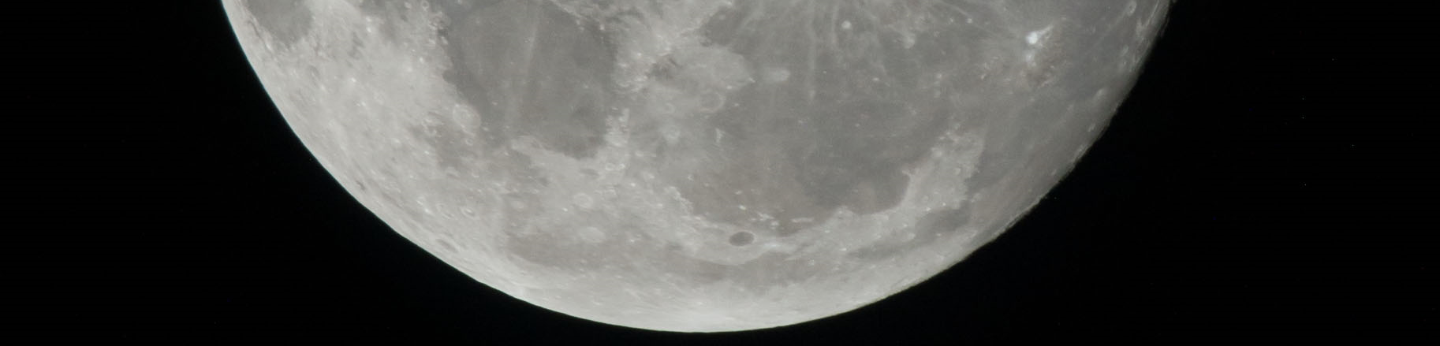

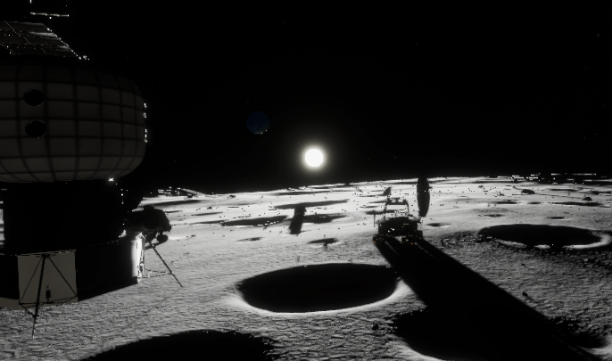
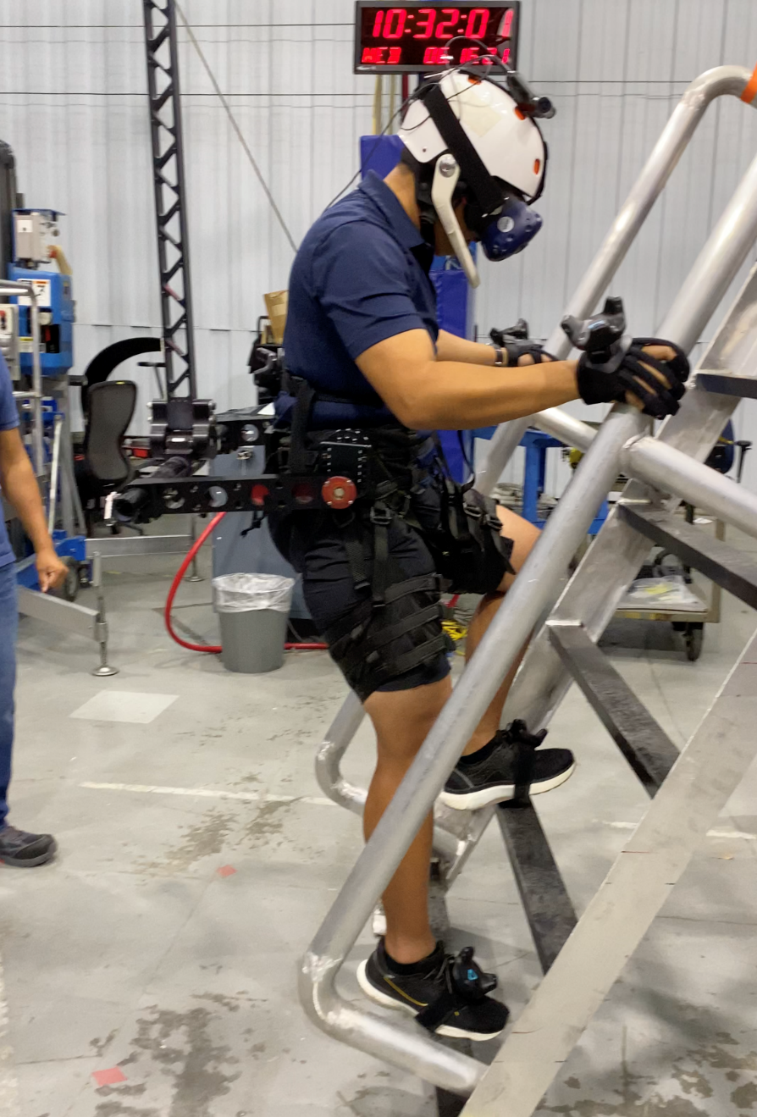
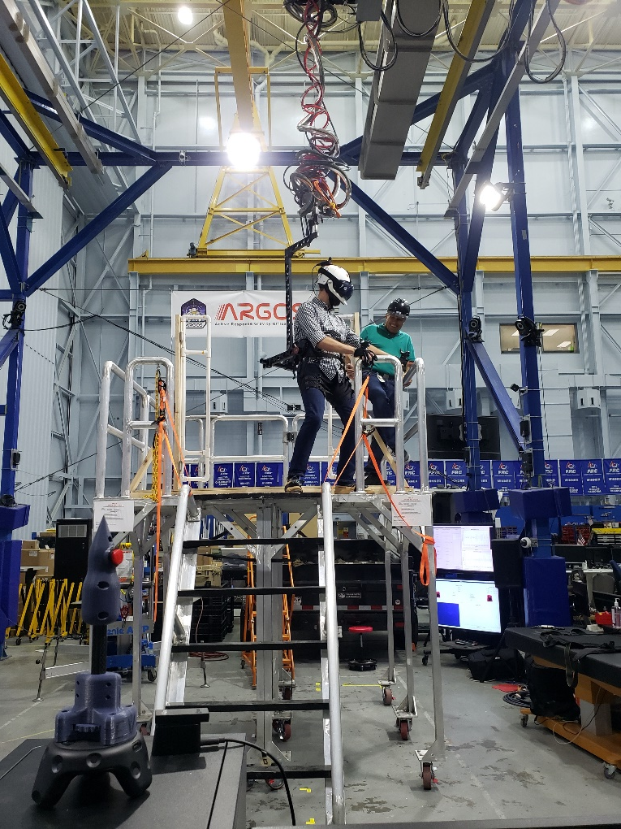
Lunar Surface VR/ARGOS Trainer
National Aeronautics and Space Administration
Johnson Space Center (JSC) / White Sands Test Facility (WSTF) 2021 JSC Technology Showcase: FY21 CIF IRAD
Lee K. Bingham / lee.k.bingham@nasa.gov, Eddie Paddock, Paul Valle
Technology Taxonomy Area (TX): 11.3.4 - Simulation-based Training Decision Support Systems; 13.4.2 - Team Preparedness and Training
TRL: start 5 / current 6
FY20 IRAD PROJECT Overview
This proposal aims to provide insight by identifying potential risks and unknowns of lander egress and surface operations through a Mixed Reality (MR) planning, training, and analysis capability that integrates Virtual Reality (VR) simulations and the Active Response Gravity Offload System (ARGOS).
INNOVATION
This project aims to provide a digital representation of the lunar south pole for risk reduction, training, and engineering design evaluation. This digital environment will be combined with a human-rated gravity off-load system and a mockup of the lander porch and ladder to simulate an initial egress from a lander to the lunar surface. The fusion of physical objects with a higher fidelity virtual representation creates an immersive experience at a lower cost than constructing an entire physical environment.
Outcome
The Artemis Lunar Surface VR/ARGOS Trainer has accomplished creating a unique tool that implements the best data available to create an accurate digital representation of the lunar south pole for EVA planning and training within a reduced gravity environment.
The development of core capabilities related to this project creates an extensible toolset that can be used for additional exploration and training activities. These capabilities include adjustable gravity and dynamics models for interaction with the environment, full-body tracking, multiple modalities of ambulation and navigation, and multiple concurrent users within the simulation.
Infusion Space / Earth
INFUSION SPACE / EARTH
This capability has applications for analysis and con-ops of lunar vehicle design concepts of the porch, ladder, or additional egress or offloading mechanisms.
Potential evaluation of artificial lighting designs to aid in EVA ops or navigation within the extreme environment of the lunar south pole.
The Lunar Site Analysis, Design, and Planning team for Artemis Base Camp Lunar Architecture Team is leveraging the visualization capabilities of this simulation for synchpoint products through a derived application, the Digital Lunar Exploration Sites Visualization Tool (DVT).
PARTNERSHIPS / collaborations
This work has been developed in collaboration with Edward Mohr from the EVA Management Office (XX), Brian Mader with the EVA, Robotics and Crew Systems (CX) to help develop potential training requirements, and Paul Valle with ER’s Dynamic System Test Branch (ER5) to provide ARGOS support.
Future Work
This work will continue as a third year Center Innovation Fund awarded project that seeks to improve the visual fidelity and include additional capability within the simulation. A full-body motion capture system will be used to improve tracking fidelity and provide an expandable workspace for use in the larger AXES system. Collaboration with CX will be required to refine the procedures and capabilities for use as a training tool for crew. Continued input from the Astromaterials and Research Exploration Science (ARES) group will help improve the visual fidelity and accuracy of the lunar environment. Human-in-the-loop engineering test runs within ARGOS will be used to refine performance of the Mixed Reality interface with the mockup platform and establish procedures for training.
Human-in-the-loop testing of the Lunar Surface VR/ARGOS Trainer
27038-1
DAA# ___________________

