Slide 1




Multi-Omics/Systems Biology Analysis Working Group (AWG)
Afshin Beheshti, PhD
KBR
Space Biosciences Division
NASA Ames Research Center, Moffett Field, CA
afshin.beheshti@nasa.gov
Visiting Researcher at Broad Institute
Cambridge, MA
abehesht@broadinstitute.org
President
COVID-19 International Research Team (COV-IRT)
afshin.beheshti@cov-irt.org
www.cov-irt.org
Notes:
STILL

Slide 2
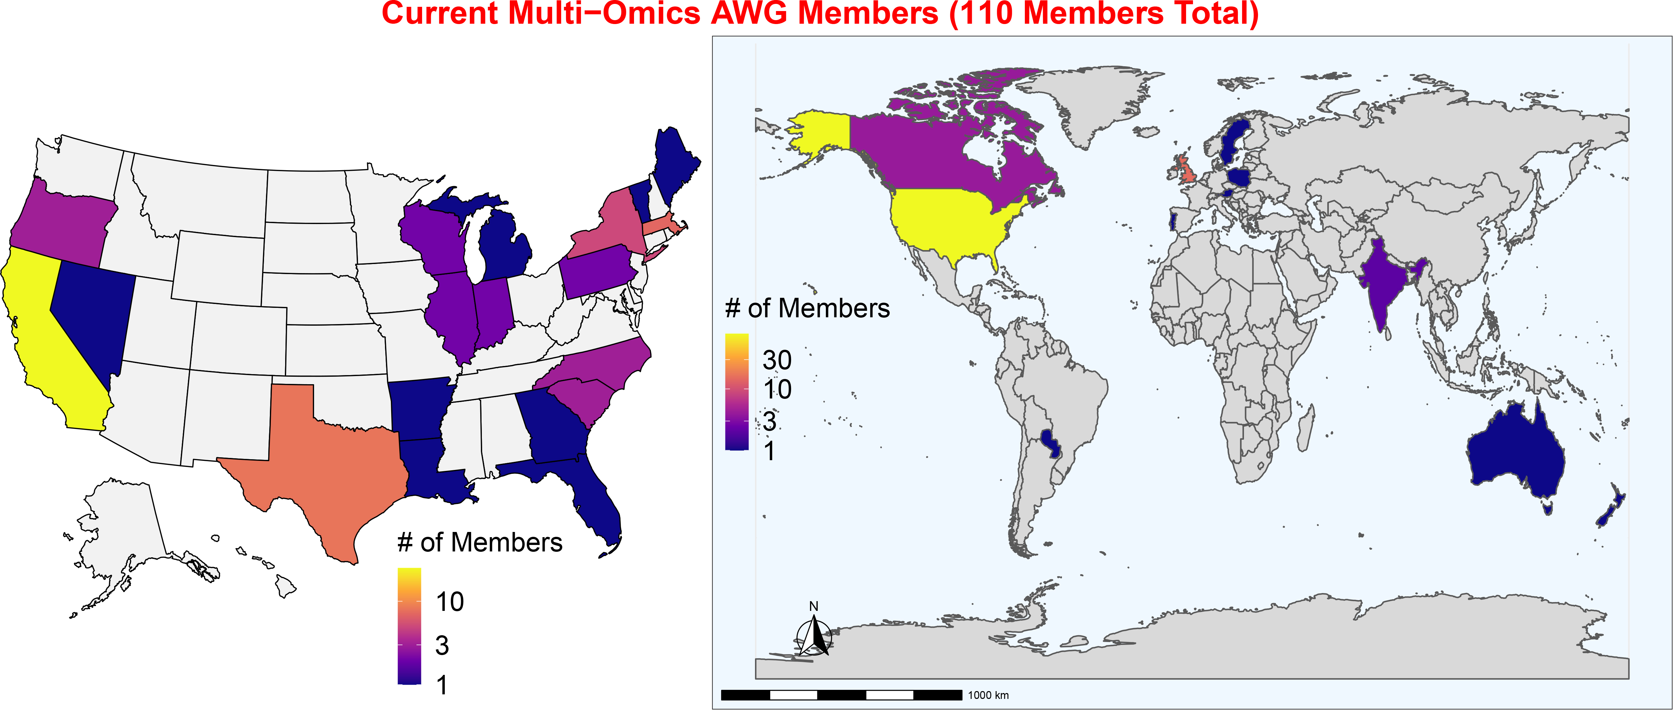






























































Slide 3
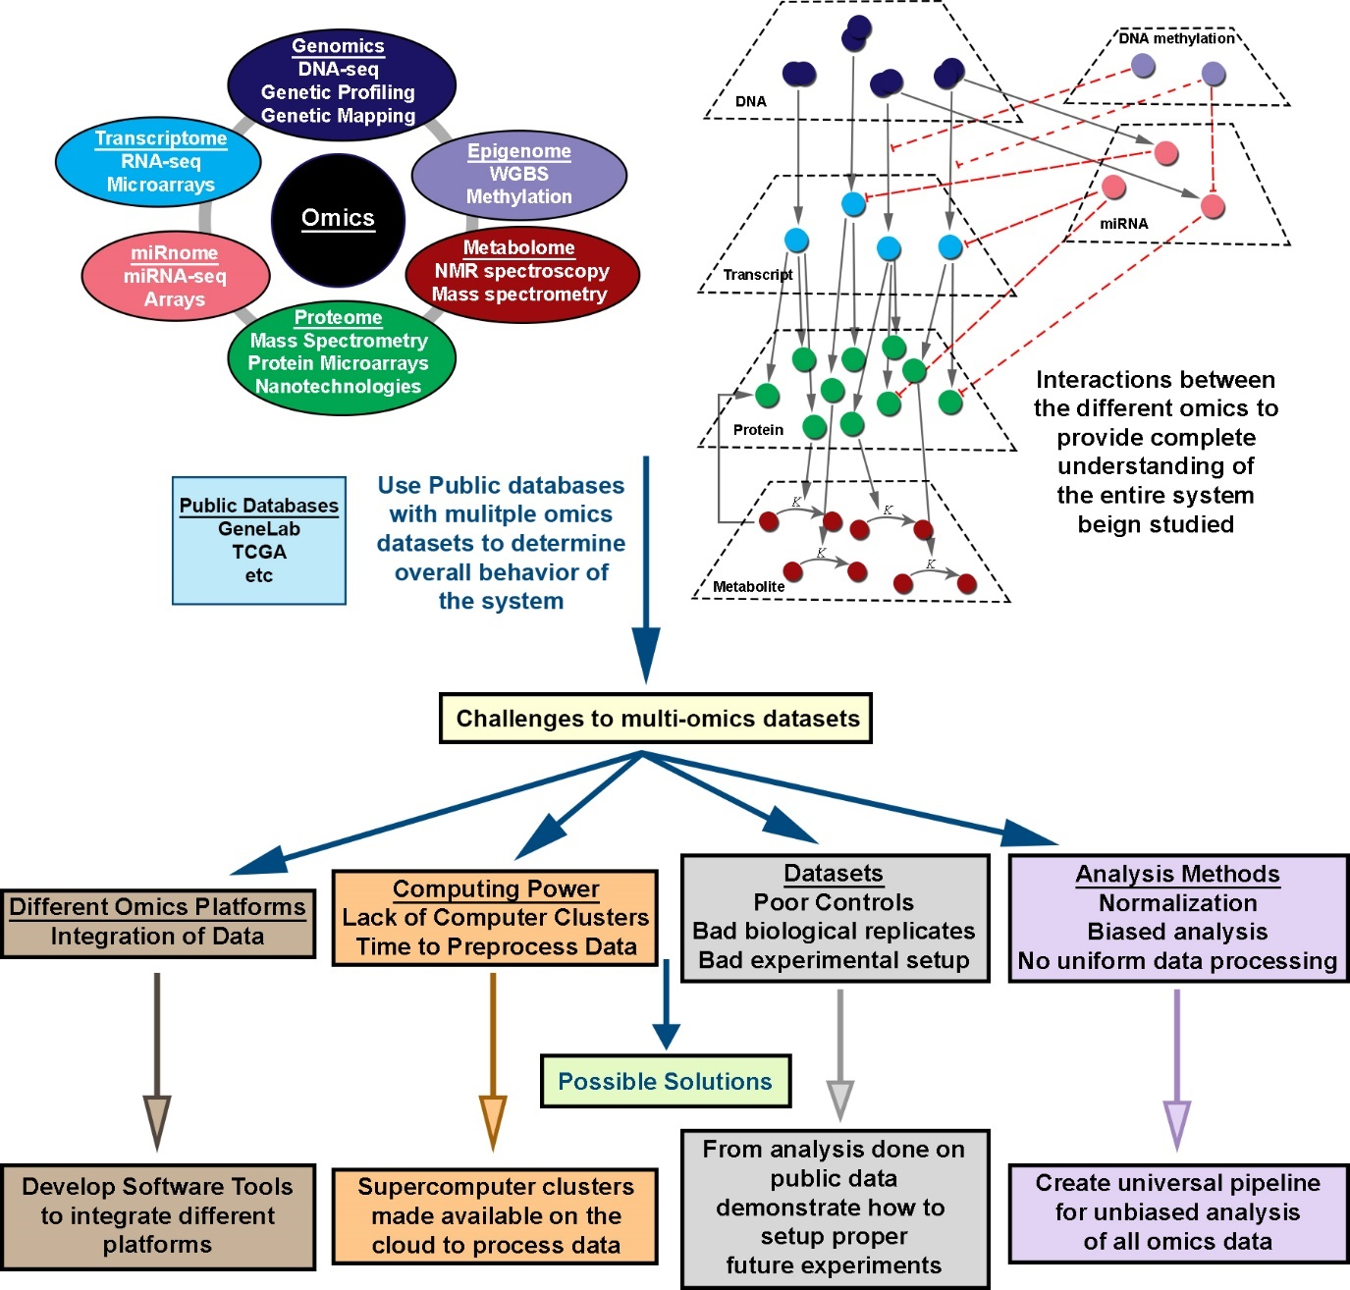
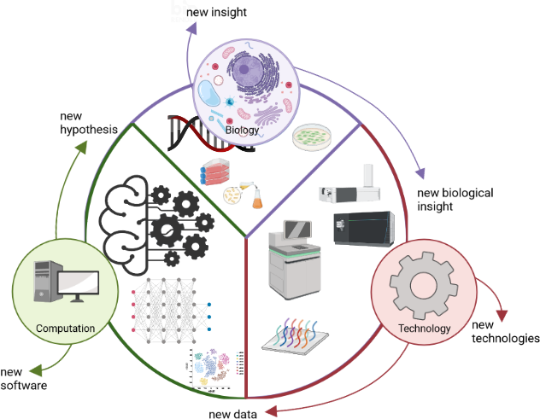
Goals of Multi-Omics/Systems Biology AWG

Slide 4
Publications Resulted from AWG Members

Slide 5
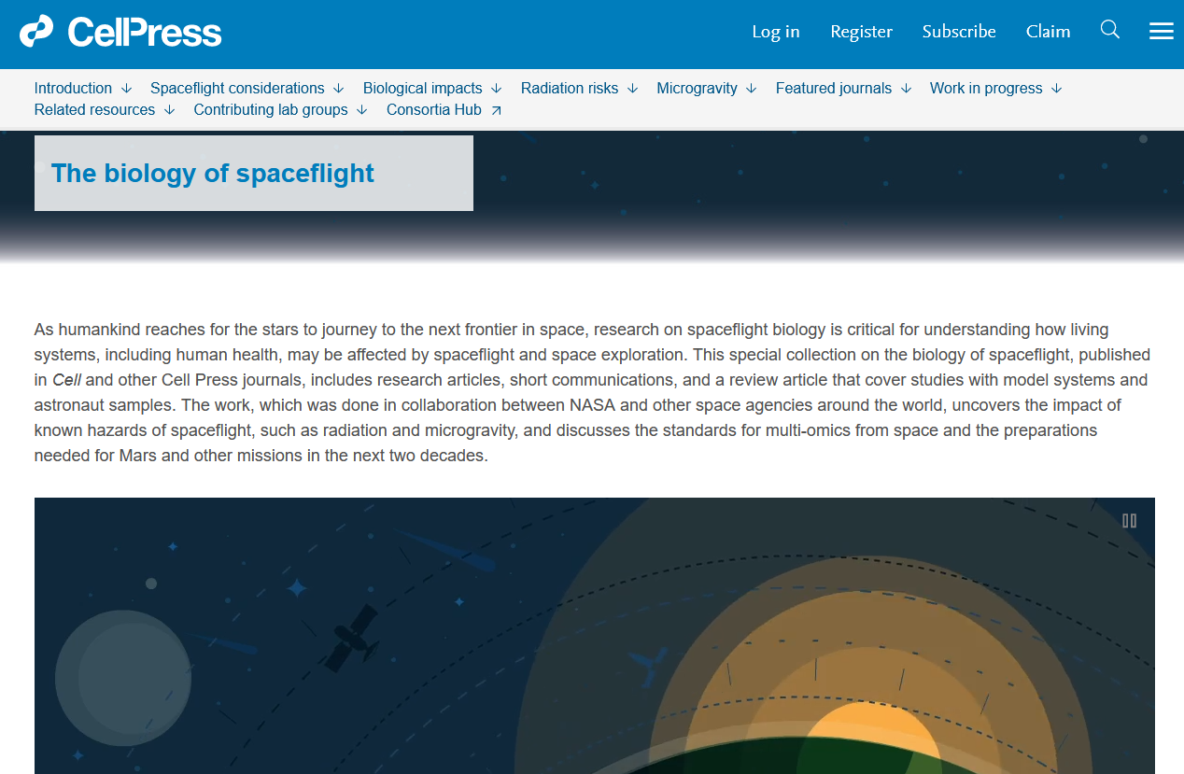
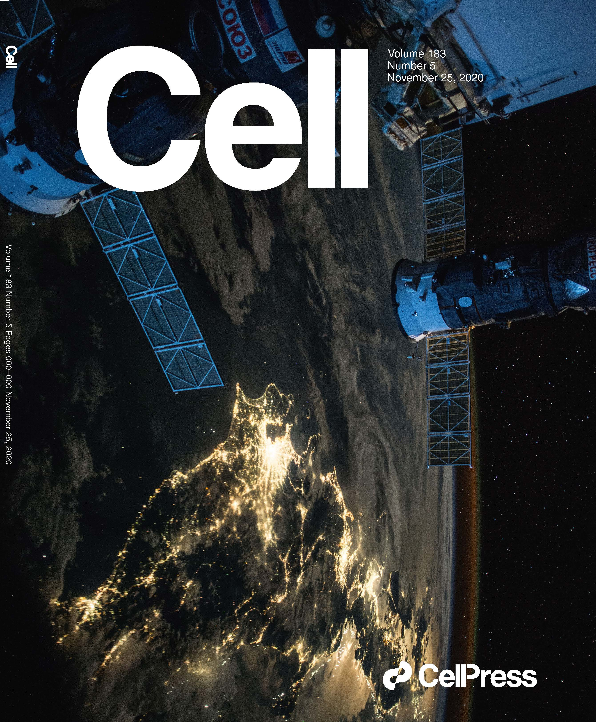
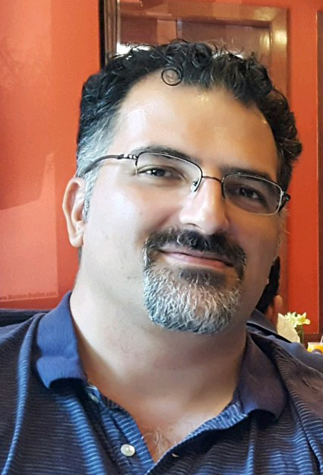


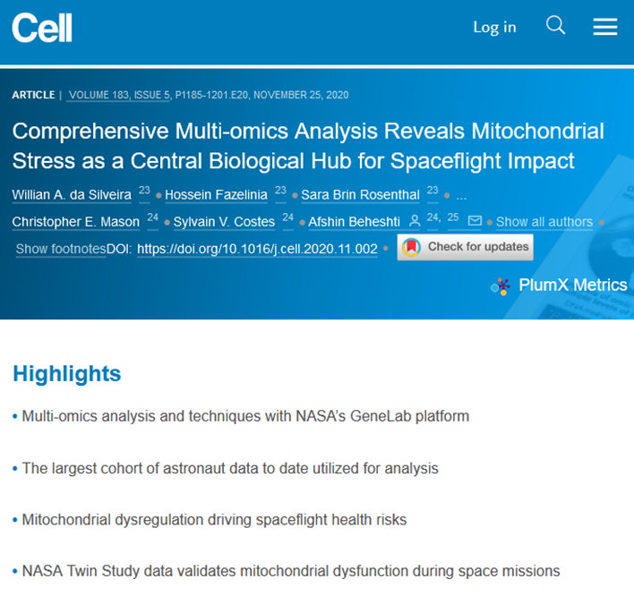
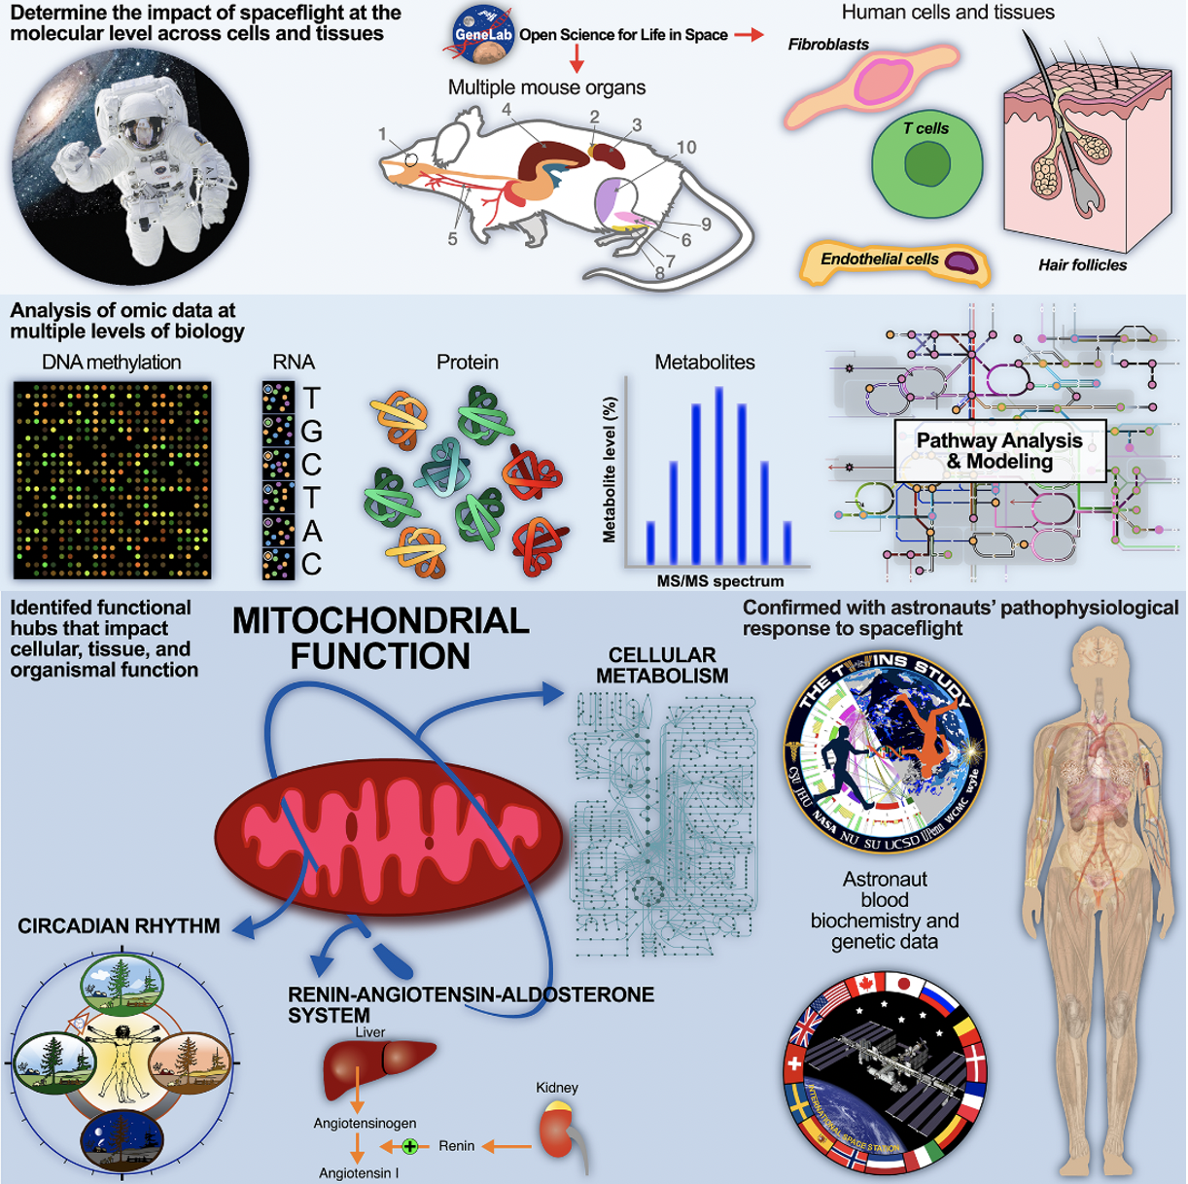

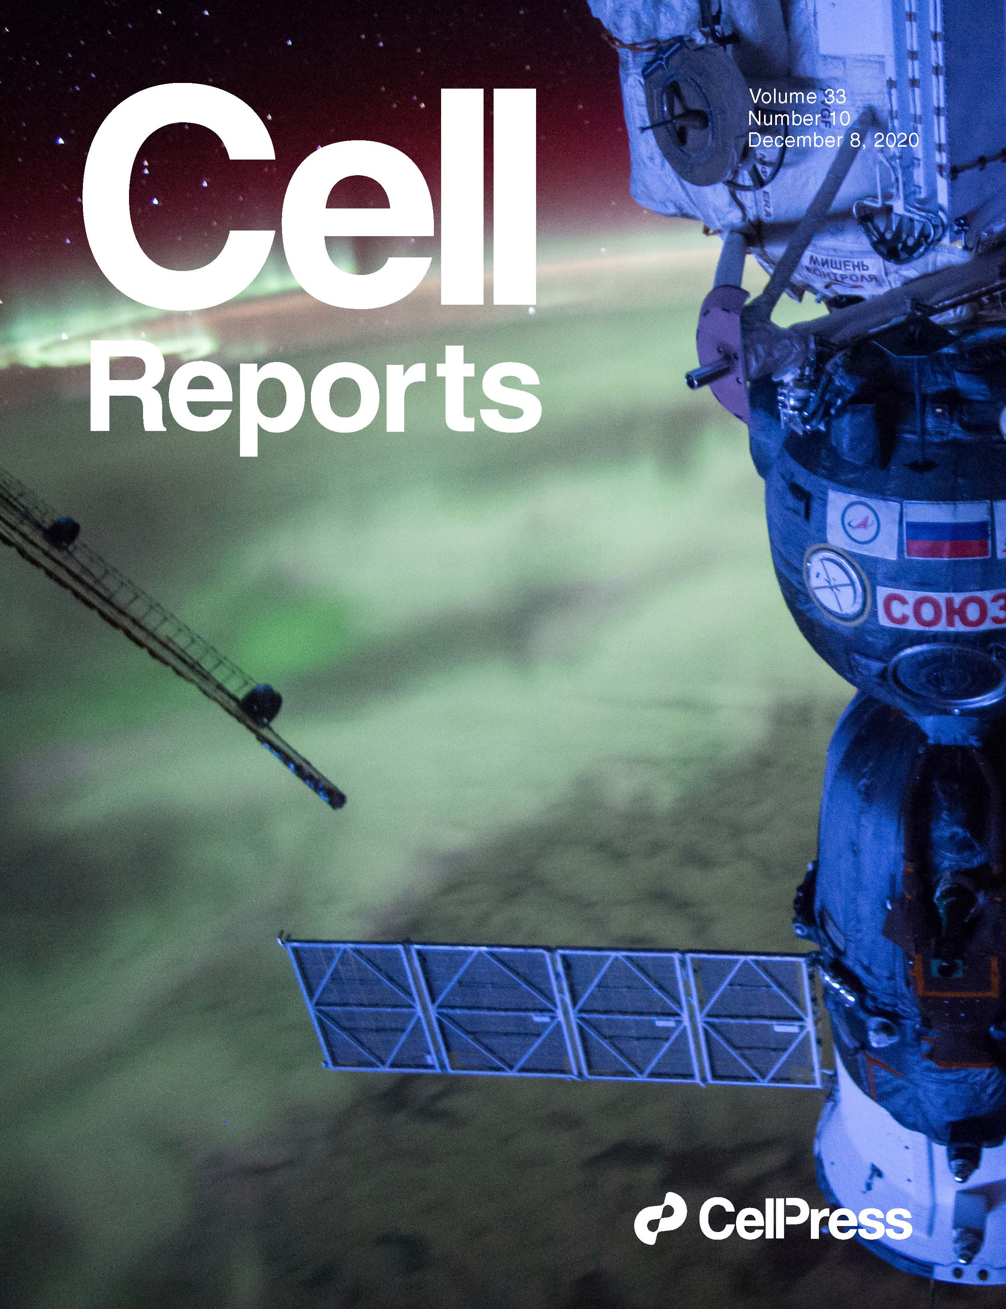
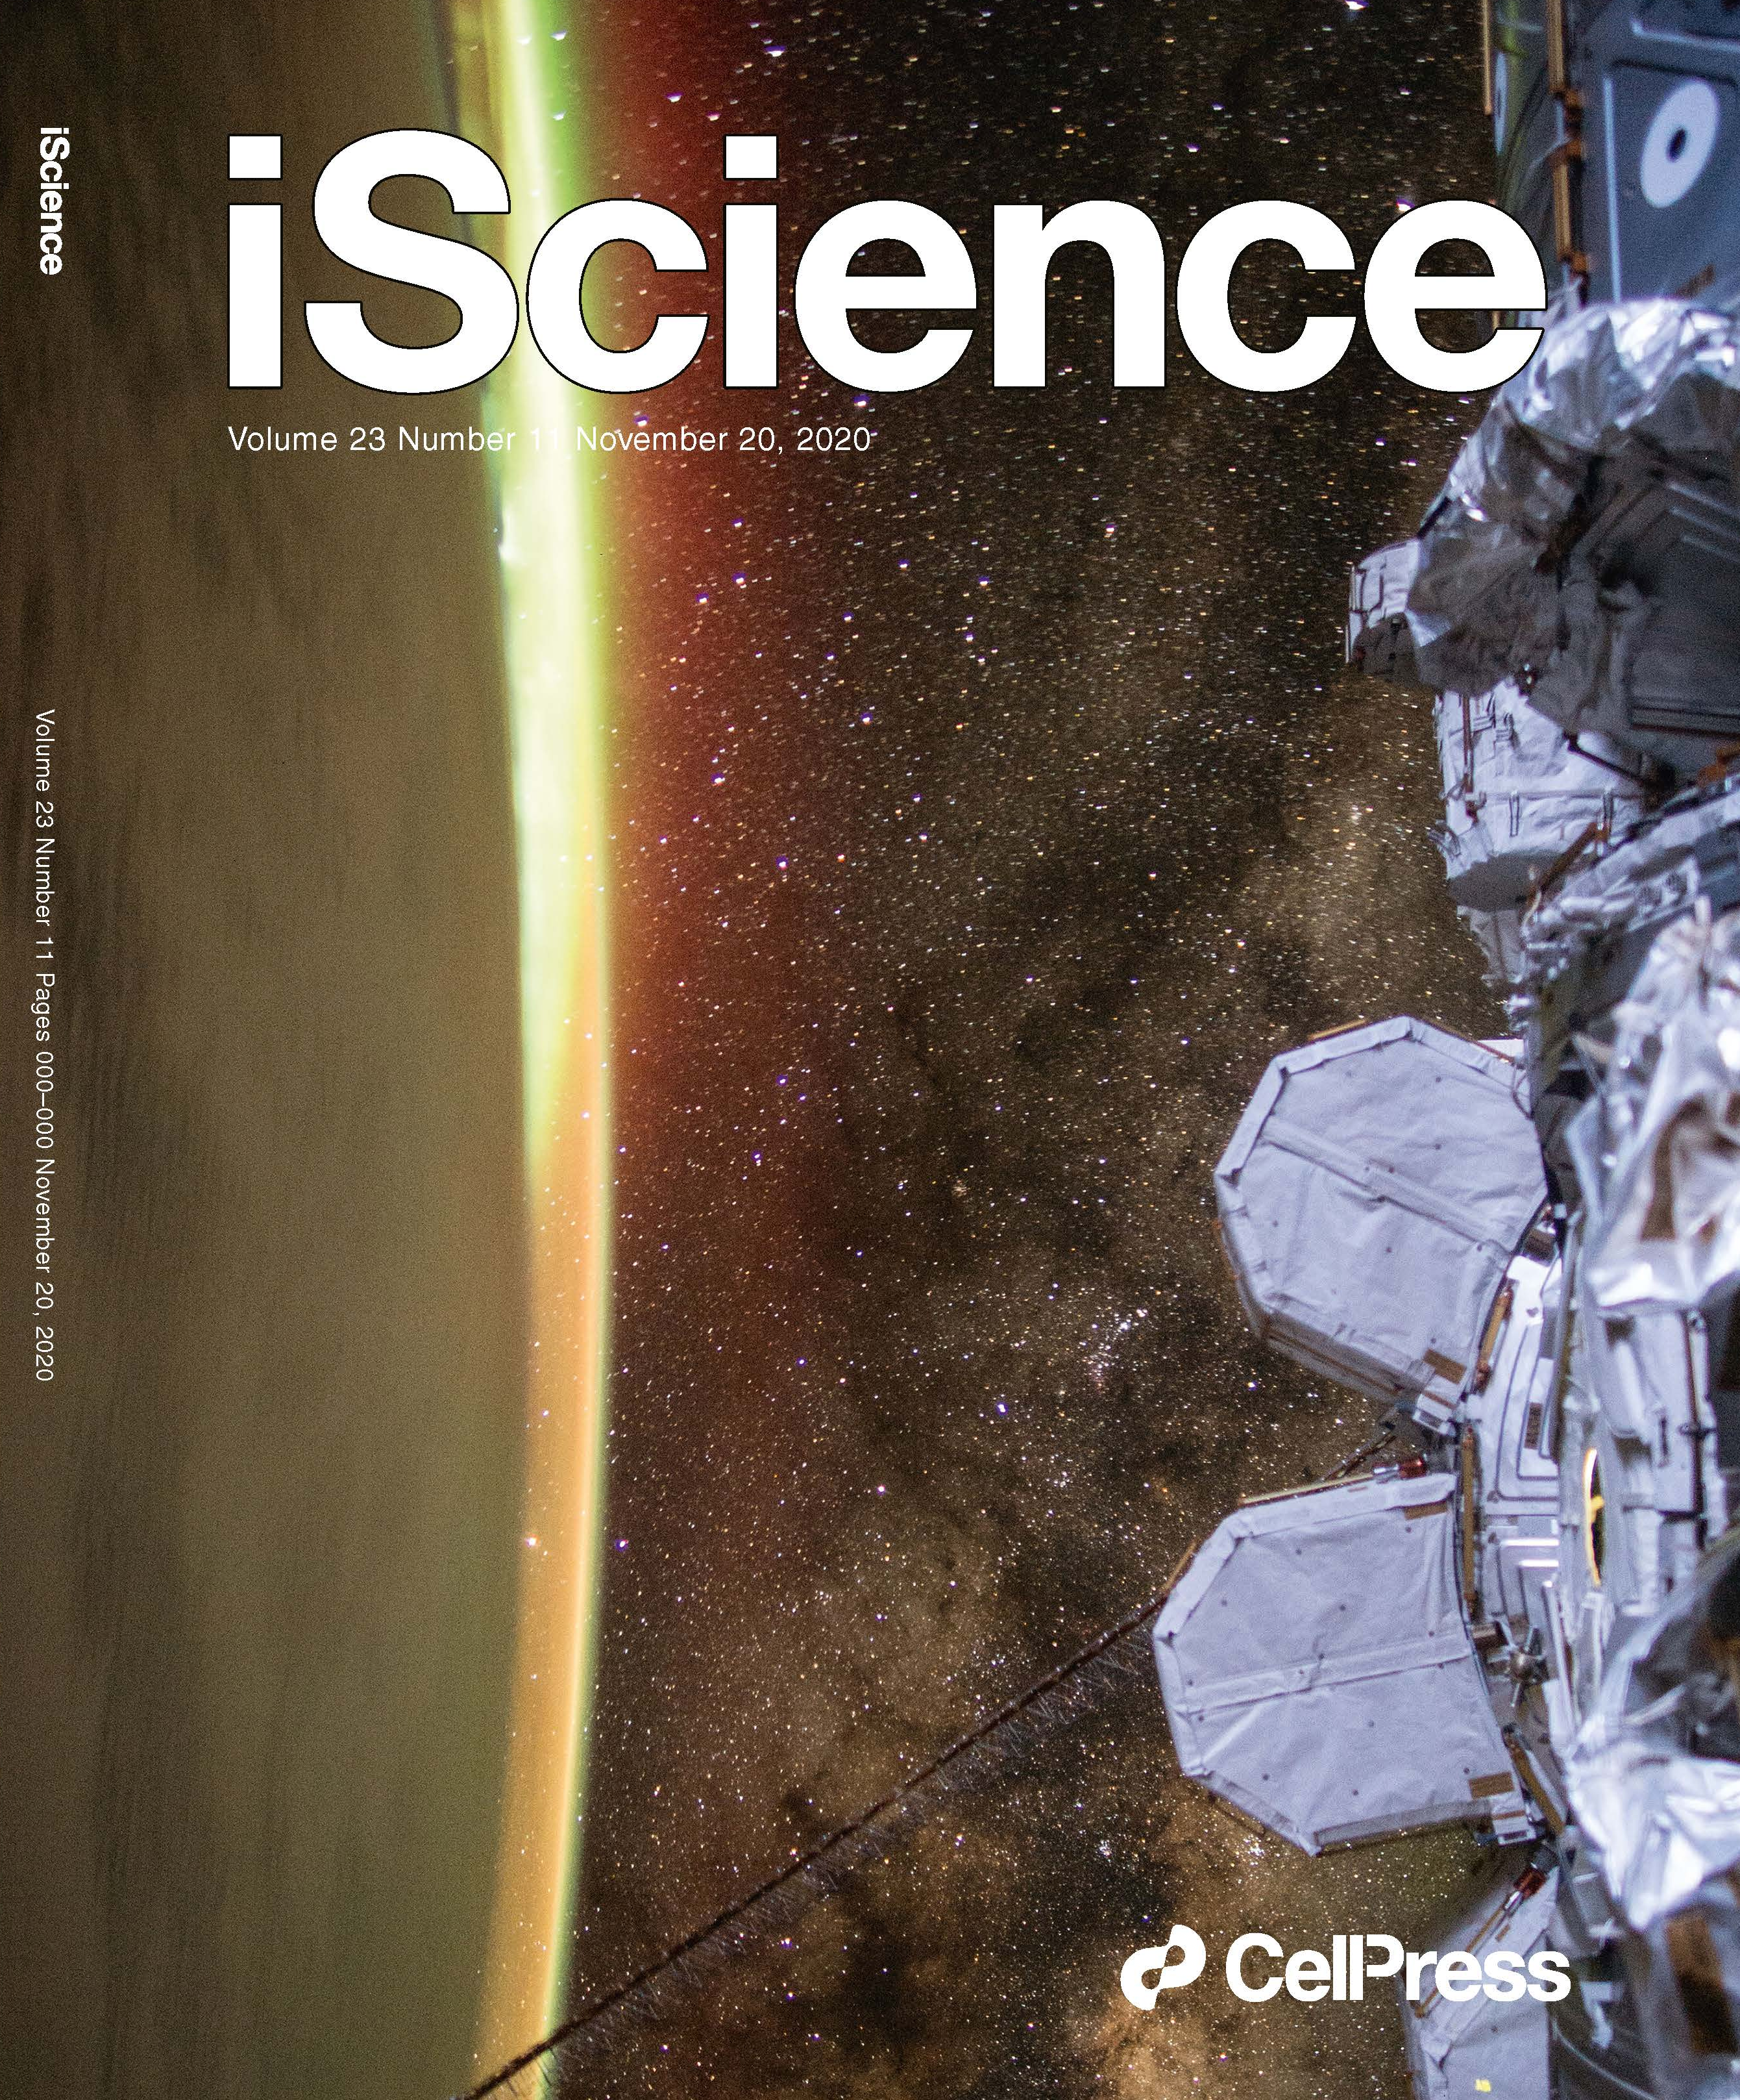
Lots of Papers Recently Published on Space Biology!!
https://www.cell.com/c/the-biology-of-spaceflight
Chris Mason
Afshin Beheshti
Susan Bailey

Slide 6



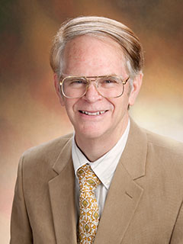

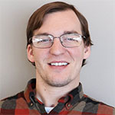







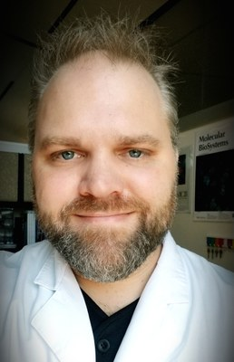
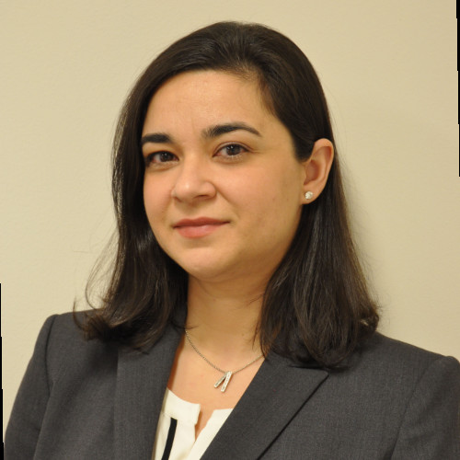
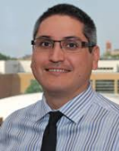
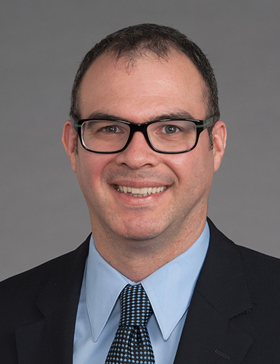
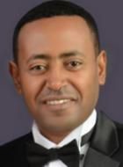
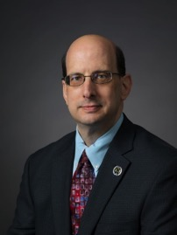

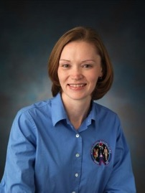
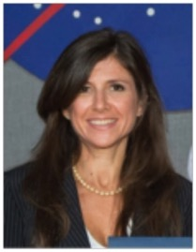






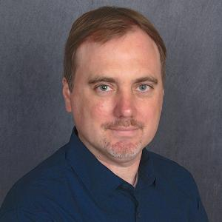

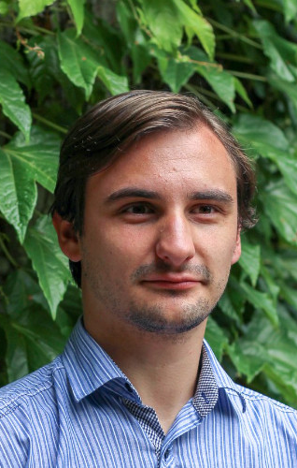
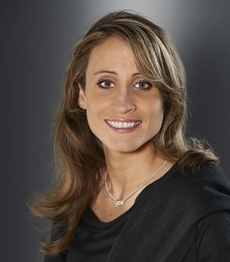
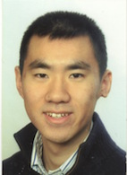
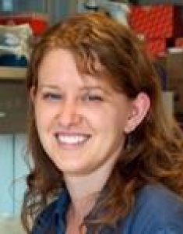

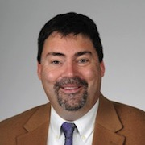
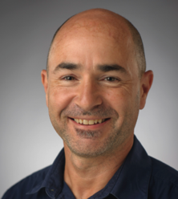



Analysis Working Group (AWG) Members and Others Involved
Willian da Silveira
Deanne Taylor Hossein Fazelinia Komal Rathi Douglas Wallace Larry Singh
Benjamin
Stear
“Jimmy” Mansuck Kim
Kathleen Fisch Brin Rosenthal
Robert Meller
Jonathan Schisler
Chris Mason Cem Meydan
Jonathan
Foox
Evagelia Laiakis
J. Tyson
McDonald
Jeffrey Willey
Yared Kidane
Scott Smith Brian Crucian Sara Zwart
Susana Zanello
Todd Treangen
Leo Elworth
Nick Sapoval
Sonja
Schrepfer
Dong
Wang
Stacy Horner
Nandan Gokhale
Gary Hardiman
Helio Costa
Kathryn Grabek
Afshin Beheshti
Sylvain
Costes

Slide 7
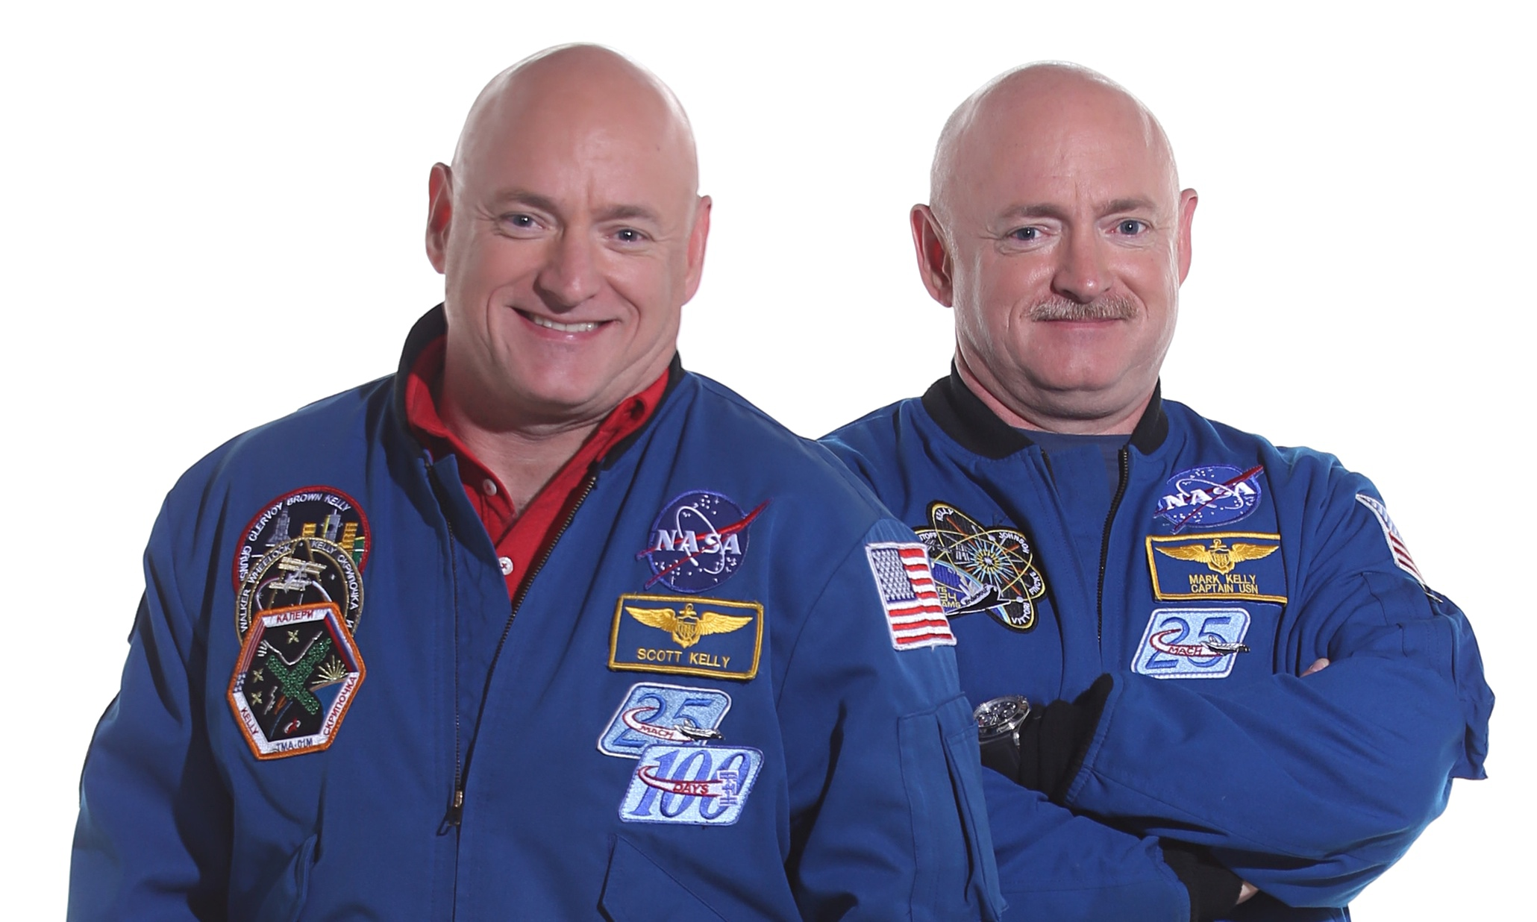
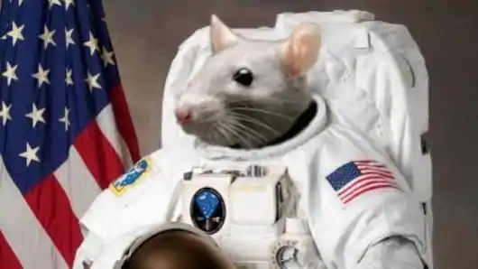

Key Highlights: Multi-Omics Analysis Using GeneLab Database Recognizes Mitochondrial Dysfunction as a Mediator of Spaceflight Health Risks
OXPHOS Genes
Integrated Stress Response Genes
Increased levels of 8-OHdG and prostaglandin F2 alpha is a biomarker of cellular oxidative stress

Slide 8
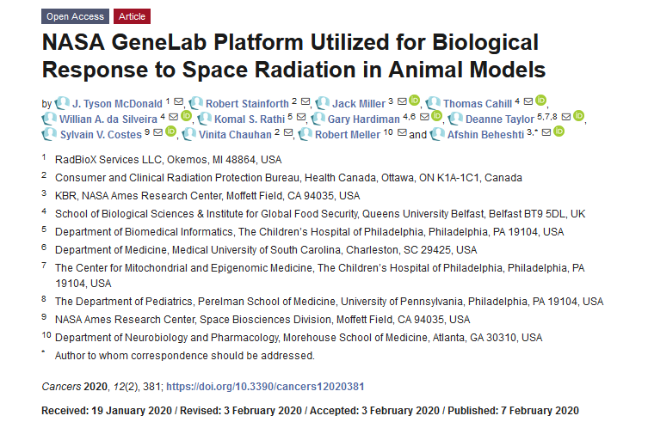
NASA GeneLab platform utilized for space radiation dosimetry biological response compared to radiation ground studies
GeneLab ground datasets were compared to both in vivo and in vitro datasets from samples flown to the ISS and on shorter shuttle missions.
From this analysis we were be able to associate distinct biological signatures associating specific ions to specific biological response to radiation exposure in space.

Slide 9
RNA-sequencing Error Rates in Spaceflight Mouse Livers
9.20 mGy total accumulated dose
Samples isolated on ISS
GLDS-168
GLDS-242
8.03 mGy total accumulated dose
Samples isolated 2 weeks after returning to Earth
Robert Meller
RNA-sequencing data using mice liver samples from two experiments were analyzed to identify potential error rates due to spaceflight

Slide 10
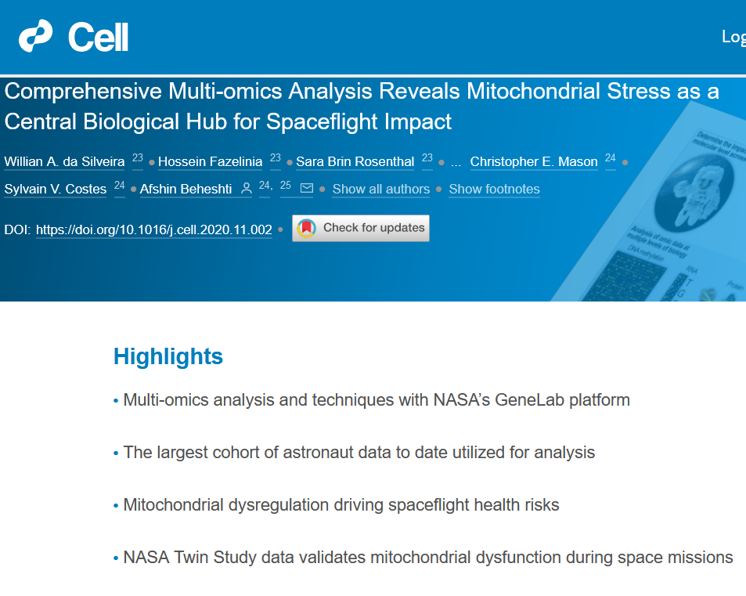
Highlight: Clustering of Pathways as a Function of Dose for Gene Ontology (GO) Terms
Activation
Activation
Inhibition
Activation
Inhibition
Inhibition
Activation
Inhibition

Slide 11

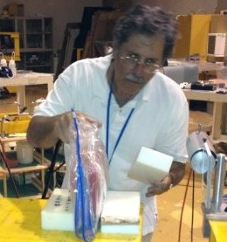




Analysis Working Group (AWG) Members Involved
Willian da Silveira
Gary Hardiman
Thomas Cahill
J. Tyson McDonald
Robert Meller
Jack Miller
Deanne Taylor Komal Rathi
Afshin Beheshti
Sylvain Costes
Robert Stainforth
Vinita Chauhan

Slide 12
Current Projects

Slide 13
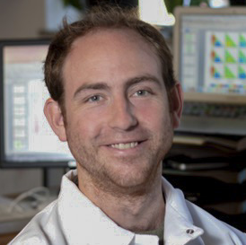
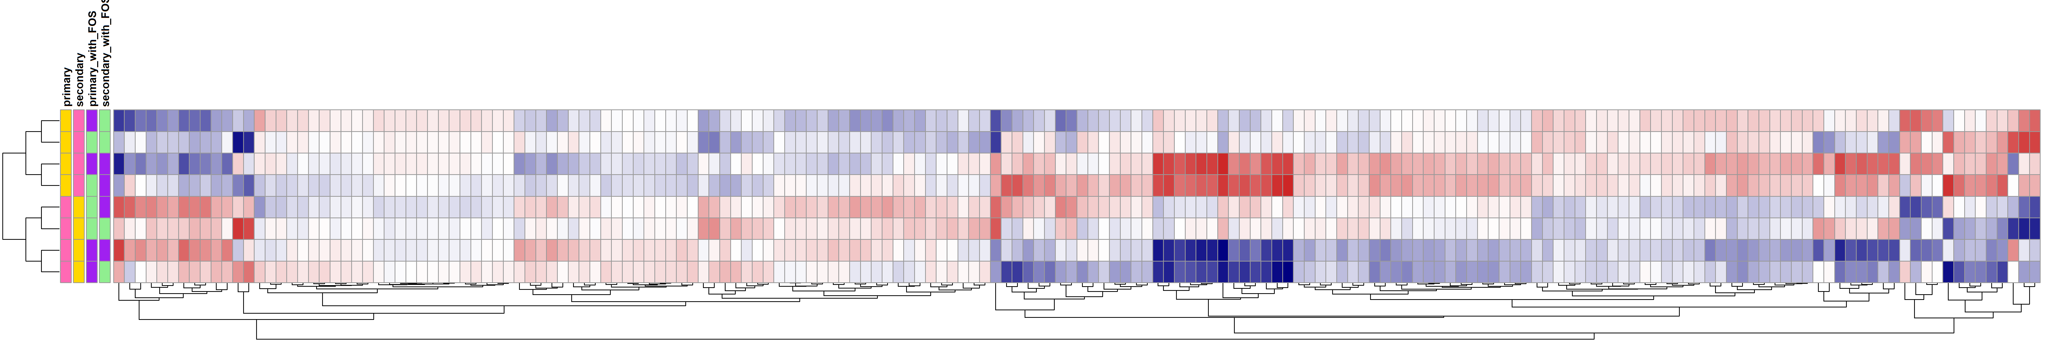


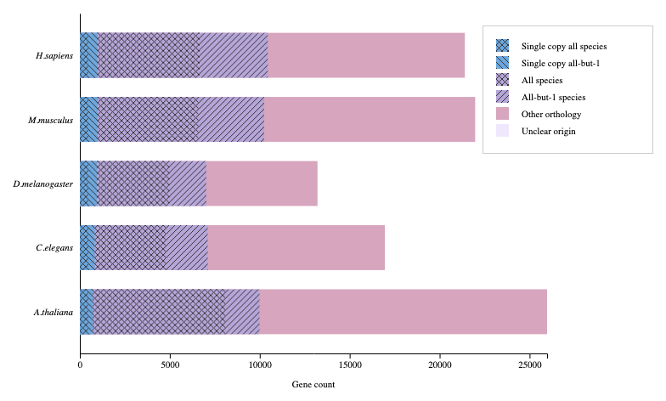
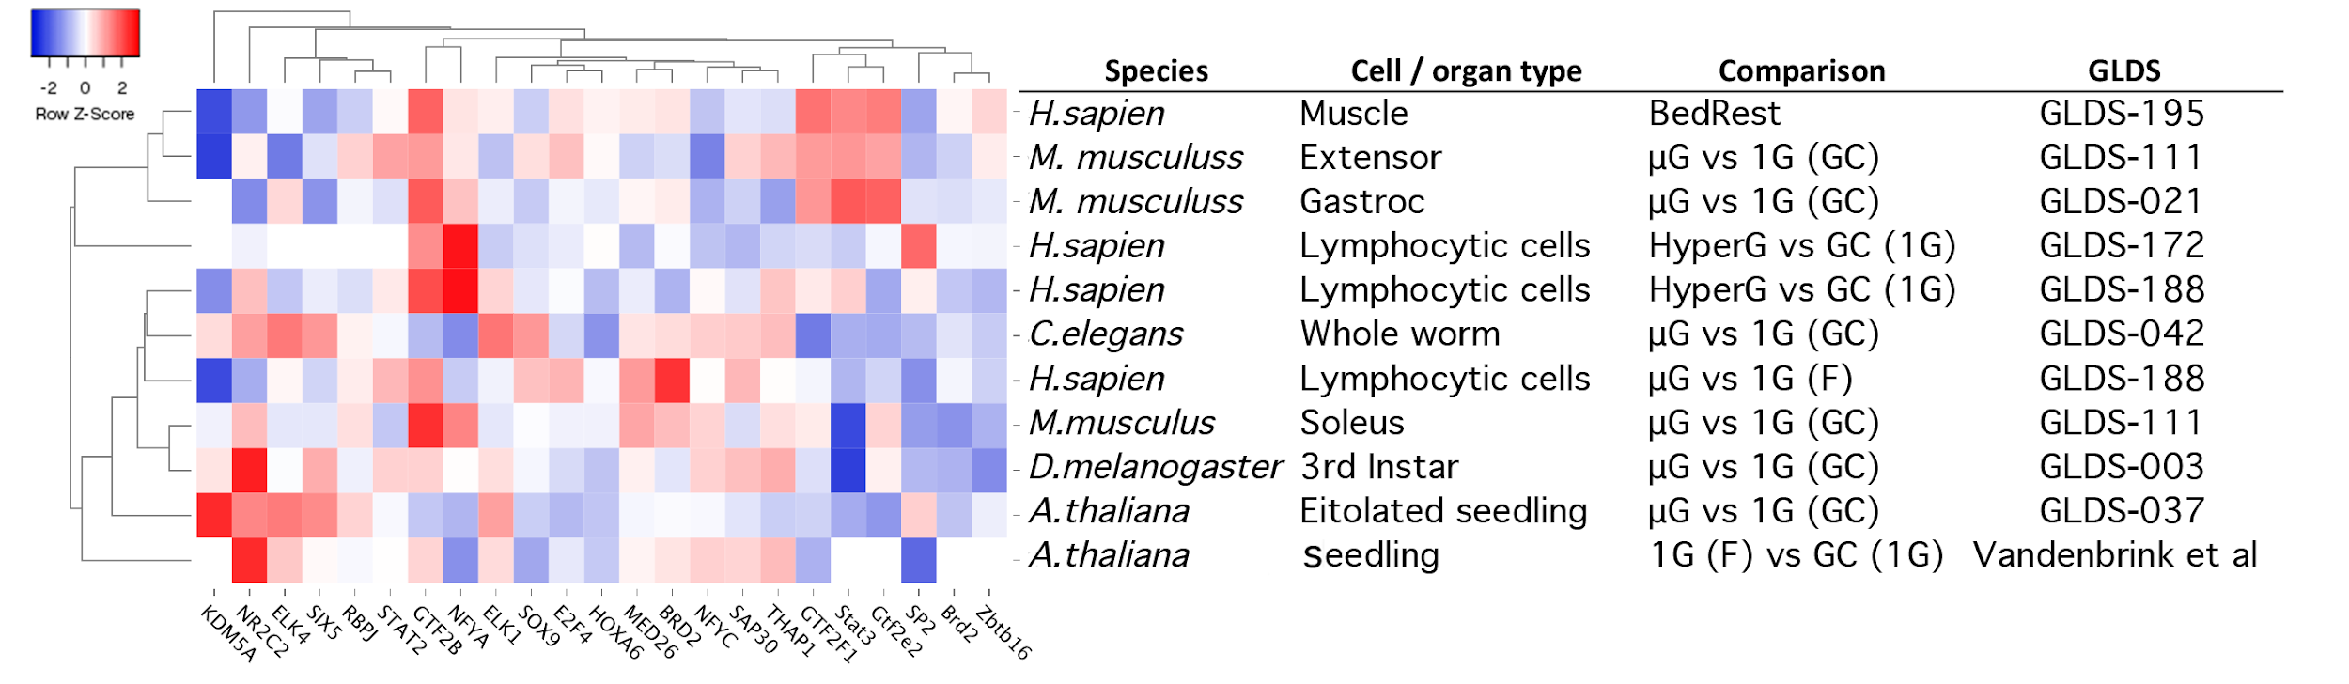
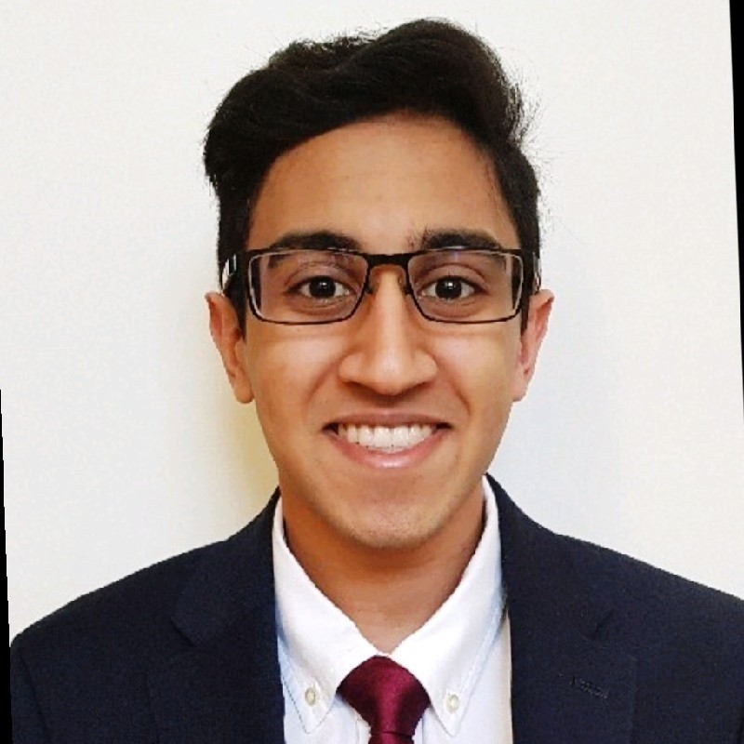


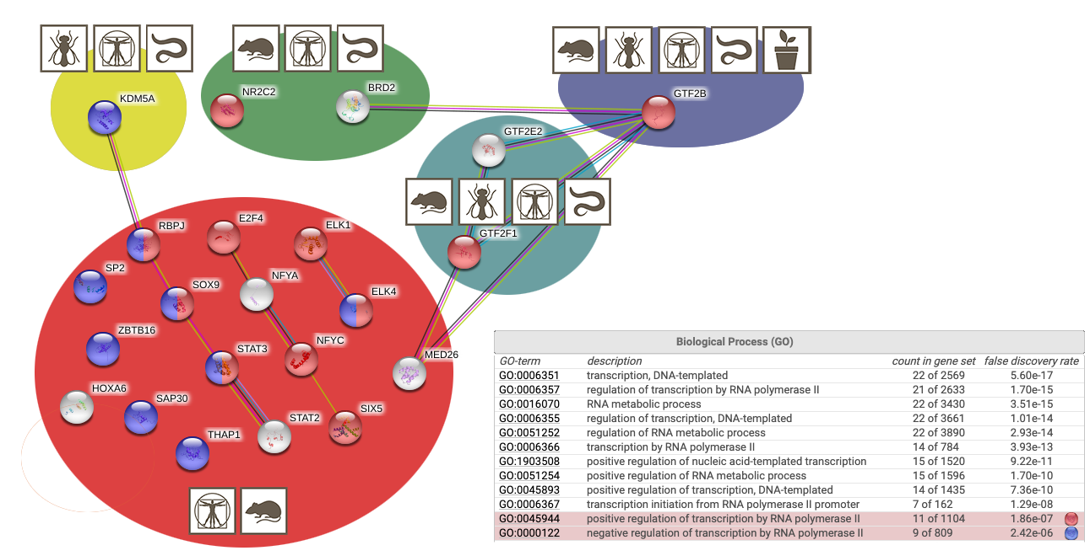

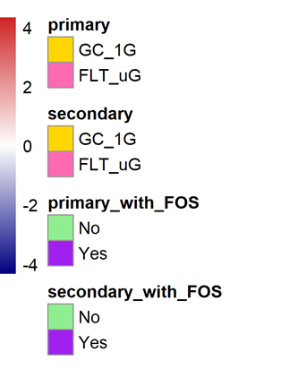
Mitochondria Dysregulation Across All Species During Spaceflight
Species Being Utilized for this Study from GeneLab
Ortho Database: Comparative overview of the gene content across selected genomes.
Richard Barker
Chirag Goel
Mitochondrial Related Genes
Neil McKenna
Mitochondria Genes (determined from MitoCarta)

Slide 14
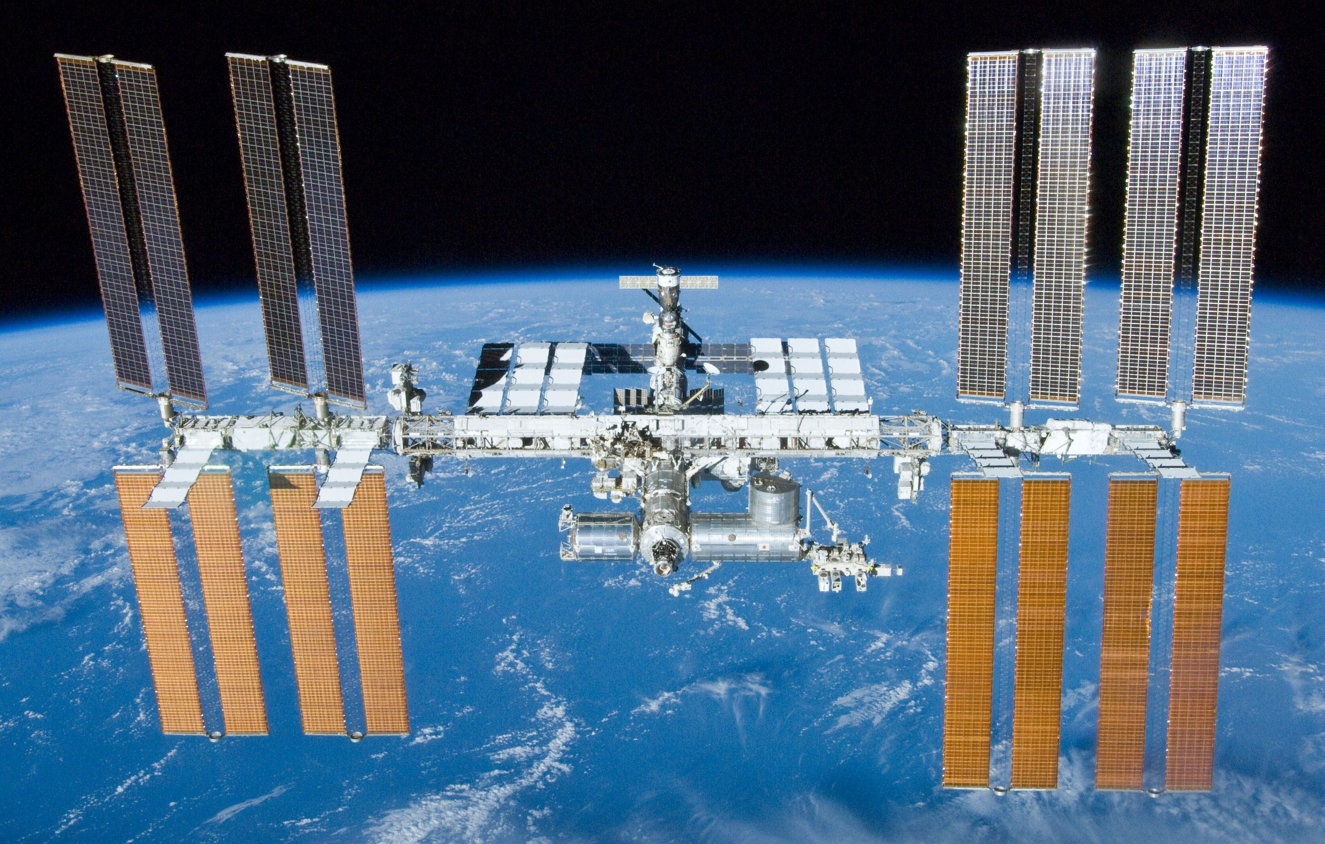
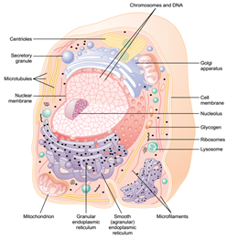
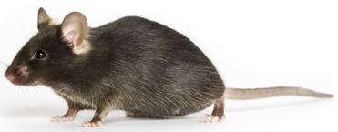
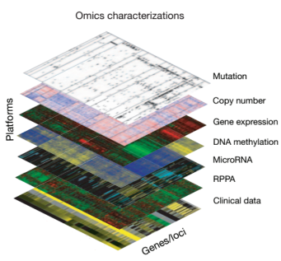
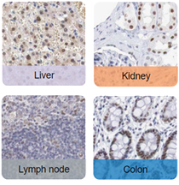
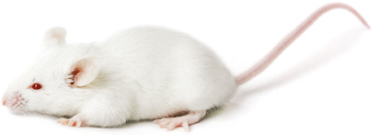


Genomic/Strain Differences impacting response to spaceflight
ISS
Experimental Design
Mice
Cells
RR1 and RR9 - C57BL/6
Omics
Exposure: ≈ 30 to 40 days
Space Flight n = 6 -10
Ground Control n = 6 -10
Tissues
Willian da Silveira
RR3 - BALB/c
Earth

Slide 15
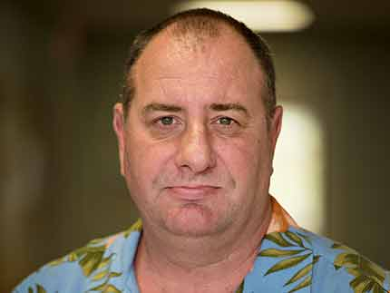
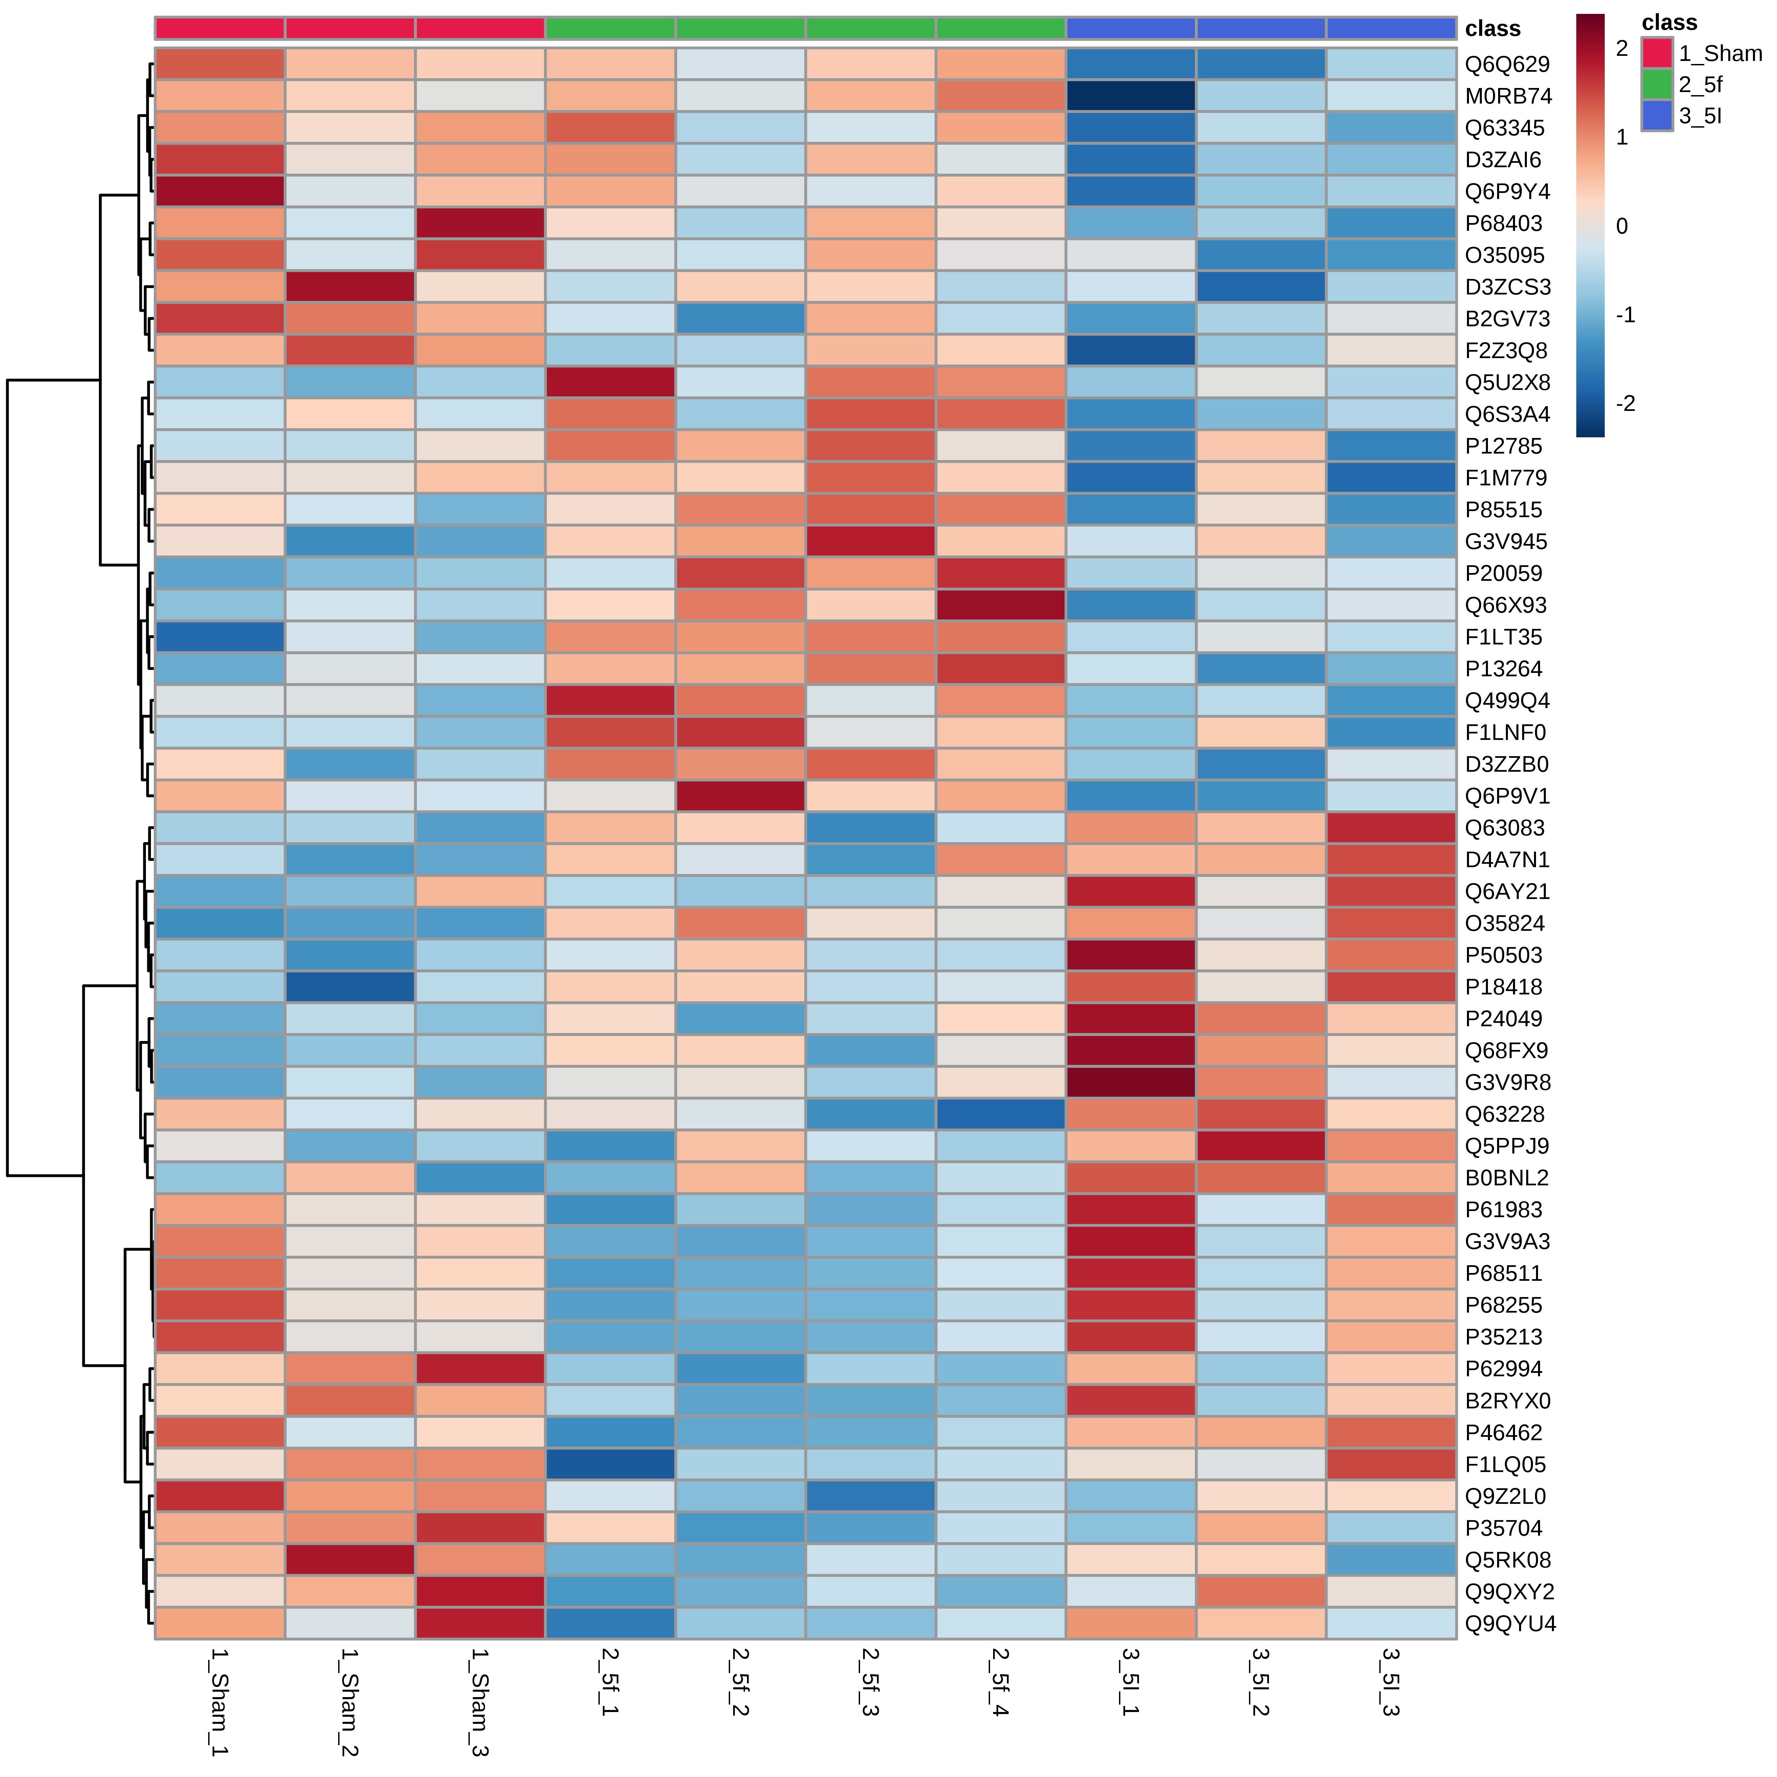

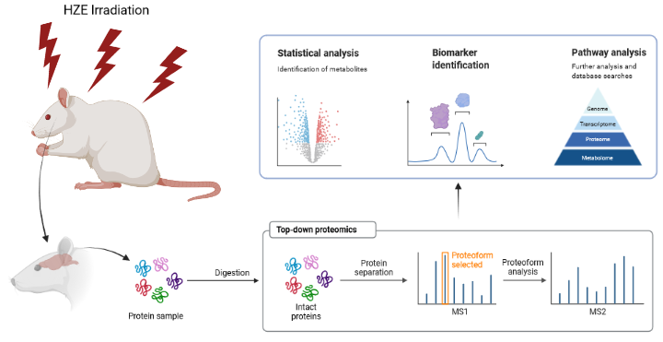
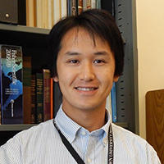
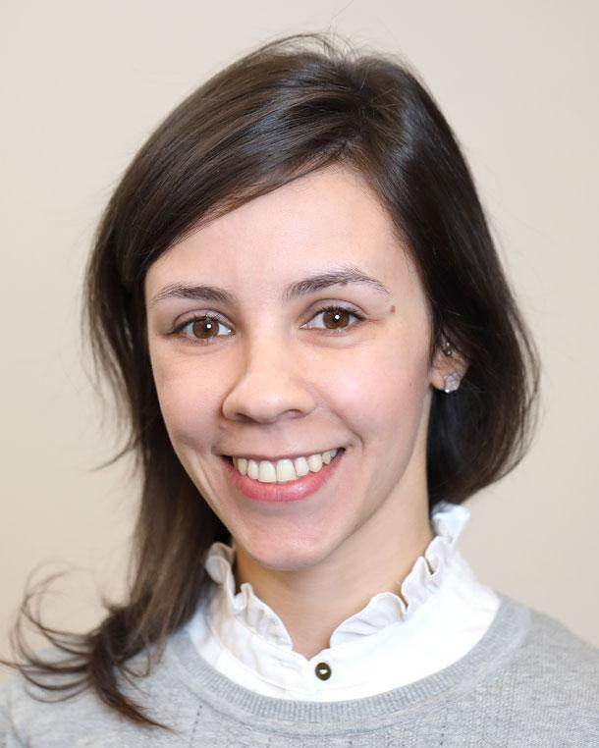


The Impact of HZE Irradiation on Brain Functions in Rats: Proteomic Analysis
Sham
5f
5I
Richard Britten
Evagelia Laiakis
Tytus Mak
Maisa Pinheiro
Lia will present this data during the Public Session on November 10th

