Slide 1
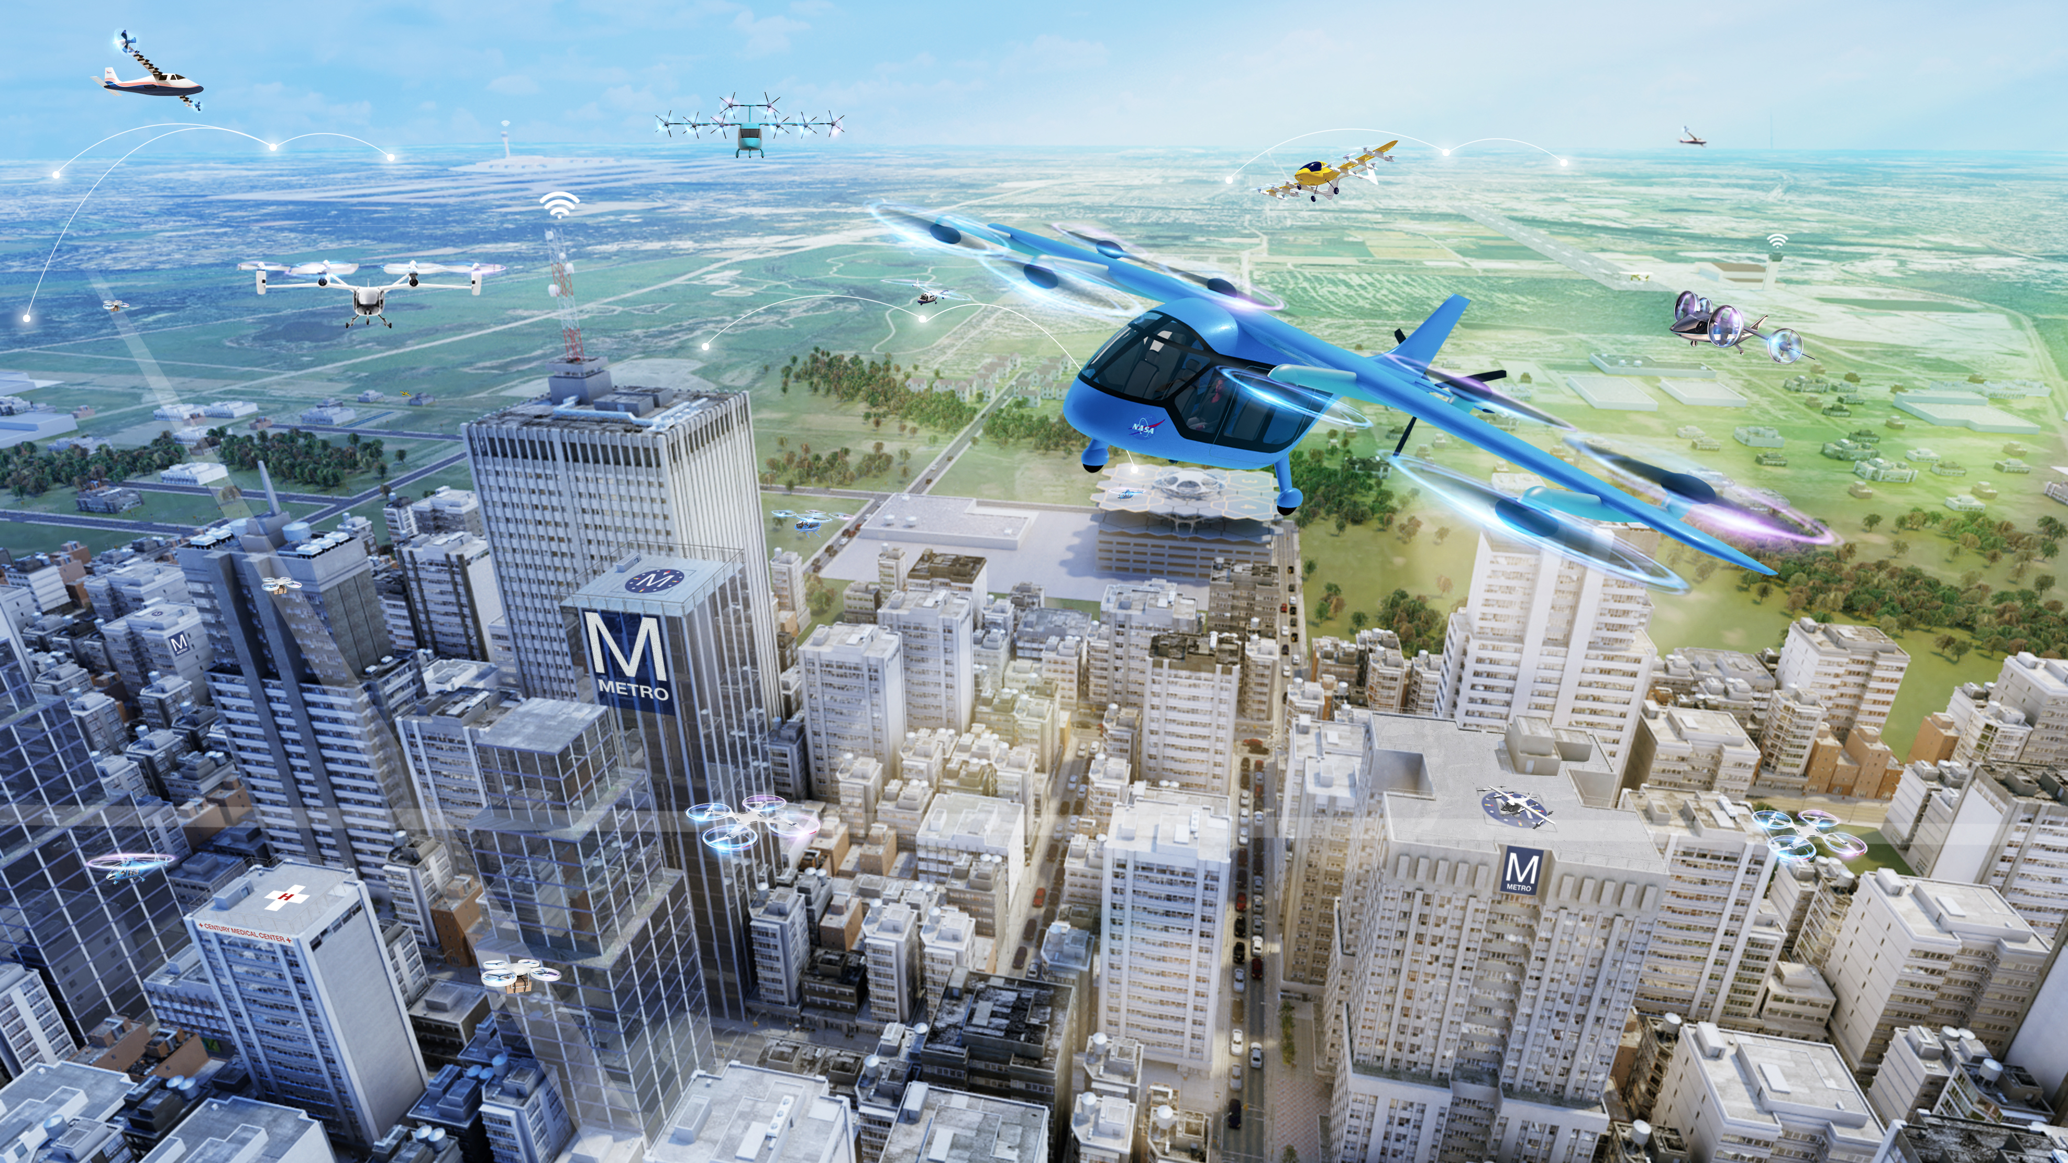
Advanced Air Mobility
November 6, 2021

Slide 2
Topic Overview
The AAM Vision
Resources - Where to find more information
Opportunities for Engagement

Slide 3
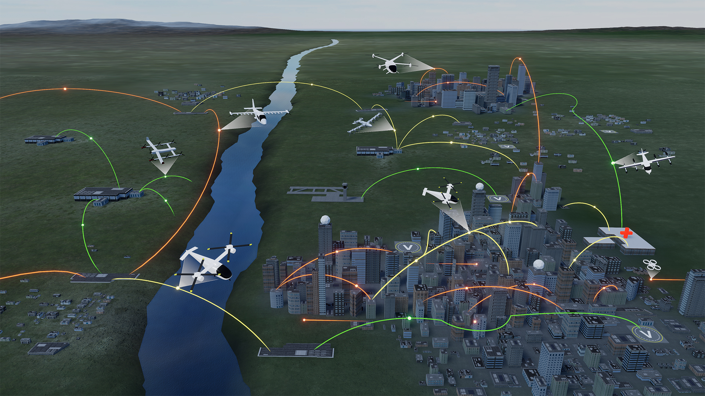



UAM Maturity Levels (UML)
Advanced Air Mobility (AAM) Mission
UML-4 Medium Density/Complexity, collaborative and responsible automated systems
UML-3 Low Density, Medium Complexity, comprehensive safety assurance automation
UML-2 Low Density/Complexity, assistive automation
UML-1 Conforming prototypes
On Demand
Air-Taxi
Rural Operations
Urban Operations
Regional
Network
Inter-City
eVTOL
Cargo
Delivery
Cargo
Delivery
Airport
Transfer
Medical
Transfer
Distribution
Center/Warehouse
High Density
Corridor
Air
Ambulance
Fleet
Operations
Inter-city
eVTOL
Small
Package Delivery
Cross-metro
Transfer
Safe, sustainable, affordable, and accessible aviation for transformational local and intraregional missions

Slide 4
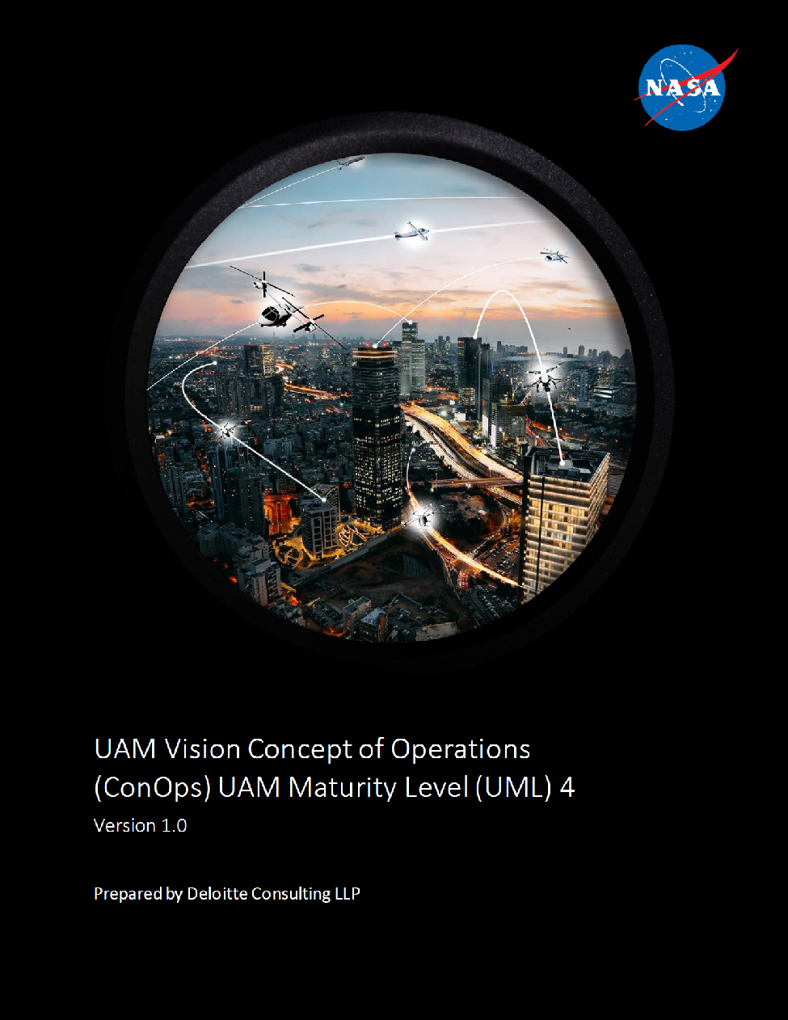
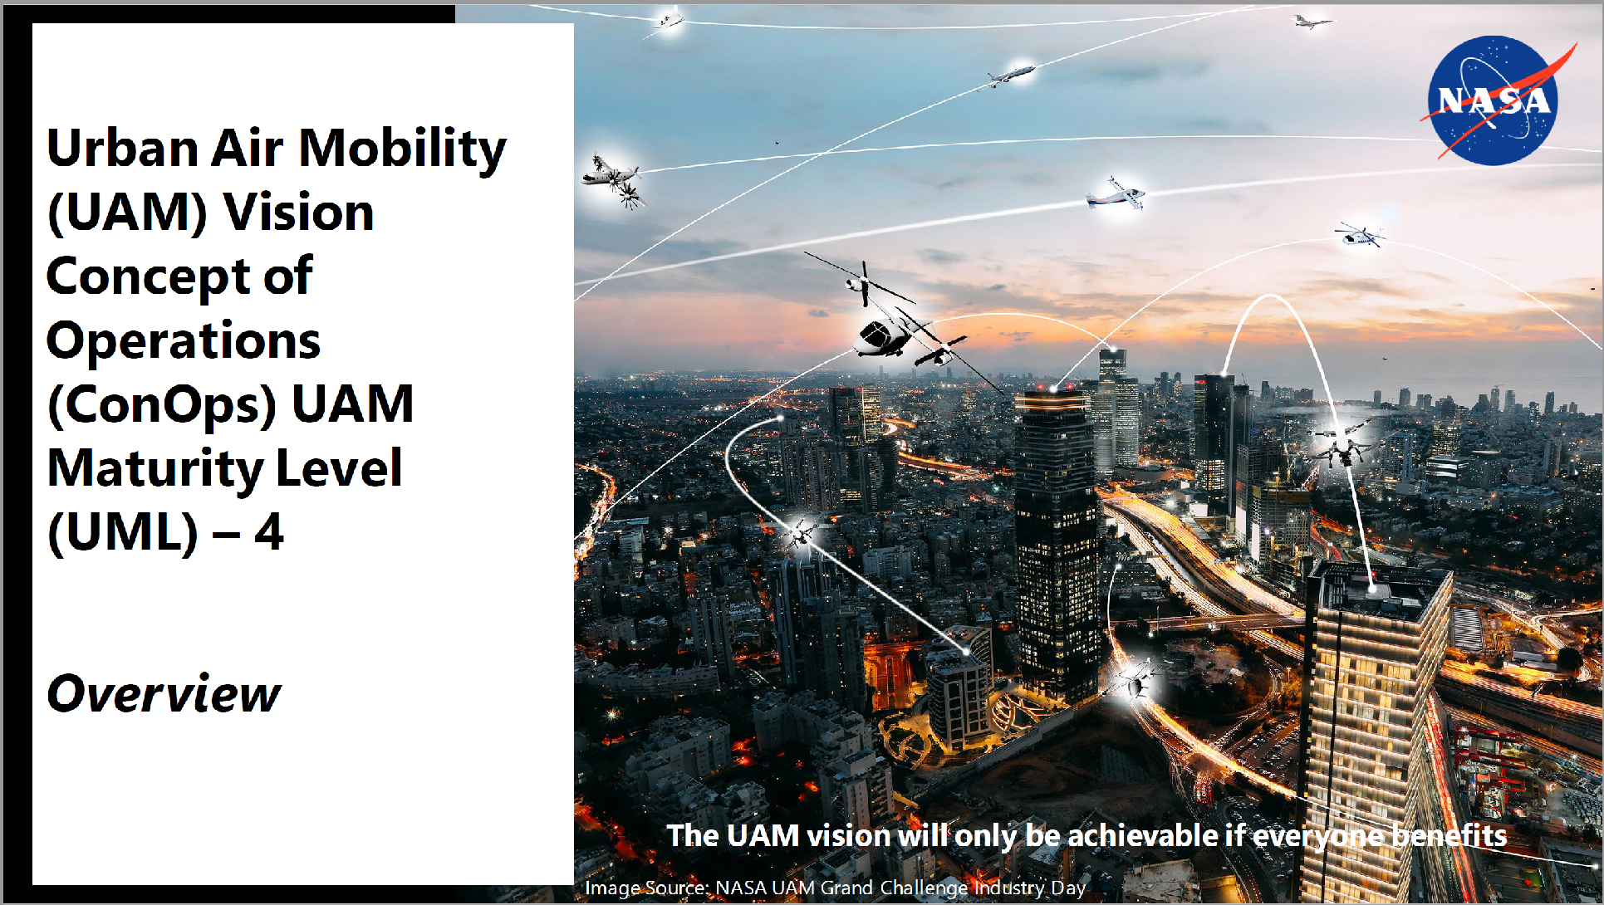
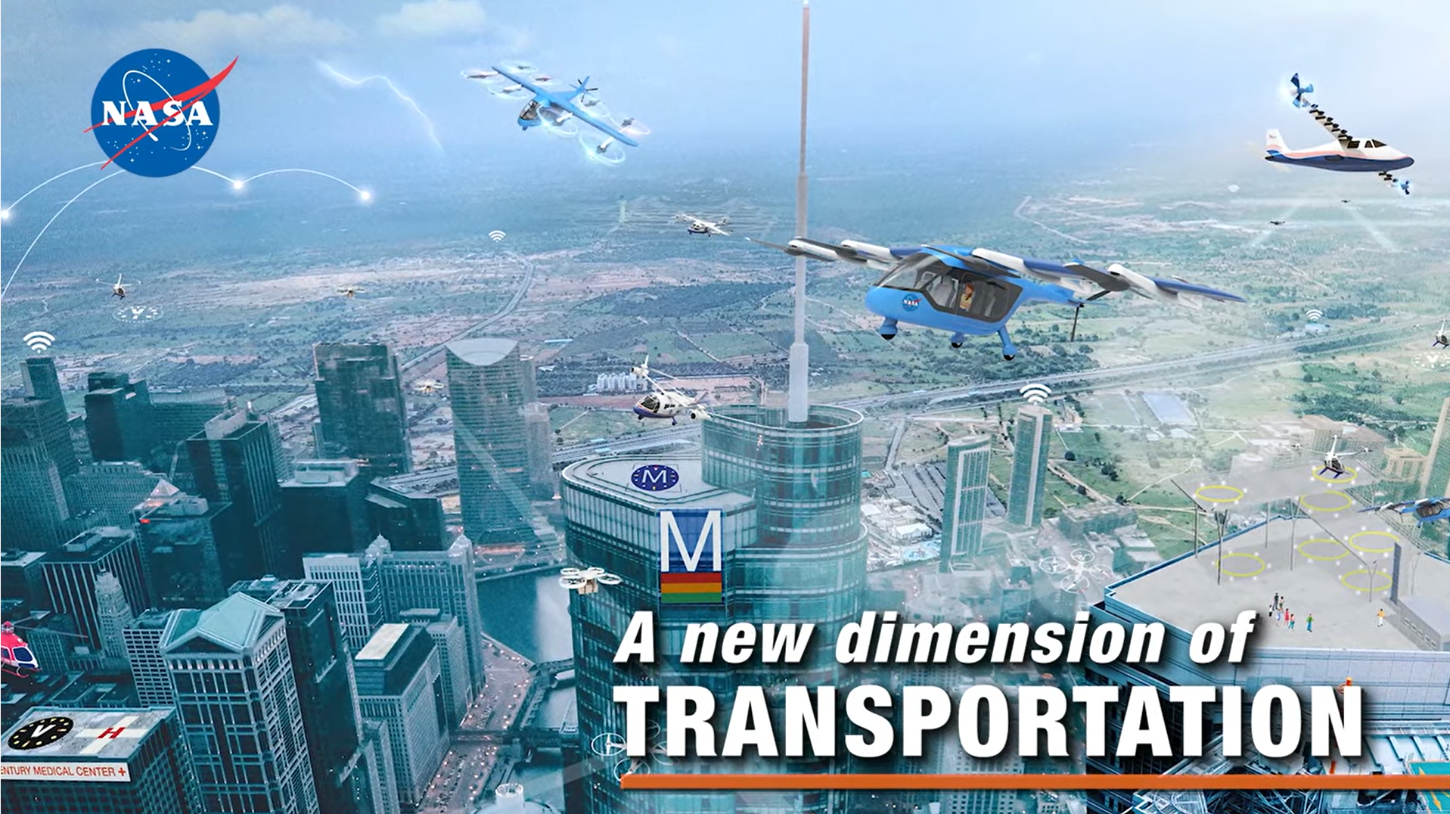

Vision Resources
NASA’s Vision ConOps
  Document: https://ntrs.nasa.gov/api/citations/20205011091/downloads/UAM%20Vision%20Concept%20of%20Operations%20UML-4%20v1.0.pdf
  Presentation: https://ntrs.nasa.gov/api/citations/20210010443/downloads/UAM%20Vision%20ConOps%20Overview%20Presentation%2018DEC2020.pdf
FAA’s AAM Webpage - https://www.faa.gov/uas/advanced_operations/urban_air_mobility/
  UAM ConOps 1.0
Videos
  https://www.youtube.com/watch?v=Vu1VWEvgd24
  https://www.youtube.com/watch?v=lKf0Y317AJw
  https://www.youtube.com/watch?v=iBsgqNFM_XU
  https://www.youtube.com/watch?v=m8KCFAh7R5Q

Slide 5




Additional Resources
Education
  AEWGs https://nari.arc.nasa.gov/aam-portal/
  STEM https://nari.arc.nasa.gov/aamcareers
    AAM Career Day Information
    Recordings Resources for students and educators
  Outreach
Research
  NASA Project Research https://www.nasa.gov/aeroresearch/programs
  SBIRs https://sbir.nasa.gov/
Partnerships
  Community Agreements
  Research Agreements
Crosscutting
  National Campaign https://www.nasa.gov/aeroresearch/aam/description/
  Internships https://intern.nasa.gov/
Aircraft
Airspace
Community
Cross Cutting

Slide 6
Opportunities for Engagement
Community Inputs and Expertise
  Comments on Documents
  Engage in the discussion
  Community Priorities & Needs
  Use Cases
Nancy Mendonca
nancy.mendonca@nasa.gov
https://asrs.arc.nasa.gov/uassafety.html
(Aviation Safety Reporting System (ASRS)

