Slide 1
What’s New In the PSI
(Physical Sciences Informatics)
ASGSR 2021
11-06-2021
Karen Stephens/MSFC

Slide 2
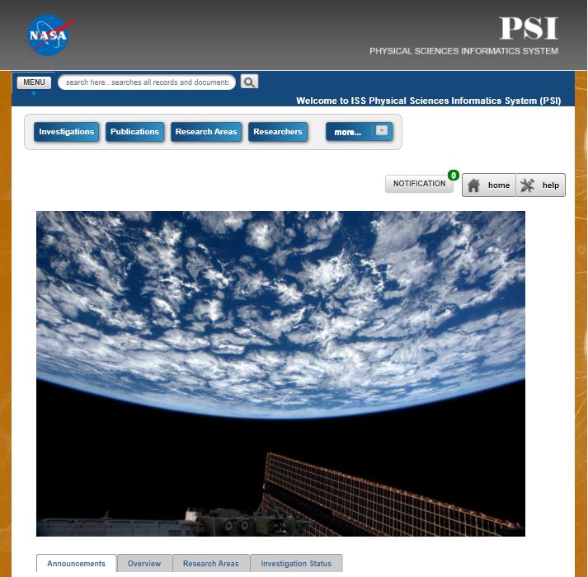
What is the PSI?
(Physical Sciences Informatics)
Open Science Repository for μG
Physical Science investigations
Sponsor is Biological and Physical Sciences (BPS) Program in SMD
Open to the public after registration at https://www.nasa.gov/psi

Slide 3
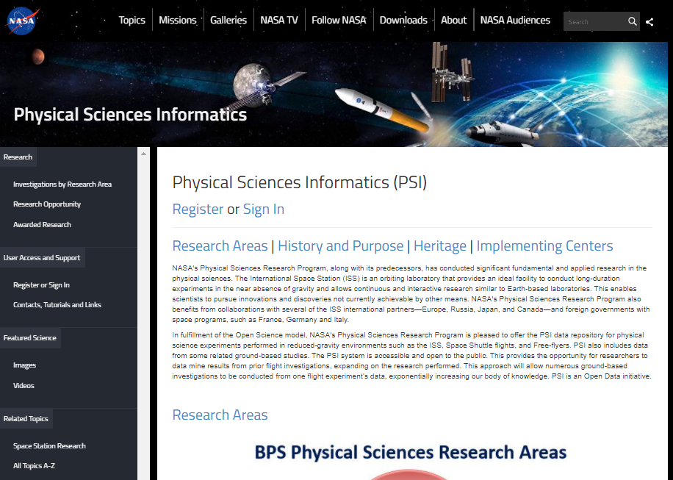
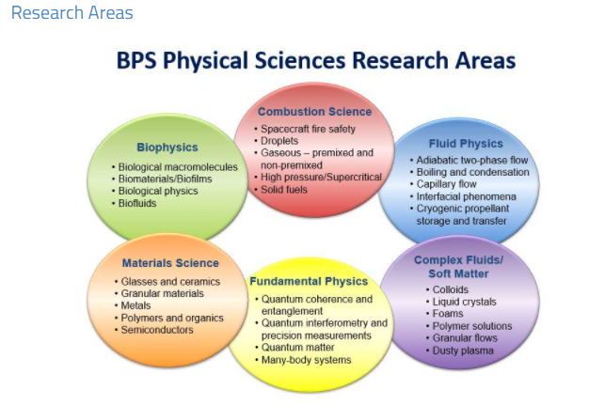
PSI
μG Physical Sciences data in
6 Research Areas
Biophysics
Combustion
Complex Fluids
Fluid Physics
Fundamental Physics
Materials

Slide 4
PSI
78 Investigations
2 Biophysics
18 Combustion
19 Complex Fluids
16 Fluid Physics
4 Fundamental Physics
19 Materials
17+ TB investigation data

Slide 5
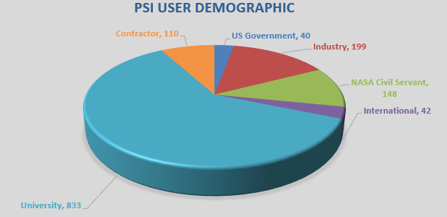
Who uses PSI?
1,372 users to date

Slide 6
New in 2020

Slide 7
New in 2021

Slide 8
New Each Year
BPS sponsors an annual opportunity to propose
$1,000,000 in 5 awards, up to $100K/year for 2 years
This year in ROSES-21 E.8
  Released 9/15/21
  NOI (optional) 10/29/21
  Proposals due 1/10/22
  Awards expected 6/15/22

Slide 9
Investigations in PSI

Slide 10
Investigations in PSI

Slide 11
Investigations in PSI

Slide 12
Investigations in PSI

Slide 13
Investigations in PSI

Slide 14
Coming in 2022
New Flight and Ground projects in work
  ACE-T11, PBRE-2, STDCE-2, Perfect Crystal, LMM, CAL
  Multiple PSI grants concluding
  Additional data for OASIS, MICS, DECLIC
Improved User Interface
New Monthly User’s Meeting
We welcome your comments and participation

