Slide 1
Neil Dennehy
NASA Technical Fellow for Guidance Navigation & Control cornelius.j.dennehy@nasa.gov
Welcome…
Launch Vehicle Load Relief: A Historical Perspective and Some New Concepts
Presented by: Jeb Orr
Mclaurin Aerospace

Slide 2




Slide 3
Launch Vehicle Load Relief: A Historical Perspective and Some New Concepts
11/17/2021
Jeb S. Orr
Colter W. Russell
Abran Alaniz
Mclaurin Aerospace (AMA TEAMS3 Contract)
A portion of this work was supported by the NASA Engineering and Safety Center (NESC) under contract 80LARC17C0003-T3-0324-FY21

Slide 4
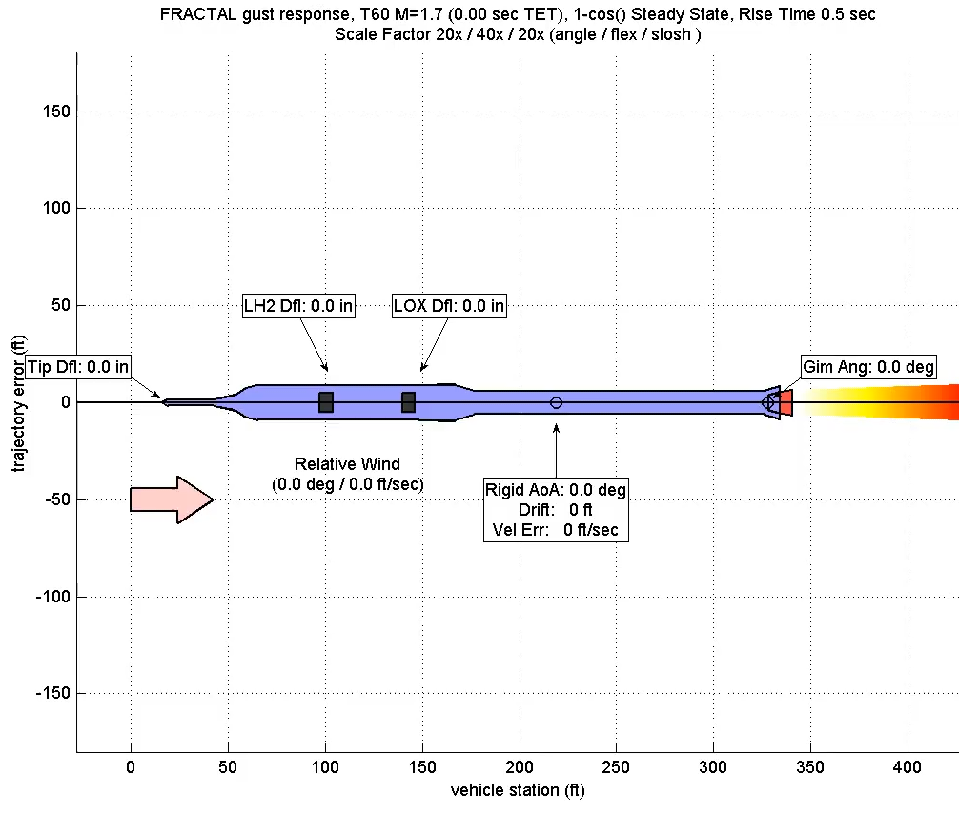
Introduction
Ares I Load Relief Example
Fully Coupled Linear Aeroelastic Model (FRACTAL 1)
Load relief is a control technique designed to reduce transient bending loads
  For launch vehicles, a primary control goal is to reduce wind induced
  It is noted that reducing does not always imply reduced bending moments
    Moments due to gimbaling can dominate over aeroelastic loads
    We will consider only rigid-body load relief approaches.
Most approaches to load relief use some sort of acceleration feedback.
  Angle of attack is substituted with a surrogate measurement, such as N_{Z} and filtered angular rate.

Slide 5
Background
For this application we can restrict the discussion to a rigid rocket on a gravity turn.
  The gravity turn is by definition the trajectory.*
  The control design is a regulator problem; i.e., drive the states toward the gravity turn.
Near the gravity turn the angle of attack without wind is
  The trajectory-relative velocity (usually not measurable) is related to the body velocity by
  The dynamics are written in a “quasi-inertial” or trajectory-relative frame in order to incorporate the angle of attack.
  This frame is accelerating and anchored to the nominal vehicle center of mass location.
| |
*With no wind.

Slide 6
Vehicle Dynamics
The vehicle dynamics near the gravity turn are described by two* coupled linear equations:
The rotation dynamics can be called “short period” although they may be unstable without feedback control.
  Most launch vehicles are statically unstable for performance reasons.
The translation dynamics are sometimes called a “drift mode” or “plunging mode”.
  The resultant linear system has 3 poles.
  We want the 2 rotation poles to be stable and well damped, and the drift root to be at worst neutrally stable.
| |
Rotation
Translation
*The angular rate is also integrated to produce the trajectory-relative attitude angle.

Slide 7
Basic PD Feedback Control
We can simplify the dynamics to second order.
  Assume no actuator dynamics and no significant plunging velocity.
Introducing simple proportional-derivative feedback:
  An approximately ideal gain set is
  The natural frequency and damping are chosen to meet a performance metric, also subject to a lower bound
  This is the aerodynamic gain margin.
  Similar closed-form gain expressions can be found for PID control.
Typical launch vehicle attitude response, PD & PID control
Gains can be designed using 2nd order dynamics and then applied to a higher-order model including translation

Slide 8
Simple Alpha-Feedback Load Relief
In order to reduce one can add pure feedback.
  Pure feedback can be unstable: vehicle will turn into the wind and deviate from the trajectory
  Eigenvalue associated with drift root is in RHP
Consider a linear combination of attitude and angle of attack feedback:
  There is a critical gain where the drift root is neutrally stable.¹
  A closed-form expression can be derived as a function of the control gains, aerodynamics, etc.
  In this case the response to a gust will be improved but the vehicle will not deviate exponentially from the trajectory.
  However, angle of attack cannot be easily measured!
PD vs. Alpha Feedback
PD control response to gust returns attitude error to zero but vehicle has nonzero angle of attack due to drift velocity
”Ideal” critical-gain alpha control is neutrally stable in drift and reduces loads.
Equivalent to “drift minimum” control.
[1] Barrows, T., and Orr, J., Dynamics and Simulation of Flexible Rockets, Chapter 9, Elsevier, 2021.

Slide 9
Classical (Saturn I/I-B) Load Relief
Reliable sensing of angle of attack was determined to be infeasible for early launch vehicle configurations
  Alpha sensing had been demonstrated using the X-15 ball nose, but was not reliable in subsonic and transonic conditions
  Vanes must survive the launch environment and are subject to aeroelastic errors
  Inertial air data was not available with high accuracy or reliability (also tried on X-15)
Early load relief approaches^{2,3} used body accelerometer feedback:
  There are 3 closed form gain sets that can be derived for steady state:
    Attitude error minimum. Vehicle attitude error is zero. Special case.
    Drift minimum. Vehicle acceleration normal to trajectory is zero.
    Load minimum (no attitude feedback). Vehicle angle of attack is zero.
        Unstable (long period / “path motion”).
[2] Jaggers, R., “Derivation of a Drift Minimum/Loads Minimum Control Law for Booster, Atmospheric Flight,” NASA JSC 5-2950-1-HOU-278, May, 1971.
[3] Haeussermann, W., “Description and Performance of The Saturn Launch Vehicle’s Navigation, Guidance, and Control System,” NASA TN D-5869, NASA Marshall Space Flight Center, July 1970.

Slide 10




Load Relief Response with PD Control
Nominal flight path
Outline of vehicle denotes steady-state orientation
$$φ_{y}(∞)=0$$
$$φ_{y}(∞)=0$$
Shading denotes transient motion
$$φ_{y}(∞)=0$$
$$\dot{z}I(∞)=V_{w}$$
$$\dot{z}I(∞)=V_{w}$$
$$\dot{z}I(∞)=V_{w}$$
PD only
Minimum Attitude Error
Minimum Drift
Unstable Drift
Increasing accelerometer gain or alpha feedback
Normal / lateral drift
Figure adapted from Yang, L., “Design of Load Relief and Anti-Drift,” Draper Laboratory, 5/23/2009.

Slide 11
Saturn Load Relief
Pure accelerometer feedback is difficult to realize in practice.
  Bending dynamics couple strongly into accelerometer feedback signal, requiring aggressive low-pass filtering.
  Angular acceleration couples into accelerometer since instrument is not at CG (requires angular rate compensation).
  Effective closed-loop bending damping (phase stable 1st mode) can be decreased.
  Time constants for “steady state” design equations may be on the order of the trajectory.
Angle of attack feedback was abandoned in favor of accelerometers.
Load relief was baselined but eventually removed from the Saturn V.^{4,5}
  Analog component tolerances for low-pass filtering were a contributing factor.
Control accelerometer
Image: Haeussermann, NASA TN D-5869
[4] Frosch, J. and Vallely, D., Saturn AS-501/S-IC Flight Control System Design," J. Spacecraft, Vol. 4, No. 8, 1967, p. 1003-1009.
[5] Orr, J., Wall, J., and Dennehy, N., “The Enduring Legacy of Saturn V Launch Vehicle Control Design Principles & Practices,” 70th International Astronautical Congress, IAC-19-9-D6.2, 21-25 October 2019.

Slide 12
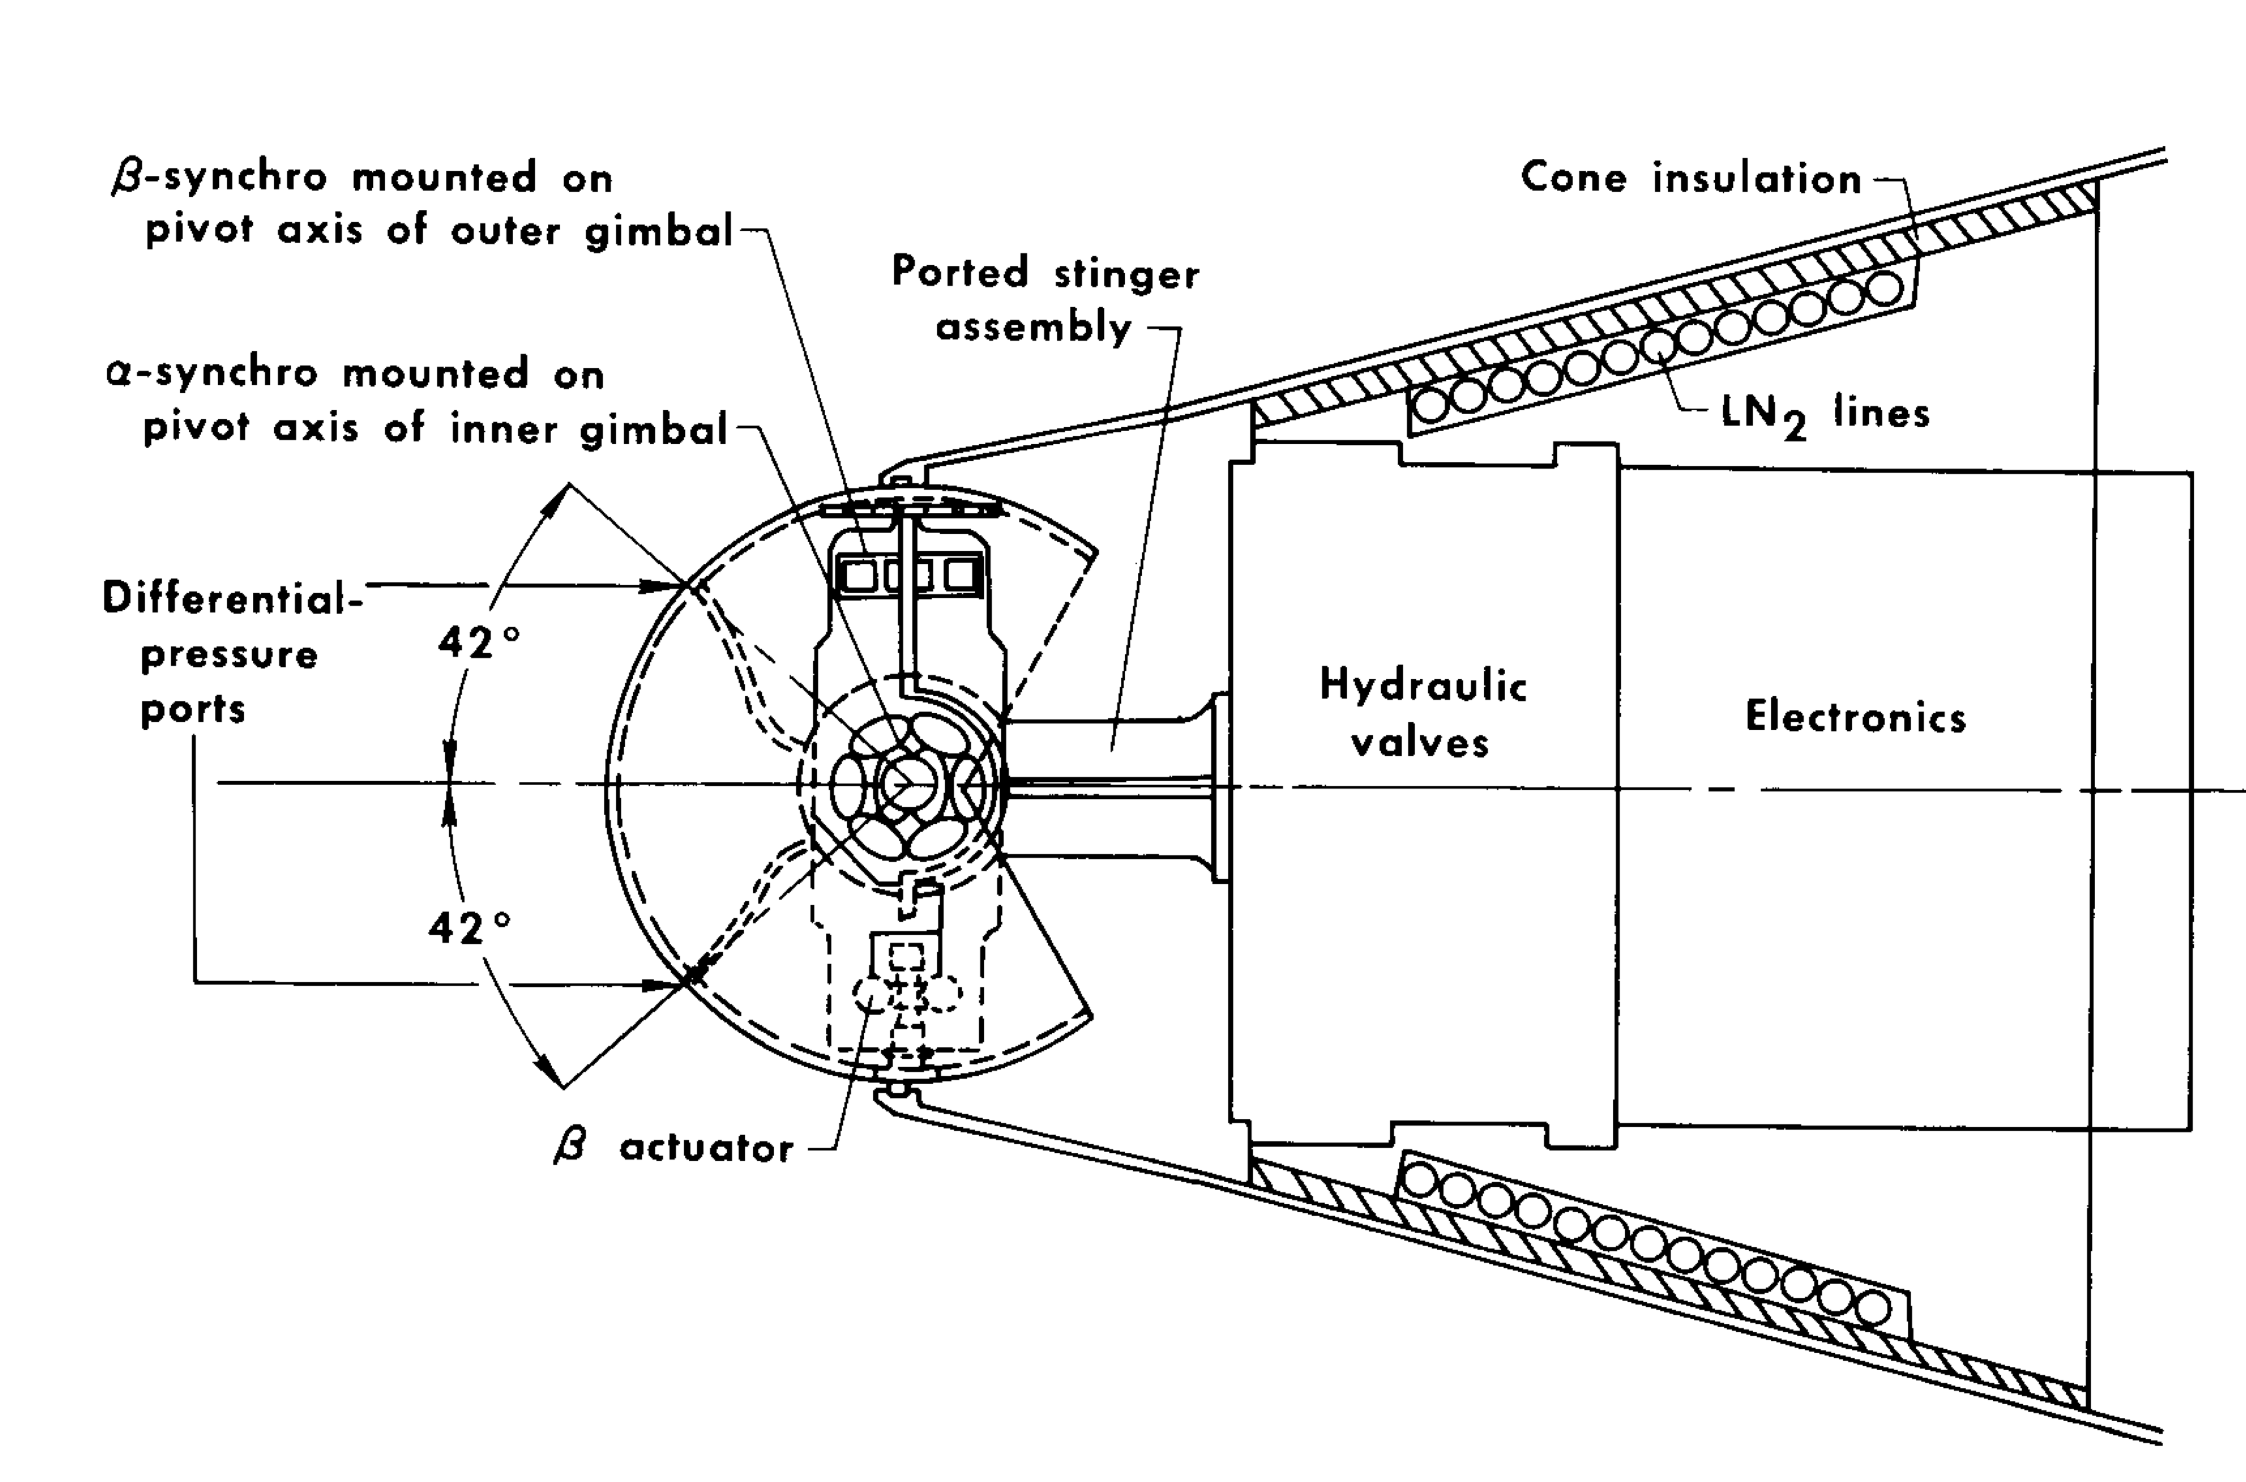
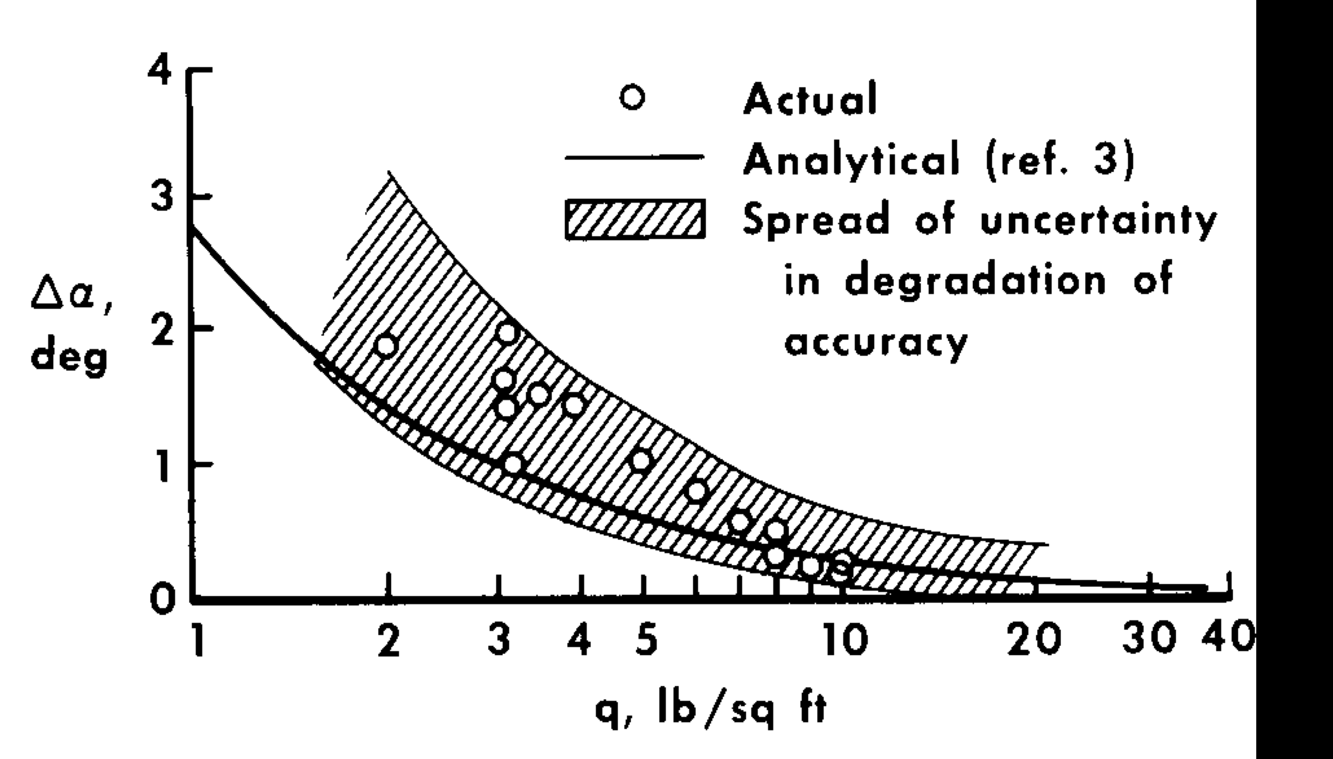
A Sidebar on Air Data and the X-15 (the “q-ball”)
A novel angle of attack sensor was developed and demonstrated on X-15
  Simple concept – use theoretical pressure distribution over a perfect sphere
  Analog servocontrol to gimbal the sphere to equalize the differential pressure
  ~0.1° alignment accuracy to airframe and <0.5° measurement accuracy up to ⍺=22°
  Excellent performance above Mach 2 except when interacting with RCS plumes at low dynamic pressure (<50 psf)
  Limited in subsonic & transonic regimes – not useful for launch vehicles.
[6] Wolowicz, C.H. and Gossett, T.D., “Operational and Performance Characteristics of the X-15 Spherical, Hypersonic Flow-Direction Sensor,” NASA TN D-3070, November 1965

Slide 13
Space Shuttle Ascent Load Relief
Typical aerodynamic angle limit squatcheloid [7]
STS Load Relief combined Ny/Nz feedback with:
  Day-of-launch wind biasing (mean monthly wind reference accelerations)
  Elevon hinge moment load relief (delta-P feedback)
  Operational design trajectory with zero-lift gravity turn (negative alpha)
Complex design approach
  Highly coupled loads & dynamics problem due to aerosurfaces and vehicle element interfaces
  Development of “squatcheloids” over range of Mach numbers
  Squatcheloids used to develop vehicle loads analysis cases
  Challenged by bending stability margin throughout the program⁸
STS-1 Design and Actual Angle of Attack [9]
[7] Schleich, W.T., Shuttle Vehicle Configuration Impact on Ascent Guidance and Control, J. Guidance, Vol. 7, No. 3., pp. 338-346.
[8] Altenbach, R., NASA STS SSD96D0526, STS Bending Flight Mechanics Data Book, September 1996.
[9] Olsen, L.M and Sunkel, J.W., Postflight Evaluation of the Shuttle Guidance, Navigation, and Control During Powered-Ascent Flight Phase, J. Guidance, Vol. 6, No. 6, pp. 418-423.

Slide 14
STS Ascent Pitch Axis FCS Block Diagram
High pass: compensate for angular accel
Nz Feedback Load Relief
Sidebar: STS-1 Ascent (April 12, 1981)
  Significant error in wind tunnel-validated aerodynamics tables causes large attitude error on ascent and lofted trajectory
  Loads approach/exceed safety factor on vertical tail (R. Ryan).
  Nz feedback is still successful in maintaining reference angle of attack profile.
Figure from Olsen, L.M and Sunkel, J.W., Postflight Evaluation of the Shuttle Guidance, Navigation, and Control During Powered-Ascent Flight Phase, J. Guidance, Vol. 6, No. 6, pp. 418-423.

Slide 15
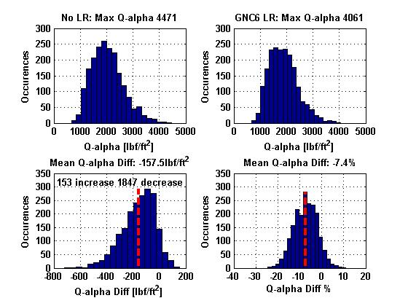
Ares I / I-X / SLS Load Relief
Ares I & SLS Load Relief derived from Ares I-X
  Ares I-X designed by Bart Bacon et. al (LaRC) and based on concept of external force and moment balance using 1st order Luenberger observers (ignoring drag)
  Provided an anti-drift function
  Modified for Ares I to schedule gains and include a load relief function
Even with numerical gain optimization, achievable gain was severely limited
  Because 1st bending mode is phase stable, bending damping decreases, possibly increasing bending loads over a “no load relief” option
  Mean rigid-body decreased about 7%.
  Typical Ares I LR bandwidth was ~0.1 Hz.
Draper PARES MC Analysis [8]
[10] “Control Algorithm and Parameters for the Ares I-X Flight Test Vehicle,” AI1-SYS-CAP-V4.00, NASA ESMD, October 21, 2009.
[11] Jang et al., “Analysis of Ares I Load Relief Controller Design,” MSFC/EV41, January 2009.
[12] Wall, J., “Analytical Presentation of the Ares I Anti-Drift / Load-Relief Flight Control Option,” MSFC/EV41, Nov 9, 2009.
[13] Orr, J., “GNC8 FS Design Rev 2,” MSFC/EV41, April 27, 2010.

Slide 16
Simplified Multi-Loop Load Relief Steering
Why? Inner-loop feedback increases the complexity of the inner-loop FCS design
  Example: The SLS autopilot has 3 primary control gains (PID), about 64 attitude, rate, and load relief (DCA) filter coefficients, and 4 load relief gains, per axis, per flight condition
Direct air data sensing has not yet been shown to be feasible & reliable for launch vehicles.
    FADS, 5-hole probe, etc. have issues with complexity, reliability, and pre-launch weather
    Possibly unacceptable impact to launch availability.
    However, GPS/INS capability and computing power has markedly improved!
INS measurements can be combined with Day of Launch I-Load Update (DOLILU) to construct a synthetic estimate of angle of attack.

Slide 17
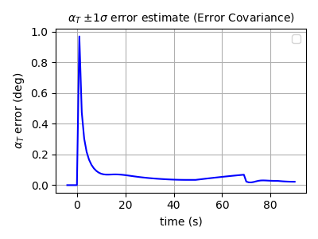
How Has the Situation Changed?
Today we have access to good inertial data.
  Inertial estimates alone (no wind) can provide angle of attack to sub-degree accuracy using GPS
  Wind data can be stored online and updated prior to launch (DOLILU)
  Winds can be determined from DRWP, balloon soundings, and forward-looking sensors
  New control laws could take advantage of the availability of reliable angle of attack data.
Strapdown navigation error states can be used to estimate inertial angle of attack errors.¹²
Example Launch Vehicle Navigation Covariance Analysis
High Tactical-Grade IMU with GPS Aiding
Inertial Angle of Attack Error Covariance
GPS SPS + GPS Out
Linear Angle of Attack Estimation Errors Depend on Strapdown Navigator Error States
[12] Orr, J., “Aerodynamic Angle Navigation Error Covariance,” Mclaurin Aerospace internal memo, August 10, 2020

Slide 18
DOLILU (Day of Launch I-Load Update)
Combining inertial velocity estimates with measured range winds can produce a significantly improved estimate
  Actual errors are difficult to know a priori due to limited range information (balloon vs. DRWP vs. postflight BET, for example)
    Some statistical data on CCAFS Jimsphere performance is available from MSFC
    Limited information at WSMR and elsewhere
  Careful: wrong DOLILU is worse than no DOLILU.
Monte Carlo error model
  Filtered random walk + GM noise model to account for spatial and temporal error in winds measurements
Altitude (ft)
Velocity (ft/s)
Example: Kodiak nominal GRAM wind with dispersed DOLILU errors (n=100)
Altitude (ft)
Velocity (ft/s)

Slide 19
New Alpha Feedback Law
Revisiting the vehicle pitch dynamics with wind:
  Note that the total normal force coefficient
  The angle of attack with wind is
These equations are valid near the gravity turn.
  If the forward and wind velocity are approximately constant:
  A rate command load relief law can be derived¹³:
| |
Rotation
Translation
[13] Orr, J., “Booster Alpha Control near a Gravity Turn,” Mclaurin Aerospace internal memo, October 18, 2020.

Slide 20
Advantages of Outer-Loop Angle of Attack Control
Inner loop stability margins are not significantly affected by outer loop closure
Inner loop autopilot structure is simple (PD/PID + bending filters)
  Easily accommodate gain-adaptive control
Acceleration feedback can be lower gain / low bandwidth
Challenges
  Accelerometer feedback still must be robustly stabilized with bending.
  Since relative velocity is in the denominator of the feedback law, the effective gain is very high at low velocity.
  Drift root is still unstable for load minimum condition.
Representative Simplified Linear Model
Truth CG acceleration feedback.

Slide 21
Monte Carlo Analysis in High Fidelity Simulation
SSTV Synthetic Vehicle Model
Representative test using a single-stage boost vehicle concept called SSTV
3 cases considered to evaluate effectiveness of a rate-command algorithm
  No load relief (zero wind χ table only)
  Load relief law with GPS error model but perfect DOLILU table
  Load relief law with GPS errors and DOLILU errors
  All runs were performed with flex off
  Identical seeds for direct comparison of results
Simplified set of uniform dispersions used to generate stressing cases with wind
  Typical vehicle dispersions (mass properties, thrust, sensors)
  Environment dispersions to assess winds (GRAM thermo properties)
Payload
IMU & FC
RCS
H₂O₂
N₂O
92 cm (3 ft)
9 m (29.5 ft)
GHe
RP1
Launch mount interface
Hydraulic TVC
100 kN pump-fed engine

Slide 22
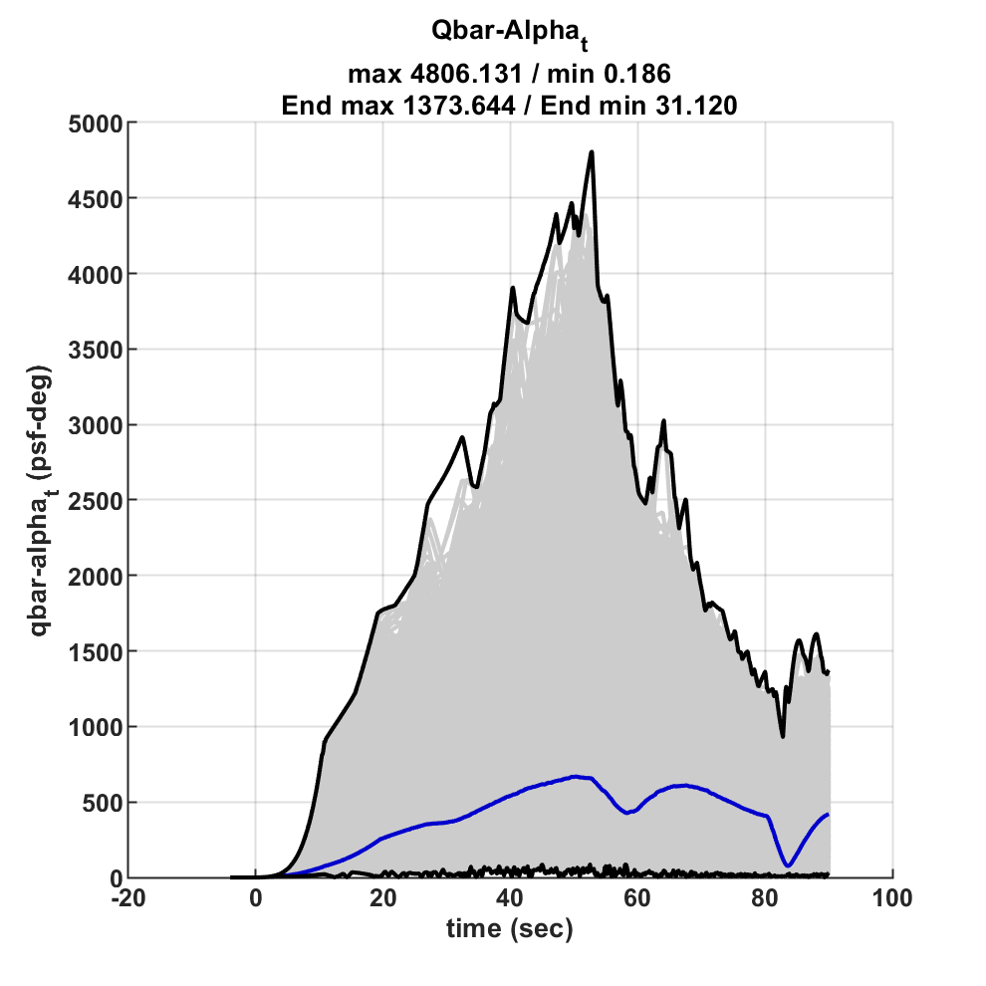
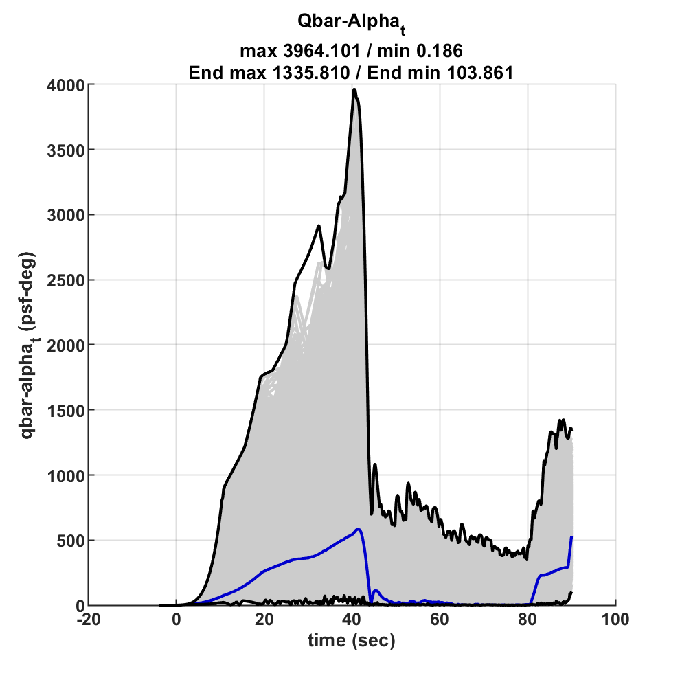
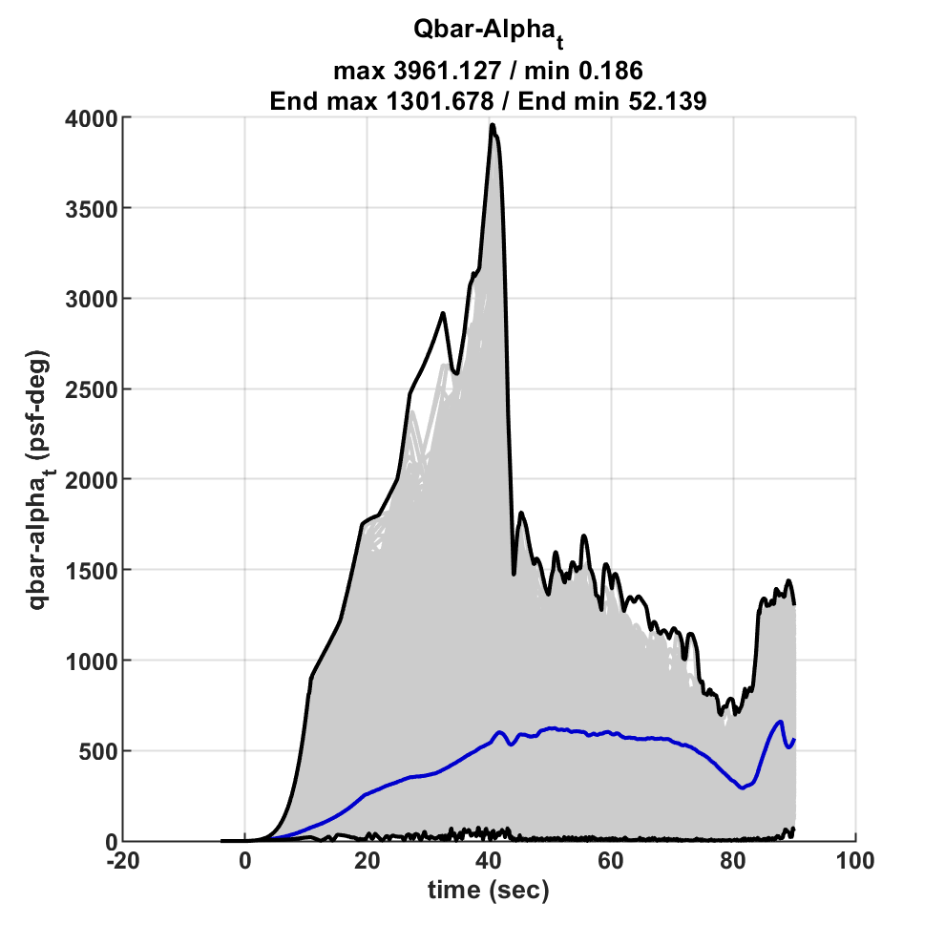
Monte Carlo Analysis – Rigid-Body Load Indicators
Load relief law is enabled at T=40 sec
  Load relief is blended in over 5 sec to reduce rate transient at engagement
  Significant improvement in envelope even with errored winds information
  Improvements are reflected in 99.865% 10% CR quantiles for loads (not shown)
  Nominal case is worse with load relief due to nominal wind table errors (expected)
No load relief
Perfect DOLILU (ideal) load relief
Load relief with DOLILU errors

Slide 23
Summary
Launch vehicle load relief is a powerful augmented control technique to reduce vehicle transient loads due to wind.
  Fundamental concepts of acceleration and angle of attack feedback have remained unchanged since their advent in the early 1960s.
  Load reductions can improve launch availability or decrease structural mass.
Tradeoffs include:
    Placement of accelerometer with respect to CG & bending mode shape/slope OR
    Feasibility of direct alpha sensing or alpha estimation
    Control loop complexity / number of parameters
    Rigid body load metrics ( ) versus transient bending moments due to TVC
    Robustness/stability margins.
    Acceptability of marginal or unstable path drift in the presence of wind.
Novel methods using modern strapdown GPS/INS combined with near real-time measurements can yield very good performance.
  Still a linear control law that can be designed/tuned using classical loop shaping techniques.

