Slide 1

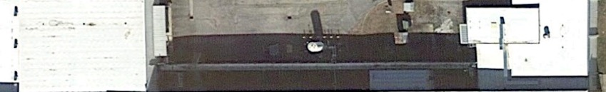
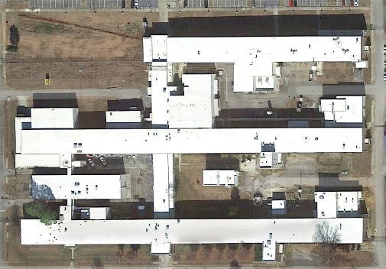
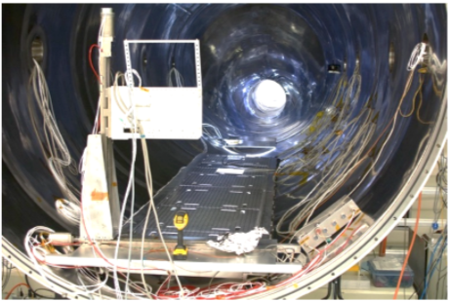
The Marshall 100-Meter X-ray Beamline
AKA The Stray Light Test Facility
Detector
End
Source
End
Bldg 4487
Guide Tube
The user-friendly Marshall Space Flight Center X-ray optical test facility
    Nick Thomas(1), W. Baumgartner (1), P. R. Champey (1), S. Cheney, J. Kolodziejczak (1), K. Kilaru (2)
NASA/MSFC(1), NASA/MSFC/USRA(2)

Slide 2
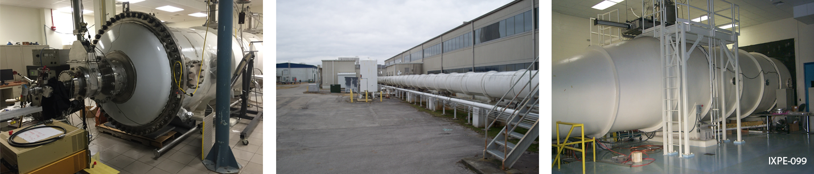
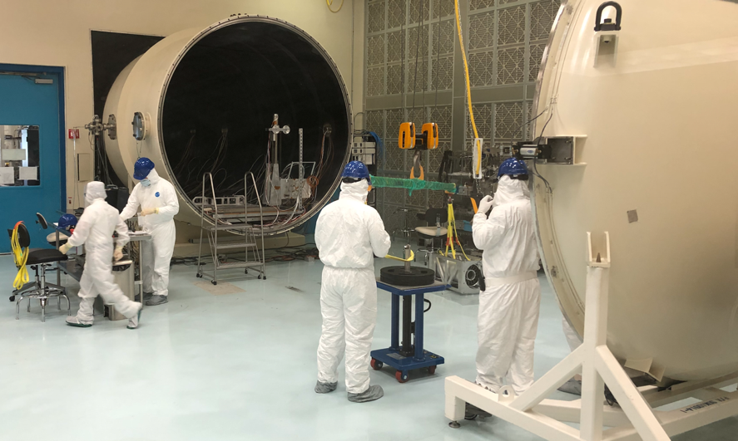
X-ray Beamlines
The Marshall 100 Meter
Calibrate X-ray Telescopes
  X-ray optics, collimators, grating spectrometers, and detectors
  Parallel beam, characterized spectrum, polarized source
  High vacuum
  Facility detectors and stages
  Flexible for small and large projects
  Cleanroom, laser alignment, lifting
  Focal length, plate scale/PSF size, and effective area

Slide 3
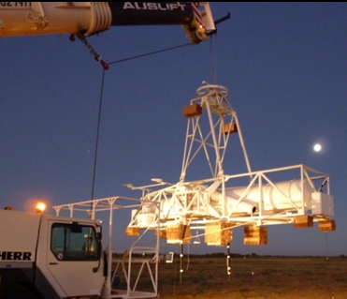
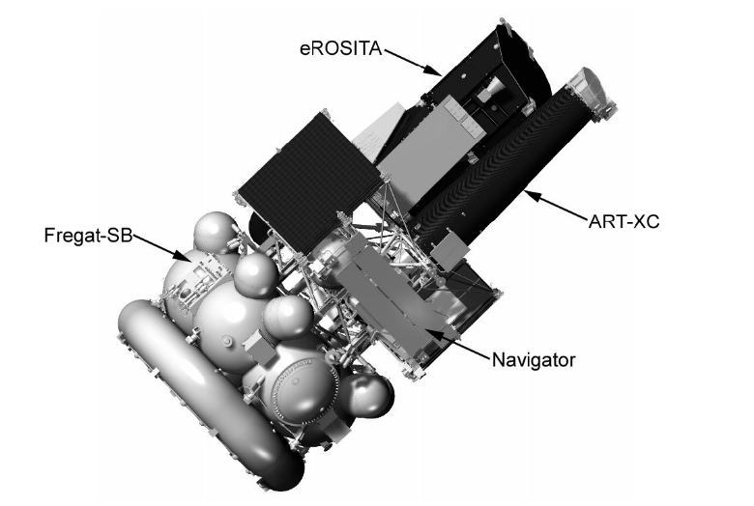
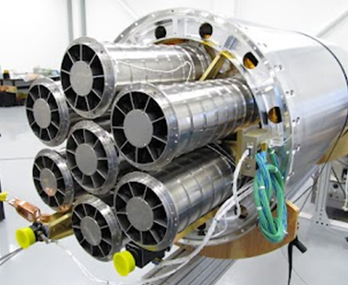
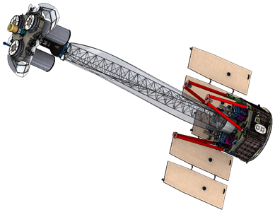
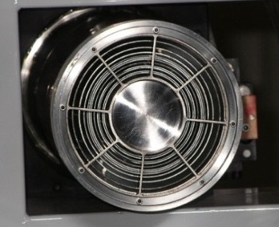
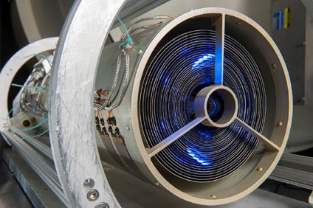
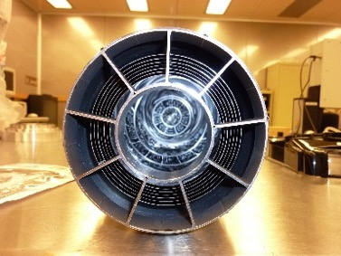
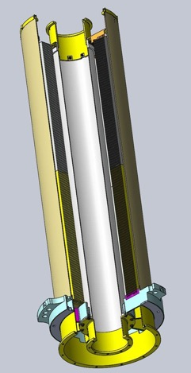
Flight Optics Tested at the MSFC 100 meter
HERO/HEROES (balloon)
8 Modules, 13/14 shells,
Multiple flights, latest in 2013
ART-XC (satellite)
8 Modules, 28 shells, qualified.
Launched July 2019
FOXSI (rocket)
7 Modules, 7/10 shells,
flown in 2012, 2014 and 2018
IXPE (SMEX)
3 Modules, 24 shells,
Calibrating, planned launch 2021

Slide 4
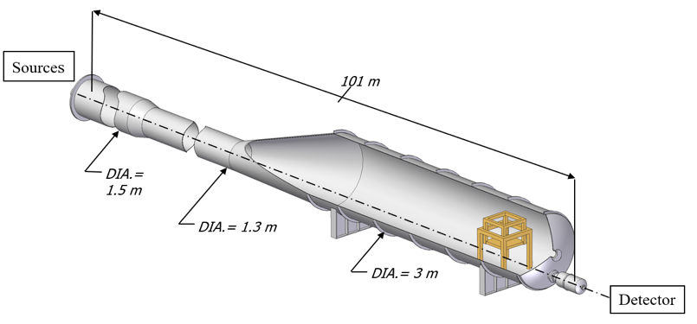
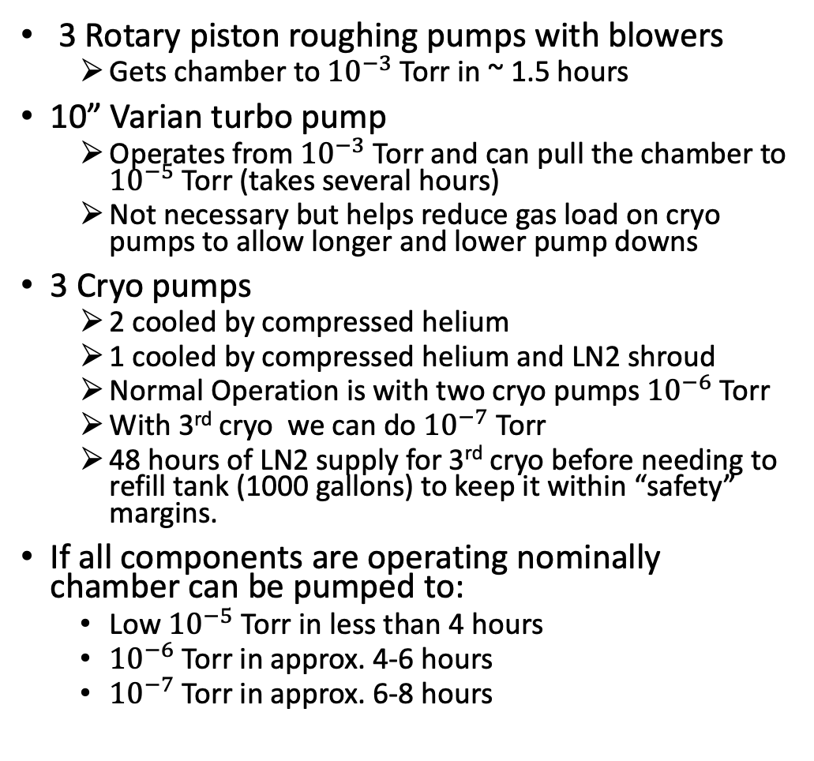
Marshall 100 Meter
General facility information
3 Rotary piston roughing pumps with blowers
  Gets chamber to ${10}^{−3}$Torr in ~ 1.5 hours
10” Varian turbo pump
  Operates from ${10}^{−3}$ Torr and can pull the chamber to ${10}^{−5}$ Torr (takes several hours)
  Not necessary but helps reduce gas load on cryo pumps to allow longer and lower pump downs
3 Cryo pumps
  2 cooled by compressed helium
  1 cooled by compressed helium and LN2 shroud
  Normal Operation is with two cryo pumps ${10}^{−6}$ Torr
  With 3rd cryo we can do ${10}^{−7}$ Torr
  48 hours of LN2 supply for 3rd cryo before needing to refill tank (1000 gallons) to keep it within “safety” margins.
If all components are operating nominally chamber can be pumped to:
  Low ${10}^{−5}$ Torr in less than 4 hours
  ${10}^{−6}$ Torr in approx. 4-6 hours
  ${10}^{−7}$ Torr in approx. 6-8 hours
Total facility: 101 meters long
Beamtube: 1.3 meter-wide
Detector chamber: 3 meter-wide, 8 meters long

Slide 5
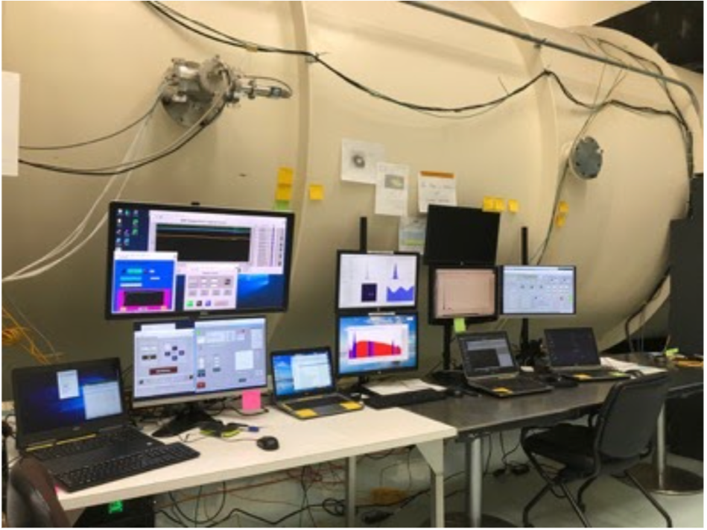
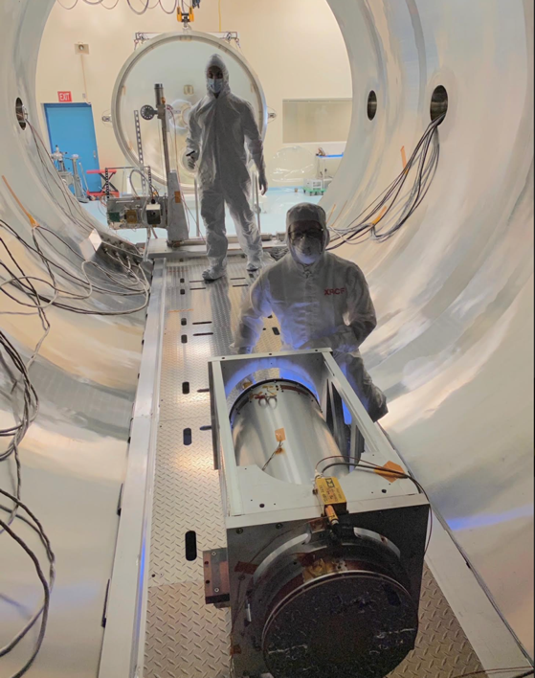
Marshall 100 Meter
General facility information
Cleanrooms
  10 K instrument chamber
  100 K work/staging area (control room)
  Gowning facility
Loading dock accessible

Slide 6
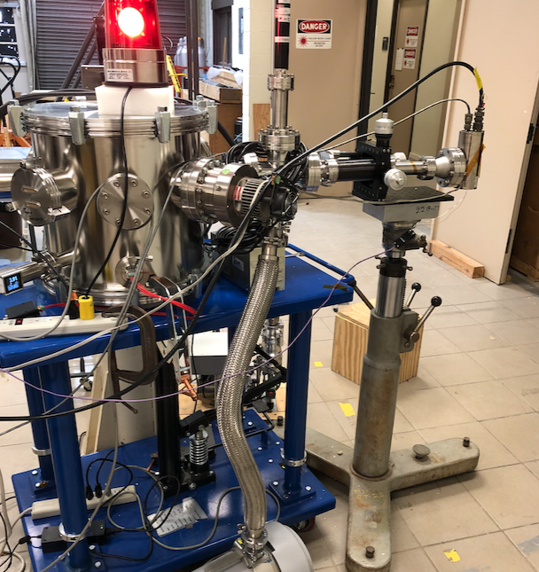
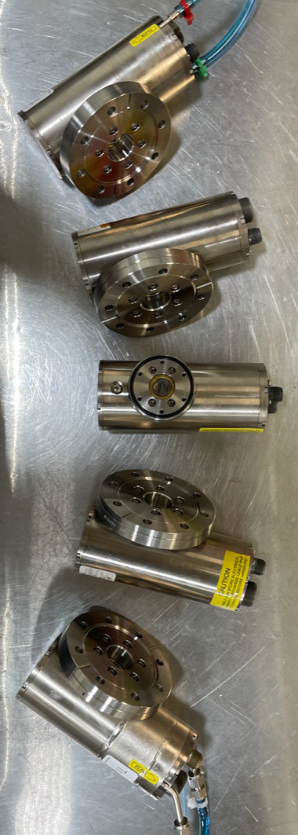
Marshall 100 Meter
Source Room
Tube Brand | Anode | Line (keV) | Max Voltage (kV) | Max Current (mA)
TruFocus 6050 | Mo | 2.2 (l) | 50 | 1
(Be window) | Rh | 2.7 (l) | 50 | 2
 | Ti | 4.5 (ka) | 50 | 2
 | Fe | 6.4 (ka) | 50 | 1
 | Cu | 8.1 (ka) | 50 | 1
TFX3110EW | W | 8.4(l),59(ka) | 110 | 2.5
TruFocus-10-2-AL | Al | 1.49 (ka) | 8.5 | 0.5
Manson Source | var | var | 10 | 1
Sub arcsecond sources
Flange alignment stage
Controlled from detector room
Filters and OBF available

Slide 7
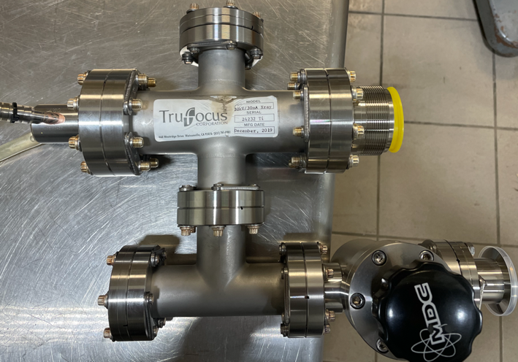
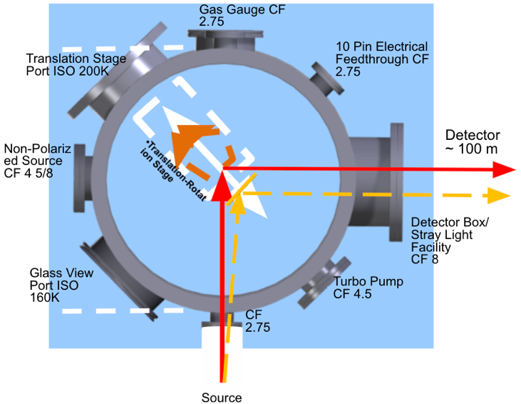
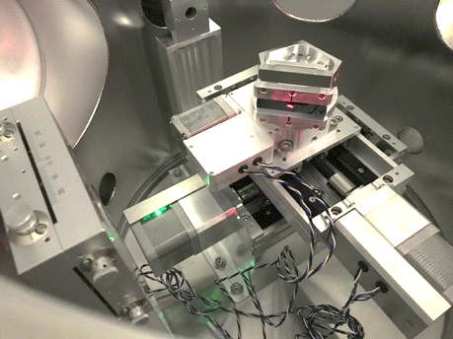
Marshall 100 Meter
Source Room
Trufocus 30kV/30mA Source
Anode | Line (keV) | Max Voltage (kV) | Max Current (mA) | Crystal
Rh | 2.7 | 30 | 30 | Ge(111)
Ti | 4.5 | 30 | 30 | Si(220)
Fe | 6.4 | 30 | 30 | Si(400)

Slide 8
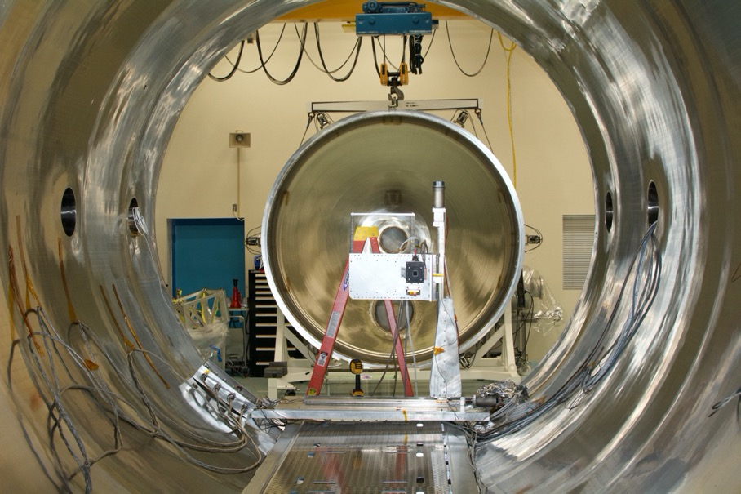
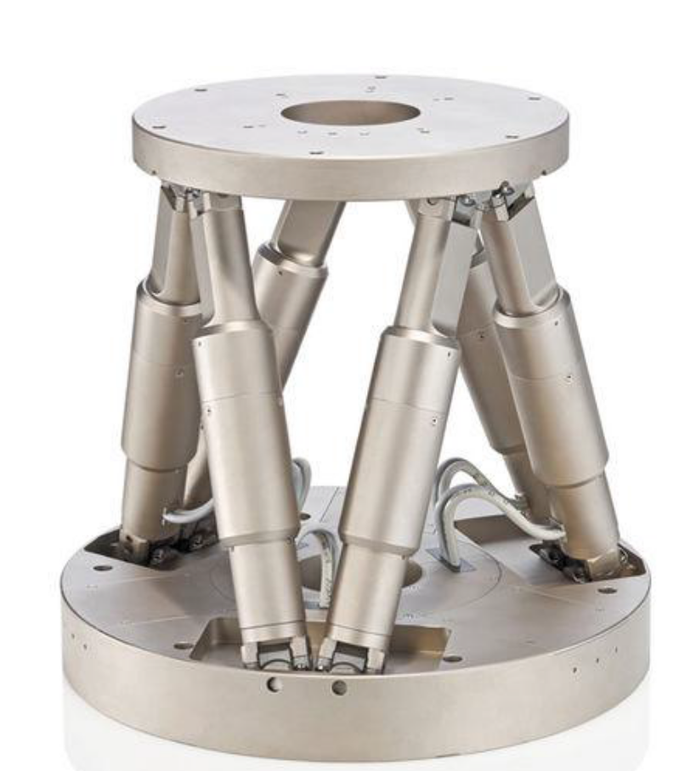
Marshall 100 Meter
Vacuum motion stages
Parker X-Y Stage
Load: 100 kg
XY Travel: 36 in by 30 in (Res 0.1 micron)
Area for additional detectors
Connected to external chiller (5 C, Water/Ethylene glycol)
Hexapod (H-850)
Load: 80 kg
Range: +/- 30 degrees
Optic/Collimator stage
Programable motion
Additional Zaber translational and rotational stage available

Slide 9
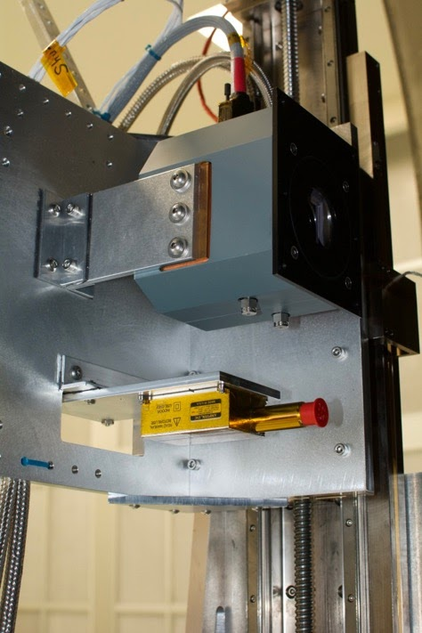
Marshall 100 Meter
Facility Detectors
CCD
  Andor DW436, SN 10513
  2048 X 2048 array of 13.5 um pixel
  Optical blocking filter and shutter
  Operates at -45 deg C
  Characterize point spread function of beam.
SDD
  Amptek Fast-SDD (50 mm^2)
  12.5 um Be window
  Si3N4 ‘C-II’ window
  Fast count rate/low deadtime
  Effective Area
    Two detectors mounted both on focal plane and near optical node
CdTe
  Amptek XR-100 CdTe (25 mm^2)
  For hard X-ray experiments (< 20 keV)

Slide 10
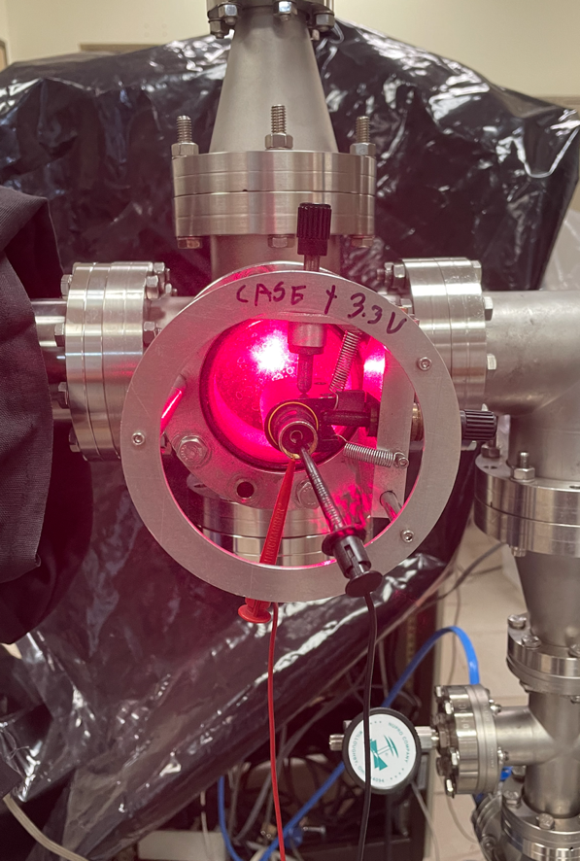
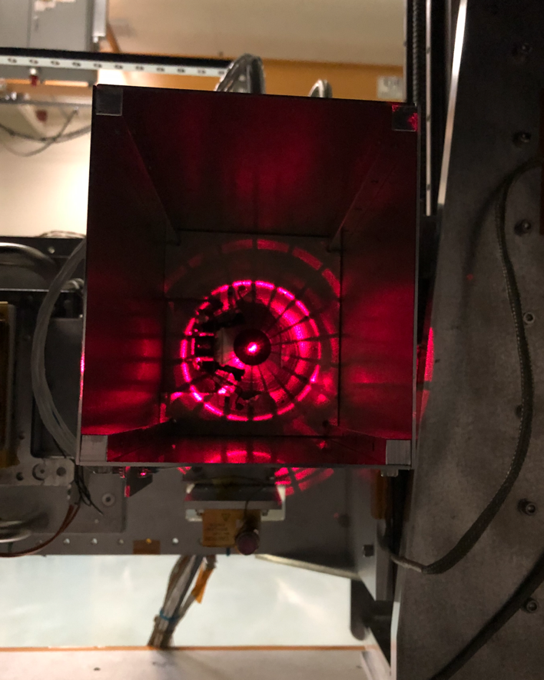
Marshall 100 Meter
Laser alignment and reference
Laser alignment
  Laser reflected off retractable mirror at source end.
  Diffuses to ~ 1 m diameter at detector end
  Allows for rough focus and alignment of X-ray optic
Laser optical axis reference

Slide 11
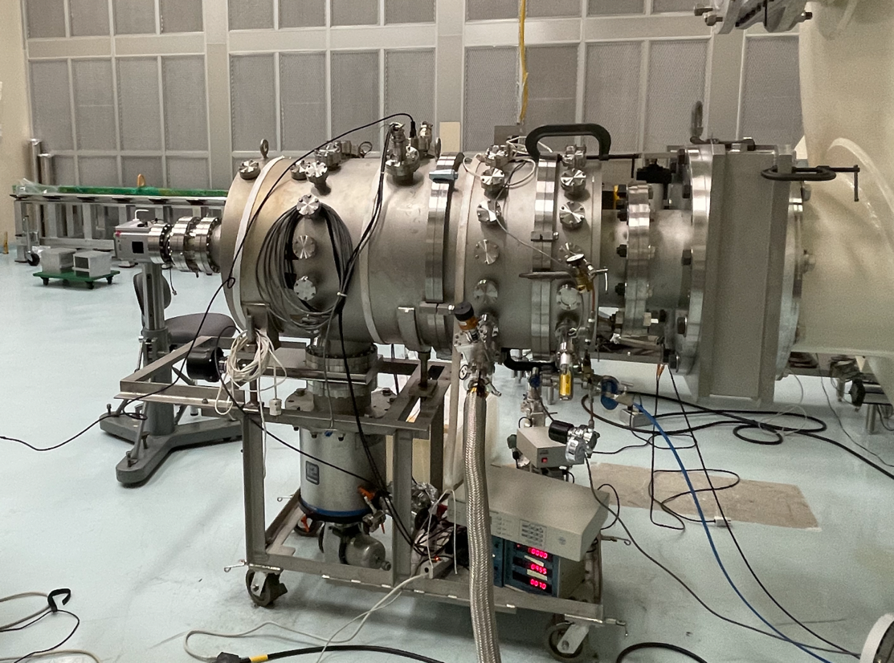
Marshall 100 Meter
Bell housing
The Bell Housing
  External vacuum chamber, co-linear to the beamline
  Quick turnaround on test optics
  Internal Tip, Pan, and linear Z-stage
    (Arc minute res/ 0.1 mm res)
  External Andor CCD camera
    (2048 X 2048 array of 13.5 um pixel)
  Be window allows for SDD measurements
  Additional tubing added for longer focal length optics

Slide 12
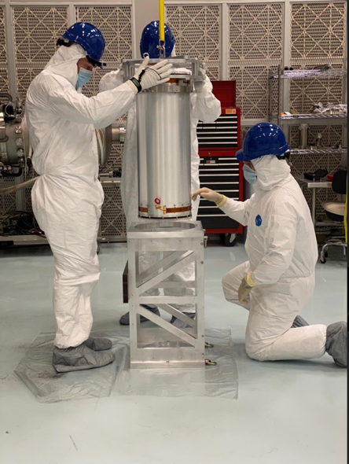
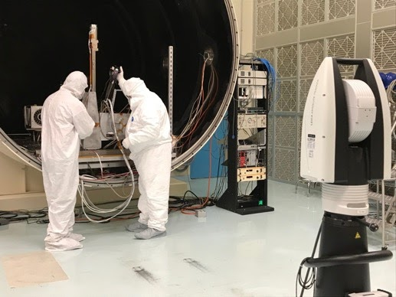
Marshall 100 Meter
Amenities
Overhead gantry chain in cleanroom
Full access to beamtube when vented
Leica laser range tracker
Temperature housekeeping
Electronic feed through flanges
Highly motivated assistance from team of scientist and engineers

Slide 13
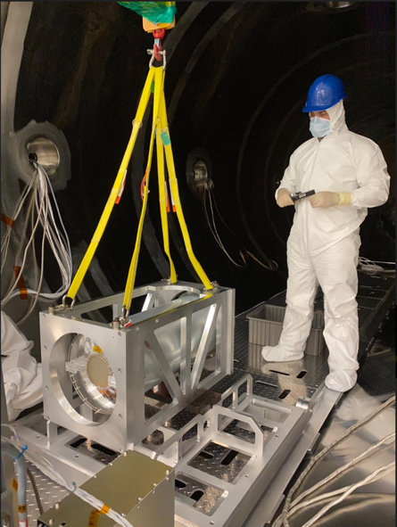
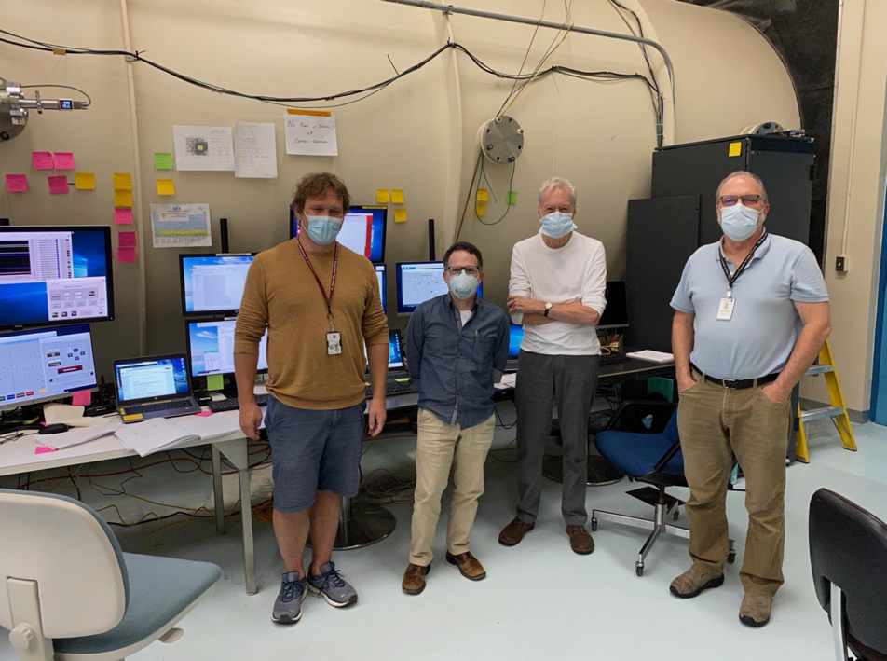
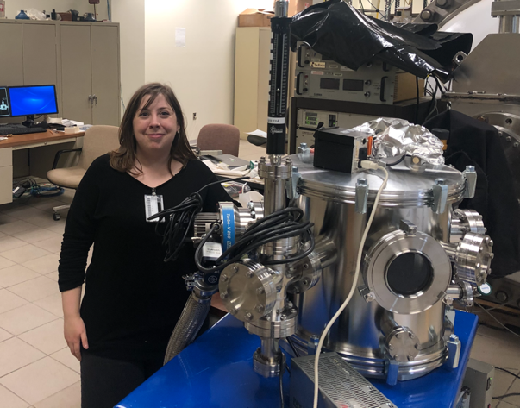
Marshall 100 Meter
People

Slide 14
Summary
The Marshall 100 Meter X-ray Beamline (aka The Stray Light Test Facility) is a world class X-ray optic test facility. It is capable of calibrating projects ranging from student lead experiments all the way to Explore size missions.
The Marshall 100 Meter is advertised to all successful APRA funded projects. For additional community support (NASA Centers, Universities, and Industry) please contact:
  nicholas.e.thomas@nasa.gov
  wayne.baumgartner@nasa.gov
  jessica.gaskin@nasa.gov

