Slide 1
Planetary Protection at NASA
Aaron Regberg

Slide 2
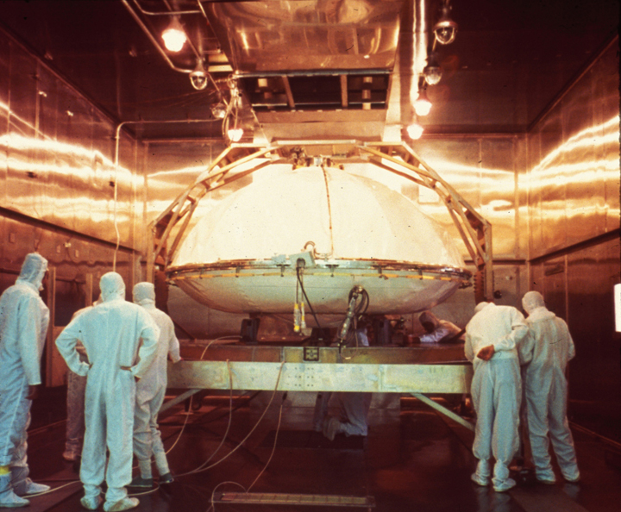
Planetary Protection is the practice of protecting solar system bodies from contamination by Earth life and protecting Earth from possible life forms that may be returned from other solar system bodies.

Slide 3
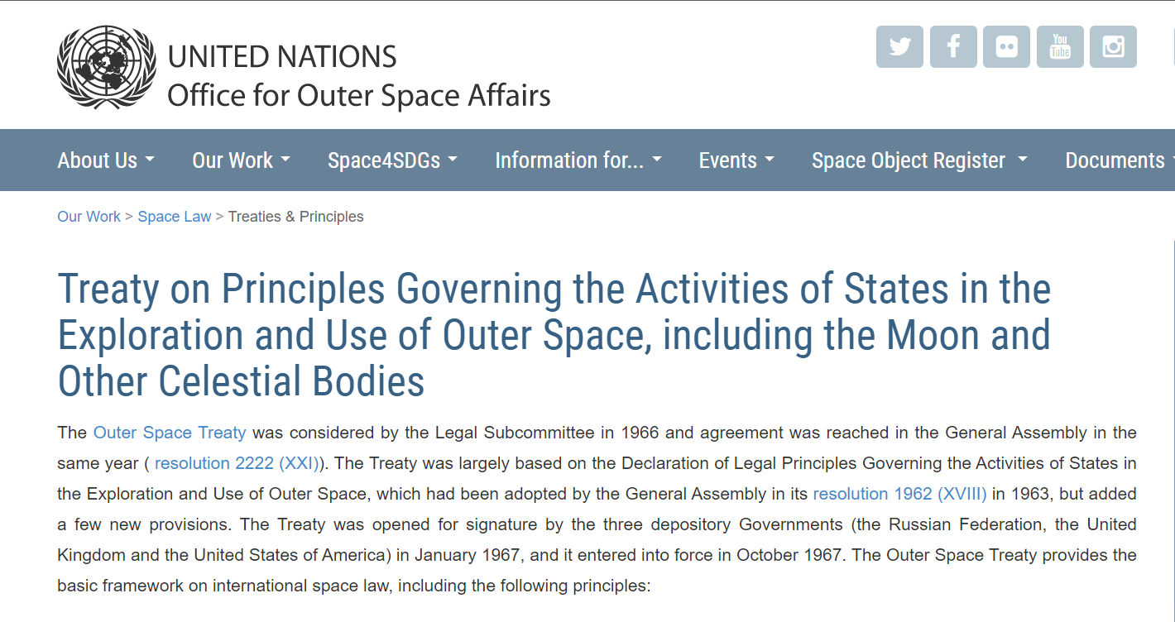
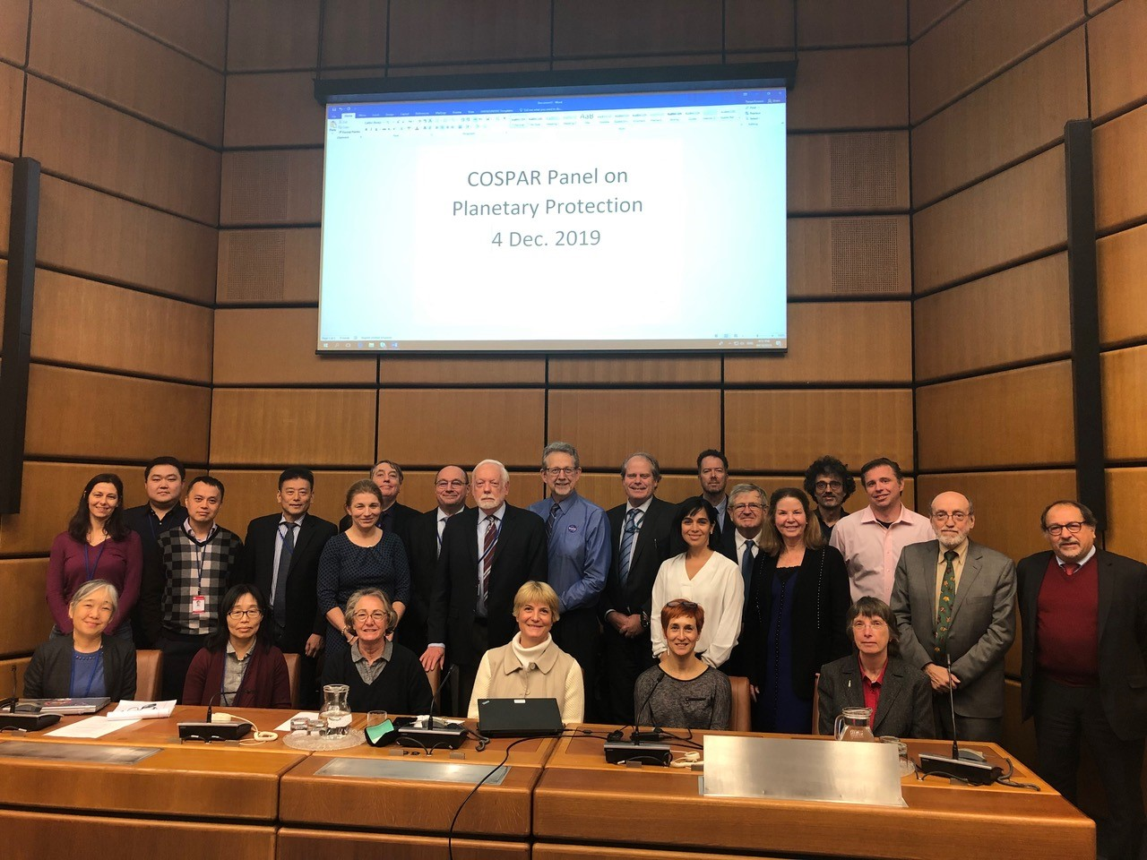
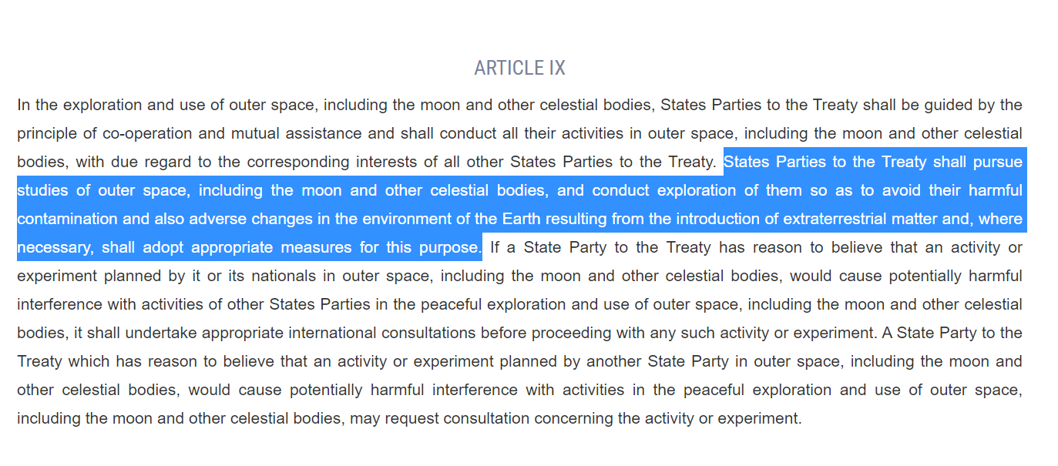
Planetary Protection: It’s the Law
https://www.unoosa.org/oosa/en/ourwork/spacelaw/treaties/outerspacetreaty.html

Slide 4
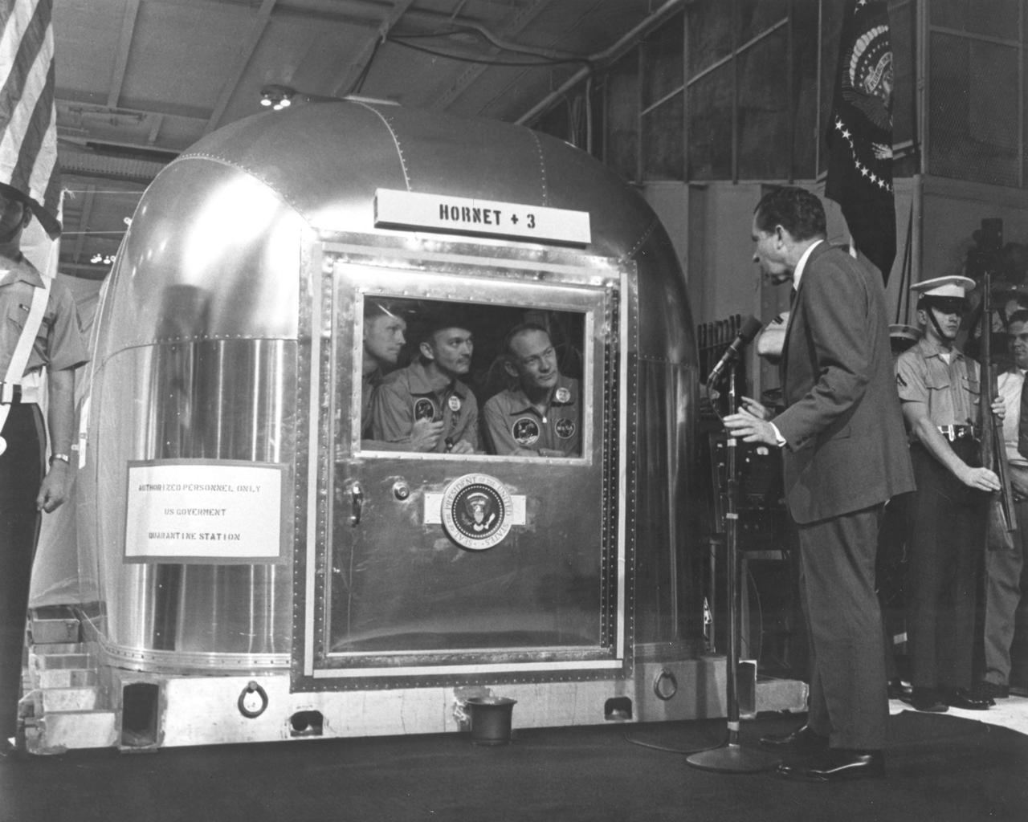
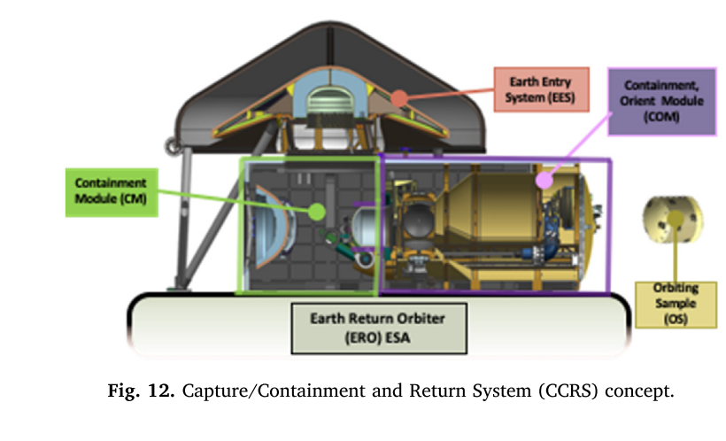
Backward Planetary Protection: Protect Earth from Extraterrestrial Contamination
Muirhead, B. K., Nicholas, A. K., Umland, J., Sutherland, O., & Vijendran, S. (2020). Mars Sample Return Campaign Concept Status. Acta Astronautica, 176, 131–138. https://doi.org/10.1016/J.ACTAASTRO.2020.06.026
images-assets.nasa.gov/image/6900602/6900602~orig.jpg

Slide 5
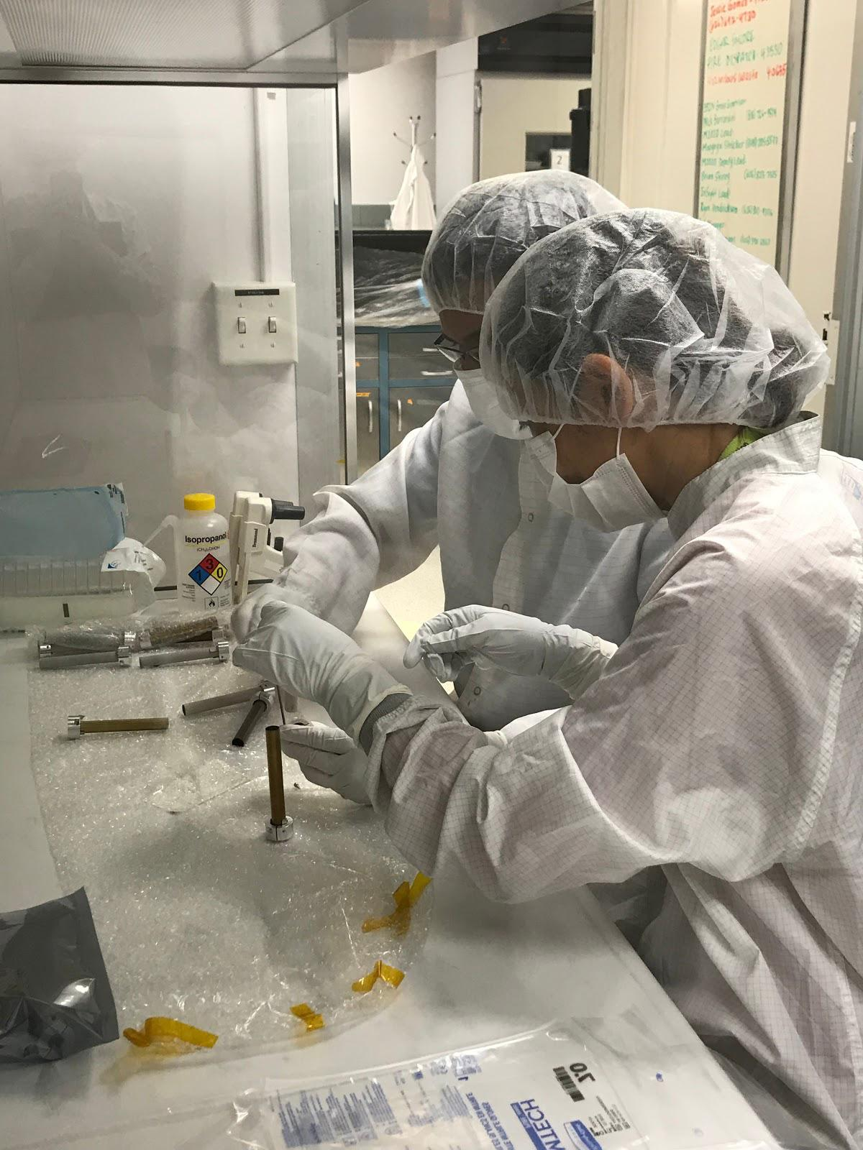
Forward Planetary Protection: Protect the solar system from Terrestrial Contamination
NASA
images-assets.nasa.gov/image/PIA23718/PIA23718~orig.jpg

Slide 6
Planetary Protection Categories
Bodies “not of direct interest for understanding the process of chemical evolution or the origin of life.”
Bodies of “significant interest relative to the process of chemical evolution and the origin of life, but where there is only a remote chance that contamination carried by a spacecraft could compromise future investigations.”
Bodies of significant interest to the process of “chemical evolution and/or the origin of life,” and where “scientific opinion provides a significant chance that contamination could compromise future investigations.”
Bodies of significant interest to the process of “chemical evolution and/or the origin of life,” and where “scientific opinion provides a significant chance that contamination could compromise future investigations.”
Earth-return missions from bodies “deemed by scientific opinion to have no indigenous life forms.” unrestricted Earth-Return V (unrestricted)
Earth-return missions from bodies deemed by scientific opinion to be of significant interest to the process of chemical evolution and/or the origin of life. Restricted Earth-Return V(restricted)
Undifferentiated, metamorphosed asteroids; Io; others TBD
Venus, Earth’s moon, comets, non-Category I asteroids, Jupiter, Jovian satellites (except Io and Europa), Saturn, Saturnian satellites (except Titan and Enceladus), Uranus, Uranian satellites, Neptune, Neptunian satellites (except Triton), Kuiper-Belt objects (< 1/2 the size of Pluto), others TBD
Mars, Europa, Enceladus, others TBD Flyby or Orbiter
Mars, Europa, Enceladus, others TBD (Categories IVa-c are for Mars) Lander or Probe
Venus, moon, others TBD: “unrestricted Earth return”
Mars, Europa, Enceladus, others TBD: “restricted Earth return”
Stricter requirements

Slide 7
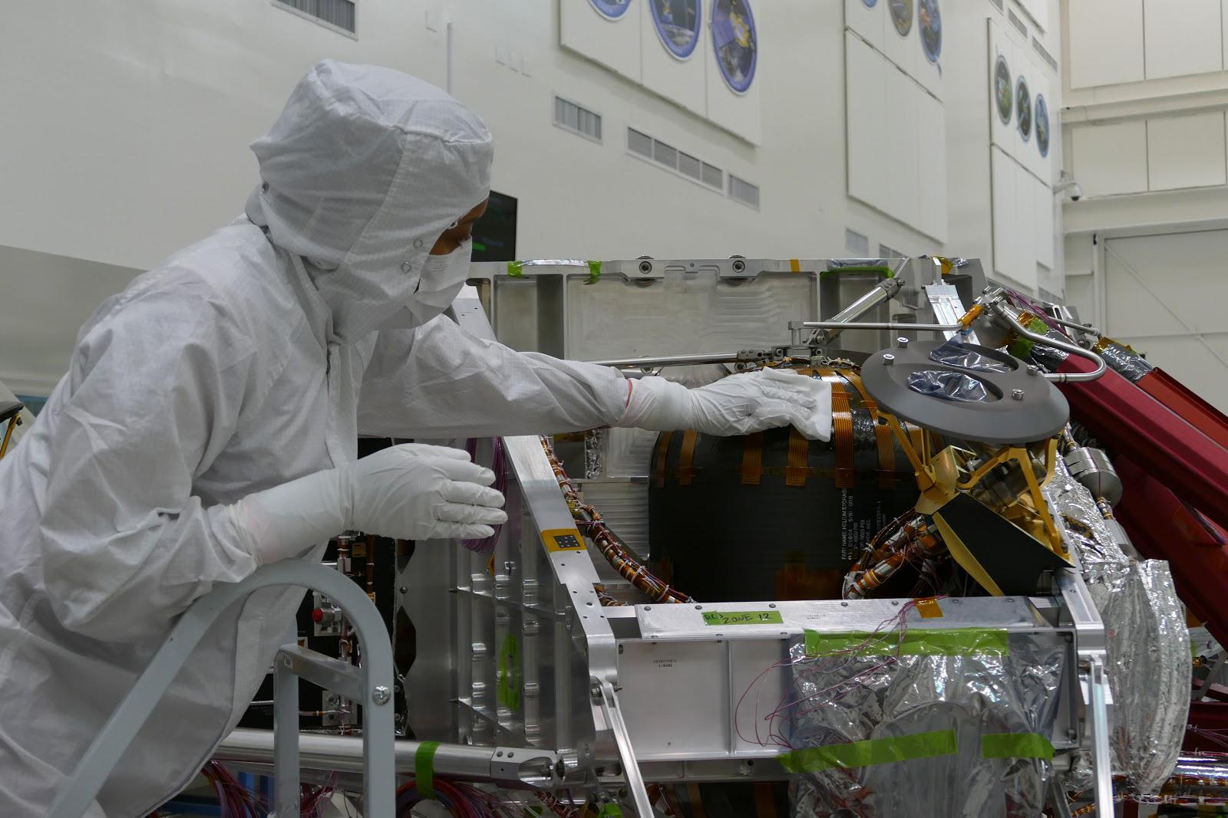
Planetary Protection for Robotic Missions is “just” a matter of Cleaning
Spore forming bacteria that can grow on tryptic soy agar (TSA) are used as a proxy for bioburden.
Clean off or kill these bacteria and you have met the requirement.
What about microbes that don’t grow on?
Are we selecting for microbes that can survive spaceflight?
images-assets.nasa.gov/image/PIA23717/PIA23717~orig.jpg

Slide 8
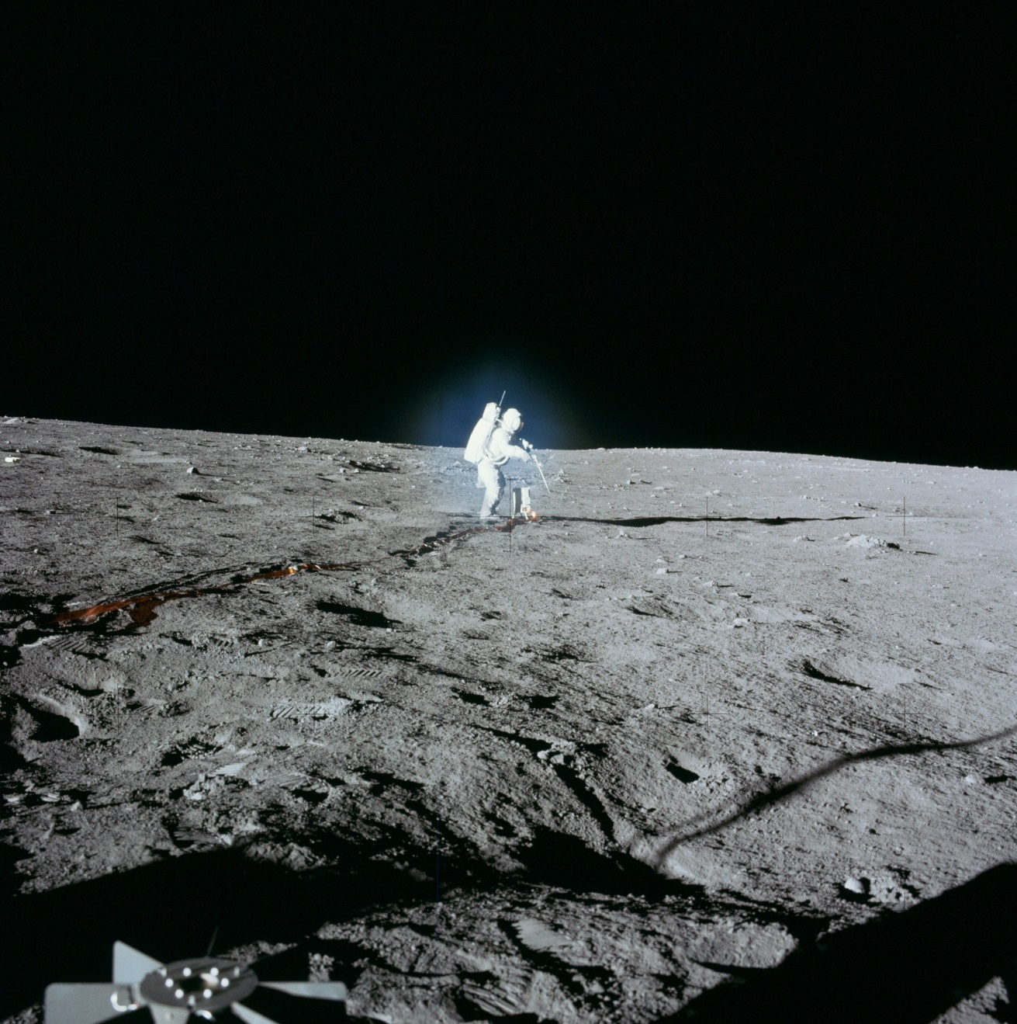
How do you Clean a crewed mission?

Slide 9
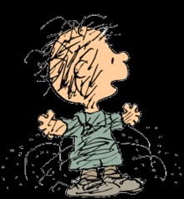
How do you Clean a crewed mission?
Do we need to filter all of our vented products?
How close can an astronaut get to a sample without contaminating it?
  Should we use robots to collect and contain sensitive samples?
What if our spacecraft create an artificial habitable zone?

Slide 10
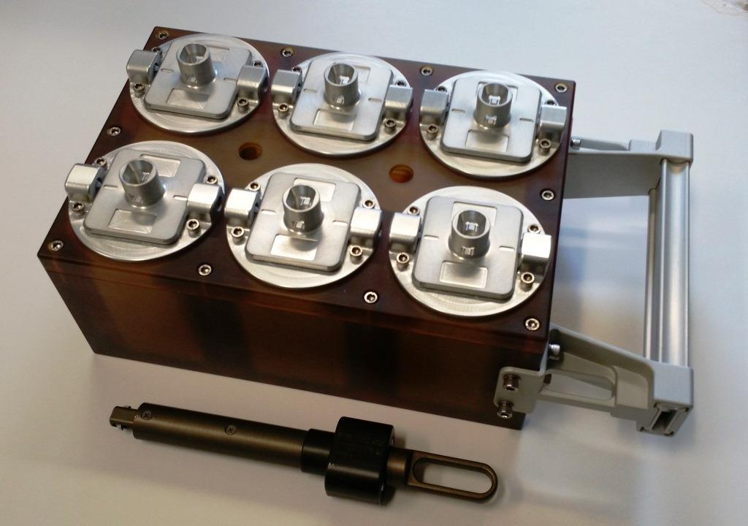
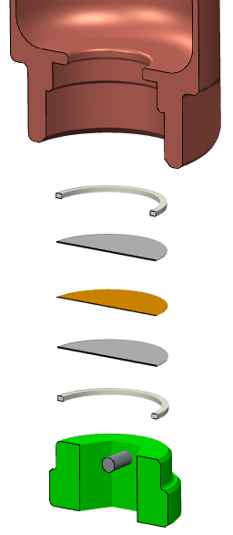
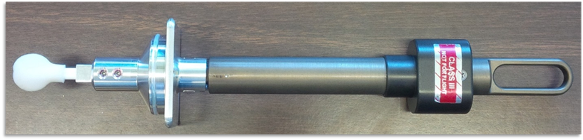
Payload Overview
8-Sample EVA Swab Kit
6 on top, 2 on bottom (not shown)
0.22 micron pore Microbial filter in bottom of each container to accommodate pressure changes
Rucker, Michelle A., Drew Hood, Mary Walker, Kasthuri J. Venkateswaran, and Andrew C. Schuerger. 2018. “EVA Swab Tool to Support Planetary Protection and Astrobiology Evaluations.” In 2018 IEEE Aerospace Conference, 1–9. IEEE. https://doi.org/10.1109/AERO.2018.8396381.

Slide 11
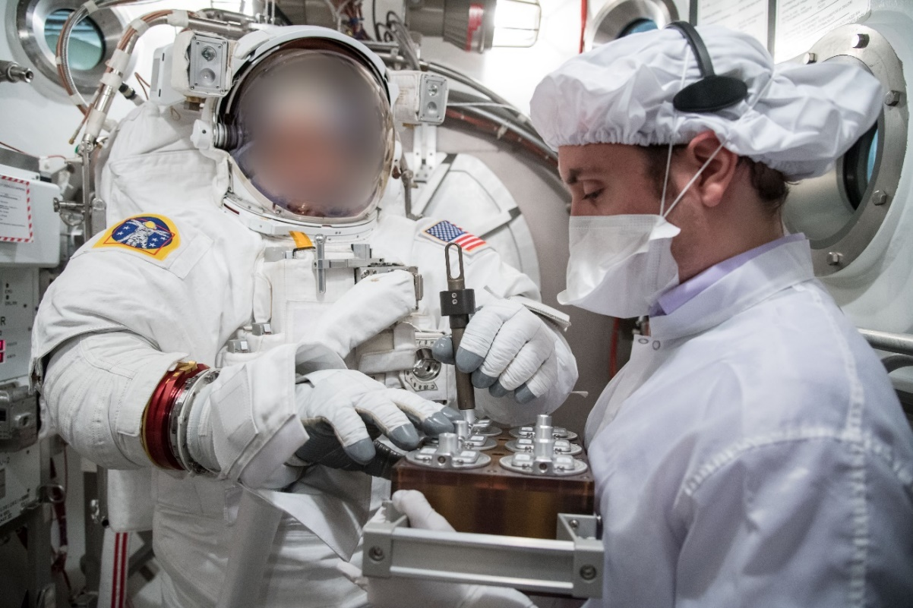
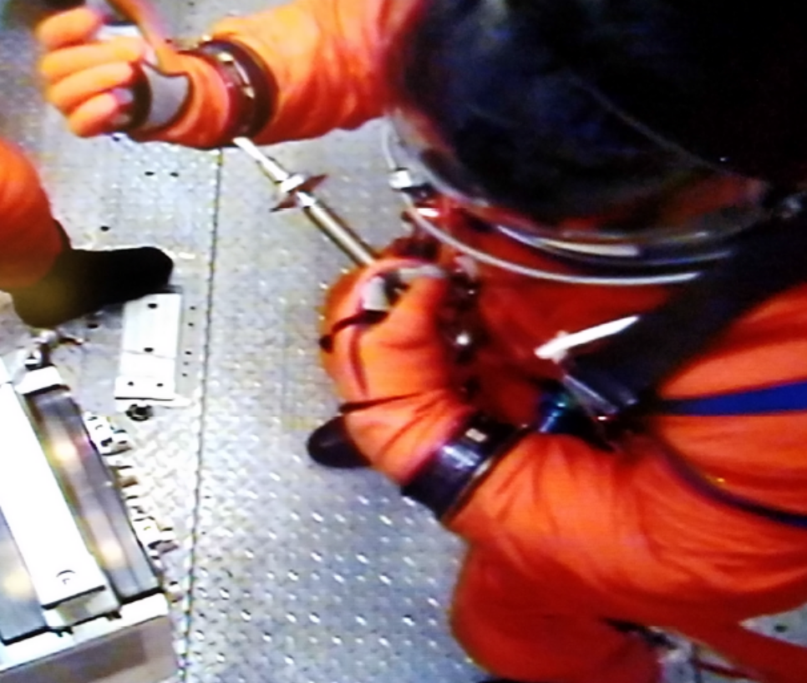
Tested the tool at Vacuum by piggybacking on Engineering Tests and Training Operations
OCSS
  Orion Crew Survival System
Swab Tool
EMU sampling during pre-breathe while the astronaut acclimatizes
Sample Caddy
OCCS sampling at vacuum
Some microbes were still viable after ~6 hrs vacuum exposure

Slide 12
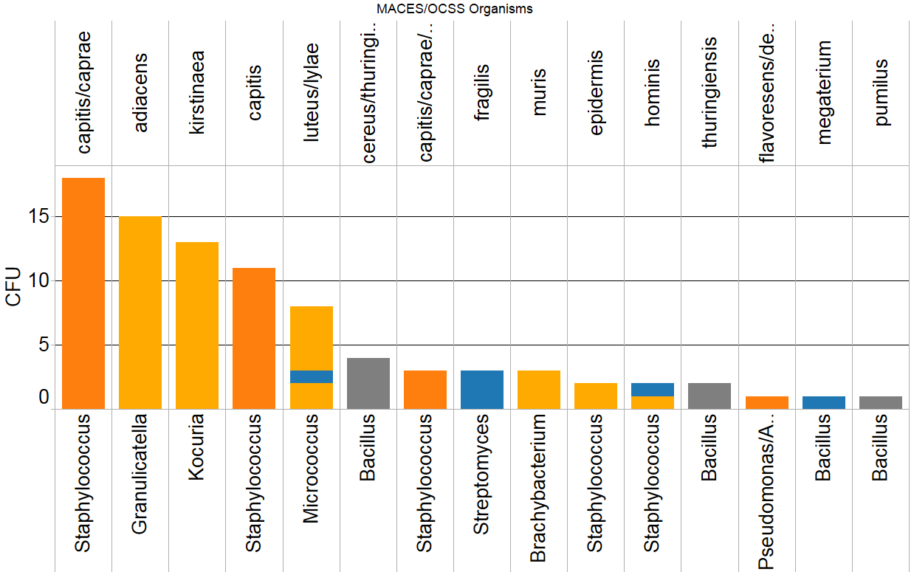
Non-spore-forming bacteria (10 species) can survive at least 4 hours of vacuum
Species
OCCS
MACES
Pre-Test Chamber
Post-Test Chamber
Genus

Slide 13
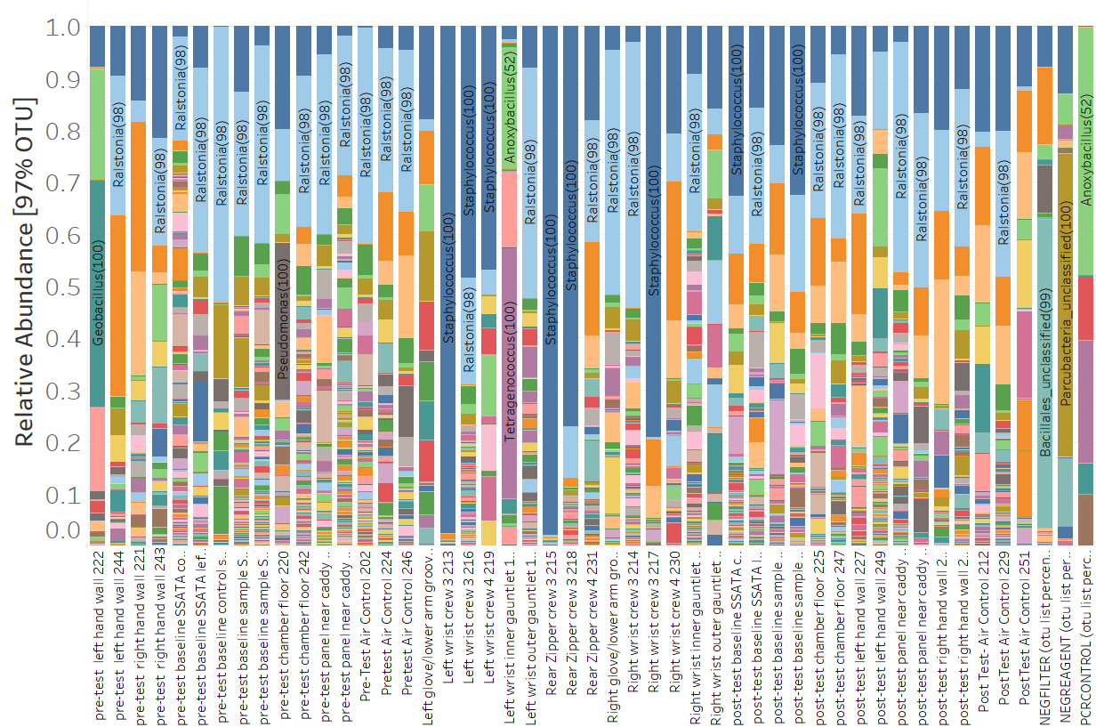
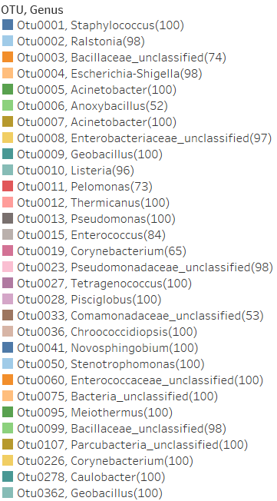
Suits are indistinguishable from their environment
Pre-Test Chamber Samples
Suit Samples
Post-Test Chamber Samples
Blanks

Slide 14
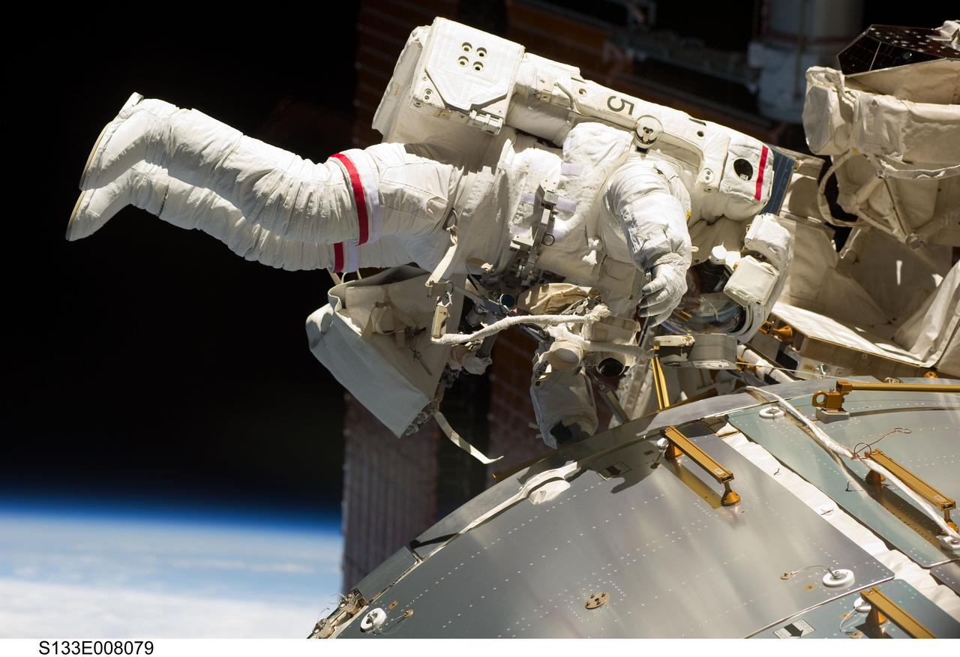
Next Steps: Sample ISS external surfaces
Piggyback onto planned EVA(s)
Sample ISS hull, handrails, hatches along translation path
  Areas near ECLS Non-Propulsive Vents (NPVs) are of particular interest
Optional: EVA suit wrist gauntlets (outer surface) – to compare w/ground tests
Samples will be returned at -80˚C for DNA sequencing
images-assets.nasa.gov/image/s133e008079/s133e008079~orig.jpg

Slide 15
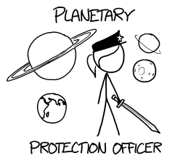
Thanks!
https://what-if.xkcd.com/117/

