Slide 1
CPF-CERES Intercalibration: Desirables
Mohan Shankar and Susan Thomas
CERES Instrument Working Group
CPF Science Workshop
Nov 3, 2021

Slide 2
CERES Background
CERES instrument enables measurement of the Reflected Solar and Outgoing LW radiation from the Earth’s Top of the Atmosphere (TOA).
CERES measures the radiation at the TOA with three channels:
  SW: 0.3-5um
  TOT: 0.3->100um
  WN: 8-12um/LW: 5->50um
Three telescopes are co-aligned and mounted on a spindle that can be rotated about the elevation axis.
Instrument can also be rotated about the azimuth axis.
There are six CERES instruments currently operational:
  Flight Models (FMs) 1 and 2 on Terra
  Flight Models 3 and 4 on Aqua
  Flight Model 5 on S-NPP
Sensors- TOT, SW, WN or LW (FM6)

Slide 3
CERES Calibration/Validation protocol Activities
 |  | Product Level | Spatial Scale | Temporal Scale | Spectral Weighting | Dynamic Range | Latitude Range | Radiometric Metric | Channel | Product
On-Board | Internal BB | Filtered Radiance | Full IFOV | Continuous Capability | 290-320 K BB | Across | All | Absolute Accuracy, Stability | TOT, WN, LW | -
On-Board | Internal Lamp | Filtered Radiance | Full IFOV | Continuous Capability | 17000, 2000, 2300 K BB | Across | All | Absolute Stability | SW | -
 | Solar | Filtered Radiance | Full IFOV | 1 per orbit capability | Solar | Fixed, High | N or S Pole | Relative Stability | TOT, SW | -
Vicarious | Theoretical Line-by-Line | Filtered Radiance | >20 Km | Instantaneous | Various Earth | Across | N/A | Inter-Channel Theoretical Agreement | TOT, WN, LW | -
 | Unfiltering Algorithm Theoretical Validation | N/A | N/A | N/A | N/A | N/A | N/A | N/A | TOT, SW, WN, LW | -
Vicarious | Inter-Satellite (Direct Comparison) | Unfiltered Radiance | 1-deg Grid | 1 per crossing | Various Earth | Mid | All | Inter-Instrument Agreement, Stability | TOT, SW, WN, LW | OLR, RS
 | Tropical Mean Geographical Average) | Unfiltered Radiance | 20N-20S | Monthly | Tropical Ocean, All Sky | Mid | 20N-20S | Inter-Instrument Agreement, Stability | TOT, WN | OLR
 | DCC Albedo | Unfiltered Radiance | > 40 Km | Monthly | Cloud RS | High | All, Daytime | Inter-Instrument Agreement, Stability | SW | RS
 | 3-Channel Intercomparison | Unfiltered Radiance | >100 Km | Monthly | Various Earth | Across | All, Daytime | Inter-Channel consistency, Stability | TOT, SW, WN, LW | OLR, RS
 | Time Space Averaging | Fluxes | Regional, Zonal, Global | Monthly, Yearly | Various Earth | Across | All | Inter-Instrument Agreement |  | OLR, RS
 | Lunar Radiance Measurements | Filtered Radiance | Sub IFOV (7-10%) | 1 day per lunar month | Lunar OLR and RS | Fixed, Low | N or S Pole | Relative Stability | TOT, SW, WN, LW

Slide 4
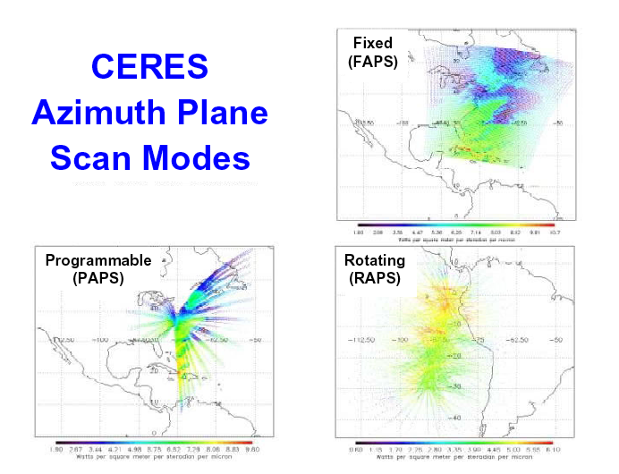
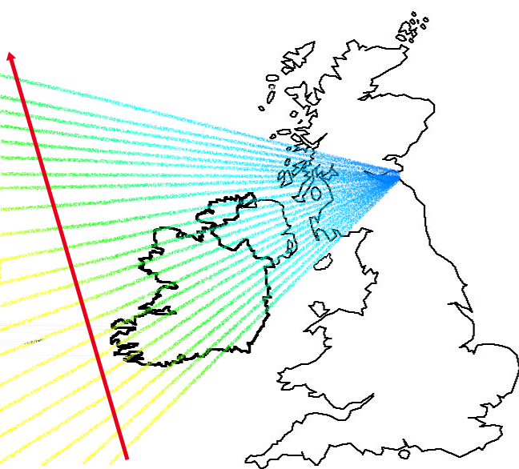
CERES Operational Scanning Capabilities
Nominal Science Mode
Tracking Capability
Sensors- TOT, SW, WN or LW (FM6)
APS: Azimuth plane Scan
Targeted Campaigns
Increased angular sampling

Slide 5
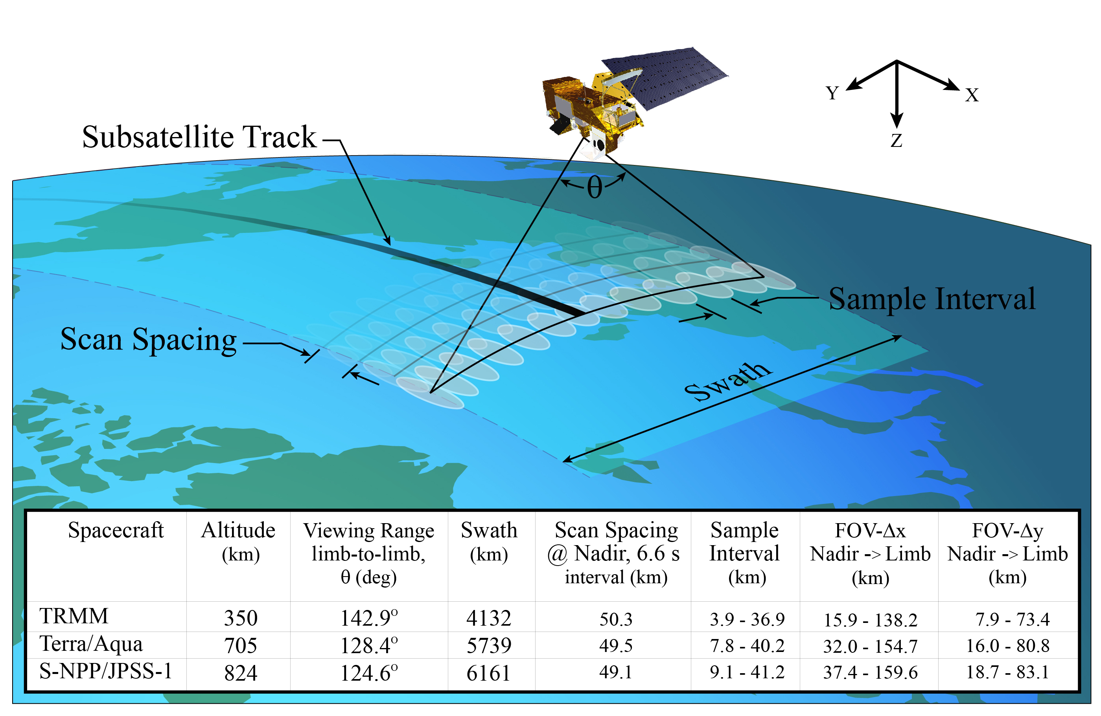
CERES spatial sampling
Cross-track spacing given by Scan Rate
Along-track spacing given by S/C motion and Scan Cycle Time

Slide 6
Current Operations
Terra: FM1 (Cross track mode), FM2 (Biaxial mode on Nov. 1, 2021).
Aqua: FM3 (Cross track mode), FM4 (Biaxial mode since July 2021).
S-NPP: FM5 (Biaxial mode since October 2019)
NOAA-20: FM6 (Cross track mode)

Slide 7
CPF-CERES Intercalibration Desirables
Co-located inter-comparisons between CERES SW sensor and CPF when the orbits cross-over to validate CERES SW performance.
  Geographically diverse scenes spanning the spectral and dynamic range of the CERES SW sensor.
    Clear Ocean scenes for checks on the UV/blue wavelengths.
    Spanning the dynamic range helps to evaluate linearity, offsets.
Independent validation of inter-instrument differences across CERES SW sensors on various spacecraft.
  Co-located CERES data obtained where the orbits cross-over, which occurs North of 70º latitude for Terra/Aqua, Terra/S-NPP, Terra/NOAA-20.
Deriving/refining corrections for CERES lunar scans using CPF’s observations of the Moon.

Slide 8
Changes to Terra and Aqua MLT
Terra:
  Completed all Inclination Adjust Maneuvers (IAMs) related to maintaining a 1030 mean local time (MLT) equator crossing and 705 km orbit altitude.
  Began drifting to an earlier MLT in April 2021.
  In October 2022, will reach and exceed a 1015 MLT crossing corresponding to a constellation exit with lower orbit altitude (694 km).
  MLT will continue to drift after this, reaching 0900 around December 2025.
Aqua:
  Completed all IAMs related to maintaining a 1330 MLT equator crossing and 705 km orbit altitude.
  Will begin drifting to a later MLT in January 2022. Will also exit A-Train constellation with lower orbit altitude (685 km).
  By mid-2022, will reach and exceed a 1345 MLT crossing.
  MLT will continue to drift after this, reaching 1530 around September 2025.
From N. Loeb’s ‘State of CERES’ presentation from Spring ‘21 CERES Science Team Meeting

