Slide 1
Overview of Fuel System Options for Nuclear Thermal Propulsion
Kelsa Palomares¹, Doug Burns², and Harold Gerrish³
¹Analytical Mechanics Associates
²Idaho National Laboratory
³NASA Marshall Spaceflight Center
Notes:
Enter speaker notes here.

Slide 2
Agenda
Introduction
Nuclear Thermal Propulsion (NTP) Overview
NTP Fuel Design Considerations
Overview of NTP Fuel Options
Historic Fuel Development Programs and Emerging Concepts
NERVA/Rover Fuel Development
Cermet Fuel Development Programs
Carbide Fuel Development Programs
SNTP Coated Particle Fuel Development
Emerging Fuels: Cercer Fuel Forms
Summary and Ongoing Development Initiatives
Comparison of NTP Fuel System Options
Current NTP Mission Needs and Ongoing Fuel Development Activities
Summary and Conclusions

Slide 3
Introduction
Nuclear Thermal Propulsion (NTP) Overview
NTP Fuel Design Considerations
Overview of NTP Fuel Options

Slide 4
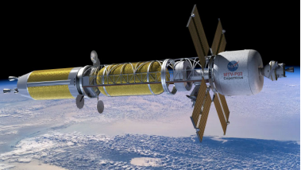
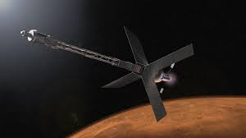
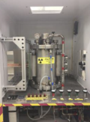
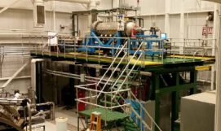
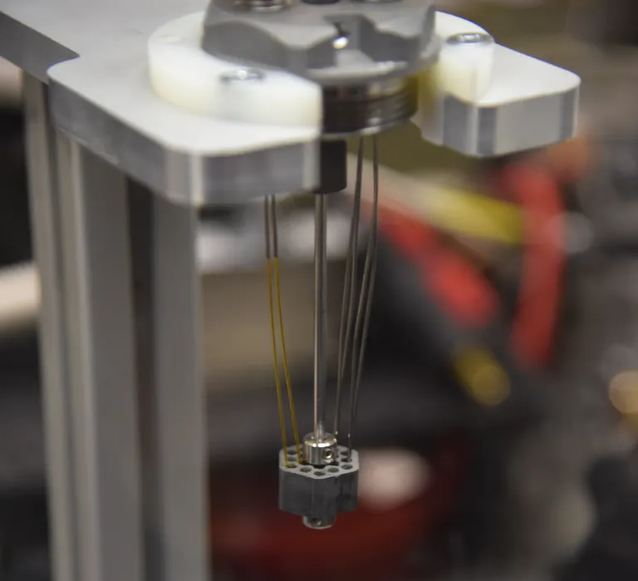
Space Nuclear Propulsion Project Overview
Nuclear technologies have the potential to enable high performance and reliable in-space propulsion
The Space Nuclear Propulsion Project is Developing HALEU Reactor Technologies for High Performance In-Space Propulsion
Crewed Mars Missions in the Late 2030s / Early 2040s
Nuclear Electric – Chemical Propulsion Hybrid
Nuclear Thermal Propulsion
HALEU: high uranium loading density and moderation is more important for HALEU NTP fuel design than historic HEU designs
Through the Fuel and Moderator Development Plan, NASA supported by the Department of Energy is developing novel fuel and moderator material technologies as a risk reduction activity
Fuel research activities: ceramic metallic (cermet), ceramic ceramic (cercer), and solid solution carbide fuels
High temperature structural and insulator materials
Hydride-based moderators
These materials may benefit future industry NTP designs
nasa.gov
Nuclear Thermal Propulsion Concept
nasa.gov
Nuclear Electric Propulsion Concept
NTP fuel specimen prepared for testing in TREAT (INL)
nasa.gov
nasa.gov
Fuel testing facilities at NASA, DOE, industry, and university laboratories provide unique environments for understanding fuel performance
inl.gov
Notes:
Top left image: Microsoft Word - E-18199_GLEX-2012_Final.docx (nasa.gov)
Top right image: calomino_nuclear_v5.pdf (nasa.gov)
Bottom left hand images: Space Technology Mission Directorate: Nuclear Thermal Propulsion Update (nasa.gov)
Lower right hand image: Space – the next frontier – requires innovation in nuclear fuel design and testing – INL

Slide 5
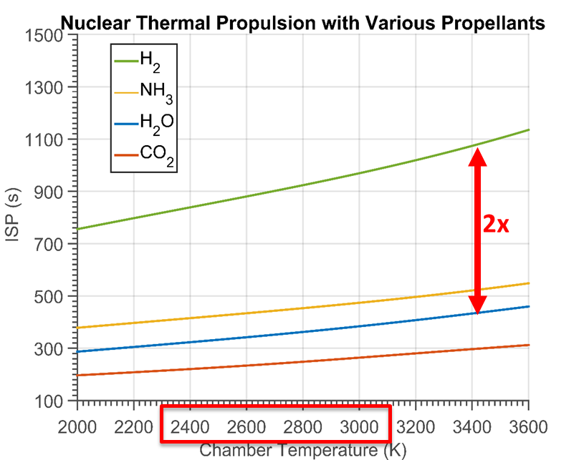
Nuclear Thermal Propulsion (NTP) Benefits
NTP is capable of high thermal power (thrust) and exit temperatures (I_{sp}) to enable high performance in-space propulsion.
Finseth, J L. Rover nuclear rocket engine program: Overview of rover engine tests. NASA Rep. No. NASA-CR-184270. 1991.
D. Koenig LA-10062-H 1986
Benensky, K., et. al., in Nuclear and Emerging Technologies for Space. 2014 (Presentation)
Table originally from: Benensky, K. Summary of Historical Solid Core Nuclear Thermal Propulsion Fuels. Pennsylvania State University.2013.
Benensky, K., et. al., in Nuclear and Emerging Technologies for Space. 2016 (Presentation)
Total operation time is dependent upon the mission, but is typically on the order of 1 – 4 hours of full power operation for crewed Mars missions

Slide 6
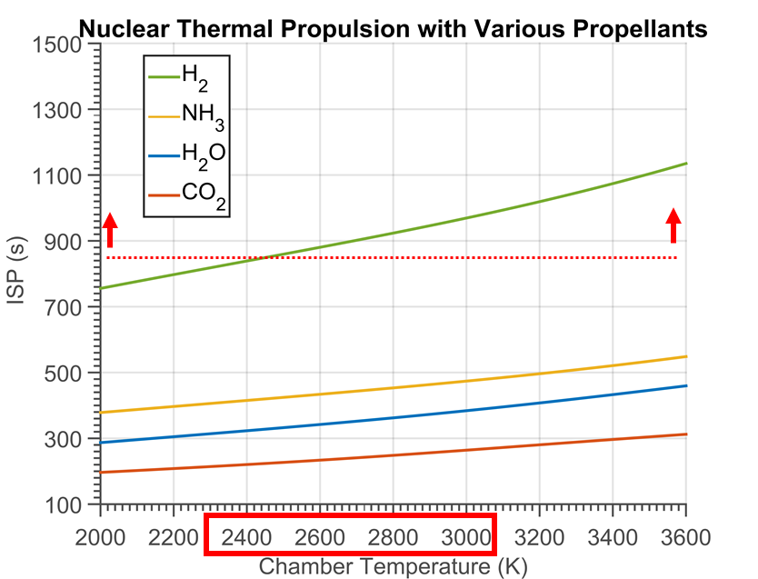
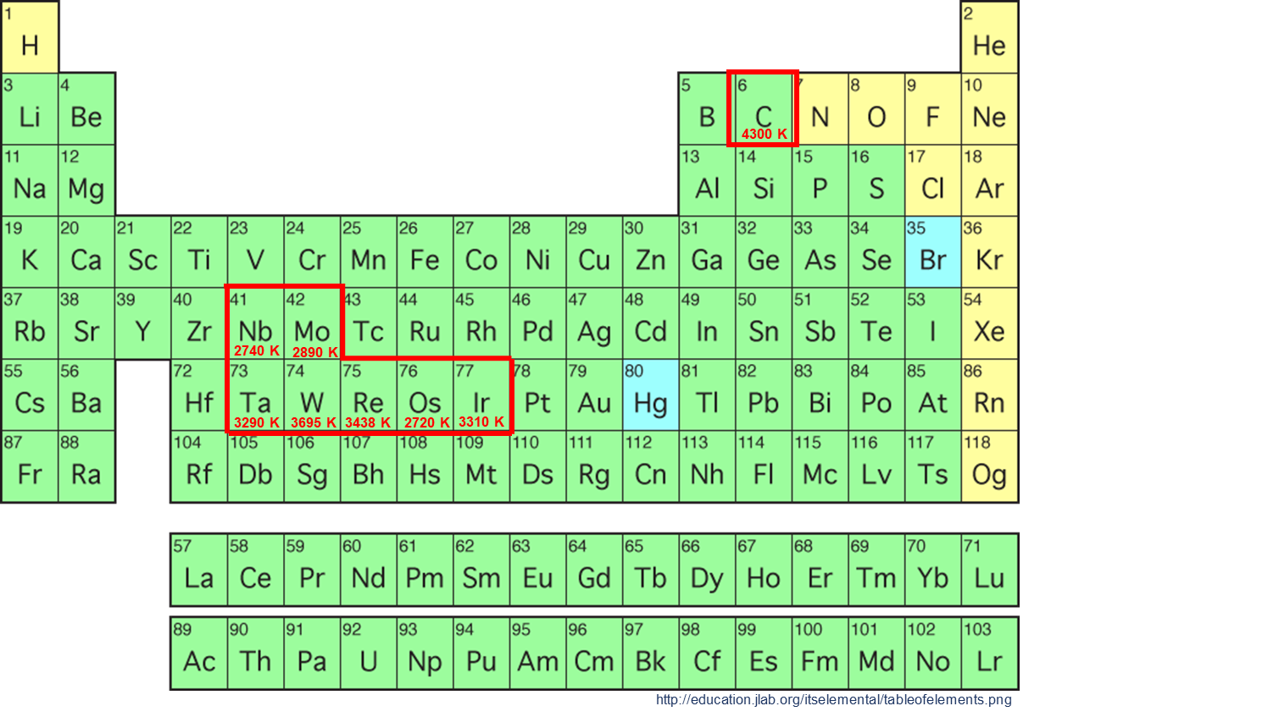
Nuclear Thermal Propulsion Fuel Design Needs
Very few materials exist that can withstand operating temperatures needed for a high performance NTP engine
Benensky, K., et. al., in Nuclear and Emerging Technologies for Space. 2016 (Presentation)
To enable the performance benefits of NTP, in-reactor materials must allow for operation at temperatures in excess of 2700 K in a hot hydrogen and high neutron flux environment

Slide 7
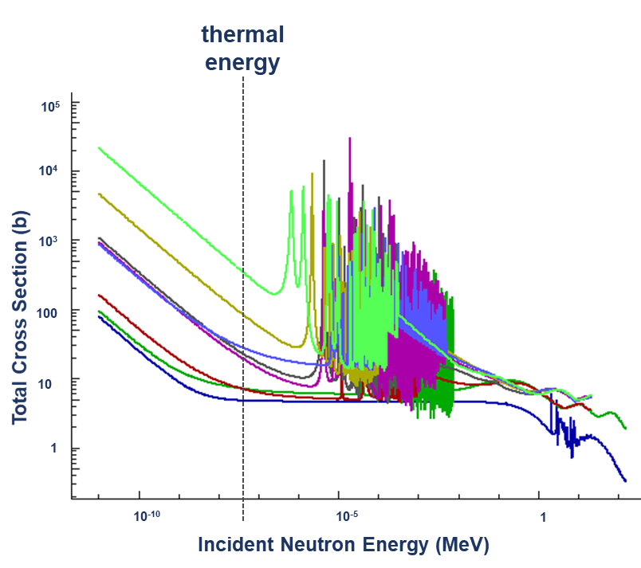
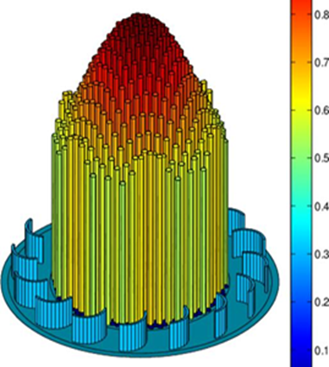
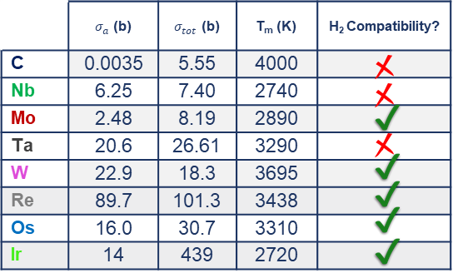
The Reactor Side of Things…
Criticality is highly dependent upon material selection, modern NTP reactors are designed to operate with lower fuel enrichment (high assay low enriched uranium, HALEU)
Some Properties of
High Melting Temperature Elements
Goal: minimize
Benensky, K., et. al., in Nuclear and Emerging Technologies for Space. 2015 (Presentation)
atom.kaeri.re.kr/nuchart
Benensky, K., et. al., in Nuclear and Emerging Technologies for Space. 2017 (Presentation)

Slide 8
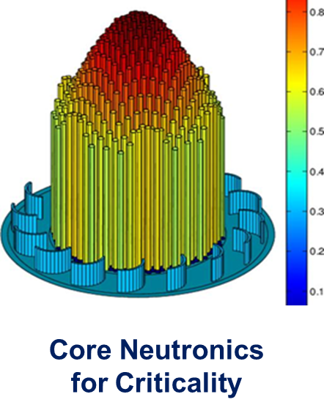
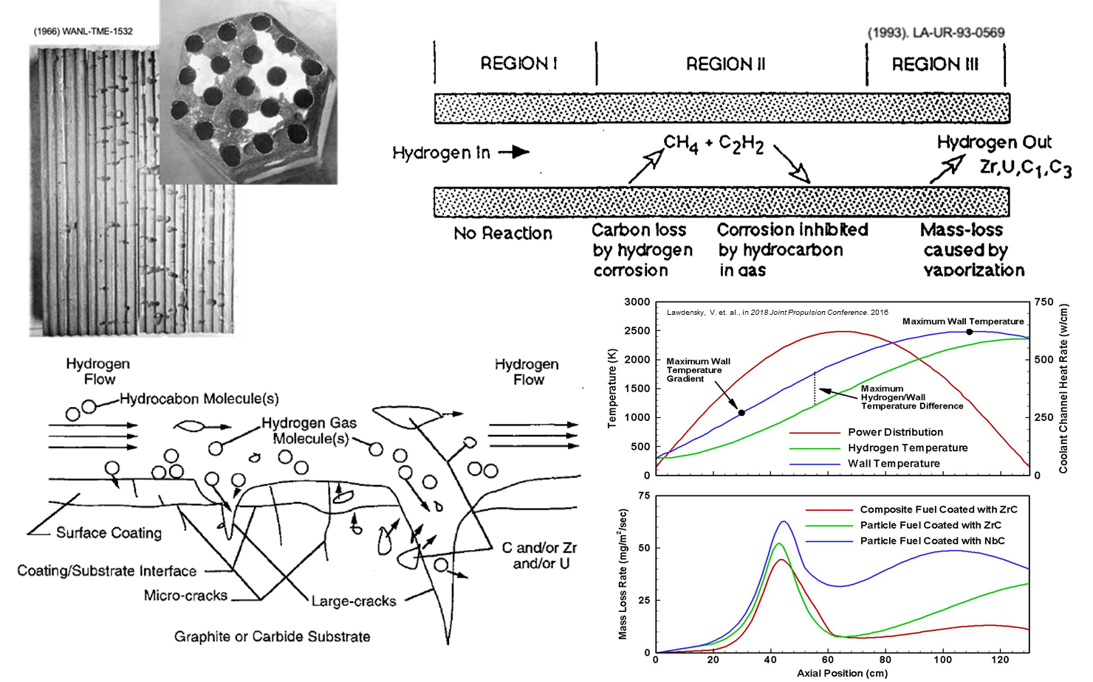
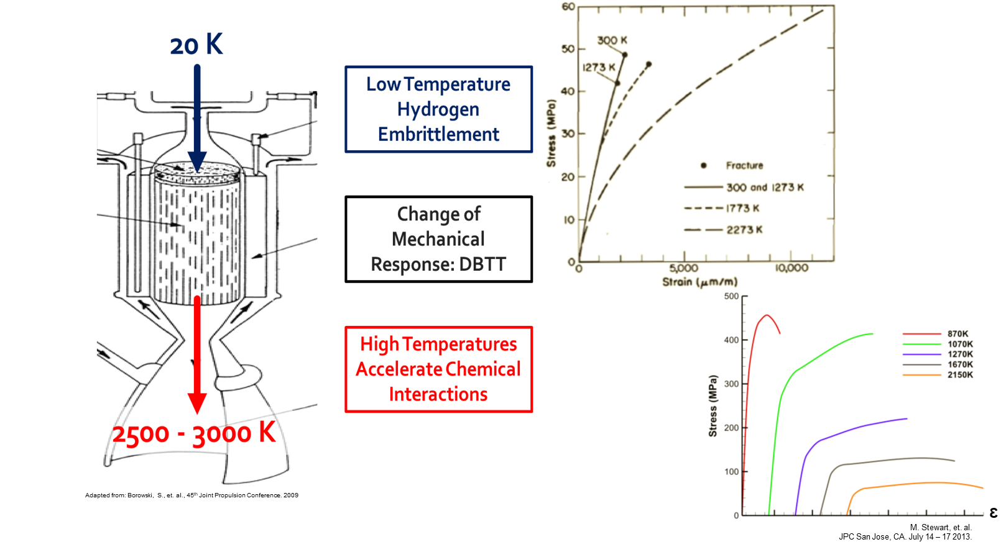
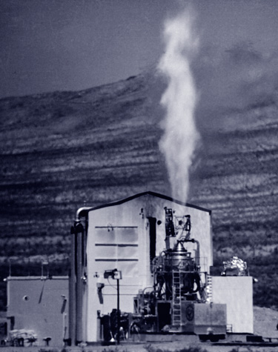
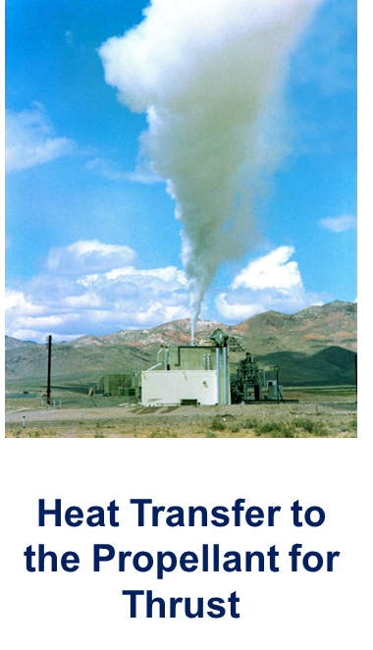
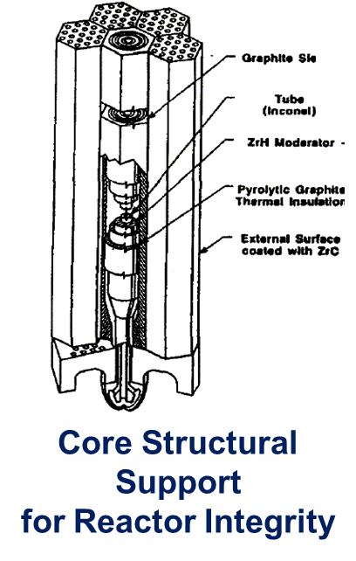
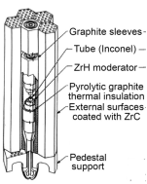
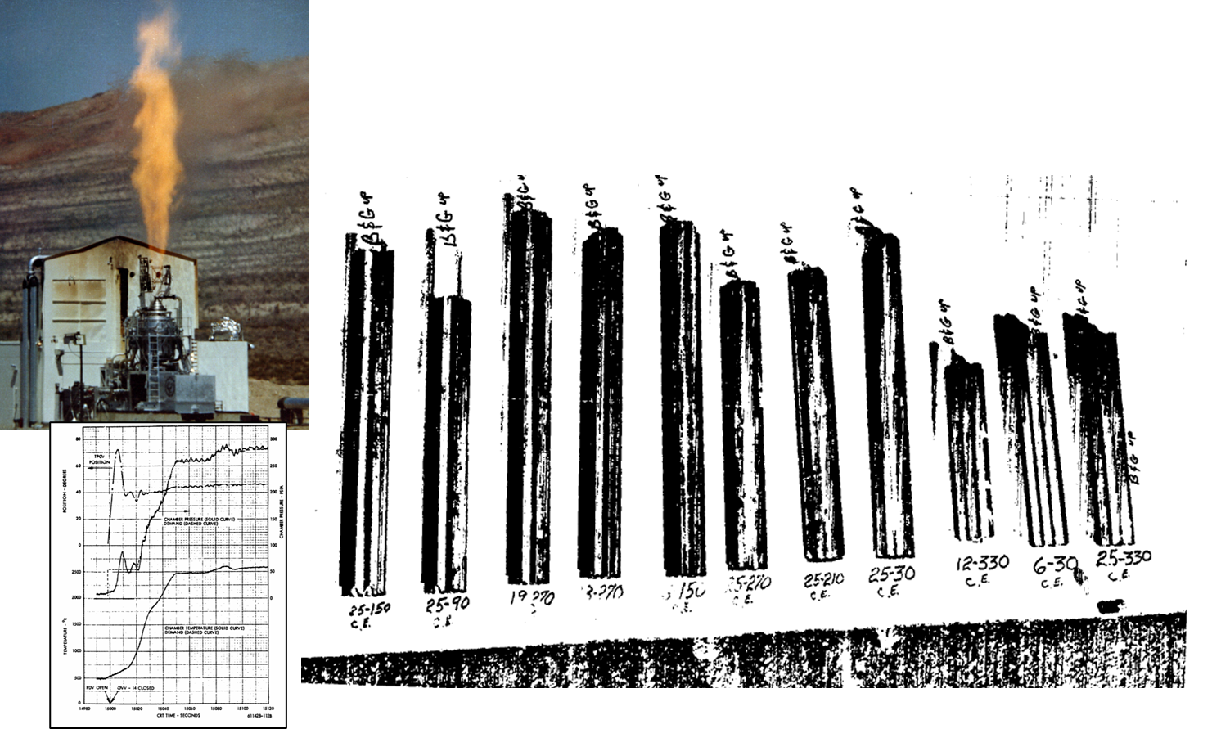
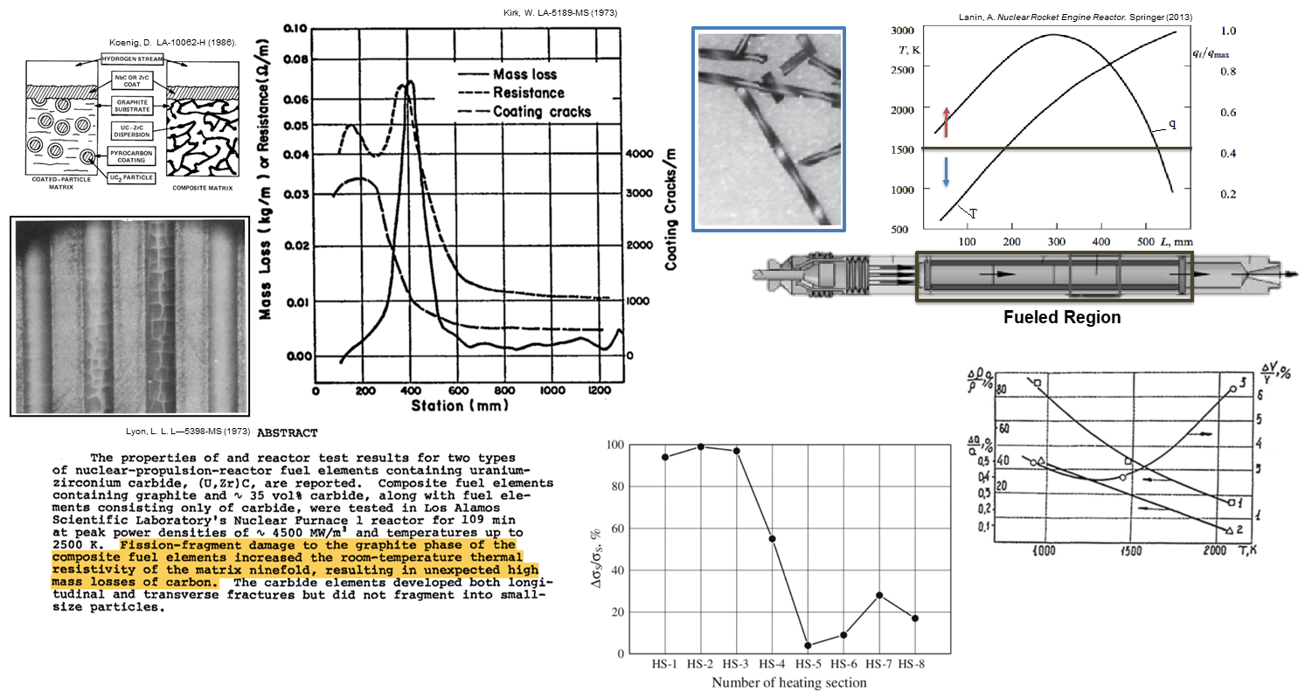
Functions and Environments of NTP Fuel Forms
Fuel design must enable reactor performance and criticality under the range of operating conditions of the NTP reactor
_{NTP Fuel Form Functions}
_{NTP Fuel Form Environments}
Borowski, S., et. al., in IEE Aerospace Conference. 2012
[1]
lanl.gov
[2]
Hot Hydrogen
(high pressure, velocity)
Large In-Reactor Temperature Gradients (40 K < T < 3000 K)
Thermal Shock (< 100 K/s)
Thermal Cycling (~ 4 – 6 cycles)
High Neutron Flux / Power Density (10¹⁵ – 10¹⁷ n/cm²s / 5+ MW/L)
[1] Benensky, K., et. al., in Nuclear and Emerging Technologies for Space. 2015 (Presentation)
[2] Fitje, J., et. al. Revised Point of Departure Design Options for Nuclear Thermal Propulsion. NASA Rep. No. GRC-E-DAA-TN25925. 2015.
Adapted From: Benensky, K., et. al., “Overview of Historic NTP Fuel Development.” NASA Marshal Space Flight Center. 2018 (Presentation)
Notes:
LANL image: https://www.lanl.gov/science/NSS/issue1_2011/story4full.shtml

Slide 9
Desirable Attributes for NTP Fuel Forms
NTP fuels must be capable of surviving operating environment and satisfying engineered functions within the reactor
[1]
[4]
[3]
1.
2.
3.
[4]
[2]
[5]
[6]
[2]
4.
5.
[see presentation notes for citations]
Notes:
[1] Shabalin, I. L. Ultra-High Temperature Materials I. Springer (Text) 2014. https://doi.org/10.1007/978-94-007-7587-9
[2] C. Haertling, R.J. Hanrahan, Literature review of thermal and radiation performance parameters for high-temperature, uranium dioxide fueled cermet materials, Journal of Nuclear Materials, Volume 366, Issue 3, 2007, Pages 317-335, https://doi.org/10.1016/j.jnucmat.2007.03.024.
[3] atom.kaeri.re.kr/nuchart
[4] Boltax, A, and Tobin, J M. Westinghouse Astronuclear Laboratory contribution to the twentieth high temperature fuel committee meeting, 18--20 May 1965. United States: N. p., 1965. Web. doi:10.2172/4163392.
[5] Lyon, L L. Performance of (U,Zr)C-graphite (composite) and of (U,Zr)C (carbide) fuel elements in the Nuclear Furnace 1 test reactor. United States: N. p., 1973. Web. doi:10.2172/4419566.
[6] Lanin, A. Nuclear Rocket Engine Reactor. Springer (Text) 2013. https://doi.org/10.1007/978-3-642-32430-7

Slide 10
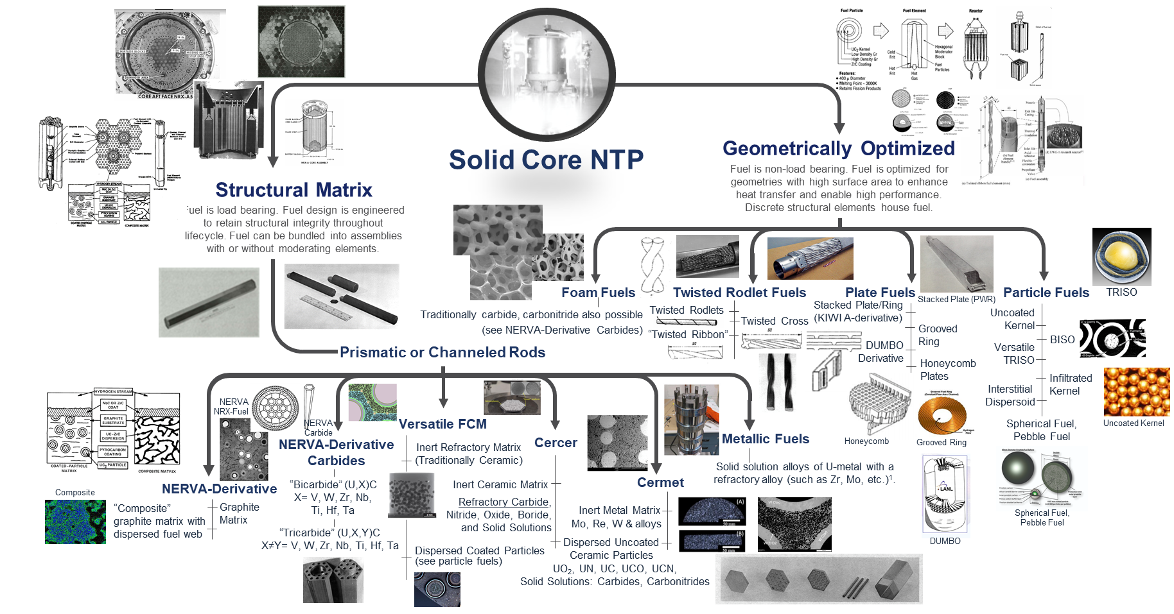
What are our options?
Many fuel form options have been proposed for NTP applications, none of these options is yet at the readiness level desired for NTP system implementation.
Benensky, K., et. al., in Nuclear Thermal Propulsion Industry Flight Demonstration Study: Midterm Presentation – Reactor Concepts. 2019 (Presentation)

Slide 11
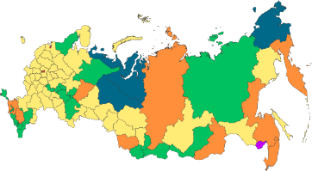
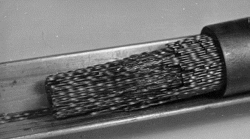


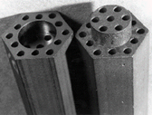
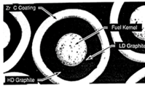
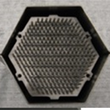
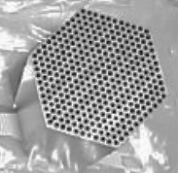
Overview of Major NTP Fuel Development Activities
The United States and Russia have developed fuel forms for NTP applications with mixed levels of success
USSR Solid-Solution Carbide Fuels (1955 – 1993)
NASA’s Space Nuclear Propulsion Project (FY20 – Present)
Solid Solution Carbides
Solid Solution Carbonitrides
Carbonitride Cermets
Poulvas, R.: Map of federal subjects of Russia (2014).svg Wikipedia.org
[1]
1950
1960
1970
1980
1990
2000
2010
2020
Graphite Matrix
Composite
Solid Solution Carbides
Coated Particle
Cermet, Composite,
Cercer, Solid Solution Carbides
[1]
[2]
[3]
NERVA/Rover (1955 – 1972)
Space Nuclear Thermal Propulsion, SNTP
(1987 – 1993)
Modern NASA NTP activities
(2010 – 2021+)
arts.gov
Mo-UO2 hot-rolled & sintered
W-UO2, W-UN sintered
[1]
Cermet Development
ANL, NASA LeRC, GE 710
(1962 – 1968)
Adapted From:
Benensky, K., et. al., “Overview of Historic NTP Fuel Development.” NASA Marshal Space Flight Center. 2018 (Presentation)
[1] Bhattacharyya, S. K. An assessment of fuels for nuclear thermal propulsion. Argonne National Laboratory ANL/TD/TM01-22 (2002)
[2] Haslett, R A. Space nuclear thermal propulsion program. Final report, September 1989-May 1995. United States: N. p., 1995. Web.
[2] Hickman, R. Fabrication and Testing of CERMET Fuel Materials for Nuclear Thermal Propulsion. AIAA/ASME/SAE/ASEE Joint Propulsion Conference. 2012 (Presentation)
Notes:
Russia image license: https://creativecommons.org/licenses/by-sa/4.0/
USA image: https://www.arts.gov/stories/blog/2018/new-arts-and-culture-stats-zoom-states

Slide 12
Historic Fuel Development Programs and Emerging Concepts
NERVA/Rover Fuel Development
Cermet Fuel Development Programs
Carbide Fuel Development Programs
SNTP Coated Particle Fuel Development
Emerging Fuels: Cercer Fuel Forms

Slide 13
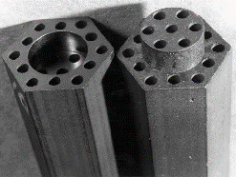
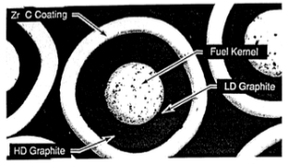
Overview of Historic NTP Fuel Development
NTP fuels have been developed by four major programs of the United States and Former Soviet Union. Historic programs have focused on the development of high enriched uranium (HEU) fuel and reactor designs.
NERVA/Rover
Graphite Composite Fuels
(1955 – 1972)
Structural Matrix
[1]
ANL/TD/TM01-22
GE-710 Gas Reactor
Ceramic Metallic (cermet) Fuels
W and Mo matrix
(1962 – 1968)
[1]
ANL/TD/TM01-22
Space Nuclear Thermal Propulsion (SNTP)
Carbide “Particle” Fuels
(1987 – 1993)
Geometrically Optimized
[2]
(1955 – 1990s)
Russian NTP Program
Carbide “Twisted Ribbon” Fuels
[1]
1950 1960 1970 1980 1990
ANL/TD/TM01-22
[1] Bhattacharyya, S. K. An assessment of fuels for nuclear thermal propulsion. Argonne National Laboratory ANL/TD/TM01-22 (2002)
[2] Haslett, R A. Space nuclear thermal propulsion program. Final report, September 1989-May 1995. United States: N. p., 1995. Web.

Slide 14
Overview of Historic NTP Fuel Development
NTP fuels have been developed by four major programs of the United States and Former Soviet Union. Historic programs have focused on the development of high enriched uranium (HEU) fuel and reactor designs.
Hot Hydrogen
Static Testing
Hot Hydrogen
Thermal Cycling
Prototypic Irradiation Testing
Prototypic Engine Testing
NERVA/Rover
Graphite Composite Fuels
Structural Matrix
[1]
ANL/TD/TM01-22
GE-710 Gas Reactor
Ceramic Metallic (cermet) Fuels
W and Mo matrix
[1]
ANL/TD/TM01-22
Space Nuclear Thermal Propulsion (SNTP)
Carbide “Particle” Fuels
Geometrically Optimized
[2]
Russian NTP Program
Carbide “Twisted Ribbon” Fuels
[1]
ANL/TD/TM01-22
Non-Nuclear
Nuclear
Adapted from: Benensky, K., "Tested and Analyzed Fuel Form Candidates for Nuclear Thermal Propulsion Applications" (2016). University of Tennessee.
[1] Bhattacharyya, S. K. An assessment of fuels for nuclear thermal propulsion. Argonne National Laboratory ANL/TD/TM01-22 (2002)
[2] Haslett, R A. Space nuclear thermal propulsion program. Final report, September 1989-May 1995. United States: N. p., 1995. Web.

Slide 15
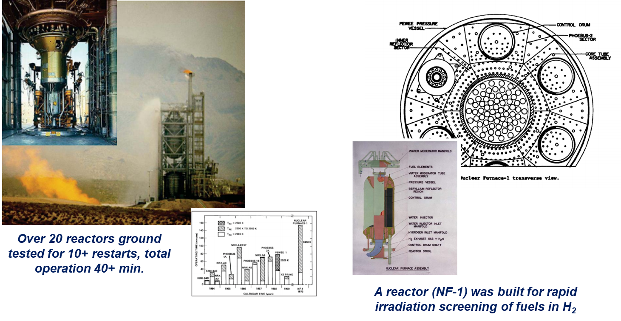
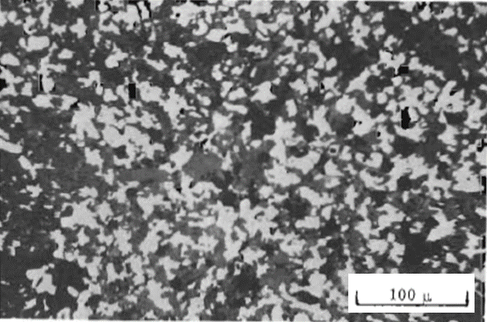
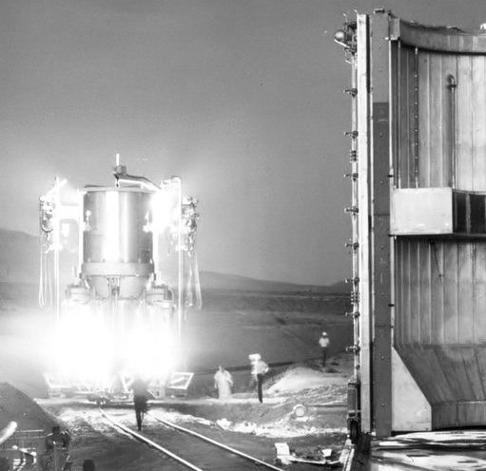
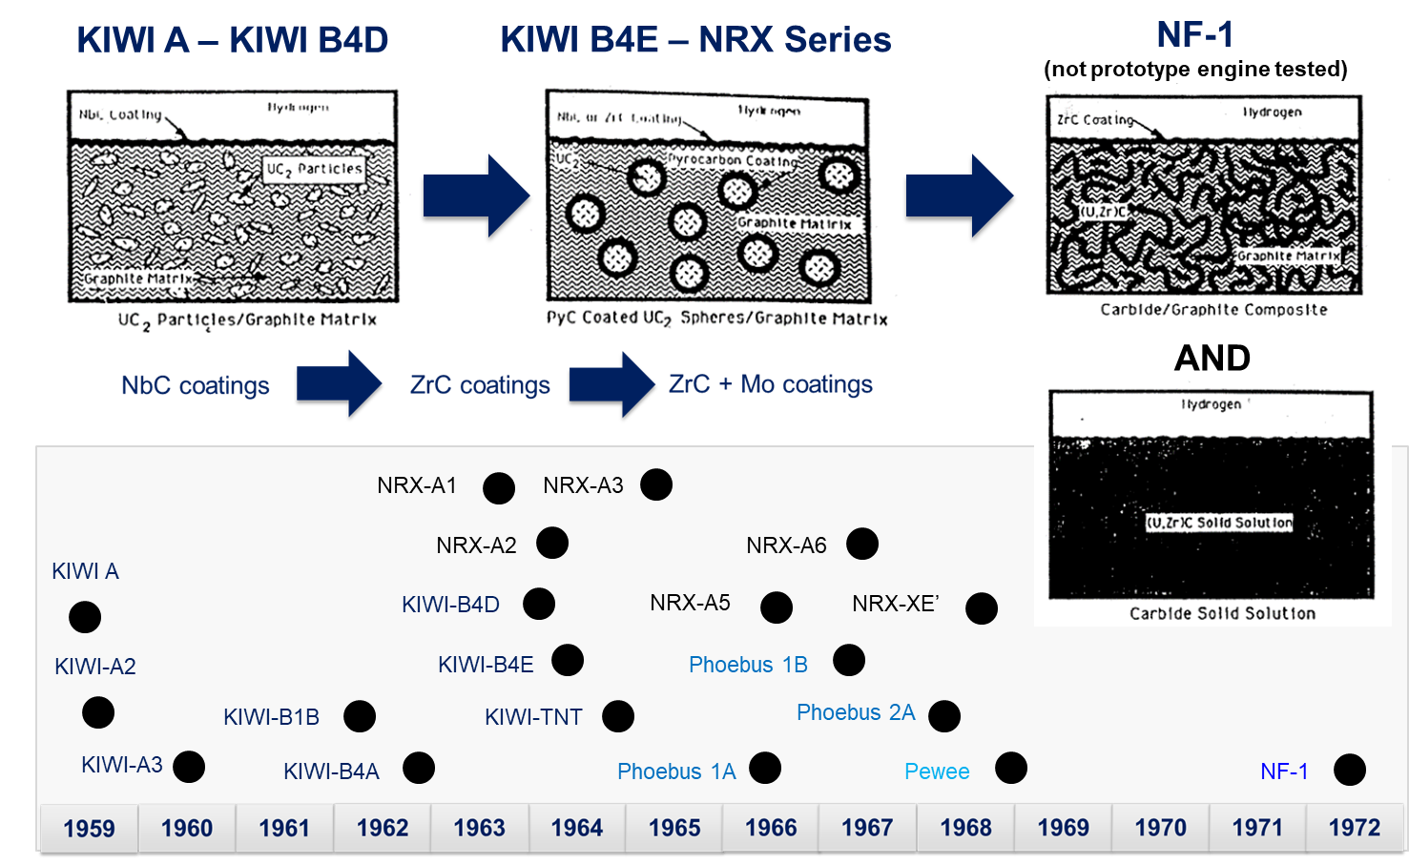
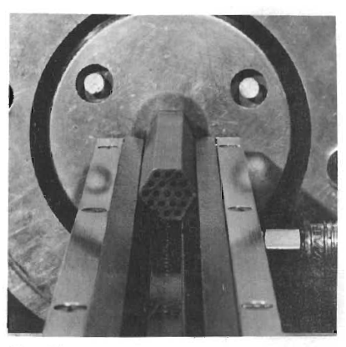
Rover NERVA Fuel Development Overview
Graphite structural matrix fuel: highest level of development status with significant remaining challenges (for I_{sp} > 850 s)
[1]
[3]
NERVA/Rover
Graphite Composite Fuels
(1955 – 1972)
Hot Hydrogen
Static Testing
Hot Hydrogen
Thermal Cycling
Prototypic Irradiation Testing
Prototypic Engine Testing
[7]
[2]
[3]
[6]
[5]
[2]
Geometry – Extruded Hexagonal
Length: 51 in.
Flat-to-Flat: 0.75 in.
19 Coolant Channels
Fabrication: Extrusion and Sinter
Fuel Types:
C- UO2
C- PyC-UC2
[4]
Emerging Fuels:
(U,Zr)C fuel web
(U,Zr)C solid solution
Highlights: Fuel Manufacture Demonstrated on Production Scale (20+ reactors fabricated), fuel performance demonstration in prototypic environments
Lessons learned from in-reactor fuel performance led to significant fuel design evolution throughout the program
[see presentation notes for citations]
Notes:
[1] Bhattacharyya, S. K. An assessment of fuels for nuclear thermal propulsion. Argonne National Laboratory ANL/TD/TM01-22 (2002)
[2] Lyon, L L. Performance of (U,Zr)C-graphite (composite) and of (U,Zr)C (carbide) fuel elements in the Nuclear Furnace 1 test reactor. United States: N. p., 1973. Web. doi:10.2172/4419566.
[3] Gerrish, H. Nuclear Thermal Propulsion Ground Test History The Rover/NERVA Program. 2014 Nuclear Emerging Technologies for Space Conference. (Presentation) https://ntrs.nasa.gov/api/citations/20140008805/downloads/20140008805.pdf
[4] Finseth, J L. Rover nuclear rocket engine program: Overview of rover engine tests. NASA Rep. No. NASA-CR-184270. 1991. https://ntrs.nasa.gov/citations/19920005899
[5] Benensky, K., et. al., “Overview of Historic NTP Fuel Development.” NASA Marshal Space Flight Center. 2018 (Presentation)
[6] Koenig, D. R. Experience Gaines from the Space Nuclear Rocket Program (Rover). Los Alamos National Laboaratory, Rep. No. LA-10062-H. 1986.
[7] Kirk, W. L. Nuclear Furnace-1 Test Report. Los Alamos National Laboratory LA-5189-MS (1973)

Slide 16
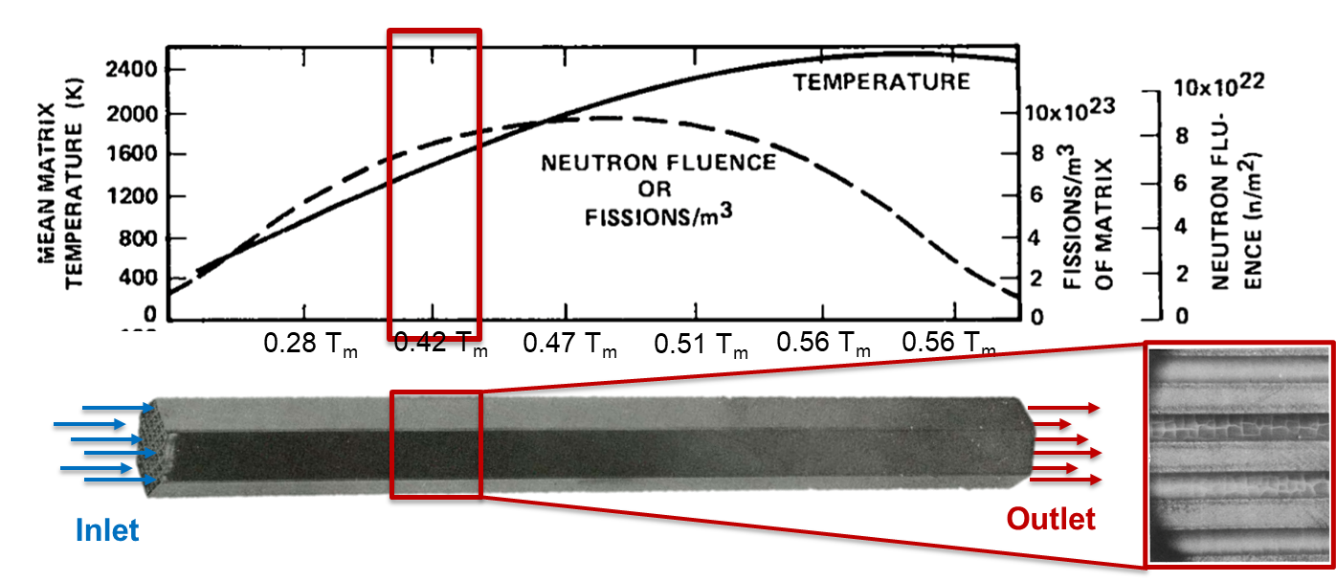
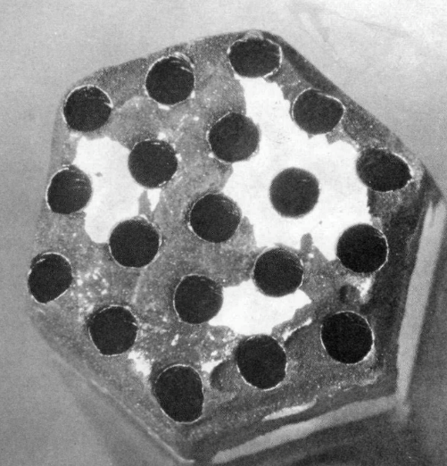
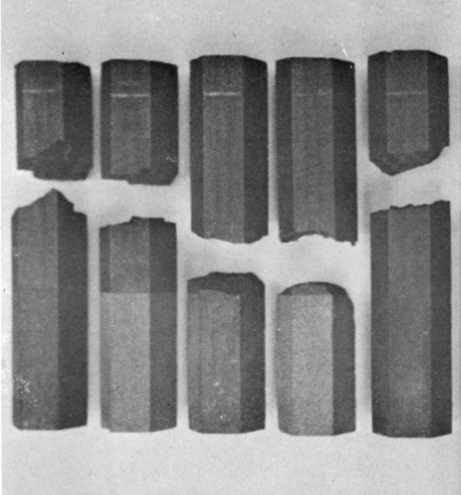
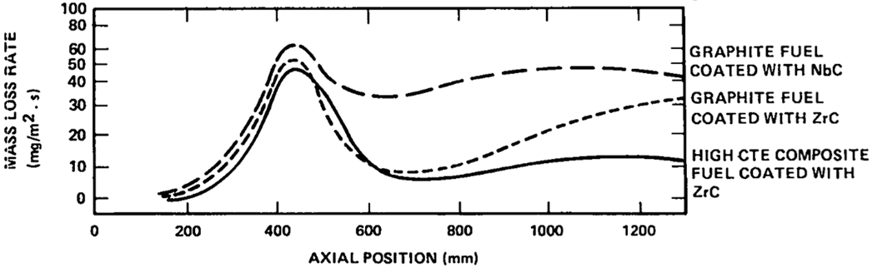
Lessons Learned from Rover / NERVA
Two major fuel failure mechanisms were discovered through reactor testing: corrosion and cracking
[3]
Corrosion Parameters
Thermal stresses between coatings and matrix
Operating temperature
Local composition of the propellant
Preferential diffusion
[1]
[3]
Cracking Parameters
Thermal stresses between fuel particles and matrix
Fuel microcracking due to fission products
Dimensional instability and evolving loading of fuel during high temperature operation
Flow induced vibrations
Fuel most susceptible in the ‘mid-band’ where thermal stresses are high and ductility still low
[2]
[3]
[see presentation notes for citations]
Notes:
[1] Boltax, A, and Tobin, J M. Westinghouse Astronuclear Laboratory contribution to the twentieth high temperature fuel committee meeting, 18--20 May 1965. United States: N. p., 1965. Web. doi:10.2172/4163392.
[2] Morris, W P. Joint WANL/LASL/Y-12 fuel and reactor development review, WANL, October 11-- 12, 1966. United States: N. p., 1966. Web. doi:10.2172/4234998.
[3] Lyon, L L. Performance of (U,Zr)C-graphite (composite) and of (U,Zr)C (carbide) fuel elements in the Nuclear Furnace 1 test reactor. United States: N. p., 1973. Web. doi:10.2172/4419566.

Slide 17
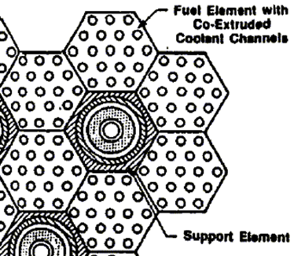
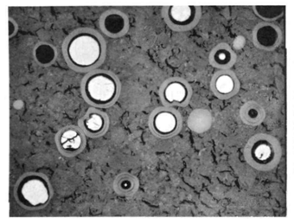
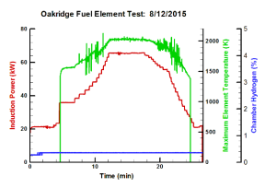
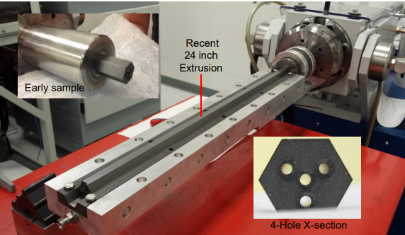
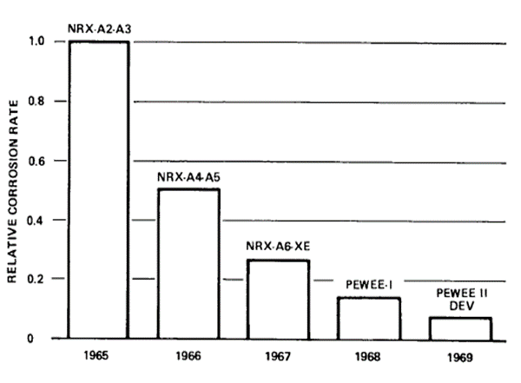
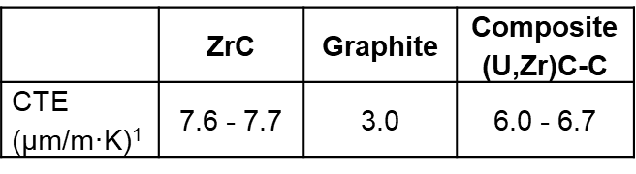
Lessons Learned from Rover / NERVA
Two major fuel failure mechanisms were discovered through reactor testing: corrosion and cracking
Failure Mitigation Parameters
Mechanical design of support structure (tie-tube) to take advantage of graphite’s compressive strength
Particle coatings, required to passivate UC2 particles, reduced FP damage to matrix
“Composite” fuels composed of the graphite structural matrix with a dispersed (U,Zr)C fuel web improved matrix CTE to reduce thermal stresses (NF-1 Tested)
[4]
[4]
Fuel most susceptible in the ‘mid-band’ where thermal stresses are high and ductility still low
[3]
[1]
[2]
[5]
[3]
Modern development activities have shown fabrication capabilities cannot be identically recaptured due to loss of infrastructure and feedstocks
[see presentation notes for citations]
¹Room Temperature
Notes:
[1] Koenig, D. R. Experience Gained from the Space Nuclear Rocket Program (Rover). Los Alamos National Laboaratory, Rep. No. LA-10062-H. 1986.
[2]
[3] Borowski, S. K., et. al. Affordable Development and Demonstration of a Small NTR Engine and Stage: How Small is Big Enough? AIAA Space & Astronautics Forum & Exposition (Space 2015). (Presentation)
20170008980.pdf (nasa.gov)
[4] Lyon, L L. Performance of (U,Zr)C-graphite (composite) and of (U,Zr)C (carbide) fuel elements in the Nuclear Furnace 1 test reactor. United States: N. p., 1973. Web. doi:10.2172/4419566.
[5] Emrich, W., Nuclear Cryogenic Propulsion Stage (NCPS) Fuel Element Testing in the Nuclear Thermal Rocket Element Environmental Simulator (NTREES). 2017 AIAA Propulsion and Energy Forum. (Paper) Nuclear Cryogenic Propulsion Stage (NCPS) Fuel Element Testing in the Nuclear Thermal Rocket Element Environmental Simulator (NTREES) - NASA Technical Reports Server (NTRS)

Slide 18
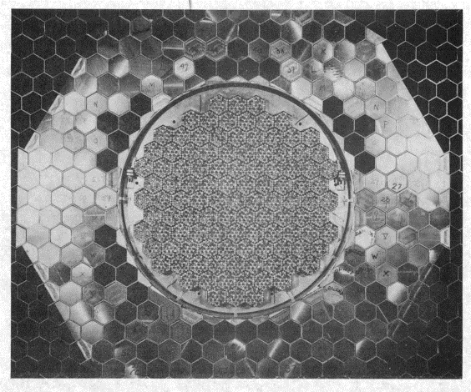
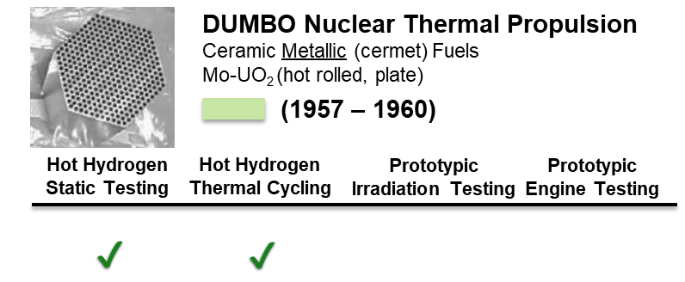
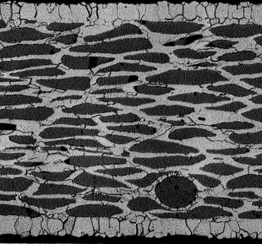
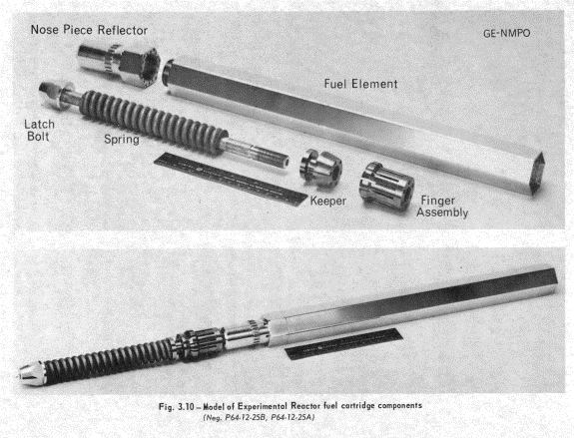
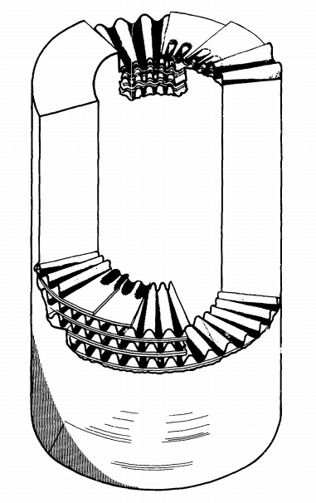
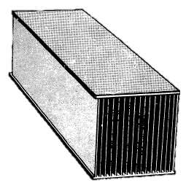





Historic U.S. Cermet Fuel Development Overview
Ceramic metallic (cermet) fuels were developed as an alternative to Rover / NERVA graphite-matrix fuel elements
[6]
GEMP-349 (1965)
[1]
LA-2091 (1957)
[3]
[4]
[5]
GEMP-600-1 (1973)
[7]
Energy.gov
ANL/TD/TM01-22 (2002)
[2]
GEMP-333 (1965)
Highlights: Fuel qualification was pursued prior to ground reactor testing, fuel behavior and failure modes well understood through separate effects testing
Geometry – Extruded Hexagonal (Typical)
Length: up 51 in. (stacked segments)
Flat-to-Flat: up to 1.87 in.
Up to 331 Coolant Channels
Fabrication: Hot Isostatic Press (HIP)
Fuel Types:
Mo-UO2
W-UO2
[3]
GEMP-333 (1965)
Emerging Fuels:
W-UO2 (with oxide stabilizers)
W-UN
[see presentation notes for citations]
Notes:
[1] Buzzard, R. J. High temperature creep-rupture properties of a tungsten-uranium dioxide cermet produced from coated particles. NASA Lewis Research Center. NASA-TM-X-1625 (1968)
[2] Bhattacharyya, S. K. An assessment of fuels for nuclear thermal propulsion. Argonne National Laboratory ANL/TD/TM01-22 (2002)
[3] 710 reactor program, progress report No. 12. United States: N. p., 1965. Web. doi:10.2172/4330664.
[4] Knight, B. W., et. al. A Metal Dumbo Rocket Reactor. Los Alamos National Laboaratory, Rep. No. LA-2091. 1957. 7265972.pdf (iaea.org)
[5] 710 high-temperature gas reactor program summary report. Volume I. Summary. United States: N. p., 1967. Web. doi:10.2172/4338293.
[6] 710 reactor program, progress report No. 13. United States: N. p., 1965. Web. doi:10.2172/4352881.
[7] TREAT Fact Sheet.pdf (energy.gov)
Note: Reported Geometry from ANL-7326 “Nuclear Rocket Program Terminal Report” (1966).

Slide 19




Lessons Learned from Historic Cermet Development
Failure modes in cermet fuels are primarily driven by the high temperature instability of the ceramic fuel which can lead to fuel loss under high temperature hydrogen thermal cycling.
Pre-Test
After Hot Hydrogen Exposure
UO2
Post-Test
Hickman, R. et. a.l. Hot Hydrogen Testing of Tungsten-Uranium Dioxide (W-UO2) CERMET Fuel Materials for Nuclear Thermal Propulsion. AIAA Joint Propulsion Conference. 2014 (Presentation)
W-UO2 slug sample cycled for 10 minutes at 2500 °C
– Sample reduced to powder after cooling
C. Haertling, R.J. Hanrahan, Literature review of thermal and radiation performance parameters for high-temperature, uranium dioxide fueled cermet materials, Journal of Nuclear Materials, Vol. 366, 3, 2007, p. 317-335
Hickman, R. et. a.l. Hot Hydrogen Testing of Tungsten-Uranium Dioxide (W-UO2) CERMET Fuel Materials for Nuclear Thermal Propulsion. AIAA Joint Propulsion Conference. 2014 (Presentation)
UN identified as an alternative to UO2 but UN dissociation under high temperatures and low nitrogen pressures may result in similar failure modes to UO2

Slide 20







Lessons Learned from Historic Cermet Development
Failure modes in cermet fuels are primarily driven by the high temperature instability of the ceramic fuel which can lead to fuel loss under high temperature hydrogen thermal cycling.
[7]
Mass Loss Mitigation Parameters
W-alloy Claddings
Gd2O₃ and ThO₂ “stabilizers”
High fuel density to reduce free U, O migration
Eliminate interparticle connectivity
Spherical particles to allow for favorable interfaces at grain boundaries
UO₂ → UN fuel particles
[1]
Pre-Test
After Hot Hydrogen Exposure
UO2
Post-Test
[8]
[6]
[2]
[4]
[5]
[3]
Modern cermet development activities have shown significant progress in fabricating net-shape HALEU cermet fuels
[see presentation notes for citations]
Notes:
[1] Hickman, R. et. a.l. Hot Hydrogen Testing of Tungsten-Uranium Dioxide (W-UO2) CERMET Fuel Materials for Nuclear Thermal Propulsion. AIAA Joint Propulsion Conference. 2014 (Presentation)
[2] https://ntrs.nasa.gov/api/citations/20190004963/downloads/20190004963.pdf?attachment=true
[3] Space Technology Mission Directorate: Nuclear Thermal Propulsion Update (nasa.gov)
[4] Benensky, K., et. al., “Overview of Historic NTP Fuel Development.” NASA Marshal Space Flight Center. 2018 (Presentation)
[5] Direct Current Sintering - Spark Plasma Sintering | Thermal Technology
[6] 710 high-temperature gas reactor program summary report. Volume I. Summary. United States: N. p., 1967. Web. doi:10.2172/4338293.
[8] Takkunen, P. D. Fabrication of cermets of uranium nitride and tungsten or molybdenum from mixed powders and from coated particles. NASA Lewis Research Center, NASA-TN-D-5136 (2013) Fabrication of cermets of uranium nitride and tungsten or molybdenum from mixed powders and from coated particles - NASA Technical Reports Server (NTRS)
Space Technology Mission Directorate: Nuclear Thermal Propulsion Update (nasa.gov)

Slide 21








Historic Solid Solution Carbide Fuel Development Overview
Solid solution carbides (SSCs) have the potential to enable the highest operating temperatures and longest lifetimes
[1]
[2]
[6]
ANL/TD/TM01-22
[2]
Geometry – Many Options!!
Twisted Ribbon (~100 mm L, 2 mm D)
Other Twisted Rodlets
Extruded hexagonal
Plates: varies, geometrically optimized for heat transfer
Spheres: ~1 cm diameter or less
Fabrication: Extrusion and Sinter
Fuel Compounds:
“Dicarbides”: (U,Zr)C, (U,Ta)C
“Tricarbides”: (U,Zr,Nb)C, (U,Zr,Ta)C
Other Solid Solutions also Proposed:
Carbonitrides: (U,Zr)C,N
Borides (requires enrichment)
ANL/TD/TM01-22
Highlights: SSC testing performed under USSR programs are the highest temperature test data gathered for NTP (in-pile and out-of-pile)
[4]
[3]
[5]
[3]
Many different SSC fuel concepts have been proposed
[see presentation notes for citations]
Notes:
[1] Lyon, L L. Performance of (U,Zr)C-graphite (composite) and of (U,Zr)C (carbide) fuel elements in the Nuclear Furnace 1 test reactor. United States: N. p., 1973. Web. doi:10.2172/4419566.
[2] Bhattacharyya, S. K. An assessment of fuels for nuclear thermal propulsion. Argonne National Laboratory ANL/TD/TM01-22 (2002)
[3] Taylor, B. et. al. Study of a Tricarbide Grooved Ring Fuel Element for Nuclear Thermal Propulsion. 2018 Nuclear Emerging Technologies for Space Conference. (Presentation https://ntrs.nasa.gov/citations/20180002033
[4] Youchison, Dennis L, Lenard, Roger X, Williams, Brian E., and Anghaie, Samim. A Tricarbide Foam Fuel Matrix for Nuclear Thermal Propulsion.. United States: N. p., 2006. Web. https://www.osti.gov/biblio/1266203-tricarbide-foam-fuel-matrix-nuclear-thermal-propulsion
[5] Goeddel, W V, Sandefur, N L, and White, J L. Advanced, graphite-matrix, dispersion-type fuel systems. First annual report, April 1, 1962--March 31, 1963. United States: N. p., 1963. Web. doi:10.2172/4310927.
[6] Holleck, Helmut, and H. Kleykamp. U Uranium: Uranium Carbides. Springer Science & Business Media, 2013.
https://www.osti.gov/servlets/purl/4310927
https://www.osti.gov/servlets/purl/4419566
https://www.osti.gov/biblio/4421676-mixed-carbide-fuel-particle-study

Slide 22





Lessons Learned from Historic SSC Development
SSCs are extremely brittle, the most common failure mode is cracking and loss of structural / dimensional integrity
Bhattacharyya, S. K. An assessment of fuels for nuclear thermal propulsion. No. ANL/TD/TM01-22. Argonne National Lab., IL (US), 2002.
Lanin, A. Nuclear Rocket Engine Reactor. Springer (Text) 2013. https://doi.org/10.1007/978-3-642-32430-7
Extensive hot-hydrogen testing was reported from USSR activities
Carbide fuels also experience the most failure in the mid-band region where power densities are high and ductility low
Anatolii G Lanin and Ivan I Fedik 2011 Phys.-Usp. 54 305
Optimization of fuel geometry to accommodate stresses

Slide 23






Historic U.S. NTP Particle Fuel Development Overview
Use of a high surface area particle fuel has the potential to enable greater heat transfer to maximize reactor exit temperature and minimize reactor mass (optimizes engine thrust to weight ratio)
Space Nuclear Thermal Propulsion (SNTP)
Carbide “Particle” Fuels
(1987 – 1993)
Hot Hydrogen
Static Testing
Hot Hydrogen
Thermal Cycling
Prototypic Irradiation Testing
Prototypic Engine Testing
Walton, L.. et. al., in the 29th Joint Propulsion Conference. 1993
(Image Above) Haslett, R A. Space nuclear thermal propulsion program. Final report, United States: N. p., 1995.
Coated Particle BISO with ZrC outer coating
Lenard, R. X. in Acta Astronautica, Vol. 57, 2–8, p. 404-414, 2005.
Highlights: Fuel design enabled rapid manufacture and testing of fuel prototypes
Geometry – Extruded Hexagonal (Typical)
Diameter: 400 – 450 µm
Fuel Kernel with multiple functional / protective coatings
PyC inner coatings
ZrC protective outer coating
Fuel Types:
Baseline:
UC or UC2
With Buffer-
PyC-ZrC coatings
Emerging Fuels:
(U,Zr)C Solid Solution
Infiltrated Kernel
Interstitial dispersoid
Ludewig, H., et al. "Design of particle bed reactors for the space nuclear thermal propulsion program." Progress in Nuclear Energy 30.1 (1996): 1-65.
(Image Above) Haslett, R A. Space nuclear thermal propulsion program. Final report, United States: N. p., 1995.
Notes:
Roger X. Lenard,
The advisability of prototypic testing for space nuclear systems,
Acta Astronautica,
Volume 57, Issues 2–8,
2005,
Pages 404-414,
ISSN 0094-5765,
https://doi.org/10.1016/j.actaastro.2005.03.056.
(https://www.sciencedirect.com/science/article/pii/S0094576505001232)
Abstract: From October 1987 until 1993, the US Department of Defense conducted the Space Nuclear Thermal Propulsion program. This program's objective was to design and develop a high specific impulse, high thrust-to-weight nuclear thermal rocket engine for upper stage applications. The author was the program manager for this program until 1992. Numerous analytical, programmatic and experimental results were generated during this period of time. This paper reviews the accomplishments of the program and highlights the importance of prototypic testing for all aspects of a space nuclear program so that a reliable and safe system compliant with all regulatory requirements can be effectively engineered. Specifically, the paper will recount how many non-prototypic tests we performed only to have more representative tests consistently generate different results. This was particularly true in area of direct nuclear heat generation. As nuclear tests are generally much more expensive than non-nuclear tests, programs attempt to avoid such tests in favor of less expensive non-nuclear tests. Each time this approach was followed, the SNTP program found these tests to not be verified by nuclear heated testing. Hence the author recommends that wherever possible, a spiral development approach that includes exploratory and confirmatory experimental testing be employed to ensure a viable design.

Slide 24



Lessons Learned from SNTP Fuel Development
Fuel performance limited by coolability of particles to maintain centerline temperature below the melting point. Hot spots due to complex flow distributions hypothesized to be the controlling failure mode.
Haslett, R A. Space nuclear thermal propulsion program. Final report, United States: N. p., 1995.
Bhattacharyya, S. K. An assessment of fuels for nuclear thermal propulsion. Argonne National Laboratory ANL/TD/TM01-22 (2002)
Rapid, separate effects testing lead to important discoveries which accelerated fuel development and design. Prototypic experiments were recommended to define performance window of the fuel.
Lenard, R. X. in Acta Astronautica, Vol. 57, 2–8, p. 404-414, 2005.
Notes:
https://apps.dtic.mil/sti/pdfs/ADA305996.pdf

Slide 25


Emerging Fuels: Cercer Fuel Overview
In a ceramic ceramic (cercer) fuel, a ceramic refractory carbide matrix (such as ZrC) can offer the benefits of high melting temperature, low neutron absorption, and hydrogen compatibility without sacrificing uranium loading.
www.world-nuclear-news.org
TRISO fuel irradiation and subsequent safety testing up to 1800 °C
Can we tailor coated particle designs to specifically meet the needs of NTP?
Adapted from: Terrani, K., et. al. J. Nuc. Mat., 2012. 427(1-3): p. 209-224.
Cercer Micro-Engineered Particle Concept

Slide 26

Cercer Fuel Form Maturation Needs
No major historic NTP programs have developed cercer fuel forms which results in some knowledge gaps related to selection of optimal manufacture processes and anticipated failure modes.
Fabrication Maturation Needs
Coated Particle Fabrication Processes
Net Shape Fabrication and Assembly
Production Quantity / Scale Facilities
Performance Maturation Needs
Identification of Failure Modes:
Inherent Brittleness like SSC Fuels?
Cracking like Rover Fuels?
Fuel Particle Instability like Cermet Fuels?
Facilities to enable testing under prototypic conditions
Carmack, W. et. al. “Technology Readiness Levels for Advanced Nuclear Fuels and Materials Development” (INL/JOU-16-38690)

Slide 27
Summary and Ongoing Development Initiatives
Comparison of NTP Fuel System Options
Current NTP Mission Needs and Ongoing Fuel Development Activities
Summary and Conclusions

Slide 28
Comparison of NTP Fuel System Options to Desirable Attributes
No fuel form uniformly excels in all categories of desirable attributes for NTP, however engineering solutions identified from lessons learned may be able to be effectively implemented
 | High Melting Temperature | Low Neutron Absorption | Hydrogen Compatibility | High Temperature Stability | Tolerance in Mid-Band Region
NERVA/Rover Graphite Matrix | Graphite: 4100 K UC₂: 2700 K | Best | Requires protective coatings | Operation above UC₂ melting point results in kernel migration | Thermal stresses and irradiation effects exacerbate
Cermet Mo-UO₂, W-UO₂, W-UN | W: 3695 K UO₂: 3125 K | Worst | Fuel particle may require protective coatings | Poor, requires cladding to prevent loss of U | Good, low temperature brittleness may exacerbate
Solid Solution Carbide (U,Zr)C / (U,Zr,Ta)C | (U_{0.1}Zr_{0.9})C: ~3500 K (U_{0.1}Ta_{0.9})C: ~3800 K | Good | Does not require protective coatings | May require U-migration barriers | Brittleness and irradiation effects exacerbate
SNTP UC₂-coated particle | ZrC: 3815 K UC₂: 2700 K | Good | Requires ZrC protective coating | Operation above UC₂ melting point results in kernel migration | Good
Cercer ZrC-UN | ZrC: 3815 K UN: 3100 K | Good | Unknown fuel particle may require protective coatings | Unknown | Unknown

Slide 29







Lessons Learned from Past NTP Fuel Development Activities
NTP fuels with highest development status have well understood degradation mechanisms to inform future development and testing activities… these lessons learned may also apply to new and novel fuel forms
[2]
Graphite Matrix Fuels
Rover NERVA is the only program to test fuels in NTP reactors
Significant development effort expended to reduce fuel failure due to corrosion and operational stresses
Composite (U,Zr)C-C fuels are the emerging fuel system concept, however they may be susceptible to radiation damage
[1]
[2]
Tungsten Cermet Fuels
High thermal strength, hydrogen compatibility, and thermal stability of W makes it stand out from other transition metal candidates
Addressed fuel failure mechanisms identified by the NERVA/Rover fuel program but susceptible to failure due to decomposition/vaporization of the UO2 fuel
W-UN fuels have potential for longer lifetimes but never proven in prototypic environments
[3]
[4]
[6]
[7]
[5]
Mixed Uranium-Refractory Metal Carbide Fuels
Highest performance potential: lifetime, operating temperature
Trade-off between minimizing thermal stresses and maximizing structural integrity never fully addressed
[see presentation notes for citations]
Notes:
[1] Lyon, L L. Performance of (U,Zr)C-graphite (composite) and of (U,Zr)C (carbide) fuel elements in the Nuclear Furnace 1 test reactor. United States: N. p., 1973. Web. doi:10.2172/4419566.
[2] Koenig, D. R. Experience Gaines from the Space Nuclear Rocket Program (Rover). Los Alamos National Laboaratory, Rep. No. LA-10062-H. 1986.
[3] Hickman, R. et. a.l. Hot Hydrogen Testing of Tungsten-Uranium Dioxide (W-UO2) CERMET Fuel Materials for Nuclear Thermal Propulsion. AIAA Joint Propulsion Conference. 2014 (Presentation) NCPS (nasa.gov)
[4] Bhattacharyya, S. K. An assessment of fuels for nuclear thermal propulsion. Argonne National Laboratory ANL/TD/TM01-22 (2002)
[5] Takkunen, P. D. Fabrication of cermets of uranium nitride and tungsten or molybdenum from mixed powders and from coated particles. NASA Lewis Research Center, NASA-TN-D-5136 (2013) Fabrication of cermets of uranium nitride and tungsten or molybdenum from mixed powders and from coated particles - NASA Technical Reports Server (NTRS)
[6] C. Haertling, R.J. Hanrahan, Literature review of thermal and radiation performance parameters for high-temperature, uranium dioxide fueled cermet materials, Journal of Nuclear Materials, Volume 366, Issue 3, 2007, Pages 317-335, https://doi.org/10.1016/j.jnucmat.2007.03.024.
[7] Anatolii G Lanin and Ivan I Fedik 2011 Phys.-Usp. 54 305 Selecting and using materials for a nuclear rocket engine reactor – IOPscience

Slide 30
Higher Performance NTP Fuels are Needed for Modern Missions
Crewed Mars missions planned for the 2030s / 2040s require longer NTP fuel operating lifetimes and temperatures than that demonstrated through historic NTP programs.
NTP performance requirements
Thrust ~25k lbf per engine
Specific Impulse~ 900 seconds
Hydrogen propellant
8 burns (for core engines)
Worst case cumulative total ~4.0 hours run time (for single engine out once Mars is reached)
Round trip <700 days
Drop tanks ejected when empty
A subscale engine demonstration is planned in the late 2020s timeframe
Picture Courtesy Aerojet/Rocketdyne

Slide 31

Maximum fuel form operating temperature limits achievable Isp
A specific impulse of 900s requires reactor exit temperatures of 2700 K and maximum fuel temperatures of 2850+ K
Nozzle Area Ratio
600
300
100
Picture Courtesy Harold Gerrish (NASA MSFC) / Doug Burns INL / Aerojet/Rocketdyne

Slide 32
Maximum fuel form operating temperature limits achievable Isp
A specific impulse of 900s requires reactor exit temperatures of 2700 K and maximum fuel temperatures of 2850+ K
Maximum peak material temperature range to produce Isp 900 sec
2
NERVA-Graphite
Advanced Carbide (Coated) Predicted
Reported H2 Testing Results for NTP Fuels:
□ Lenz, 1964 (LA-MS-2971)
□ Saunders, 1968 (NASA-TM-X-1421)
□ GE-710 Reported Best (ANL/TD/TM01-22)
Advanced
Carbide
(Uncoated)
Predicted
NERVA-Composite
○ (U,Zr)C: Storms, 1992 (LA-12043-MS)
○ (U,Zr)C: Storms, 1990 (LA-11867-MS)
○ (U,Zr,Nb)C: Cunningham, 2008 (Thesis)
USSR (U,Zr)C Reported Best (ANL/TD/TM01-22)
USSR (U,Zr,Ta)C Reported Best (ANL/TD/TM01-22)
US Gen I
CERMET
US Gen I Carbide
→ ZrC: Cunningham, 2008 (Thesis)
→ ZrC: Benensky, 2019 (Thesis)
Mars Opposition
Burn Time Cumulative with engine out
NF-1 (average T)
NRX-Best
Mars Conjunction
Burn Time Cumulative
Picture Courtesy of: Kelsa Palomares, Harold Gerrish/AMA/NASA SNP

Slide 33

Ongoing Fuel Development Activities in NASA’s SNP Project
SNP is actively investing in government led, risk reduction fuel development activities
Fuel Forms under Development
Primary - Cercer: ZrC matrix, UN coated particle
Alternative - Carbide: Solid Solutions of UC
Winding Down – Cermet: MoW matrix, UN coated particle
Related Fuel Assembly Materials
Production and Manufacture Research Areas
Optimization of sintering techniques via spark plasma sintering
Net-shape fuel element machining and assembly
Fuel particle kernel and coating fabrication techniques
High temperature material characterization
Fuel Performance and Testing Research Areas
Fundamental Material Studies: High temperature chemical compatibility and thermal stability testing
Separate Effects Testing: hot hydrogen testing in CFEET and NTREES, low fluence irradiation testing at MITR, transient irradiation testing at TREAT
Prototypic Reactor Irradiation for Multicomponent Examination (PRIME): Combined Hot Hydrogen – Transient of a representative reactor unit cell in TREAT
Advanced Modeling and Simulation: Thermal-hydraulic, structural, and neutronic analysis of reactor and engine systems
23 mm diameter cercer sample fabricated using SPS: angular UN particles and ZrC matrix fabricated to 88% of theoretical density.
Picture Courtesy of: Doug Burns / INL

Slide 34
Summary and Conclusions
Nuclear thermal propulsion has the potential to enable high performance in-space propulsion to reduce crewed trip times. NTP fuel forms limit NTP reactor operating temperatures and lifetimes.
Fuel development requires the successful demonstration of performance and fabrication methods at a relevant scale / complexity.
Non-nuclear testing is useful to address baseline thermal and corrosion processes – however there exists uncertainty in the relative importance of irradiation damage; combined effects testing capabilities may be needed to confirm fuel reliability prior to in-reactor operations.
New manufacturing processes may enable development of fuel systems with more desirable microstructures which can better accommodate operational stresses and reduce fuel failure
New fuel systems do not offer the development history of derived fuel concepts
No fuel system is perfect, however fuels which can operate at higher temperatures and longer time periods will appear more promising for development and are needed for modern missions

Slide 35
Supplementary Slides

Slide 36
Conventional U-Compounds
Solid Solution Carbides
Cermet Matrix
Candidates
Graphite and Cercer Carbide Matrix Candidates
Image Credit: Analytical Mechanics Associates, Inc. Nuclear Thermal Propulsion Industry Flight Demonstration Study Final Report Sep. 2020

Slide 37

Image Credit: Analytical Mechanics Associates, Inc. Nuclear Thermal Propulsion Industry Flight Demonstration Study Final Report Sep. 2020

