Slide 1
CPF-CERES intercalibration: Expected Impact
David Doelling and the CERES team
CLARREO Pathfinder Science Workshop
November 2-3, 2021

Slide 2
CERES Earth Radiation Budget (ed4.1)
Based on CERES instrument calibration | 2005-2105 global mean (Wm-2)
Incoming Solar (from SORCE) | 340.0
All-sky LW (emitted) | 238.6
All-sky SW (reflected) | 97.1
All-sky Net (solar – LW – SW absorbed) | 4.3
Ocean heat storage* (Argo) | 0.7
* Johnson, G. C., J. M. Lyman, and N. G. Loeb. 2016. Improving estimates of Earth's energy imbalance. Nature Climate Change, 6, 639-640, doi:10.1038/nclimate3043.
• A net imbalance of 4.3 Wm-2 (based on CERES instrument calibration) is much larger than the estimated ocean heat storage
• The Earth’s energy imbalance (EEI) or how much the earth is warming or cooling is mostly a function of the ocean heat storage

Slide 3
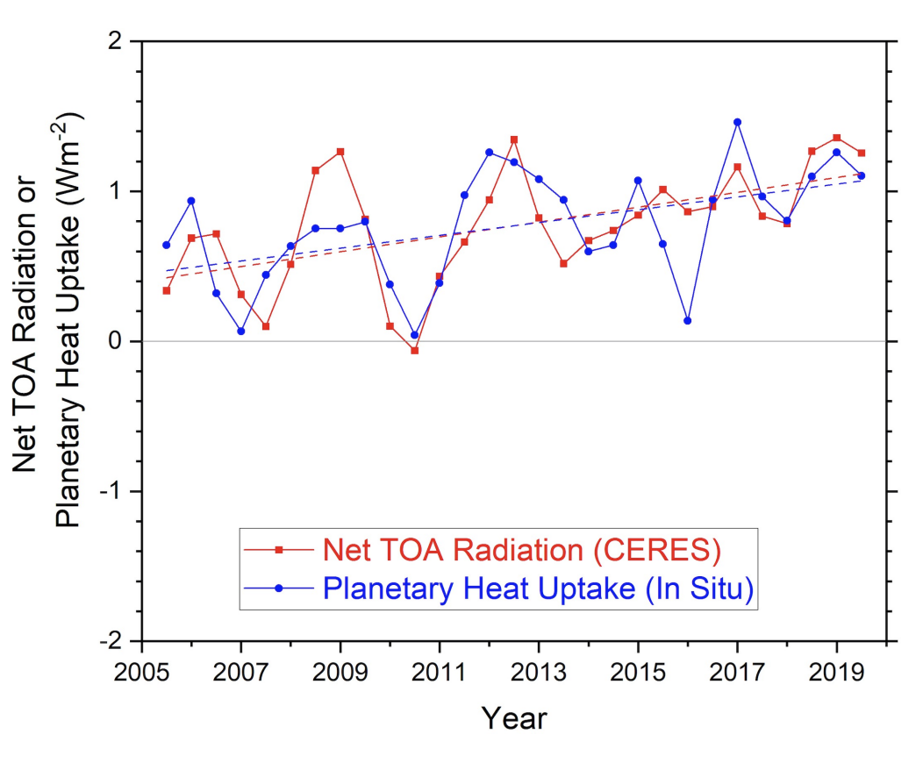
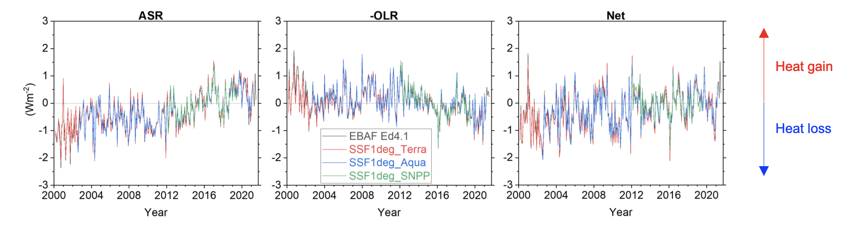
CERES global flux trends
Loeb et al. 2021 GRL
note how well CERES and Argo EEI tracks
argo
Deseasonalized CERES monthly fluxes from 2012-2019 climatology
Note that all of CERES instruments are showing the same anomalies over time indicating that they have stable calibration

Slide 4
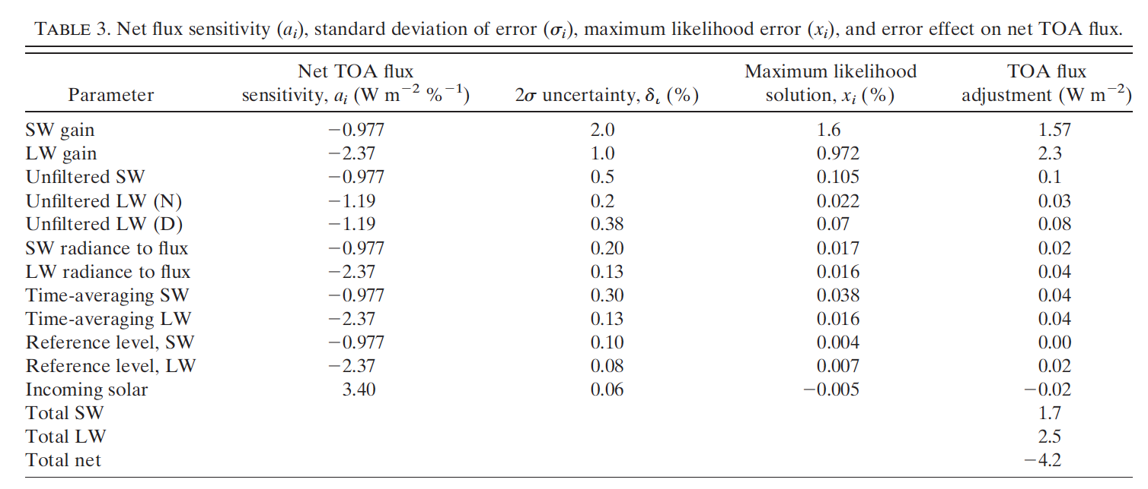
What are the largest CERES EEI uncertainties?
CERES cal
CERES SRF
ADM
TISA
Loeb et al. 2008
* Maximum likelihood solution tries to adjust the parameters within their uncertainty extent
CPF will aid in nailing down the CERES instrument calibration and the unfiltering (which is account for the CERES spectral response) as well as time averaging (hourly GEO derived broadband fluxes)

Slide 5
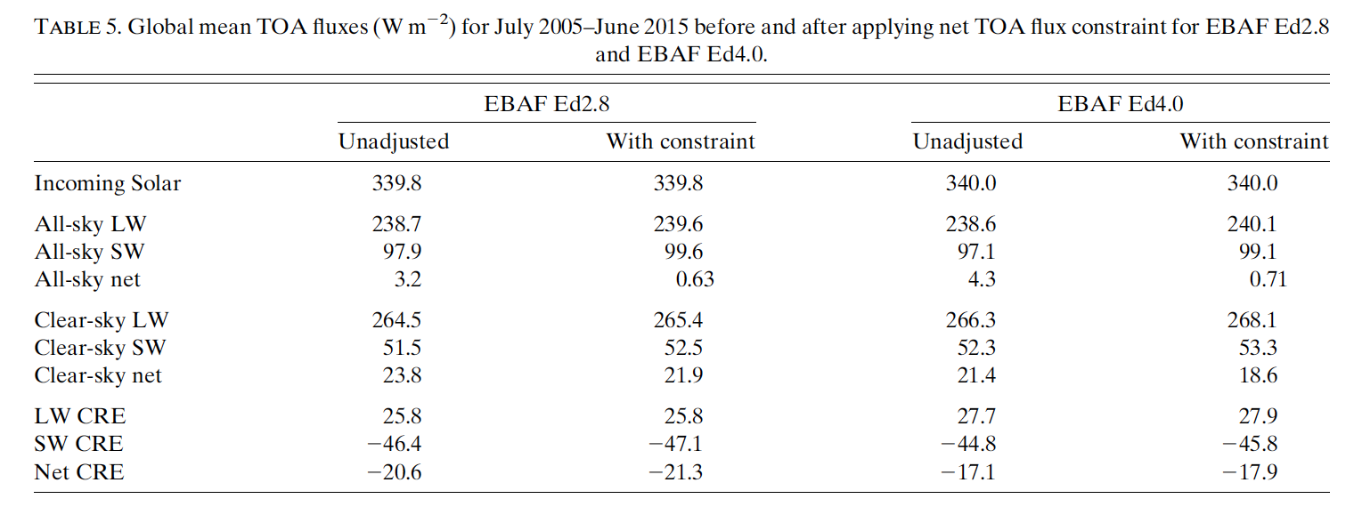
CERES Cloud Radiative Effect
Loeb et al. 2018
• Some of the clear-sky flux difference between Edition 2.8 and 4.0 is the cloud mask (cloud identification)
• CERES EBAF also adds in the clear-sky portion of the partly cloud CERES footprint fluxes (based on MODIS NB to BB)
• Clear-sky fluxes next to cloud edges would have lower LW fluxes (more humid) and larger SW fluxes (more aerosols) compared to large domain clear-sky fluxes
• CPF will provide high resolution clear-sky fluxes

Slide 6
CERES GEO derived broadband fluxes
To estimate the regional (100² km) diurnal flux between Terra (10:30AM) and Aqua (13:30PM) CERES measurements, CERES uses hourly geostationary (GEO) derived broadband fluxes
  Maritime stratus regions will have more clouds in the morning than the afternoon
  Land afternoon convection regions have more clouds in the late afternoon and clear-sky mornings
  The CERES daily mean fluxes should be independent of the CERES instrument satellite orbit
  The hourly/daily/monthly SYN1deg product is a combined Terra+Aqua+GEO TOA and compute surface flux product
Once Terra and Aqua start drifting (mid 2022), CERES will have to migrate to a NOAA-20 based CERES EBAF dataset
  CERES would need to rely more on the GEO derived fluxes
Since ISS is in a precessionary orbit would allow CLARREO to validate the GEO derived SW broadband fluxes across all sunlit hours of the day

Slide 7
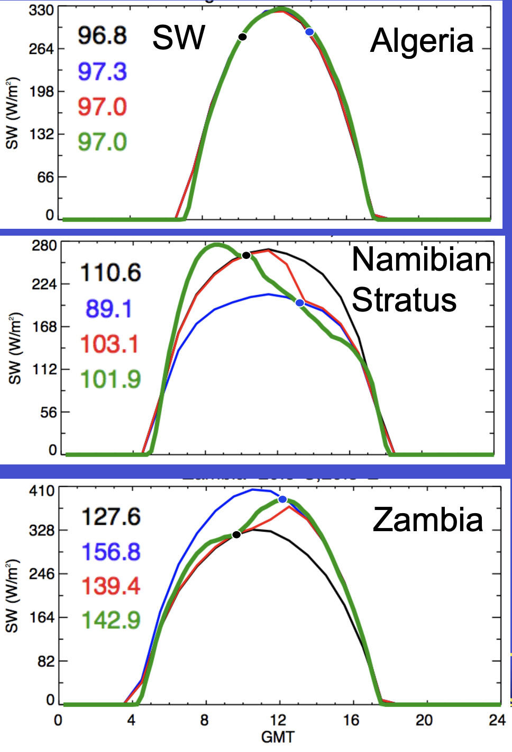
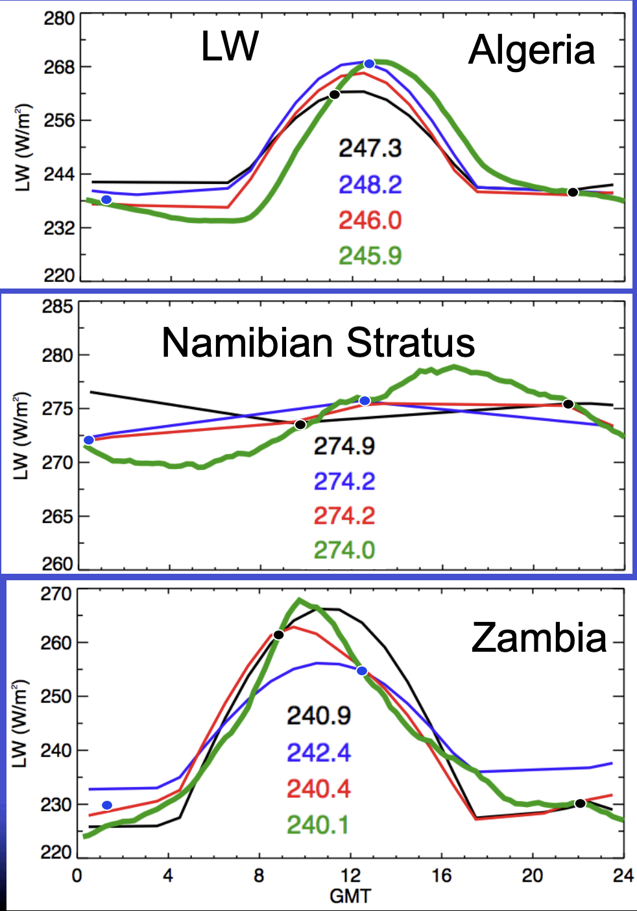
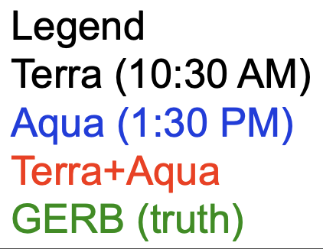
CERES-only monthly averaged fluxes based on constant meteorology
Note the hourly SW and LW fluxes from constant meteorology do not capture the GERB diurnal fluxes

Slide 8
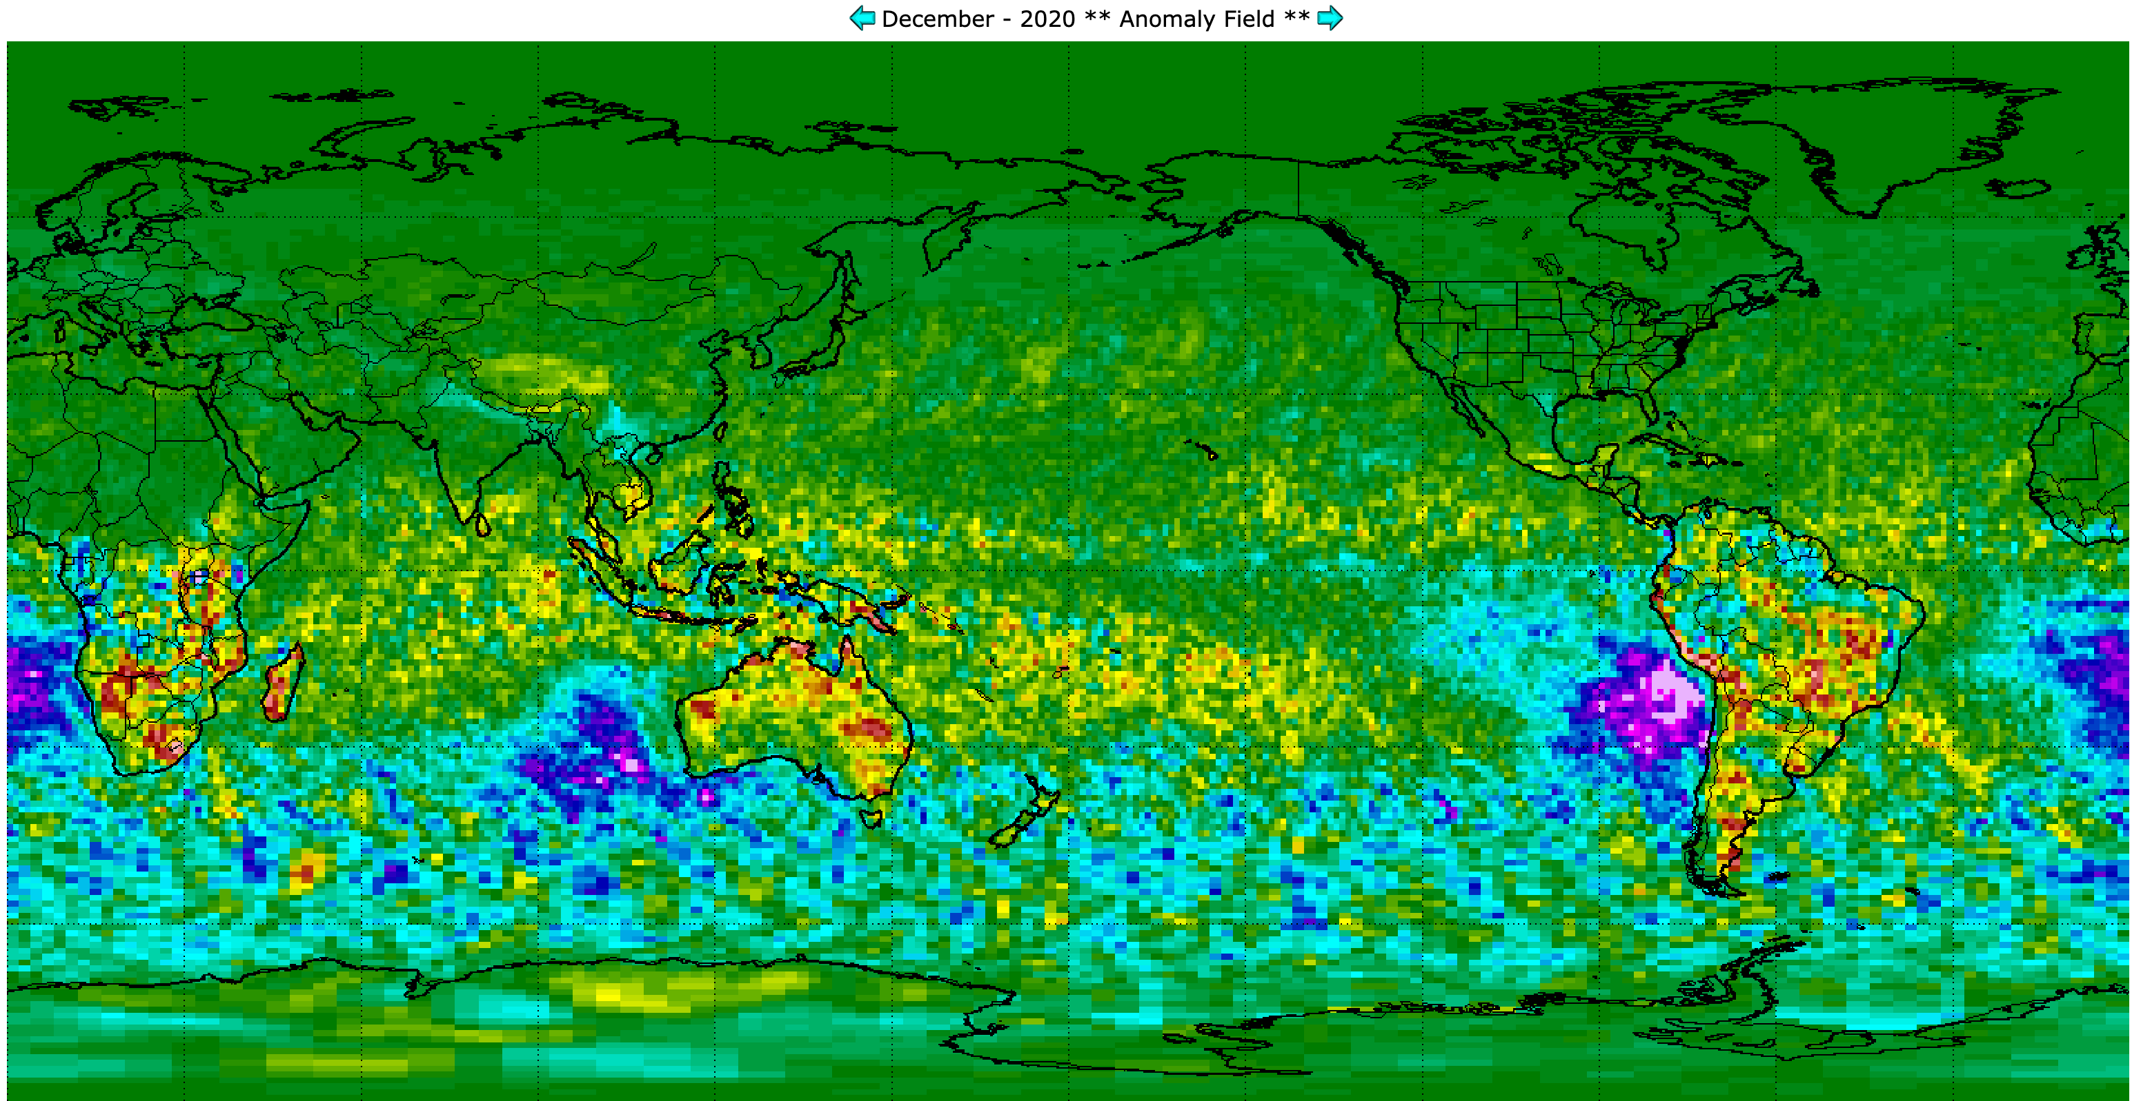
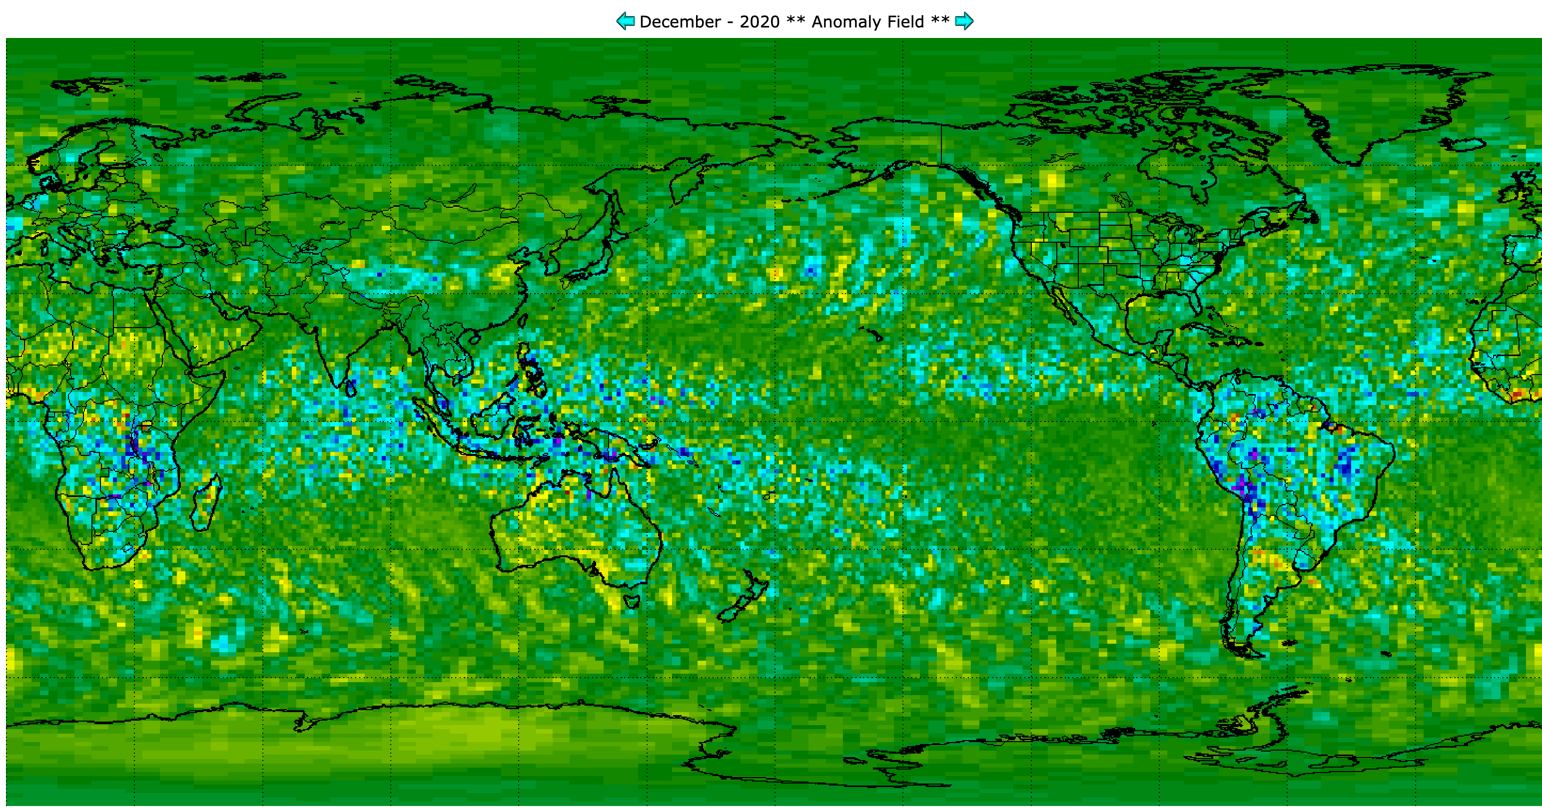
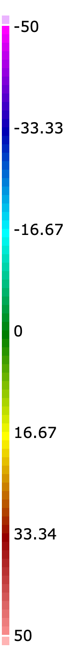
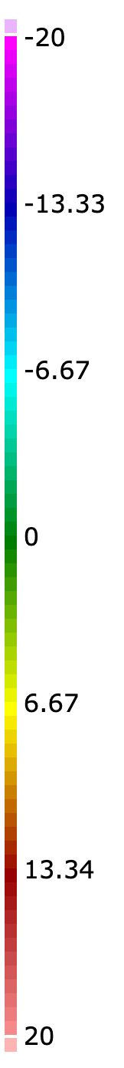
Aqua – Terra SSF1deg fluxes (constant meteorology diurnal averaging)
Global mean -1.6 Wm-2
2002-2020 -0.14 Wm-2
SW Dec 2020, Aqua-Terra SSF1deg
Global mean -0.4 Wm-2
2002-2020 -0.46 Wm-2
LW Dec 2020, Aqua-Terra SSF1deg
SW (m-2)
LW (m-2)
• Note that the Aqua-Terra regional flux difference can exceed 50Wm-2 (SW) and 20Wm-2 (LW)
• The Aqua-Terra global mean flux difference is very small (orbit is optimal to compute global daily mean fluxes)

Slide 9
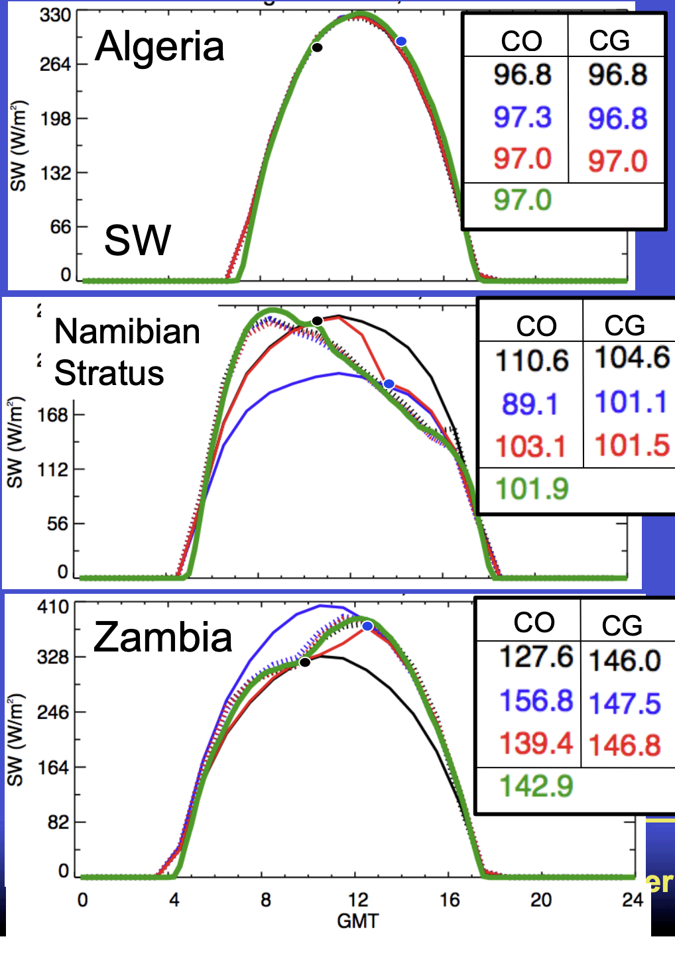
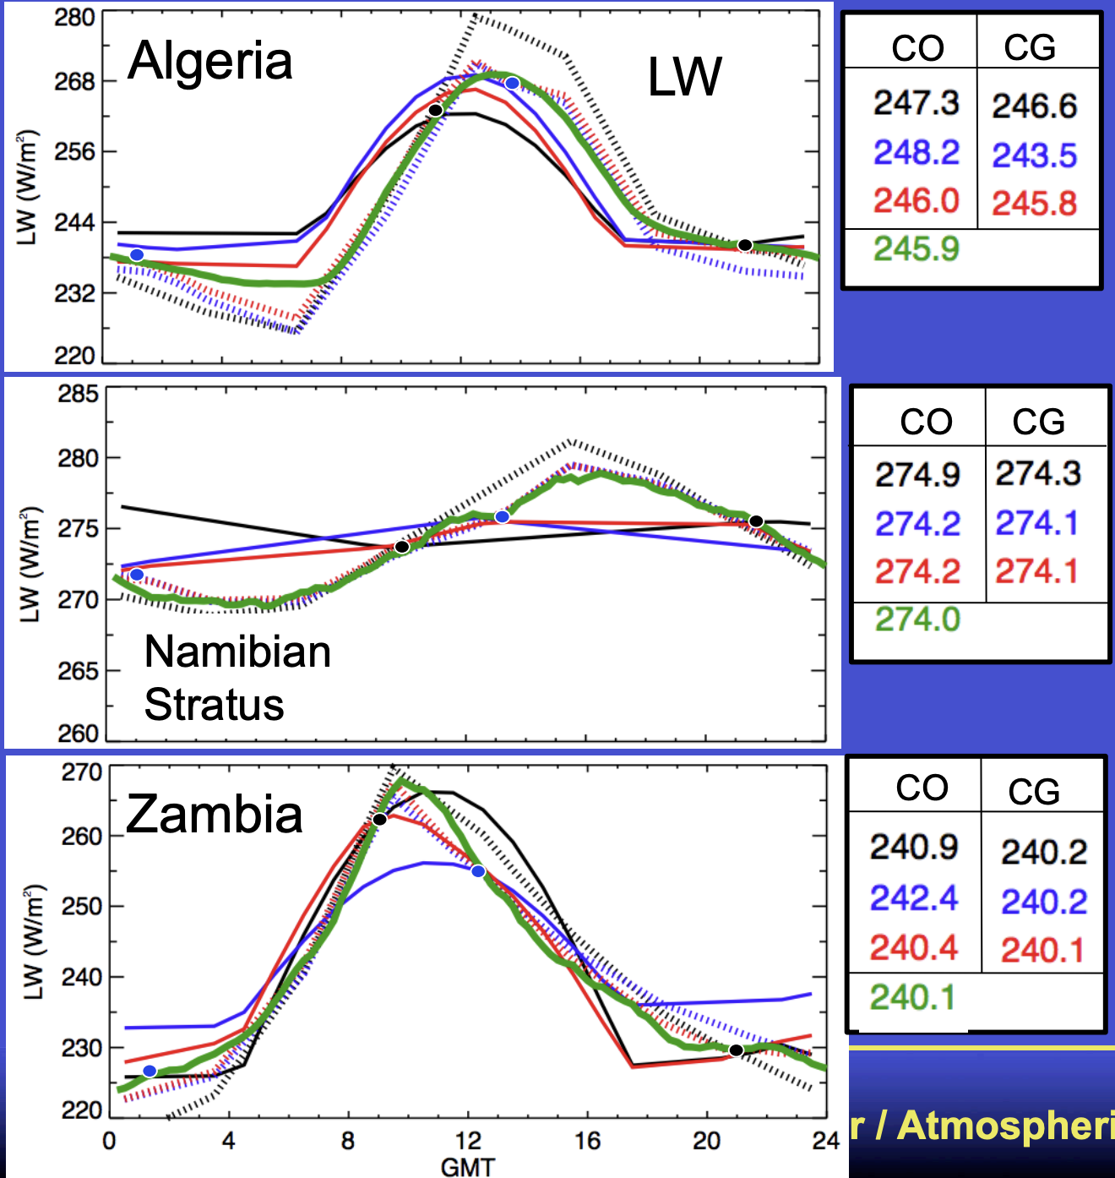
CERES-only monthly averaged GEO derived fluxes
GEO
GEO
dashed lines are GEO
GEO
GEO
Though not perfect the hourly SW and LW fluxes from GEO are more consistent to GERB
GEO
GEO

Slide 10
GEO derived broadband fluxes
GEO broadband radiances are based on empirical and theoretical GEO channel narrowband to broadband relationships that are a function of angles, cloud fraction, phase, optical depth
GEO broadband radiances are converted to fluxes using the Ed2 CERES TRMM ADM and are based on angles, cloud fraction, phase, optical depth from CERES RAPS mode scans
  GEO Cloud properties need to be consistent across GEO platforms in space and time and with the MODIS imager clouds to ensure consistent GEO derived broadband fluxes
  Also required for consistent hourly computed surface fluxes
Consistent GEO channel radiances and cloud properties required to retrieve GEO derived fluxes is accomplished by inter-calibrating GEOs with Aqua-MODIS
  This Radiometrically scales the GEO channel radiance to the Aqua-MODIS imager calibration reference.
  Transfers the MODIS calibration stability to the GEO constellation
  The MODIS channel calibration stability is further verified using invariant targets such as deep convective clouds, desert, and polar ice targets

Slide 11
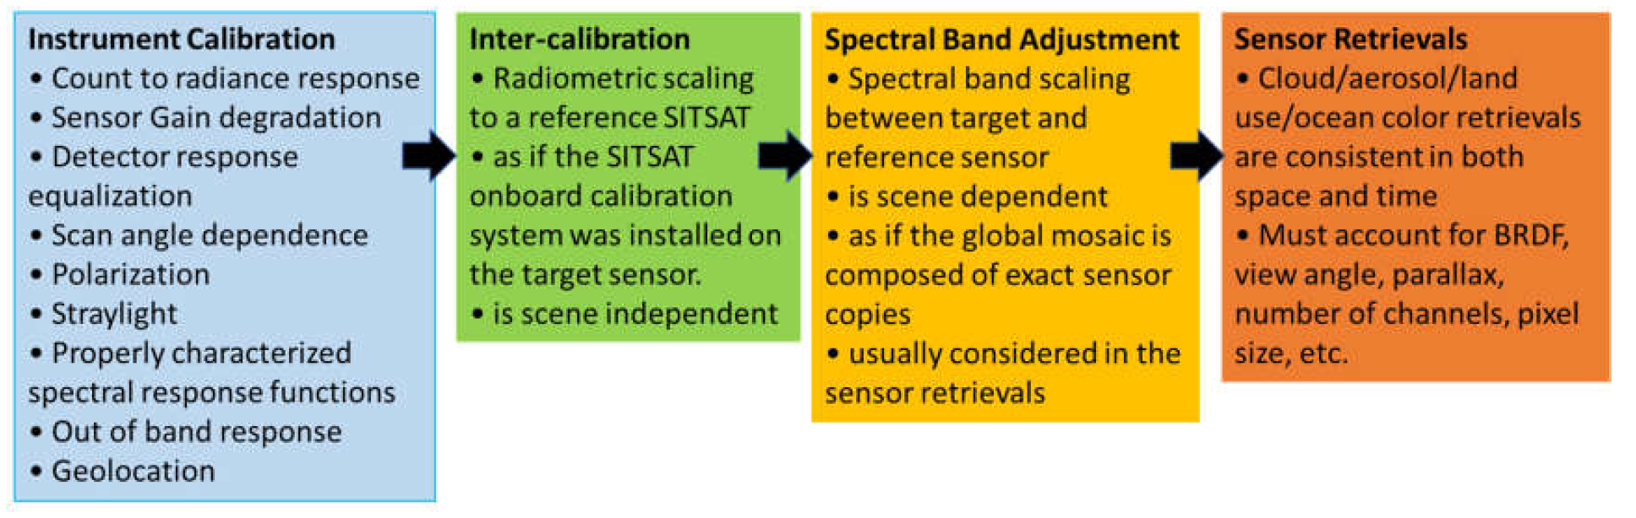
Steps needed for cross-sensor consistent retrievals
CLARREO observations will provide an absolute calibration reference and reduce inter-calibration and PICS characterization uncertainties
retrievals that are consistent across all angular observations
Sensor capabilities and channels vary across the constellation – exact sensor copies difficult to achieve
Rely on sensor onboard calibration systems and calibration teams

Slide 12
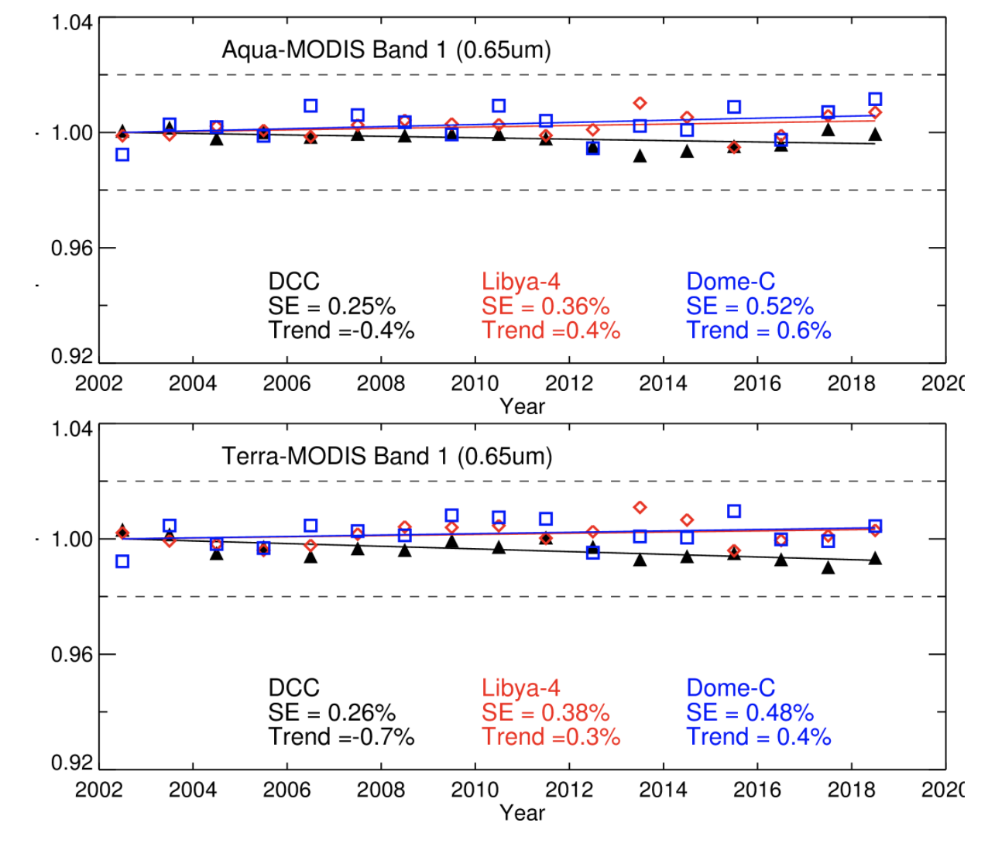
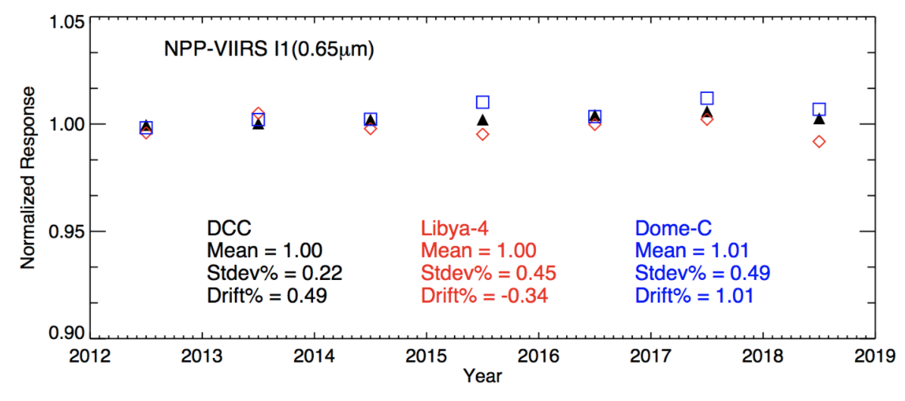
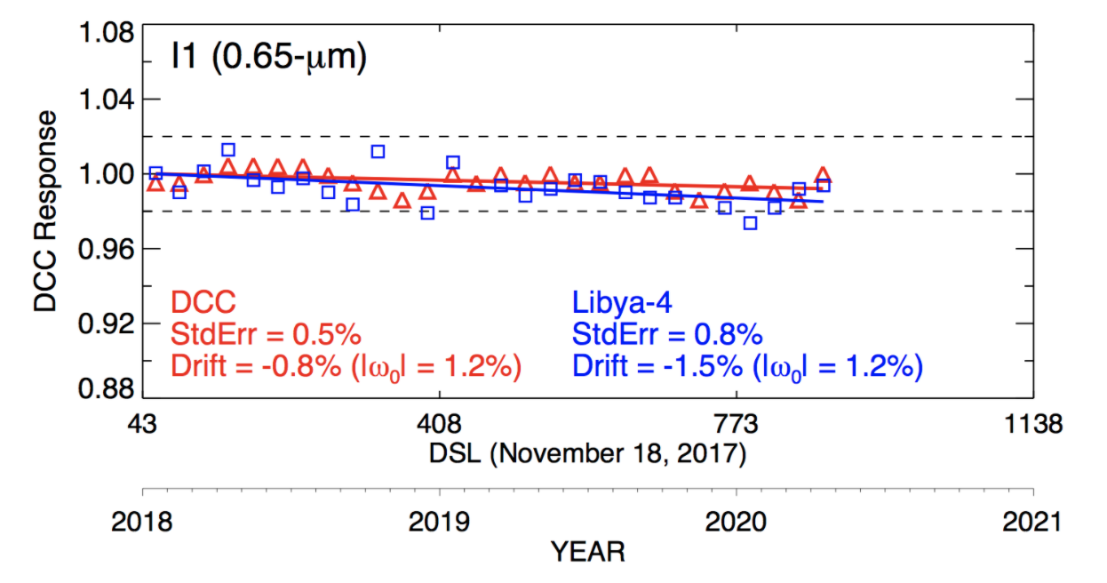
MODIS and VIIRS imager 0.64µm stability tracking

Slide 13
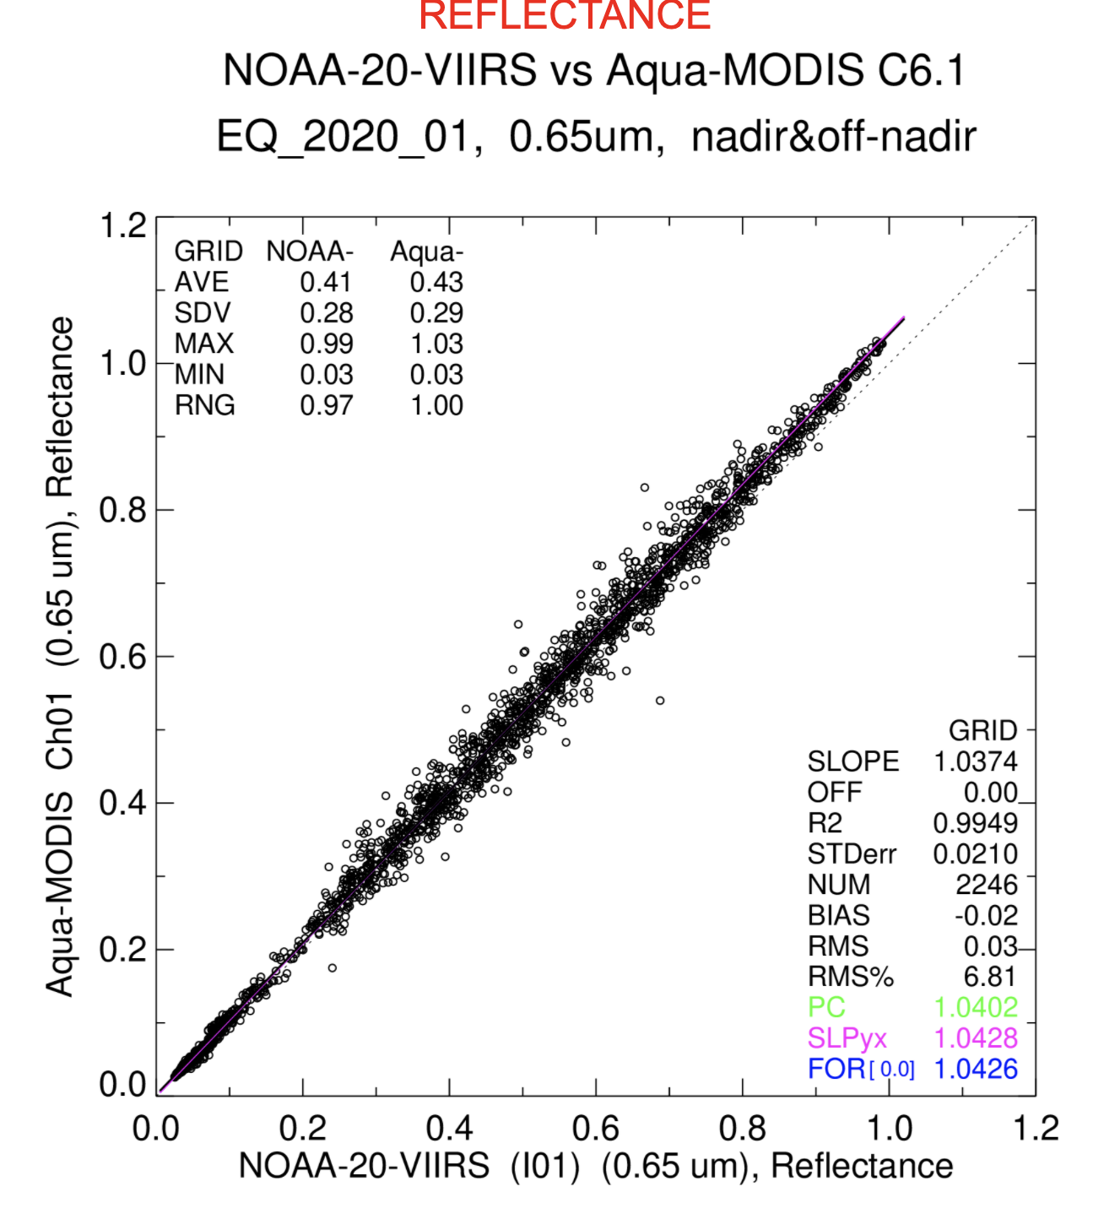
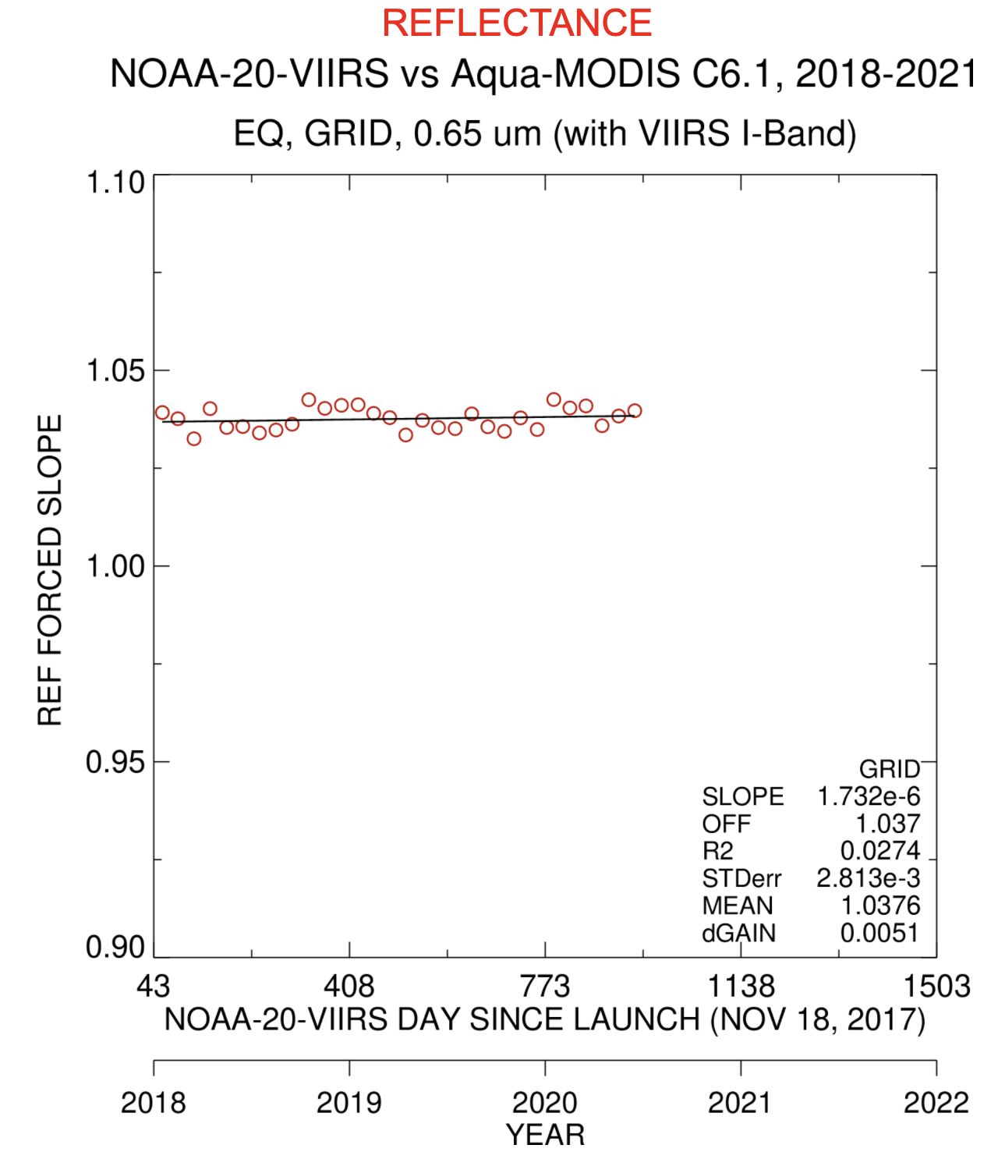
NOAA20-VIIRS radiometric scaling (inter-calibration) to Aqua-MODIS
Using coincident ray-matched VIIRS and MODIS reflectance gridded pairs over all-sky tropical ocean

Slide 14
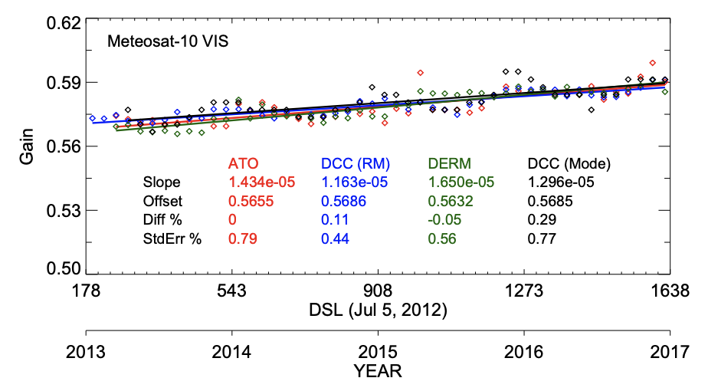
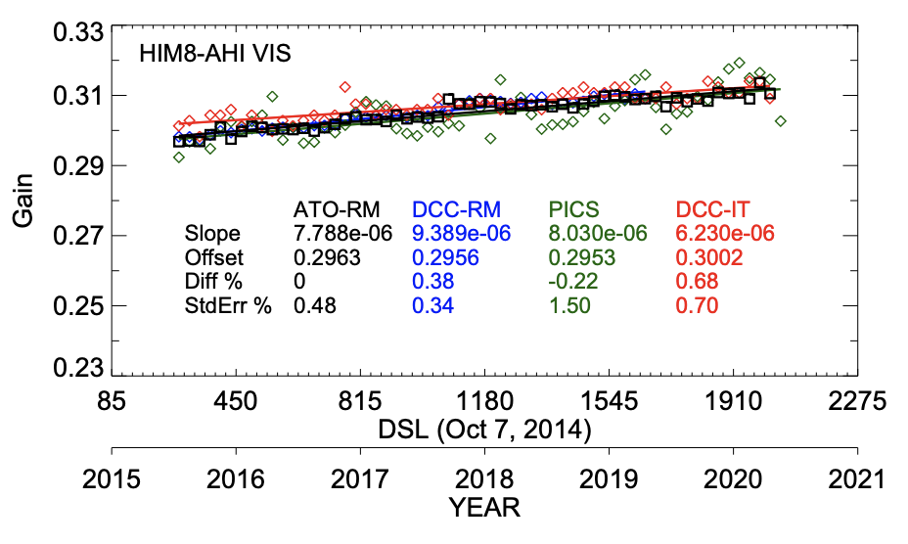
GEO to Aqua-MODIS radiometric scaling
Legend
ATO All-sky tropical ocean ray matching
DCC-RM Deep convective cloud ray-matching
PICS Pseudo invariant calibration site (desert)
DCC-IT Deep convective cloud invariant target
• The primary approach is all-sky tropical ocean (ATO) ray-matching
• the other approaches validate the primary approach

Slide 15
Conclusions
CLARREO will help reduce CERES flux uncertainties by
  Reducing the uncertainty of the CERES derived Earth’s Energy Imbalance flux
  Radiometrically scaling the CERES instrument calibration to the CLARREO SI-traceable reference
  Improving CERES unfiltering (instrument SRF -> BB flat spectra) algorithm
  Validating CERES clear-sky fluxes from partly cloud footprints
  Validate the CERES GEO derived regional diurnal flux (CPF in ISS precessionary orbit) to properly compute the daily mean flux from CERES instantaneous obs
CLARREO will help provide consistent cloud and visible channel radiances across the constellation of GEO, MODIS and VIIRS imagers
  Radiometrically scaling the GEO, MODIS and VIIRS visible channel radiance to the CLARREO SI-traceable reference
  Reducing the scene specific spectral band adjustment factor uncertainties to improve GEO inter-calibration with either MODIS or VIIRS
  Improve the GEO, MODIS, VIIRS stability monitoring by further angular and spectral characterization of PICS and DCC

